Slide 1
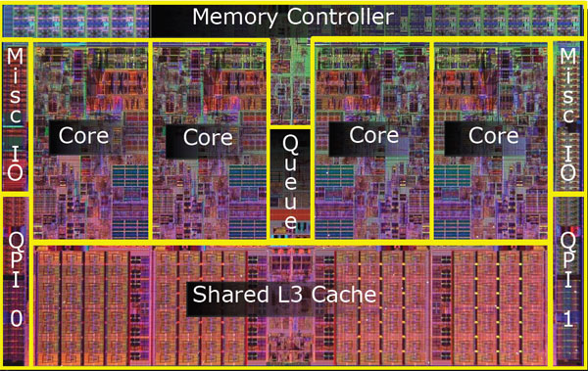
CPEN 411: Computer Architecture Slide Set #19: Cache Coherence, Part 2 Instructor: Dr. Tor M. Aamodt aamodt@ece.ubc.ca

Slide 2
Learning Objectives
By the time we finish talking about this slide set in lectures you should be able to:
Define true and false sharing, and coherency misses
List three approaches to reduce false sharing
Describe how a directory based cache coherence protocol differs from a snooping cache coherence protocol
Evaluate which events are generated when loads and stores operate with a simple directory cache coherence protocol
List/define several synchronization primitives
Explain sequential consistency.

Slide 3
Coherence Misses
Recall: Uniprocessor cache miss traffic
3 C’s: Compulsory, Capacity, Conflict
New: Cache misses caused by communication
Writing block in remote cache causes invalidation
4th C: Coherence miss

Slide 4
Coherence Misses
True sharing misses arise from the communication of data through the cache coherence mechanism
First write to shared block
Read miss of word modified by remote processor
Note: Miss would still occur if block size were 1 word
False sharing misses arise when a block was invalidated because some word in the block was written to other than the one now being read or written
Invalidation does not cause a new value to be communicated, but only causes an extra cache miss
Block is shared, but no word in block is actually shared
Note: Miss would not occur if block size were 1 word

Slide 5
Example: True v. False Sharing v. Hit?
Initial conditions (both caches):
Valid Dirty Tag Data
Assume x1 and x2 in same cache block. P1 and P2 both read x1 and x2 before.
1
0
…x1 … x2 ...
Time | P1 | P2 | True, False, Hit? Why?
1 | Write x1
2 |  | Read x2
3 | Write x1
4 |  | Write x2
5 | Read x2
True miss; invalidate x1 in P2
False miss; x2 irrelevant to P1
False miss; x1 irrelevant to P2
False miss; x2 irrelevant to P1
True miss; x2 wr in P2, rd in P1

Slide 6
Impact on Coherence Misses: Cache Size
Uniprocessor cache misses improve with cache size increase (Instruction, Capacity/Conflict, Compulsory)
True sharing and false sharing unchanged going from 1 MB to 8 MB (L3 cache)
(Memory) Cycles per Instruction

Slide 7
Impact on Coherence Misses: Processor Count
True sharing, false sharing increase going from 1 to 8 CPUs
(Memory) Cycles per Instruction

Slide 8
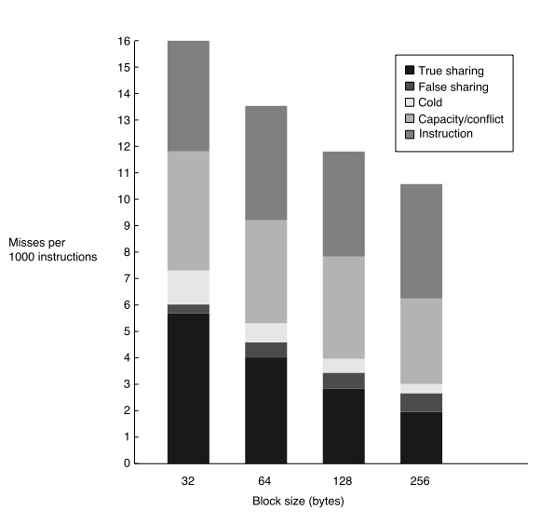
Impact on Coherence Misses: Cache Size: Block Size
True sharing misses decrease due to locality in sharing patterns.
False sharing misses increase (more likely to have unrelated data stored on same cache block)

Slide 9
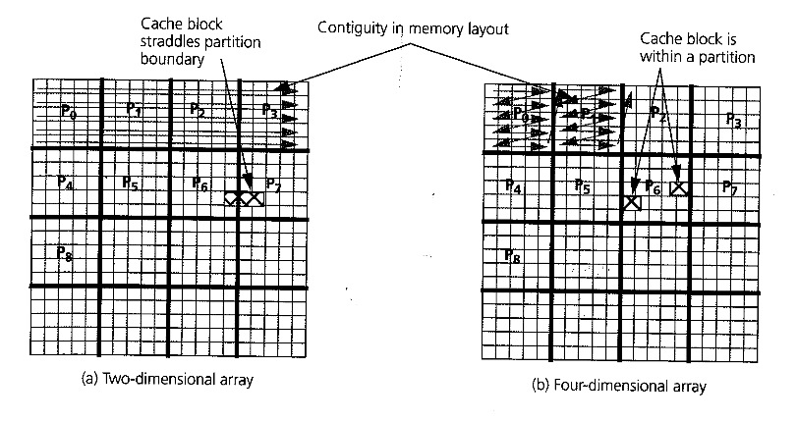
Reducing False Sharing (1)
j
i
“float A[N][N]”
“float A[N/b][N/b][b][b]”
Consider how “float A[N][N];” is stored in memory: A[i][j+1] is adjacent to A[i][j] in memory, but A[i+1][j] is not adjacent to A[i][j].
Reduce false sharing by structure data to reduce “spatial interleaving” (e.g., using “higher order” arrays as illustrated in “b” above)

Slide 10
Reducing False Sharing (2)
Beware using thread/process ID to index arrays:
#define NCORES 4
int g_foo[NCORES];
...
g_foo[ tid ] ++; // BAD! FALSE SHARING!
Instead, “pad” to cache block size (so each processor accesses an element of g_foo on a different block)
#define NCORES 4
#define INTS_PER_BLOCK (32/sizeof(int)) /* for 32 B cache blocks */
int g_foo[NCORES*INTS_PER_BLOCK];
...
g_foo[ tid*INTS_PER_BLOCK ] ++; // GOOD! NO FALSE SHARING.

Slide 11
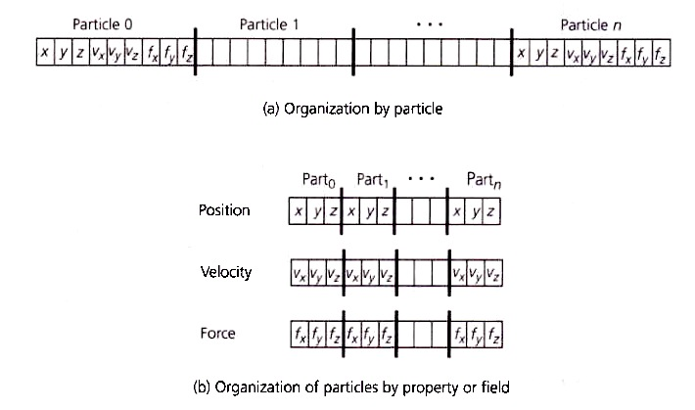
Reducing False Sharing (3)
Consider carefully how to organize arrays of “structs” (or arrays of “objects”):
Consider “n-body problem” (physics).
Need to know position of all “particles”
to compute force on any given particle.
Parallelize so each processor computes
force on a particular particle.
Each processor wants to read position
of other particles to update force and
velocity of particle it is processing.
Position for each particle could be in
“shared state” in all processor caches,
but updates to force or velocity increase
false sharing misses in (a) versus (b).

Slide 12
Directory Based Coherence
Problem: As number of processors increases, broadcast becomes too expensive.
Solution: Replace bus with scalable interconnection network (e.g., 2D mesh) and only send messages to caches containing blocks that need to change state.
MEM
CPU
$
CPU
$
CPU
$
CPU
$
P
P
1
n
CPU
$
CPU
$
CPU
$
CPU
$
MEM
Mem
$
Mem
$
MEM
CPU
$
CPU
$
CPU
$
CPU
$
CPU
$
CPU
$
CPU
$
CPU
$
MEM
Interconnection network
Multicore Processor with 2D mesh
Distributed shared memory multiprocessor
(interconnect might be 2D torus topology)

Slide 13
Basic Operation of Directory



Each block in memory has a corresponding directory entry.
Directory entry contains “presence bits” and dirty bit.
If copy of block is in cache “i” then presence bit “i” is set to 1 (dot in figure).
Invalidate by sending messages to processors with presence bit set.

Slide 14
Directory Protocol
Terminology: three processors involved
Local node where a request originates
Home node where the memory location of an address resides
Remote node has a copy of a cache block, whether modified or shared
Example messages on next slide: P = processor number, A = address
LD R1,0(R2)
P
L
P
H
P
R
D
Mem
$
D
Mem
$
D
Mem
$
Inter
connection network

Slide 15
Directory Protocol Messages
Message type Source Destination Msg Content
Read miss Local cache Home directory P, A
Processor P reads data at address A; make P a read sharer and request data
Write miss Local cache Home directory P, A
Processor P has a write miss at address A; make P the exclusive owner and request data
Invalidate Home directory Remote caches A
Invalidate a shared copy at address A
Fetch Home directory Remote cache A
Fetch the block at address A and send it to its home directory; change the state of A in the remote cache to shared
Fetch/Invalidate Home directory Remote cache A
Fetch the block at address A and send it to its home directory; invalidate the block in the cache
Data value reply Home directory Local cache A, Data
Return a data value from the home memory (read miss response)
Data write back Remote cache Home directory A, Data
Write back a data value for address A
Other messages that might be used in a real implementation: Acknowledgements (ACK’s)

Slide 16
CPU -Cache State Machine
CPU Read hit
State machine for CPU requests (+ requests from
home node) for
each memory block
Invalid state if in memory
Invalidate
Shared
(read/only)
Invalid
CPU Read
Send Read Miss
message
CPU read miss:
CPU Write:
Send Read Miss
Send Write Miss
msg to home directory
CPU Write: Send Write Miss message
to home directory
CPU Write:
Fetch/Invalidate
Fetch/Invalidate
send Data Write Back message
to home directory
Fetch:
Fetch:
send Data Write Back message to home directory
CPU read miss: send Data Write Back message and read miss to home directory
CPU read miss:
Modified
(&Exclusive)
(read/write)
CPU read hit
CPU write hit
CPU write miss:
send Data Write Back message
and Write Miss to home directory
CPU write miss:
Notes:
Invalid:
read => shared
write => dirty
shared looks the same

Slide 17
Directory State Machine
Read miss:
Sharers += {P};
send Data Value Reply
State machine for Directory requests for each memory block
Uncached state if in memory
Read miss:
Sharers = {P}
send Data Value
Reply
Shared
(read only)
Uncached
Write Miss:
Sharers = {P};
send Data
Value Reply
msg
Write Miss:
send Invalidate
to Sharers;
then Sharers = {P};
send Data Value
Reply msg
Data Write Back:
Sharers = {}
(Write back block)
Write Miss:
Sharers = {P};
send Fetch/Invalidate;
send Data Value Reply
msg to remote cache
Read miss:
Sharers += {P};
send Fetch;
send Data Value Reply
msg to remote cache
(Write back block)
Modified
(&Exclusive)
(read/write)
Notes:
Invalid:
read => shared
write => dirty
shared looks the same

Slide 18
Example Question
P0
P1
P2
P3
state tag data
state tag data
state tag data
state tag data
B0
B1
B2
B3
I | 100 | 00 | 80
S | 108 | 10 | 20
M | 110 | 00 | 01
S | 118 | 80 | 40
B0
B1
B2
B3
I | 100 | 02 | 34
S | 108 | 10 | 20
I | 110 | 00 | 80
I | 118 | 00 | 42
B0
B1
B2
B3
I | 100 | 02 | 34
S | 108 | 10 | 20
I | 110 | 00 | 00
S | 118 | 80 | 40
B0
B1
B2
B3
I | 100 | 00 | 00
I | 108 | 00 | 42
M | 130 | 00 | 02
I | 118 | 00 | 00
100 | DI |  | 00 | 00
108 | DS | P0,P1,P2 | 10 | 20
110 | DM | P0 | 00 | 80
118 | DS | P0,P2 | 80 | 40
120 | DI |  | 02 | 01
Writeback invalidate directory protocol.
Direct-mapped caches: 4 blocks, each with 2 words (word = 4B). two words separated by dotted line (smaller addresses on the right).
Tag contains the full address (in hex).

Slide 19
Synchronization
Acquire method
Acquire right to enter critical section, go past event
Waiting algorithm
Wait for synch to become available when it isn’t
busy-waiting, blocking, or hybrid
Release method
Enable other processors to acquire right to the synch
Waiting algorithm is independent of type of synchronization
makes no sense to put in hardware

Slide 20
Strawman Lock
Busy-Wait
lock: LD R1,location /* copy location to register */
BNEZ R1,lock /* compare with 0, if not 0, try again */
SD location, #1 /* store 1 to mark it locked */
RET /* return control to caller */
unlock: SD location, #0 /* write 0 to location */
RET /* return control to caller */
Why doesn’t the acquire method (“lock”) work?
Release method OK?

Slide 21
Atomic Instructions
Specifies a memory location, register, and an atomic operation
Value in location read into a register
Another value (maybe function of value read) stored into location
Many variants
Varying degrees of flexibility in what is stored into location

Slide 22
Simple Test & Set Lock
lock: t&s register, location
bnez register, lock /* if not 0, try again */
ret /* return control to caller */
unlock: sw location, #0 /* write 0 to location */
ret /* return control to caller */
Test&set (t&s) instruction:
Value in location read into a specified register
Constant 1 stored into location
Successful if value loaded into register is 0
Other constants could be used instead of 1 and 0

Slide 23
Other Atomic Instructions
Atomic exchange: interchange a value in a register for a value in memory
0 ⇒ synchronization variable is free
1 ⇒ synchronization variable is locked and unavailable
Use to implement test-and-set: Set register to 1 and then do atomic exchange. New value in register determines success in getting lock 0 if you succeeded in setting the lock (you were first) 1 if other processor had already claimed access
Fetch-and-increment: returns the value of a memory location and atomically increments it
0 ⇒ synchronization variable is free

Slide 24
Load Locked, Store Conditional
Implementing atomic read-modify-write requires significant hardware changes and can cause poor performance for unrelated memory accesses.
An alternative to forcing the read-modify-write to be atomic is to instead detect when a read-modify-write did not execute atomically (some other operation accessed the value between the read and write).
“Load locked” also sometimes called “load linked”.

Slide 25
Load Locked, Store Conditional
Load locked + store conditional
Load locked returns initial value of memory location.
Store conditional returns “1” if no other store wrote to same memory location since preceding load locked, and returns 0 otherwise.
A return value of 0 means the sequence of load-locked and store conditional did not execute atomically. In this case, we might repeat the load locked and store conditional to try again.
Load locked and store conditional can be used to implement a wide variety of atomic operations

Slide 26
Examples
Atomic swap of “Regs[R4]” and “Mem[Regs[R1]]”
try: mov R3,R4 ; copy R4 ll R2,0(R1) ; load locked sc R3,0(R1) ; store conditional beqz R3,try ; branch if store conditional fails (R3 = 0) mov R4,R2 ; put load value in R4
Fetch & increment of “Mem[Regs[R1]]”
try: ll R2,0(R1) ; load locked addi R2,R2,#1 ; increment (OK if reg–reg) sc R2,0(R1) ; store conditional beqz R2,try ; branch store fails (R2 = 0)

Slide 27
Spin Lock Performance
Spin locks: processor continuously tries to acquire, spinning around a loop trying to get the lock
ld R2,#1 lockit: exch R2,0(R1) ;atomic exchange bnez R2,lockit ;already locked?
What about cache coherency?
Problem: exchange includes a write, which invalidates all other copies; this generates considerable bus traffic.

Slide 28
Test and test and set
For parallel programs with long critical sections, we can reduce bus traffic by first reading the variable using a normal load instruction which will cause a shared copy of the lock variable to be placed in the cache attached to the processor.
When a different processor modifies the location (to release the lock), the local version gets invalidated, then reloaded the next time the normal load instruction reads it. The new value of the memory location might indicate the lock is available and only then will we attempt to atomically perform a read-modify-write using a test and set instruction.
This is known as a “test and test&set” lock.
Example “test and test&set” using an atomic exchange instruction:
try: addui R2,R0,#1 lockit: ld R3,0(R1) ;normal load of Mem[Regs[R1]] bnez R3,lockit ; ≠ 0 ⇒ not free ⇒ spin exch R2,0(R1) ;atomic exchange bnez R2,try ;already locked?

