Slide 1
Energy Conservation in Residential Building
Decision Analysis
BLDG 6581
Instructor Dr. T. Stathopoulos
Group Members
Gianina Martinez
Vivekkumar Chatrola
Nishit Jagdishkumar Kadia
Mohammad Mehmood Syed

Slide 2

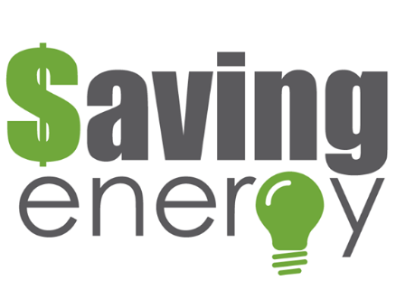
ENERGY EFFICIENCY DESIGNS ON RESIDENTIALS BUILDINGS
CHOSING THE BEST DESICION TO DECREASE A RESIDENCIAL BUILDING’S ENERGY CONSUMPTION
USING MOTION SENSING LIGHTS
USING SOLAR WALLS

Slide 3

1. Lifetime of this project = 30 years 2. Natural gas price, fixed rate = $0.55/m ³ 3. Price of electricity = $0.05/kwh 4. Interest rate = 4%
GENERAL PARAMETERS

Slide 4
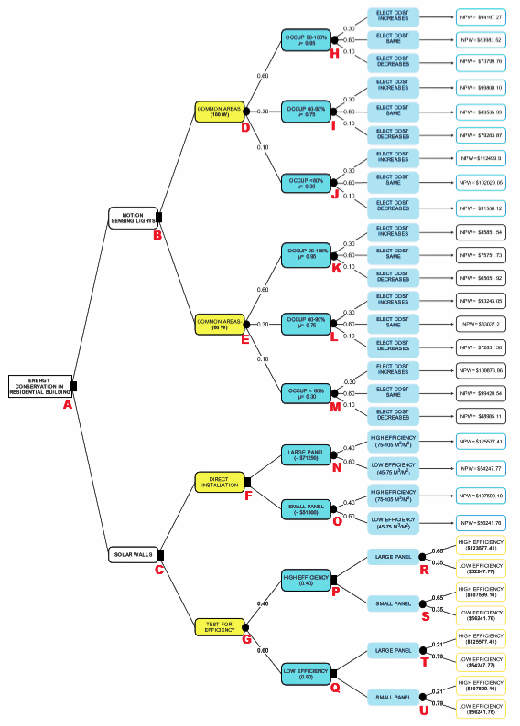
DECISION TREE

Slide 5
SOLARWALLS
SolarWall is used to substitute the building heating system
It captures the heat from the sun as passes it to the building ventilation system
Cost of the Solar Wall as per manufacturer is $285/m2 (included the cost of installation, material and labor)
Heating obtained from SolarWall is calculated to m3 of natural gas saved per m2 of SolarWall.
Thus to calculate annual savings:
Annual Savings = Size Solar Wall (m2) x Price Natural Gas ($/m3) x Efficiency (m3/m2)

Slide 6
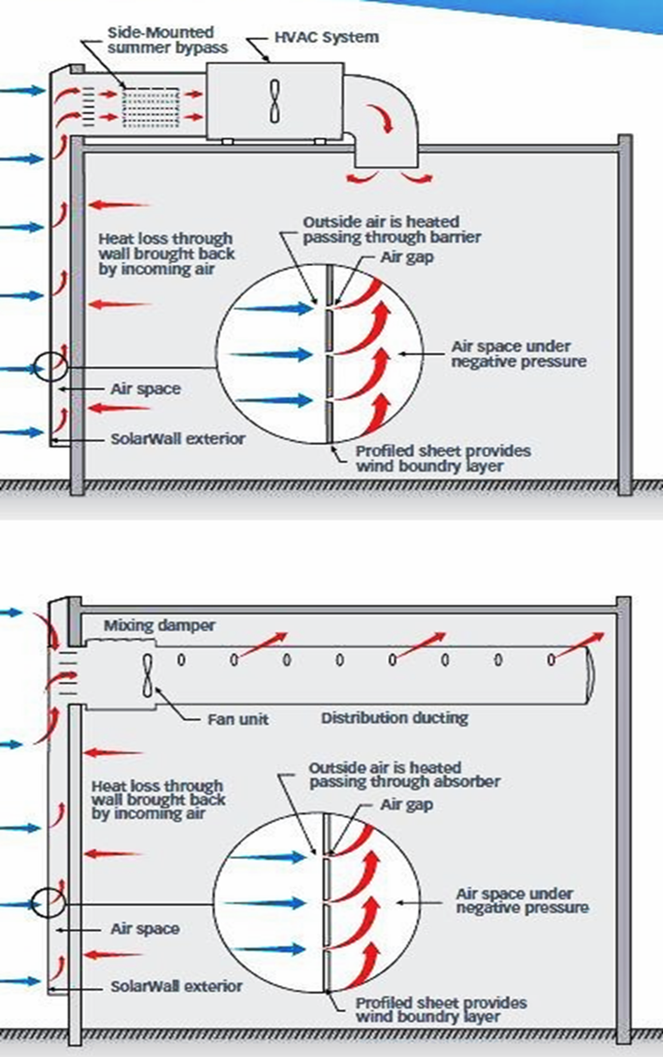
SOLARWALLS
SolarWall System

Slide 7
SOLAR WALLS

Slide 8
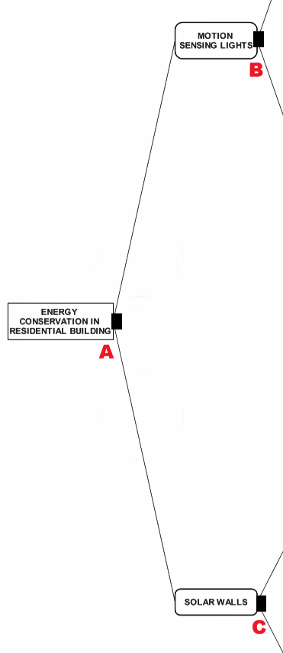
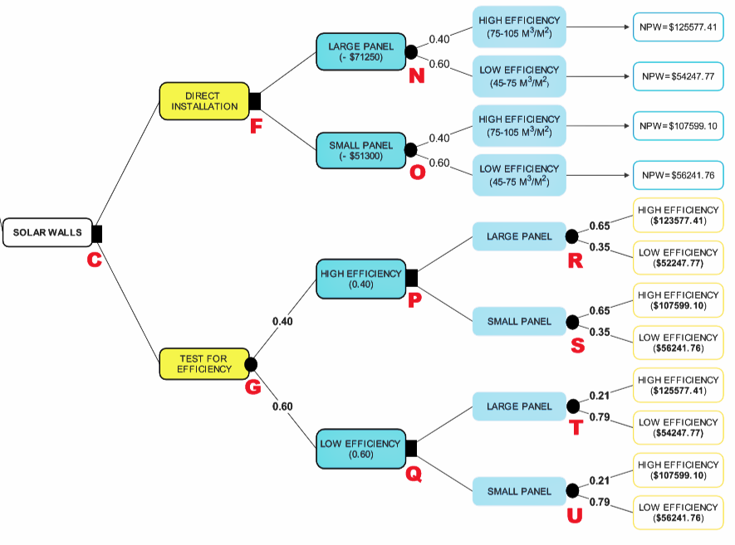
DECISION TREE
DECISION TREE
(SOLARWALLS)

Slide 9
The calculation of Net Present Worth is carried as under:
NPW = PV (rate, years, annual savings) - (Initial Cost + Govt. Benefits)
LARGE PANEL
The calculation of EMV for NPW = $82,779.63
While the EMV for ROR = 10.75%

Slide 10
The calculation of Net Present Worth is carried as under:
NPW = PV (rate, years, annual savings) - (Initial Cost + Govt. Benefits)
SMALL PANEL
The calculation of EMV for NPW = $76,784.69
While the EMV for ROR = 15.10%

Slide 11
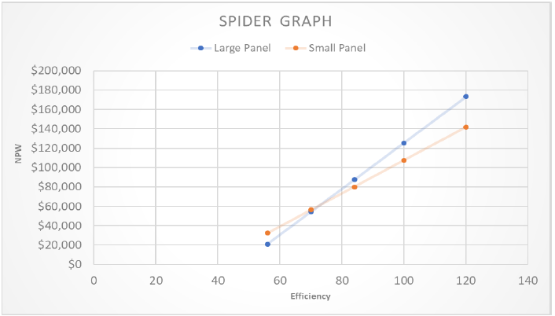
Sensitivity Analysis:
A Sensitivity analysis for SolarWall is carried out to find out the variations that can happen in the NPW with the variations in the efficiency of the panel
The variation of +20% for each case of High and Low efficiency.

Slide 12
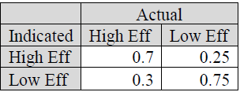
Preposterior Analysis
The cost of the test is $2000.
The probability table obtained from the effectiveness of the test is shown as under:
The level of uncertainty is due to the changing weather conditions, but the better probabilities are obtained because of factoring the certainty of the location.

Slide 13
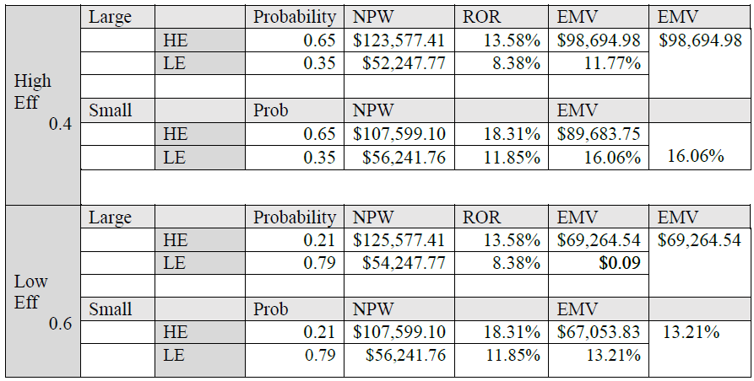
Preposterior Analysis
The final EMV of the test alternative is obtained as, EMV(test) = $81,036
the Rate of Return(test) = 14.35%
According to the EMV the preference is obtained as
$82,779.63 > $81,036 > $76,784.89
Large Panel ≻ Test Alternative ≻ Small Panel

Slide 14
Value of Information
Value of Information is calculated as:
VI = EMV(T) – EMV(a*)
VI = $81,036 - $82,779.63
VI = -$1,743.63
Thus, the test is not justified.

Slide 15
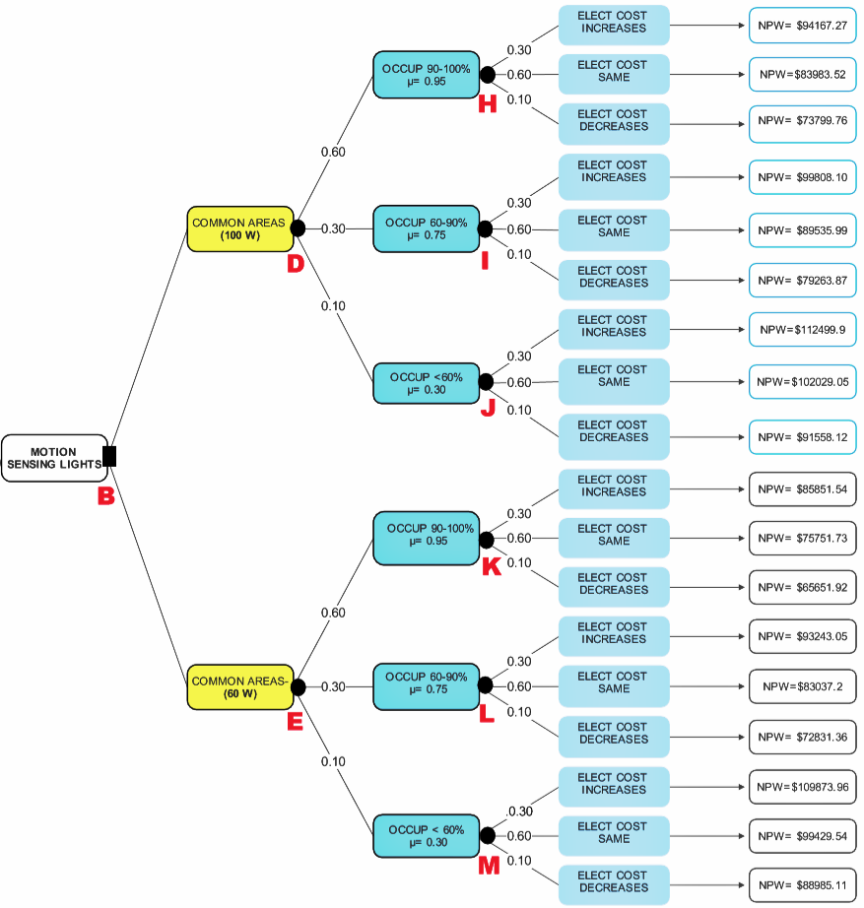
DECISION TREE
DECISION TREE
(MOTION S LIGHTS)

Slide 16
MOTION SENSING LIGHTS

Slide 17
MOTION SENSING LIGHTS (100 W)
No. of hours convention lights used in a year
=No. Floors * Lights each/floor * Hours per day * Days per year 14x10x24x365= 1226400 hr/yr

Slide 18
MOTION SENSING LIGHTS
100 WATTS Lights

Slide 19
MOTION SENSING LIGHTS (60 W)
= No. of floors * Lights in each floor * No. of apartments in each floor * No. of time turned on * seconds it stays on * Days per year / 3600

Slide 20
MOTION SENSING LIGHTS
60 WATTS Lights

Slide 21
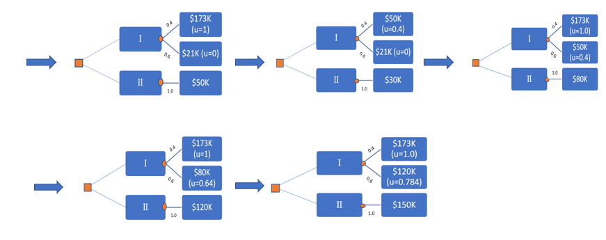
U($50k) =0.4*1=0.4
U($30k) =0.4*0.4=0.16
U($80k) =0.4*1.0+0.6*0.4=0.64
U($120k) =0.4*1+0.6*0.64=0.784
U($150k) =0.4*1+0.6*0.784=0.87
UTILITY CRITERION

Slide 22
DECISION TREE
UTILITY CRITERION
NPW | U(G) | U(M) | U(V) | U(N)
173000 | 1 | 1 | 1 | 1
170000
165000
160000 | 0.98
155000 |  |  | 0.784
150000 |  | 0.87 |  | 0.784
145000 | 0.97
140000
135000 |  |  | 0.64
130000 |  |  |  | 0.64
125000 | 0.95
120000 |  | 0.784
115000
110000
105000 | 0.92
100000 |  |  | 0.4
95000 | 0.87
90000
85000 |  |  |  | 0.4
80000 | 0.78 | 0.64
75000
70000 | 0.64
65000 |  |  | 0.16
60000
55000 | 0.4
50000 |  | 0.4 |  | 0.16
45000 |  |  | 0.064
40000
35000 |  |  |  | 0.064
30000 | 0.16 | 0.16
25000
20000 | 0 | 0 | 0 | 0
 | y = -6E-11x² + 2E-05x - 0.3478 | y = 0.4527ln(x) - 4.4933 | y = 2E-11x² + 2E-06x - 0.0589 | y = 6E-06x -0.1513
 | R² = 0.9906 | R² = 0.9962 | R² = 0.9977 | R² = 0.9944
The utility values for the range of monetary values from $20 to $173K have been determined

Slide 23
A Utility function of money (NPW)
A Utility function of money (NPW)

Slide 24
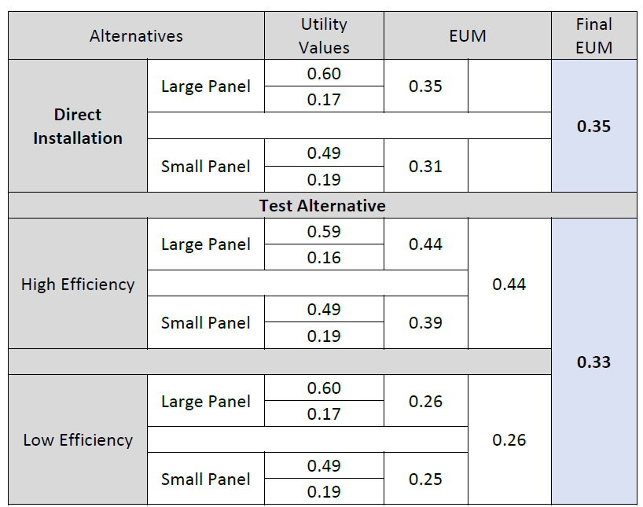
Utility Values for SolarWall
Equation y = (6*10⁻⁶x) – (0.1513) associated with Utility(N) is used to obtain utility values of various SolarWall alternatives in consideration as under
Large Panel (Direct Installation) ≻ Test Alternative

Slide 25
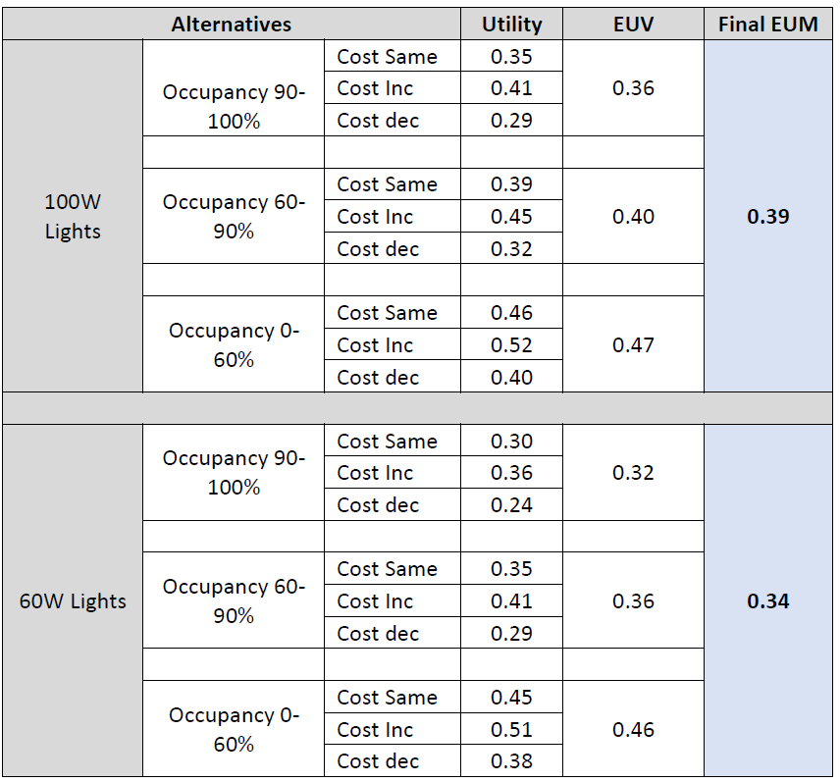
Utility Values for Motion Sensing Lights
Equation y = (6*10-6x) – (0.1513) associated with Utility(N) is used to obtain utility values of Motion Sensing Lights alternatives in consideration as under
100W Motion Sensing Lights ≻ Large Panel (Direct Installation)
100W Motion Sensing Lights ≻ 60W Motion Sensing Lights

Slide 26
Considering the conditions of the project, four objectives are decided to be considered as follows:
• Net Present Worth (NPW) - A
• Rate of Return - B
• Convenience to Tenants - C
• Chance of Successful Implementation – D
The weights to each of the parameters are given as under:
MULTIPLE OBJETIVE ANALYSIS

Slide 27
The table below shows the probabilities for the Multi-Objective parameters
MULTIPLE OBJETIVE ANALYSIS
The results are obtained as under

Slide 28
Conclusion
Based on prior analysis of the SolarWall alternative large panels should be installed instead of small panels when compared using Net Present Worth.
While the independent analysis for the two alternatives of Motion Sensing Light shows that the NPW of 100W option yields higher NPW
according the Expected Monetary Value (EMV) the criteria of 100W is most preferred
Also, NPW has been obtained using the Utility theory
Motion Sensing Light of 100W has higher EUV then the best alternative of SolarWall
Finally, Multiple objective analysis has been carried and according to it alternative of 100W motion sensing light must be preferred

Slide 29
Thank You

