Slide 1

SQL DATA ANALYSIS ON COMMODITY AND SUPPLY CHAIN DATASETS

Slide 2
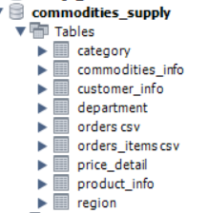
Introduction to the SQL Data Analysis
Analysis performed on Commodity and Supply Chain datasets
MySQL database used for querying and business analysis
All Excel sheets were converted into CSV format
CSV files were imported into MySQL Workbench
A single database named commodities_supply was created
Notes:
Before starting the SQL analysis, all dataset sheets were first converted into CSV format to ensure compatibility with MySQL Workbench. The CSV files were then imported individually into the database environment.
A single database named commodities_supply was created to manage all related datasets in one place. Separate tables such as price_detail, commodities_info, region, orders csv, orders_items csv, customer_info, product_info, and department were created during the import process.
During the implementation stage, table names and column names were verified carefully to ensure correct joins and query execution. Additional corrections were made for date formatting issues using STR_TO_DATE() because some date fields were stored as text instead of proper date datatypes.

Slide 3
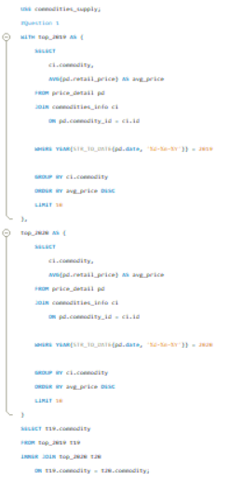
Commodity Q1: Common Top 10 Costliest Commodities
Used CTEs to separate 2019 and 2020 analysis
Calculated average retail price for each commodity
Selected Top 10 highest priced commodities per year
Applied INNER JOIN to find common commodities
Notes:
The objective of this question was to identify the commodities that were common in the Top 10 most expensive commodities in both 2019 and 2020. To solve this problem, two Common Table Expressions named top_2019 and top_2020 were created. In both CTEs, the price_detail table was joined with commodities_info using commodity_id and id to retrieve the commodity names.
The query used the AVG(retail_price) function to calculate the average price of each commodity for each year separately. The YEAR() function along with STR_TO_DATE() was used to extract the year from the date column because the date field was stored in text format. After grouping by commodity name, the results were sorted in descending order based on average price, and LIMIT 10 was applied to retain only the top 10 commodities for each year.
Finally, an INNER JOIN was performed between the two CTEs to identify the commodities appearing in both top 10 lists. This demonstrated the use of CTEs, joins, aggregation, filtering, sorting, and ranking techniques in SQL.

Slide 4
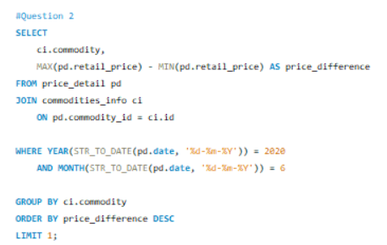
Commodity Q2: Maximum Price Difference in June 2020
Filtered records for June 2020 using YEAR and MONTH
Grouped data by commodity
Calculated MAX and MIN retail prices
Computed highest regional price difference
Notes:
The purpose of this question was to determine which commodity showed the maximum difference between the highest and lowest retail prices across different locations during June 2020. The query started by joining the price_detail table with the commodities_info table to obtain the commodity names.
The WHERE clause filtered records only for June 2020 using the YEAR() and MONTH() functions. Since the date column was stored as text, STR_TO_DATE() was applied before extracting the year and month. The query grouped the data by commodity name and used the aggregate functions MAX(retail_price) and MIN(retail_price) to identify the highest and lowest prices for each commodity.
A new calculated field called price_difference was created by subtracting the minimum price from the maximum price. The results were then sorted in descending order using ORDER BY price_difference DESC, and LIMIT 1 was used to retain only the commodity with the greatest variation. This question demonstrated filtering, grouping, aggregation, calculations, and sorting operations in SQL.

Slide 5
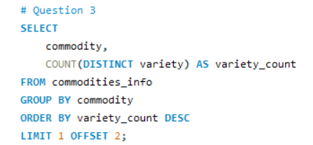
Commodity Q3: Commodity Varieties Ranking
Grouped data using commodity names
Counted distinct varieties using COUNT(DISTINCT)
Sorted commodities by variety count
Retrieved the 3rd highest ranked commodity
Notes:
The objective of this question was to rank commodities according to the number of varieties available and identify the commodity in the third position. The query used only the commodities_info table because all required information was available within it.
The COUNT(DISTINCT variety) function was applied to count the number of unique varieties available for each commodity. GROUP BY commodity was used to aggregate the records commodity-wise. The results were sorted in descending order using ORDER BY variety_count DESC so that commodities with the highest variety counts appeared at the top.
To retrieve the third ranked commodity, the query used LIMIT 1 OFFSET 2. The offset skipped the first two rows, and the limit retained only the third row. This question demonstrated the use of distinct counting, aggregation, sorting, and ranking techniques in SQL.

Slide 6
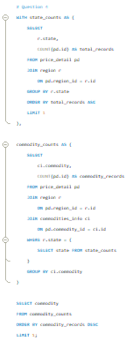
Commodity Q4: Commodity with Highest Records in Least Active State
Joined region and price tables
Identified state with minimum data records
Filtered commodity records within that state
Selected commodity with highest occurrences
Notes:
The requirement of this question was to first identify the state with the least number of data records and then determine which commodity had the highest number of records within that state. To solve this, the query used two Common Table Expressions.
The first CTE named state_counts joined the price_detail table with the region table using region_id and id. The query counted the number of records for each state using COUNT() and grouped the results by state. The records were sorted in ascending order, and LIMIT 1 was applied to identify the state with the minimum number of records.
The second CTE named commodity_counts filtered records only for that selected state and joined the data with commodities_info to retrieve commodity names. The query then counted the number of occurrences of each commodity and sorted the results in descending order. Finally, the top commodity was selected. This question demonstrated advanced SQL concepts such as CTEs, joins, aggregation, filtering, and nested logic.

Slide 7
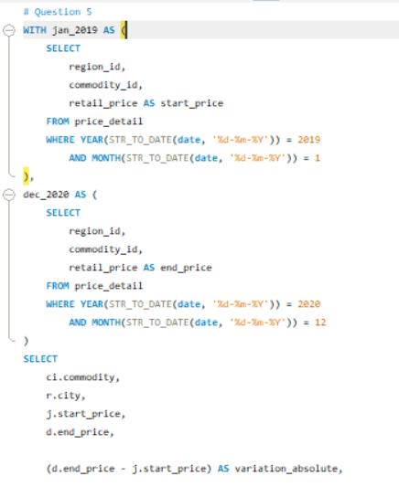
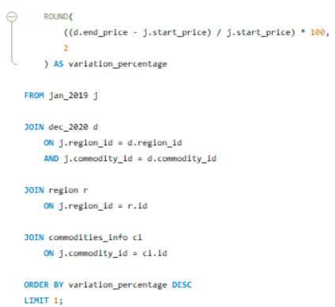
Commodity Q5: Highest Price Variation Between 2019 and 2020
Separated Jan 2019 and Dec 2020 records
Joined records by region and commodity
Calculated absolute and percentage variation
Sorted to identify highest price increase
Notes:
The objective of this question was to analyze commodity price variation between January 2019 and December 2020 for each city and identify the commodity with the highest percentage variation. Two Common Table Expressions named jan_2019 and dec_2020 were created to separately store records for January 2019 and December 2020.
The query filtered records using the YEAR() and MONTH() functions together with STR_TO_DATE() because the date column was stored as text. The CTEs stored the start price and end price for each commodity and region combination. These two datasets were then joined using region_id and commodity_id to compare the same commodity in the same location across two time periods.
The query calculated absolute variation using end_price - start_price. Percentage variation was calculated using the formula ((end_price - start_price) / start_price) * 100. The ROUND() function was used to format percentage values to two decimal places. Finally, the results were sorted in descending order of variation percentage, and the top record was selected. This question demonstrated joins, calculations, CTEs, filtering, and percentage analysis in SQL.

Slide 8
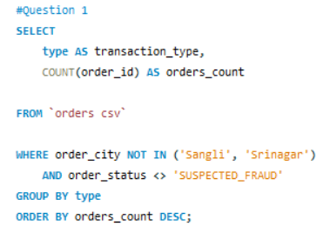
Supply Chain Q1: Orders by Transaction Type
Filtered out Sangli and Srinagar orders
Excluded SUSPECTED_FRAUD cases
Grouped orders by transaction type
Sorted order counts in descending order
Notes:
The objective of this question was to analyze the number of orders by transaction type while excluding specific cities and fraudulent orders. The query used the orders csv table as the main data source.
The WHERE clause excluded orders from Sangli and Srinagar using the NOT IN condition. In addition, orders with the status SUSPECTED_FRAUD were filtered out using the <> operator. After applying the filters, the query grouped the records by transaction type using GROUP BY type.
The COUNT(Order_Id) function was used to calculate the total number of valid orders for each transaction type. Finally, the results were sorted in descending order using ORDER BY orders_count DESC. This question demonstrated filtering, aggregation, grouping, and sorting operations in SQL.

Slide 9
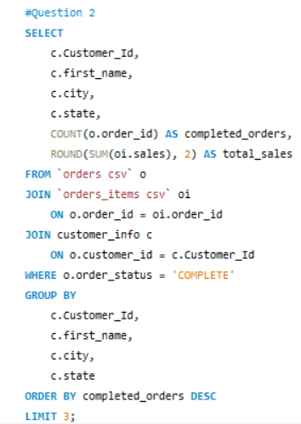
Supply Chain Q2: Top 3 Customers by Completed Orders
Joined orders, items, and customer tables
Filtered COMPLETE order status
Calculated total sales and completed orders
Selected top 3 customers
Notes:
The requirement of this question was to identify the top three customers based on completed orders along with their sales details. The query joined three tables: orders csv, orders_items csv, and customer_info.
The orders csv table was joined with orders_items csv using Order_Id to retrieve order-level sales information. Then, the customer_info table was joined using Customer_Id to obtain customer details such as first name, city, and state. The query filtered only completed orders using the condition Order_Status = 'COMPLETE'.
The records were grouped by customer information. COUNT(Order_Id) was used to calculate the number of completed orders, while SUM(Sales) calculated the total sales generated by each customer. The results were sorted in descending order of completed orders, and LIMIT 3 was applied to retain the top three customers. This question demonstrated multi-table joins, aggregation, filtering, and ranking techniques.

Slide 10
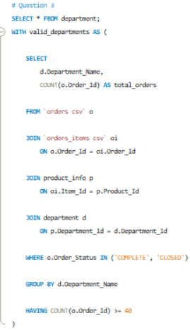
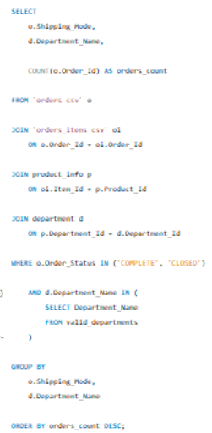
Supply Chain Q3: Orders by Shipping Mode and Department
Joined orders with product and department data
Filtered COMPLETE and CLOSED orders
Applied HAVING clause for minimum 40 orders
Grouped by shipping mode and department
Notes:
The objective of this question was to analyze order counts by shipping mode and department while considering only departments with at least 40 completed or closed orders. The query joined the orders csv, orders_items csv, product_info, and department tables.
The joins connected orders to products through Order_Id and Item_Id, and departments were linked using Department_Id. The query filtered only valid order statuses using Order_Status IN ('COMPLETE', 'CLOSED'). A Common Table Expression named valid_departments was created to identify departments having at least 40 valid orders using the HAVING COUNT(Order_Id) >= 40 condition.
The main query then grouped the filtered records by Shipping_Mode and Department_Name. COUNT(Order_Id) calculated the number of orders for each combination. Finally, the results were sorted in descending order. This question demonstrated the use of joins, filtering, aggregation, CTEs, and HAVING clauses.

Slide 11
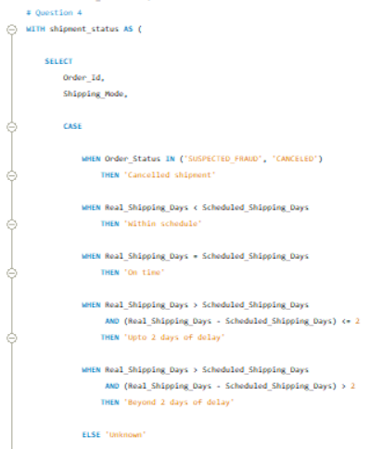
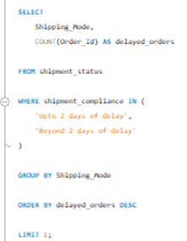
Supply Chain Q4: Shipment Compliance Analysis
Created shipment compliance categories using CASE
Compared real and scheduled shipping days
Identified delayed shipment categories
Found shipping mode with maximum delays
Notes:
The purpose of this question was to classify shipments based on delivery performance and determine which shipping mode experienced the highest number of delayed orders. The query used the orders csv table and created a new derived field called shipment_compliance using a CASE statement.
Different delivery conditions were evaluated using Real_Shipping_Days and Scheduled_Shipping_Days. Orders with statuses SUSPECTED_FRAUD or CANCELED were labeled as cancelled shipments. Orders delivered before schedule were labeled within schedule, while orders delivered exactly on schedule were labeled on time. Additional conditions categorized delays up to two days and delays beyond two days.
After creating the shipment compliance categories, the query filtered only delayed shipments. The records were grouped by Shipping_Mode, and COUNT(Order_Id) calculated the number of delayed orders for each mode. The results were sorted in descending order, and the top shipping mode was retained. This question demonstrated the use of CASE statements, conditional logic, filtering, grouping, and aggregation.

Slide 12
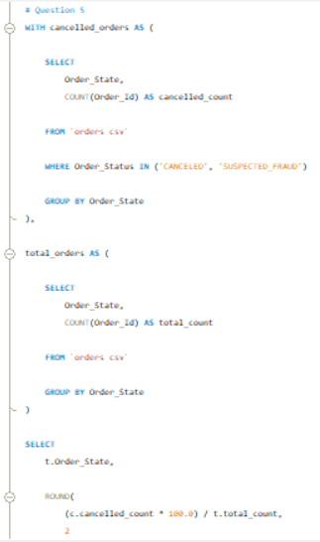
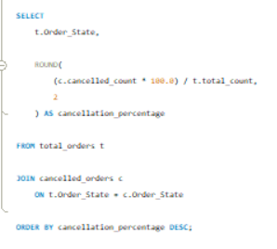
Supply Chain Q5: Cancellation Percentage by State
Filtered canceled and fraudulent orders
Calculated total orders per state
Computed cancellation percentage
Sorted states by cancellation rate
Notes:
The objective of this question was to calculate the cancellation percentage for each state. An order was considered cancelled if the status was either CANCELED or SUSPECTED_FRAUD. The query used two Common Table Expressions named cancelled_orders and total_orders.
The first CTE filtered cancelled orders and counted them for each state using COUNT(Order_Id). The second CTE calculated the total number of orders for each state without applying any filters. Both results were grouped using GROUP BY Order_State.
The final query joined the two CTEs using Order_State and calculated cancellation percentage using the formula (cancelled_count / total_count) * 100. The ROUND() function formatted the results to two decimal places. Finally, the results were sorted in descending order of cancellation percentage. This question demonstrated CTEs, aggregation, joins, filtering, calculations, and percentage analysis in SQL.

Slide 13
Summary
Commodity analysis identified pricing trends and variations
Supply chain analysis evaluated customer behavior and shipment performance
ChatGPT was used for SQL query debugging and error correction
AI assistance helped identify table structures, column mismatches, and dataset loading issues
Notes:
The Commodity dataset analysis helped identify pricing patterns, commodity variations, and regional price differences over time.
The Supply Chain dataset analysis provided insights into customer purchasing behavior, shipment delays, cancellation percentages, and departmental performance. Throughout the assignment, several important SQL concepts were applied, including joins, aggregation functions, Common Table Expressions, CASE statements, filtering, grouping, and percentage calculations.
ChatGPT provided guidance during the dataset loading process, including converting Excel sheets into CSV format, importing CSV files into MySQL Workbench, and structuring the database correctly. AI support also improved the efficiency of documentation, presentation preparation, and explanation of SQL concepts used in the analysis.

Slide 14


