Slide 1
SUPPLY CHAIN ANALYTICS
Business Performance &
Customer Behavior Analysis
Using SQL · Python · Pandas · Seaborn
Data stored in MySQL: commodities_supply
Python connected via mysql.connector
EDA: Univariate · Bivariate · Multivariate
Goal: Actionable supply chain insights
Notes:
This project focuses on analyzing supply chain operations and customer order behavior using business analytics techniques. The dataset was stored in a MySQL database called commodities_supply, which contains information related to orders, customers, products, shipping methods, and sales transactions. Python was connected to the database using the mysql.connector library, and the required data was imported into Pandas DataFrames for analysis. SQL was used to extract and prepare the data, while Python libraries such as Pandas, Matplotlib, and Seaborn were used for visualization and analysis. The project follows three stages of Exploratory Data Analysis: Univariate, Bivariate, and Multivariate Analysis to generate actionable business insights.

Slide 2
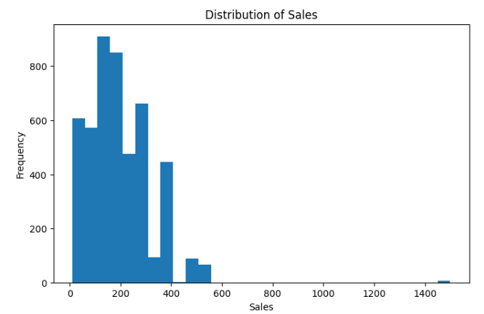
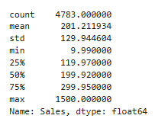
UNIVARIATE ANALYSIS 1
Sales Distribution
BUSINESS PROBLEM
What is the overall distribution of sales across customer orders, and are there any significant spending patterns? Does the business rely heavily on a small number of high-value transactions for revenue generation?
📊 Concentrated Transactions
💰 Positively Skewed Revenue
Most sales transactions were concentrated within a specific sales range, indicating common purchasing behavior among customers.
A small number of high-value orders contributed disproportionately to total revenue, resulting in a positively skewed distribution.
RECOMMENDATIONS
→ Develop targeted retention strategies for customers who consistently place high-value orders.
→ Use customer segmentation to create personalized marketing campaigns that encourage larger purchases.
Notes:
The objective of this analysis was to understand how sales are distributed across customer orders. By examining the sales variable independently, we can identify common spending patterns and determine whether revenue is evenly distributed. The histogram revealed that most transactions occur within a specific sales range, while a small number of orders generate exceptionally high revenue. This suggests that a limited group of customers contributes significantly to total sales. These insights are valuable for customer segmentation, revenue forecasting, and developing strategies to retain high-value customers.

Slide 3
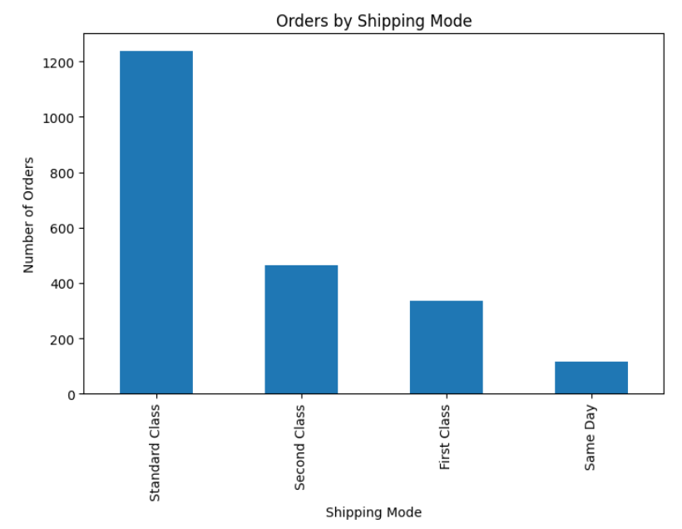
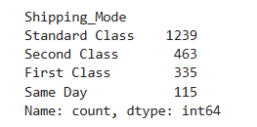
UNIVARIATE ANALYSIS 2
Shipping Mode Usage
BUSINESS PROBLEM
Which shipping method is most preferred by customers when placing orders? How can shipping preferences help improve logistics planning and resource allocation?
🚚 Dominant Shipping Mode
📉 Uneven Utilization
One shipping mode accounted for the majority of customer orders, demonstrating a strong and clear customer preference.
Several shipping methods had relatively low utilization, indicating uneven demand distribution across delivery options.
RECOMMENDATIONS
→ Allocate additional logistics resources to support the most frequently used shipping method.
→ Promote underutilized delivery options through incentives or discounted shipping offers.
Notes:
This analysis focused on identifying customer preferences regarding shipping methods. Understanding which shipping mode customers select most frequently helps the company allocate logistics resources more effectively. The analysis showed that one shipping method was significantly more popular than the others, indicating a clear customer preference. This information is important for planning delivery operations, improving service quality, and ensuring that resources are aligned with customer demand.

Slide 4
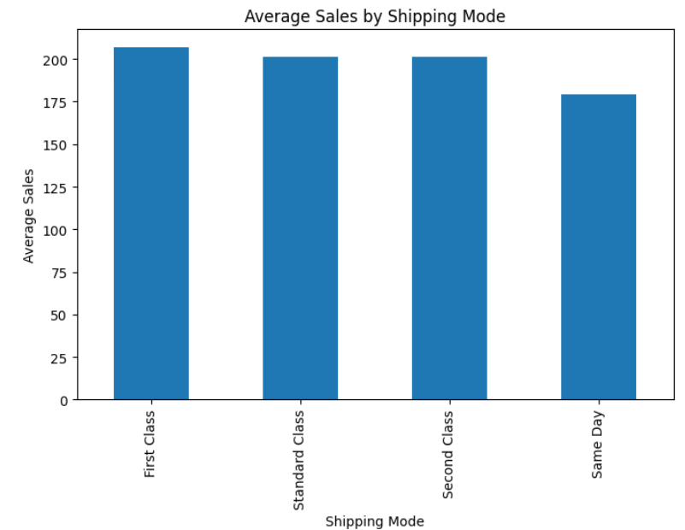
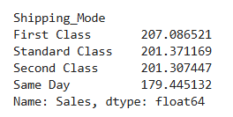
BIVARIATE ANALYSIS 1
Shipping Mode vs Sales
BUSINESS PROBLEM
Does customer spending vary depending on the shipping method selected? Which shipping modes are associated with the highest revenue generation?
📈 Higher Sales per Mode
💎 Premium Delivery Behavior
Certain shipping methods produced significantly higher average sales values compared to others.
Customers selecting premium delivery options generally placed larger orders, linking delivery choice to spending level.
RECOMMENDATIONS
→ Promote high-performing shipping methods through targeted marketing campaigns.
→ Bundle premium delivery services with high-value products to encourage larger purchases.
Notes:
This analysis examined the relationship between shipping mode and sales performance. The objective was to determine whether customers who choose different delivery options exhibit different spending behaviors. Average sales values were calculated for each shipping mode and compared. The results showed that certain shipping methods were associated with higher average sales, suggesting that customers selecting those options may represent higher-value segments. These insights can help the company optimize shipping services, improve customer targeting, and increase revenue through more effective logistics strategies.

Slide 5
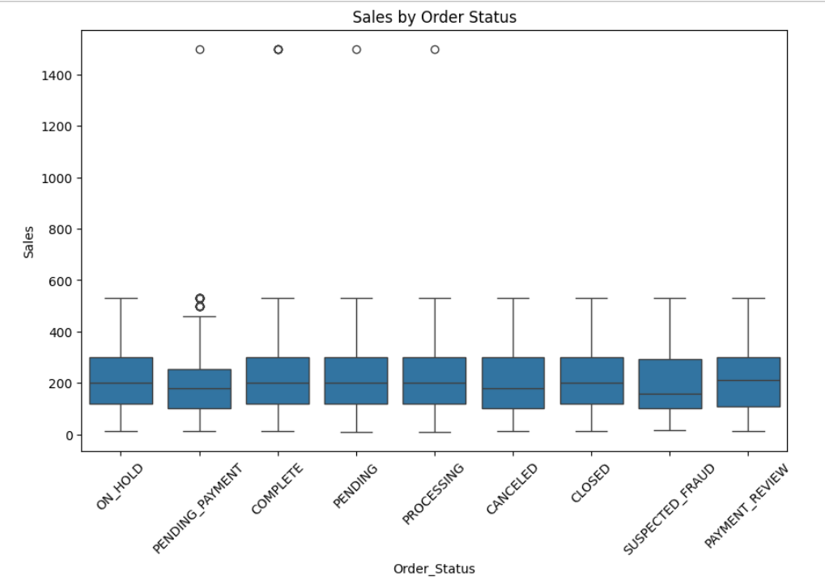
BIVARIATE ANALYSIS 2
Order Status vs Sales
BUSINESS PROBLEM
How do different order outcomes impact overall revenue generation? What financial impact do cancelled orders have on the business?
✅ Completed Orders Drive Revenue
⚠️ Cancellations = Lost Revenue
Completed orders contributed the majority of total sales revenue, forming the backbone of business income.
Cancelled orders represented a significant loss of potential revenue and missed business opportunities.
RECOMMENDATIONS
→ Investigate the main causes of order cancellations and implement corrective measures.
→ Improve customer communication and order tracking to increase completion rates.
Notes:
The purpose of this analysis was to understand how order outcomes influence revenue generation. Sales were compared across different order statuses such as Complete, Closed, and Cancelled. The analysis demonstrated that completed orders contribute the majority of business revenue, while cancelled orders represent lost sales opportunities. Understanding the relationship between order status and revenue is important because it highlights the financial impact of operational inefficiencies. The findings can help management focus on reducing cancellations and improving fulfillment processes to protect revenue.

Slide 6
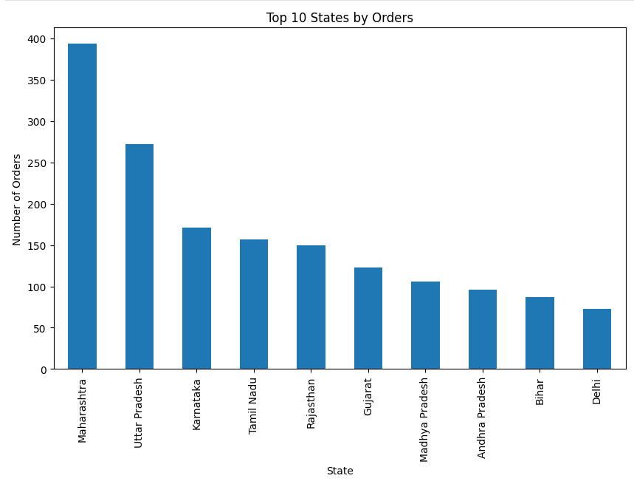
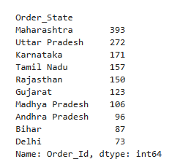
BIVARIATE ANALYSIS 3
State vs Order Volume
BUSINESS PROBLEM
Which states generate the highest customer demand and order volumes? Where should the company focus its marketing and operational resources?
🏆 High-Demand States Dominate
🗺️ Regional Demand Variation
A small number of states contributed a large proportion of total orders, driving most business demand.
Customer demand varied considerably across geographic regions, revealing distinct regional market opportunities.
RECOMMENDATIONS
→ Increase marketing efforts and inventory availability in high-demand states.
→ Explore growth opportunities in regions showing emerging customer demand.
Notes:
This analysis investigated which states generate the highest number of customer orders. By aggregating order counts by state, we were able to identify the regions that contribute most significantly to business demand. The results showed that a small number of states account for a large proportion of total orders. These findings are important because they help management prioritize inventory allocation, logistics planning, and marketing investments. Understanding regional demand patterns also supports future business expansion strategies.

Slide 7
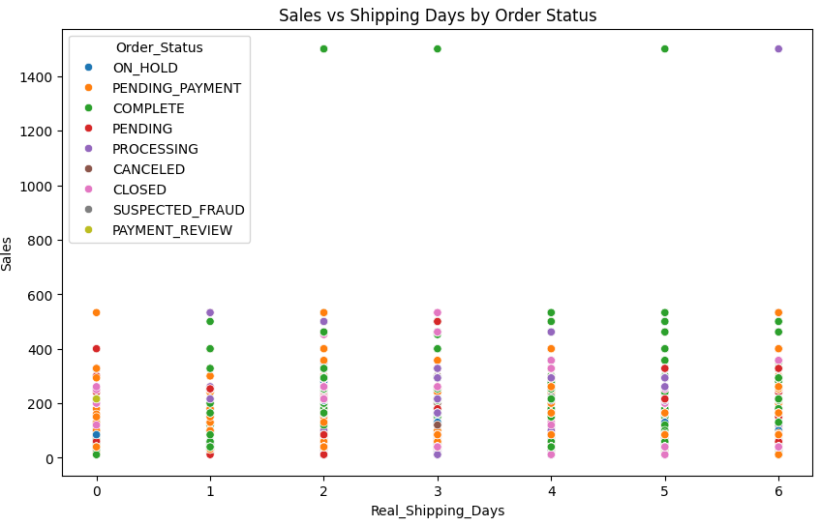
MULTIVARIATE ANALYSIS 1
Sales · Shipping Days · Order Status
BUSINESS PROBLEM
Do shipping delays influence sales performance and order outcomes? How does delivery efficiency affect customer satisfaction and business performance?
⏱️ Delays Linked to Poor Outcomes
📦 Delivery Affects Revenue
Longer shipping times were associated with less favorable order outcomes, linking delivery speed to fulfillment success.
Delivery performance appeared to influence both revenue generation and order success, making logistics a strategic priority.
RECOMMENDATIONS
→ Reduce shipping delays through process optimization and improved logistics coordination.
→ Establish performance monitoring systems to track shipping efficiency and customer satisfaction.
Notes:
This multivariate analysis combined sales, shipping duration, and order status to evaluate how delivery performance affects business outcomes. The goal was to determine whether longer shipping times are associated with lower sales or unsuccessful order completion. The results suggested that delivery delays may negatively impact customer satisfaction and order outcomes. Since timely delivery is an important factor in customer experience, improving shipping performance can contribute to higher completion rates, increased revenue, and stronger customer loyalty.

Slide 8
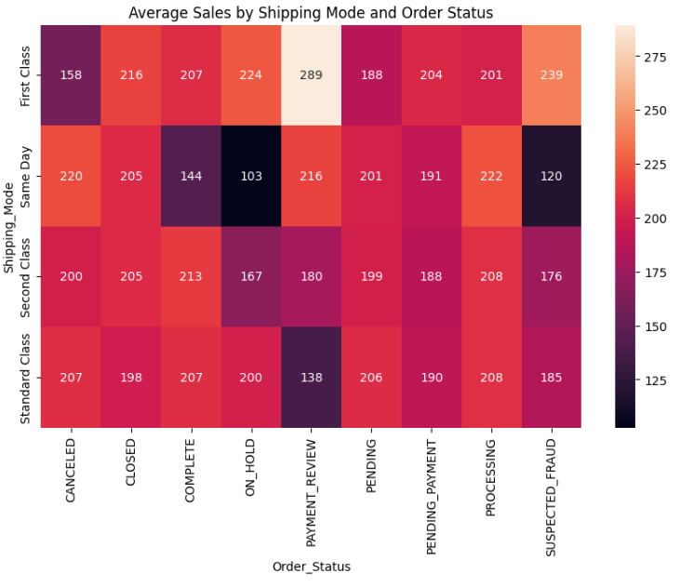
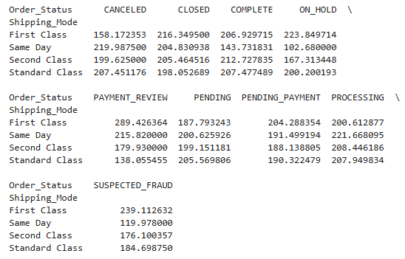
MULTIVARIATE ANALYSIS 2
Shipping Mode · Sales · Order Status
BUSINESS PROBLEM
Which shipping methods perform best when considering both revenue and order completion rates? How can the company optimize its delivery strategy for better business outcomes?
🥇 Best-Performing Modes
📊 Variable Effectiveness
Certain shipping methods consistently achieved higher sales and stronger completion rates across orders.
Shipping effectiveness varied significantly across different delivery options, revealing clear performance gaps between modes.
RECOMMENDATIONS
→ Prioritize investment in shipping methods that deliver strong financial and operational performance.
→ Improve service quality for delivery methods that show lower completion rates.
Notes:
This analysis explored the combined relationship between shipping methods, sales performance, and order outcomes. By evaluating these variables together, we can identify which delivery options generate the best overall business performance. The results indicated that some shipping methods consistently achieved stronger sales performance and higher completion rates. These findings help the company identify the most effective logistics strategies and prioritize investment in shipping services that provide both operational and financial benefits.

Slide 9
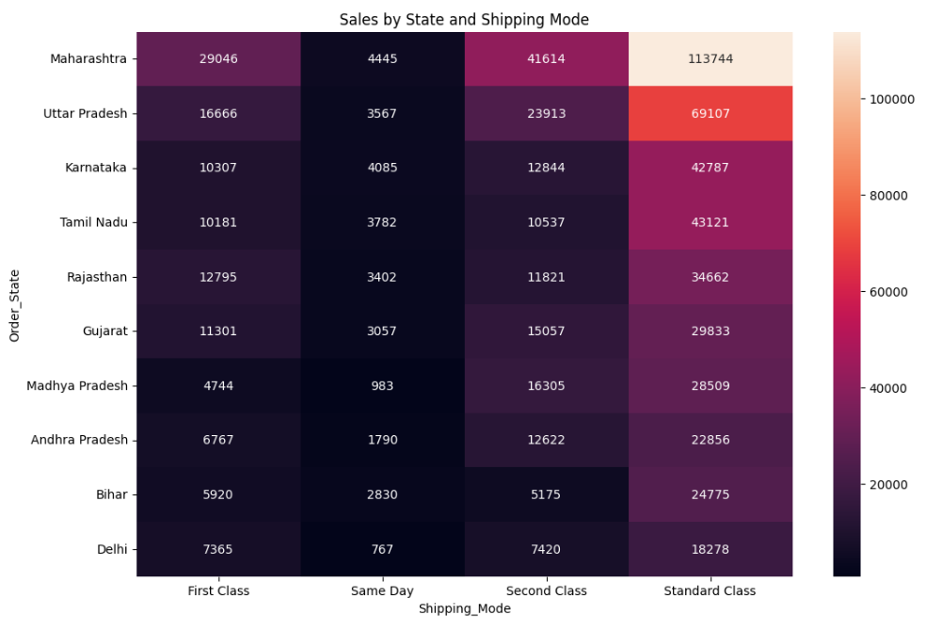
MULTIVARIATE ANALYSIS 3
State · Shipping Mode · Sales
BUSINESS PROBLEM
How do regional customer preferences and shipping choices affect revenue generation? Which geographic markets provide the greatest revenue opportunities?
🌎 Regional Revenue Gaps
💡 High-Value Combinations
Revenue generation differed significantly across states and shipping methods, exposing strong geographic patterns.
Certain combinations of region and shipping mode generated substantially higher sales, indicating strategic sweet spots.
RECOMMENDATIONS
→ Develop region-specific marketing and shipping strategies based on customer behavior.
→ Increase investment and operational support in high-revenue markets.
Notes:
The objective of this analysis was to understand how geographic location and shipping preferences influence revenue generation. By combining state, shipping mode, and sales data, we were able to identify regional patterns in customer behavior. The analysis showed that certain states and shipping method combinations generated substantially higher revenue than others. These findings can support regional marketing initiatives, logistics planning, and resource allocation decisions. Tailoring business strategies to regional customer preferences can improve both operational efficiency and profitability.

Slide 10
OVERALL SUMMARY
Key Findings &
Strategic Recommendations
KEY FINDINGS
Customer spending, shipping preferences, and geographic location all significantly influenced business performance.
Delivery efficiency and order completion rates played a critical role in revenue generation and customer satisfaction.
STRATEGIC RECOMMENDATIONS
Focus on retaining high-value customers while improving order fulfillment and delivery performance.
Continue using data-driven analytics to support logistics optimization, customer targeting, and business growth.
Notes:
This project demonstrated how SQL and Python can be integrated to perform business analytics and generate meaningful insights from operational data. The univariate analyses helped understand customer spending behavior and shipping preferences. The bivariate analyses revealed important relationships between sales, order outcomes, shipping methods, and regional demand. The multivariate analyses showed how multiple operational factors interact to influence business performance. Based on these findings, the company should focus on retaining high-value customers, improving delivery efficiency, reducing order cancellations, and investing resources in high-performing regions.

