Slide 1
Chatterpaul Joseph
Seeker Trade Study - Homework
Notes:
https://www.free-power-point-templates.com/free-green-design-powerpoint-template/

Slide 2
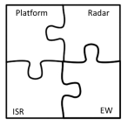
Agenda
Laser & LADAR Link Budget, Trade-offs and Feasibility
Monostatic vs Bi-static RF Seeker
Surface to Air
COTS Component, Software & Test Tools, Size, Power, Weight & Cost, Calibration

Slide 3
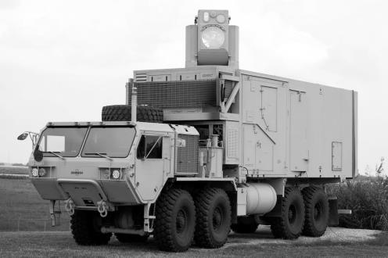
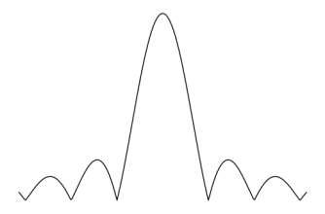
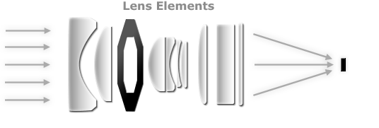
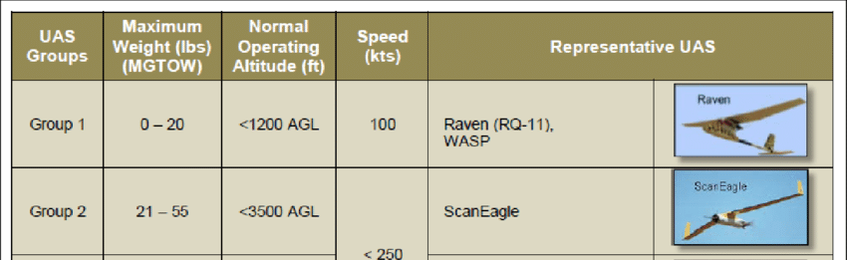

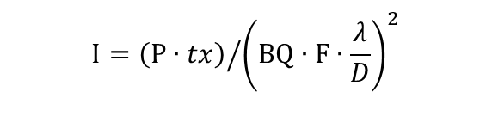
Laser 101
Diffraction Limited Focal Spot on Target
d
$$d=BQ∙F∙\frac{λ}{D}$$
Intensity (W/cm²) is Power on Target over Area
$$I={\left(P∙tx\right)}/{{\left(BQ∙F∙\frac{λ}{D}\right)}^{2}}$$
tx is the transmission fraction through air/haze/cloud/etc.
D
Focusing
F
Target
Laser Source
Peak Power P(kW) | Wavelength λ(um) | Diameter D(cm) | Beam Quality BQ | Focal Length(km)
1 – 10 | ~1 | 5 – 10? | 1.4 – 2 | ≤ 20
Pulse Width (ns) | Pulse Energy (mJ) | Cost ($K)
.010 – 10 | .01 – 10 | $$≥{20}^{∗}$$
Notes:
Vehicle: https://www.defense.gov/observe/photo-gallery/igphoto/2002121156
Lens: https://www.cambridgeincolour.com/tutorials/camera-lenses.htm
UAS Target: https://www.researchgate.net/figure/US-DoD-Unmanned-Aerial-System-Group-Classifications-14_fig3_295873907
*Based on laser cutter: https://www.google.com/search?q=high+power+laser+cutter+cost but it’s not eye-safe

Slide 4
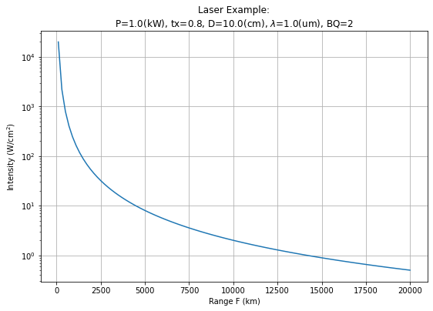
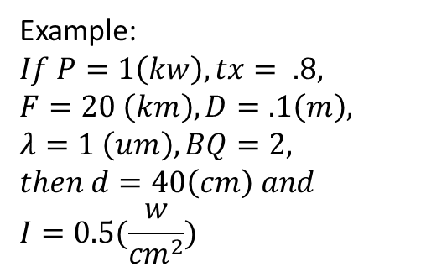
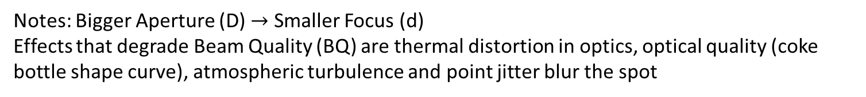
A Laser Performance Example: Power on Target
Notes: Bigger Aperture (D) $→$ Smaller Focus (d)
Effects that degrade Beam Quality (BQ) are thermal distortion in optics, optical quality (coke bottle shape curve), atmospheric turbulence and point jitter blur the spot
Example:
$$If P=1\left(kw\right),tx= .8,$$
$$F=20 \left(km\right), D=.1\left(m\right),$$
$$λ=1 \left(um\right),BQ=2,$$
$$then d=40\left(cm\right) and$$
$$I=0.5(\frac{w}{{cm}^{2}})$$
“Hard” Structure Lethality – Direct Energy
“Soft” Lethality – Blinds IR Seekers

Slide 5
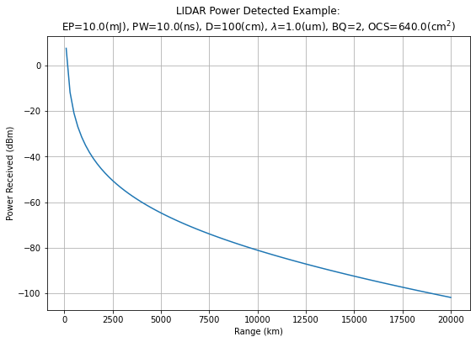
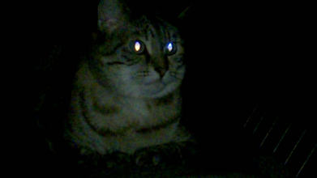
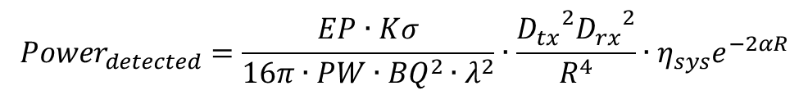

A Laser Performance Example: Detect Target
Using a form of the LADAR/LIDAR range equation to determine the detected off a target
$${Power}_{detected}=\frac{EP∙Kσ}{16π∙PW∙{BQ}^{2}∙λ^{2}}∙\frac{{D_{tx}}^{2}{D_{rx}}^{2}}{R^{4}}∙η_{sys}e^{−2αR}$$
$$EP is the pulse energy$$
$$K is the illumination constant, in this case set to \frac{1}{e}$$
$σ=4∙ρ∙A_{target}$ is the target optical cross section (OCS)
$$PW is the pulse width$$
$$BQ is beam quality$$
$$λ is wavelength$$
$$D is the diameter of the aperture \left(tx and rx\right)$$
$$R is the the range to the target$$
$$η_{sys} is the transmittance of the internal optics$$
$$∝ is the atmospheric extinction coefficient$$
A LADAR would need at > ~60 (dBm) for detection, which would requires a Higher Energy, Larger Diameter and Larger OCS
What is reasonable OCS and Power Receiver for an IR camera and delta temperature is need?
The ability to see the reflections off a target is dependant on the optical cross section of the target. If there is an IR seeker at your laser’s wavelength, then there could be a strong reflection like a cat’s eye reflecting light.
Notes:
Cat’s Eye: https://www.youtube.com/watch?v=qU6Sz1SIwPs
Example Designator: https://www.military.com/video/operations-and-strategy/air-strikes/laser-targeted-strike-in-afghanistan/2707623470001

Slide 6
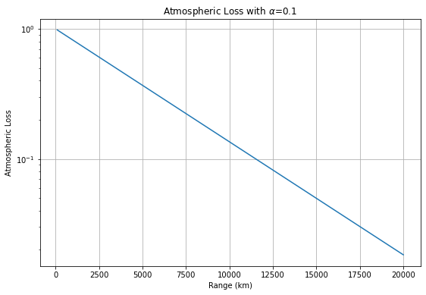
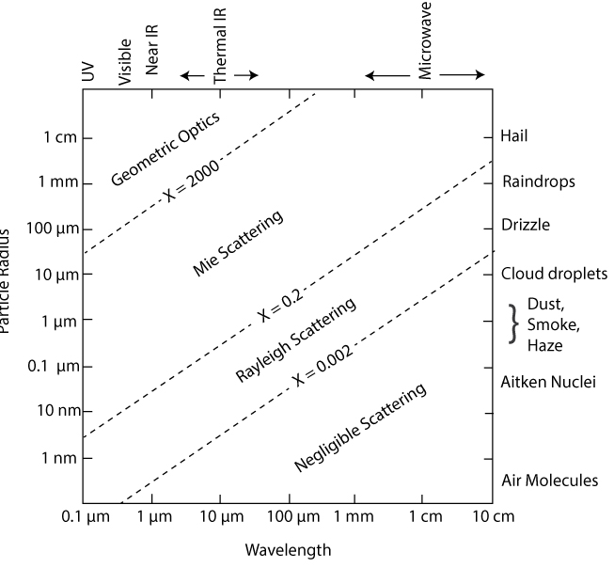
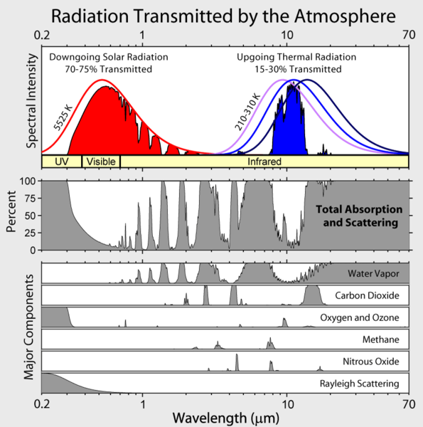
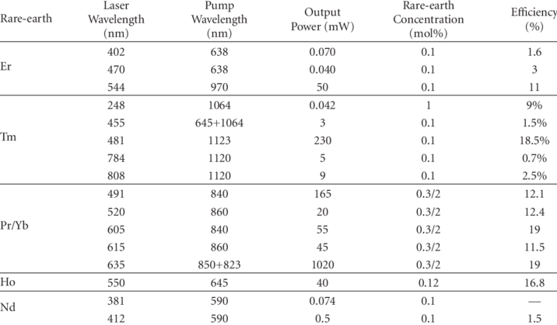
Commercial Off The Self Laser Challenges
- Atmospheric effects can potentially make LADAR detectable to adversaries
- Short pulses mean better range and resolution but also scatter off particulates and water droplets in the atmosphere
- Lasers are inefficient, so higher prime power and heat dissipation issues
Atmospheric Loss and 1/R⁴ are significant non-design terms in the power receive
Notes:
Particle Radius Wavelength: https://www.e-education.psu.edu/meteo300/node/785
Transmitted by the Atmosphere: https://commons.wikimedia.org/wiki/File:Atmospheric_Transmission.png
COTS Rare-earth Lasers: https://www.researchgate.net/figure/Summary-of-upconversion-rare-earth-doped-ZBLAN-fiber-lasers-with-the-highest-output_tbl2_43170278

Slide 7
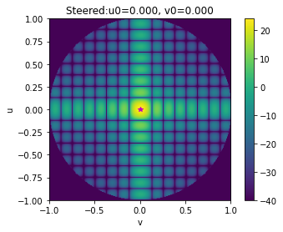
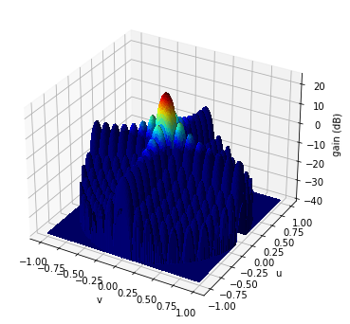
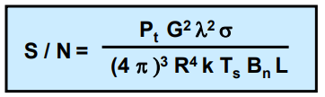

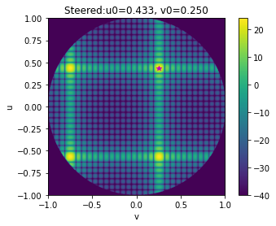
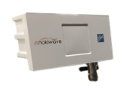
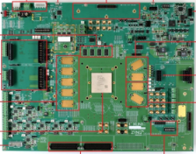


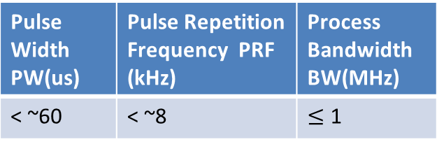
RF Rectangular Antenna Phased Array Hardware
$$d_{max}=\frac{λ}{2}$$
Recommend Design Tools:
CST – Antenna
Microwave office - HW
Python Analysis
$$d_{max}=0.8∙λ$$
Pulse Width PW(us) | Pulse Repetition Frequency PRF (kHz) | Process Bandwidth BW(MHz)
< ~60 | < ~8 | $≤$ 1
Cost $K
(> 20 for unambiguous range rate)
Smaller bandwidth, lower noise level but also lower range-resolution
# RF Channel
Peak Power P(W) | Wavelength λ(mm) | Antenna Gain G (dB)
256*.010 = ~2.5 to 10 | ~10 | 24
Grating Lobes
To get 30 (dB) would require 32x32 array
Notes:
https://www.anokiwave.com/products/index.html
https://www.xilinx.com/products/boards-and-kits/device-family/nav-zynq-ultrascale-plus-rfsoc.html

Slide 8
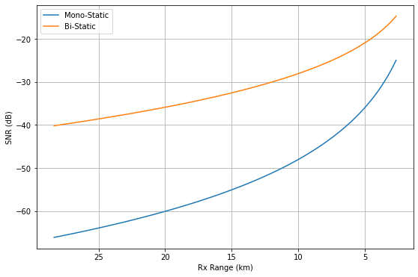
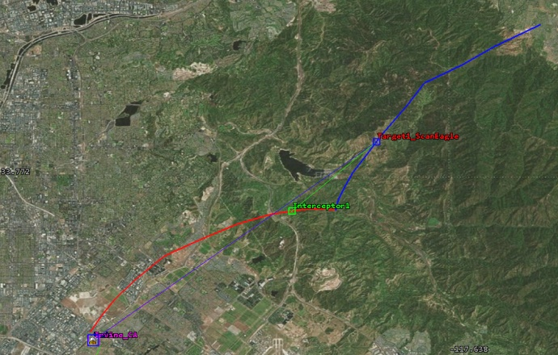
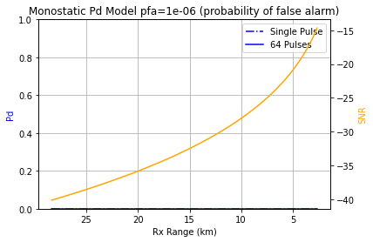
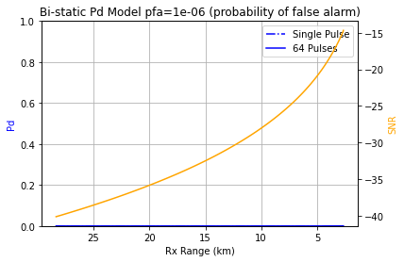
Radar Monostatic & Bi-static Link Budget
Monostatic Parameters:
RCS = -20 (dBsm), Bw = 100e3 (Hz)
Ptx = 10 (W), Freq=30e9 (Hz)
G=24 (dB), NF=6 (dB), Loss=1 (dB)
Bi-static Parameters:
Ptx =100 (W), Gtx=40 (dB), Grx=24 (dB)
For reasonable power and gain parameters, the SNR is too low for the given RCS and geometry, resulting in the target being undetectable.

Slide 9
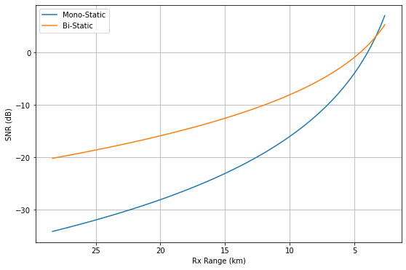
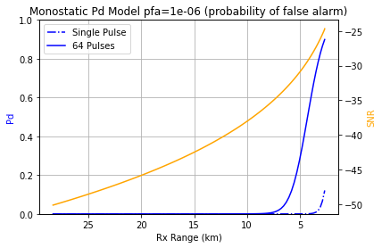
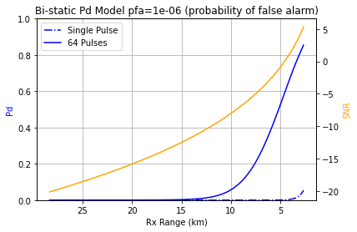
Optimistic Link Budget
Monostatic Parameters:
RCS = -20 (dBsm), Bw = 100e3 (Hz)
Ptx = 1 (kW), Freq=30e9 (Hz)
G=30 (dB), NF=6 (dB), Loss=1 (dB)
Bi-static Parameters:
Ptx =10 (kW), Gtx=40 (dB), Grx=24 (dB)
For optimistic power and gain parameters, the SNR is become positive for the given RCS and geometry under 5 km, resulting in the target being coming detectable.
Note: Generally, there is a burn through range at which a mono-static seeker outperforms the bi-static seeker. Also, note that coherently integrating 64 pulses is only applicable to the mono-static case.

Slide 10
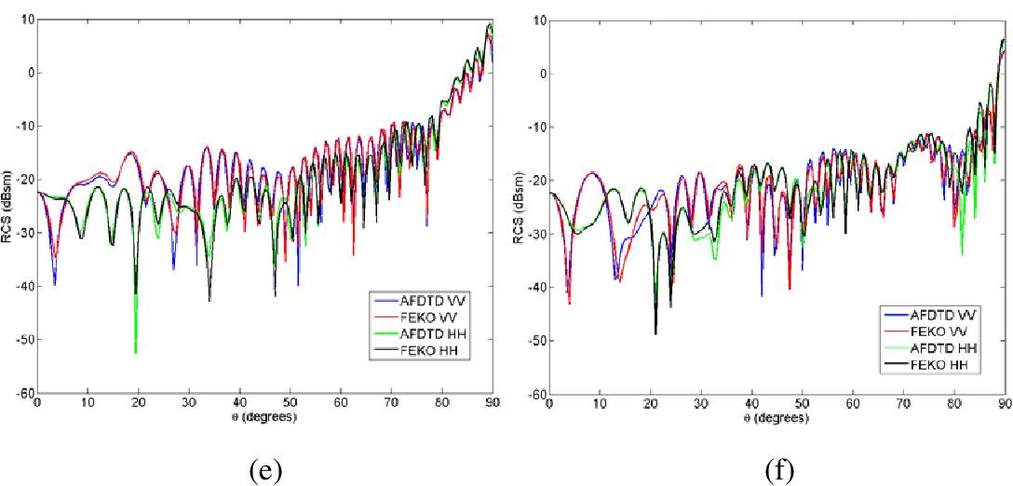
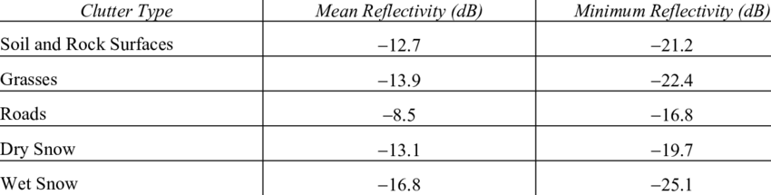
Challenges – Clutter, RCS
In order to solve these hardware radar problem, it is better to build a custom seeker instead of trying to repurpose a solution from a company like ImSAR
Base-band frequency
Notes:
https://www.researchgate.net/figure/Ku-band-clutter-reflectivity-values-at-30-degree-grazing-angle-VV-polarization-13_tbl1_253215976
https://www.semanticscholar.org/paper/Numerical-Computation-of-the-Radar-Cross-Section-of-Kenyon-Dogaru/6c3170d1f8725bf1e552b63e0fda76527949e100
https://apps.dtic.mil/sti/pdfs/ADA622300.pdf

