Slide 1
IPL VISUALISATION USING TABLEAU By – Iranna Chatti

Slide 2


Slide 3

The Indian Premier League, or IPL, is a T20 cricket league, which was founded in 2008 and is held every year. It sees participation from both national and international players, and eight teams representing eight Indian cities compete with each other in a double round-robin format in the league stages, which are followed by playoffs. Over the years, IPL has become one of the most-watched and most attended live sporting events all over the world. You work as a data analyst at IFP, a nationally recognized news agency, which is based out of New Delhi, and provides news reports and feeds to magazines, newspapers and TV broadcasters all over the country. The Sports Editor of the agency has approached you to build a Tableau dashboard of IPL statistics over the years since its inception in order to create an infographic for a newsletter that their team is working on. For this newsletter, in some cases, they will use the visual representations as you have created in Tableau directly for their infographic, and in a few other cases, they will use important statistics after trying out the different filters and customizations that you have provided for interactivity. Therefore, you are expected to build an interactive dashboard in Tableau for this purpose
Problem Statement

Slide 4
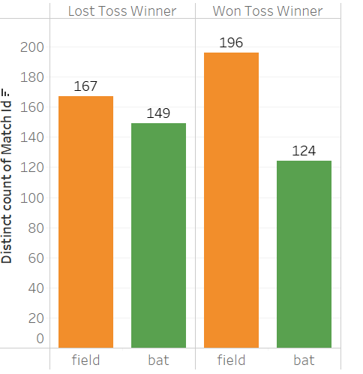
Match Statistics
Toss outcome vs Match outcome
INSIGHTS
Team Winning the TOSS and Choosing Fielding is Having highest Number of Wins Across the Venues.
Losing the Toss and Goes To Field has the highest rate of wins for toss loser.
Green bar represents field option chosen by Captain and orange represent Batting.

Slide 5
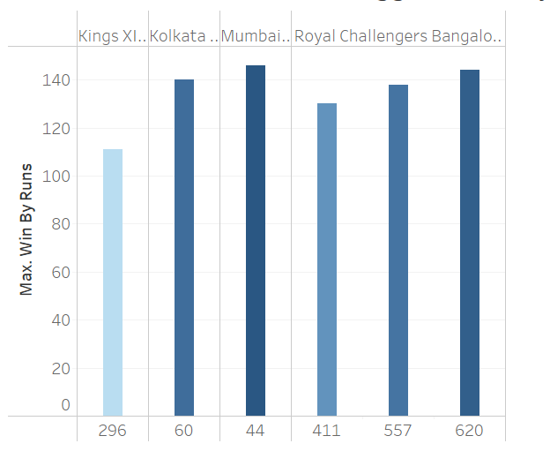
Match Statistics
Biggest Wins By Runs
INSIGHTS
Mumbai Indians top the charts with the Win against Delhi Daredevils 146 Runs
Royal Challenger Bangalore registered three biggest wins in top 5 charts.

Slide 6
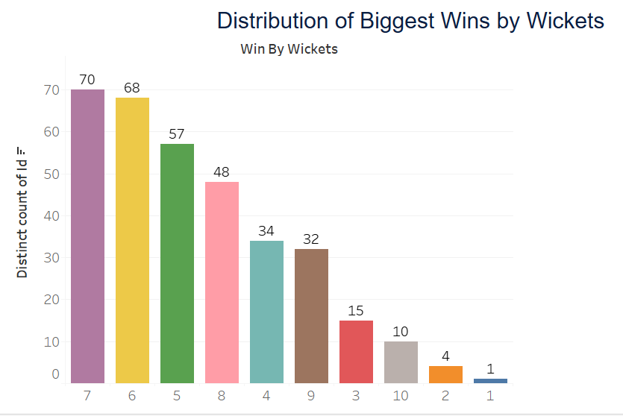
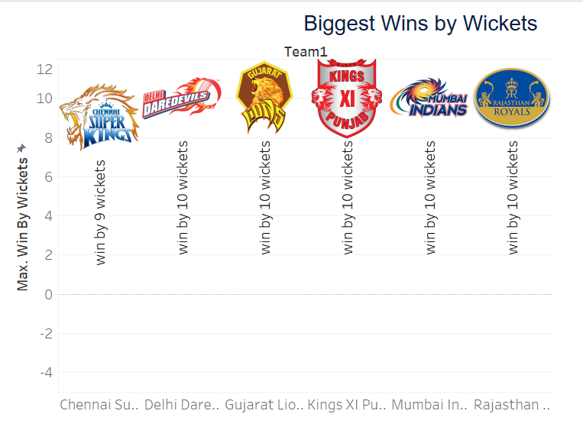
Biggest Wins by Wickets
INSIGHTS
As per data first biggest win by 10 wickets was registered by Delhi Daredevils.

Slide 7
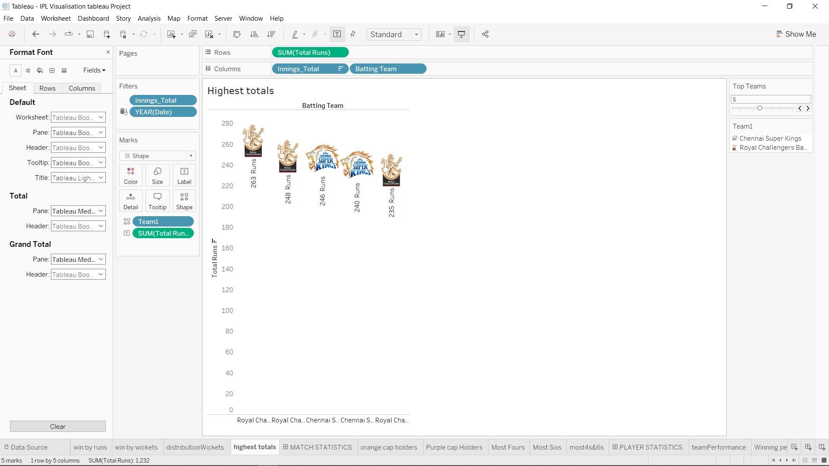
Highest Totals
INSIGHTS
Royal Challengers Bangalore scored highest runs 263
Royal Challengers Bangalore is the first team to set 3 highest scores in season.
Followed by Chennai Super kings with highest 246 Runs and secure second position in chart.

Slide 8
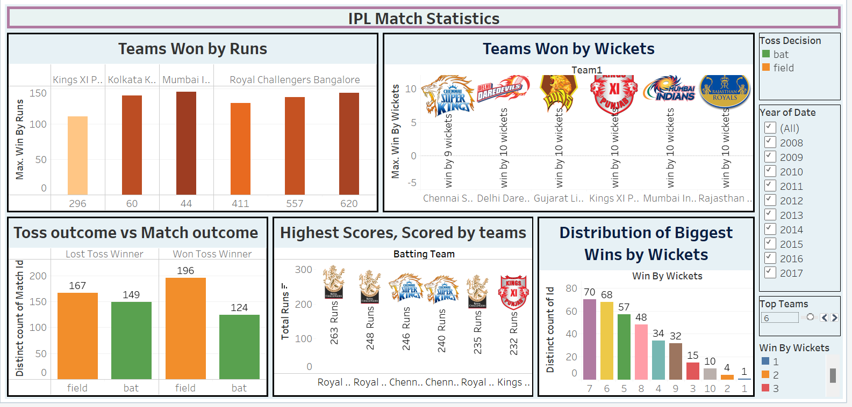
IPL Match Statistics
The Above Dashboard is showing Top Five in All Formats Performance.
We can Manipulated the Dashboard for particular season by Year and Selecting Top Teams Parameter

Slide 9
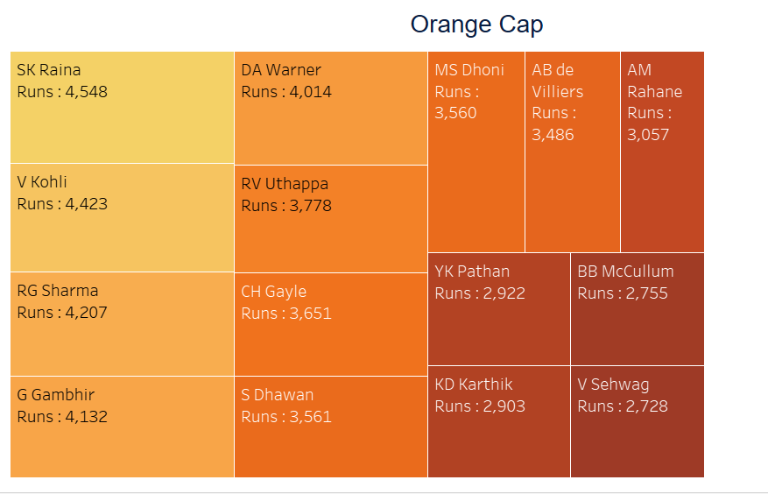
Orange Cap contenders
INSIGHTS
Suresh Raina is highest runner getter in the IPL followed by Virat Kohli, scored 4548 runs.
For the batsman who have scored the maximum number of runs in a particular season we can filter it out with help of year filter and we can select top players from parameter TOP PLAYERS

Slide 10
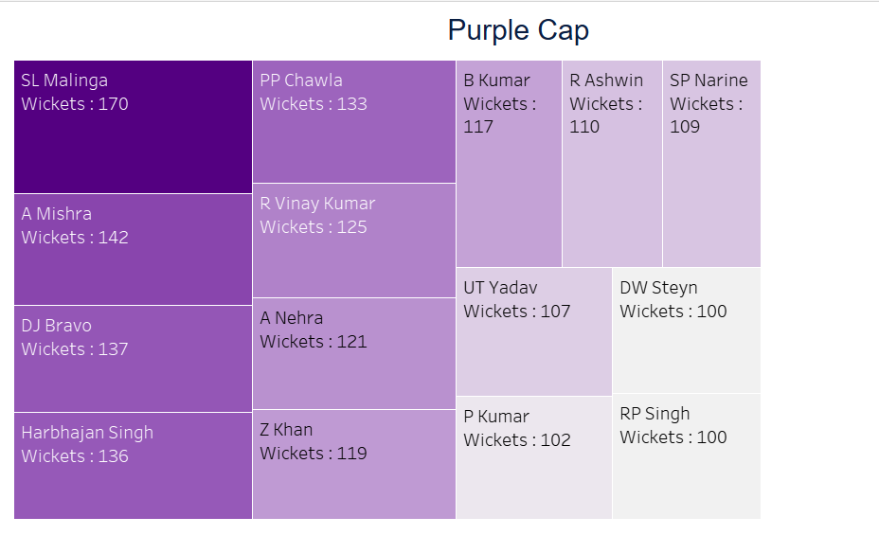
Purple Cap Contenders
INSIGHTS
Lasith Maling is the Highest Wickets taker in the IPL with 170 and followed by A Mishra with 142.

Slide 11
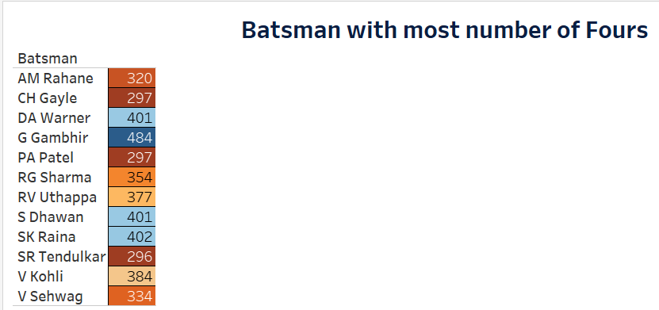
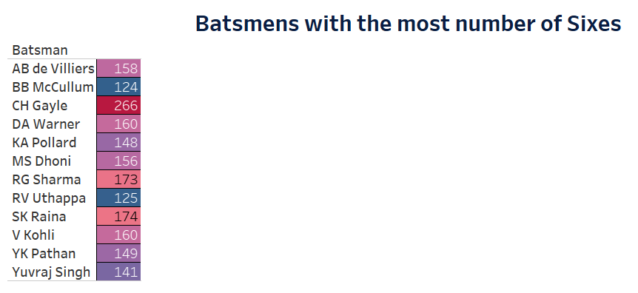
Batmen's with Most fours INSIGHTS: Goutam Gambhir is Hitted Highest Number Of Fours 484 Suresh Raina got second place for hitting Fours 402.
Batmen’s With Most Sixes
INSIGHTS: Chris Gayle is Hitted Highest Number of Sixes 266.
Suresh Raina Suresh Raina got second place for hitting Sixes 174 with neck to neck RG Sharma 173.

Slide 12
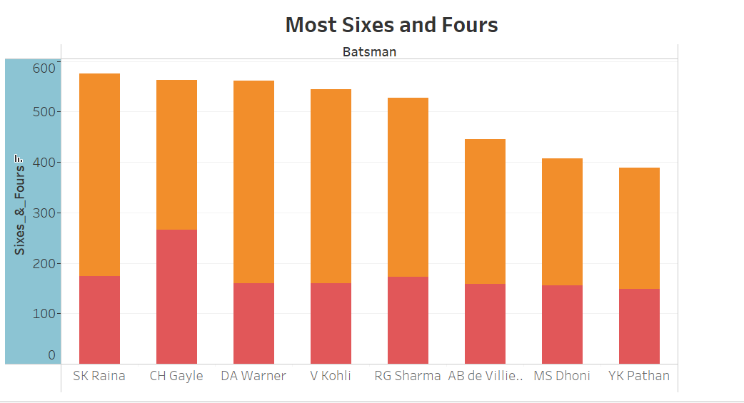
Overall data
INSIGHTS
Suresh Raina is player with the most number of fours and sixes in the IPL and Gayle at second.
Warner and Virat Kohli are just behind to achieve this goal.

Slide 13
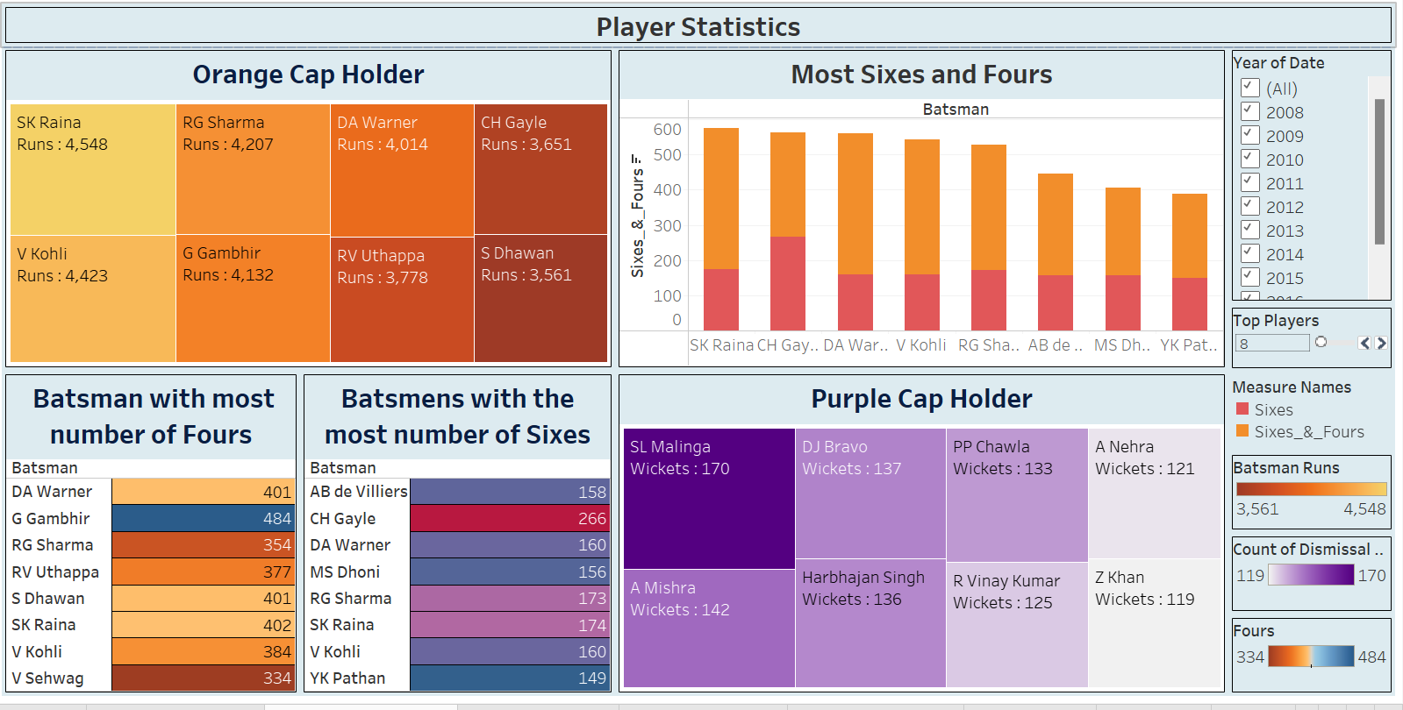
PLAYER STATISTICS DASHBOARD
This Dashboard represent overall analysis of Player statistics and performance and achievement of orange cap, purple cap most fours and sixes hit by Player. All can be seen from this Dashboard.

Slide 14
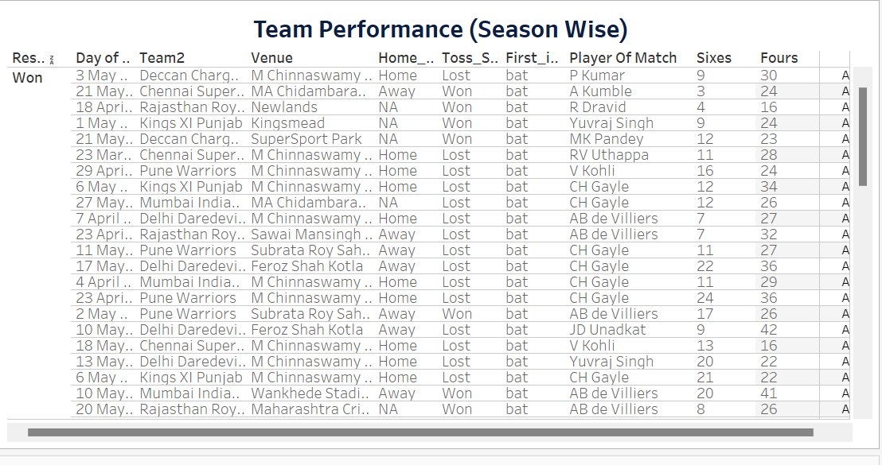
Season-wise team performance (wins vs losses)
The above table is having particular Team performance in season wise.
The above table is breakdown by Result status showing two Category Won and lost with details of matches.

Slide 15
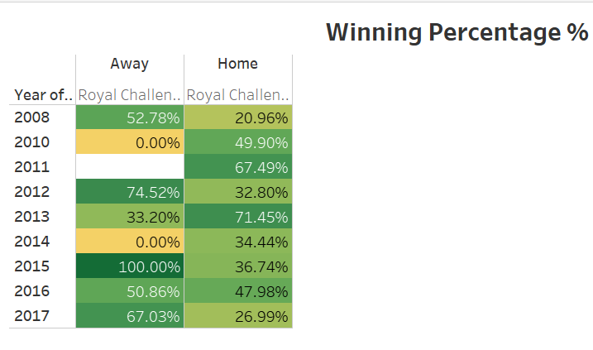
Win %age ( Away vs Home)
The above table is showing the winning percentage of the team if team played in home ground or Away
The above table is representing the Royal Challengers Bengaluru Winning percentage
In 2015 team Having 100% in Away
In 2012 team wins 74% in Away

Slide 16
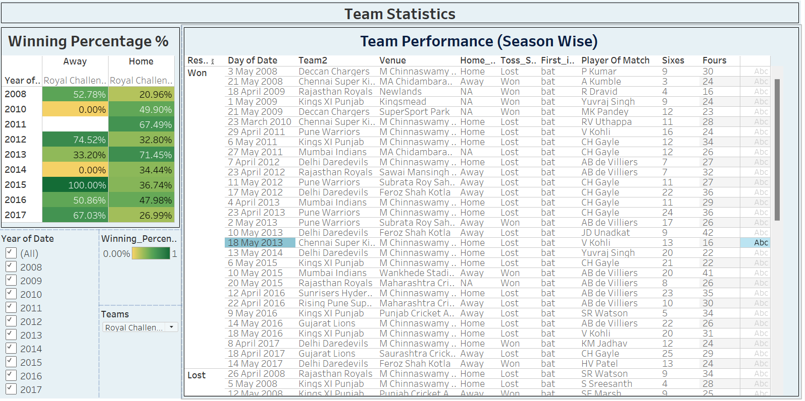
Team Statistics Dashboard
The above Dashboard showing insights for the Royal Challengers Bengaluru for all Seasons

Slide 17
CONCLUSIONS
Team Winning the TOSS And Choosing Fielding is Having highest Number of Wins Across the Venues
Mumbai Indians top the charts With the Win against Delhi Daredevils by All time Huge margin of 146 Runs
Followed By Royal Challenger Bangalore registered three biggest wins at the top 5 chart and Kolkata Knight riders registered 1 biggest win by runs.
first biggest win by 10 wickets was registered by Delhi Daredevils 7 wickets wins registered Most of the times in IPL History.
Royal Challengers Bangalore Leads the chart with 263 Runs and RCB has 3 highest Totals in IPL history and in top 5 chart got 3 highest totals and Chennai Super kings with highest 246Runs and got 2 spots among top 5 chart.
Suresh Raina is highest runner getter in the IPL followed by Virat kohli.
For the batsman who have scored the maximum number of runs in a particular season we can filter it out with help of year filter and we can select top N players from parameter TOP PLAYERS.
Lasith Maling is the Highest Wickets getter in the IPL and followed by A Mishra.
Chris Gayle having Highest Number of Sixes and Goutam Gambhir is Having Highest Number Of Fours.
Royal challengers is the team to score highest and the lowest score.

