Slide 1
Control Engineering
Stability Analysis

Slide 2
Poles and Zeros
A rational transfer function can be described as
The roots of the numerator zi are the zeros, i.e when H(s)=0.
Similarly pi are the poles of the system, H(s)=∞.
The poles determine the stability of the system.
Poles also determine the natural or unforced response of the system.

Slide 3
System stability definitions
Natural response definition:
A system is stable if the natural response approaches zero as time approaches infinity
A system is unstable if the natural response approaches infinity as time approaches infinity
A system is marginally stable if the natural response neither decays nor grows but remains constant or oscillates
BIBO Definition
A system is stable if every bounded input yields a bounded output
A system is unstable if any bounded input yields an unbounded output

Slide 4
Stable System
Bounded input yields bounded output
Poles lie only in the left half plane
As time approaches infinity the natural response approaches zero.

Slide 5
Unstable System
Bounded input results in an unbounded output
Unstable systems have atleast one pole on right half plane
As time approaches infinity natural response approaches infinity

Slide 6
Stability of a differential equation
The stability of a solution (of a differential equation) determines whether or not solutions nearby the solution remain close, get closer or move further away.
Definition:
Let x(t,a) be a solution to the differential equation with initial condition a. A solution is stable if other solutions that start near a stay close to x(t,a).
Formally we say that the solution x(t,a) is stable if for allε>0, there existsδ>0 such that ||b-a||<δimplies ||x(t,b)-x(t,a)||<ε, for all t>0.
The value of δmay depend onε, so that if we wish to stay very close to the solution we may have to start very close. (δ<<ε). – Stability in sense of Lyapunov.

Slide 7
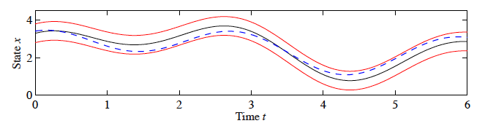
Stability of a differential equation
If a solution is stable in this sense and the trajectories do not converge – Neutrally Stable.
In case x(t,a)=xe, an equilibrium point – Instead of saying that the solution is stable we say the equilibrium point is stable.
A solution is asymptotically stable if it is stable in sense of Lyapunov and also x(t,b)➔x(t,a) as t➔∞ for b suffifiently close to a.

Slide 8
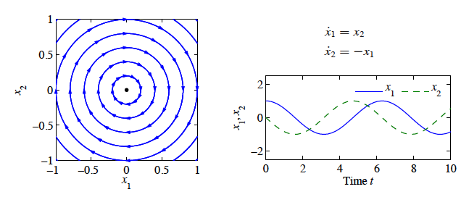
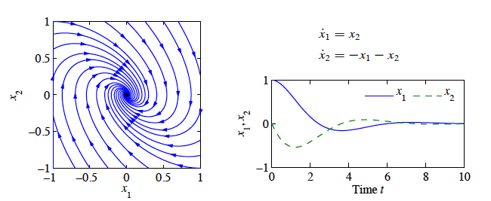
Stability of a differential equation
Neutrally Stable (Phase portrait)
Asymptotically Stable

Slide 9
Stability in state space representation
The easiest case of linear systems to analyze is
The equilibrium point x=0 is asymptotically stable if
and stable is
Another case

Slide 10
Stability in state space representation
With solutions
This system is asymptotically stable if and only if
In general the linear system is asymptotically stab e if and only if all eigen values of A all have a strictly negative real part.
Is unstable if any eigen value of A has a strictly positive real part.

Slide 11
Routh-Hurwitz Stability Criterion
Method to determine how many closed loop poles are on the left half plane, how many are on the right haf plane and how many are on the imaginary axis.
Steps
Generate the Routh Table
Interpret the Routh Table

Slide 12
Generating the Routh Table
Given System
The corresponding Routh Table

Slide 13
Routh Table
Determining various values in the Routh Table

Slide 14
Generating Routh Table - Example

Slide 15
Generating Routh table - Example

Slide 16
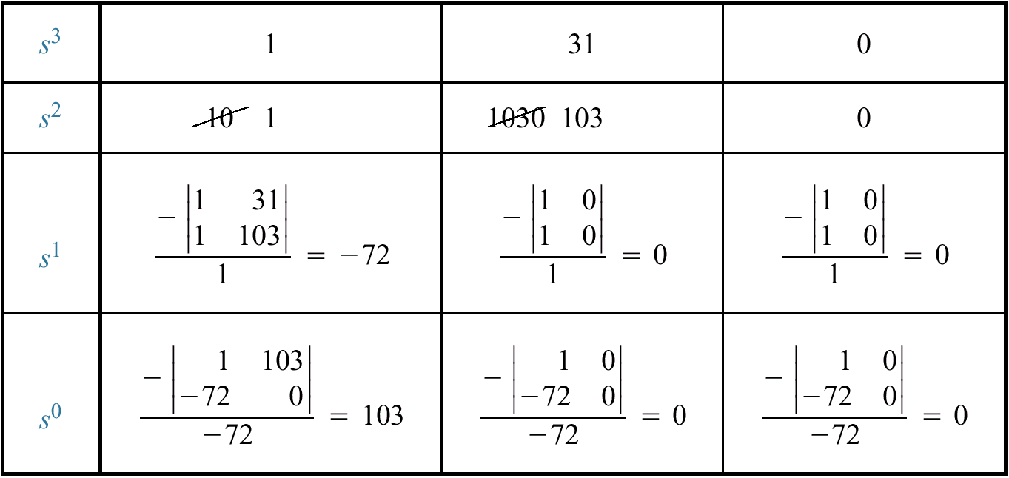
Interpretation of the Routh Table
The number of roots of the polynomial that are in the right-half plane is equal to the number of sign changes in the first column
Two sign changes (2 poles in right half plane), hence an unstable system.

Slide 17
Special Cases
Zero in the first column

Slide 18
Special Cases
Two sign changes, two poles in the right half plane and hence system is unstable

Slide 19
Alternative method: Reverse the coefficients

Slide 20
Special Cases
Two sign changes, leading to an unstable system
Same as previous result

Slide 22
Special case
0
0
0
What to do?
4
12
0

Slide 23
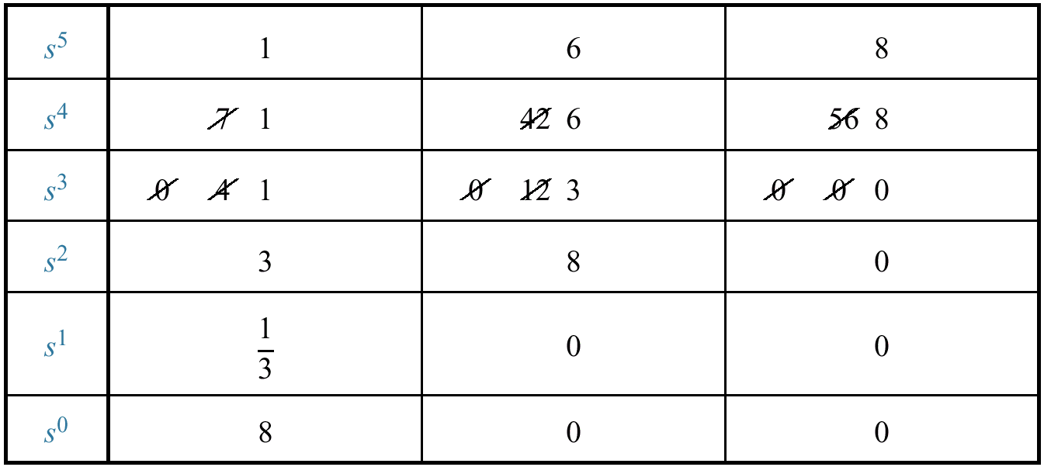
Special Case
No sign changes

Slide 24
Special Case
What can we learn when the entire row is zero?
An entire row of zero will appear in the Routh Table when a purely even or a purely odd polynomial is a factor of original polynomial
Even polynomial only has roots symmetry about the origin
If we do not have row of zeros, we don’t have roots on imaginary axis

Slide 25
Relative Stability Analysis
The Routh’s criterion provides answer to the question of absolute stability.
In many practical cases, we require information about the relative stability of the system.
Supposed we need to to find the roots which lie to the left of –k instead of the origin.
In this case we substitute s = z-k, and write the polynomial in terms of z.
The number of sign changes are equal to the number of roots which lie to the right of s = -k.
Thus giving information on relative stability of the system.

