Slide 1
Dantzig-Wolfe Decomposition

Slide 2
Outline
block structure of a problem
representing a point by extreme points
Revised Simplex to the extreme point representation
an example

Slide 3
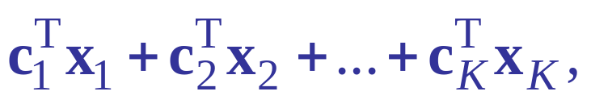
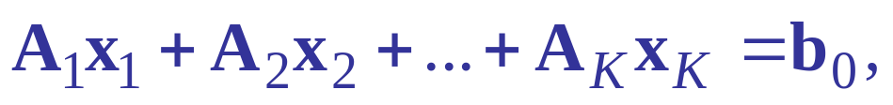

General Problem
min
s.t.
B₁x₁ = b₁,
B₂x₂ = b₂,
…
B_{K}x_{K} = b_{K},
0 ≤ x_{k}, k = 1, 2, …, K.
common in network-based problems
  distribution of K types of products
  B_{k}x_{k} = b_{k}: constraints related to the flow of the kth type of products
  constraints of common resources for the K products:

Slide 4
General Problem
min
s.t.
B₁x₁ = b₁,
B₂x₂ = b₂,
…
B_{K}x_{K} = b_{K},
0 ≤ x_{k}, k = 1, 2, …, K.

Slide 5
General Problem
min
s.t.
B₁x₁ = b₁,
B₂x₂ = b₂,
…
B_{K}x_{K} = b_{K},
0 ≤ x_{k}, k = 1, 2, …, K.
Possible to avoid solving a large problem?

Slide 6
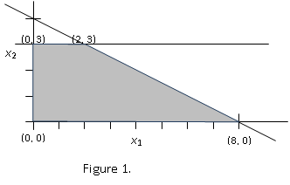
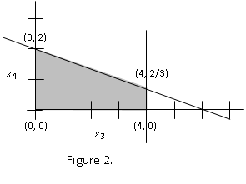
A Numerical Example
Problem P2:
min –3x₁ – 2x₂ – 2x₃ – 4x₄,
s.t. x₁ + x₂ + 2x₃ + x₄ ≤ 10,
x₁ + 2x₂ ≤ 8,
x₂ ≤ 3,
x₃ + 3x₄ ≤ 6,
x₃ ≤ 4,
x_{i} ≥ 0.

Slide 7
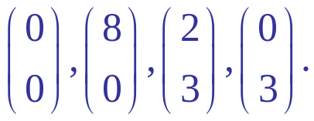
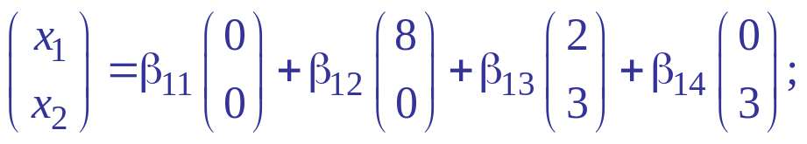


A Numerical Example
feasible region: {(x₁, x₂): x₁ + 2x₂ ≤ 8, x₂ ≤ 3}
  extreme points:
  a feasible point: convex combination of the extreme points

Slide 8
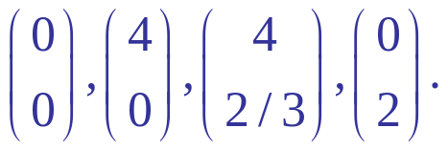
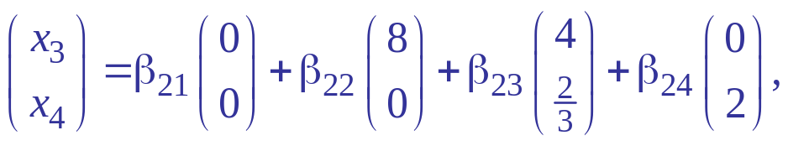


A Numerical Example
feasible region: {(x₃, x₄): x₃ + 3x₄ ≤ 6, x₃ ≤ 4}
  extreme points:
  a feasible point: convex combination of the extreme points

Slide 9
A Numerical Example
Problem P3: problem in terms of extreme points
min -3(8β₁₂+2β₁₃) – 2(3β₁₃+3β₁₄) – 2(4β₂₂+4β₂₃) – 4( β₂₃+2β₂₄),
s.t. (8β₁₂+2β₁₃) + (3β₁₃+3β₁₄) + 2(4β₂₂+4β₂₃) + ( β₂₃+2β₂₄) ≤ 10,
β₁₁ + β₁₂ + β₁₃ + β₁₄ = 1,
β₂₁ + β₂₂ + β₂₃ + β₂₄ = 1,
β_{ij} ≥ 0, i = 1, 2; j = 1, 2, 3, 4.
a subspace B_{k}x_{k} = b_{k} is represented by a single constraint Σ_{n} β_{kn} = 1

Slide 10
A Numerical Example
Problem P3: problem in terms of extreme points
min –24β₁₂ – 12β₁₃ – 6β₁₄ – 8β₂₂ – (32/3)β₂₃ – 8β₂₄,
s.t. 8β₁₂ + 5β₁₃ + 3β₁₄ + 8β₂₂ +8 β₂₃ +2β₂₄ ≤ 10,
β₁₁ + β₁₂ + β₁₃ + β₁₄ = 1,
β₂₁ + β₂₂ + β₂₃ + β₂₄ = 1,
β_{ij} ≥ 0, i = 1, 2; j = 1, 2, 3, 4.
The previous representation suits DW Decomposition more.

Slide 11
Practical?
impractical approach
impossible to generate all the extreme points of a block B_{k}x_{k} = b_{k}
Dantzig-Wolfe Decomposition: check all extremely points without explicitly generating them

Slide 12
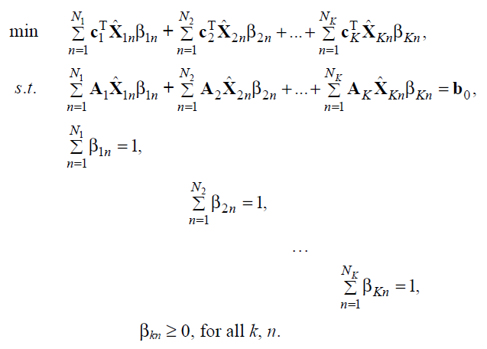
General Problem
K blocks, B_{k}x_{k} = b_{k}, k = 1, …, K
N_{k} extreme points in the kth block
dual variable π₀ →
dual variable π₁ →
dual variable π₂ →
…
dual variable π_{K} →

Slide 13
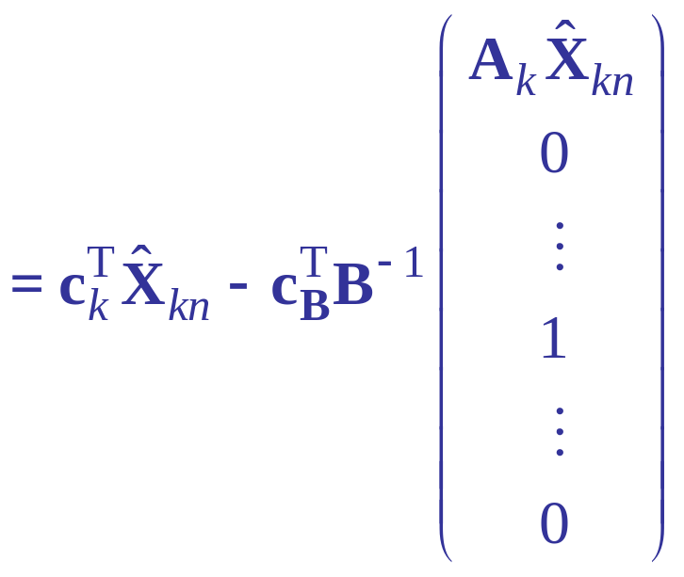
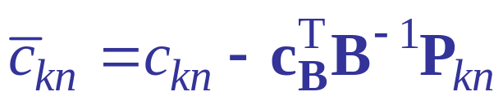
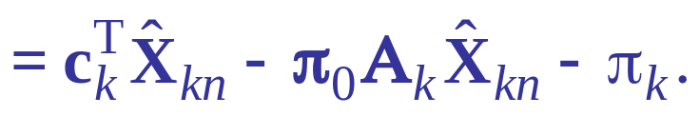
Reduced Cost for a Non-Basic Variable β_{kn}
reduced cost of β_{kn}

Slide 14
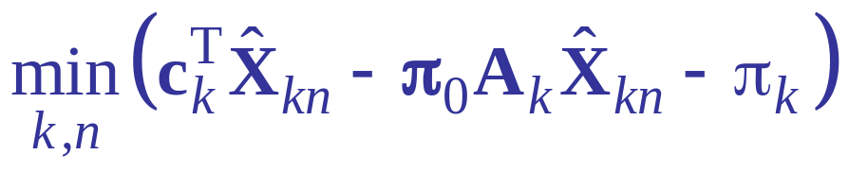
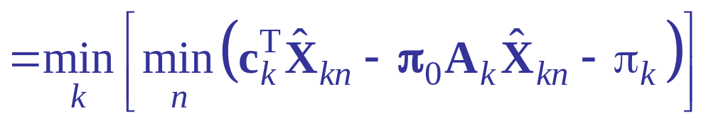
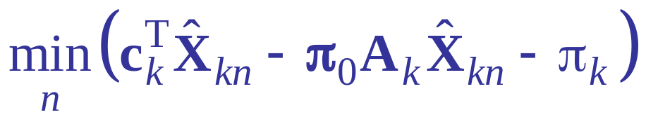
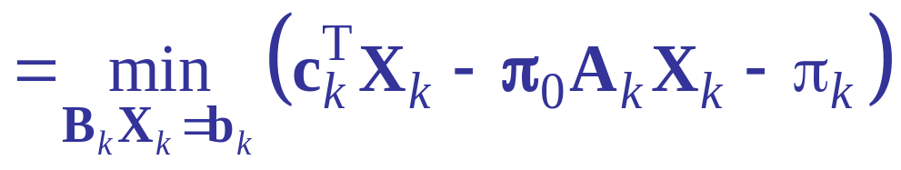
Most Negative Reduced Cost
where
Check each extreme point for each block, which is equivalent to solving a linear program. Result: Solving K+1 small linear programs.

Slide 15
General Approach
1° Form the master program (MP) by the β−representation
2° Get a feasible solution of the MP; find the corresponding π
3° Solve the subproblems to check the reduced costs of β_{kn}
3.1° stop if the MP is optimal;
3.2° else carry a standard revised simplex iteration (i.e., identifying the entering and leaving variables, stopping for an unbounded problem , and determining B⁻¹ otherwise)
3.3° go back to 2° if the problem is not unbounded

Slide 16
An Example of the Dantzig-Wolfe Approach
min –3y₁ – 2y₂ – 2y₃ – 4y₄,
s.t. y₁ + y₂ + 2y₃ + y₄ ≤ 10,
y₁ + 2y₂ ≤ 8,
y₂ ≤ 3,
y₃ + 3y₄ ≤ 6,
y₃ ≤ 4,
y_{i} ≥ 0.

Slide 17
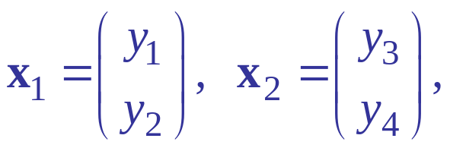
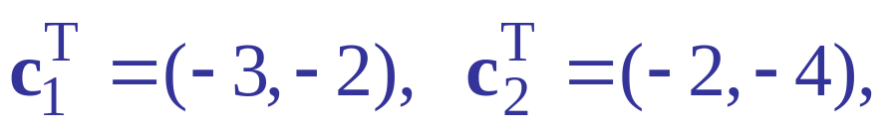
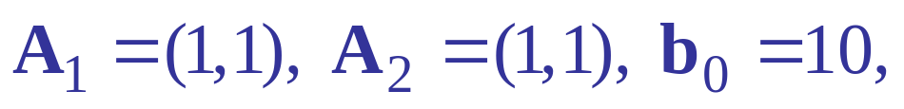
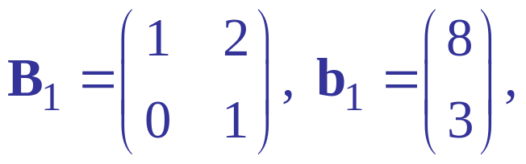
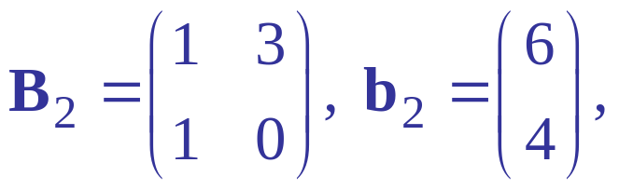
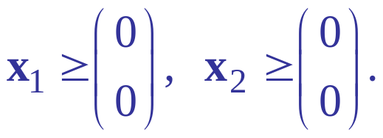
An Example of the Dantzig-Wolfe Approach
problem in general form with

Slide 18
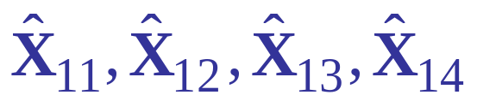
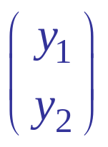
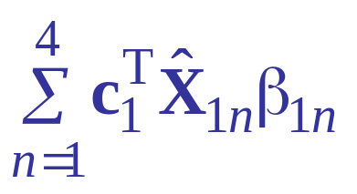
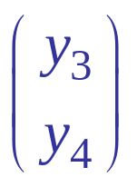
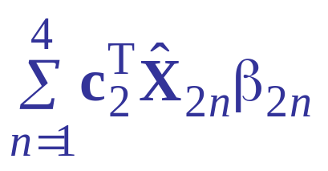
An Example of the Dantzig-Wolfe Approach
let be the extreme points of B₁x₁ = b₁
any point in B₁x₁ = b₁:
similarly, any point in B₂x₂ = b₂:

Slide 19
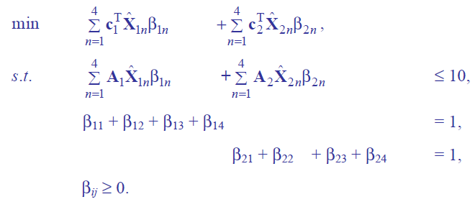
An Example of the Dantzig-Wolfe Approach
in terms of the extreme points

Slide 20
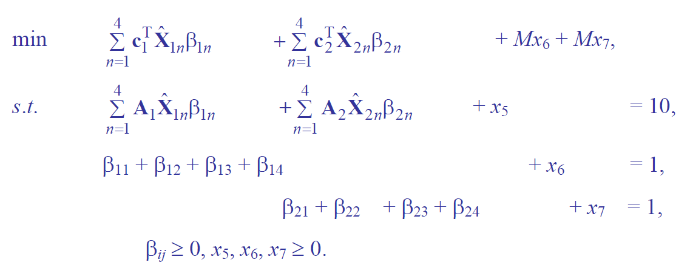
An Example of the Dantzig-Wolfe Approach
to solve the problem, introduce the slack variable x₅ and artificial variables x₆ and x₇

Slide 21
An Example of the Dantzig-Wolfe Approach
initial basic variable x_{B} = (x₅, x₆, x₇)^{T}, B = I, (c_{B})^{T} = (0, M, M), b = (10, 1, 1)^{T}
π = (c_{B})^{T}B = (0, M, M)
for the kth subproblem, the reduced costs:

