Slide 1
Integrated Geospatial Workflows
Mini Research
on
Geo-Intelligence
In areas of
Geo-information Integration, Geo-Information Processing, SDI
Group Members:
Harsh Chaturvedi
Vijayudu Kondi

Slide 2
Introduction
1
What is AI?
Artificial intelligence (AI) refers to the simulation of human intelligence in machines that are programmed to think like humans and mimic their actions.
The term may also be applied to any machine that exhibits traits associated with a human mind such as learning and problem-solving.
Component includes intelligent algorithms, data classification and smart predictive analysis.
What is Geo AI?
Discipline that combines innovations in spatial science, artificial intelligence methods in machine learning (e.g., deep learning), data mining, and high-performance computing to extract knowledge from spatial big data.
A more specific subset of AI.
New form of machine learning that is based on a geographic component.
Critical to enterprises and governments ranging from weather centres, national labs, defence agencies, healthcare, agriculture, insurance, transportation, and many more.

Slide 3

Basic Principles
2
Big Data/Geo Big Data
In general:
Field that treats ways to analyse, systematically extract information from, or otherwise deal with data sets that are too large or complex to be dealt with by traditional data-processing application software.
Volume, Variety Veracity, Velocity, Scalability, Value, Variability etc are some the characteristics through which Big Data is described.
Types of architecture includes parallel processing, distributed processing, high-throughput computing, MapReduce, Data Lake, Parallel Distributed etc
In Context:
Growth approx. 20% per year.
Spatial data sets exceeding capacity of current computing systems.
The collection of geospatial big data becomes pretty easy thanks to the advancements of sensor and communication technologies. Some platforms are being developed for the sharing of collected data from sensors, VGI etc.
Interactive analytics of real-time or dynamic data is an important part of the Geo big Data system.

Slide 4
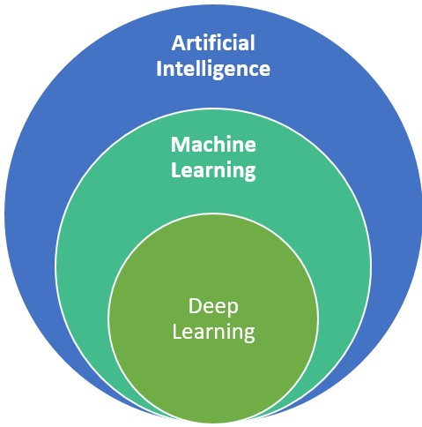
Basic Principles
3
Machine Learning & Deep Learning
In general:
ML uses algorithms to parse data, learn from that data, and make informed decisions based on what it has learned
Deep learning structures algorithms in layers to create an "artificial neural network” that can learn and make intelligent decisions on its own.
In Context:
Apart from Supervised and Unsupervised techniques, the future lies in applying active learning techniques in order to improve efficiency and quality of data processing using supervised techniques, semi-supervised and manifold learning taking into account unlabelled data and real life constraints.
Deep Learning is particularly useful for GIS as the rate of data production through satellites drones sensors is near impossible to handle by traditional means.
Example: Increasing crop yield through precision agriculture, in fighting crime by deploying predictive policing models, or predicting when the next big storm will hit and being better equipped to handle it.

Slide 5
Basic principles
4
Computing Systems
Big Data Computing; a new paradigm which combines large scale compute, new data intensive techniques and mathematical models to build data analytics.
Demands a huge storage and computing for data curation and processing that could be delivered from on-premise or clouds infrastructures.
Challenges with Geospatial Domain:
Geo-cyberinfrastructure integrating spatiotemporal principles and advanced computational technologies
New geospatial data management strategies and data storage models coupled with high-performance computing for efficient data query, retrieval, and processing (e.g. new spatiotemporal indexing mechanisms).
New computing and programming frameworks and architecture or parallel computing algorithms for geospatial applications.
Integrating scientific workflows in cloud computing and/or high performance computing environment.

Slide 6
Relation to SDIs
5
Problems/Challenges in Geospatial Workflows:
Inefficiency in computational processing and time (particularly when big data are compounded with large geographic study areas)
Data-related constraints that affect spatial and/or temporal resolution.
Intervention of GeoAI in Geospatial Workflows:
Big Data Infrastructures such as Spark, Hadoop with AI and ML methods can be applied to address several challenges in Geospatial modelling of data.
Recent DL algorithms cannot demonstrate their ability to create value out of data without having high-performance computing and distributed data processing infrastructures.

Slide 7
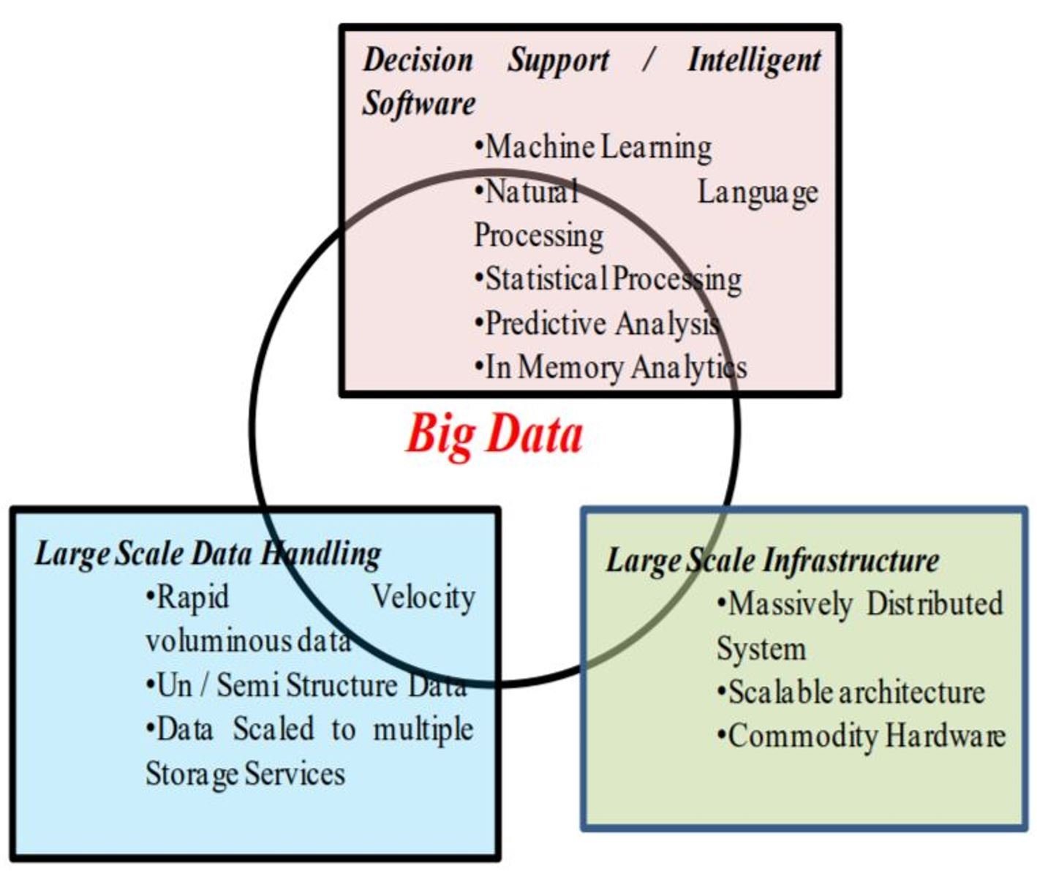
Tools
7
Modern Spatial Data Science Workflow:
Data Wrangling – GDAL(OGR/OSR)
Scripting – R, Python(TensorFlow, SciKitLearn)
Querying Geo Big Data - Postgres/PostGIS
Cloud Computing platform for analysis – AWS
Geovisualization - D3
Other Toolkits
The Microsoft Cognitive Toolkit (CNTK) is an open-source toolkit for commercial-grade distributed deep learning.
Modern Big data Handling Platforms

