Slide 1
QUARTILE 4
MODELLING TICK BITES USING ML AND ABM TECHNIQUES
SPATIO-TEMPORAL ANALYTICS AND MODELLING
GROUP 3:
Harsh Chaturvedi
Vijayaudu Kondi

Slide 2
INTRODUCTION
Ticks:
Arthropod, spider like insects that transmit Borrelia burgdorferi/mayonii bacterium to hosts.
Have four life cycles(egg, larva, nymph and adult tick), with 3-4 years of life span.
Abundance and habitats of ticks can vary spatially or temporally
Usually active in warm seasons where temperature is more than at least 7 degrees Celsius
Ticks are found in areas with vegetation
Lyme Disease:
Most common vector-borne disease, observed in Northern Hemisphere.
Symptoms include fever, headache, fatigue, and a characteristic skin rash called erythema migrans. If untreated, infection can spread to joints, the heart, and the nervous system.
Diagnosis is performed by symptoms, physical findings (e.g., rash), and the possibility of exposure to infected ticks and laboratory testing.
Can be prevented by reducing tick habitat, removing ticks promptly, applying pesticides, insect repellent etc.
If detected early, can be treated with antibiotics.
Tekkenradar:
Founded in 2012 by RIVM and Wageningen University
Platform deriving information on Tick bites and Lyme disease
Shows national average of activity of nymphs in five categories. Forecast of 10 days ahead is visible with current forecast.
1

Slide 3
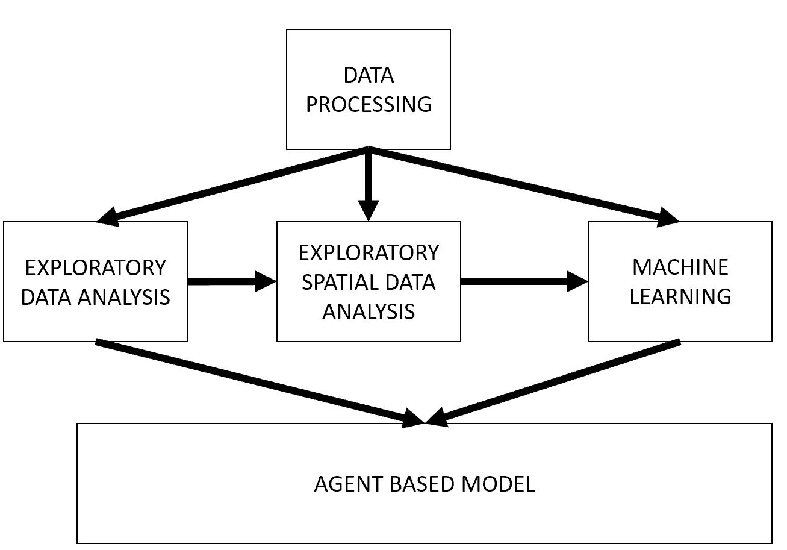
METHODOLOGY
NL tick bites shapefile – 2006-2014(.Shp file)
Ede municipality boundary (.Shp file)
Land use data (.Asc file)
Tick nymphs collection data - Tekkenvangsten (.Xlsx file)
Tick nymphs collection – dragging locations (.Shp file)
KNMI weather data, per day from 2006-2016 for all 39 weather variables
Hazard Map for NL
Data Pre-processing was performed and then some Exploratory(Spatial)Data Analysis, Machine Learning Algorithms were applied to obtain certain agent characteristics.
PROBLEM STATEMENT:
To arrive at certain weather variables and other factors for simulating the dynamics of tick bites and how do those factors affect the dynamics over the study area of Ede.
2

Slide 4
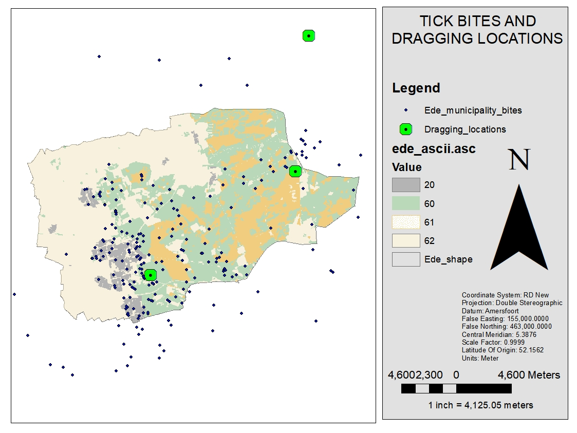
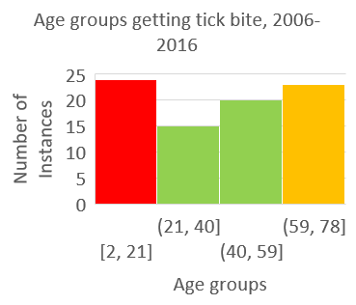
EXPLORATORY(SPATIAL) DATA ANALYSIS
3

Slide 5
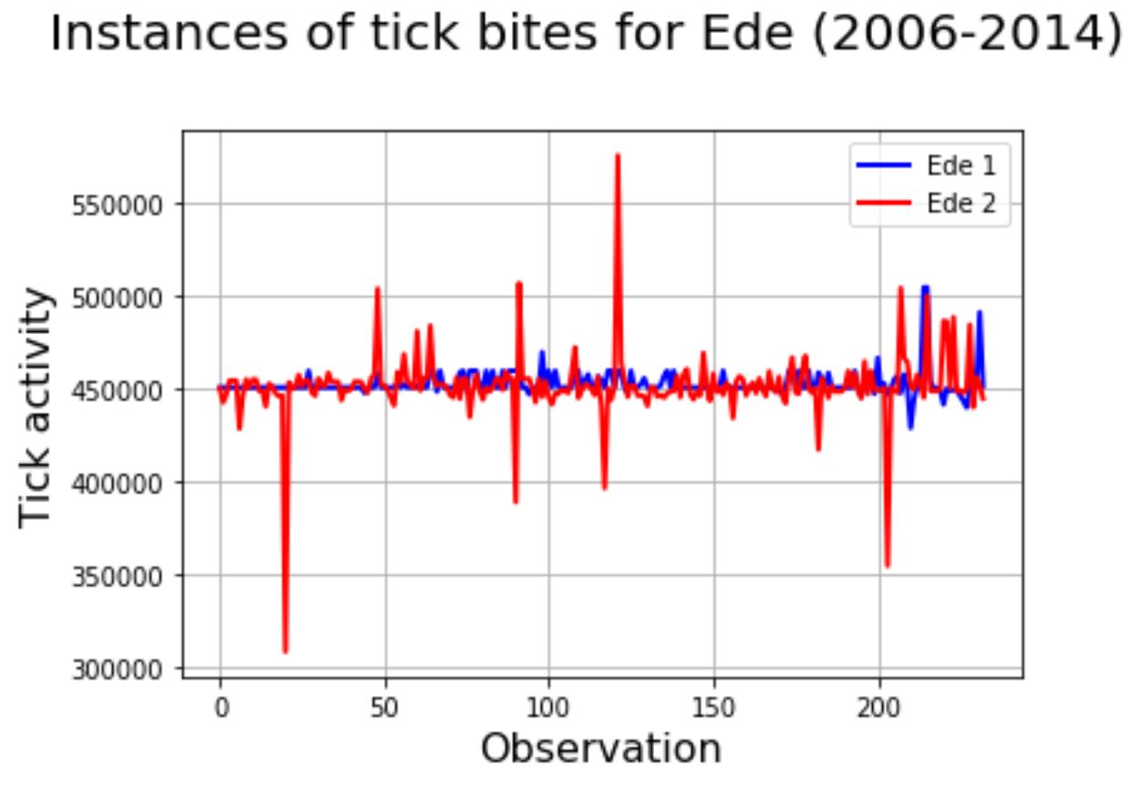
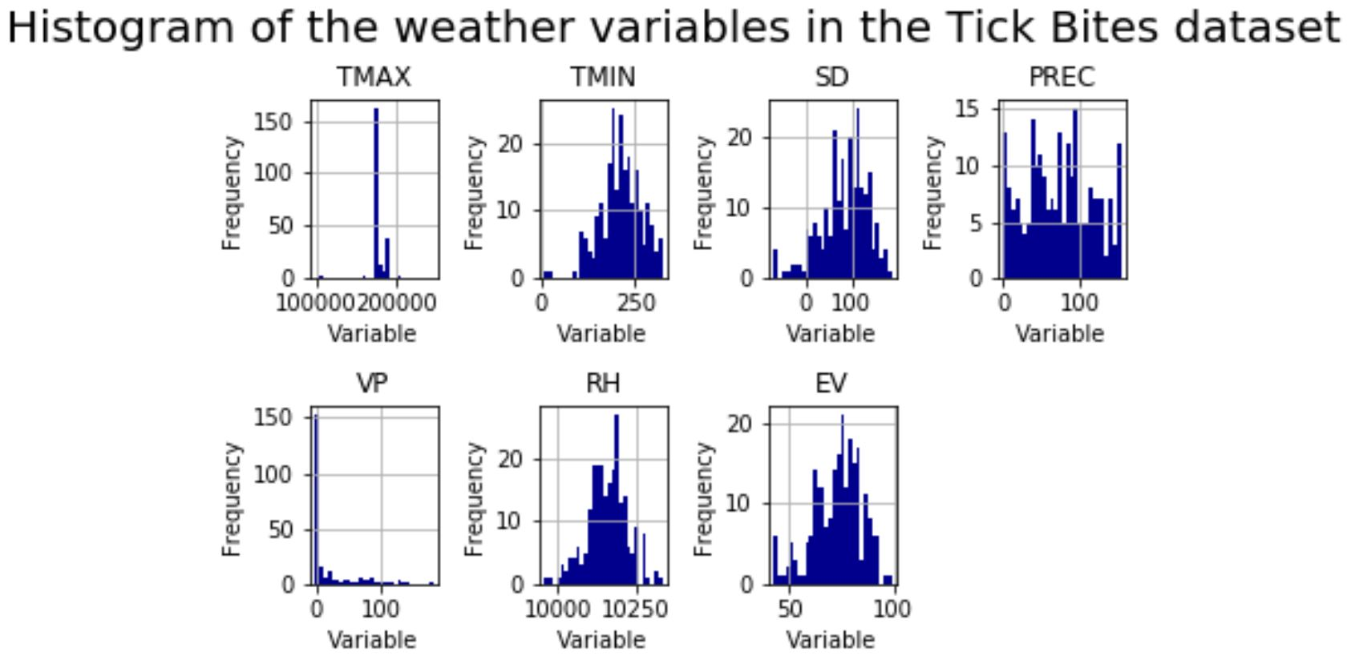
MACHINE LEARNING
Ensemble:
Training multiple models using same learning algorithms. Helps in reducing bias, variance and noise in data.
Algorithm used:
Random Forest, Implemented in scikit-learn as Random Forest Regressor.
Boosting Algorithm:
Gradient Boosting , to reduce variance and improve stability of the model.
Tick Bites
Feature Importance:
Assigning scores to input features on a model to indicate relative importance of a feature when making a prediction
Important Features:
TMAX>SD>TMIN>
4

Slide 6
INTEGRATION AT PREPROCESSING STAGE
Data cleansing: Removing outliers , Null values etc
Data binning: Categorized data containing activities of humans getting tick bites.
Data reduction:
Reducing and matching the weather variable to the instances of tick bites.
Selecting most important weather variables
From E(S)DA, and Machine Learning Algorithms :
Extracted Risk of Agents by Age groups
Extracted Important weather variables to be used in Agent Based Model
Extracted Most occurring Activities of Agents while getting a tick bite to be used by Agents(Humans) in model.
5

Slide 7
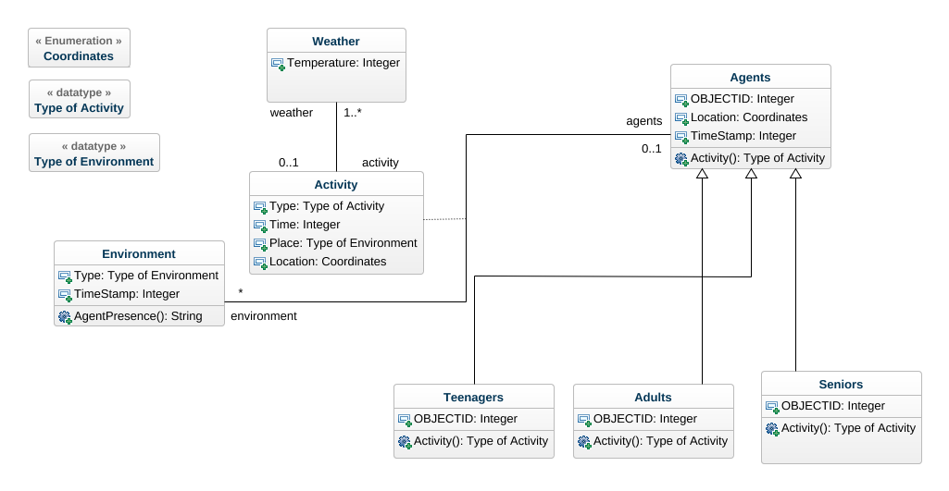
AGENT BASED MODELLING
Purpose: The main purpose of the model is to simulate tick bites on humans and understand how certain factors considered model would influence the occurrence of tick bites.
Class diagram
6

Slide 8
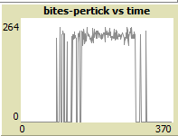
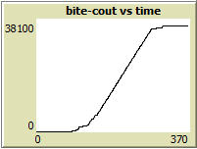
AGENT BASED MODELLING
Agents: Teenagers (33%), Adults (50%) and Seniors (17%).
Environment: Boundary of Ede ,Residential -20, Forest - 60, Dunes – 61 and Others – 62.
Risk of Tick bite:
Agent risk : Teenagers > Seniors > Adults
Activity risk : Walking > Land scaping > Picnic
Patch risk : Forests > Dunes > others > Residential
Scales:
Temporal: 1 year i.e., for 2016
Spatial: Each patch = 1.3 pixels, Land use map 50 m.
Output: The major outputs of the model are two graphs which shows number of tick bites per day over one year and the other shows total number of tick bites for a year.
7

Slide 9
AGENT BASED MODELLING
Interaction:
Monday to Friday → Teenagers and Adults → Work → Residential land use
Saturday and Sunday → Teenagers and Adults →Random Recreation → chosen according to the activity.
Walking → Any of the land use types except residential.
Land scaping → Any of the land use types except residential.
Picnic → Forests.
Seniors → Walking, If temperature is between 15 and 20 C and go for Picnic if temperature is between 21 and 35.
Stochasticity:
1. Initially all the agents are randomly placed within residential land use.
2. Teenagers and Adults randomly choose activities during the weekends.
3. Land scaping and Picnic can be performed in any of the land use types except Residential.
8

Slide 10
AGENT BASED MODELLING
Observations:
For each day (for one tick):
The number of the day (tick number),
Total number of tick bites of the day (bites-pertick).
Total number of bites (bite-count).
For each agent:
The coordinate of each agent (X, Y).
The agent name (e.g., Teenager 25).
Activity done on that day (represented by activity number) and,
Land use where the activity was done (represented by pixel value).
10

Slide 11
BEHAVIOUR SPACE
Using Behavioral Space of NetLogo:
As there are many random elements on which the elements are dependent, the output of the model will be different. So the model is run 100, 500 and 1000 times to check the difference in outputs.
11

Slide 12
SENSITIVITY ANALYSIS
Sensitivity Analysis:
To check the model behavior if number of agents are changed the model is run starting from 100 to 1000 increasing 100 each time. Each multiple of 100 is run 10 times till 1000.
12

Slide 13
RESULTS AND CONCLUSIONS
This model shows there would be around 36000 tick bites for 1000 population in 2016, which is not real, and the purpose of the model is to see how and when tick bite occurs for the given parameters but not to predict. This is achieved through the output graphs of the model,
After running it for 1000 times, it is known that the number of tick bites would vary from 35400 to 35900 per year. This is because of the randomness in the model. From the sensitivity analysis, increase in number of agents will not really change the output of the model.
From the plots in the model, there are no tick bites in the first quarter (winter), there is a gradual increase in the second quarter of the year (spring) and rapidly increases in the third quarter (summer) and gradually decreases in the fourth quarter (autumn).
13

