Slide 1
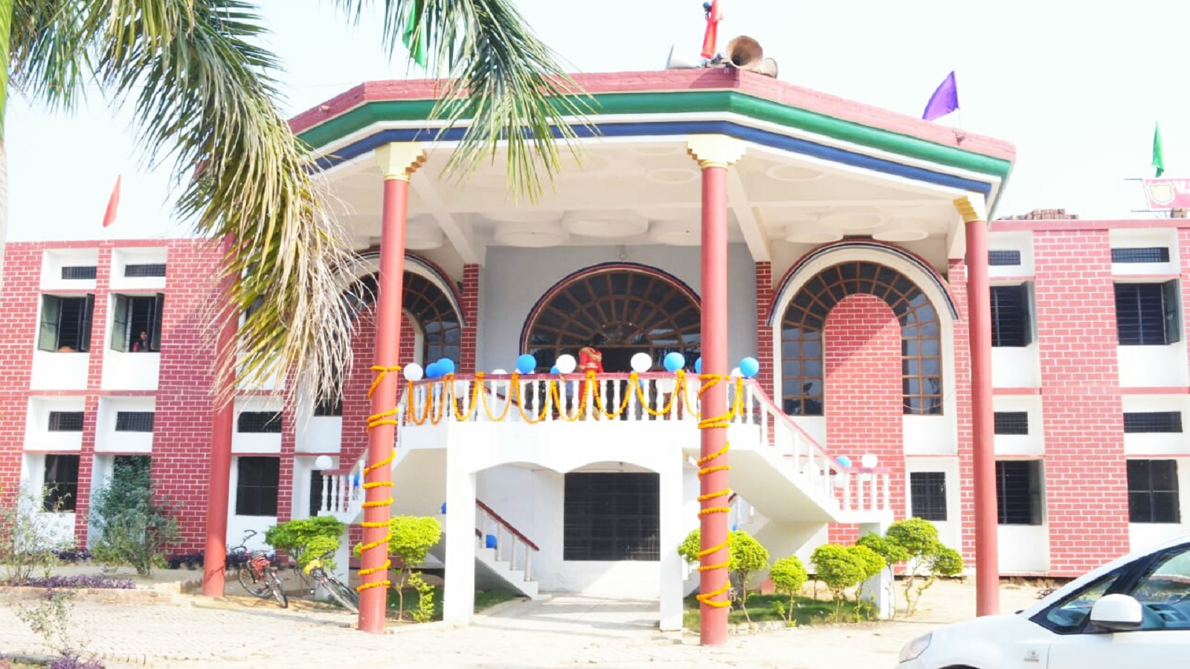



Now
CBSE 10+2 Affiliated
Admission Open
2020-21
Online Classes
VSS Educational Academy
We are happy to inform you that now VSS Educational Academy is CBSE affiliated till 12th std.
Near Water Corporation Office, Faizabad Road, Ambedkar Nagar -224122
http://vssacademy.in
+91-8052009351

