Slide 1
Reddit WallStreetBets and stock prediction
Replication, new models and leakage-free evaluation
Kaushik Krishna Dwarakanath (PES1UG24CS900) | Chaturya Prabhakar Reddy (PES1UG24CS126)

Slide 2
Problem statement
• Replicate the CS229 report 'Predicting market volatility and building short-term trading strategies using data from Reddit's WallStreetBets', then build and compare further models and a more rigorous evaluation. Task: from a WSB post that mentions GME, AMC, TSLA or FB, predict (a) whether the stock's open rises at the next trading day (direction) and (b) whether the move is large (volatility).
• Long-term goal of the paper: a bot that makes short-term trades from unconventional sources like WSB.
• Our goal: reproduce the results, add models, and test whether the gains survive a rigorous evaluation.

Slide 3
Dataset and features
• Kaggle 'gpreda/reddit-wallstreetsbets-posts' (title, score, comments, body, timestamp) joined with Yahoo Finance daily open prices. Posts mentioning GME, AMC, TSLA or FB give AMC 5,336, FB 260, GME 14,688, TSLA 1,238 labelled posts. Features (paper): post score, comment count, length, VADER positive/neutral/negative sentiment (+ bias). Labels: direction = open(t1) > open(t0), volatility = |open(t1)/open(t0)-1| above the training median, where t0 is the first trading day on/after the post and t1 the next trading day.

Slide 4
Approach
• Replication: Newton logistic regression (from scratch) + 3x256 ReLU network, random and majority baselines
• Extension: six extra model families, extended features, randomized hyperparameter search
• Evaluation: random (paper) vs day-grouped vs chronological split; day-based CV for tuning; 5-seed NNs
• Backtest: walk-forward long/flat with costs, bootstrap CI and permutation test

Slide 5
Models built and tested
• Baselines: random, majority class
• Paper models: Newton logistic regression, NN 3x256 (ReLU, Adam 1e-3, batch 16, 30 epochs)
• Ablation: Random Forest and Gradient Boosting on the paper's 6 features
• New (extended features, tuned): NN, Logistic Regression (tuned L2), Random Forest, Gradient Boosting, SVM-RBF, KNN
• Selection and tuning use day-grouped / forward-chaining CV on training days only

Slide 6
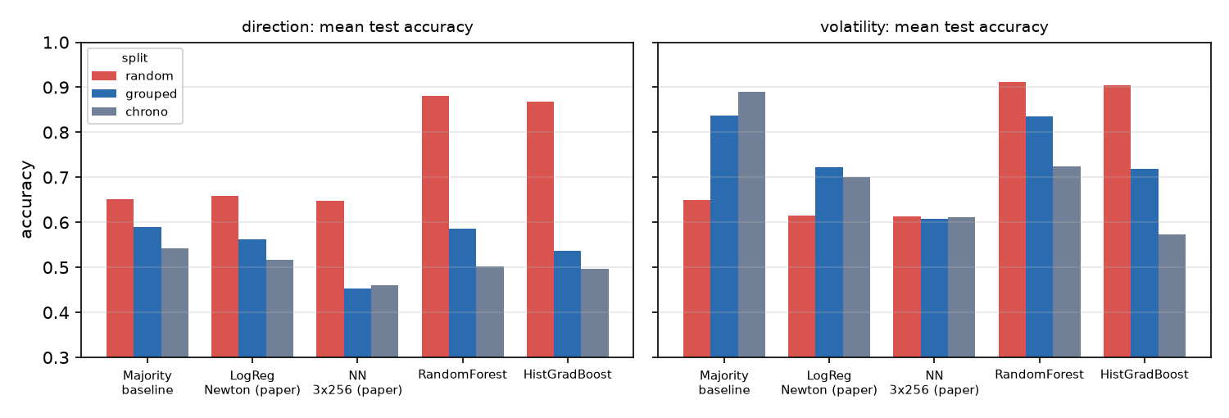
Finding 1: the random split leaks
• All posts of a trading day share one label, so a post-level shuffle lets models memorise days.
• RF direction: 0.880 (random) -> 0.586 (day-grouped). RF volatility: 0.911 -> 0.835.

Slide 7
Results: mean test accuracy over the 4 stocks
Model | Dir rand | Dir grp | Dir chr | Vol rand | Vol grp | Vol chr | BalAcc dir | BalAcc vol
Majority baseline | 0.652 | 0.589 | 0.542 | 0.650 | 0.837 | 0.890 | 0.500 | 0.500
Random baseline | 0.482 | 0.484 | 0.429 | 0.506 | 0.410 | 0.549 | 0.482 | 0.410
LogReg Newton (paper) | 0.658 | 0.563 | 0.516 | 0.614 | 0.723 | 0.701 | 0.512 | 0.653
NN 3x256 (paper) | 0.647 | 0.453 | 0.461 | 0.613 | 0.607 | 0.612 | 0.473 | 0.575
RF, paper feats | 0.671 | 0.462 | 0.508 | 0.657 | 0.567 | 0.577 | 0.486 | 0.576
HGB, paper feats | 0.664 | 0.426 | 0.513 | 0.647 | 0.491 | 0.594 | 0.457 | 0.495
NN 3x256, ext feats | 0.798 | 0.475 | 0.491 | 0.816 | 0.695 | 0.640 | 0.476 | 0.724
LogReg, tuned L2 | 0.693 | 0.513 | 0.535 | 0.758 | 0.609 | 0.647 | 0.485 | 0.553
RandomForest | 0.880 | 0.586 | 0.503 | 0.911 | 0.835 | 0.724 | 0.601 | 0.771
HistGradBoost | 0.868 | 0.536 | 0.497 | 0.905 | 0.720 | 0.573 | 0.571 | 0.698
SVM-RBF | 0.757 | 0.439 | 0.502 | 0.774 | 0.755 | 0.696 | 0.458 | 0.750
KNN | 0.755 | 0.461 | 0.477 | 0.769 | 0.668 | 0.675 | 0.474 | 0.643

Slide 8
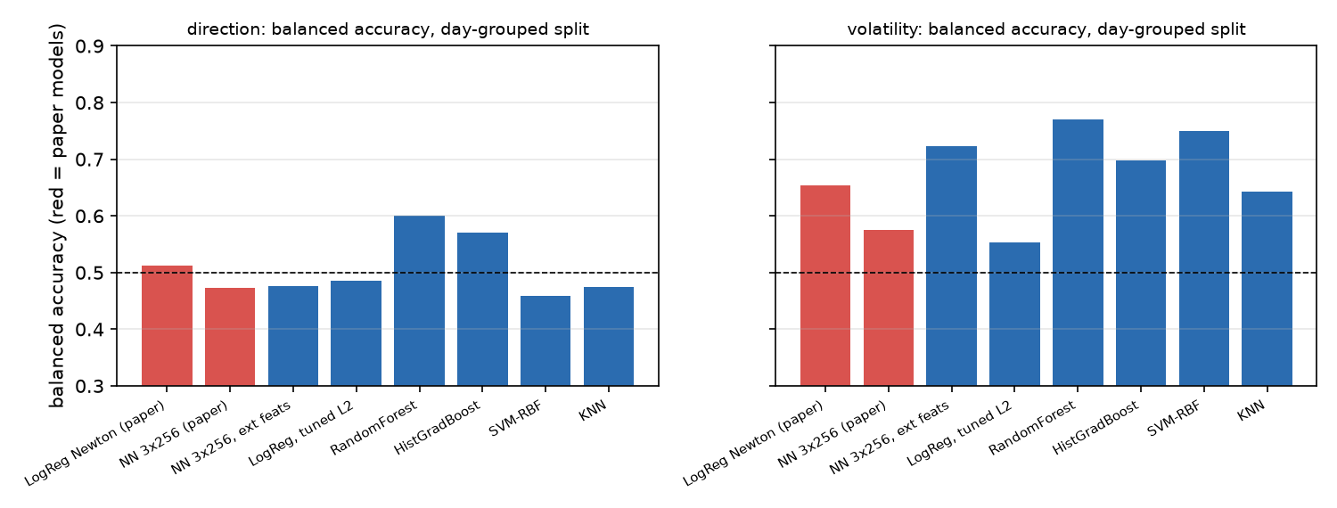
Finding 2: balanced accuracy on a leak-free split
• Direction: best new RandomForest 0.601 vs best paper 0.512. Volatility: 0.771 vs 0.653.
• Raw accuracy does not beat the majority baseline, so the improvement is modest and not consistent across stocks.

Slide 9
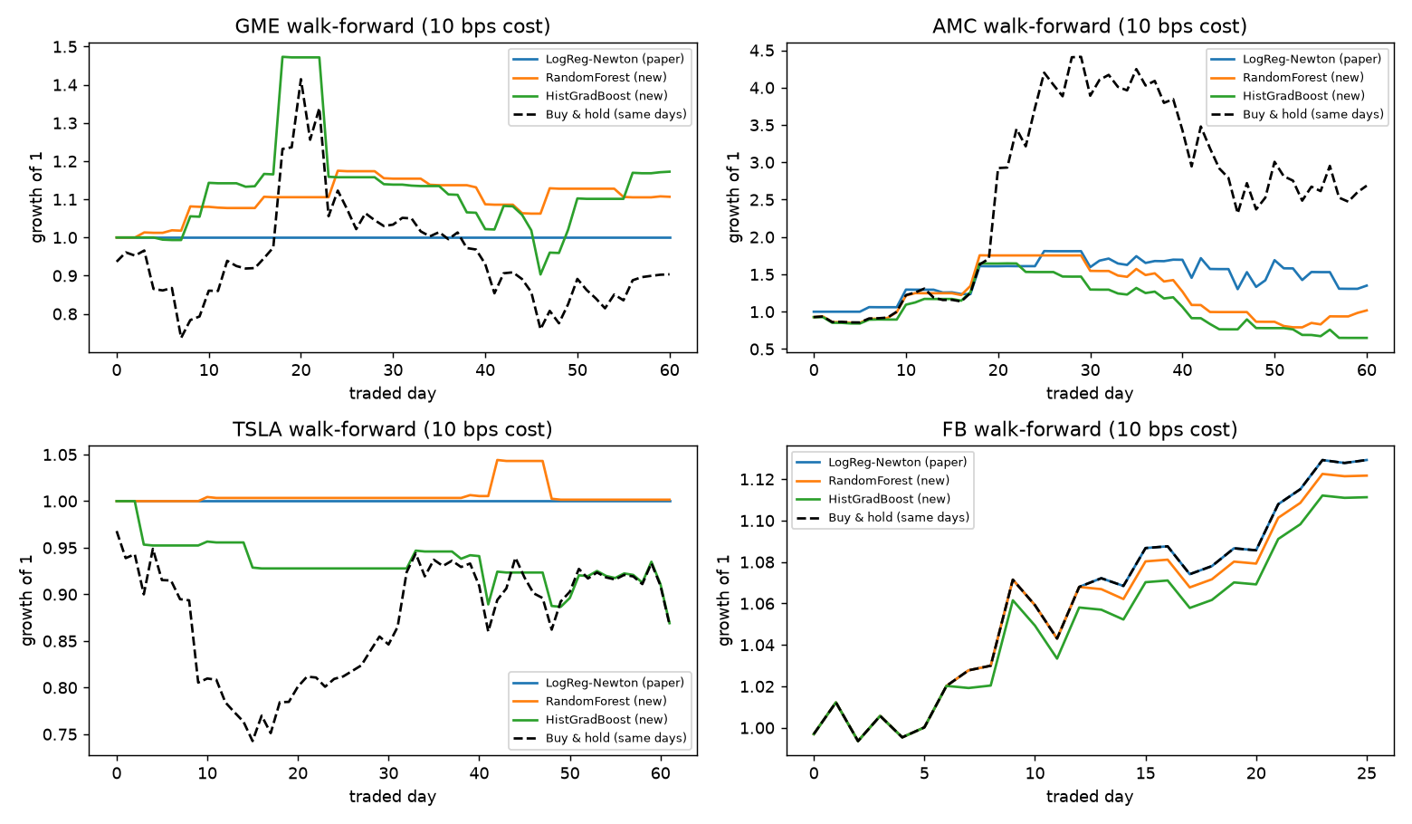
Walk-forward backtest
• About 61 traded days per stock; 0 of 12 combinations beat random timing (p<0.05).

Slide 10
Conclusions
• Leakage: the paper-style random split lets same-day posts (which share one label) fall in both train and test. Random Forest direction accuracy falls from 0.880 (random) to 0.586 (day-grouped); volatility from 0.911 to 0.835. The paper's own models barely move, so reported paper-style accuracies are likely optimistic.
• Direction, leak-free: best new model by balanced accuracy is RandomForest (0.601) vs best paper model LogReg Newton (paper) (0.512); however the best new raw accuracy 0.586 does not beat the majority baseline (0.589).
• Volatility, leak-free: best new model by balanced accuracy is RandomForest (0.771) vs best paper model LogReg Newton (paper) (0.653); however the best new raw accuracy 0.835 does not beat the majority baseline (0.837).
• Walk-forward backtest (about 61 traded days per stock, 10 bps costs): 0 of 12 stock-model combinations beat random timing at p<0.05 (smallest p = 0.17), so there is no statistically reliable trading edge.
• Limitations: few days per stock, tiny chronological test sets, regime shifts around the Jan 2021 spike; results are exploratory. Chronological-split numbers should be read with caution.

Slide 11
Contributions and future work
• Member 1: <fill in>
• Member 2: <fill in>
• Future work: pool stocks at the day level, longer price history, FinBERT sentiment, intraday timestamps for exact market-open alignment, more data beyond early 2021.

