Slide 1


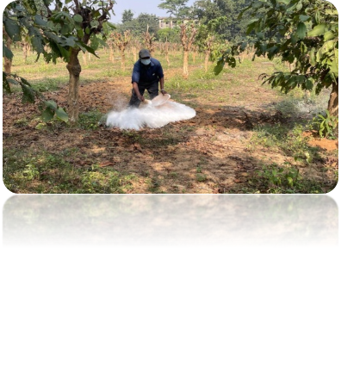
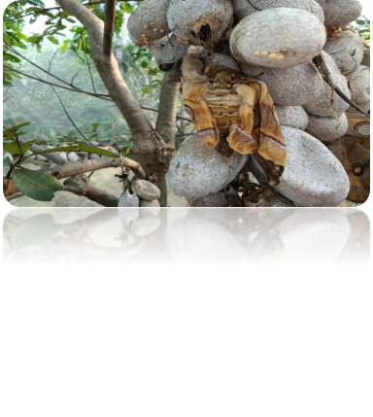
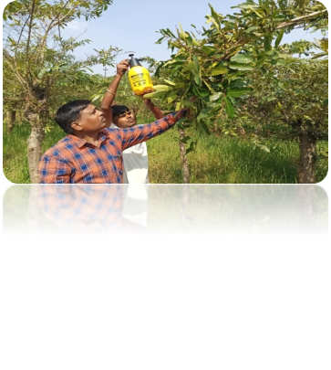
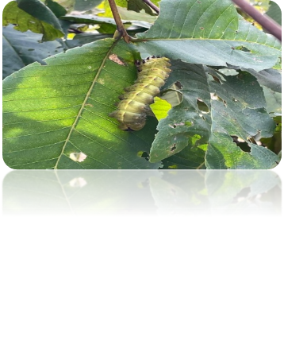
TASAR SILKWORM DISEASE MONITORING AND MANAGEMENT IN NORTH & CENTRAL STATES OF INDIA
Project code: ARP4016MI
Dr. Nidhi Sukhija (PI)
Dr. M. M. Baig (CI)
Dr. H. S. Gadad (CI)
Dr. P. C. Geddam (CI)
Dr. B. T. Reddy (CI)
In-charge, RSRS, Dumka (CI)
Executive Authority: Dr. S. Balasaraswathi, Director/Coordinator

Slide 2
Objectives
To monitor the diseases incidence in tasar sericulture.
To implement disease management module in the tasar industry.
To develop the disease forewarning systems for different climatic zones and interactive portal.
Project Period: March 2023 to February 2028
Total Budget 3rd Year: Rs.14.64 Lakhs
Total Expenditure, 2025: Rs. 5.92194 Lakhs (Till March, 2026)
Notes:
72.82 Lakhs; 27.617 Lakhs

Slide 3

Progress against set milestones
Milestone set | Progress / achievement
Disease monitoring and detection as per schedule (random samplings) Preceding year’s data on weather conditions, environmental factors and disease incidence data will be retrieved. | Correspondence to DoS and TDF regd. Nomination of Units. Initial health condition of the worms were monitored Preceding year’s data on weather conditions, environmental factors and disease incidence data retrieved.
Any constraint for not achieving the set target: No

Slide 4


DMC Team observation in 3rd year (2025-2026)
S. No. | State | Cocoon preserved in grainage | Cocoon recommended for stifling due to high % of disease | Cocoon stifled (%)
1. | Andhra Pradesh | 68220 | 0 | 0
2. | Bihar | 509921 | 0 | 0
3. | Jharkhand | 10083126 | 1018300 | 10.09
4. | West Bengal | 369758 | 97000 | 26.23
5. | Telangana | 640655 | 0 | 0
6. | Chhattisgarh | 6098315 | 115400 | 1.89
7. | Odisha | 2328243 | 55000 | 2.36
8. | Madhya Pradesh | 537500 | 0 | 0
9. | Maharashtra | 560250 | 30,000 | 5.35
 | Total | 21195988 | 1315700 | 6.20

Slide 5
Work conducted (2025-2026)
Progress achieved | Preceding year’s environmental data were collected and analyzed for the study regions with disease incidence data Correspondence to 9 DoS and TDF
Specific outcome | Disease incidence patterns studied Machine learning algorithms applied

Slide 6


Work conducted (2025-2026)
Microscopic observation of random samples and DMC data analysis was carried out.
Initial health conditions of the different instars’ larvae were monitored in CSB-CTRTI along with Environmental data.
Weather data has been collected across different units and integrated with disease records.
Correspondence for nomination of units has also been made.
Surveillance formats were revised to include all diseases.
Histopathological studies were done.
Ensemble modelling was implemented, yielding an initial prototype needing further curation.
Samples are being processed for FE-SEM and FTIR analysis.

Slide 7
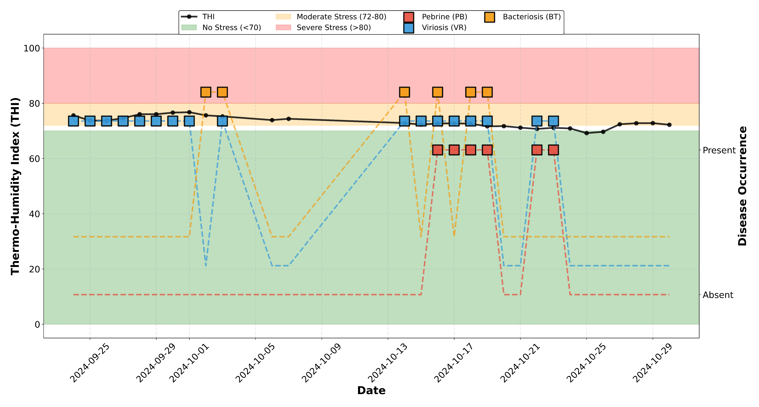
Temperature Humidity Index (2024-2025)

Slide 8
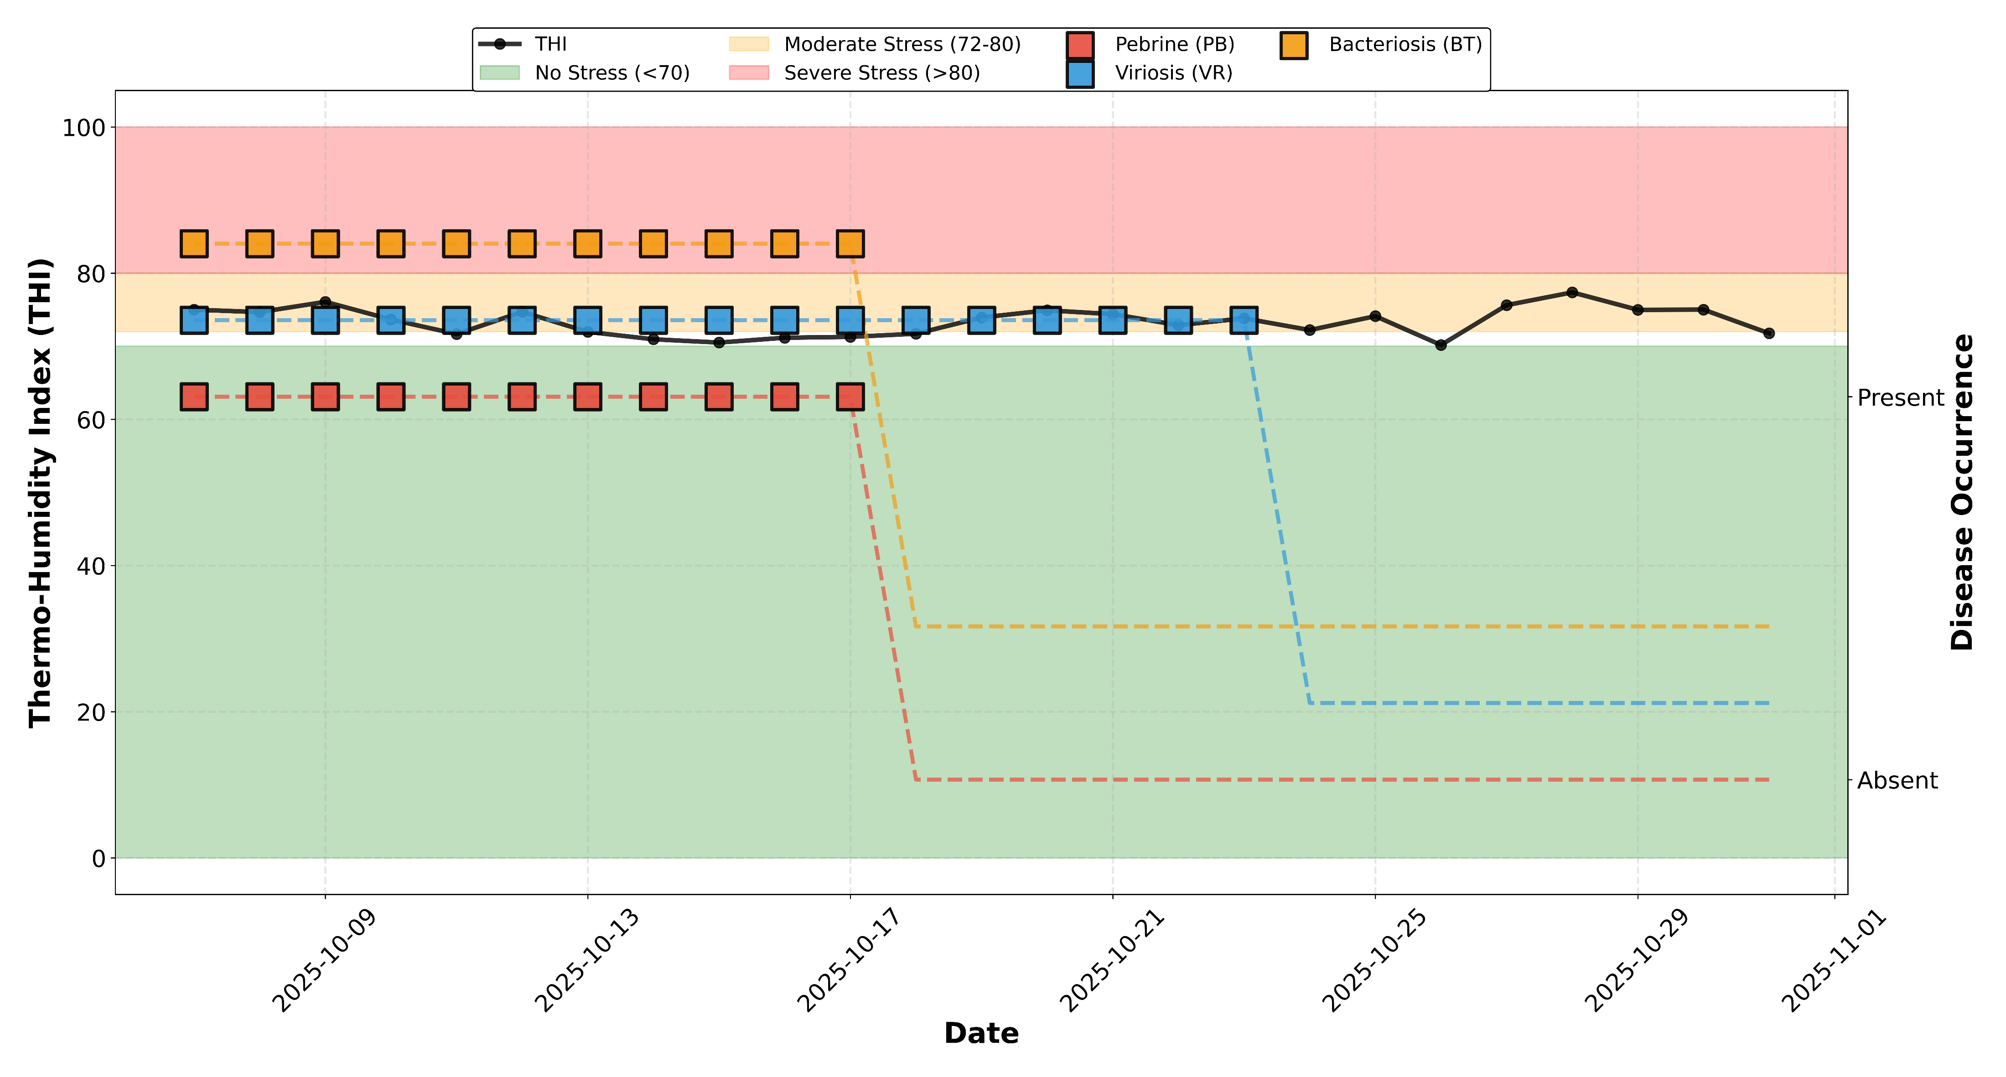
Temperature Humidity Index (2025-2026)

Slide 9
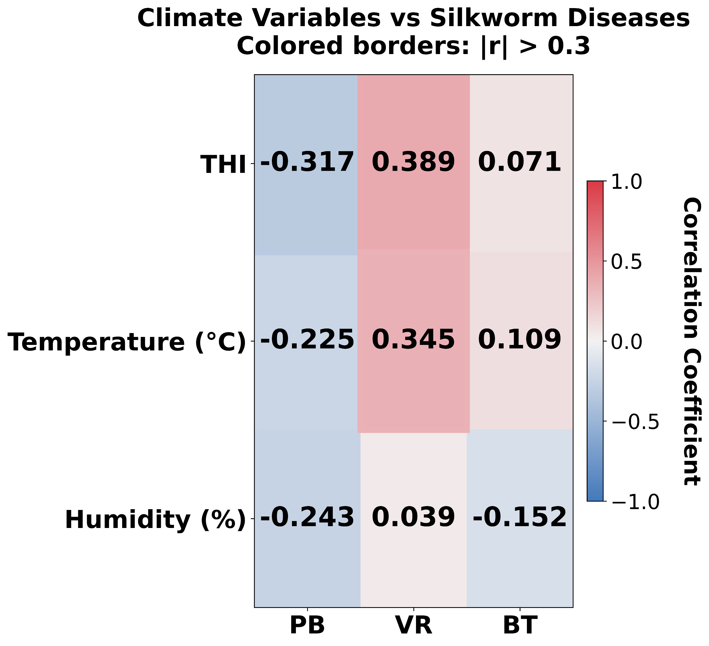
Correlation Patterns (2024-2025)
Disease | Code | Positive Cases | Negative Cases | Correlation (r) | P-value | Significant | THI (Disease Present) | THI (Disease Absent) | Difference
Pebrine | PB | 6 | 23 | -0.3165 | 0.09432 | No | 71.9 | 73.48 | -1.57
Viriosis | VR | 17 | 12 | 0.3892 | 0.0369 | Yes | 73.81 | 72.22 | 1.59
Bacteriosis | BT | 6 | 23 | 0.0709 | 0.71482 | No | 73.43 | 73.08 | 0.35

Slide 10
BEST MODELS (Accuracy > 93%):
Random Forest: 93.5% accuracy, 98.3% ROC-AUC
Gradient Boosting: 93.5% accuracy, 95.2% ROC-AUC
Support Vector Machine (SVM): 91.3% accuracy, 95.2% ROC-AUC
High shell ratio (>14%) correlates with lower disease incidence
Heavier cocoons (>11g) show better disease resistance
Shell weight >1.5g indicates healthier batches
Quality parameters (shell ratio, weights) are stronger predictors than geographic factors alone.

Slide 11
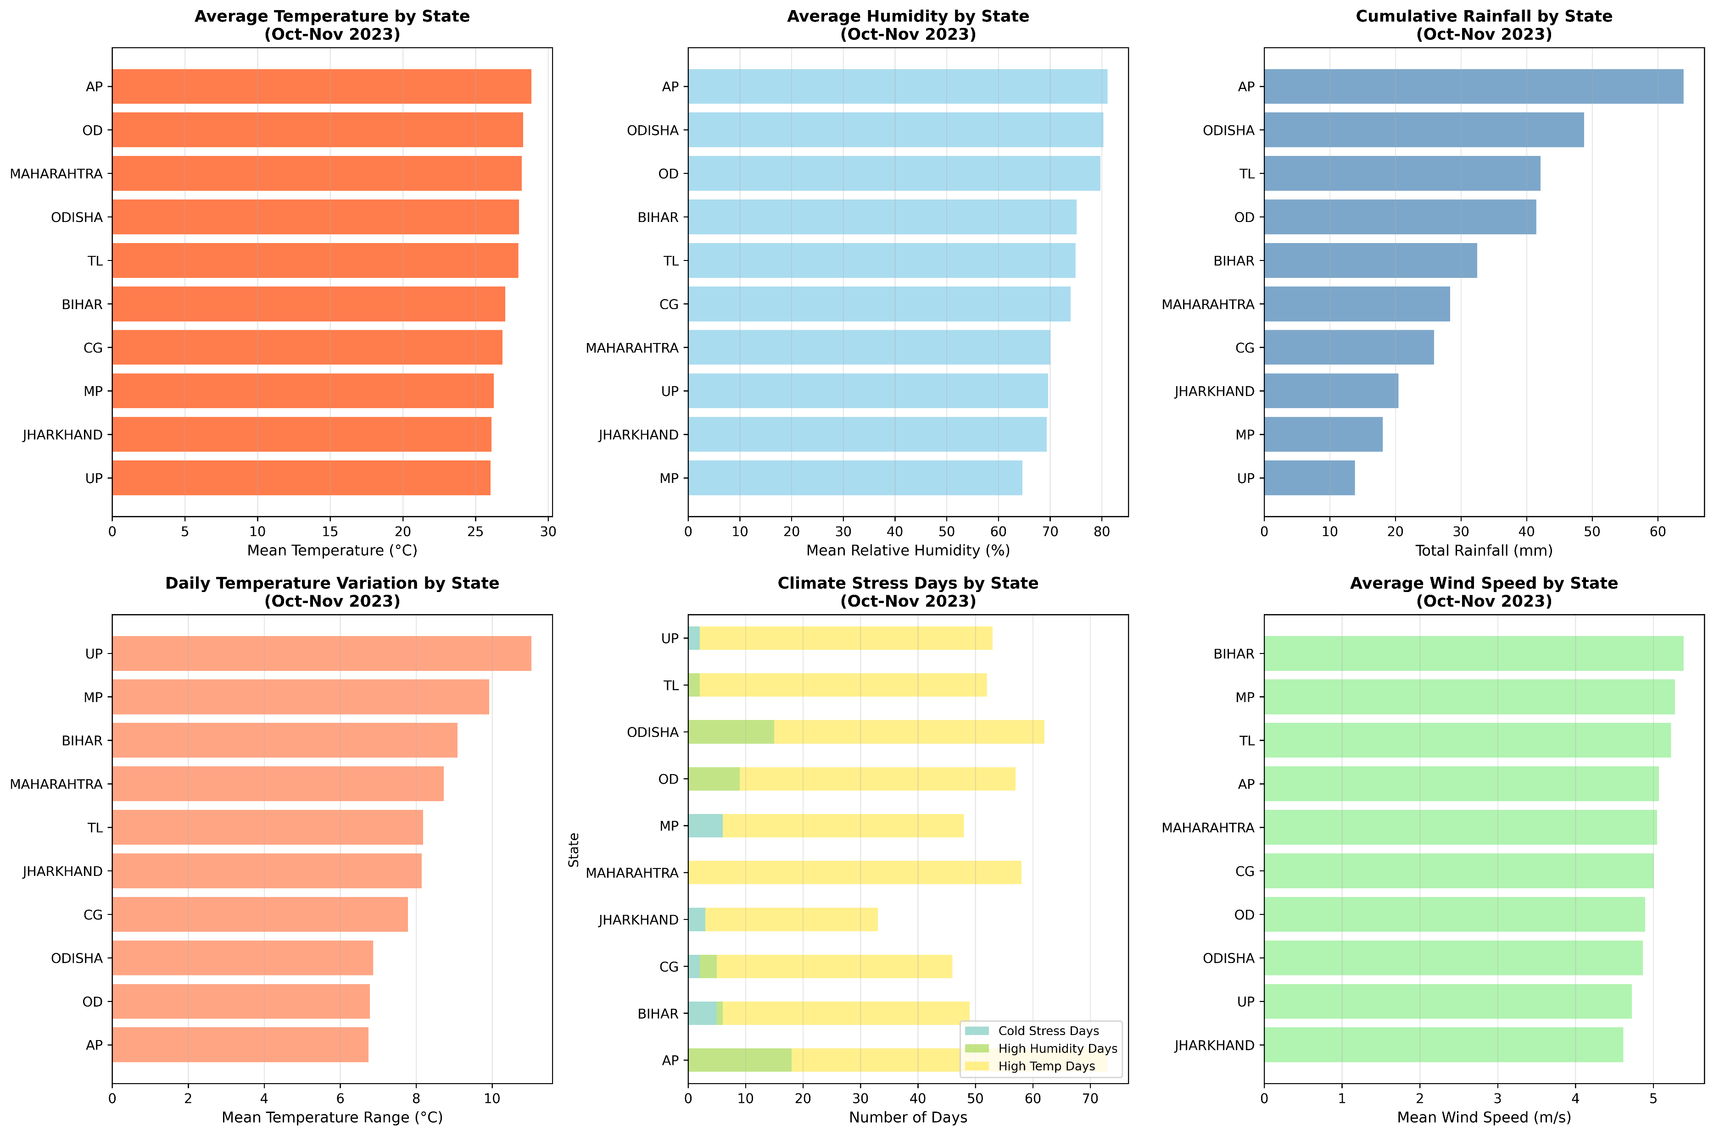

Slide 12
Environment dataset
Environment Data was collected for sampling locations
BIOVARIABLE
BIO1 | Annual Mean Temperature
BIO2 | Mean Diurnal Range (Mean of monthly (max temp - min temp))
BIO3 | Isothermality (BIO2/BIO7) (×100)
BIO4 | Temperature Seasonality (standard deviation ×100)
BIO5 | Max Temperature of Warmest Month
BIO6 | Min Temperature of Coldest Month
BIO7 | Temperature Annual Range (BIO5-BIO6)
BIO8 | Mean Temperature of Wettest Quarter
BIO9 | Mean Temperature of Driest Quarter
BIO10 | Mean Temperature of Warmest Quarter
BIO11 | Mean Temperature of Coldest Quarter
BIO12 | Annual Precipitation
BIO13 | Precipitation of Wettest Month
BIO14 | Precipitation of Driest Month
BIO15 | Precipitation Seasonality (Coefficient of Variation)
BIO16 | Precipitation of Wettest Quarter
BIO17 | Precipitation of Driest Quarter
BIO18 | Precipitation of Warmest Quarter
BIO19 | Precipitation of Coldest Quarter
Temperature Bio-variables
Precipitation Bio-variables
https://www.worldclim.org/data/bioclim.html

Slide 13
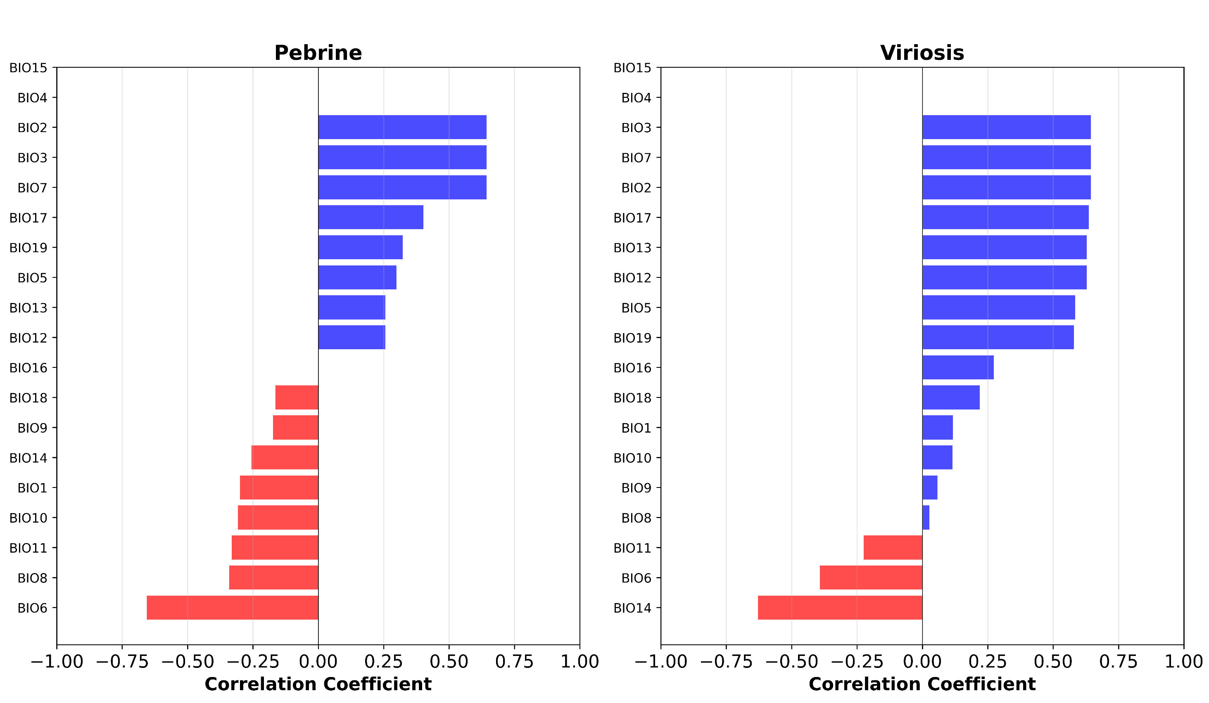
Correlation of Bioclimatic Factors with Disease Incidence
Pebrine
Virosis

Slide 14
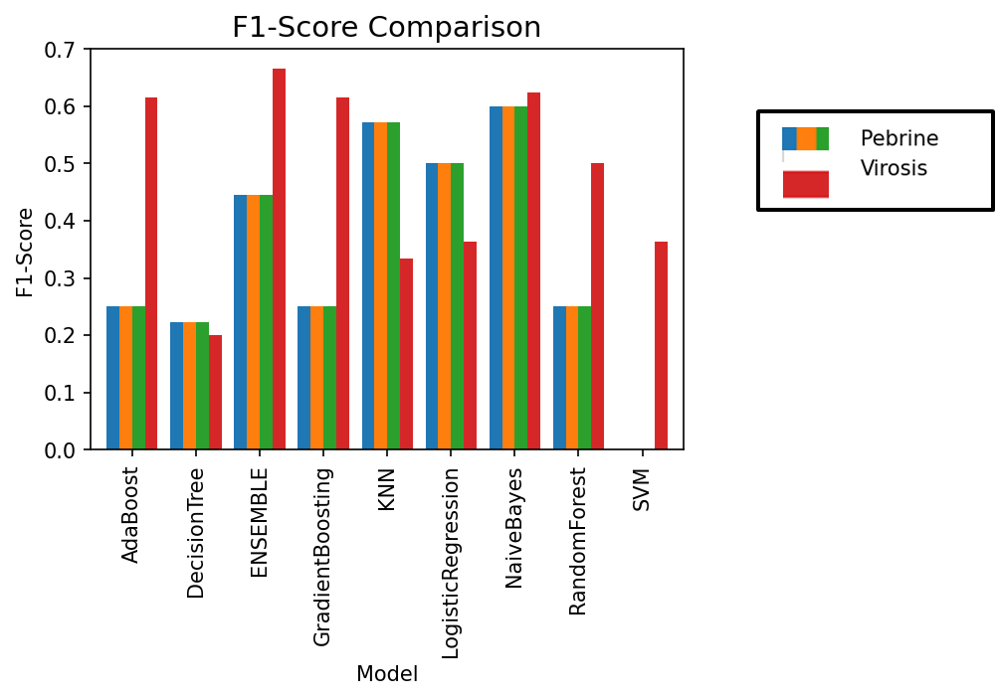
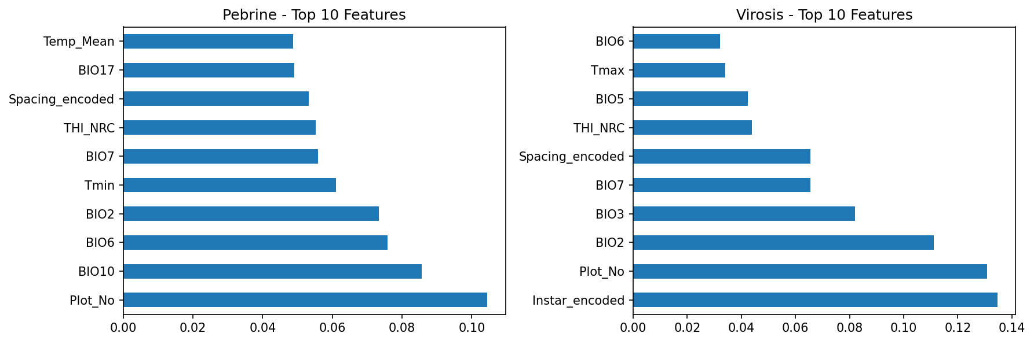
Machine Learning Algorithms

Slide 15
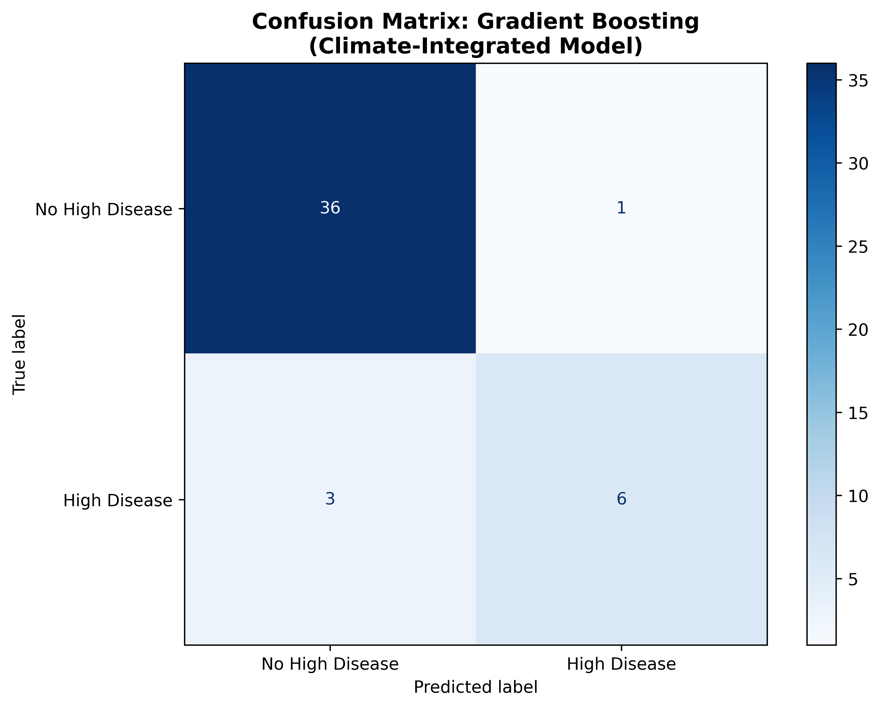
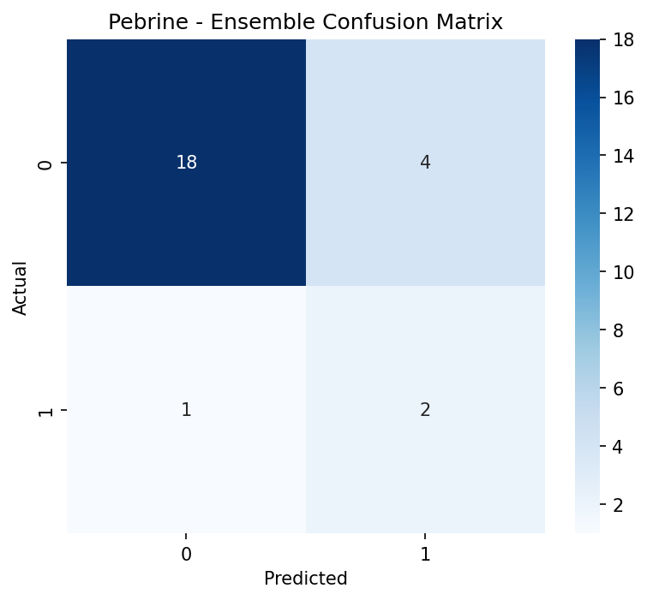
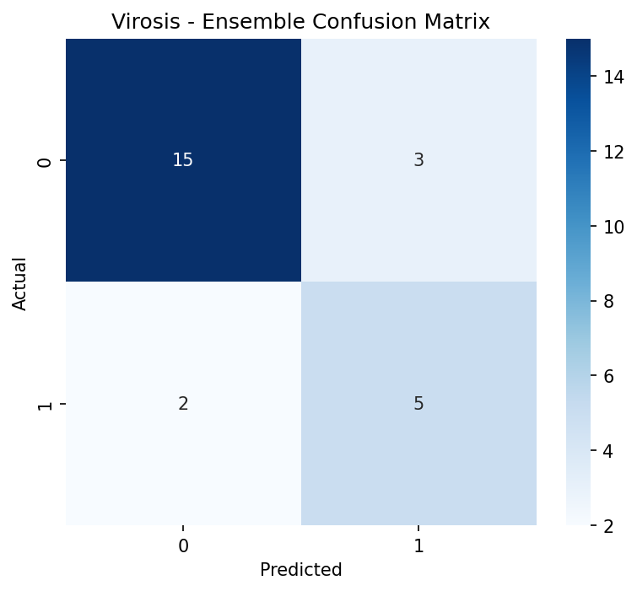
Confusion Matrix

Slide 16
Disease | Bioclimatic Variable (BCV) | Code | Correlation (r)
Pebrine | Mean Diurnal Range | BIO2 | +0.643***
 | Isothermality | BIO3 | +0.643***
 | Min Temperature of Coldest Month | BIO6 | −0.656***
 | Annual Temperature Range | BIO7 | +0.643***
 | Precipitation of Driest Quarter | BIO17 | +0.402*
Viriosis | Mean Diurnal Range | BIO2 | +0.644***
 | Isothermality | BIO3 | +0.644***
 | Max Temperature of Warmest Month | BIO5 | +0.584**
 | Annual Temperature Range | BIO7 | +0.644***
 | Annual Precipitation | BIO12 | +0.628***
 | Precipitation of Wettest Month | BIO13 | +0.628***
 | Precipitation of Driest Month | BIO14 | −0.628***
 | Precipitation of Driest Quarter | BIO17 | +0.636***
 | Precipitation of Coldest Quarter | BIO19 | +0.580**
p < 0.05
** p < 0.01
*** p < 0.001

Slide 17
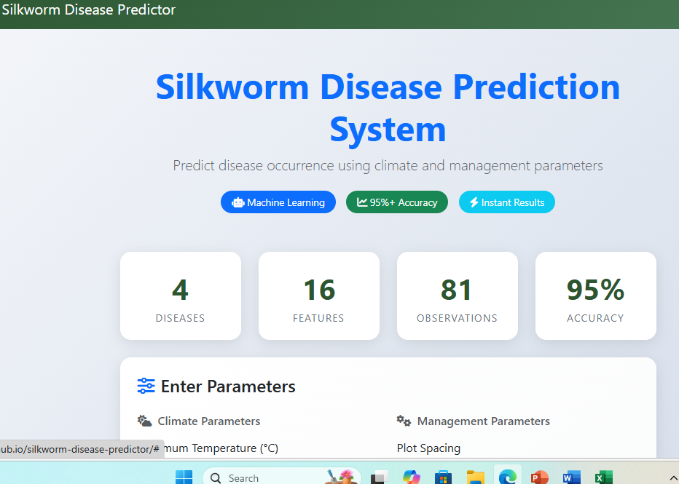
https://chau-mau.github.io/silkworm-disease-predictor/

Slide 18
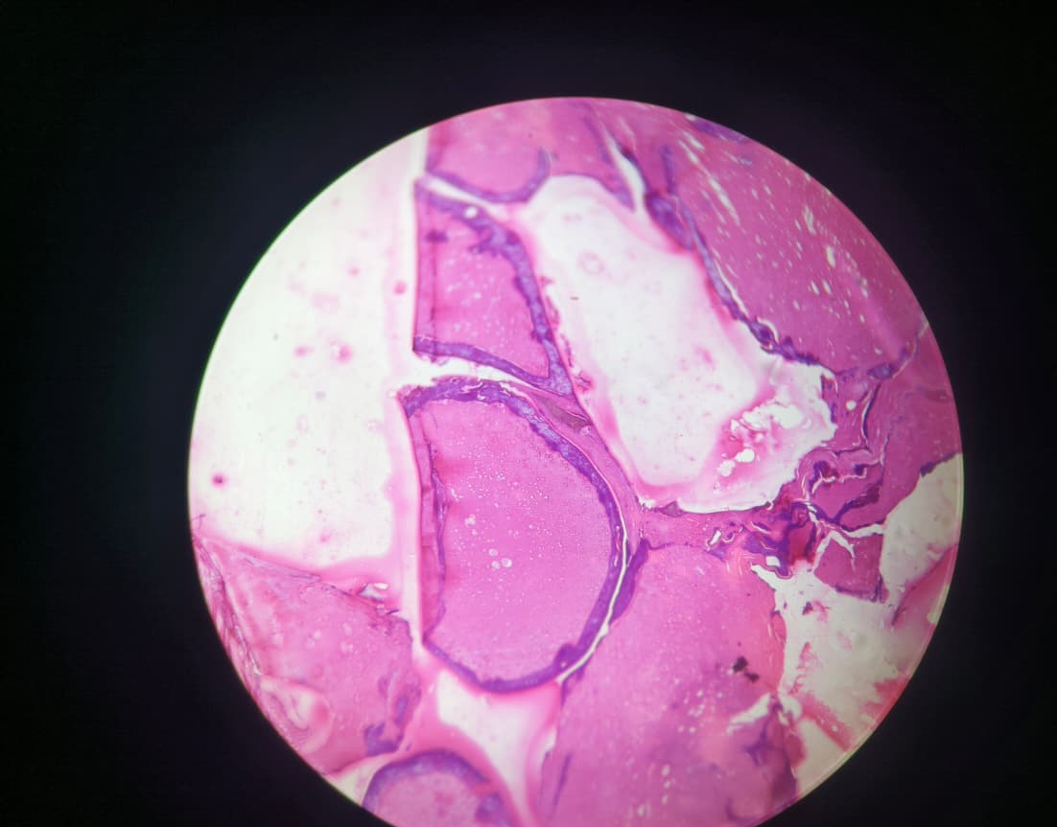
Silk Gland

Slide 19
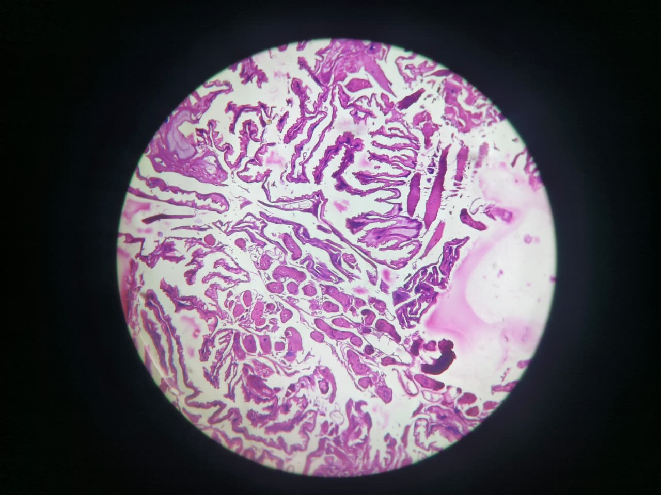
Mid-gut

Slide 20
Suggestions of RC & follow up action taken
RC Observation: Dr. Nidhi Sukhija, Scientist-B & PI of the project presented the progress and committee took note the progress.
Follow up Action: Progress duly recorded and updated; further action points are being implemented as per the Project.

Slide 21


Conclusion
As the plan of the project disease monitoring conducted in 09 states.
Lowest level of disease (2025-2026) was observed in Andhra Pradesh, Bihar, Telangana and Madhya Pradesh and zero cocoons were stifled.
Max. percentage of cocoons stifled was observed in Uttar Pradesh, followed by West Bengal, Orissa, Chhattisgarh, Jharkhand and Maharashtra.
Disease data has to be strengthened with more robust data recording.
Precipitation patterns (especially driest quarter) significantly correlate with disease occurrence
Virosis shows the strongest association with precipitation-related bioclimatic variables
NaiveBayes is the most consistent performer across diseases, suggesting probabilistic relationships between bioclimatic variables and disease occurrence

Slide 22
Future plan
Database of tasar silkworm diseases will be maintained
Tasar silkworm seed replenishment and decision making
Curation of Interactive Model.

Slide 23
Expenditure
Budget head |  | Budget Allocation 2025-2026 | Budget Utilization (Rs. In lakhs)
Equipment |  | - | -
Manpower | (JRF) | 4.87 | 2.78980
 | (CRPs) | 2.37* | -
Consumables |  | 3.9 | 0.85014
Travel |  | 3.0 | 1.782
Contingency |  | 0.50 | 0.50
Overhead |  | - | -
Total |  | Rs. 14.64 | Rs. 5.92194 lakhs

Slide 24
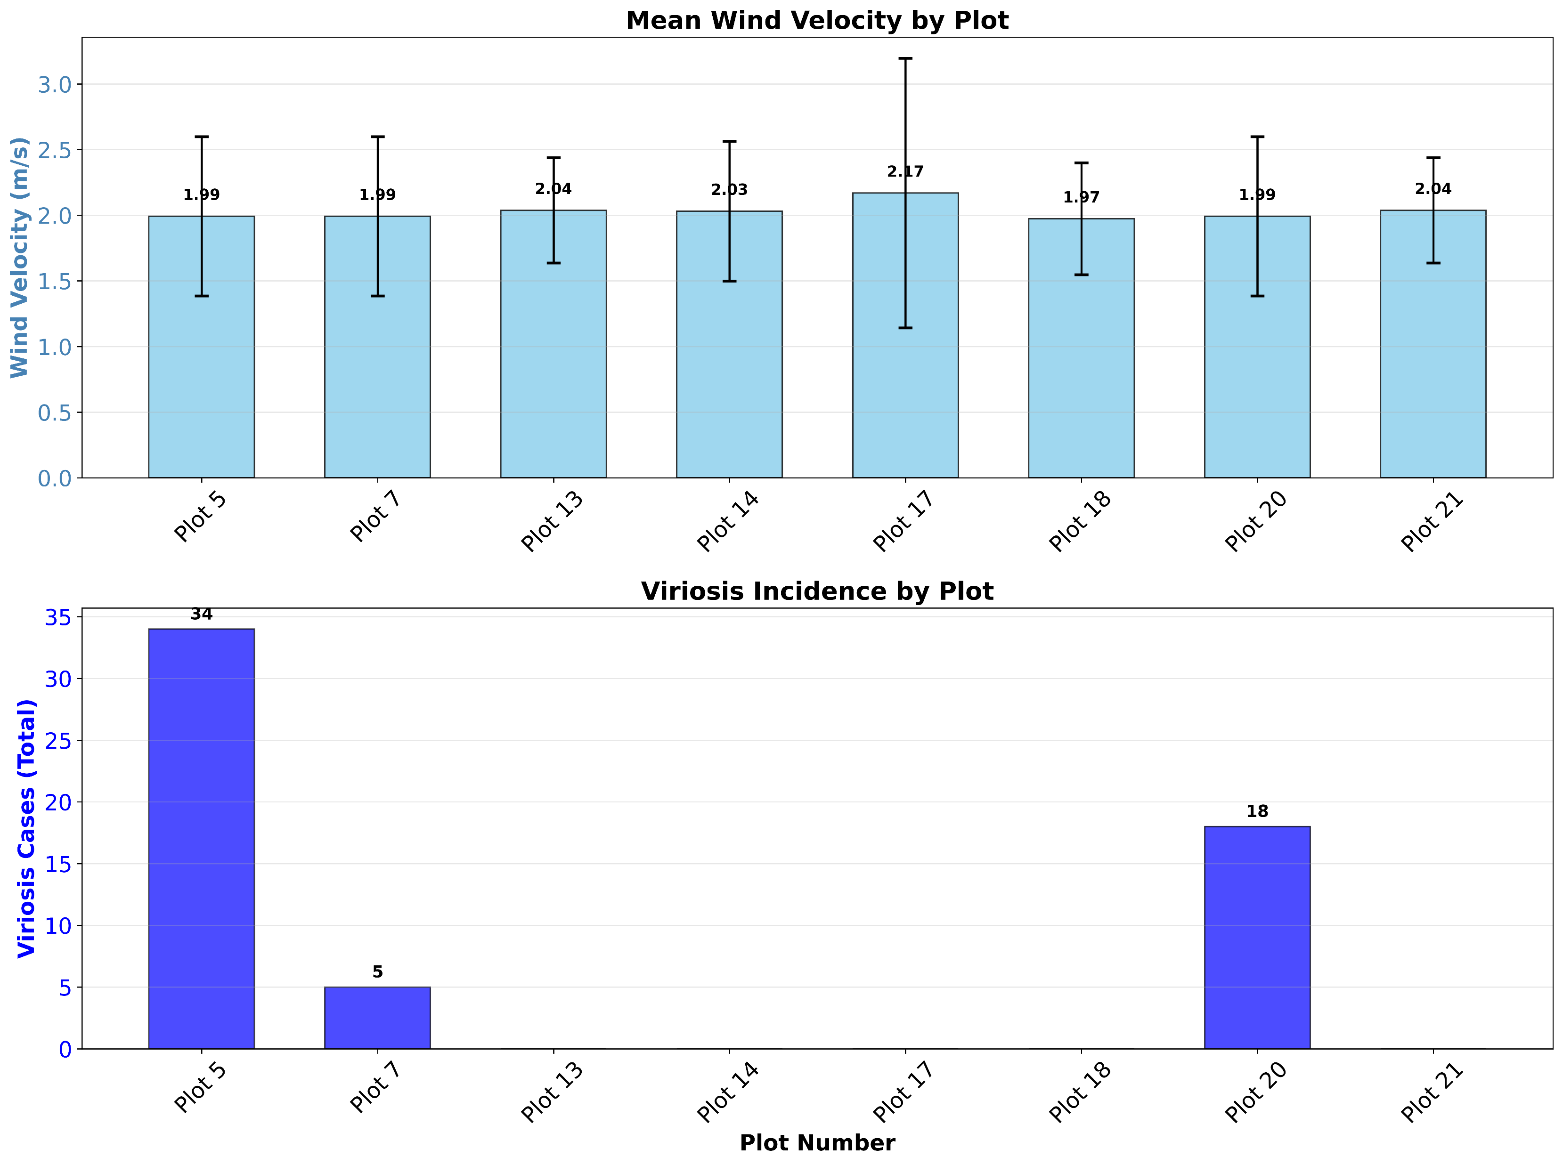

Slide 25
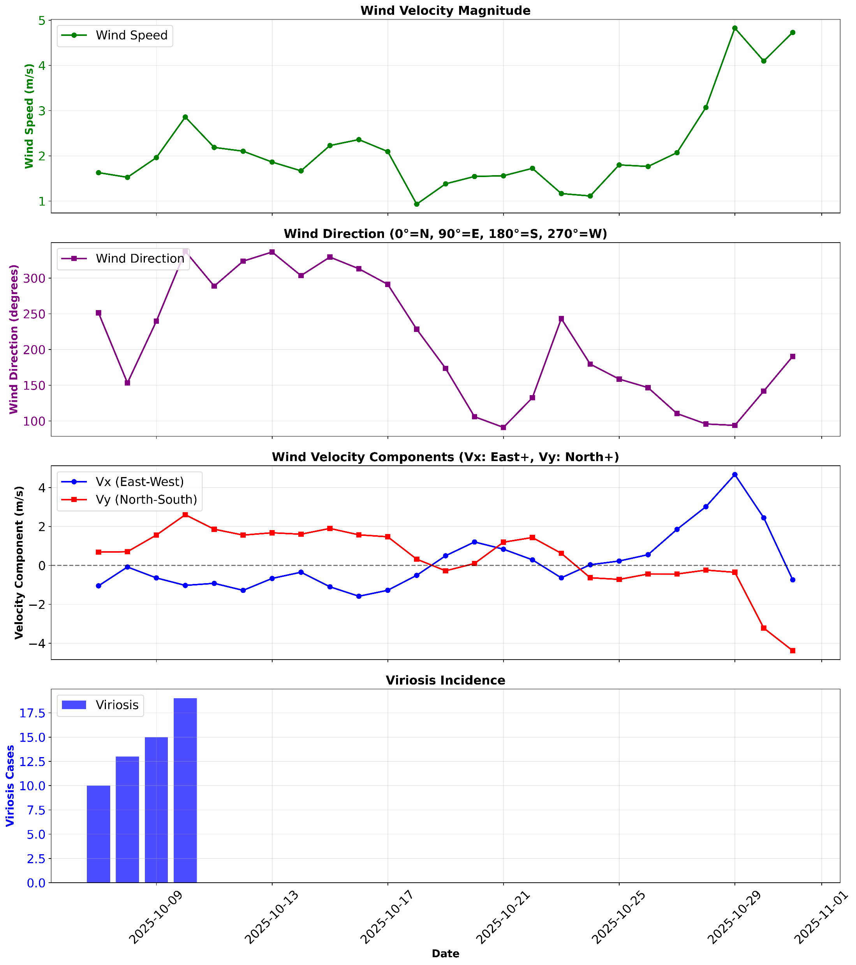

Slide 26
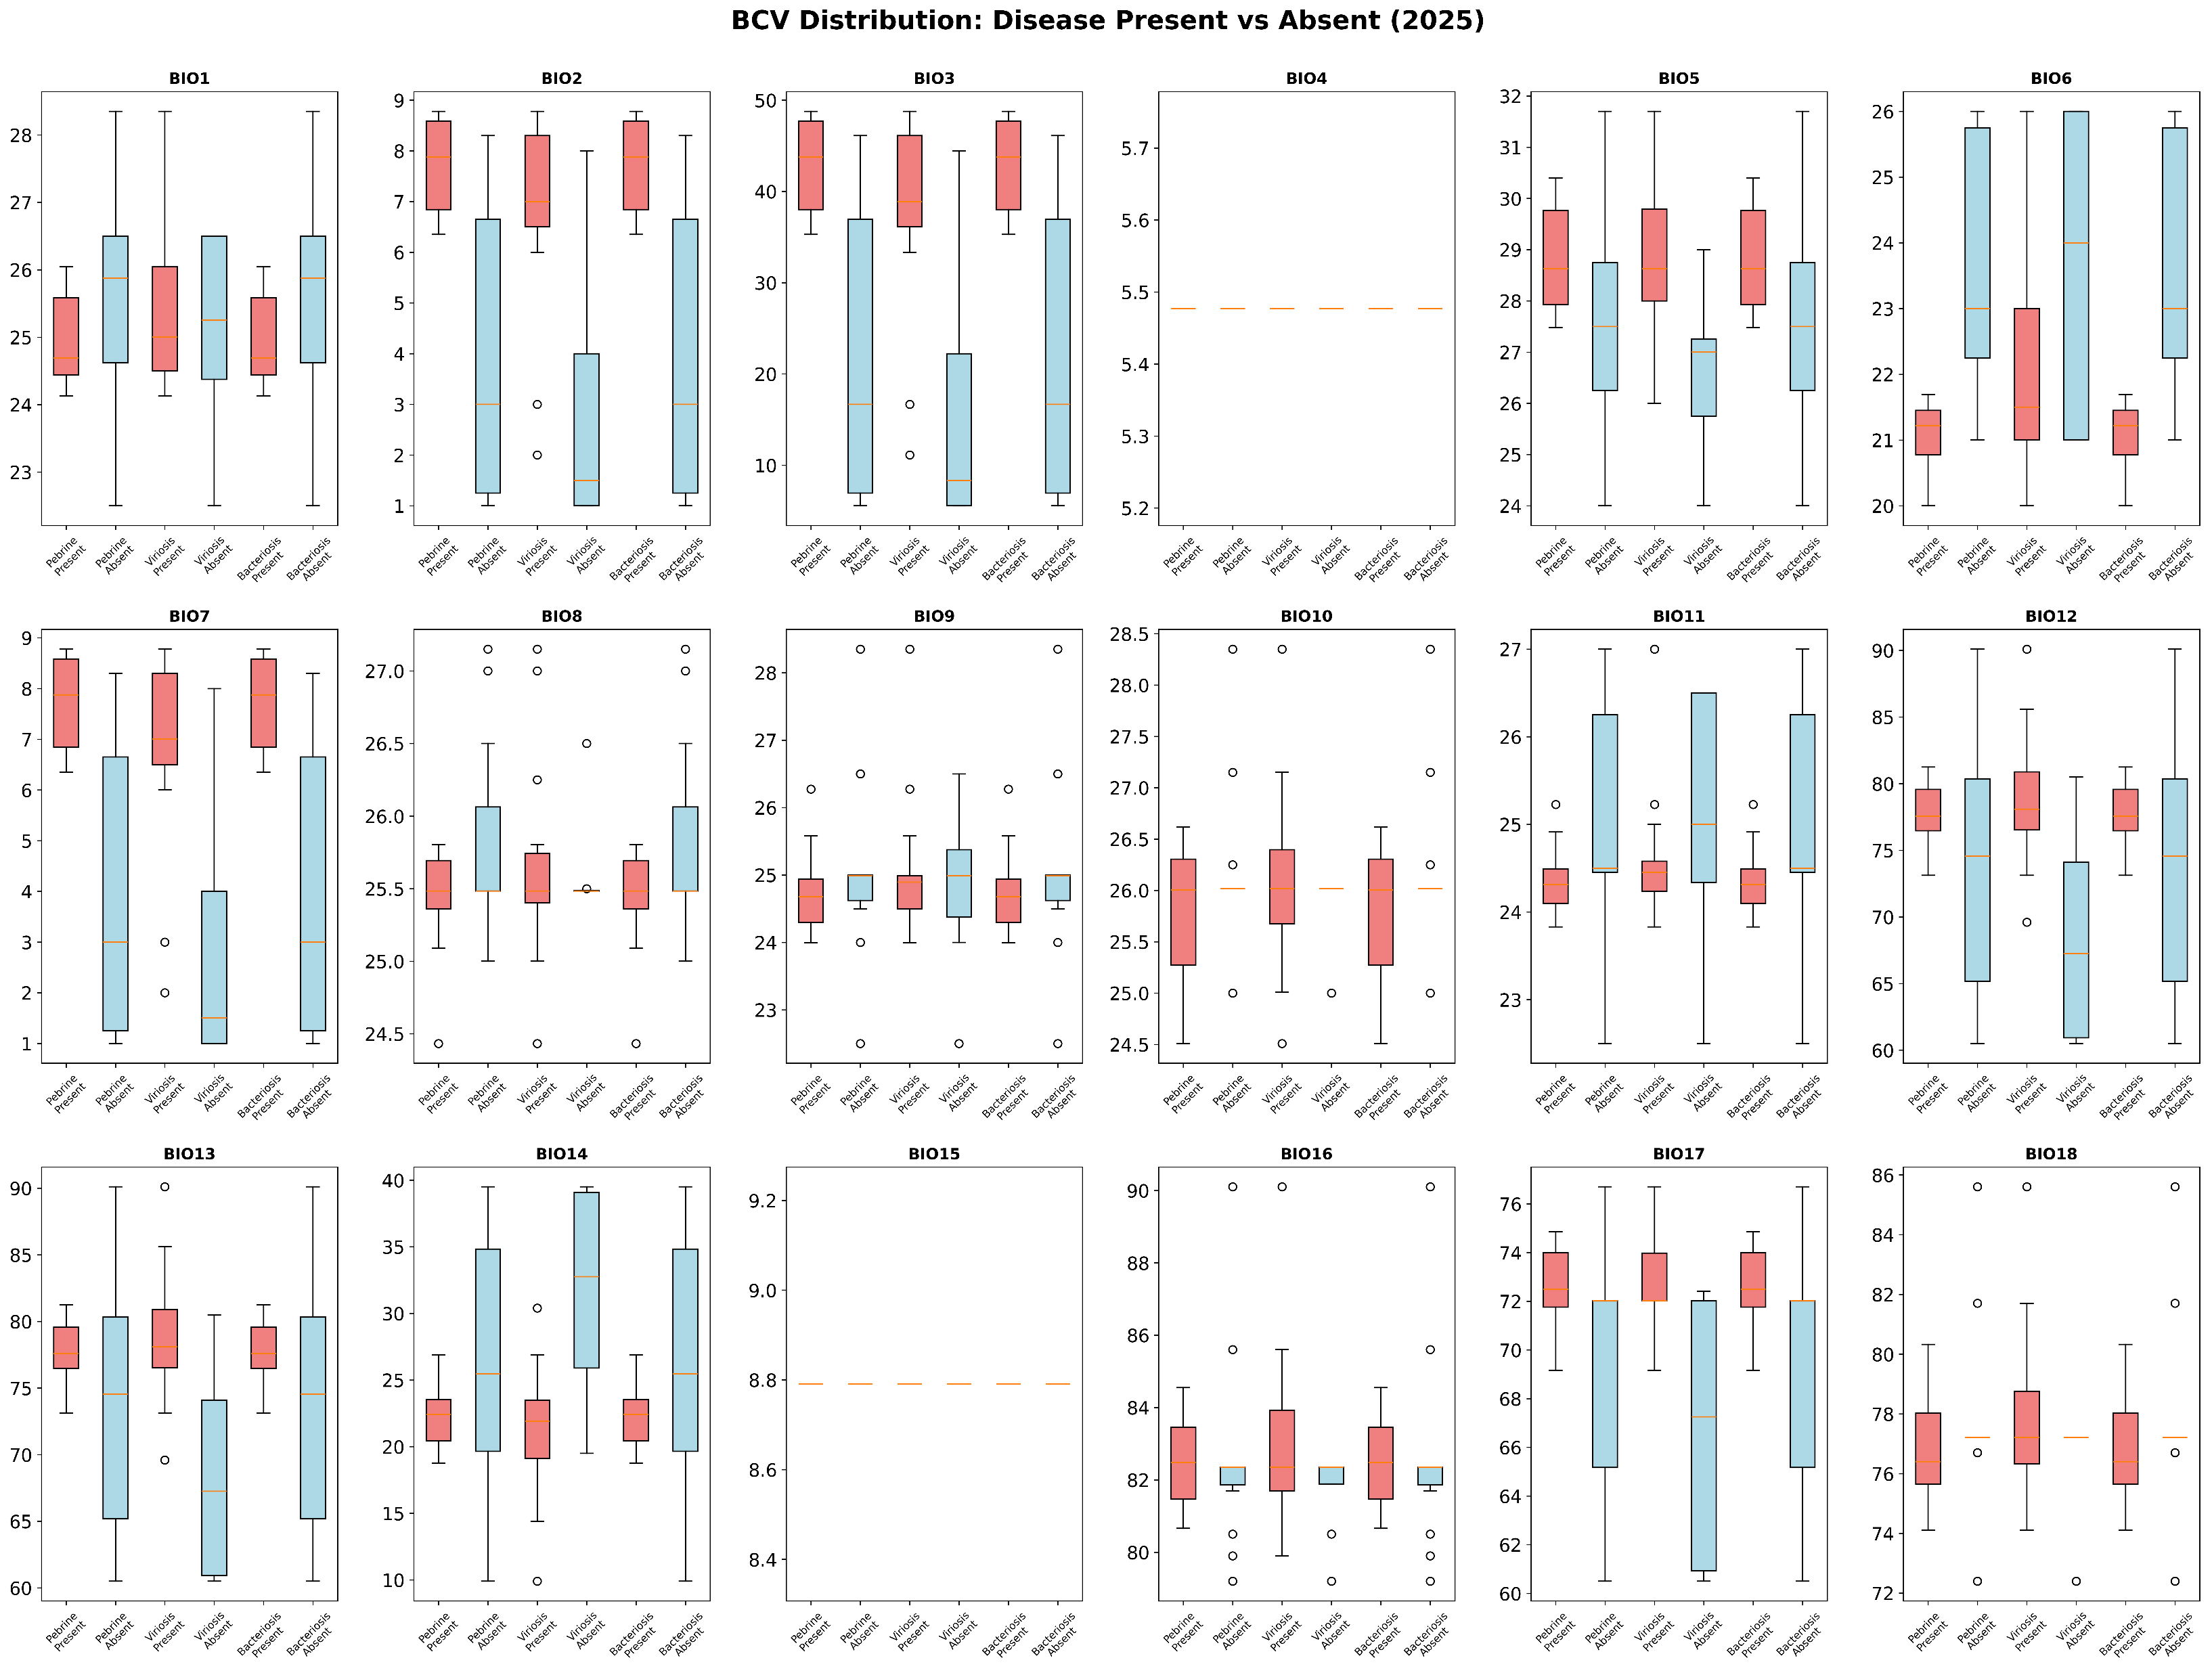

Slide 27
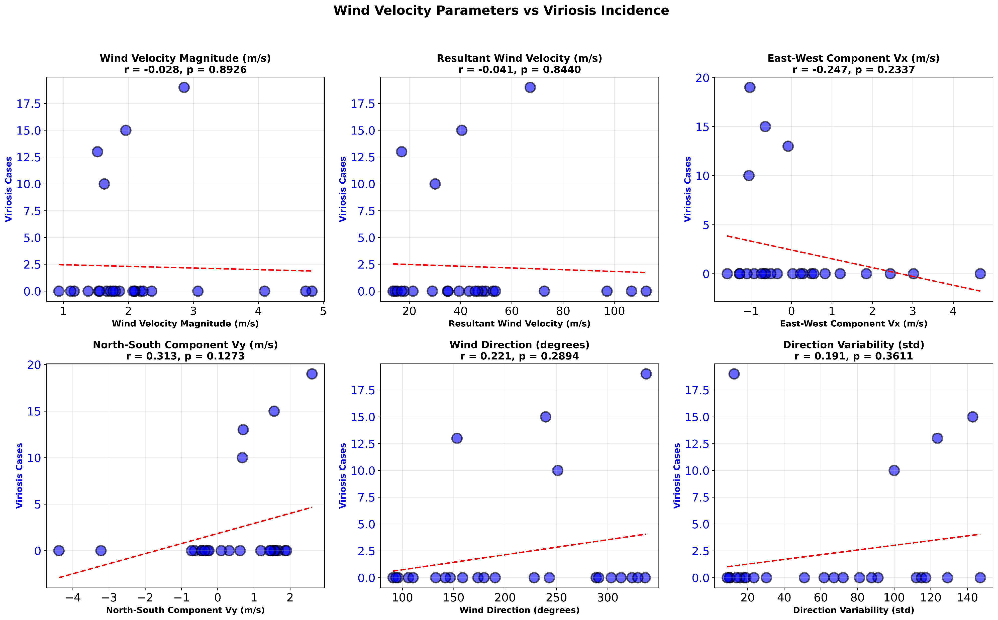

Slide 28
 | Budget Allocation |  |  | Budget utilization (Rs. in Lakhs)
Budget head | Total | For the year under report | Since inception till end of the year under report | During the quarter under report | Utilization during the year | Utilization% during the year | Utilization since inception | Utilization % since inception | Anticipated expenditure till March, 2026
Equipment | 11 | 0.00 | 11 | 0.00 | 0.00 | - | 7.908 | 71.89 | -
Manpower | 35.1 | 7.24 | 20.95 | 1.0788 | 2.48 | 34.25 | 9.008 | 42.99 | 5.20
Consumables | 10.22 | 3.90 | 7.42 | 0.64 | 0.64 | 16.41 | 3.613 | 48.69 | 3.00
Travel | 14.2 | 3.00 | 8.20 | 1.782 | 1.782 | 56.66 | 6.704 | 81.75 | 3.00
Contingency | 2.3 | 0.50 | 1.30 | 0.20 | 0.20 | 40.00 | 0.384 | 29.53 | 0.45
Overhead | - | - | - | - | - | - | - | - | -
Total | 72.82 | 14.64 | 48.87 | 3.70 | 5.102 | 34.84 | 27.617 |  | 11.65
 |  |  |  |  |  |  |  | 56.51% | 79.57 %

