Slide 1

Visual Traffic Simulation

Slide 2
Objective
To visualise traffic flow.
  Using 2D animated graphics
  Using simple models of microscopic traffic behaviour
  Using simple models of junction
Simple simulation results

Slide 3
Traffic simulation applications
Big business
Used for
  Transportation Planning
  Motorway Design
  Traffic Control & Operations
  Traffic Management
  Public Transportation
  ITS Evaluation
  Research & Development

Slide 4
Introduction
The key element in improving traffic operations and performing real-time management is the ability to assess the effectiveness of various alternatives prior to implementation. Simulation methods have long been recognized as the most effective tool for such analysis, and various simulators have been developed by different agencies for analyzing freeway and/or arterial networks. However, simulation has not yet become a suitable tool for practical application. One reason for is the extensive labor required to input the different kinds of traffic data into most simulation programs, which points to the need for a simulation tool that provides automatic access to large amounts of traffic data.

Slide 5
Original motivation
Noticed traffic junctions could be better.
Now realised traffic systems are not optimised for the individual.
Road-traffic networks are model-based systems ideally suited to an object-oriented programming approach.

Slide 6
The Application
Single Software Product
Works as an Application or Applet
Written in Java version

Slide 7
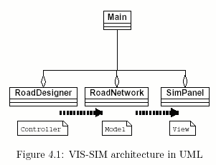
General Architecture

Slide 8
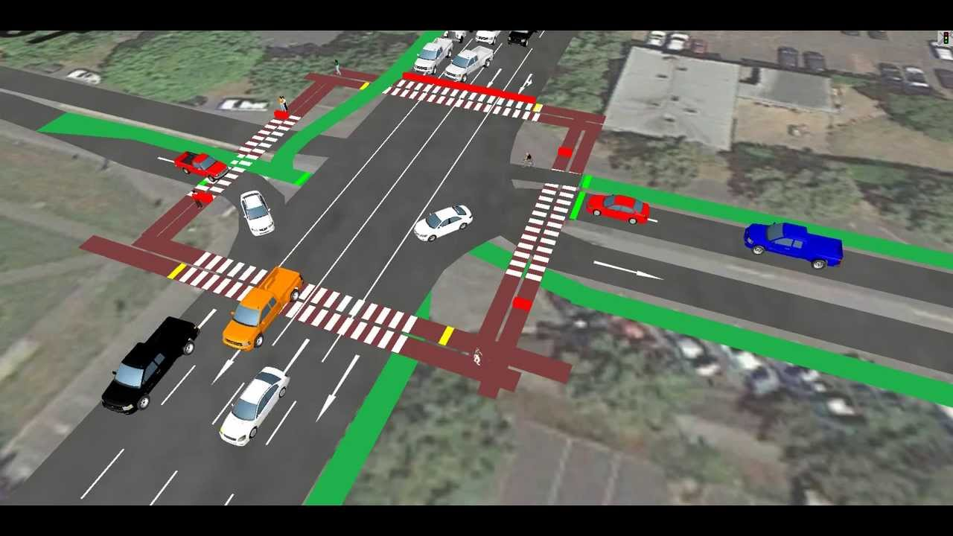
Editor Algorithms
Road Drawing
The main class contains 4 lane road with the traffic signals .and user can draw the road on the screen and user can also extend the road .Java’s road object perfect for drawing road

Slide 9
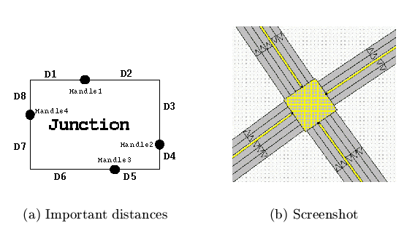
Junction Drawing
Handled rectangle
Drawn with a textured paint
Automatic resizing
Junction rotation

Slide 10
Painting the screen
Strong use of Back-buffered images
Keep track of selected objects
Number of internal states of the system

Slide 11
Saving and Loading
Human readable
Enables possibility of project being a graphical front-end to a more detailed traffic model.

Slide 12
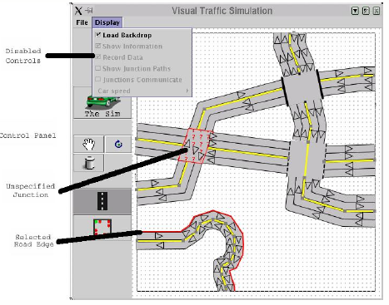
Usability

Slide 13
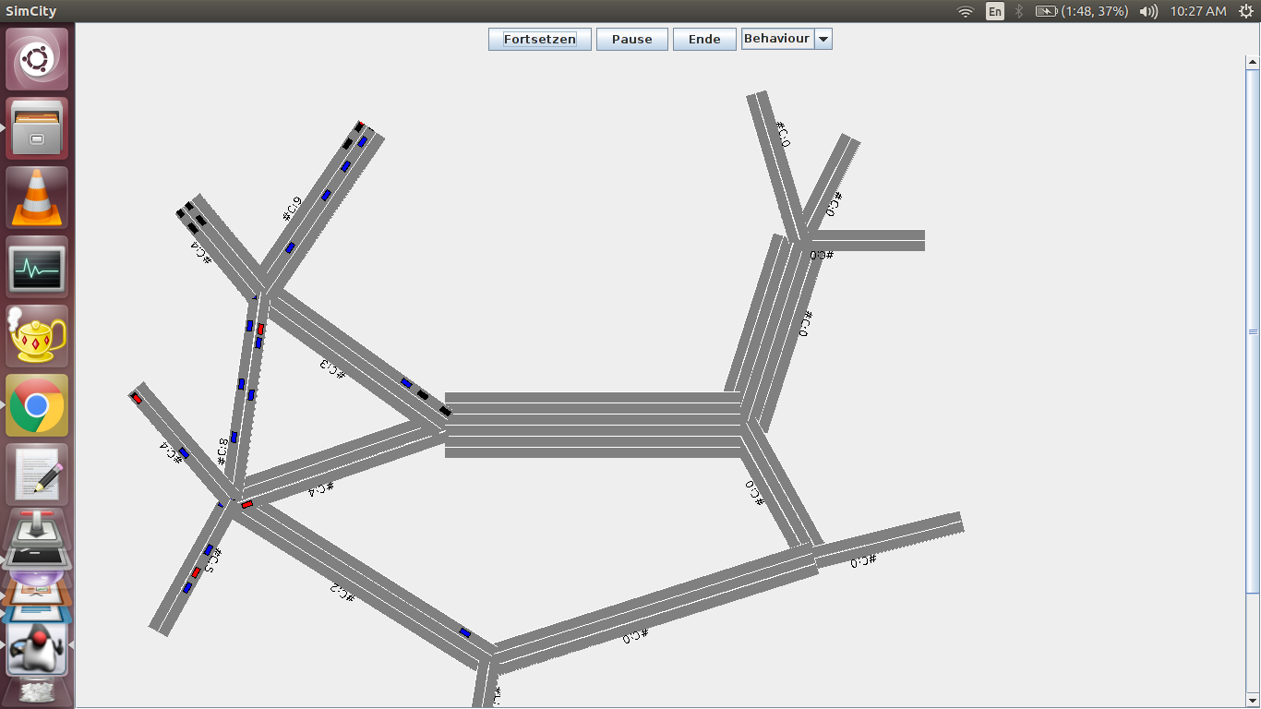
Final result

Slide 14
Simulator Algorithms
The timing system
The animation of vehicles
  The vehicle movement model
  Gap acceptance
Junction models
ITS constructs

Slide 15
The timing system
A thread that generates two events each “tick”
Objects registered with the timer must implement the timer interface and provide fun() and fun2() methods.
Vehicles calculate their new position in the fun2() phase
The whole simulation frame is drawn in the fun() phase

Slide 16
Animation of vehicles
Movement calculated using car-following model
  Linear model.
  Speed is proportional to distance of object ahead.
Gap-acceptance model controls vehicles pulling out of junctions
Vehicles have a “carContainer”
Know distance to end of carContainer
If < 0 change to new carContainer and rotate vehicle image.

Slide 17
Junction Models
Junction paths
Non-signalled junctions
  Priority traffic
  Gap acceptance model
Signalled junctions
  Traffic light sets

Slide 18
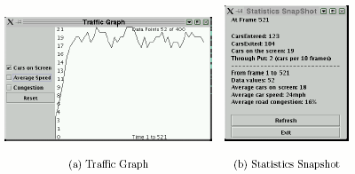
Simulation Results

Slide 19
Strengths
Microscopic simulation approach
Input editor
Animated output
Graphical user interface
Accessibility
Extendibility.

Slide 20
Knowledge gained
Object-orientated approaches to traffic simulation do well to accommodate the necessary modular design of different traffic models
Simple traffic models can lead to good visualisations of traffic flow
Visualisations are resource intensive limiting the number of vehicles in the simulation
Flexibility can be problematic

Slide 21
Conclusion
A set of simple traffic models and algorithms
A fully independent application
Can quickly model simple urban road networks
Can animate user-defined traffic data on a road network
Produces intuitive visualisations of traffic flow
Enable different road networks to be compared for efficiency
Documentation and background information also help annotate the project application

