Slide 1

· · · BETA IS LIVE · · ·
Your motor insurance,
audited.
One email forward. Two minutes. Free.
r
RIGHTOFFER
CAR

Slide 2

· · · WHAT WE DO · · ·
We read it.
So you don’t have to.
Fifteen pages of fine print. We read every line and tell you what to ask.

Slide 3

· · · WHAT’S AT STAKE · · ·
Most policies have
a gap.
Zero-dep that expired. IDV set below market. Engine protector missing on a new car.

Slide 4

· · · THE WEDGE · · ·
An honest read.
Not a quote table.
No comparator. No commission. No insurer push. Just what your policy says.

Slide 5
· · · HOW IT WORKS · · ·
From inbox to audit.
1
2
3
FORWARD
READ
AUDIT
Email your policy
Aryan reads it
Lands in your inbox
Two minutes from forward to audit. No app, no signup, no calls.

Slide 6
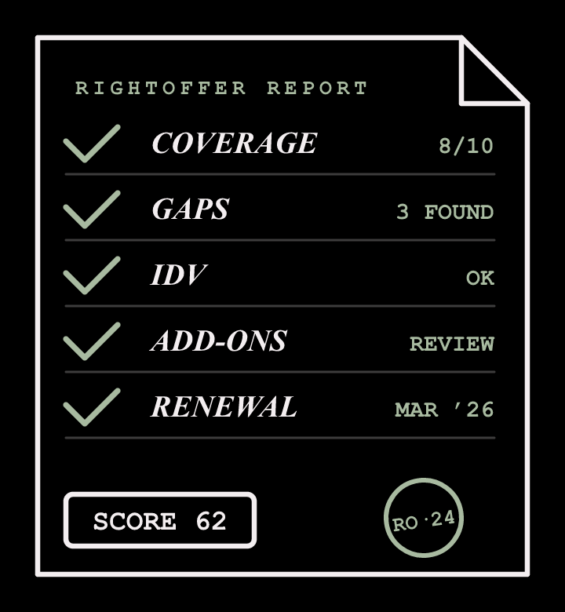
· · · WHAT YOU’LL GET · · ·
Five things, one report.
01
Coverage snapshot
02
Gap analysis
03
IDV cross-check
04
Add-on relevance
05
Renewal calendar
One audit. One report. Everything you need to renew with confidence.

Slide 7







· · · HOW WE RATE · · ·
Every finding,
on a 5-point scale.
1
2
3
4
5
Awful
Bad
Okay
Good
Delighted
Every gap gets a face. You see exactly where you stand.

Slide 8


· · · BEFORE & AFTER · · ·
From confused
to clear.
BEFORE
AFTER
Fifteen pages of fine print.
A two-minute audit.

Slide 9



· · · WHAT’S BREWING · · ·
Phase 2 is
brewing.
We’re building something that’ll change how you renew. Stay close.

Slide 10

· · · FORWARD YOUR POLICY · · ·
FORWARD TO
review@rightoffer.in
Two minutes. No signup. The audit is on us.
rightoffer.in
r
RIGHTOFFER
CAR

