Slide 1

STATE PROFILE
Maharashtra District Dashboard
Project By Neha Santosh Chaudhari

Slide 2
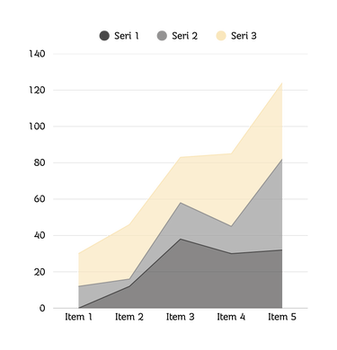
INTRODUCTION
Maharashtra is a big state with many districts. Each district is different in terms of population, literacy, urban areas, economy, and tourism. Even though data is available, it is spread across reports and is not easy to understand. This project creates an interactive dashboard that brings all this information together so that people can see, compare, and study districts in a simple way.

Slide 3
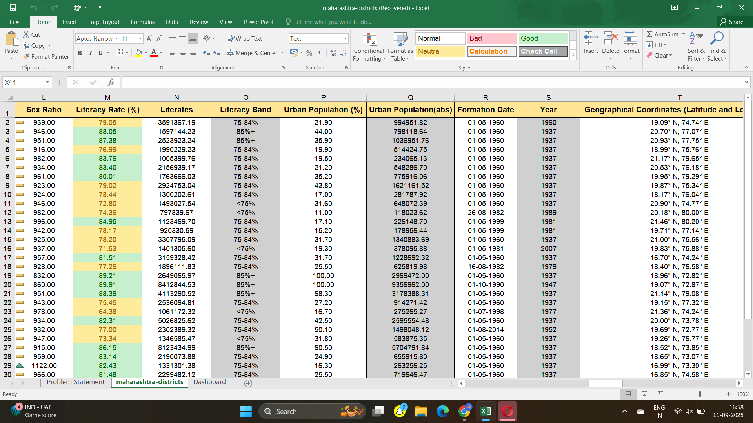

Data Set

Slide 4
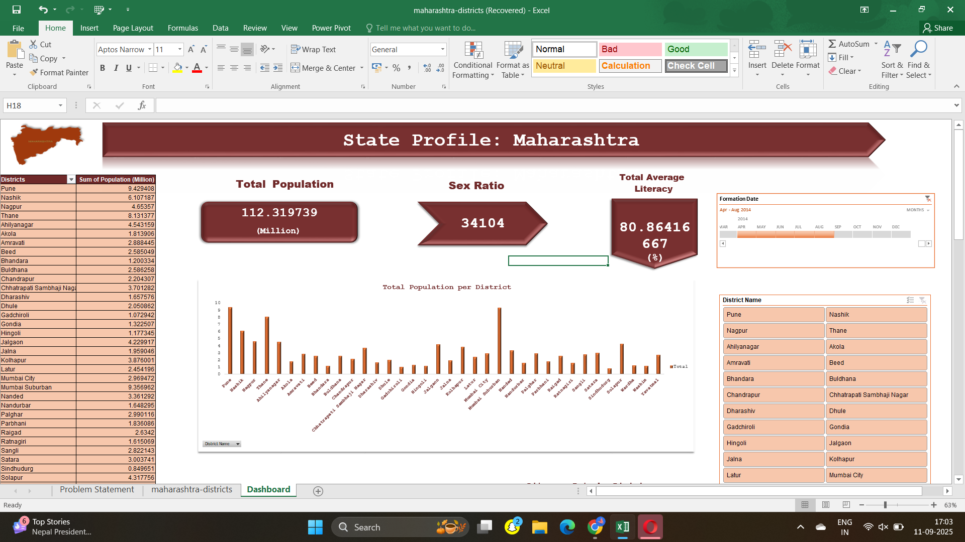
Dashboard

Slide 5
INSIGHTS
Population is concentrated in Mumbai, Pune, Thane, while districts like Gadchiroli, Sindhudurg are less populated
Urban districts show higher literacy rates, while rural/tribal districts have lower literacy.
Sex ratio is better in rural areas but lower in metro cities due to migration.
Population density is extremely high in Mumbai and very low in remote districts.
Economy varies: metros = IT & services, Vidarbha = agriculture, Konkan = tourism.

Slide 6
CONCLUSION
The Maharashtra District Dashboard makes district data easy to understand through visuals and comparisons. It helps turn numbers into insights and supports better decision-making.

Slide 7
THANK YOU

