Slide 1
Smart City – Smart Water

Slide 2
Problem statement
Pune’s water sources are mostly located on the west side. And with the rapid growth it is experiencing, Pune’s increasing population is getting spread over a larger area which is creating more pressure on water distribution network and water resources in general. Moreover the growth is mostly in directly away from the water sources due to which longer piping network is un-avoidable. Currently it is almost 2500 kms and growing.
Maintaining and monitoring such a vast network is a difficult job and issues like breakdowns, uneven terrain etc. makes equitable distribution and smooth water supply a difficult job.

Slide 3
Approach
Systematic and planned automated water metering and distribution monitoring can help address some of the key issues.
In order to prove the above concept, the idea is to present a Simulation of water distribution network electrically to demonstrate how equitable distribution can be achieved using smart metering.

Slide 4
Team details
Prashant Chaudhari: Product/Functional Evangelist, Java – J2EE software engineer, recently acquired skills in Hardware
Girish Kolte: Electronics Engineer

Slide 5
Benefits
Equitable water distribution
Evidence-based water demand forecasting
Proactive water loss management
Better city-wide urban water planning
Water leakage detection
Reducing the labor necessary to read traditional water meters, as well as streamlined bill generation
Better prioritize infrastructure investments
Reveal problematic areas within the system and better manage the collection, storage and distribution of water

Slide 6
Benefits continued
Give customers the information they need to conserve water, thereby lowering their water bills
Real-time data to better serve their customers by understanding their unique usage patterns and needs
Data analytics helps utilities target performance and equipment improvement programs
Ultimately, this information leads to better planning and forward-thinking capital investment decisions
Water conservation also positively affects the bottom line of water utilities by reducing energy consumption. This factor is significant for utilities, since around one-third of their total costs are for energy to treat and pump the water. Less wasted water equates to less wasted energy.

Slide 7
Solution
Get data - Build the core infrastructure that will gather the data. This includes networks, systems, meters, sensors, automation and other software and hardware. Solution should be customizable and meet the utility’s needs both now and into the future. POC is expected to represent our vision for the same.
Manage data - To use data effectively, it’ll need to be stored in a common repository and structured in a manner that makes sense for the utility’s unique needs. There are many storage options available, including cloud-based systems that can supply unlimited computing power. This may not be our full focus during POC phase.
Analyze and use data - Advanced analytics solutions to reveal trends and patterns that will help the utility solve its most pressing challenges. Think about the utility’s major “pain points” and choose a couple of these to focus on as an initial test. Create a pilot program to help managers better understand the actual return on investment that can be achieved with analysis of this captured data.

Slide 8
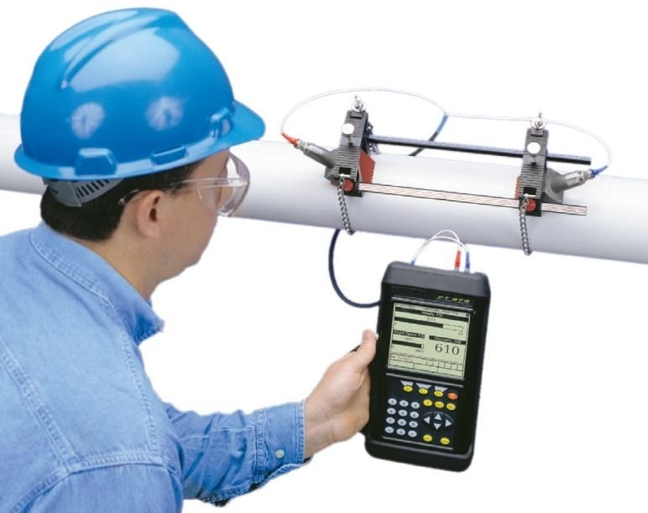
Suggestion for choice of flow meters in Practical scenario
Sonar flow sensor – need to couple it with capacitive sensor
Clamp on meters fixed with GPRS on major (big size) pipelines.
Pinwheel type of sensors (or variable pressure sensor if cost permits) at consumer end connected with broadband wired to customer’s broadband.
Water Grid structures can have one major meter at entry and individual consumer meters which should be helpful to detect leaks in Grid (which may be hard to find otherwise).

