Slide 1










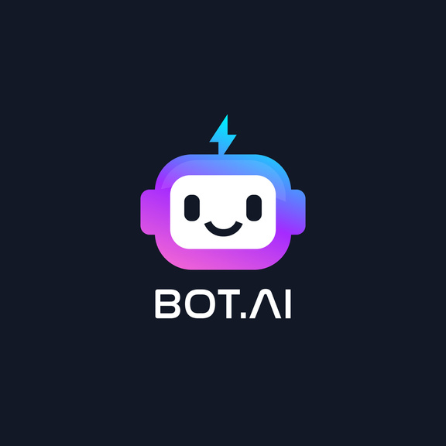




CHATBOT
DEVELOPMENT

Slide 2
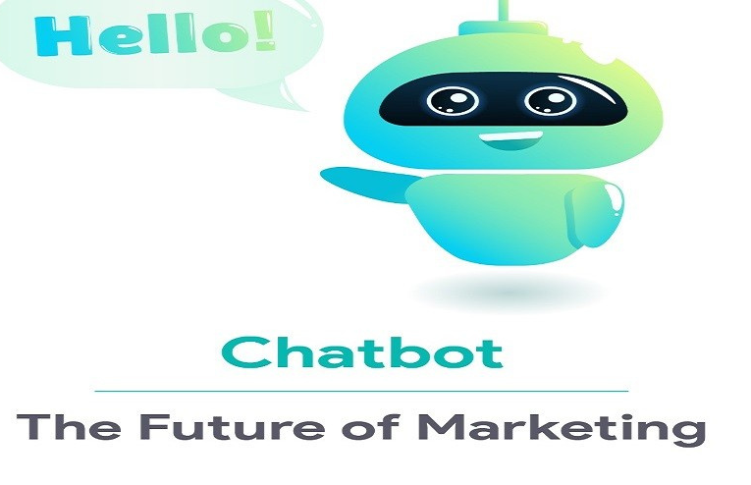

INTRODUCTION: CHATBOT DEVELOPMENT.....
  A chatbot is a smart computer program that talks to you like a friend. It can answer your questions, help you with tasks, and chat with you. People create chatbots to make your life easier by having virtual conversations with you.

Slide 3
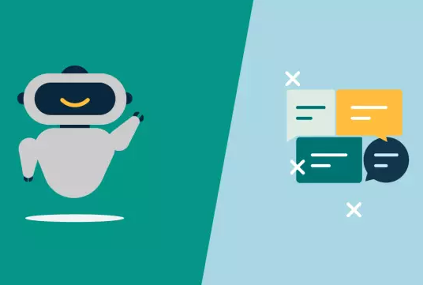
DIFFER FROM TREDITIONAL SOFTWARE APPLICATION:
  It differs from traditional software applications by offering more engaging, accessible, and user-friendly interactions, while traditional software often relies on graphical interfaces, manual input, and lacks the ability to understand and respond in natural language.

Slide 4


CHATBOTS CAN BE CATEGORIZED BASED ON FUNCTIONALITY INTO:
Information Retrieval Chatbots:
  Function: Retrieve specific information from databases or external sources.
  Example: A chatbot for a bank that provides account balances, transaction history, and interest rates.
Educational Chatbots:
  Function: Facilitate learning experiences and assist with educational tasks.
  Example: A language learning chatbot that helps users practice vocabulary and grammar.
Customer Support Chatbots:
  Function: Assist customers with common queries and issues.
  Example: A chatbot on a company's website that helps users with product information, troubleshooting, and FAQ.
E-commerce Chatbots:
  Function: Help users navigate and make purchases on online stores.
  Example: A chatbot on an e-commerce website that suggests products, helps with checkout, and tracks orders.

Slide 5
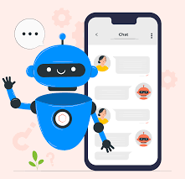
PROGRAMMING LANHUAGES AND FRAMEWORK FOR CHATBOT DEVELOPMENT:-
  Python: People like using it for chatbots because it has many tools to understand and use human language, making chatbots smart.
  Node.js: It's great for chatbots that need to reply quickly, especially on the web.
  Java: It works well for chatbots on Android and big projects because it's flexible and works on different devices.
(Microsoft Bot Framework):
  C#: is widely used in the Microsoft ecosystem. The Microsoft Bot Framework provides a comprehensive set of tools and services for building chatbots. It integrates seamlessly with other Microsoft services like Azure, making it a strong choice for businesses in the Microsoft ecosystem

Slide 6
"CONTRIBUTIONS OF POPULAR CHATBOT PLATFORMS TO THE DEVELOPMENT PROCESS"
Popular chatbot platforms like Dialogflow, Microsoft Bot Framework, and Rasa contribute to the development process by providing pre-built tools and frameworks for creating chatbots. They offer features such as natural language understanding, dialogue management, and integration with messaging platforms, saving developers time and effort. These platforms make it easier to design, train, and deploy chatbots, even for those without extensive AI expertise.

Slide 7
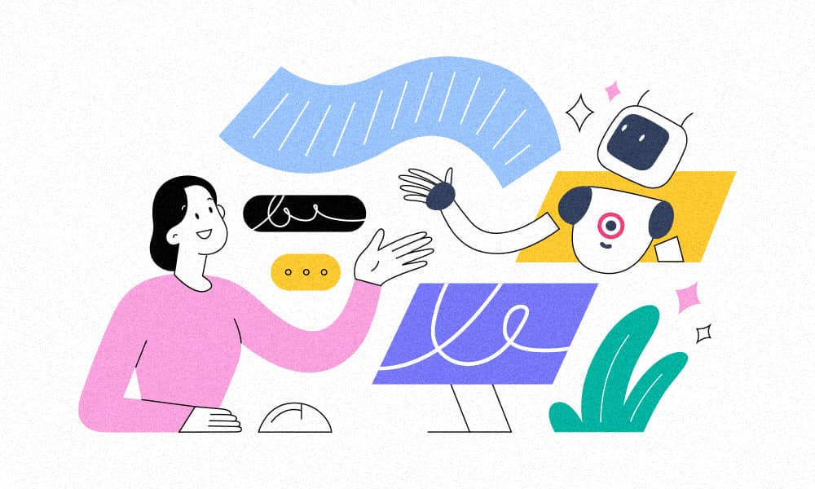
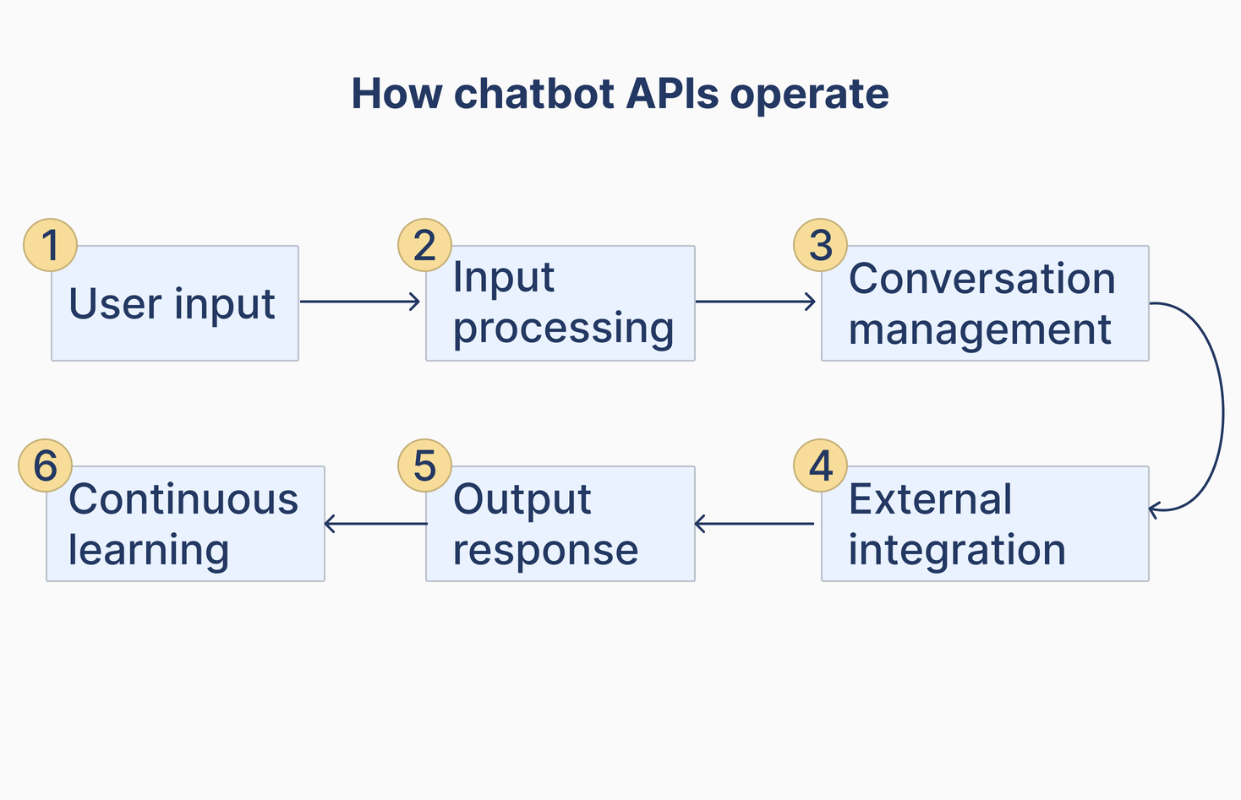
APIS IN CHATBOT INTEGRATION WITH EXTERNAL SERVICES AND DATABASE:-
  APIs serve as the links that enable chatbot to access and interact with external services and databases, facilitating data exchange and extending chatbot functionality.

Slide 8


REAL-WORLD APPLICATIONS FOR CHATBOTS"
01
02
03
Customer Support: Chatbots assist in handling customer inquiries and resolving issues, providing 24/7 support.
Healthcare: Chatbots provide medical information, appointment scheduling, and mental health support.
Education: They aid in learning, answer questions, and provide educational content and support.
04
05
06
Language Translation: They translate text and facilitate multilingual communication.
Entertainment: Chatbots engage users in interactive experiences and gaming on platforms like Twitch.
Financial Services: They assist with account inquiries, transactions, and financial advice.

Slide 9




1. Retail: Chatbots can provide personalized product recommendations, assist with order tracking, and answer customer inquiries.
3 . Customer Support: Chatbots can handle common customer inquiries, provide troubleshooting assistance, and offer self-service options.
SUCCESSFUL CHATBOT IMPLEMENTATIONS ACROSS INDUSTRIES"
2. Banking: Chatbots can help customers with account balance inquiries, transaction history, and provide financial advice.
4. Travel: Chatbots can assist with flight bookings, hotel reservations, and provide travel recommendations based on user preferences.
2. Banking: Chatbots can help customers with account balance inquiries, transaction history, and provide financial advice.

Slide 10
THANK YOU VERY MUCH!
For watching

