Slide 1
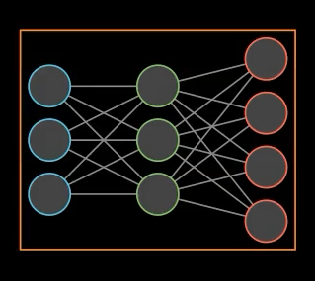
Data Collection Phase
Experience Buffer
ENVIRONMENT
LLM
Training Phase
Experience Buffer
Policy Optimization

Slide 2




|o|
A | B | C
D | E | F
1
-1
G
$$A_{i}$$
Responses generated by LLM
Advantage calculated from env rewards
This is fixed
Increase this
$$π_{θ}$$
0.25 | 0.1 | 0.2
0.2 | 0.4 | 0.1
*
1 | 1 | 1
-1 | -1 | -1
$$A_{it}$$
Decrease this
Probabilities of the tokens
Advantage per token
-0.02
MEAN
To increase this
0.25 | 0.1 | 0.2
-0.2 | -0.4 | -0.1
We need to
Increase both
$$π_{θ} A_{it}$$

Slide 3
1. Model Capability vs. Task Difficulty
Small models, have limitations.
1B param models have less world knowledge compared to models with over 14B parameters.
Check the model's base accuracy on your task.
If accuracy is below 10-20%, the task is likely very hard
Qwen-0.6B
DeepSeek-7B
Llama-70B
GPT-4.1

Slide 4
2. The Power of SFT
Remember, SLMs are immensely tunable.
SFT can lead to massive accuracy gains on small models.
Quality SFT might eliminate the need for RL in many scenarios.
The SFT bump is real!
Base
SFT
RL

Slide 5
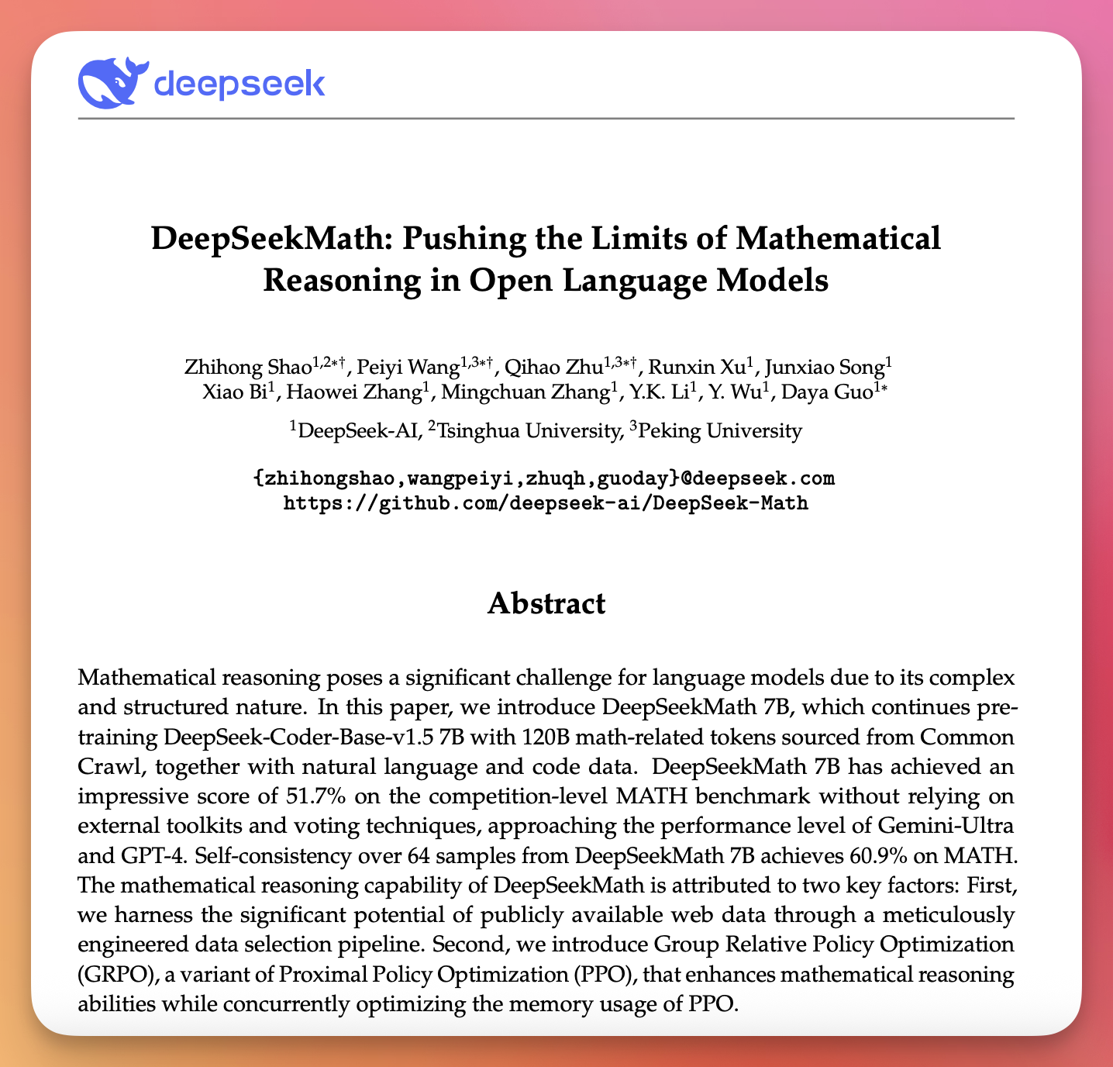
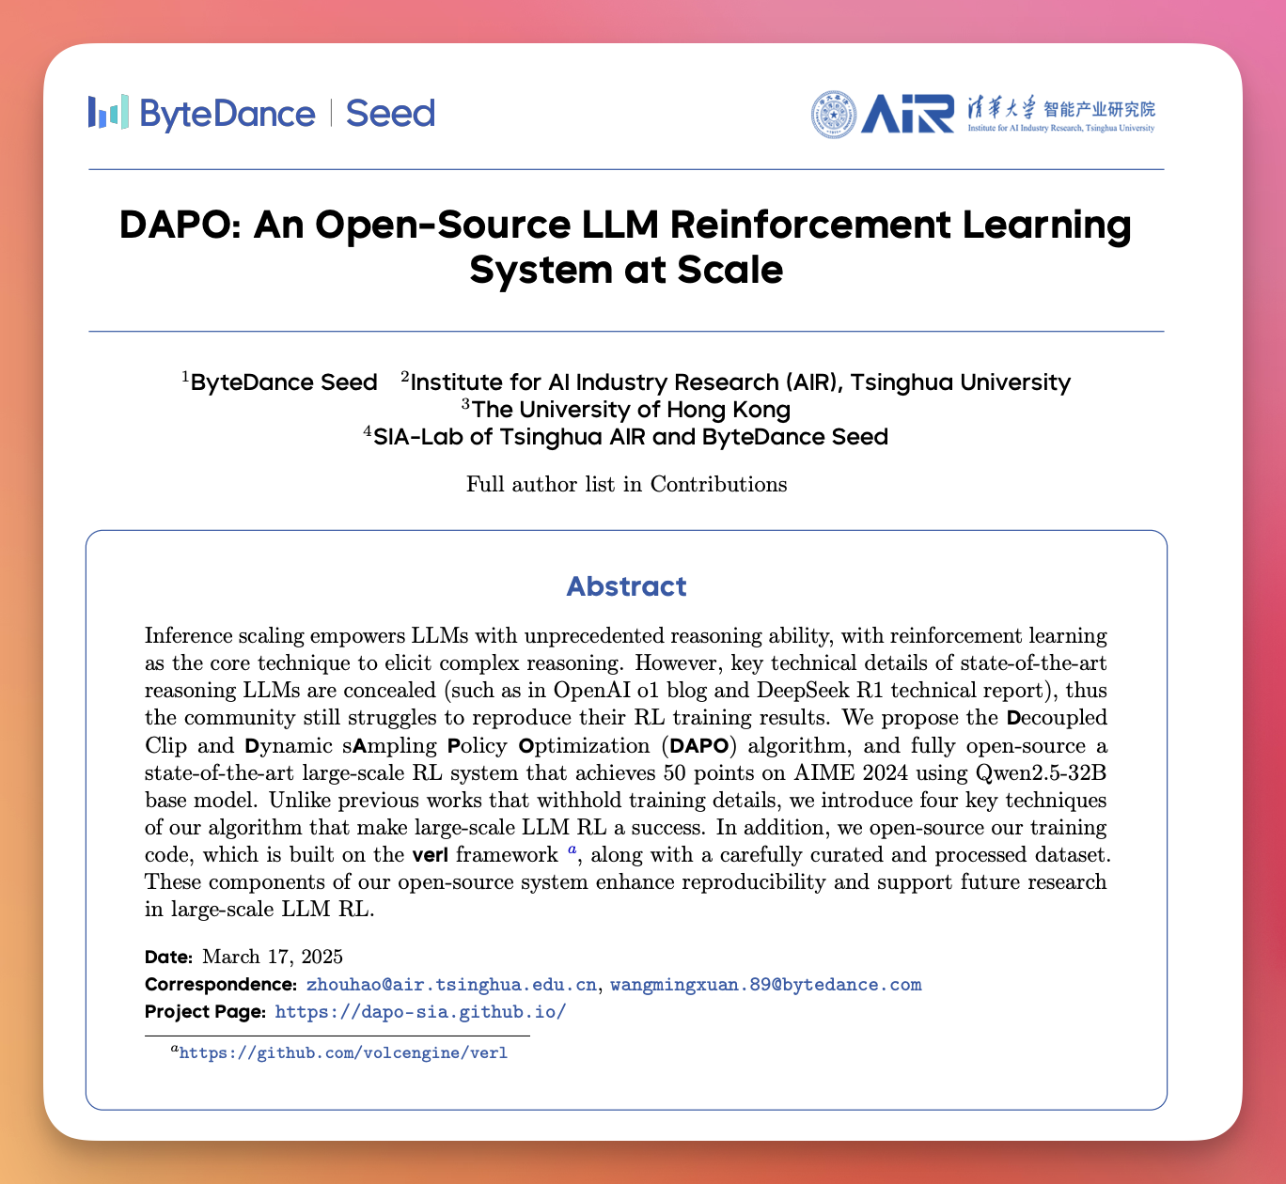
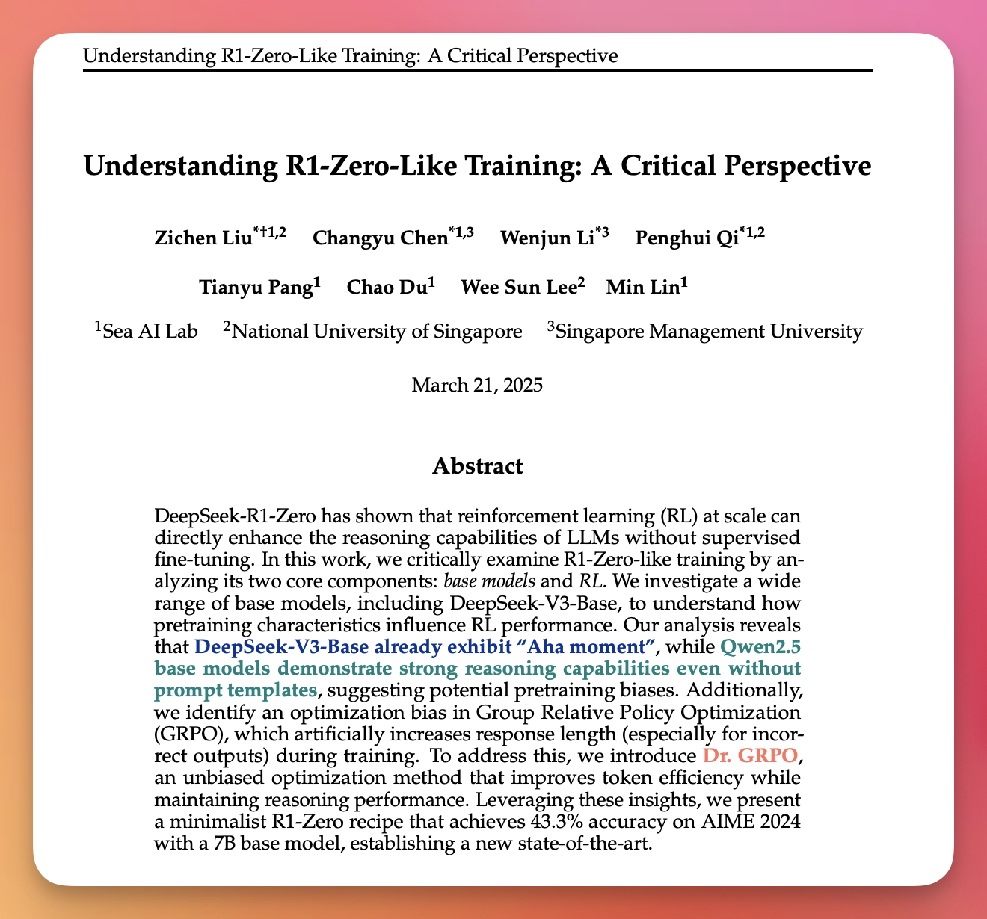
3. Reasoning Research: An Evolving Landscape
The field of reasoning research is constantly evolving, with new insights challenging older assumptions.

Slide 6
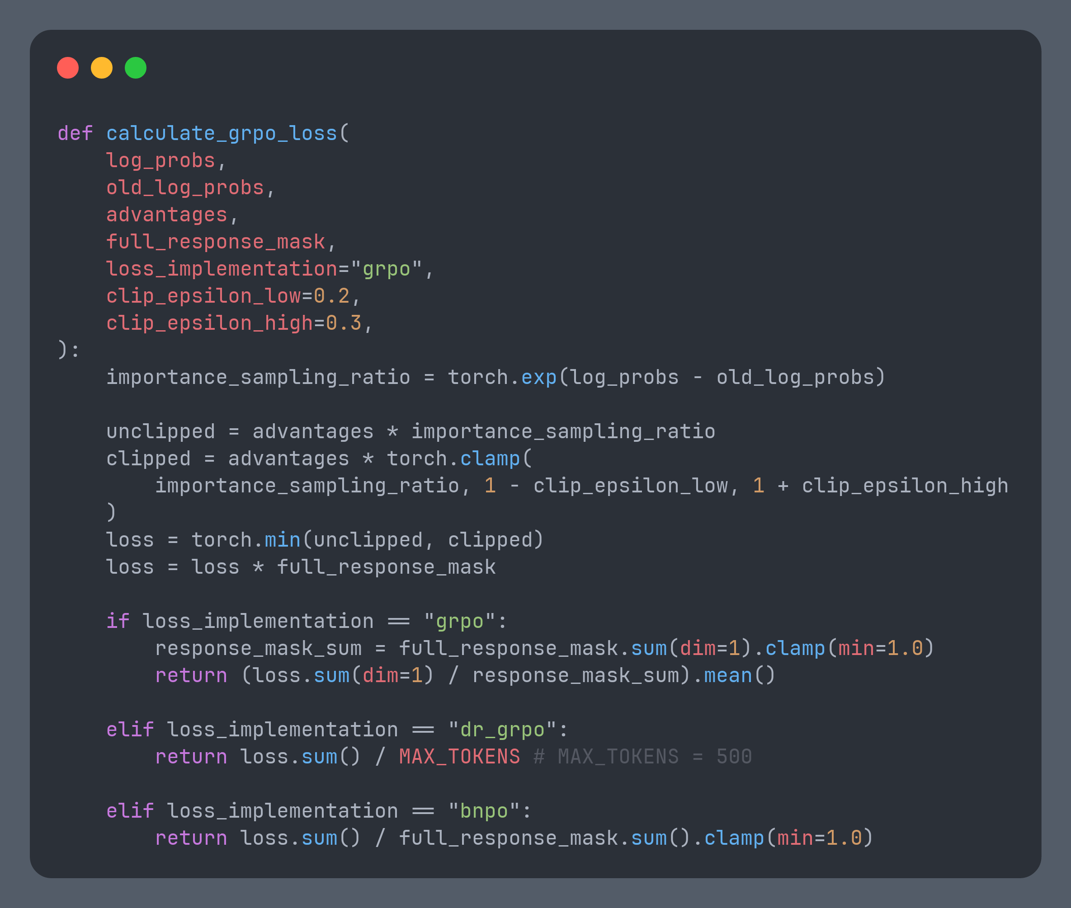
Loss Variants
For many math-style tasks, vanilla GRPO still shines.
Test multiple variants.
Long generation does not equals intelligence

Slide 7
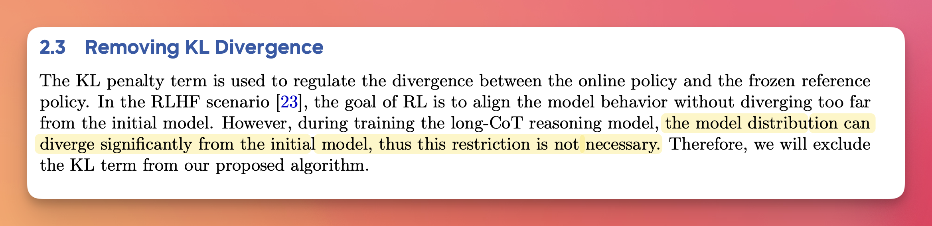
4. The missing KLD Term
The DAPO paper suggests a significant change regarding the Kullback-Leibler divergence (KLD) term used in some RL approaches.
DAPO recommends removing the KLD term from the loss function (as used in the original R1 paper).

Slide 8
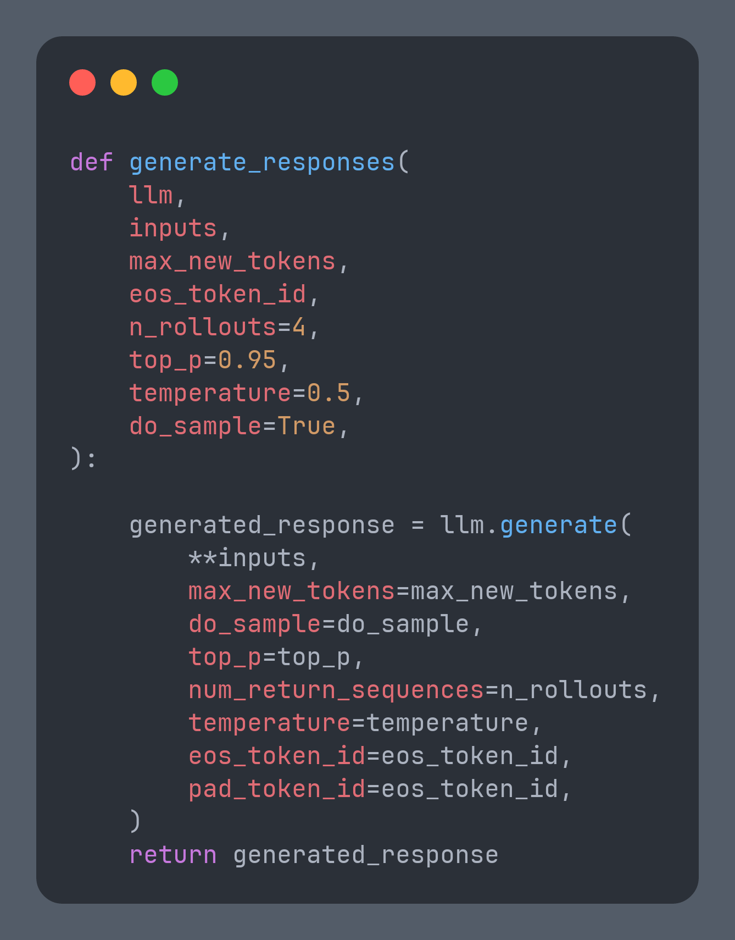
5. Diverse Responses Drive RL
No diversity → no gradient.
Sample at higher temperature.
Generate several answers per question.
Track both reward mean AND standard deviation

Slide 9
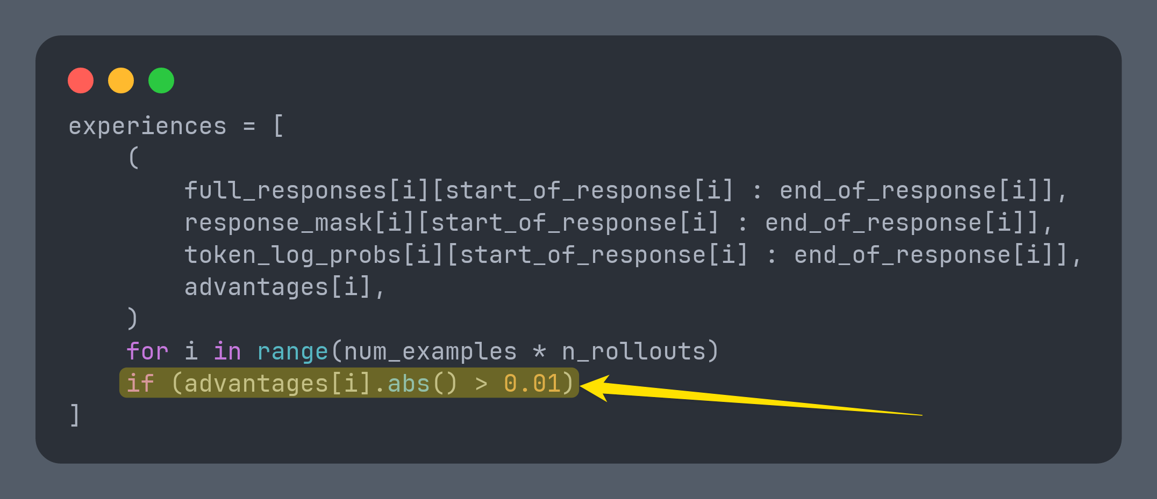
6. Optimizing Experiences & Staying Updated
Refine your training data and keep an eye on the latest research for continuous improvement.
Remove useless examples: Filter out experiences with close to zero advantages (an optimization from DAPO)

Slide 10
7. Balancing Stability and Compute Cost
Certain parameters can enhance training stability, though they might increase computational requirements.
To increase stability (at the cost of compute):
Increase the number of generations per rollout.
Increase the size of the buffer.
Lower the learning rate.

Slide 11
8. Don’t let go of the basics
Small formatting tweaks in SFT datasets may pay huge dividends.
Consistent whitespace around answer tags
Don’t blindly trust sub-word tokenizers
<answer>P</answer>
<answer>
P</
answer>
No whitespace:
<answer>R</answer>
<answer>
R
</ answer>
<answer> P </answer>
<answer>
P
</ answer>
With whitespace:
<answer> R </answer>
<answer>
R
</ answer>

Slide 12
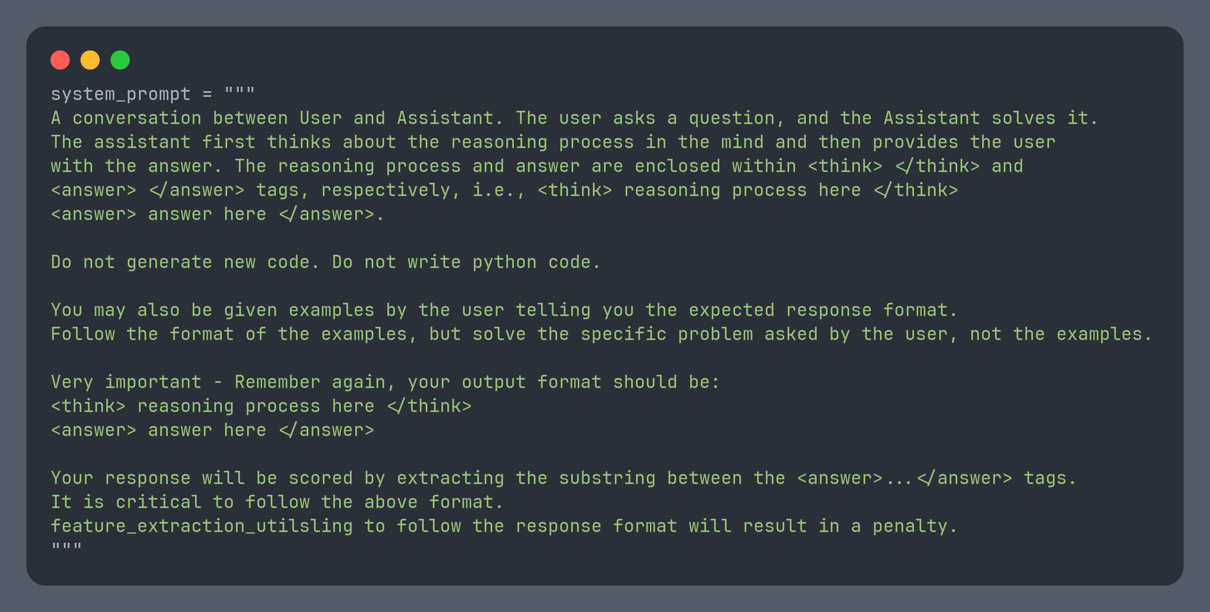
9. Don't Forget the System Prompt!
DeepSeek R1 used a specific system prompt, but you can customize it.
You can include few-shot examples too

Slide 13
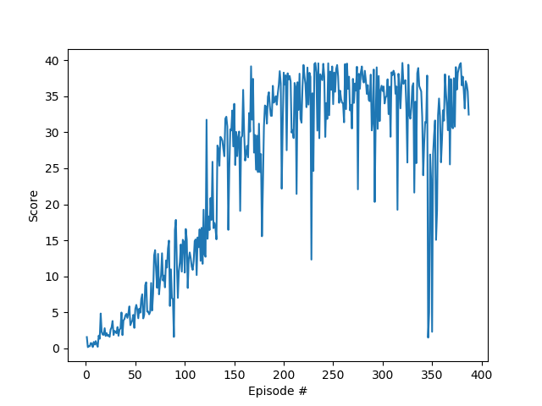
10. Inference and save your model often
As models get better, it starts to see high rewards, leading to muted advantage. Bad hyperparams can cause certain epochs to cause model degradation.

Slide 14
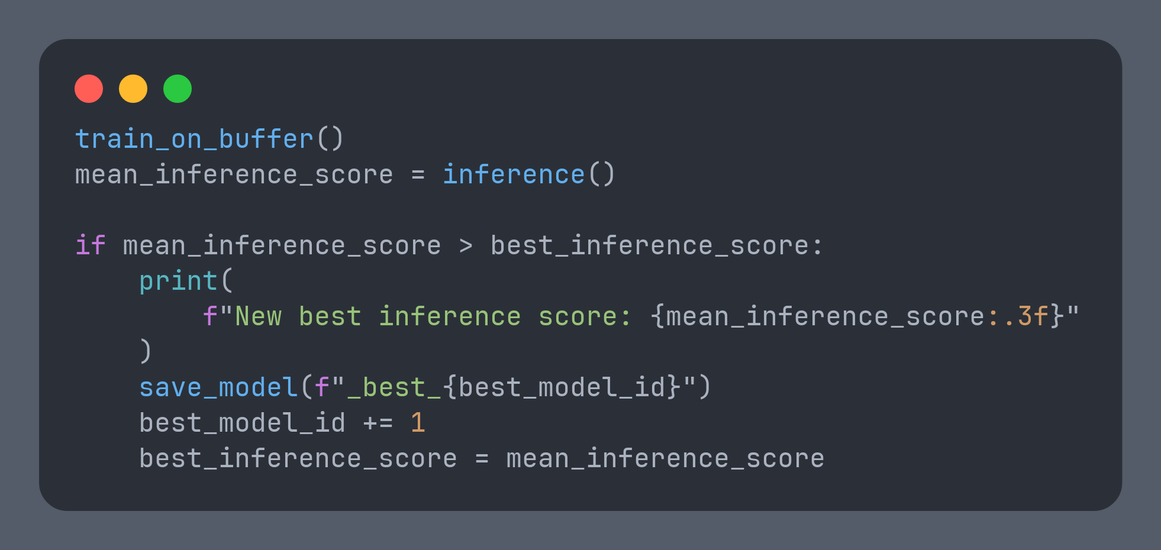
Policy gradients can bite at the finish line.
As rewards rise, advantages shrink; gradients fade.
Checkpoint frequently — capture “best so far.”
You can anneal learning-rate & tighten clipping ratios too.

