Slide 1

INTERNATIONAL INSTITUTE OF INFORMATION TECHNOLOGY, NAYA RAIPUR STATISTICAL DATA ANALYSIS COURSE PROJECT
DIGIT RECONGNITION

Slide 2
GROUP MEMBERS
Abhishek Chaudary - 191020403
Khushi Agrawal - 191020429
Prabhat Kumar – 191020438
Department of DSAI, DSPM IIIT-NR

Slide 3
Table of Content
Objective
Dataset used and description
Project pipeline
Data visualization
SDA ( Statistical data analysis )
Hypothesis testing
Dimensionality reduction
Data classification
Department of DSAI, DSPM IIIT-NR

Slide 4
OBJECTIVE
Recognizing the digits in the range [0 – 9] from a huge dataset of images of handwritten digits .
Predicting labels for test dataset
Perform Statistical Data Analysis.
Create Visualization.
Perform Dimensionality Reduction - SVD, PCA and LDA.
Perform Classification on data using Decision Trees.
Department of DSAI, DSPM IIIT-NR

Slide 5
DATASET USED
NAME : Digit recognizer
ROWS = 42,000 (training dataset) AND 28,000 (testing data)
COLUMNS = 785 (training dataset) AND 784 (testing dataset)
Data Description
The data files train.csv and test.csv contain gray-scale images of hand-drawn digits, from zero through nine.
Each image is 28 pixels in height and 28 pixels in width, for a total of 784 pixels in total. Each pixel has a single pixel-value associated with it, indicating the lightness or darkness of that pixel, with higher numbers meaning darker. This pixel-value is an integer between 0 and 255 (hue value), inclusive.
Department of DSAI, DSPM IIIT-NR

Slide 6
THE PROJECT PIPELINE
DATA DESCRIPTION / VISUALIZATION
Getting to know our dataset using the “df.describe()” method for data frame .
Visualizing the data in different manners .
SDA ( Statistical data analysis )
Location estimation , Variability estimation , Percentile based estimation.
Exploring the binary and categorical data and finding the correlation.
HYPOTHESIS TESTING AND DIMENSIONALITY REDUCTION
Student’s T – testing.
Dimensionality reduction using PCA , SVD and LDA.
CLASSIFICATION
Decision tree
Department of DSAI, DSPM IIIT-NR

Slide 7

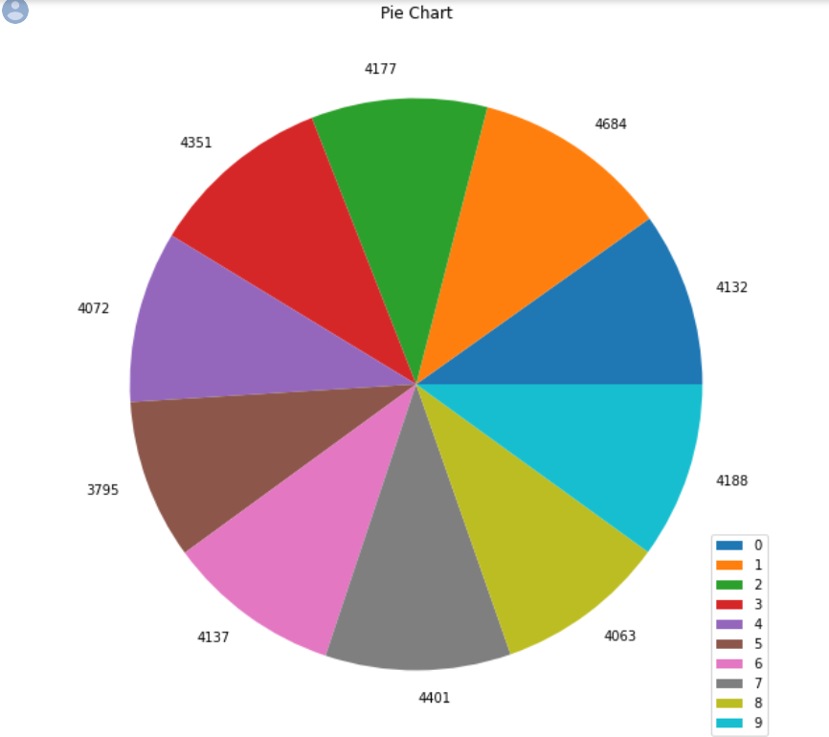
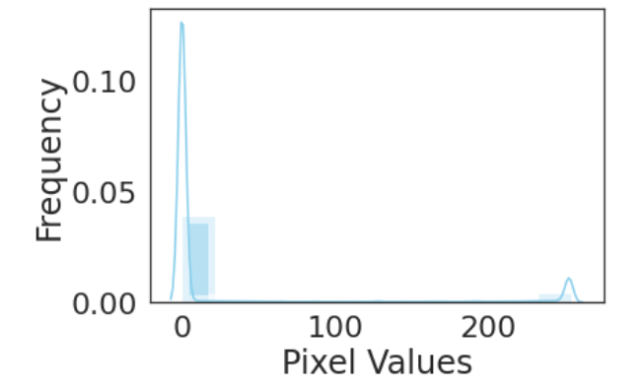
DATA VISUALISATION
PIE CHART
Pie chart is helpful in describing how one group count is relative to another in the dataset.
The data was grouped by “ dataframe.groupby() “ .
INTENSITY PLOT
The intensity plot gave an idea of all the pixel value frequencies in the entire dataset.
As the images have black background and some hint of grey around the white digits, most of the intensity is near 0 and very small peak at 255 which is white . Thus, verified.
Fig-1: Pie chart
Fig-2: Freq. of various pixels
Department of DSAI, DSPM IIIT-NR

Slide 8
SDA ( STATISTICAL DATA ANALYSIS )
LOCATION ESTIMATION
To find `typical` or `central` value that best describes the data.
Mean = 32.95 or 33 (approx.)
Trimmed mean = 10.62
Median = 127.5
ESTIMATES OF VARIABILITY
It measures whether data values are `Tightly Clustered` or `Spread`.
Mean absolute deviation (row ,dev) = (21,54.18096326 ) to (41998 ,54.998217)
Variance = [6481.95, 9632.64, … , 6621.29, 7029.26]
Std. Deviation = [80.51, 98.14 ... 81.37, 83.84]
Department of DSAI, DSPM IIIT-NR

Slide 9




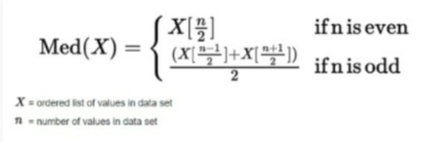

FORMULAS USED
LOCATION ESTIMATES
VARIABILITY ESTIMATES
1.
1.
2.
2.
3.
3.
Department of DSAI, DSPM IIIT-NR

Slide 10


SDA ( STATISTICAL DATA ANALYSIS
ESTIMATES BASED ON PERCENTILES
Range = 0 – 255 (black – white)
Percentile = None
IQR (Interquartile range) = *Refer colab file*
Where,
Department of DSAI, DSPM IIIT-NR

Slide 11
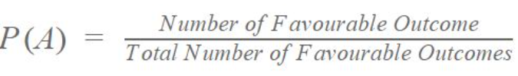
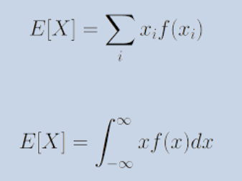
SDA ( STATISTICAL DATA ANALYSIS )
BINARY AND CATEGORICAL DATA
Mode (digit, mode) = (0, 3795) to (9, 4684)
Probability of each digit = *Refer colab file*
Expected value (Total) = 4212.04
Department of DSAI, DSPM IIIT-NR

Slide 12
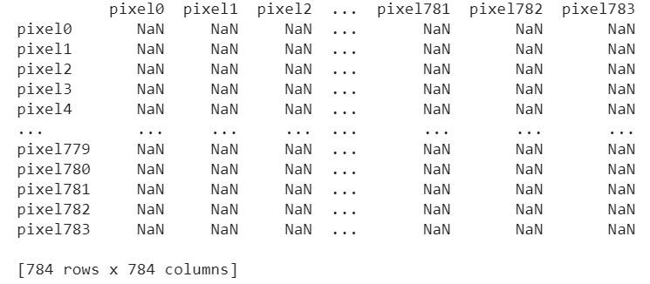
SDA ( STATISTICAL DATA ANALYSIS
CORRELATION ESTIMATE
It is the measure which is used to know how similar the two variables are.
Correlation matrix :-
Department of DSAI, DSPM IIIT-NR

Slide 13
HYPOTHESIS TESTING
We performed the t-test on our dataset.
IMPORTANT DEFININTIONS :-
T-test : The T-test compares two means and tells us if they are different from each other. It tells whether two samples have been drawn from same sample or not. It tells how significant our result is, more specifically it tells whether it happened by chance or not.
T-value and deg. of freedom : T-Value is the ratio of the difference between the mean of the two sample sets and the variation that exists within the sample sets and Degree Of Freedom are the values that has a freedom to vary.
Department of DSAI, DSPM IIIT-NR

Slide 14
HYPOTHESIS TESTING
Z-score / Normalization : The process of putting different variables to a same scale is known as normalization. It allows us to compare scores between different types of variables. z-score tells the overall data lies compared to overall population. The formula for the same is given as :-
Significance level OR α : It is a probability of rejecting the null hypothesis when it is true.
P-value : The probability that the results from our sample data occurred by chance is known as p-value. If the observed p-value is less than alpha, then the results are statistically significant.
Department of DSAI, DSPM IIIT-NR

Slide 15

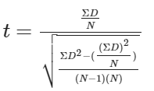
HYPOTHESIS TESTING
Student’s t-test : Sample’s in this are Independent. Sample's drawn from the Gaussian Distribution have same size and variance but with different mean. Value(s) of one sample does not have any effect to values of other sample. Formula of this is given as :-
Paired Student’s t-test : Sample's are Dependent. They may be from same population. Samples are drawn from the gaussion distribution with unequal variances. Values of one sample effect the values of other sample. Formula for the same is given as :-
Department of DSAI, DSPM IIIT-NR

Slide 16
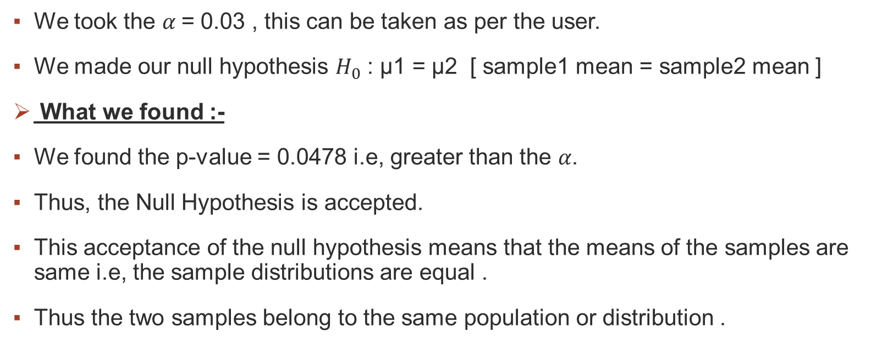
WHAT WE DID
We took the $α$= 0.03 , this can be taken as per the user.
We made our null hypothesis $H_{0}$ : µ1 = µ2 [ sample1 mean = sample2 mean ]
What we found :-
We found the p-value = 0.0478 i.e, greater than the 𝛼.
Thus, the Null Hypothesis is accepted.
This acceptance of the null hypothesis means that the means of the samples are same i.e, the sample distributions are equal .
Thus the two samples belong to the same population or distribution .
Department of DSAI, DSPM IIIT-NR

Slide 17
DIMENSIONALITY REDUCTION
The process of obtaining a set of principle variables and by reducing the number of random variables is known as Dimensionality Reduction.
It can be done in two ways namely “Feature selection” and “Feature Extraction”.
We performed three major dimensionality reduction methods which goes by the name of PCA , SVD and LDA .
The data is visualized and plotted for each of them.
Department of DSAI, DSPM IIIT-NR

Slide 18
PCA ( PRINCIPAL COMPONENT ANALYSIS )
The extraction of new set of variables from the existing set of variables in known as Principal Component Analysis and the newly extracted variables is known as Principal Components.
Principal components are the linear combination of the original variables.
First component explains maximum variance in dataset.
The second component tries to explain the rest variance in the dataset and is uncorrelated to the first component.
Third component explains which is not covered in the first two.
Department of DSAI, DSPM IIIT-NR

Slide 19
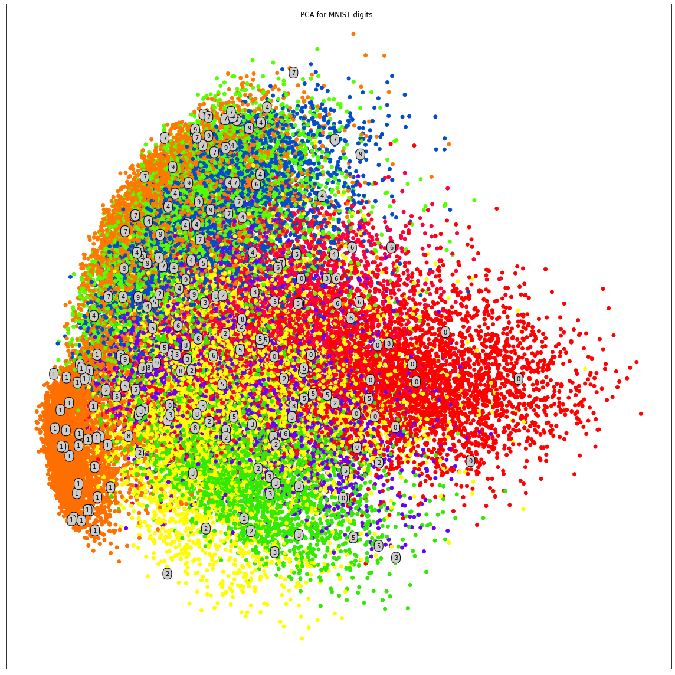
PCA VISUALIZATION
Fig-3 : The Output plot of PCA
Department of DSAI, DSPM IIIT-NR

Slide 20


SVD ( SINGULAR VALUE DECOMPOSITION )
Any rectangular matrix A can be decomposed into three matrices of particular shapes and characteristics: .
U and V are orthogonal matrices.
$Σ$ is a diagonal matrix containing the singular values of A, which can be positive, zero, or negative.
Department of DSAI, DSPM IIIT-NR

Slide 21
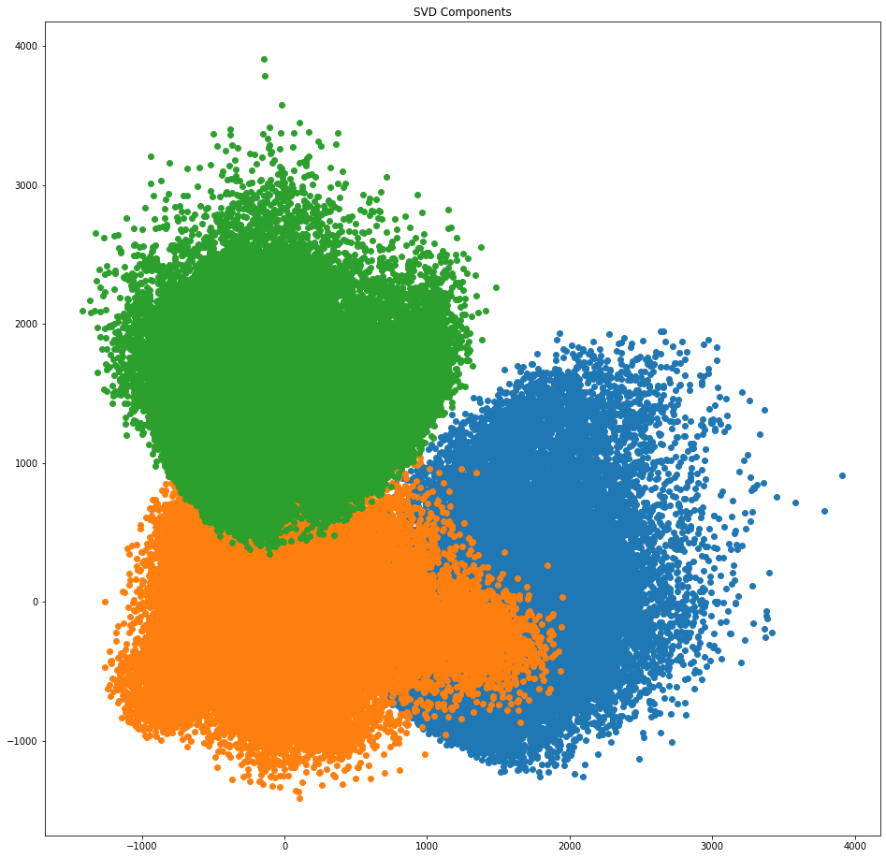
SVD VISUALIZATION
Fig-4 : The SVD plot
Department of DSAI, DSPM IIIT-NR

Slide 22
LDA ( LINEAR DISCRIMINANT ANALYSIS )
LDA is a dimensionality reduction technique used for data preprocessing.
LDA is used to find the axes that maximize the separation between multiple classes instead PCA is used to find the component axes that maximize the variance of our data.
Department of DSAI, DSPM IIIT-NR

Slide 23
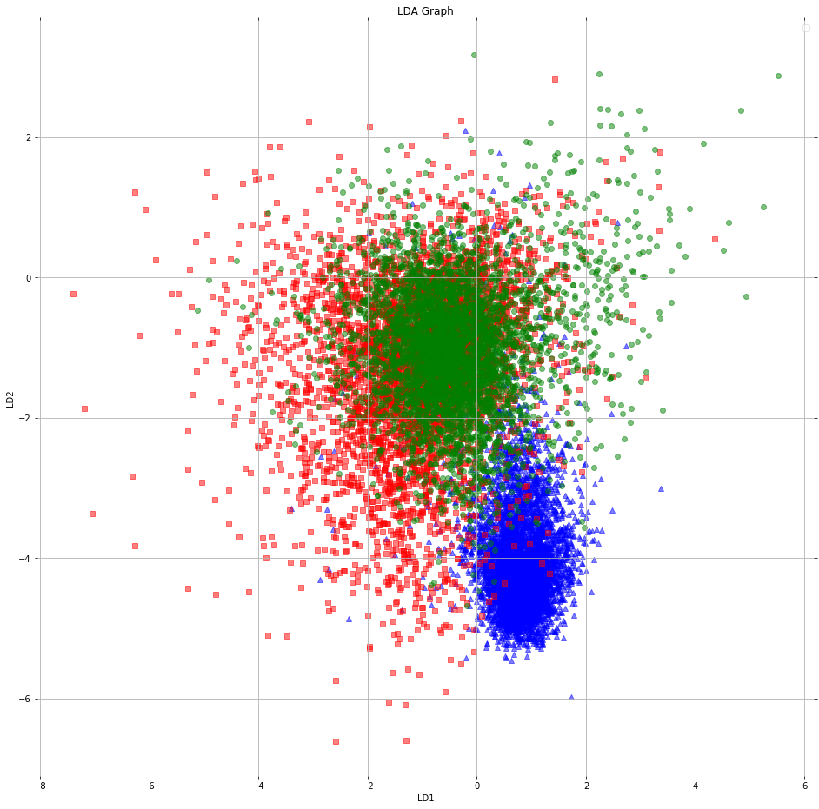
LDA VISUALIZATION
Fig-5 : The LDA plot
Department of DSAI, DSPM IIIT-NR

Slide 24
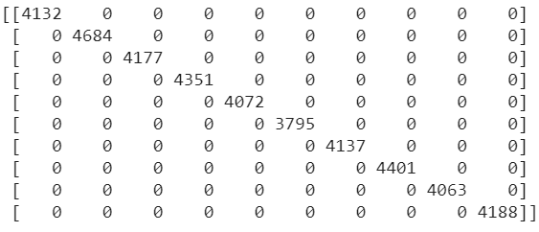
CLASSICATION OF THE DATA
In this project we were asked to use the Decision tree in the classification process of the dataset we choose.
We plotted the graph using three methods plot_tree() , graphviz() and dtreeviz().
Training evaluation of the model :-
Confusion matrix :
Department of DSAI, DSPM IIIT-NR

Slide 25

CLASSIFICATION OF THE DATA
NOTE : We have used the training data to generate labels for our testing dataset.
Accuracy : 20.99%
Error :
Inference from this data :-
The accuracy is very poor which hints that Decision Tree classification for this dataset is not suitable at all .
The model is over fitted as all the errors are zero.
The confusion matrix is a diagonal matrix which shows that the model made no errors in classifying the “wrong rights” and the “right wrongs” . Thus , proving the model fit is not suitable at all.
Department of DSAI, DSPM IIIT-NR

Slide 26
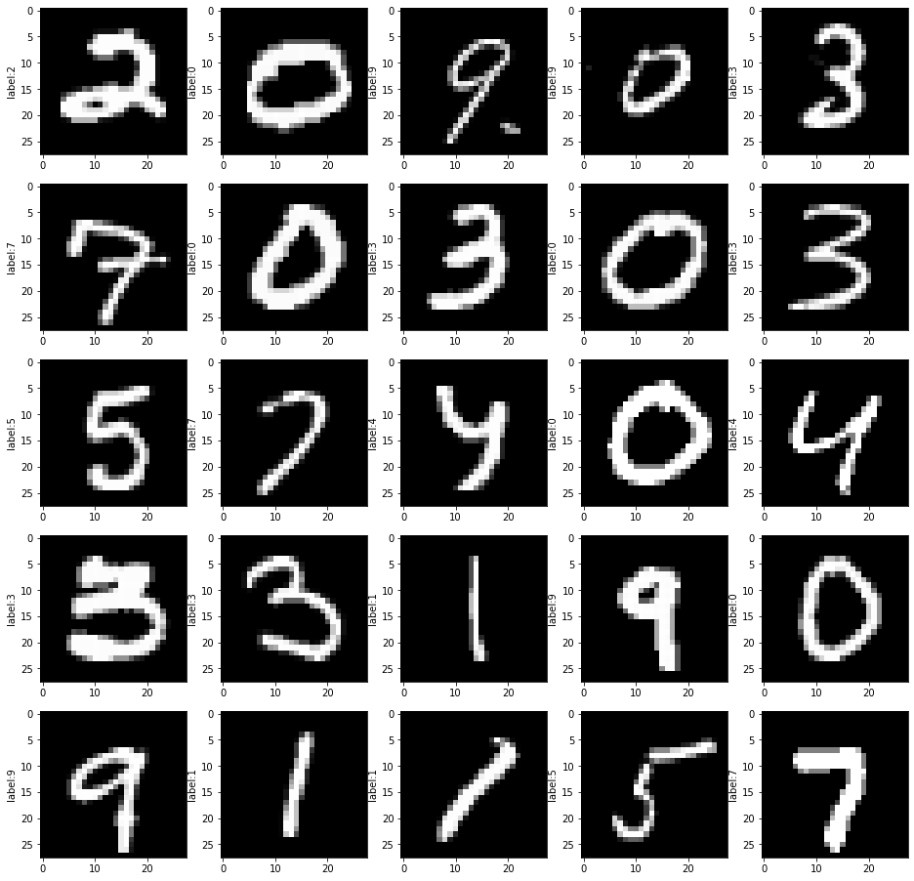
THE DECISION TREE VISUALIZATION
Testing evaluation of the model :-
Accuracy = This dataset is basically not for decision tree classification. So we got very overfitted results as all the errors equal to zero with very less accuracy.
REMARKS :-
The 4th entry of 1st row is incorrect [ 0 labelled 9 ]
The model is highly over fitted .
Accuracy is very poor .
Fig-6 : The output of the testing model
Department of DSAI, DSPM IIIT-NR

Slide 27
CONCLUSION
The dataset we chose was a highly non linear data.
The Decision Tree classification did not proved to be even a good classifier for this model .
How can we solve the issue ?
We instead of using the decision tree for the classification of this dataset might want to use the KNN , CNN or Random forest.
Department of DSAI, DSPM IIIT-NR

Slide 28
THANK YOU

