Slide 1

Movie Dashboard
Analysis
Muhammad Ali Zaib
SU92-BSDSM-F22-009 | Section 8A | Data Science
Built with Power BI Desktop

Slide 2


Project Overview
Objective
Tools and Approach
To analyze movie industry trends across Bollywood and Hollywood by building an interactive Power BI dashboard that explores revenue, budget, profit, actor performance, and language distribution.
Tool: Power BI Desktop
Data: Self-created dataset from mixed sources with custom edits
Pages: 6 interactive dashboard pages
Focus: Revenue, budget, profit, actors, industry, and language analysis
Dashboard Pages
1
2
3
4
5
Main Dashboard
Actor Analysis
Financial Analysis
Industry Analysis
Language Analysis
KPIs, top movies, revenue trends
Movies and revenue by actor
Budget vs revenue, ROI, profit
Bollywood vs Hollywood trends
Movies and revenue by language

Slide 3

About the Dataset
Data was collected from multiple online sources and then cleaned, merged, and customized to fit the analysis requirements.
movies
movie_id, title, industry, studio, language_id, year
financials
movie_id, budget_in_usd, revenue_in_usd
actors
actor_id, name (+ calculated measures: Profit, ROI, Avg Rating)
movie_actor
movie_id, actor_id (bridge table)
languages
language_id, name
The dataset also includes DAX calculated measures such as Total Profit, ROI, Budget Category, Year Group, and actor-level aggregations.

Slide 4
Data Model
Table Relationships (Star Schema)
financials
budget_in_usd, revenue_in_usd
movie_actor
languages
movies
movie_id, actor_id
language_id, name
movie_id, title, industry,
studio, language_id, year
actors
actor_id, name + measures
Dashed lines indicate table relationships through shared keys (movie_id, actor_id, language_id).
Key Calculated Measures: Total Profit | ROI | Avg Rating | Budget Category | Year Group | Actor Revenue | Profit By Actor | Total Movies By Actor

Slide 5
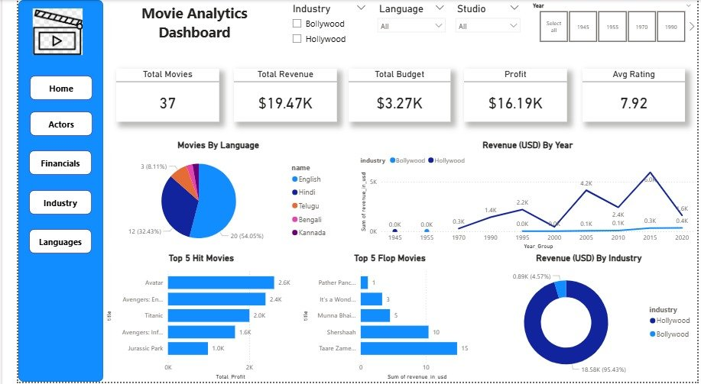
Main Dashboard
What this page shows:
KPI Cards: Total Movies, Revenue, Budget, Profit, Avg Rating
Charts: Revenue by Year (line), Top 5 Hit/Flop Movies (bar), Movies by Language (pie), Revenue by Industry (donut)
Filters: Industry, Language, Studio, Year Group slicers for interactive filtering

Slide 6
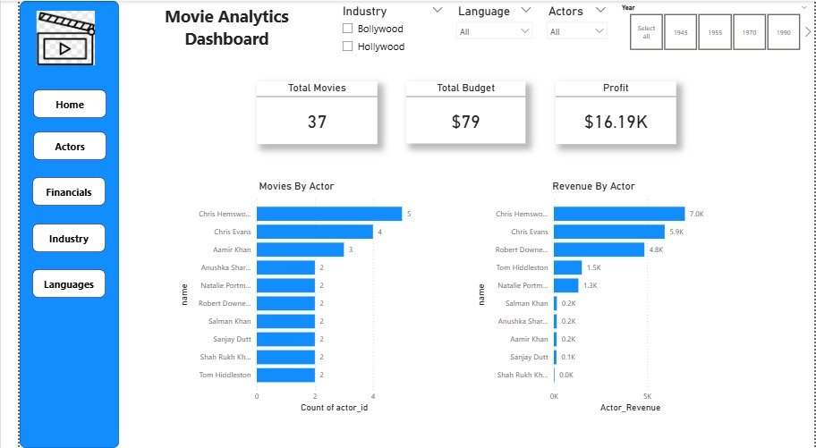
Actor Analysis
What this page shows:
Movies By Actor: Bar chart showing movie count per actor
Revenue By Actor: Bar chart showing total revenue generated by each actor
KPIs: Total Movies, Total Budget, Profit at actor level with actor name slicer

Slide 7
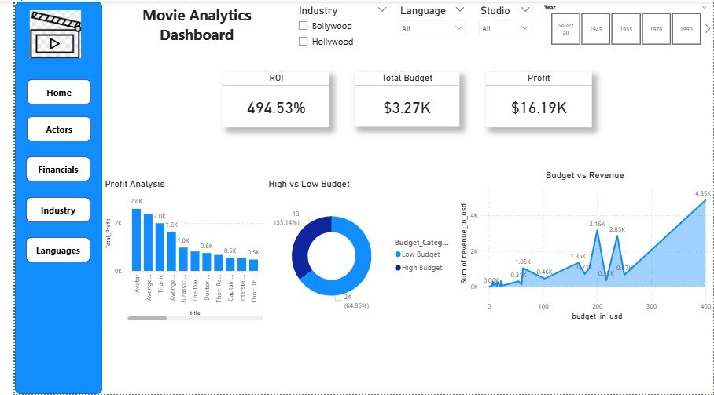
Financial Analysis
What this page shows:
Budget vs Revenue: Stacked area chart comparing spending and earnings
Profit Analysis: Column chart showing profit by movie title
High vs Low Budget: Donut chart splitting movies by budget category. KPIs include ROI, Total Budget, and Profit.

Slide 8
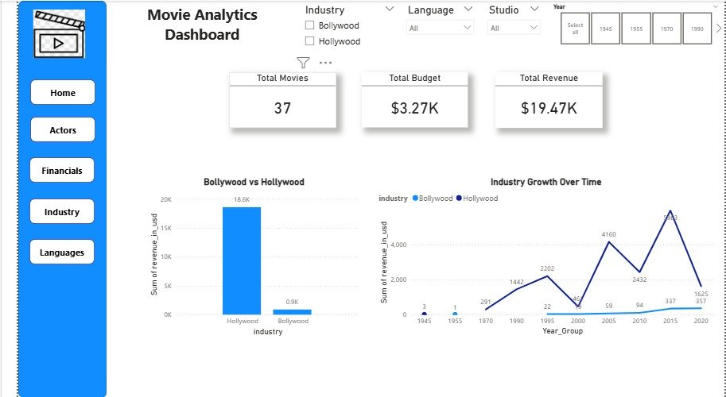
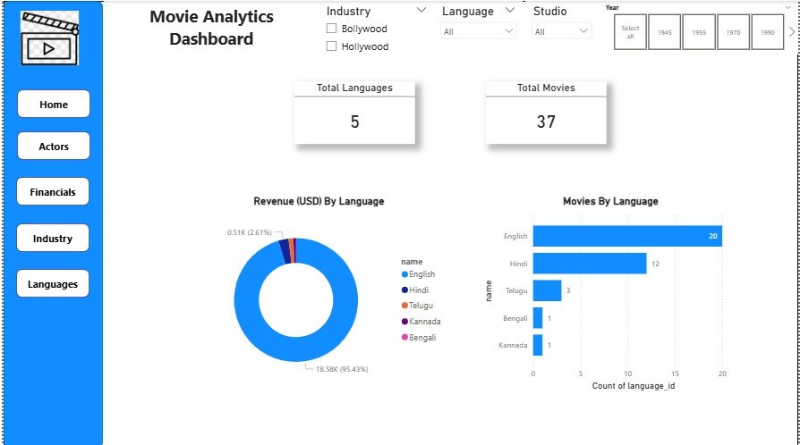


Industry and Language Analysis
Industry Analysis
Language Analysis
Bollywood vs Hollywood revenue comparison (column chart)
Industry growth over time by year (line chart with series)
Revenue distribution by language (donut chart)
Movie count by language (bar chart)

Slide 9

Key Findings
Insights from the Dashboard Analysis
Revenue Dominance
Actor Impact
Hollywood generates significantly higher total revenue compared to Bollywood, driven by larger budgets and global distribution.
Certain actors consistently appear in high-revenue films, showing a strong correlation between star power and box office performance.
Budget vs Profit
Language Distribution
Higher budgets do not always guarantee higher profits. Several low-budget Bollywood films outperform high-budget Hollywood movies in terms of ROI.
English and Hindi dominate the movie count and revenue, while other languages show niche but growing market presence.
Top Performers
Industry Growth
A small number of blockbuster movies contribute the majority of total revenue, while many movies underperform relative to their budgets.
Both industries show revenue growth over time, with notable spikes in specific years tied to major blockbuster releases.

Slide 10
Thank You
Questions and Discussion
Muhammad Ali Zaib
SU92-BSDSM-F22-009 | Section 8A | Data Science

