Slide 1
Functional Dependencies and Normalization
R&G Chapter 19
Lectures 25 & 26
Science is the knowledge of consequences, and dependence of one fact upon another.
Thomas Hobbes
(1588-1679)

Slide 2
Administrivia
Homework 5 available by Thursday
Final exam 4 weeks from tomorrow

Slide 3
Review: Database Design
Requirements Analysis
  user needs; what must database do?
Conceptual Design
  high level descr (often done w/ER model)
Logical Design
  translate ER into DBMS data model
Schema Refinement
  consistency,normalization
Physical Design - indexes, disk layout
Security Design - who accesses what

Slide 4
Database Design Question:
When modelling the real world in a database, what is the combination of relations and attributes?
Want to find a design that is efficient, and correct.

Slide 5
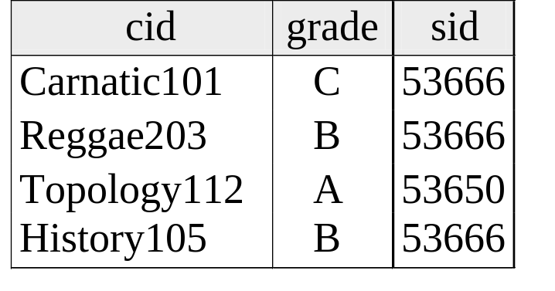
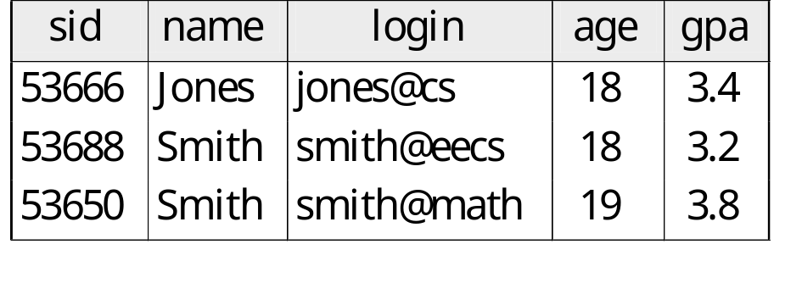
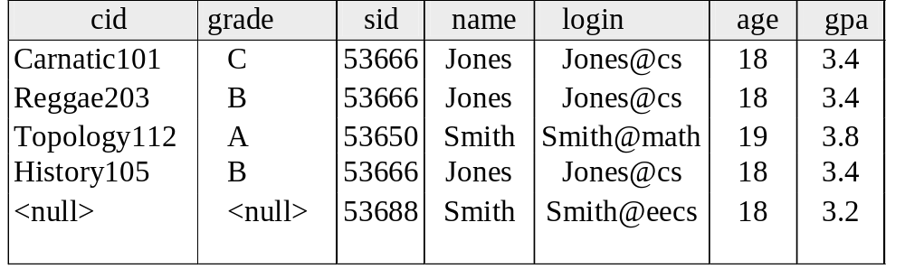
Schema Refinement
In other words, what columns go in what tables/entities?
Enrolled
Students

Slide 6
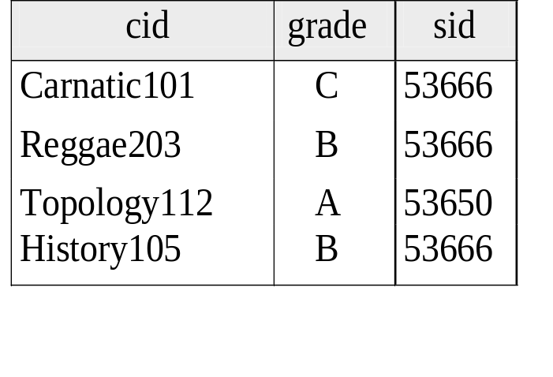
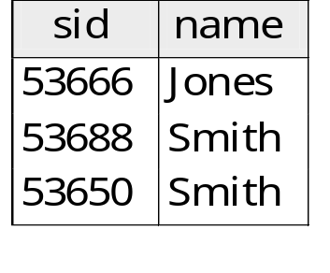
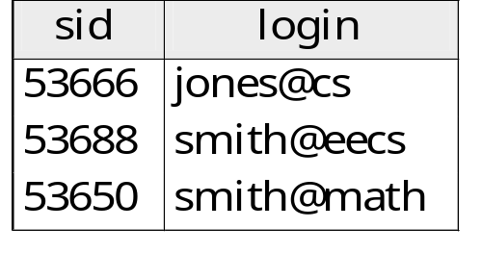

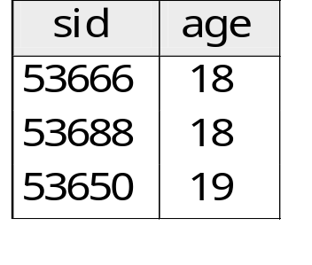
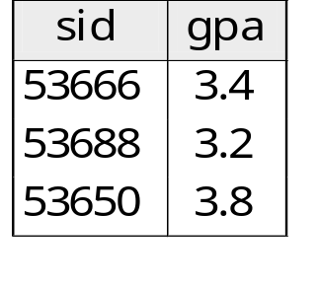
Schema Refinement 2
In other words, what columns go in what tables/entities?
Enrolled
Students

Slide 7
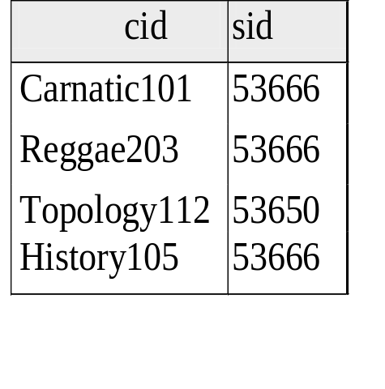
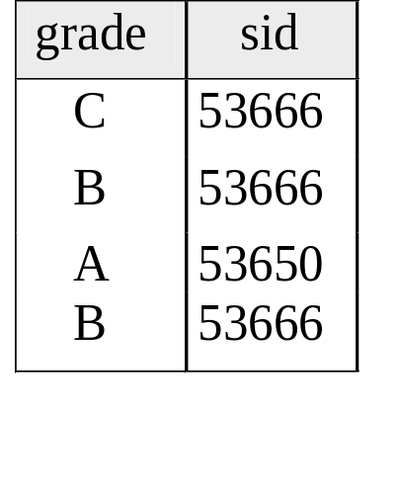
Schema Refinement 3
In other words, what columns go in what tables?
Enrolled
Students

Slide 8
Design Tradeoffs
Too few relations -> redundancy
Too many relations -> inefficiency
Way too many relations -> loss of information

Slide 9
Problems of Redundancy
Redundancy is at the root of several problems associated with relational schemas:
  redundant storage, insert/delete/update anomalies
functional dependencies can be used to identify schemas with such problems and to suggest refinements.
Main refinement technique: decomposition
  replacing ABCD with, say, AB and BCD, or ACD and ABD.
Decomposition should be used judiciously:
  Is there reason to decompose a relation?
  What problems (if any) does the decomposition cause?

Slide 10
But...
In avoiding redundancy, don’t lose data!

Slide 11
Functional Dependencies (FDs)
A functional dependency X → Y holds over relation schema R if, for every allowable instance r of R:
  t1 ∈ r, t2 ∈ r, π_{X} (t1) = π_{X} (t2)
  implies π_{Y} (t1) = π_{Y} (t2)
  (where t1 and t2 are tuples;X and Y are sets of attributes)
In other words: X → Y means
  Given any two tuples in r, if the X values are the same, then the Y values must also be the same. (but not vice versa)
Can read “→” as “determines”

Slide 12
FD’s Continued
An FD is a statement about all allowable relations.
  Must be identified based on semantics of application.
  Given some instance r1 of R, we can check if r1 violates some FD f, but we cannot determine if f holds over R.
Question: How related to keys?
if “K → all attributes of R” then K is a superkey for R
  (does not require K to be minimal.)
FDs are a generalization of keys.

Slide 13
Example: Constraints on Entity Set
Consider relation obtained from Hourly_Emps:
Hourly_Emps (ssn, name, lot, rating, wage_per_hr, hrs_per_wk)
We sometimes denote a relation schema by listing the attributes: e.g., SNLRWH
This is really the set of attributes {S,N,L,R,W,H}.
Sometimes, we refer to the set of all attributes of a relation by using the relation name. e.g., “Hourly_Emps” for SNLRWH
What are some FDs on Hourly_Emps?
  ssn is the key: S → SNLRWH
  rating determines wage_per_hr: R → W
  lot determines lot: L → L (“trivial” dependnency)

Slide 14
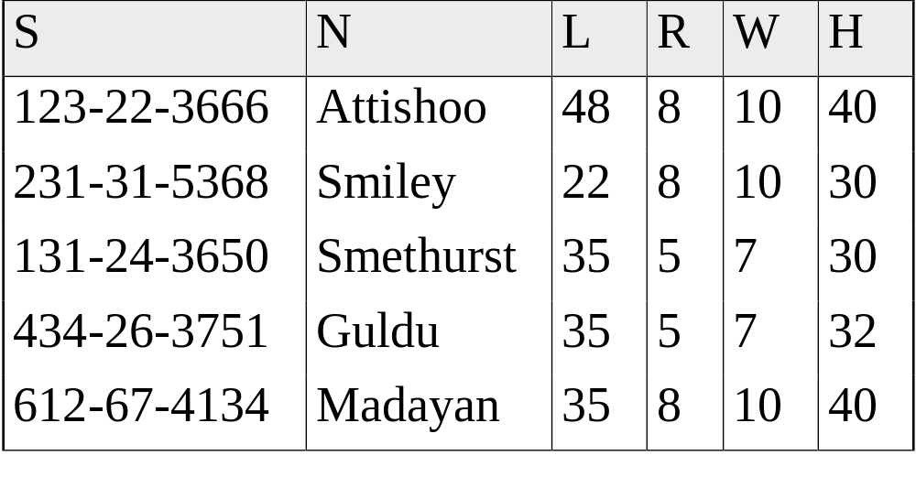
Problems Due to R → W
Hourly_Emps
Update anomaly: Can we modify W in only the 1st tuple of SNLRWH?
Insertion anomaly: What if we want to insert an employee and don’t know the hourly wage for his or her rating? (or we get it wrong?)
Deletion anomaly: If we delete all employees with rating 5, we lose the information about the wage for rating 5!

Slide 15
Detecting Reduncancy
Hourly_Emps
Q: Why was R → W problematic, but S →W not?

Slide 16
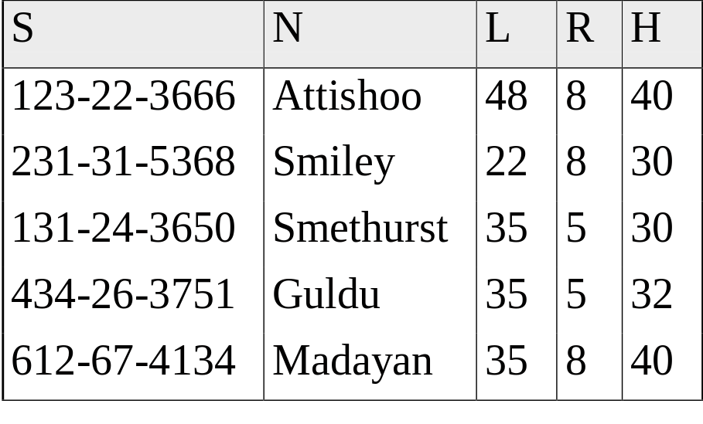
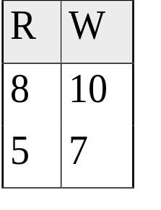
Decomposing a Relation
Redundancy can be removed by “chopping” the relation into pieces.
FD’s are used to drive this process.
  R → W is causing the problems, so decompose SNLRWH into what relations?
Wages
Hourly_Emps2

Slide 17
Refining an ER Diagram
1st diagram becomes: Workers(S,N,L,D,Si) Departments(D,M,B)
  Lots associated with workers.
Suppose all workers in a dept are assigned the same lot: D → L
Redundancy; fixed by: Workers2(S,N,D,Si) Dept_Lots(D,L) Departments(D,M,B)
Can fine-tune this: Workers2(S,N,D,Si) Departments(D,M,B,L)
Before:
since
name
dname
ssn
lot
did
budget
Employees
Works_In
Departments
After:
budget
since
name
dname
ssn
did
lot
Employees
Works_In
Departments

Slide 18
Reasoning About FDs
Given some FDs, we can usually infer additional FDs:
  title → studio, star implies title → studio and title → star
  title → studio and title → star implies title → studio, star
  title → studio, studio → star implies title → star
  But,
  title, star → studio does NOT necessarily imply that title → studio or that star → studio
An FD f is implied by a set of FDs F if f holds whenever all FDs in F hold.
F⁺ = closure of F is the set of all FDs that are implied by F. (includes “trivial dependencies”)

Slide 19
Rules of Inference
Armstrong’s Axioms (X, Y, Z are sets of attributes):
  Reflexivity: If X ⊇ Y, then X → Y
  Augmentation: If X → Y, then XZ → YZ for any Z
  Transitivity: If X → Y and Y → Z, then X → Z
These are sound and complete inference rules for FDs!
  i.e., using AA you can compute all the FDs in F+ and only these FDs.
Some additional rules (that follow from AA):
  Union: If X → Y and X → Z, then X → YZ
  Decomposition: If X → YZ, then X → Y and X → Z
Notes:
UNION: X->Y, XX->XY (Aug), so X->XY. XY->YZ (Aug) so X->YZ (Trans)
DECOMP: X->YZ, YZ->Y (Reflex), so X->Y (Trans). Similar for X->Z.

Slide 20
Example
Contracts(cid,sid,jid,did,pid,qty,value), and:
  C is the key: C → CSJDPQV
  Proj purchases each part using single contract: JP → C
  Dept purchases at most 1 part from a supplier: SD → P
Problem: Prove that SDJ is a key for Contracts
JP → C, C → CSJDPQV imply JP → CSJDPQV
  (by transitivity) (shows that JP is a key)
SD → P implies SDJ → JP (by augmentation)
SDJ → JP, JP → CSJDPQV imply SDJ → CSJDPQV
(by transitivity) thus SDJ is a key.
Q: can you now infer that SD → CSDPQV (i.e., drop J on both sides)?
No! FD inference is not like arithmetic multiplication.

Slide 21
Attribute Closure
Computing the closure of a set of FDs can be expensive. (Size of closure is exponential in # attrs!)
Typically, we just want to check if a given FD X → Y is in the closure of a set of FDs F. An efficient check:
  Compute attribute closure of X (denoted X⁺) wrt F. X⁺ = Set of all attributes A such that X → A is in F⁺
    X⁺ := X
    Repeat until no change: if there is an fd U → V in F such that U is in X⁺, then add V to X⁺
  Check if Y is in X⁺
  Approach can also be used to find the keys of a relation.
    If all attributes of R are in the closure of X then X is a superkey for R.
    Q: How to check if X is a “candidate key”?

Slide 22
Attribute Closure (example)
R = {A, B, C, D, E}
F = { B →CD, D → E, B → A, E → C, AD →B }
Is B → E in F⁺ ?
B⁺ = B
  B⁺ = BCD
  B⁺ = BCDA
  B⁺ = BCDAE … Yes! and B is a key for R too!
Is D a key for R?
  D⁺ = D
  D⁺ = DE
  D⁺ = DEC
  … Nope!
Is AD a key for R? AD⁺ = AD
AD⁺ = ABD and B is a key, so Yes!
Is AD a candidate key for R?
  A⁺ = A, D+ = DEC
  … A,D not keys, so Yes!
Is ADE a candidate key for R?
… No! AD is a key, so ADE is a superkey, but not a cand. key

Slide 23
Exercise

Slide 24
Next…
Normal forms and normalization
Table decompositions

Slide 25
Normal Forms
Q1: when is any refinement needed??!
A: If relation is in a normal form (BCNF, 3NF etc.):
  we know that certain problems are avoided/minimized.
  helps decide whether decomposing a relation is useful.
Role of FDs in detecting redundancy:
  Consider a relation R with 3 attributes, ABC.
    No (non-trivial) FDs hold: There is no redundancy here.
    Given A → B: If A is not a key, then several tuples could have the same A value, and if so, they’ll all have the same B value!
1st Normal Form – all attributes are atomic
1st ⊃2nd (of historical interest) ⊃ 3rd ⊃ Boyce-Codd ⊃ …

Slide 26
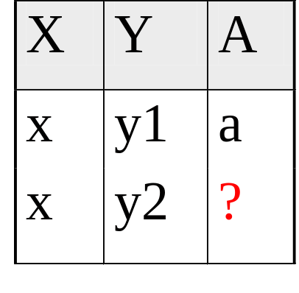
Boyce-Codd Normal Form (BCNF)
Reln R with FDs F is in BCNF if, for all X → A in F⁺
  A ∈ X (called a trivial FD), or
  X is a superkey for R.
In other words: “R is in BCNF if the only non-trivial FDs over R are key constraints.”
If R in BCNF, then every field of every tuple records information that cannot be inferred using FDs alone.
  Say we know FD X → A holds this example relation:
Can you guess the value of the missing attribute?
Yes, so relation is not in BCNF

Slide 27
Decomposition of a Relation Schema
If a relation is not in a desired normal form, it can be decomposed into multiple relations that each are in that normal form.
Suppose that relation R contains attributes A1 ... An. A decomposition of R consists of replacing R by two or more relations such that:
  Each new relation scheme contains a subset of the attributes of R, and
  Every attribute of R appears as an attribute of at least one of the new relations.

Slide 28
Example (same as before)
Hourly_Emps
SNLRWH has FDs S → SNLRWH and R → W
Q: Is this relation in BCNF?
No, The second FD causes a violation; W values repeatedly associated with R values.

Slide 29
Decomposing a Relation
Easiest fix is to create a relation RW to store these associations, and to remove W from the main schema:
Wages
Hourly_Emps2
Q: Are both of these relations are now in BCNF?
Decompositions should be used only when needed.
  Q: potential problems of decomposition?

Slide 30
Problems with Decompositions
There are three potential problems to consider:
  1) Lossiness: impossible to reconstruct the original relation!
    Fortunately, not in the SNLRWH example.
  2) Dependency checking may require joins.
    Fortunately, not in the SNLRWH example.
  3) Some queries become more expensive.
    e.g., How much does Guldu earn?
    Tradeoff: Must consider these issues vs. redundancy.

Slide 31

Lossless Decomposition (example)
=

Slide 32
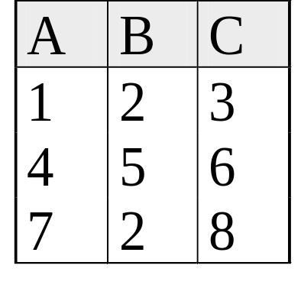
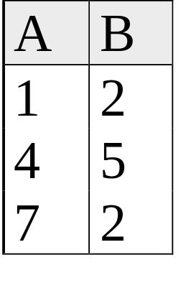
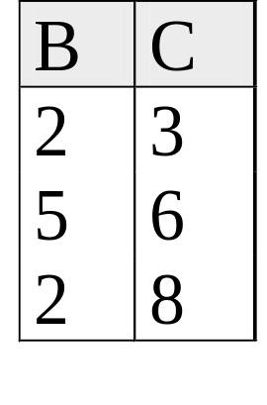
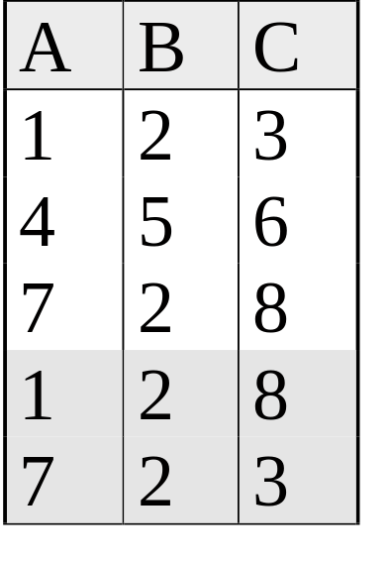
Lossy Decomposition (example)
A → B; C → B
=

Slide 33
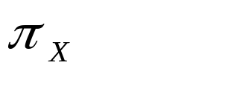
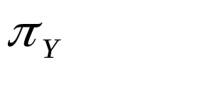

Lossless Join Decompositions
Decomposition of R into X and Y is lossless-join w.r.t. a set of FDs F if, for every instance r that satisfies F:
  (r) (r) = r
It is always true that r (r) (r)
  In general, the other direction does not hold! If it does, the decomposition is lossless-join.
Definition extended to decomposition into 3 or more relations in a straightforward way.
It is essential that all decompositions used to deal with redundancy be lossless! (Avoids Problem #1)

Slide 34
More on Lossless Decomposition
The decomposition of R into X and Y is lossless with respect to F if and only if the closure of F contains:
  X ∩ Y → X, or
  X ∩ Y → Y
  I.E.: decomposing ABC into AB and BC is lossy, because intersection (i.e., “B”) is not a key of either resulting relation.
Useful result: If W → Z holds over R and W ∩ Z is empty, then decomposition of R into R-Z and WZ is loss-less.

Slide 35
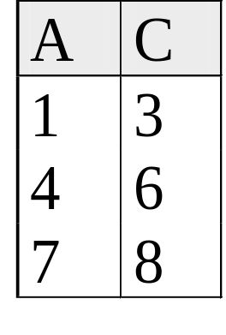
Lossless Decomposition (example)
A → B; C → B
=
But, now we can’t check A → B without doing a join!

Slide 36
Dependency Preserving Decomposition
Dependency preserving decomposition (Intuitive):
  If R is decomposed into X, Y and Z, and we enforce the FDs that hold individually on X, on Y and on Z, then all FDs that were given to hold on R must also hold. (Avoids Problem #2 on our list.)
Projection of set of FDs F : If R is decomposed into X and Y the projection of F on X (denoted F_{X} ) is the set of FDs U → V in F⁺ (closure of F , not just F ) such that all of the attributes U, V are in X. (same holds for Y of course)

Slide 37
Dependency Preserving Decompositions (Contd.)
Decomposition of R into X and Y is dependency preserving if (F_{X} ∪ F_{Y} ) ⁺ = F ⁺
  i.e., if we consider only dependencies in the closure F ⁺ that can be checked in X without considering Y, and in Y without considering X, these imply all dependencies in F ⁺.
Important to consider F ⁺ in this definition:
  ABC, A → B, B → C, C → A, decomposed into AB and BC.
  Is this dependency preserving? Is C → A preserved?????
    note: F ⁺ contains F ∪ {A → C, B → A, C → B}, so…
FAB contains A →B and B → A; FBC contains B → C and C → B
So, (FAB ∪ FBC)⁺ contains C → A

Slide 38
Decomposition into BCNF
Consider relation R with FDs F. If X → Y violates BCNF, decompose R into R - Y and XY (guaranteed to be loss-less).
  Repeated application of this idea will give us a collection of relations that are in BCNF; lossless join decomposition, and guaranteed to terminate.
  e.g., CSJDPQV, key C, JP → C, SD → P, J → S
  {contractid, supplierid, projectid,deptid,partid, qty, value}
  To deal with SD → P, decompose into SDP, CSJDQV.
  To deal with J → S, decompose CSJDQV into JS and CJDQV
  So we end up with: SDP, JS, and CJDQV
Note: several dependencies may cause violation of BCNF. The order in which we ``deal with’’ them could lead to very different sets of relations!

Slide 39
BCNF and Dependency Preservation
In general, there may not be a dependency preserving decomposition into BCNF.
  e.g., CSZ, CS → Z, Z → C
  Can’t decompose while preserving 1st FD; not in BCNF.
Similarly, decomposition of CSJDPQV into SDP, JS and CJDQV is not dependency preserving (w.r.t. the FDs JP → C, SD → P and J → S).
{contractid, supplierid, projectid,deptid,partid, qty, value}
  However, it is a lossless join decomposition.
  In this case, adding JPC to the collection of relations gives us a dependency preserving decomposition.
    but JPC tuples are stored only for checking the f.d. (Redundancy!)

Slide 40
Third Normal Form (3NF)
Reln R with FDs F is in 3NF if, for all X → A in F⁺
  A ∈ X (called a trivial FD), or
  X is a superkey of R, or
  A is part of some candidate key (not superkey!) for R. (sometimes stated as “A is prime”)
Minimality of a key is crucial in third condition above!
If R is in BCNF, obviously in 3NF.
If R is in 3NF, some redundancy is possible. It is a compromise, used when BCNF not achievable (e.g., no ``good’’ decomp, or performance considerations).
  Lossless-join, dependency-preserving decomposition of R into a collection of 3NF relations always possible.

Slide 41
What Does 3NF Achieve?
If 3NF violated by X → A, one of the following holds:
  X is a subset of some key K (“partial dependency”)
    We store (X, A) pairs redundantly.
    e.g. Reserves SBDC (C is for credit card) with key SBD and S → C
  X is not a proper subset of any key. (“transitive dep.”)
    There is a chain of FDs K → X → A
    So we can’t associate an X value with a K value unless we also associate an A value with an X value (different K’s, same X implies same A!) – problem with initial SNLRWH example.
But: even if R is in 3NF, these problems could arise.
  e.g., Reserves SBDC (note: “C” is for credit card here), S → C, C → S is in 3NF (why?), but for each reservation of sailor S, same (S, C) pair is stored.
Thus, 3NF is indeed a compromise relative to BCNF.
  You have to deal with the partial and transitive dependency issues in your application code!

Slide 42
Decomposition into 3NF
Obviously, the algorithm for lossless join decomp into BCNF can be used to obtain a lossless join decomp into 3NF (typically, can stop earlier) but does not ensure dependency preservation.
To ensure dependency preservation, one idea:
  If X → Y is not preserved, add relation XY.
  Problem is that XY may violate 3NF! e.g., consider the addition of CJP to `preserve’ JP → C. What if we also have J → C ?
Refinement: Instead of the given set of FDs F, use a minimal cover for F.

Slide 43
Minimal Cover for a Set of FDs
Minimal cover G for a set of FDs F:
  Closure of F = closure of G.
  Right hand side of each FD in G is a single attribute.
  If we modify G by deleting an FD or by deleting attributes from an FD in G, the closure changes.
Intuitively, every FD in G is needed, and ``as small as possible’’ in order to get the same closure as F.
e.g., A → B, ABCD → E, EF → GH, ACDF → EG has the following minimal cover:
  A → B, ACD → E, EF → G and EF → H
M.C. implies Lossless-Join, Dep. Pres. Decomp!!!
  (in book)

Slide 44
Summary of Schema Refinement
BCNF: each field contains information that cannot be inferred using only FDs.
  ensuring BCNF is a good heuristic.
Not in BCNF? Try decomposing into BCNF relations.
  Must consider whether all FDs are preserved!
Lossless-join, dependency preserving decomposition into BCNF impossible? Consider 3NF.
  Same if BCNF decomp is unsuitable for typical queries
  Decompositions should be carried out and/or re-examined while keeping performance requirements in mind.
Note: even more restrictive Normal Forms exist (we don’t cover them in this course, but some are in the book.)

