Slide 1
Functional Dependencies, BCNF and Normalization
Notes:
1
The slides for this text are organized into chapters. This lecture covers Chapter 15.
Chapter 1: Introduction to Database Systems
Chapter 2: The Entity-Relationship Model
Chapter 3: The Relational Model
Chapter 4 (Part A): Relational Algebra
Chapter 4 (Part B): Relational Calculus
Chapter 5: SQL: Queries, Programming, Triggers
Chapter 6: Query-by-Example (QBE)
Chapter 7: Storing Data: Disks and Files
Chapter 8: File Organizations and Indexing
Chapter 9: Tree-Structured Indexing
Chapter 10: Hash-Based Indexing
Chapter 11: External Sorting
Chapter 12 (Part A): Evaluation of Relational Operators
Chapter 12 (Part B): Evaluation of Relational Operators: Other Techniques
Chapter 13: Introduction to Query Optimization
Chapter 14: A Typical Relational Optimizer
Chapter 15: Schema Refinement and Normal Forms
Chapter 16 (Part A): Physical Database Design
Chapter 16 (Part B): Database Tuning
Chapter 17: Security
Chapter 18: Transaction Management Overview
Chapter 19: Concurrency Control
Chapter 20: Crash Recovery
Chapter 21: Parallel and Distributed Databases
Chapter 22: Internet Databases
Chapter 23: Decision Support
Chapter 24: Data Mining
Chapter 25: Object-Database Systems
Chapter 26: Spatial Data Management
Chapter 27: Deductive Databases
Chapter 28: Additional Topics

Slide 2
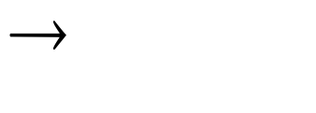
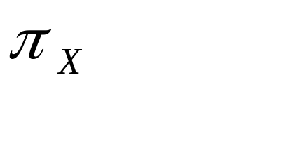

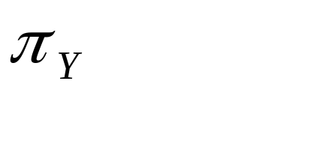
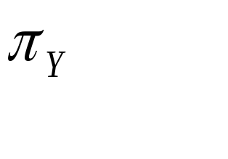
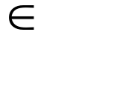
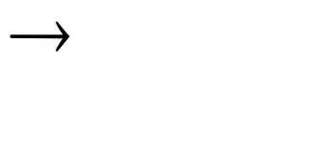

Functional Dependencies (FDs)
A functional dependency X Y holds over relation R if, for every allowable instance r of R:
  t1 r, t2 r, (t1) = (t2) implies (t1) = (t2)
  i.e., given two tuples in r, if the X values agree, then the Y values must also agree. (X and Y are sets of attributes.)
An FD is a statement about all allowable relations.
  Must be identified based on semantics of application.
  Given some allowable instance r1 of R, we can check if it violates some FD f, but we cannot tell if f holds over R!
K is a candidate key for R means that K R
  However, K R does not require K to be minimal!
Notes:
15

Slide 3
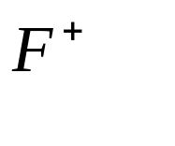

Reasoning About FDs
Given some FDs, we can usually infer additional FDs:
  ssn did, did lot implies ssn lot
An FD f is implied by a set of FDs F if f holds whenever all FDs in F hold.
  = closure of F is the set of all FDs that are implied by F.
Armstrong’s Axioms (X, Y, Z are sets of attributes):
  Reflexivity: If Y X, then X Y
  Augmentation: If X Y, then XZ YZ for any Z
  Transitivity: If X Y and Y Z, then X Z
These are sound and complete inference rules for FDs!
Notes:
19

Slide 4
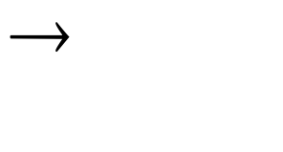

Reasoning About FDs (Contd.)
Couple of additional rules (that follow from AA):
  Union: If X Y and X Z, then X YZ
  Decomposition: If X YZ, then X Y and X Z
Example: Contracts(cid,sid,jid,did,pid,qty,value), and:
  C is the key: C CSJDPQV
  Project purchases each part using single contract: JP C
  Dept purchases at most one part from a supplier: SD P
JP C, C CSJDPQV imply JP CSJDPQV
SD P implies SDJ JP
SDJ JP, JP CSJDPQV imply SDJ CSJDPQV
Notes:
20

Slide 5
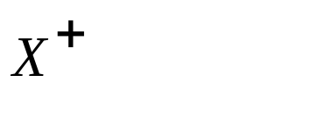
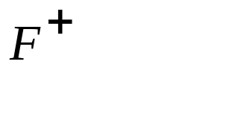

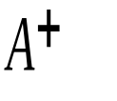
Reasoning About FDs (Contd.)
Computing the closure of a set of FDs can be expensive. (Size of closure is exponential in # attrs!)
Typically, we just want to check if a given FD X Y is in the closure of a set of FDs F. An efficient check:
  Compute attribute closure of X (denoted ) wrt F:
    Set of all attributes A such that X A is in
    There is a linear time algorithm to compute this.
  Check if Y is in
Does F = {A B, B C, C D E } imply A E?
  i.e, is A E in the closure ? Equivalently, is E in ?
Notes:
21

Slide 6
An Algorithm to Compute Attribute
Closure X⁺ with respect to F
Let X be a subset of the attributes of a relation R and F be the set of functional dependencies that hold for R.
Create a hypergraph in which the nodes are the attributes of the relation in question.
Create hyperlinks for all functional dependencies in F.
Mark all attributes belonging to X
Recursively continue marking unmarked attributes of the hypergraph that can be reached by a hyperlink with all ingoing edges being marked.
Result: X⁺ is the set of attributes that have been marked by this process.

Slide 7
The Evils of Redundancy
Redundancy is at the root of several problems associated with relational schemas:
  redundant storage, insert/delete/update anomalies
Integrity constraints, in particular functional dependencies, can be used to identify schemas with such problems and to suggest refinements.
Main refinement technique: decomposition (replacing ABCD with, say, AB and BCD, or ACD and ABD).
Decomposition should be used judiciously:
  Is there reason to decompose a relation?
  What problems (if any) does the decomposition cause?
Notes:
14

Slide 8
Example: A Bad Relational Design
(0,*)
Works-
for
Person
(0,*)
Company
ssn
name
C#
loc
salary
Table: X (ssn, name, salary, C#, loc)

Slide 9

Example: Constraints on Entity Set
Consider relation obtained from Hourly_Emps:
  Hourly_Emps (ssn, name, lot, rating, hrly_wages, hrs_worked)
Notation: We will denote this relation schema by listing the attributes: SNLRWH
  This is really the set of attributes {S,N,L,R,W,H}.
  Sometimes, we will refer to all attributes of a relation by using the relation name. (e.g., Hourly_Emps for SNLRWH)
Some FDs on Hourly_Emps:
  ssn is the key: S SNLRWH
  rating determines hrly_wages: R W
Notes:
16

Slide 10
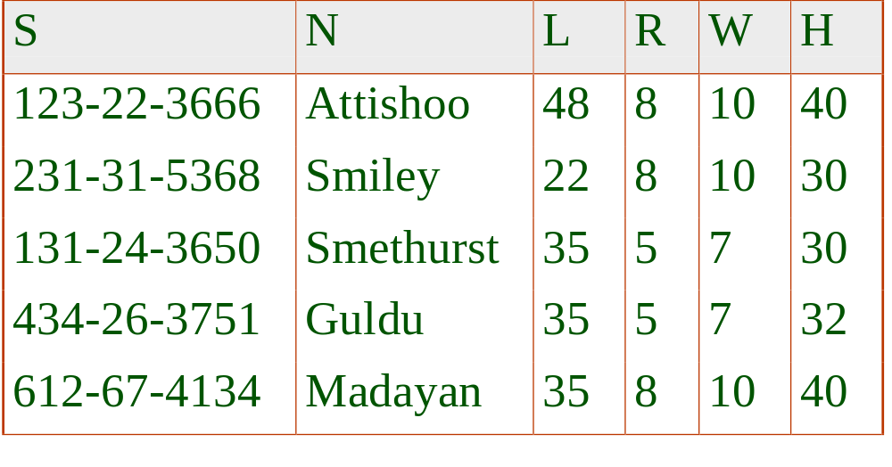

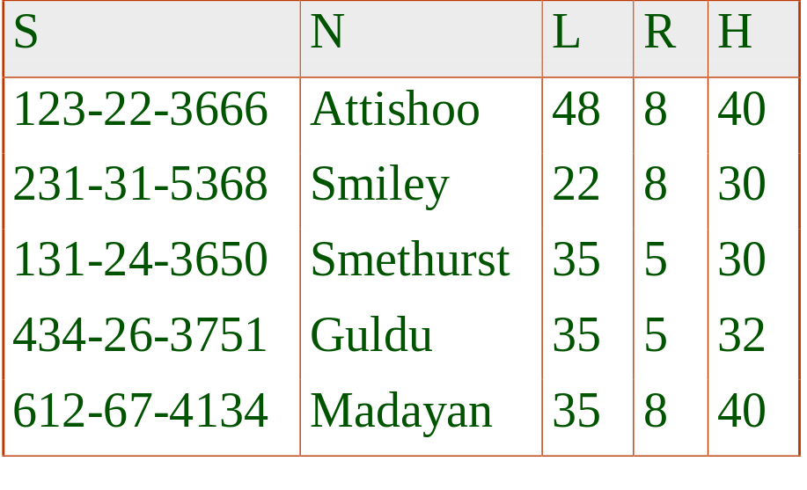
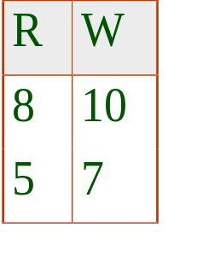
Example (Contd.)
Problems due to R W :
  Update anomaly: Can we change W in just the 1st tuple of SNLRWH?
  Insertion anomaly: What if we want to insert an employee and don’t know the hourly wage for his rating?
  Deletion anomaly: If we delete all employees with rating 5, we lose the information about the wage for rating 5!
Hourly_Emps2
Wages
Notes:
17

Slide 11
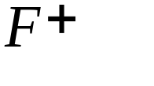
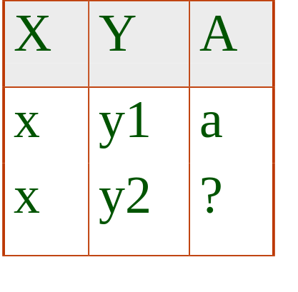
Boyce-Codd Normal Form (BCNF)
Reln R with FDs F is in BCNF if, for all X A in
  A is a subset of X (called a trivial FD), or
  X contains the attributes of a candidate key for R.
In other words, R is in BCNF if the only non-trivial FDs that hold over R are key constraints.
  No dependency in R that can be predicted using FDs alone.
  If we are shown two tuples that agree upon the X value, we cannot infer the A value in one tuple from the A value in the other.
  If example relation is in BCNF, the 2 tuples must be identical (since X is a key).
Notes:
23

Slide 12
Decompositions: the Good and Bad News
Decompositions of “bad” functional dependencies reduce redundancy.
There are three potential problems to consider:
  Some queries become more expensive.
  Given instances of the decomposed relations, we may not be able to reconstruct the corresponding instance of the original relation (lossless join problem)!
  Checking some dependencies may require joining the instances of the decomposed relations (problem with lost dependencies).
Tradeoff: Must consider these issues vs. redundancy.

Slide 13
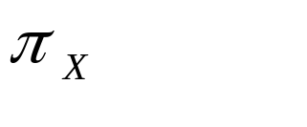
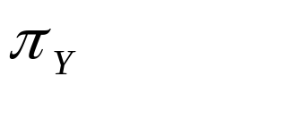


Lossless Join Decompositions
Decomposition of R into X and Y is lossless-join w.r.t. a set of FDs F if, for every instance r that satisfies F:
  (r) (r) = r
It is always true that r (r) (r)
  In general, the other direction does not hold! If it does, the decomposition is lossless-join.
Definition extended to decomposition into 3 or more relations in a straightforward way.
It is essential that all decompositions used to deal with redundancy be lossless! (Avoids Problem (2).)
Notes:
29

Slide 14
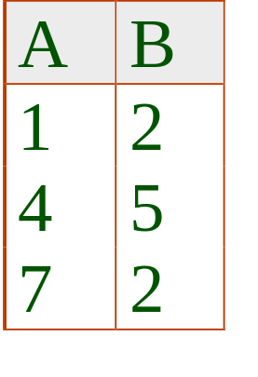
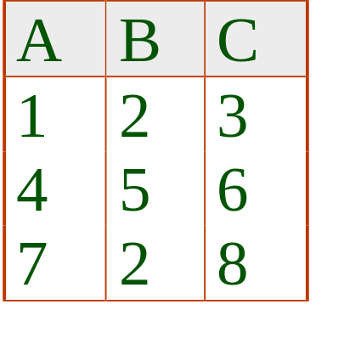
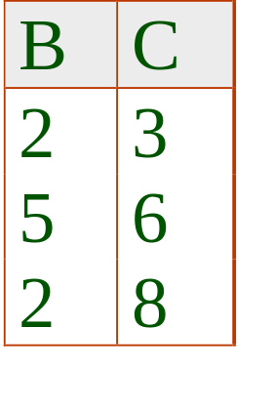
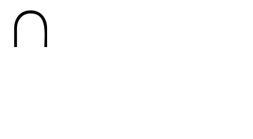

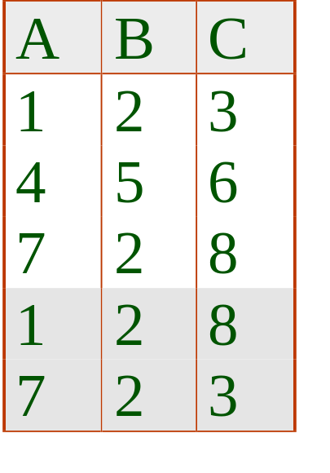
More on Lossless Join
The decomposition of R into X and Y is lossless-join wrt F if the closure of F contains:
  X Y X, or
  X Y Y
In particular, the decomposition of R into UV and R − V is lossless-join if U V holds over R.
Notes:
30

Slide 15
Dependency Preserving Decomposition
Dependency preserving decomposition (Intuitive): If R with attribute set Z is decomposed into X and Y, and we enforce the FDs that hold on X and on Y, then all FDs that were given to hold on Z must also hold. (Avoids Problem (3).)
Projection of set of FDs F: If Z is decomposed into X, ... The projection of F onto X (denoted F_{X} ) is the set of FDs U V in F⁺ (closure of F ) such that U, V subset of X.
How to compute the F_{X}? (see Ullman book)
  Compute the attribute closure for every subset U of X;
  If B in X, B in U⁺, B not in U: add U B to F_{X}.
Notes:
3

Slide 16
Dependency Preserving Decompositions (Contd.)
Decomposition of R into X and Y is dependency preserving if (F_{X} union F_{Y} ) ⁺ = F ⁺
  i.e., if we consider only dependencies in the closure F ⁺ that can be checked in X without considering Y, and in Y without considering X, these imply all dependencies in F ⁺.
Important to consider F ⁺, not F, in this definition:
  ABC, A B, B C, C A, decomposed into AB and BC.
  Is this dependency preserving? Is C A preserved?????
Dependency preserving does not imply lossless join:
  ABC, A B, decomposed into AB and BC.
And vice-versa! (Example?)
Notes:
4

Slide 17
BCNF and Dependency Preservation
In general, there may not be a dependency preserving decomposition into BCNF.
  e.g., R(C,S,Z) CS Z, Z C
  Can’t decompose while preserving 1st FD; not in BCNF.
Notes:
6

Slide 18

Minimal Cover for a Set of FDs
Minimal cover G for a set of FDs F:
  Closure of F = closure of G.
  Right hand side of each FD in G is a single attribute.
  If we modify G by deleting an FD or by deleting attributes from an FD in G, the closure changes.
Intuitively, every FD in G is needed, and ``as small as possible’’ in order to get the same closure as F.
e.g., A B, ABCD E, EF GH, ACDF EG has the following minimal cover:
  A B, ACD E, EF G and EF H
M.C. → Lossless-Join, Dep. Pres. Decomp!!! (in book)
Notes:
8

Slide 19
What is a “good” relational schema?
BCNF (or 4th, 5th,… normal form)
No lost functional dependencies
No unnecessary decompositions (minimum number of relations that satisfy the first and second condition).
Remark: In same cases, conditions 1 and 2 cannot be jointly achieved.

Slide 20
Decomposition with respect to a functional dependency X→ Y
Decompositions with respect to X→Y: Let R a relation with attributes ATT; furthermore, (X ∪ Y)⊂ATT, Z=ATT− (X ∪ Y) and X→Y holds
In this case, R can be decomposed into R1 with attributes X ∪ Y and R2 with attributes X ∪ Z and R1 R2=R (that is R can be reconstructed without loss of information).
Remark: In the normalization process only decompositions with respect to a given functional dependency are used; from the above statement we know that all these decompositions are lossless.

Slide 21
Finding a “Good” Schema in BCNF
A relation R with ATT (R) =X and functional dependencies F is given
BCNF Decomposition Problem: Find the smallest n and X₁,…,X_{n} such that:
X_{i}⊆X for i=1,..,n
X₁∪ … ∪ X_{n} =X
R_{i} with ATT(R_{i} )=X_{i} and functional dependencies F_{i} is in BCNF for i=1,…,n
(F₁∪ … ∪ F_{n} )⁺ =F⁺ (no lost functional dependencies)
((R₁ |X| R₂)… |X|R_{n})=R (|X|:= natural join)
Remark: Problem does not necessarily have a solution for certain relations R (e.g. R(A,B,C) with A→C and B→C)

Slide 22
Algorithm1 to find a “good” BCNF Relational Schema
Write down all (non-trivial) functional dependencies for the relation. Transform A→B1 and A→B2 into A→B1∪B2
Identify the candidate keys of the relation
Classify functional dependencies into
  Good: have complete candidate key on their left-hand side
  Bad: not good
Compute all possible relational schemas using decompositions involving bad functional dependencies
Select the relational schema that is in BCNF and does not have any lost functional dependencies. If no such schema exists select a schema that comes closest to the ideal.

Slide 23
A Second Algorithm to Compute all BCNF Schemas
Let Z be the attributes of the relation R to be analyzed. Compute all subsets X of Z that have the following property (trouble making left-hand sides):
  X⁺ is a true subset Z (X is not a candidate key)
  X⁺ is different from X (something is dependent on X)
Let DEC={X₁,…,X_{n}} be the results of the last step:
  If DEC is empty, R is in BCNF and will not be further decomposed.
  If DEC is nonempty, apply the following decompositions of Z into: X_{i}⁺ and (Z − X_{i}⁺ ) union X_{i} (for i=1,..,n) and analyze the obtained relations.
Continue until there are no more relations to be analyzed!
Remark: The algorithm computes all relational schemas that are in BCNF (excluding those that can be obtained by decomposing relations that are already in BCNF).

Slide 24
Summary of Schema Refinement
If a relation is in BCNF, it is free of redundancies that can be detected using FDs. Thus, trying to ensure that all relations are in BCNF is a good heuristic.
If a relation is not in BCNF, we can try to decompose it into a collection of BCNF relations.
  Must consider whether all FDs are preserved.
  Decompositions that do not guarantee the lossless-join property have to be avoided.
  Decompositions should be carried out and/or re-examined while keeping performance requirements in mind.
  Decompositions that do not reduce redundancy should be avoided.
Notes:
9

Slide 25
Coalescence Inference Rule for MVD
X →→ Y
If:
∅
Then: X → Z
⊆
W → Z
Remark: Y and W have to be disjoint and Z has to be a subset of or equal to Y

