Slide 1
EMO PLAYER
The emotion based music player
1

Slide 2
GUIDED BY:- Dr. Sudheep Elayidom Professor Division of Computer Science and Engineering Group Members : - Gurudatt Kumar(12170030) Kumar Gaurav(12170039) Manish Kr Chaudhary(12170041)

Slide 3
ABSTRACT
A novel approach that provides, the user with an automatically generated playlist of songs based on the mood of the user.
Music plays a very important role in human’s daily life and in the modern advanced technologies .
The difficulties in the creation of large playlists can overcome here.
This Music player itself selects songs according to the
current mood of the user.
2

Slide 4
Cont…
Existing methods
for automating the playlist generation
process are computationally slow, less accurate and sometimes even require use of additional hardware like EEG or sensors.
This proposed
system based on extraction of facial
expressions that will generate a playlist automatically thereby reducing the effort and time.
4

Slide 5
Cont…
User dependent and user independent datasets can be done here and the Facial expressions are captured using an inbuilt camera.
The accuracy of the detection algorithm used for real time images is around 85-90%, while for static images it is around 98-100%
5

Slide 6
INTRODUCTION
From others this plays a novel approach that removes the risk that the user has to face the task of manually browsing through the playlist of songs to select.
Here an
efficient and accurate algorithm, that would
generate a playlist based on current emotional state and behavior of the user.
6

Slide 7
Cont…
The introduction of Facial Emotion Recognition (FER) and Music Information Retrieval (MIR) in the traditional music players provided automatically parsing the playlist based on various classes of emotions and moods.
Facial expression is the most ancient and natural way of expressing feelings, emotions and mood and its algorithm requires less computational, time, and cost.
7

Slide 8
Emotion Basics
The facial expressions categorize into 5 different of facial expressions like anger, joy, surprise, sad, and excitement.
An emotion model is proposed that classifies a song based on any of the 7 classes of emotions viz sad, joy-anger, joy- surprise, joy-excitement, joy, anger, and sad-anger.
8

Slide 9
Requirement
Take Image
Face Detection and Tracking User Emotion
Recommend by Sorting playlist based on user’s current emotion
Sort songs by User Relevancy Preference or play a random song as per emotion category.
9

Slide 10

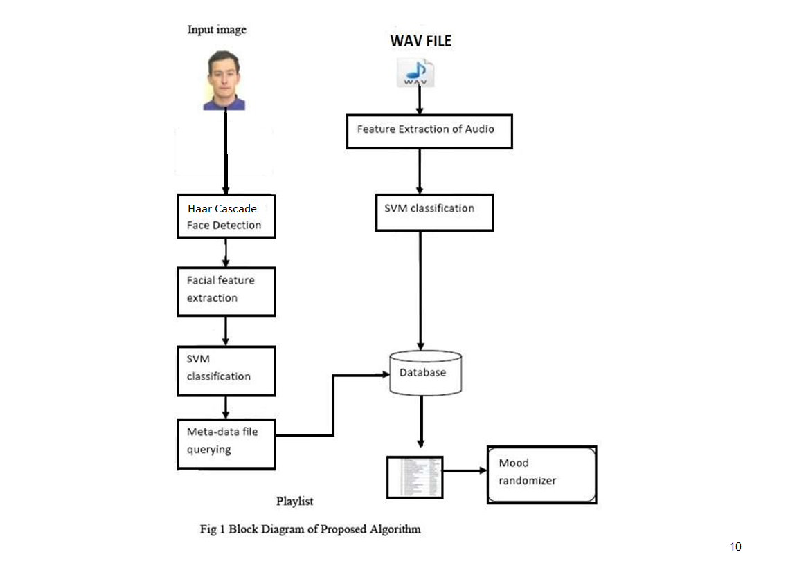

Slide 11
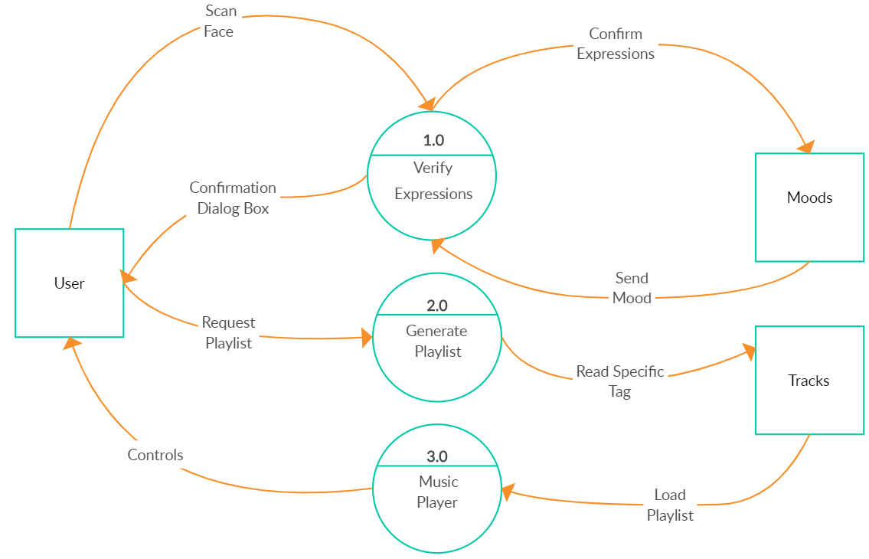

Slide 12
METHODOLOGY
Three major modules:
Emotion extraction module(EEM) Audio feature extraction module(AEM) Emotion-Audio recognition module.
EEM and AEM are two separate modules and Emotion- Audio recognition module performs the mapping of modules by querying the audio meta-data file.
The EEM and AEM are combined in Emotion-Audio integration module.
12

Slide 13
Emotion extraction module
Done by the analysis on Images, Image of a user is captured using a webcam or it can be accessed from the stored image in the hard disk.
Detection of frontal face using Haar Cascade.
Image features extraction and emotion classification using SVM.

Slide 14
Haar Cascade Algorithm
It is based on the technique to analyze pixels in the image into squares by function. This uses machine learning techniques to get a high degree of accuracy from what is called “training data”.
Haar Cascade selects a small number of important features from a large set to give an efficient result of classifiers.

Slide 15
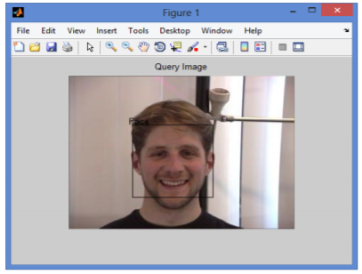
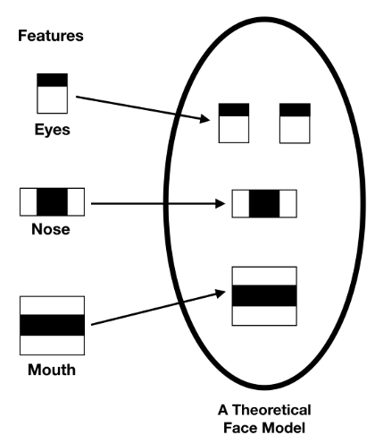

Slide 16
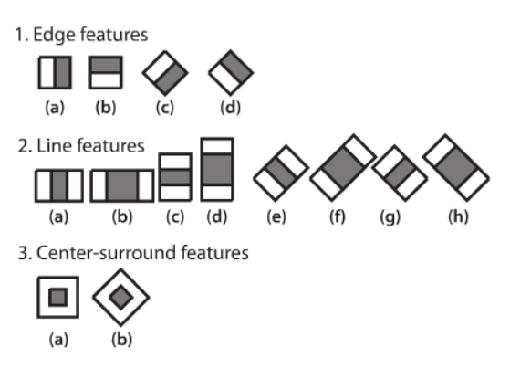
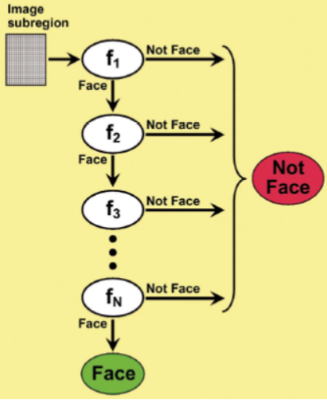

Slide 17
7 Types
Songs that resemble cheerfulness, energetic and playfulness are classified
under joy.
Songs that resemble very depressing are classified under the sad.
Songs that reflect mere attitude, revenge are classified under anger.
Songs with anger in playful is classified under Joy-anger category.
Songs with very depress mode and anger mood are classified under Sad- Anger category.
6. Songs which
reflect excitement of joy is classified
under Joy-
Excitement category.
7. Songs which reflect surprise of joy is classified under Joy-surprise category.
23

Slide 18
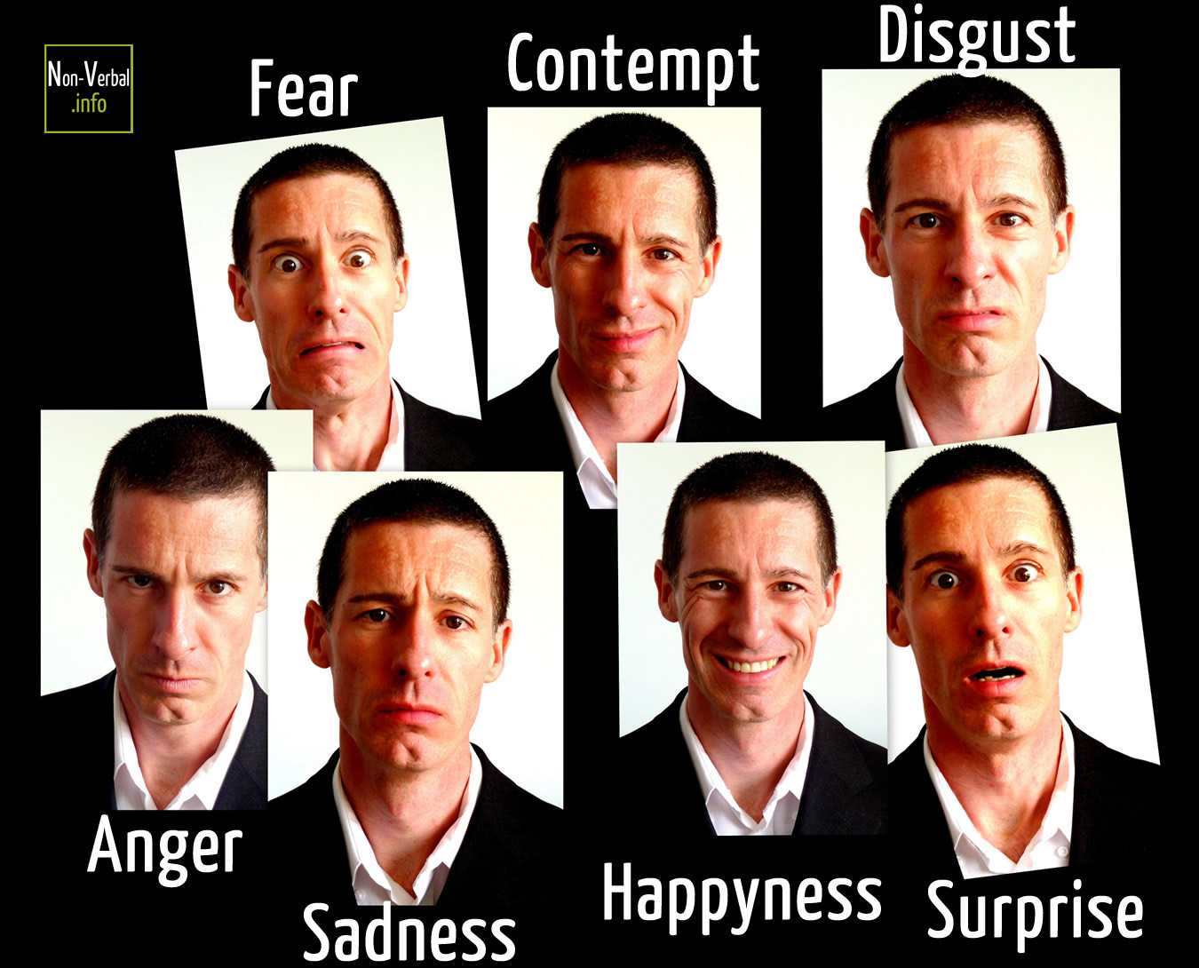

Slide 19
Facial features extraction and classification
Multi-class Support Vector Machine Classifier
Support vector machine (SVM) is a set of supervised learning method used for classification, regression and outliers’ detection.
The goal of a support vector machine is to find the optimal separating hyperplane which maximizes the margin of the training data.
The SVM is useful in a number of pattern analysis tasks with the help of binary classifiers which differentiates effectively between various classifications of expression.

Slide 20
Cont.….
SVM works by classifying data with the help of evaluation of an optimal hyper plane that separates one class's data points from those of the other.
It optimally separates the data by making use of an N-dimensional hyper plane.
One-vs-all, learn N SVM’s
SVM 1 learns “Output==1” vs “Output != 1”
SVM 2 learns “Output==2” vs “Output != 2”
:
SVM N learns “Output==N” vs “Output != N”

Slide 21
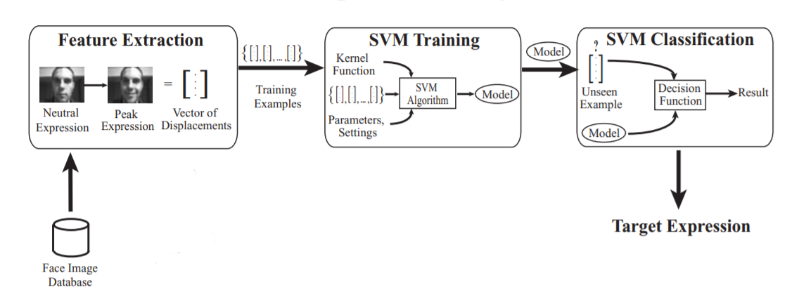

Slide 22
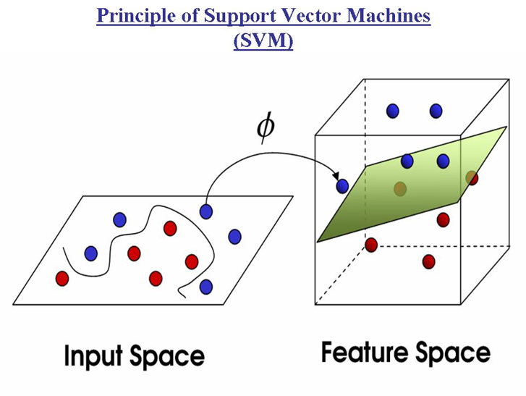

Slide 23
Recommended Kernel Function
SVM algorithms use a set of mathematical functions that are defined as the kernel. The function of kernel is to take data as input and transform it into the required form. Different SVM algorithms use different types of kernel functions. These functions can be different types. For example linear, nonlinear, polynomial, radial basis function (RBF), and sigmoid.
* Sigmoid Kernel Function

Slide 24
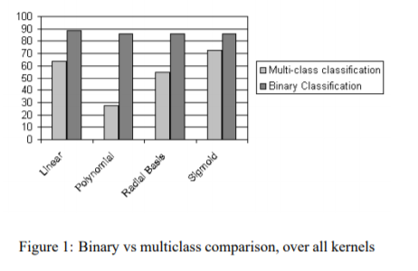
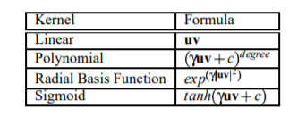
Reason for Using Sigmoid kernel
u and v are testing vector and support vector

Slide 25
Training Data Set
Kaggle Fer2013, It contains 30,000 images of expressions grouped in seven categories: Angry, Disgust, Fear, Happy, Sad, Surprise and Neutral.
The data consists of 48x48 pixel grayscale images of faces. The faces have been automatically registered so that the face is more or less centered and occupies about the same amount of space in each image. The task is to categorize each face based on the emotion shown in the facial expression in to one of seven categories (0=Angry, 1=Disgust, 2=Fear, 3=Happy, 4=Sad, 5=Surprise, 6=Neutral).
train.csv contains two columns, "emotion" and "pixels". The "emotion" column contains a numeric code ranging from 0 to 6, inclusive, for the emotion that is present in the image. The "pixels" column contains a string surrounded in quotes for each image. The contents of this string a space-separated pixel values in row major order.

Slide 26
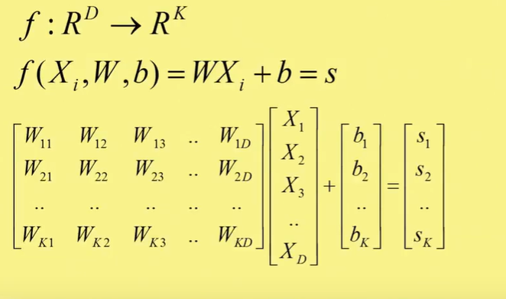
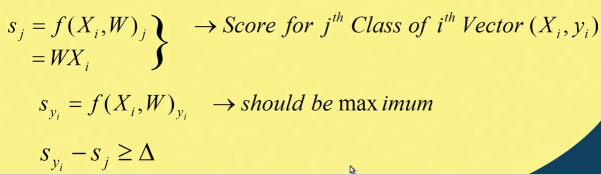
C-SVM

Slide 27
Emotion-Audio recognition module
The emotion extraction module and audio feature extraction
module is finally mapped and combined using an Emotion
Audio integration module.
The extracted for the songs are stored as a meta-data in the database. Mapping is performed by querying the meta-data database.

Slide 28
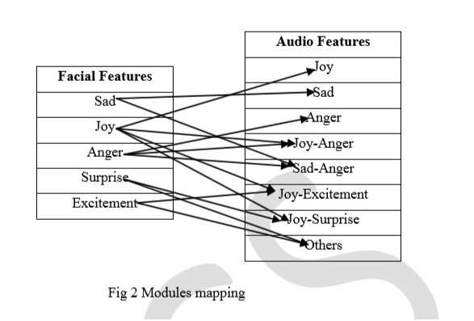
Mapping of Facial and Audio features

Slide 29
CONCLUSION
The Emotion-Based Music Player is used to automate and give a better music player experience for the end user. The application solves the basic needs of music listeners without troubling them as existing applications do. It uses technology to increase the interaction of the system with the user in many ways. It eases the work of the end-user by capturing the image using a camera, determining their emotion, and suggesting a customized play-list through a more advanced and interactive system. The user will also be notiﬁed of songs that are not being played, to help them free up storage space.

Slide 30
FUTURE SCOPE
The future scope in the system would to design a mechanism that would be helpful in music therapy treatment and provide the music therapist the help needed to treat the patients suffering from disorders like mental stress, anxiety, acute depression and trauma. The proposed system also tends to avoid in future the unpredictable results produced in extreme bad light conditions and very poor camera resolution.

Slide 31
REFERENCES
Chang, C. Hu, R. Feris, and M. Turk, ―Manifold based analysis of facial expression,‖ Image Vision Comput ,IEEE Trans. Pattern Anal. Mach. Intell. vol. 24, pp. 05–614, June 2006.
A. habibzad, ninavin, Mir kamalMirnia,‖ A new algorithm to classify face emotions through eye and lip feature by using particle swarm optimization.‖
Byeong-jun Han, Seungmin Rho, Roger B. Dannenberg and Eenjun Hwang,
―SMERS: music emotion recognition using support vector regression‖,
10thISMIR , 2009.
Alvin I. Goldmana, b.Chandra and SekharSripadab, ―Simulationist models of face-based emotion recognition‖.
Carlos A. Cervantes and Kai-Tai Song , ―Embedded Design of an Emotion- Aware Music Player‖, IEEE International Conference on Systems, Man, and Cybernetics, pp 2528-2533 ,2013.

Slide 32
Thank You

