Slide 1




G.H. RAISONI COLLEGE OF ENGINEERING
AND MANAGEMENT, WAGHOLI, PUNE.
Department of AI & AIML
< Project Title >
Guide:
< Prof. Bhagyashri Wankar> <Prof. Vaishali Baviskar>
Name of Projectees
<Vyanktesh Dale # 1> <Ganesh lad # 2>
<Sejal Hande # 3> <Sejal Ikhar # 4>

Slide 2
Contents
Introduction
Justifications for Selecting the Title
Problem Statement
Literature Survey
Block Diagram
Expected Result
Work plan
References

Slide 3
Introduction
Introduction / background about the project
The Minor project weather forecast is a comprehensive presentation that provides detailed information about the weather forecast for a specific location. The presentation is designed to help individuals and organizations plan their activities based on the weather conditions.
The presentation includes a range of weather-related information, such as temperature, precipitation, wind speed, and humidity. It also provides an overview of weather patterns and trends in the region, helping users make informed decisions about their plans.

Slide 4
Justification For Selecting The Title
Justification of Title with Project
Trends in weather forecasts provide insights for future weather predictions and with this template, you can take important facts and create an informative infographic using those facts. Use a range of interactive data visualization tools, images and icons to explain your points effectively.

Slide 5
Problem Statement
Problem identified and its justification
The Minor Project Weather Forecast offers numerous benefits for individuals and organizations. By providing accurate and up-to-date weather information, it allows users to plan their activities more effectively and avoid potential weather-related risks.
The presentation can also be used to optimize resource allocation and reduce costs associated with weather-related disruptions. For example, businesses can use the presentation to adjust their supply chain logistics or reschedule outdoor events based on weather condition

Slide 6
Literature Survey
Sr. No. | Paper Title and its Author | Details of Publication | Findings
1 | Weather Forecast Prediction Munmun Biswas | Researchgate | Use of website
2 | Weather Forecast Prediction Tanni Dhoom | Researchgate | Learn of New interface
3 | Weather Forecast Prediction Sayantanu Barua | Researchgate | Handling of Api
4
5
6

Slide 7
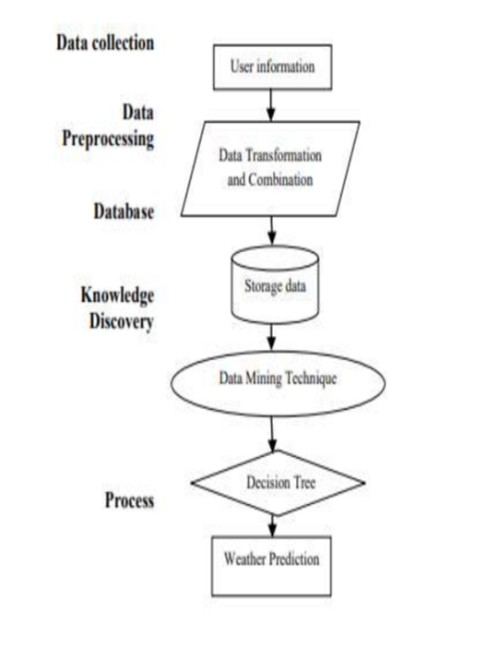
Block Diagram
Block diagram of various stages of project

Slide 8
Expected Result
Expected output of the project
The Minor Project Weather Forecast includes a range of features that make it a valuable tool for planning activities. These features include real-time weather updates, long-term weather forecasts, and historical weather data
The presentation also includes interactive maps that allow users to explore weather patterns and conditions in detail. In addition, users can customize the presentation to focus on specific weather variables, such as temperature or precipitation.

Slide 9
Work – Plan
Months Activities | August’23 | Sept’23 | Oct’23 | Nov’23
Literature Reviews | √
Requirement Analysis | √
Designing | √
Experimental Analysis | √ | √ | √
Module wise Implementation |  | √ | √
Testing and Debugging |  |  | √ | √
Preparation of Project Report |  |  |  | √

Slide 10
References
List of papers/books/websites etc refer for project
[1] Holmstrom, M., Liu, D., & Vo, C. (2016). Machine learning applied to weather
forecasting.[2] Gupta, S., Indumathy, K., & Singhal, G. (2016). Weather prediction using normal
equation method and linear regression techniques.
[3] Grover, A., Kapoor, A., & Horvitz, E. (2015, August). A deep hybrid model for
weather forecasting.
[4] Priya, S. B. A survey on weather forecasting to predict rainfall using big data analytics.
[5] Chauhan, D., & Thakur, J. (2014). Data mining techniques for weather prediction

Slide 11
Thank you !

