Slide 1




G.H. RAISONI COLLEGE OF ENGINEERING
AND MANAGEMENT, WAGHOLI, PUNE.
Department of AI & AIML
MOVIE RECOMMENDATION SYSTEM
Guide:
Prof.Vaishali Baviskar
Name of Projectees
Yash Nagtode B-19 Shyam Patil B-26
Bhalchandra Patil B-25 Vaishnav Patil B-27

Slide 2
Contents
Introduction
Justifications for Selecting the Title
Problem Statement
Literature Survey
Block Diagram
Expected Result
Work plan
References

Slide 3

Introduction
A movie recommendation system is a specialized software or algorithm designed to suggest movies to users based on their preferences, viewing history, and other relevant factors. These systems are widely used by streaming platforms and movie websites to enhance user experience and engagement.

Slide 4
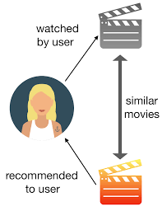
Justification For Selecting The Title
In recent years, there has been a growing interest in personalized movie recommendations, which can be achieved through various approaches such as collaborative filtering and content-based filtering. One of the key justifications for selecting this title is that content-based recommendation systems are able to provide more accurate recommendations by analyzing the content of movies, such as their genre, plot, and cast.

Slide 5
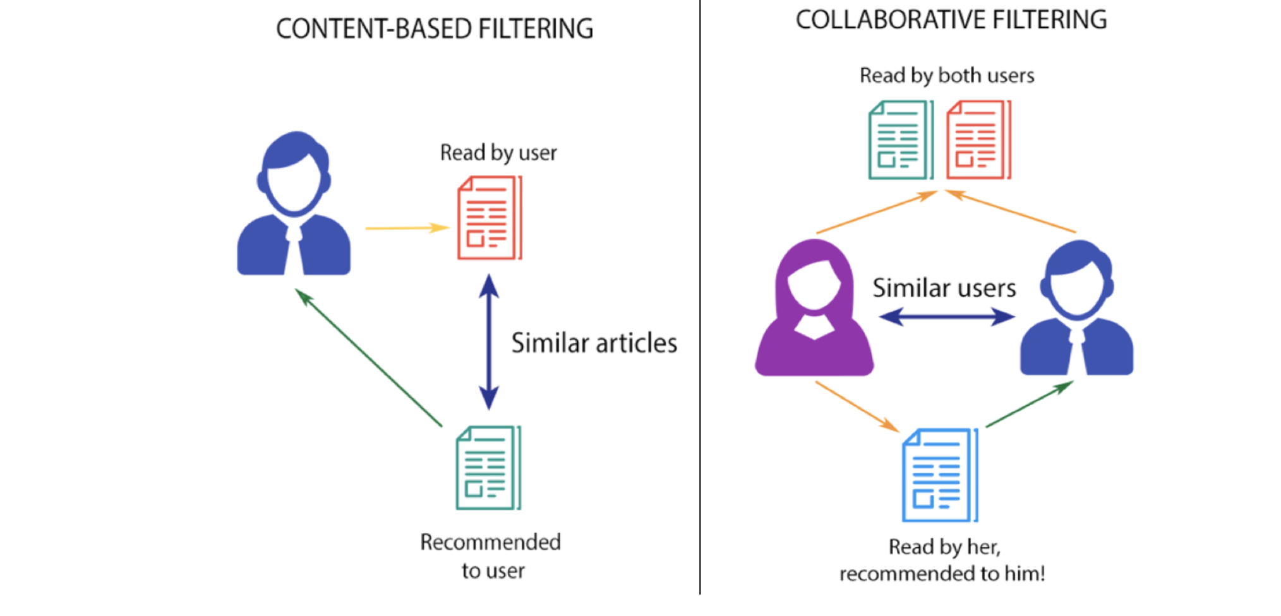
Problem Statement
The problem we aim to address with content-based movie recommendation systems is that traditional collaborative filtering methods suffer from the cold start problem. Content-based methods, on the other hand, rely on the characteristics of items themselves, such as genre, actors, and plot keywords, to make recommendations.
Content-based methods, however, can provide more diverse recommendations by taking into account the unique preferences of each individual user. This can lead to a more satisfying user experience

Slide 6
Literature Survey
Sr. No. | Paper Title and its Author | Details of Publication | Findings
1 | Movie Recommendation System Authors: Jose Immanuvel. J, Sheelavathi. A, Priyadharshan. M, Vignesh. S, Elango. K | Publish Date : 2022-06-17 Publisher:-International Journal of Research in Industrial Engineering | Recommendation system can be implemented using various techniques such as using collaborative filtering, Svm, cosine similarity
2 | Content based movie recommendation system N. Pradeep K. K. Rao Mangalore B. Rajpal N. Prasad R. Shastri | Publish Date : 05-07-2020 Publisher:-International Journal of Research in Industrial Engineering | recommendation system helps to retrieve personalized information for different users.
3 | Movies Recommendation System using Cosine Similarity Shubham Pawar, Pritesh Patne, Priya Ratanghayra, Simran Dadhich, Shree Jaswal | Publish Date : 04-04-2022 Publisher:-International Journal of Innovative Science and Research Technology | How to use cosine similarity in In recommendation system.
4 | Movie Recommendation System Modeling Using Machine Learning Raja Marappan and S. Bhaskaran | Publish Date : 06-05-2022 | Different ways to implement content based recommendation system

Slide 7
Key Techniques and Libraries
Data Collection:- We have taken two datasets:-
Tmdb 5000 movies
Tmdb 5000 credits
2. Data Preprocessing:- For data preprocessing we have used libraries such as numpy, pandas.
In data preprocessing we have removed duplicate values, merged two datasets, dropping columns, formatting, noise entity removal and removal of stopwords.
3. Model:-
For creating content based recommendation system we have used some techniques of NLP and sklearn library.
For example using techniques of NLP we have done stemming, noise entity removal.
Using sklearn library for measuring cosine similarity, text vectorization.
4. Website:- Website is built using streamlit library

Slide 8
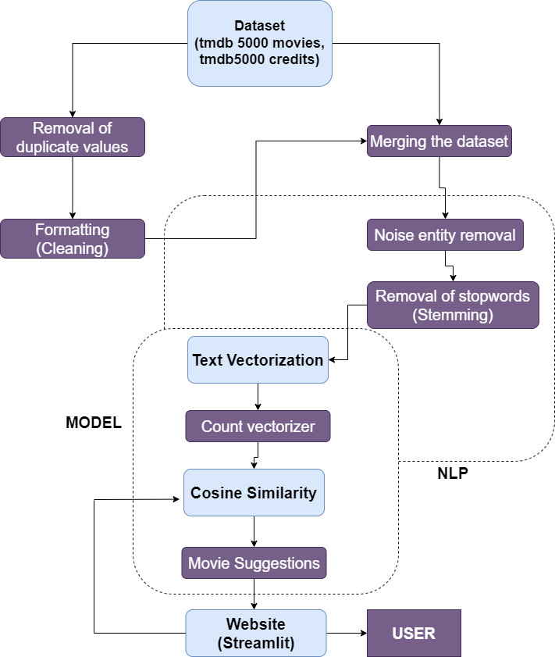
Block Diagram

Slide 9
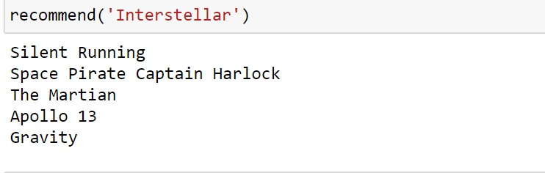
Expected Result
The expected output of a content-based recommendation system deployed on a website is personalized content recommendations for each user.
Similar Movies

Slide 10

References
MOVIE RECOMMENDER
Search
1
2
3
4
Movie Name
Genre
Director
Movie Name
Genre
Director
Movie Name
Genre
Director
Movie Name
Genre
Director

Slide 11
Work – Plan
Months Activities | August’23 | Sept’23 | Oct’23 | Nov’23
Literature Reviews | √
Requirement Analysis | √
Designing | √
Experimental Analysis | √ | √ | √
Module wise Implementation |  | √ | √
Testing and Debugging |  |  | √ | √
Preparation of Project Report |  |  |  | √

Slide 12
References
A Guide to Content-Based Filtering In Recommender Systems:-
https://www.turing.com/kb/content-based-filtering-in-recommender-systems
2. Content Based Recommender System :-
https://www.geeksforgeeks.org/ml-content-based-recommender-system/
3. Movies Recommendation System using Cosine Similarity :-
https://ijisrt.com/assets/upload/files/IJISRT22APR1053_(1).pdf
4. Implementation of Content-Based Recommendation System :-
Author:- Gowtham SR

Slide 13
Thank you !

