Slide 1




G.H. RAISONI COLLEGE OF ENGINEERING
AND MANAGEMENT, WAGHOLI, PUNE.
Department of AI & AIML
TextEmotize
Guided By : Prof .Pranita Mokal
Name of Projectees
Abhijeet Borate
Rohan Chavan
Nirupam Asmar
Omkar Jagtap

Slide 2
Contents
Introduction
Justifications for Selecting the Title
Problem Statement
Literature Survey
Block Diagram
Expected Result
Work plan
References

Slide 3

Introduction
Welcome to TextEmotize
In our digital age, we're overload with text from emails, social media, and news. Sorting through this flood of information is overwhelming. We often rely on algorithms to help, but they could do better with some emotional intelligence.
That's where TextEmotize comes in. We're building a system that can accurately and consistently analyze the emotional content of text. By understanding emotions, algorithms can serve users better, delivering more relevant content..
In essence, TextEmotize's integration of emotional intelligence into algorithms marks a revolutionary step in how users engage with digital content.

Slide 4
Justification For Selecting The Title
TextEmotize blends "Text" and "Emotions" to signify its mission: deciphering the concealed emotions in written content.
The tagline, "Decode the Heart of Text," perfectly captures TextEmotize's objective of revealing the often hidden emotions within textual communication.
TextEmotize acknowledges the challenge people face in sensitive emotions in text and aims to bridge this gap, improving our understanding of written content.

Slide 5
Problem Statement
Text emotion analysis is a challenging task because emotions are often expressed subtly and indirectly.
Additionally, emotions can be influenced by a variety of factors, such as the cultural background of the writer, the context in which the text was written, and the reader's own personal experiences.
As a result, it can be difficult to create a text emotion analysis system that is both accurate and reliable.

Slide 6
Literature Survey
Sr. No. | Paper Title and its Author | Details of Publication | Findings
1 | Mohammad, S. M., & Turney, P. D. (2010). "Emotions Evoked by Common Words and Phrases: Using Mechanical Turk to Create an Emotion Lexicon." Proceedings of NAACL-HLT. | Authors: Saif M. Mohammad and Peter D. TurneyYear of Publication: 2010 Link : https://aclanthology.org/W10-0204.pdf | The paper "Emotions Evoked by Common Words and Phrases: Using Mechanical Turk to Create an Emotion Lexicon" successfully crowdsourced emotional associations with words and phrases, providing valuable data for sentiment and emotion analysis in text.
2 | Whissell, C. (2009). "Using the Revised Dictionary of Affect in Language to Quantify the Emotional Undertones of Samples of Natural Language." Psychological Reports, 105(2), 509-521. | Author: Charles Whissell Year of Publication: 2009 Link :https://www.researchgate.net/publication/40022096_Using_the_Revised_Dictionary_of_Affect_in_Language_to_Quantify_the_Emotional_Undertones_of_Samples_of_Natural_Language | focuses on using the Revised Dictionary of Affect in Language to quantify emotional nuances in natural language samples. While a detailed summary may require reading the paper, in short, it discusses the application of a revised affective dictionary to analyze emotions conveyed in text, contributing to the field of emotional analysis in language.

Slide 7
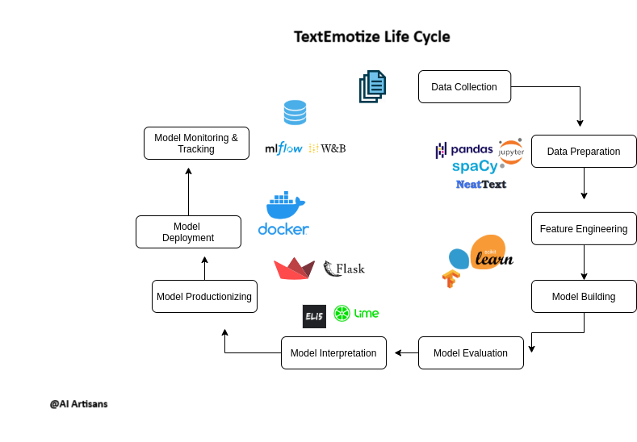
Block Diagram
[emotional_dataset_raw.csv]
emotions
text
emotions
LogisticRegression
{

Slide 8
Expected Result
TextEmotize typically involves identifying and categorizing the emotional content expressed in a given text. Here's what you can expect as the output:
Emotion Category: Categorizing text into one or more predefined emotional categories, such as "joy," "anger," "sadness," "fear," "surprise," "disgust," and others, to specify the emotion(s) expressed in the text.
"Emotion Intensity: Assigning numerical scores to indicate the strength of expressed emotions in text, e.g., high intensity for 'joy' or moderate intensity for 'anger'."
Emotion Visualization: The output may include visualizations, such as graphs or charts, that depict the emotional content over time or across multiple texts. "Key Insight: Visualizing Emotional Trends Across Texts."..

Slide 9
Work – Plan
Months Activities | August’23 | Sept’23 | Oct’23 | Nov’23
Literature Reviews | √
Requirement Analysis | √
Designing | √
Experimental Analysis | √ | √ | √
Module wise Implementation |  | √ | √
Testing and Debugging |  |  | √ | √
Preparation of Project Report |  |  |  | √

Slide 10
References
https://www.researchgate.net/publication/342051182_Text-based_emotion_prediction_system
https://ieeexplore.ieee.org/document/10170212 -
"In this area of text-based emotion detection, this review paper explores the challenges and strategies, including machine learning algorithms and preprocessing techniques, to accurately identify emotions from text data."

Slide 11
Thank You!

