Slide 1



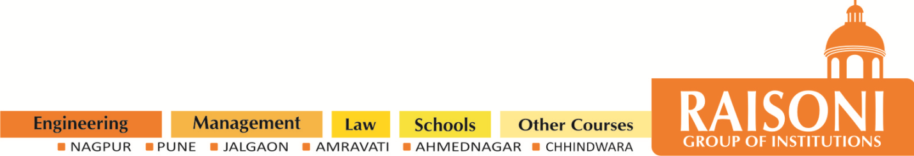
G.H. RAISONI COLLEGE OF ENGINEERING
AND MANAGEMENT, WAGHOLI, PUNE.
Department of AI & AIML
Hotel Table Manager
Guide: Vaishali Baviskar
Name of Projectees
Sarthak Mathpati Samarth Mokashi
Mayur Zarekar Om Misal

Slide 2
Contents
Introduction
Justifications for Selecting the Title
Problem Statement
Literature Survey
Block Diagram
Expected Result
Work plan
References

Slide 3
Introduction
Reservation System
Hotels use reservation systems to manage their dining areas and ensure that customers know when a table is booked and what time it is available.
Overview
A hotel table manager is a software solution that helps hotel staff manage table reservations, order taking, and billing process.
Ordering System
Orders can be placed directly into the system rather than written on slips of paper which can be easily lost or misinterpreted by the kitchen staff.

Slide 4

Justification For Selecting The Title
A "Hotel Table Manager" system helps hotels optimize the allocation of dining tables in their restaurants or dining areas. This optimization ensures that available tables are used efficiently, which can lead to cost savings in terms of staffing and space usage.
With this people can give order easily with the help of software
Not need to wait for Waiter/Waitress
Easily booking of table in a click
Help for chief to configure the orders

Slide 5

Problem Statement
In the hospitality industry, managing dining tables efficiently in hotel restaurants and dining areas is a complex and demanding task. Hotels face numerous challenges related to table allocation, reservation handling, waitlist management, and optimizing resource utilization.
If there is lot of rush at any restaurant the customer handling is biggest issue
For the restaurant and there reputation
Now a days people don’t want wait for too long on table for orders and if there is rush then it’s nearly impossible for Waiter/Waiterss to give attention to every customer at the same time
People always try to find less crowded areas

Slide 6


Block Diagram
Hotel Table Manager
User interface
Table Reservation
Table Allocation
Wait list Management
Reporting and Analytics
Database and Storage
Customer Data
Table Availability
Reservation Records
Historical usage Data
Staff Management
Host/Hostess Console
Waitstaff Management
Kitchen Integration
Table Status Updates
Reservation System
User Registration
Reservation Booking
Real-time Availability Check Confirmation Notifications

Slide 7


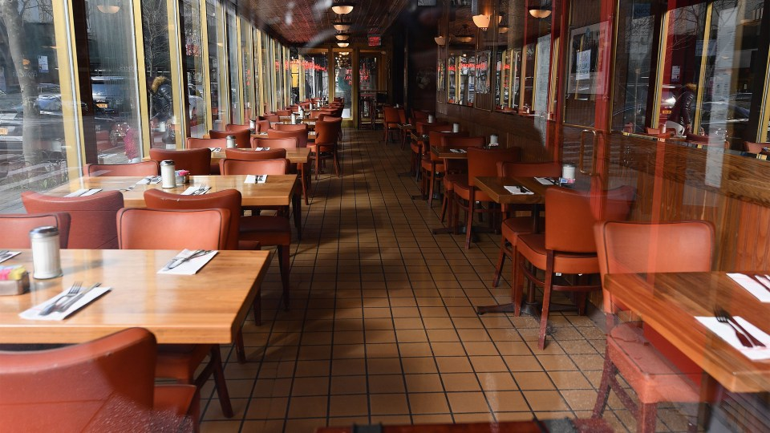
Expected Result
Improved Team Communication
Another study found that implementing a table management system improved team communication, leading to better cooperation and more efficient service.
Enhanced Customer Satisfaction
A case study showed that restaurant staff using the system had an average guest satisfaction score of 93%, compared to 83% for those who didn't use it.
Preventing Overbooking
One notable case study found that table managers reduced the number of overbookings by 67%, even during peak season.

Slide 8
References
https://timesofindia.indiatimes.com/blogs/voices/the-restaurant-industry-in-2023
According to a report by the National Restaurant Association of India (NRAI)
https://www.cvent.com/en/blog/hospitality/types-of-hotel-guests
According to cvent this type People likes things in hotel
https://www.bu.edu/hospitality/2023/01/26/technology-trends-in-hospitality/
According to Boston University Future of Hotels

Slide 9
Thank you !

