Slide 1




G.H. RAISONI COLLEGE OF ENGINEERING
AND MANAGEMENT, WAGHOLI, PUNE.
Department of Artificial Intelligence
Draw & Guess: Doodle guessing using Machine Learning
Guide:
Prof. Hemant Chaudhari
Name of Projectees:
Samiksha Karanjkar-B60, Srushti Gholap-B66, Yashraj Patil-B65

Slide 2
Contents
Introduction
Justifications for Selecting the Title
Problem Statement
Requirements & Module Used
Literature Survey
Block Diagram
Expected Result
Work plan
References

Slide 3
Introduction
Draw & Guess: Doodle guessing using Machine Learning
Welcome to Draw & Guess! Our project combines art and technology to decode hand-drawn doodles using the power of Artificial Intelligence (AI).
Doodles are unique drawings, sometimes puzzling.
Draw & Guess uses advanced machine learning to recognize and decode doodles.
Our project will offer an interactive platform for anyone to explore and enjoy the world of hand-drawn art.

Slide 4
Justification For Selecting The Title
Communication Aid: Enable individuals with limited verbal communication abilities to express themselves by doodling, with the system interpreting and vocalizing their intentions.
Guessing Games: Create interactive games where users draw doodles, and the AI system guesses what they're drawing, adding an element of challenge and fun.
Art Education: It can serve as an educational tool for teaching art fundamentals, allowing students to receive immediate feedback on their drawings.
Language Learning: Use doodles as a fun way to reinforce vocabulary in language learning by having learners draw and guess words in a new language.

Slide 5
Problem Statement
This is a supervised machine learning problem, where the input is a doodle and the output is a label (the object in the doodle). The model can be trained on a dataset of doodles and their corresponding labels. Once the model is trained, it can be used to predict the objects in new doodles.
There are several challenges involved in developing a doodle guessing app. One challenge is that doodles can vary widely in appearance. A user can draw a doodle of a cat in many different ways. The model needs to be able to generalize to new doodles and correctly identify the object in the doodle, even if it has never seen that particular doodle before.
Another challenge is that doodles can be noisy and incomplete. A user may not draw a perfect doodle of a cat. The model needs to be able to handle noisy and incomplete doodles and still correctly identify the object in the doodle.

Slide 6
Requirements & Modules Used
FastAPI: FastAPI is used to create a web-based interface for users to interact with your Doodle Guessing system.
Pillow: It is used for various image-related tasks, including image resizing, format conversion, and enhancing image quality.
TensorFlow: In this project, it's used for training and running the model responsible for recognizing and guessing doodles.
NumPy: used in machine learning for data manipulation and numerical operations.
QuickDraw dataset: It gives our AI lots of doodles to learn from.
Matplotlib: used for generating graphical representations of doodles, visualizing model performance, or creating reports
Jupyter Notebook: Jupyter notebooks are used for data exploration, prototyping machine learning models, and documenting.

Slide 7
Literature Survey
Sr. No. | Paper Title and its Author | Details of Publication | Findings
1 | Convolutional Neural Network (CNN) for Image Detection and Recognition. Authors: Rahul Chauhan; Kamal Kumar Ghanshala; R.C Joshi | Date of Conference: 15-17 December 2018 Date Added to IEEE Xplore: 02 May 2019 | https://ieeexplore.ieee.org/abstract/document/8703316
2 | Object Detection With Deep Learning: A Review. Authors: Zhong-Qiu Zhao; Peng Zheng; Shou-Tao Xu; Xindong Wu. | Date of Publication: 27 January 2019 | https://ieeexplore.ieee.org/abstract/document/8627998

Slide 8
Working
Training a Machine Learning Model:
Train a convolutional neural network using TensorFlow and Google’s Open Source Quick, Draw! dataset to recognize hand drawn images including a webapp to draw them.
Architecture: we make use of the following 7 Keras layers:
Rescaling: Pre processes input data by scaling it to a specified range, ensuring consistent input values.
Batch Normalization: Normalizes activations within a layer, stabilizing training and potentially improving convergence.
Conv2D: Applies 2D convolutional operations to detect patterns and features in input data.
MaxPooling2D: Reduces the spatial dimensions of feature maps, retaining essential information by selecting the maximum value in local regions.
Flatten: Converts multi-dimensional feature maps into a one-dimensional vector for input into fully connected layers.
Dropout: Prevents overfitting by randomly deactivating a portion of neurons during training, promoting robustness and generalization.
Web-App:
Next we’ll create the web application which is a simple FastApi server that hosts a single static HTML page.
Here the user can draw a canvas and the predicted labels are output as a pie chart with their probabilities. The REST API includes a single POST endpoint which is used for transforming the canvas.
Backend:
The backend is required to resize the canvas to 28x28 pixel as our training images and to crop its content square and remove blank space.
The endpoint /transform expects an image’s strokes and the bounding box for cropping it. Using these two parameters we call transform image which draws the image using it strokes, resize it and crops it. The resulting image is returned from the endpoint.

Slide 9
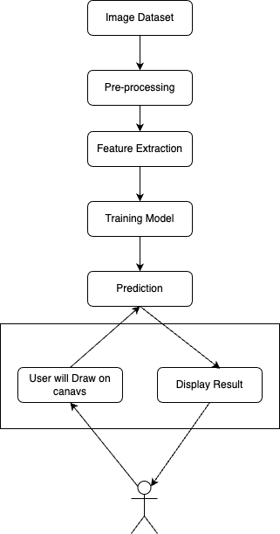
Block Diagram
user

Slide 10
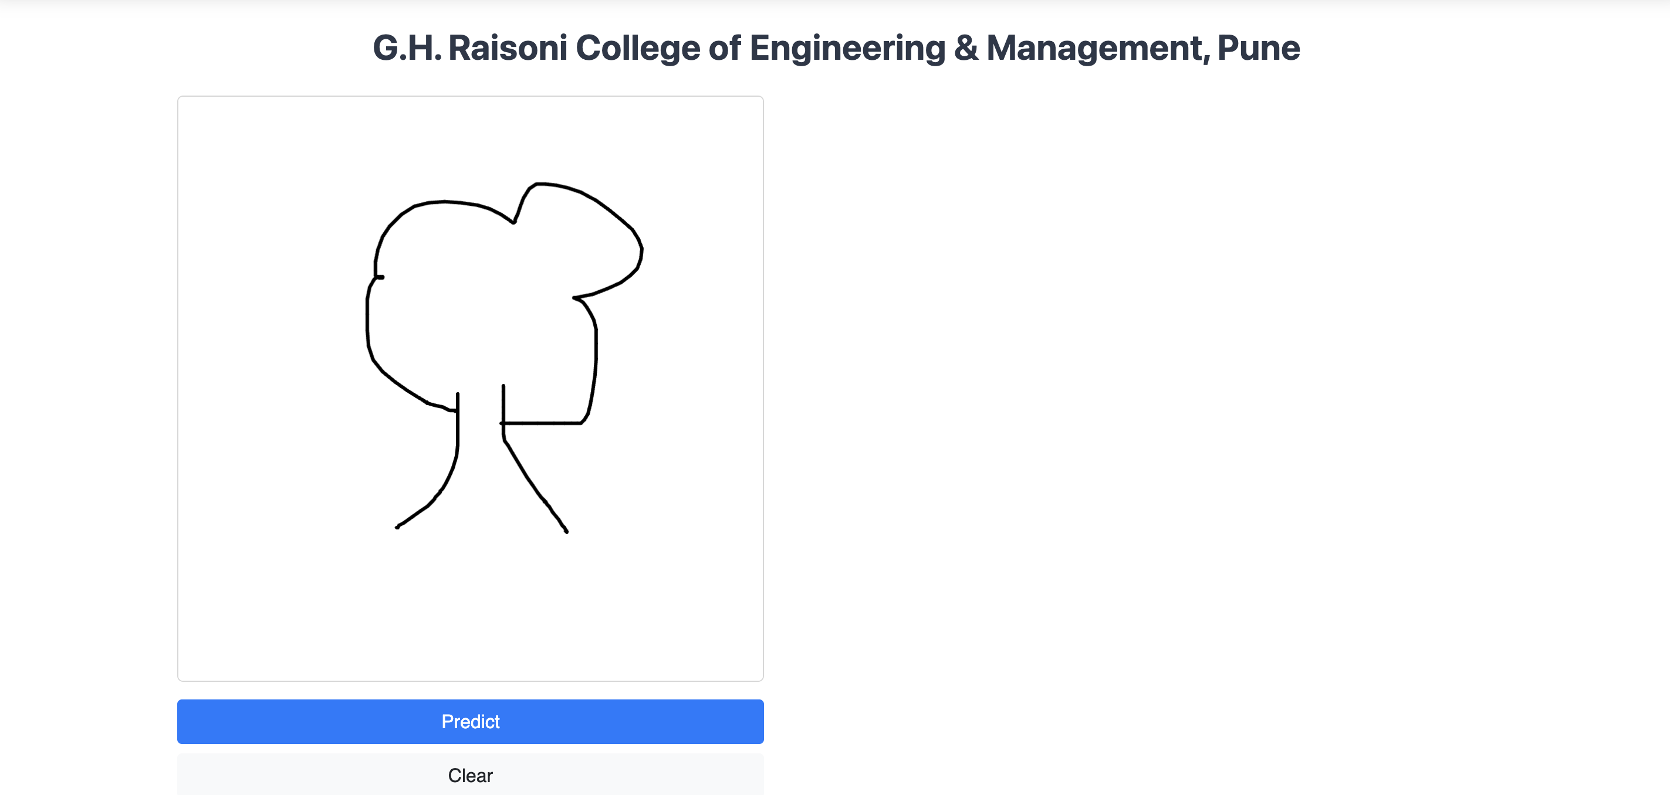
Expected Result
User-Friendly Interface: The project should provide an intuitive and user-friendly interface for users to interact with the system. Users should be able to easily input their doodles and receive prompt responses.
Accurate Doodle Recognition: The primary expected result is a machine learning model that accurately recognizes and guesses hand-drawn doodles. This means that when users submit doodles, the system can correctly identify and categorize them.
Feedback and Improvement Mechanisms: The project may include mechanisms for users to provide feedback on the accuracy of the doodle recognition. This feedback can be used to improve the machine learning model over time.
Top 3 Predictions here

Slide 11
References
Google’s Open source dataset: https://github.com/googlecreativelab/quickdraw-dataset
CNN for Image Detection and Recognition: https://ieeexplore.ieee.org/abstract/document/8703316
Object Detection With Deep Learning: https://ieeexplore.ieee.org/abstract/document/8627998
FastAPI Handbook: https://www.freecodecamp.org/news/fastapi-quickstart

Slide 12
Thank you !

