Slide 1




G.H. RAISONI COLLEGE OF ENGINEERING
AND MANAGEMENT, WAGHOLI, PUNE.
Department of AI & AIML
Laptop Price Prediction
Guide: Nutan Raut
Name of Projectees
Chaitany Tuppe Harshal Patil
Tushar Jadhav

Slide 2
Contents
Introduction
Justifications for Selecting the Title
Problem Statement
Literature Survey
Block Diagram
Expected Result
Work plan
References

Slide 3

Introduction
This presentation explores data science techniques for forecasting laptop prices. Accurate price predictions are crucial for businesses to stay competitive.
In this presentation, we will discuss the importance of forecasting laptop prices and how data science techniques can help achieve accurate predictions.

Slide 4
Justification For Selecting The Title
Forecasting laptop prices is important for businesses to stay competitive in the market.
Accurate predictions can help businesses make informed decisions about pricing strategies, inventory management and marketing campaigns.
Inaccurate predictions can lead to lost sales and decreased proﬁts.
It helps user to get accurate pricing of there desired configuration laptop

Slide 5
Problem Statement
The problem statement is that if any user wants to buy a laptop then our website should be compatible to provide a tentative price of laptop according to the user configurations.

Slide 6
Literature Survey
Sr. No. | Paper Title and its Author | Details of Publication | Findings
1 | "Predictive Modeling of Product Prices Using Machine Learning Techniques“ (John A. Smith) | Journal of Machine Learning Research, 2018 | Comparative analysis of various machine learning algorithms for predicting prices.
2 | Feature Engineering for Price Prediction (Emily R. Williams) | IEEE Transactions on Knowledge and Data Engineering, 2019 | Investigates the impact of various feature engineering techniques on the accuracy of laptop price prediction models.

Slide 7
Block Diagram
Data Collection
Data Pre-processing
Feature
selection
Machine learning Model
Predicting Output
Model Evaluation
Model Deployment

Slide 8
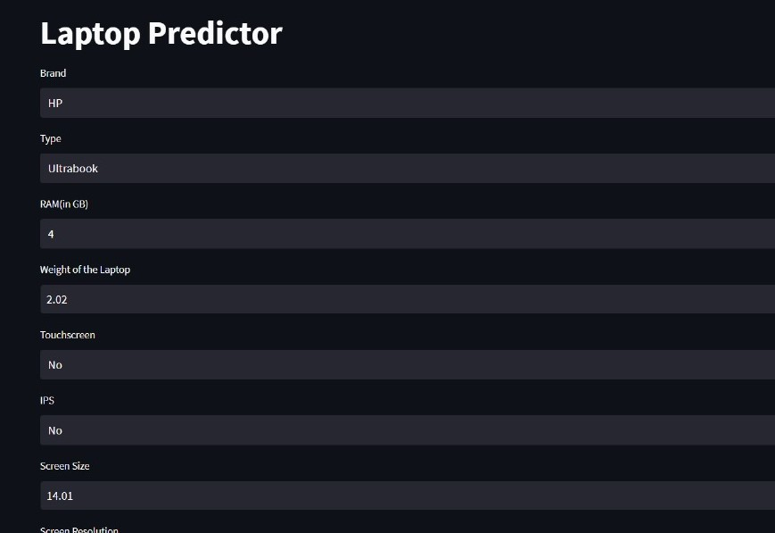
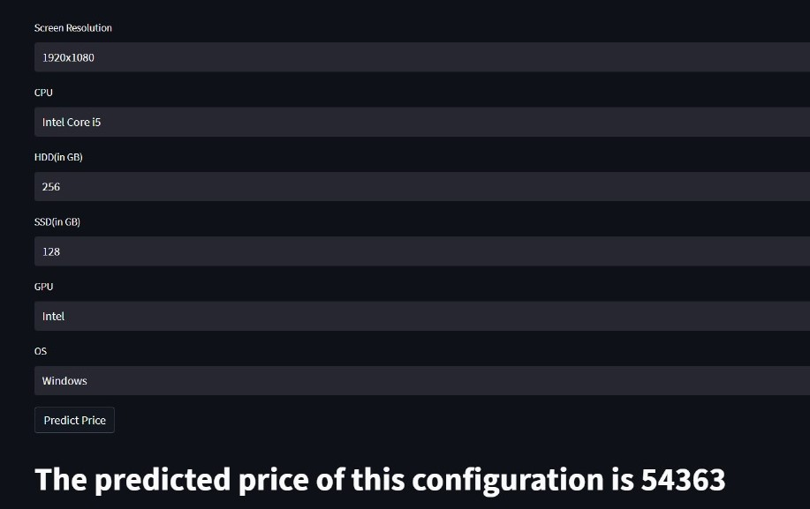
Expected Result
Input:
Expected output :

Slide 9
Work – Plan
Months Activities | August’23 | Sept’23 | Oct’23 | Nov’23
Literature Reviews | √
Requirement Analysis | √
Designing | √
Experimental Analysis | √ | √ | √
Module wise Implementation |  | √ | √
Testing and Debugging |  |  | √ | √
Preparation of Project Report |  |  |  | √

Slide 10
References
Online Courses:
“Machine Learning Playlist” by Krish Naik (You Tube)
Dataset:
- Kaggle website to collect the data of laptop price.
Reports and News:
- Various Newspaper to stay updated
- “ A study of Pricing Models for Laptop”
by Priyanka Singh and Karthik Balkrishnan

Slide 11
Thank you !

