Slide 1
BDAT 1001 – Information encoding standards
Final Group Project – G4
Trupal Vijaykumar Chaudhary
Amit Malik
Khushi

Slide 2
Project Summary
Part 1
In this project, we developed an ASP.NET Core web app that uses authorization to protect user data. The app displays a list of contacts that registered users have created, which can be approved, rejected, edited, or deleted by managers or administrators, depending on their role.
The project showcases three security groups with different permissions and highlights the importance of role-based access control to safeguard sensitive information.
Part 2:
As a security consultant, we provided recommendations for various security technologies to address a company's concerns. We suggested using encryption protocols to securely transfer personal data within their network.
We also recommended implementing a secure API architecture to allow external access to their database and suggested using a secure coding framework for developing the API.
Finally, we discussed ethical concerns related to the transmission of personal data and suggested storing data in secure locations using appropriate encryption techniques.

Slide 3
ABOUT US
Trupal Chaudhary – Bachelor’s in Computer Engineering
Work Contribution : Development of ASP.NET CORE Web Application by implementing concepts of Authorization
Amit Malik – Bachelor’s in Computer Engineering
Work Contribution : Aided in Development of the Web Application by setting up SQL server using docker and brainstormed on the security recommendations along with Khushi
Khushi – Master of Computer Application (MCA)
Work Contribution : Provided Security Recommendations along with Amit and developed/formatted the Presentation

Slide 4
PART 1 : Authorization
We focused on developing a web application using ASP.NET Core that implements an authorization mechanism to protect user data. The application is designed to display a list of contacts that registered users have created, which can be approved, rejected, edited, or deleted by managers or administrators, depending on their role. The project shows the importance of implementing role-based access control to safeguard sensitive information and prevent unauthorized access.
We utilized the built-in Identity framework, which provides a complete user authentication and authorization system that is easy to configure and customize.
Furthermore, we used Entity Framework Core, to interact with the database and perform CRUD operations on contacts.
Overall, this project provides a practical example of how to build a secure web application that protects user data from unauthorized access.

Slide 5
Demonstration
There are three security groups:
Registered users can view all the approved data and can edit/delete their own data.
Managers can approve or reject contact data. Only approved contacts are visible to users.
Administrators can approve/reject and edit/delete any data.

Slide 6
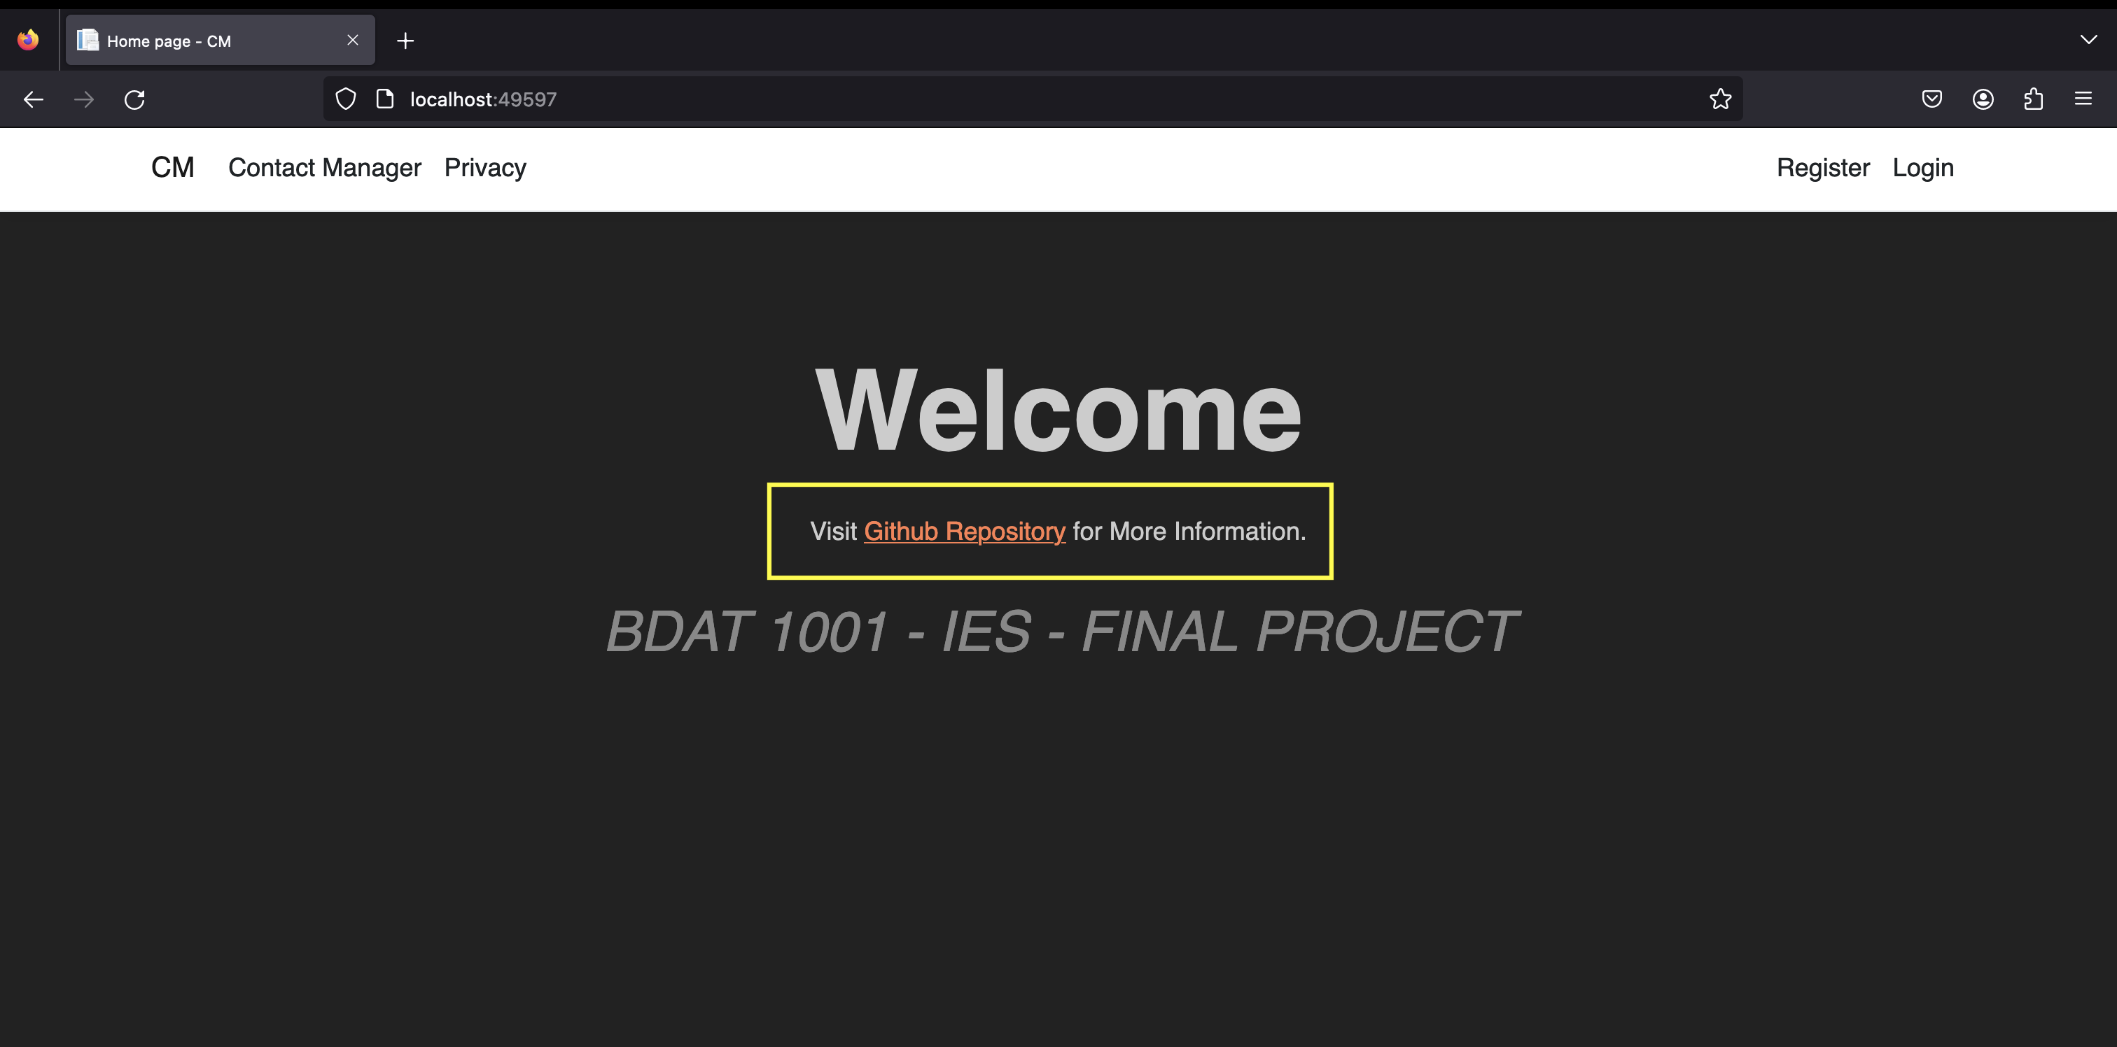
Index Page : Modified the Index Page to include the link to the GitHub Repository. Also performed minor CSS Styling.

Slide 7
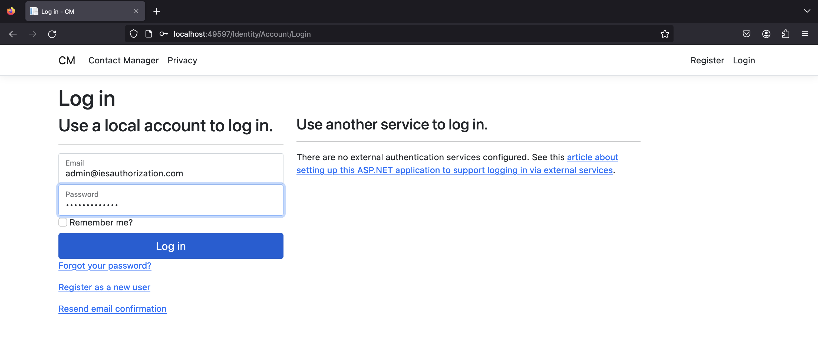
Login Page : The Login Page authenticates the users according to their username and passwords (stored as hashes) by using Identity API of ASP.NET Core

Slide 8
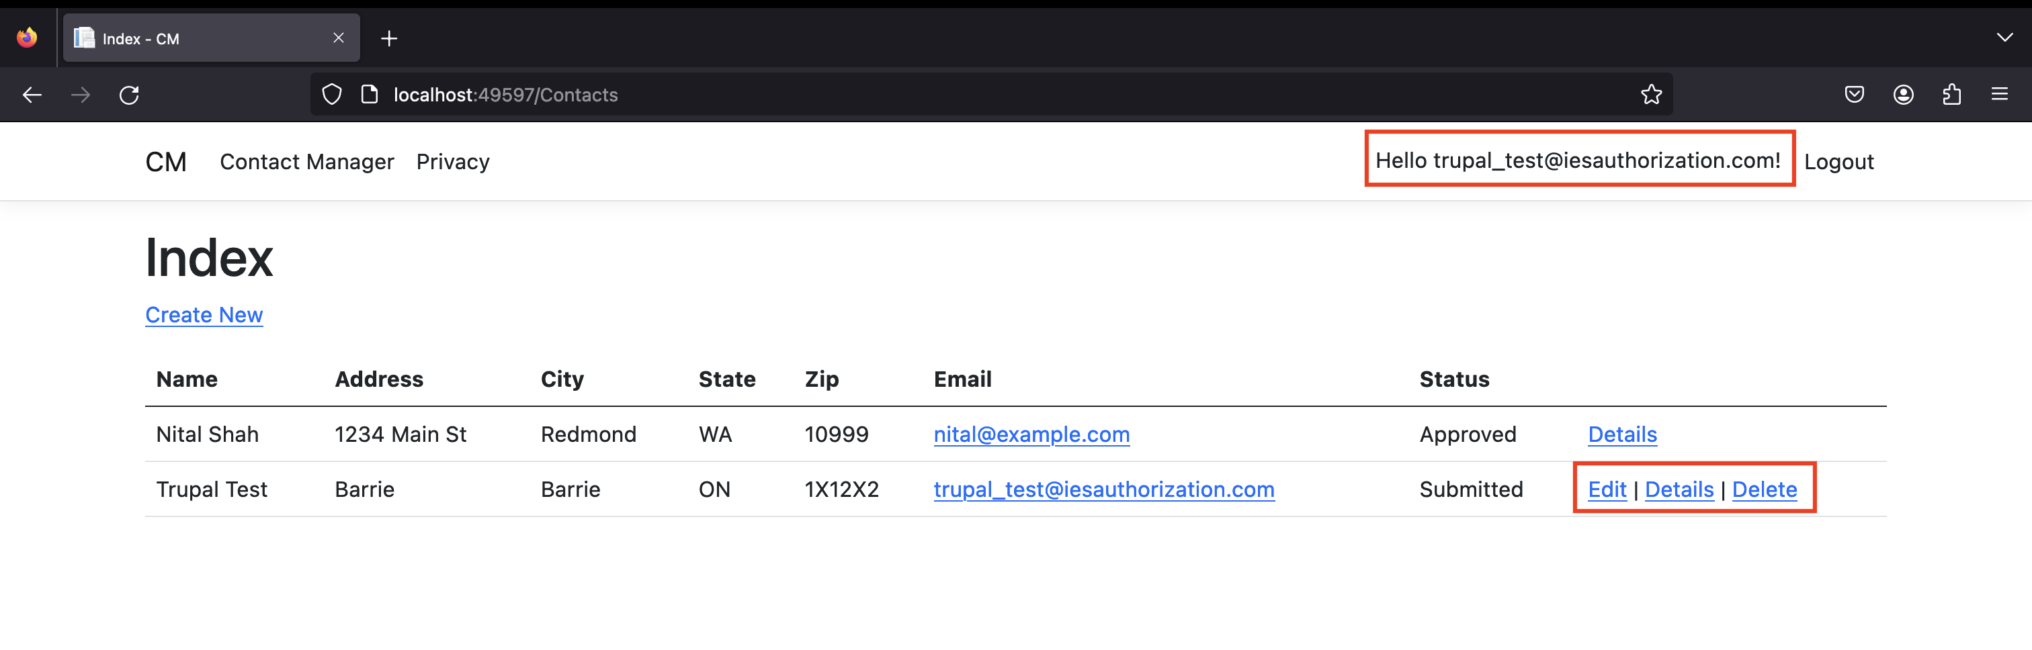
In the following image, user Trupal (trupal_test@iesauthorization.com) is signed in. He can only view approved contacts and Edit/Delete/Create New links for his contacts.
Only the last record, created by him, displays Edit and Delete links. Other users won't see the last record until a manager or administrator changes the status to "Approved".

Slide 9
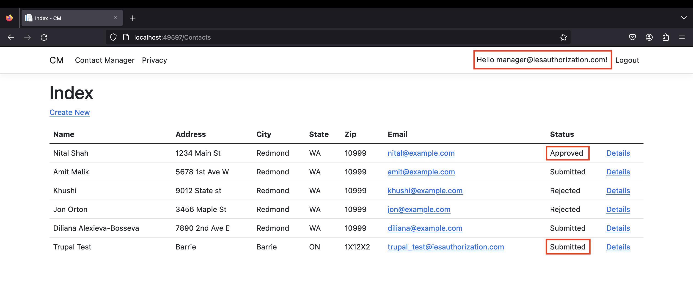
In the following image, manager@iesauthorization.com is signed in and in the manager's role:

Slide 10
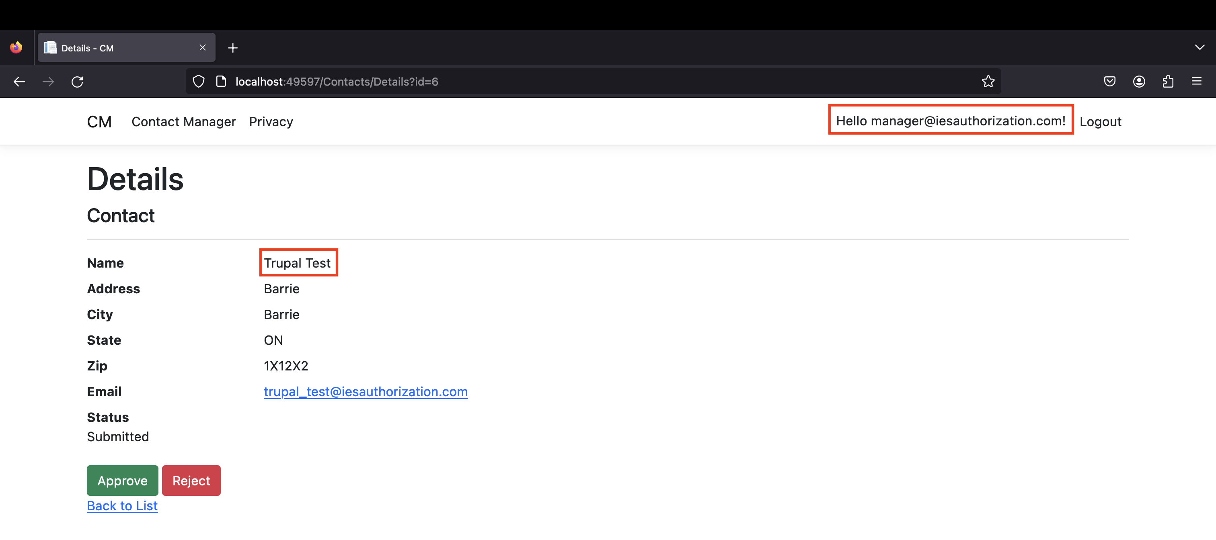
The following image shows the managers details view of a contact:
The Approve and Reject buttons are only displayed for managers and administrators.

Slide 11
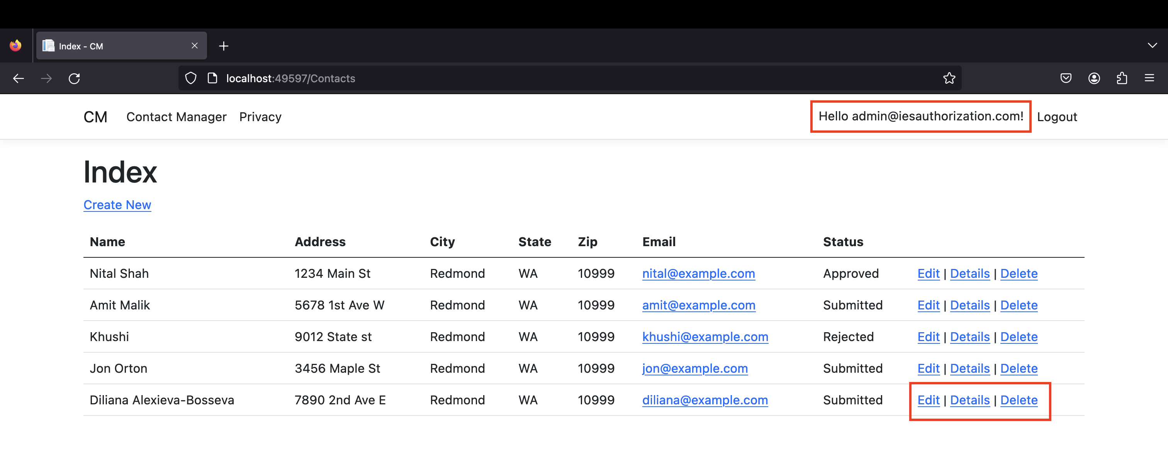
In the following image, admin@iesauthorization.com is signed in and in the administrator's role:
The administrator has all privileges. She can read, edit, or delete any contact and change the status of contacts.

Slide 12
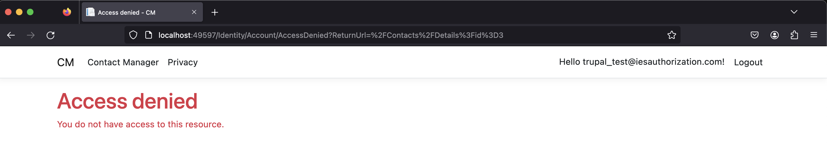
To check if the authorization is working properly, we try to open the details view URL in the test user session:
http://localhost:49597/Contacts/Details?id=3

Slide 13
PART 2 : Security Recommendations
We acted as security consultants for a company and provided recommendations on various security technologies to address their concerns.
Overall, our recommendations provided a comprehensive and practical approach to ensure the security of personal data within the company's network, enabling them to meet regulatory compliance requirements and protect their reputation.

Slide 14
1. How can we transfer personal data securely within their network?
Secure transmission of personal data within a network requires some means of ensuring the confidentiality, integrity and availability of the data. Here are some steps we can take:
Encryption: Encryption is the process of converting data into code that is unreadable without the proper decryption key. Encrypting personal data ensures that even if the data is intercepted, it cannot be read without the decryption key.
Use secure file transfer protocols: There are several secure file transfer protocols available, such as Secure FTP (SFTP) and HTTPS. These protocols use encryption to protect the data in transit and provide authentication to ensure that only authorized users can access the data.
Regularly update software and security patches: It is essential to keep all software and security patches up-to-date to prevent any vulnerabilities from being exploited. This is especially important for systems that are accessible from the internet.
Implement data loss prevention (DLP): DLP solutions can monitor data in real time and prevent it from being sent outside your network or to unauthorized third parties. Examples : Intrusion Detection Systems, McaFee DLP, Trend Micro DLP

Slide 15
2. What security protocol is best for transferring personal files?
Here are some of the most commonly used security protocols for transferring personal files:
SFTP (Secure File Transfer Protocol): SFTP is a secure protocol that uses SSH (Secure Shell Protocol) to encrypt and secure data during transfer. SFTP is widely used for transferring sensitive files securely, and it is supported by most operating systems and file transfer clients.
FTPS (File Transfer Protocol Secure): FTPS is an extension of FTP that adds SSL/TLS encryption to protect data during transfer. FTPS is a good choice for transferring large files securely, but it requires a separate SSL/TLS certificate.
HTTPS (Hypertext Transfer Protocol Secure): HTTPS is a secure version of the HTTP protocol used for communication between web servers and web browsers. It uses SSL/TLS encryption to protect data during transmission. If we need to transfer personal files via a web browser, using HTTPS can provide an additional layer of security.

Slide 16
3. Can we encode and encrypt images?
It is possible to encode and encrypt images. Image encoding involves converting an image from one format to another, while encryption involves using cryptographic algorithms to scramble the data so that it can only be read by someone who has the decryption key.
Some image file formats like PNG and JPEG support encoding and encryption by compressing the image data and encrypting the compressed data. However, it is important to ensure that the original image quality is not significantly compromised during the encoding and encryption process.
Cryptography involves using encryption algorithms such as Advanced Encryption Standard (AES), Data Encryption Standard (DES), or RSA Algorithm to encrypt the image data. The encrypted image can only be accessed by someone who has the decryption key.

Slide 17
4. Our database cannot be moved from A site, and we need to be able to access it externally using a secure API. Can you explain the architecture of a secure API?
Authentication: To access the API, users must first be authenticated using secure authentication measures such as OAuth, JWT, or API Keys. This ensures that only authorized users can access the API.
Authorization: Once authenticated, the API should apply appropriate authorization rules to ensure that only authorized users can access certain data or perform certain actions. This can be achieved by using permit certificates to control access to specific data.
Rate limiting: To prevent abuse and denial-of-service attacks, APIs should implement rate limiting to limit the number of requests that can be made in a given period of time.
Logging and monitoring: APIs should log all requests and responses, including errors and anomalies, and monitor for suspicious activity and unusual traffic patterns.
Overall, these security measures help to maintain the confidentiality, integrity, and availability of data accessed and transmitted through the API.

Slide 18
5. Can you recommend a secure framework for coding an API?
ASP.NET Core: This is a framework for building web applications and APIs using the .NET platform. It provides several security features such as authentication, authorization, and protection against cross-site scripting and cross-site request forgery (CSRF) attacks. CSRF is an attack that tricks the victim into submitting a malicious request.
Flask: Flask is a lightweight Python web framework that is easy to use and highly customizable. It offers a range of extensions that can be used to add security features, such as CSRF protection and JWT authentication.
Ruby: This is a popular Ruby framework that is used for building web applications and APIs. It provides several security features such as CSRF protection, input validation, and protection against SQL injection.

Slide 19
6. What data interchange format should we use while transferring data between locations?
JSON (JavaScript Object Notation): This is a lightweight data interchange format that is easy to read and write. It is widely supported by modern programming languages and is commonly used for web APIs and mobile applications.
XML (Extensible Markup Language): This is a markup language that is used for encoding documents in a format that is both human-readable and machine-readable. It is widely used for data interchange and is supported by many programming languages and technologies.
CSV (Comma-Separated Values): This is a simple data interchange format that uses commas to separate values in a text file. It is commonly used for exchanging tabular data between applications.

Slide 20
7. How should we store our data in our many locations?
Cloud-based storage: Cloud-based storage is becoming increasingly popular due to its scalability and flexibility. This type of storage allows you to store data in a remote server that can be accessed from any location with an internet connection. Cloud-based storage also offers automatic backups and disaster recovery options.
Distributed data storage: Another option is to store data in a distributed manner, with each location having its own server or storage device. This approach can improve performance and minimize the risk of data loss due to a single point of failure. However, it can be more complex to manage and synchronize data across multiple locations
Backup and disaster recovery: Regardless of the storage approach, backup and disaster recovery plans are essential to ensure the availability and integrity of data. This includes regular backups, data replication, and redundant storage devices.
Data security: All data storage solutions should prioritize data security. This includes access control, encryption, and regular security audits.

Slide 21
8. What are the ethical concerns related to the transmission of personal data?
Privacy: Personal data can include sensitive information such as a person's name, address, contact details, medical records, and financial information. The unauthorized transmission or use of this data can lead to breaches of privacy, identity theft, and other malicious activities.
Security: Personal data must be protected from unauthorized access, modification, or disclosure. Companies must implement appropriate security measures to ensure the confidentiality and integrity of personal data.
Transparency: Companies should be transparent about their data practices and provide clear and concise information about how personal data is collected, used, and transmitted. Lack of transparency can undermine trust and lead to ethical concerns.
Accountability: Companies are responsible for ensuring that personal data is processed in compliance with applicable laws and regulations. This includes taking appropriate measures to prevent data breaches and responding to incidents in a timely and responsible manner.

Slide 22
Thank YOU

