Slide 1

EDA on BigMart Sales
Project by:
Trupal Vijaykumar Chaudhary (200557631)
Sushank Saini (200540699)
Arun saMBATH
MUSTAFA

Slide 2
Objective
The objective of this project is to utilize the "BigMart Sales" dataset to conduct Exploratory Data Analysis by retrieving the data from a remote URL, storing it in MongoDB, and building a FastAPI application to expose the data.
Additionally, the project aims to create visualizations using Google Charts to enhance data interpretation and analysis.

Slide 3
Dataset: BigMart Sales
Source : https://www.kaggle.com/datasets/brijbhushannanda1979/bigmart-sales-data
The dataset contains a set of 8,523 records (rows) under 12 attributes (measures and categories/dimensions)
Few Measures/Aggregates found in the dataset are with their ranges:
1. Item_Visibility – The % of total display area of all similar products in a store
2. Item_MRP – The Maximum Retail Price for a product
3. Item_Outlet_Sales – Sales of the product in the specific outlet
Few Categories/Dimensions found in the dataset are:
1. Item_Type – Product Category
2. Outlet_Size – The size of the store
3. Outlet_Type – Grocery store or a type of Supermarket

Slide 4
Our Team
1. Trupal Chaudhary – Developer
Work Contribution: Developed front-end and back-end of the application along with cloud implementation
2. Arun Sambath– Project Lead
Work Contribution: Managed the deliverables of the project, aided in documentation
3. Sushank Saini – Data Analyst
Work Contribution: Acquired data, built database and aided in creating visualizations with developer
4. Mustafa– Business Analyst
Work Contribution: Built documentation for proposal and aided DA in visualizations

Slide 5
Programming Languages and Cloud Infrastructures
- Python
- FastAPI / Uvicorn
- Google Charts
- Nginx
- Amazon EC2: VM to host web application
- Amazon S3
- MongoDB: Database

Slide 6
Why FastAPI
Great performance
FastAPI surpasses Flask in terms of performance, and it is one of the fastest Python web frameworks.
Because of ASGI, FastAPI supports concurrency and asynchronous code by declaring the endpoints.
Built-in concurrency
For concurrent programming, Python 3.4 introduced Async I/O.
FastAPI simplifies concurrency by eliminating the need for an event loop or async/await management.

Slide 7
Data Flow
1. Using Python, Acquired the data from a remote source (https://dp-final-project.s3.ca-central-1.amazonaws.com/Train.csv)
2. Then stored the fetched data into MongoDB using python and pymongo.
3. Created a pseudo-batch process that runs every 24-hours to acquire data and store into database.
4. Used FastAPI along with Jinja2 to create a web application.
5. Using Google Charts (js), created visualizations for Univariate Analysis of the dependent and independent variables.
6. Created a Bonus API which a. gets all item, b. gets range of items, c. gets item by id
7. Using Amazon EC2, hosted the FastAPI using uvicorn and nginx

Slide 8
Target Audience
The target audience for this business case includes
stakeholders from BigMart,
researchers and
other competitors
who want to remain competitive in today’s data-driven world.

Slide 9
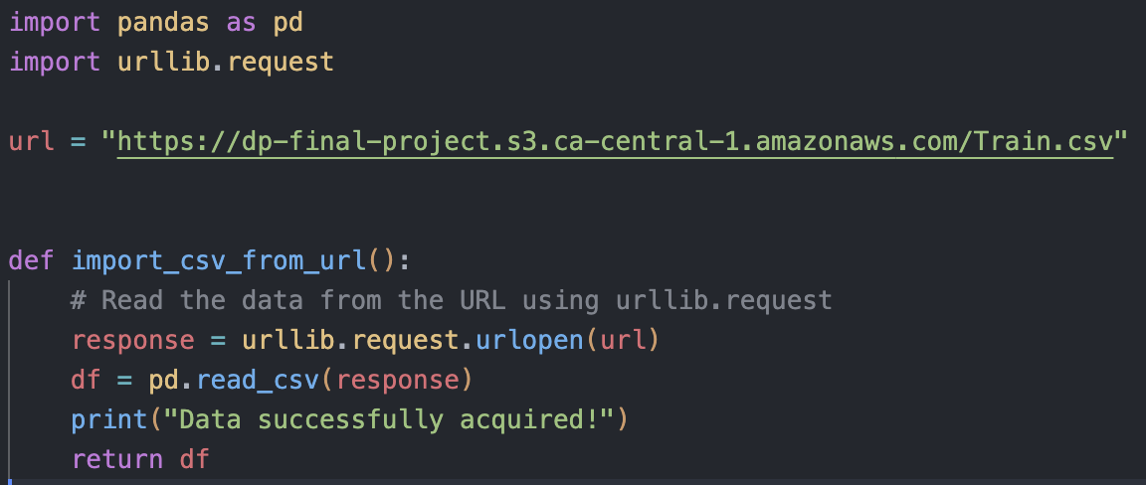
Demo and Screenshots

Slide 10
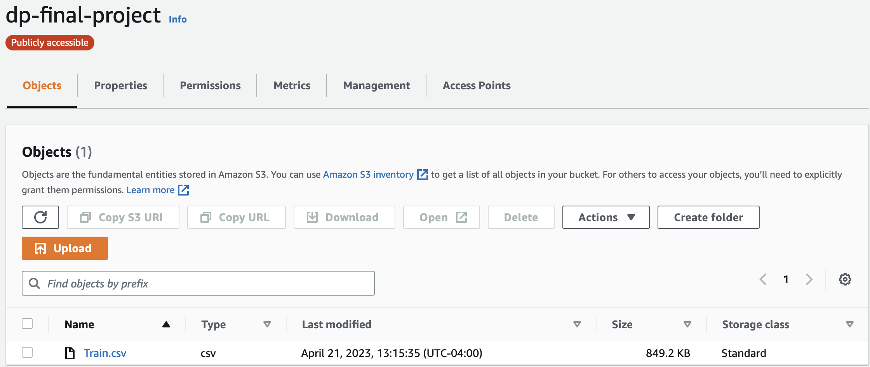

Slide 11
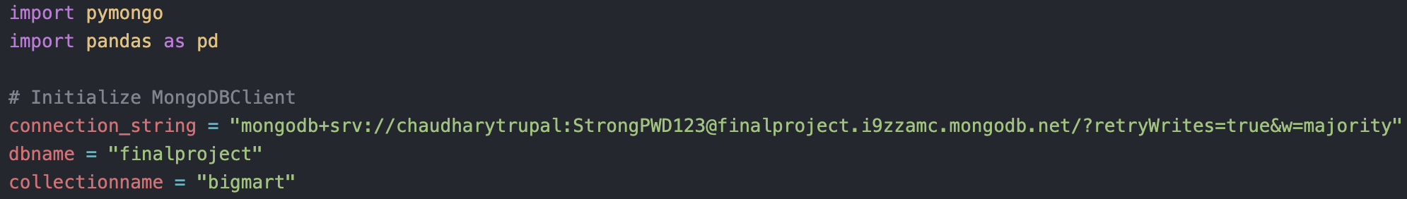
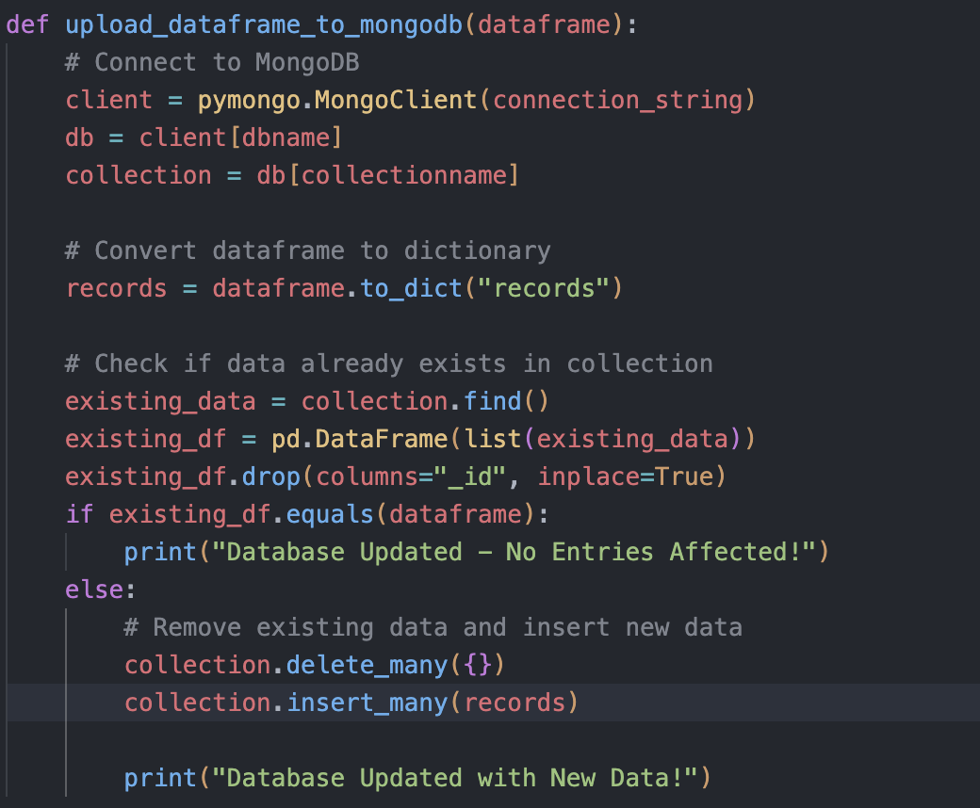

Slide 12
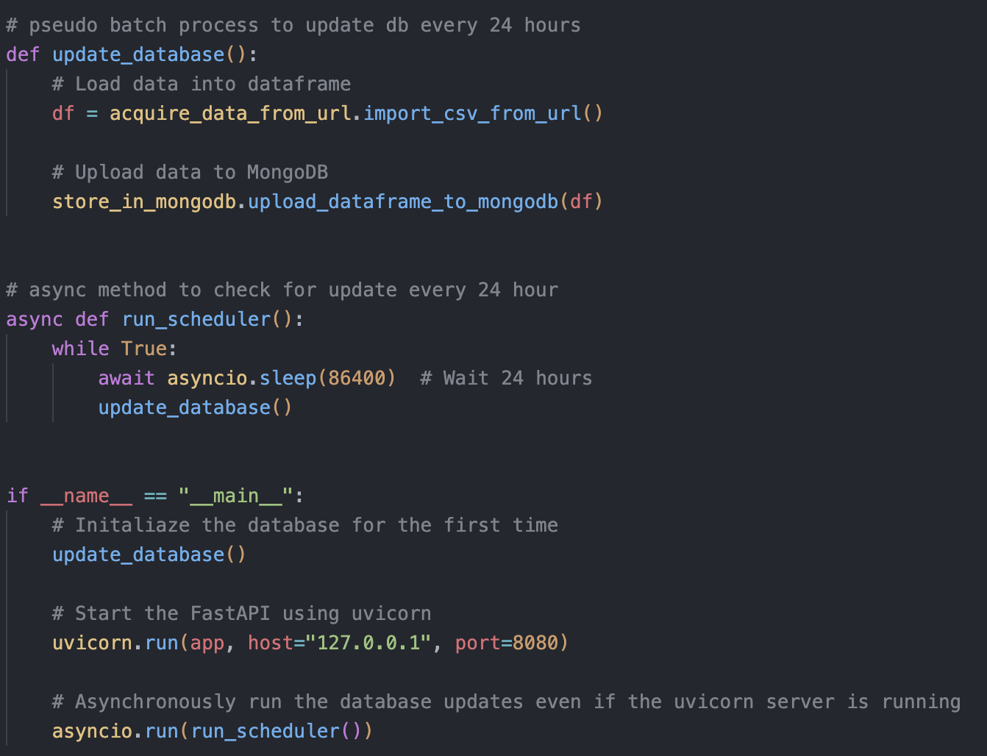

Slide 13
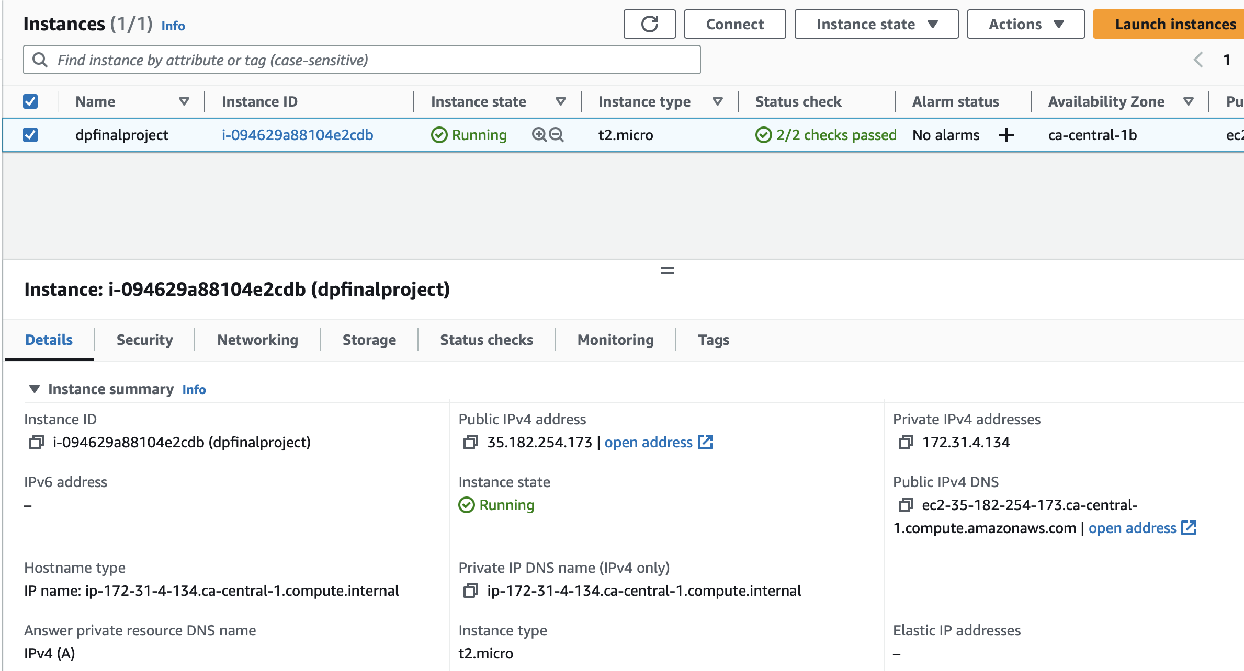

Slide 14
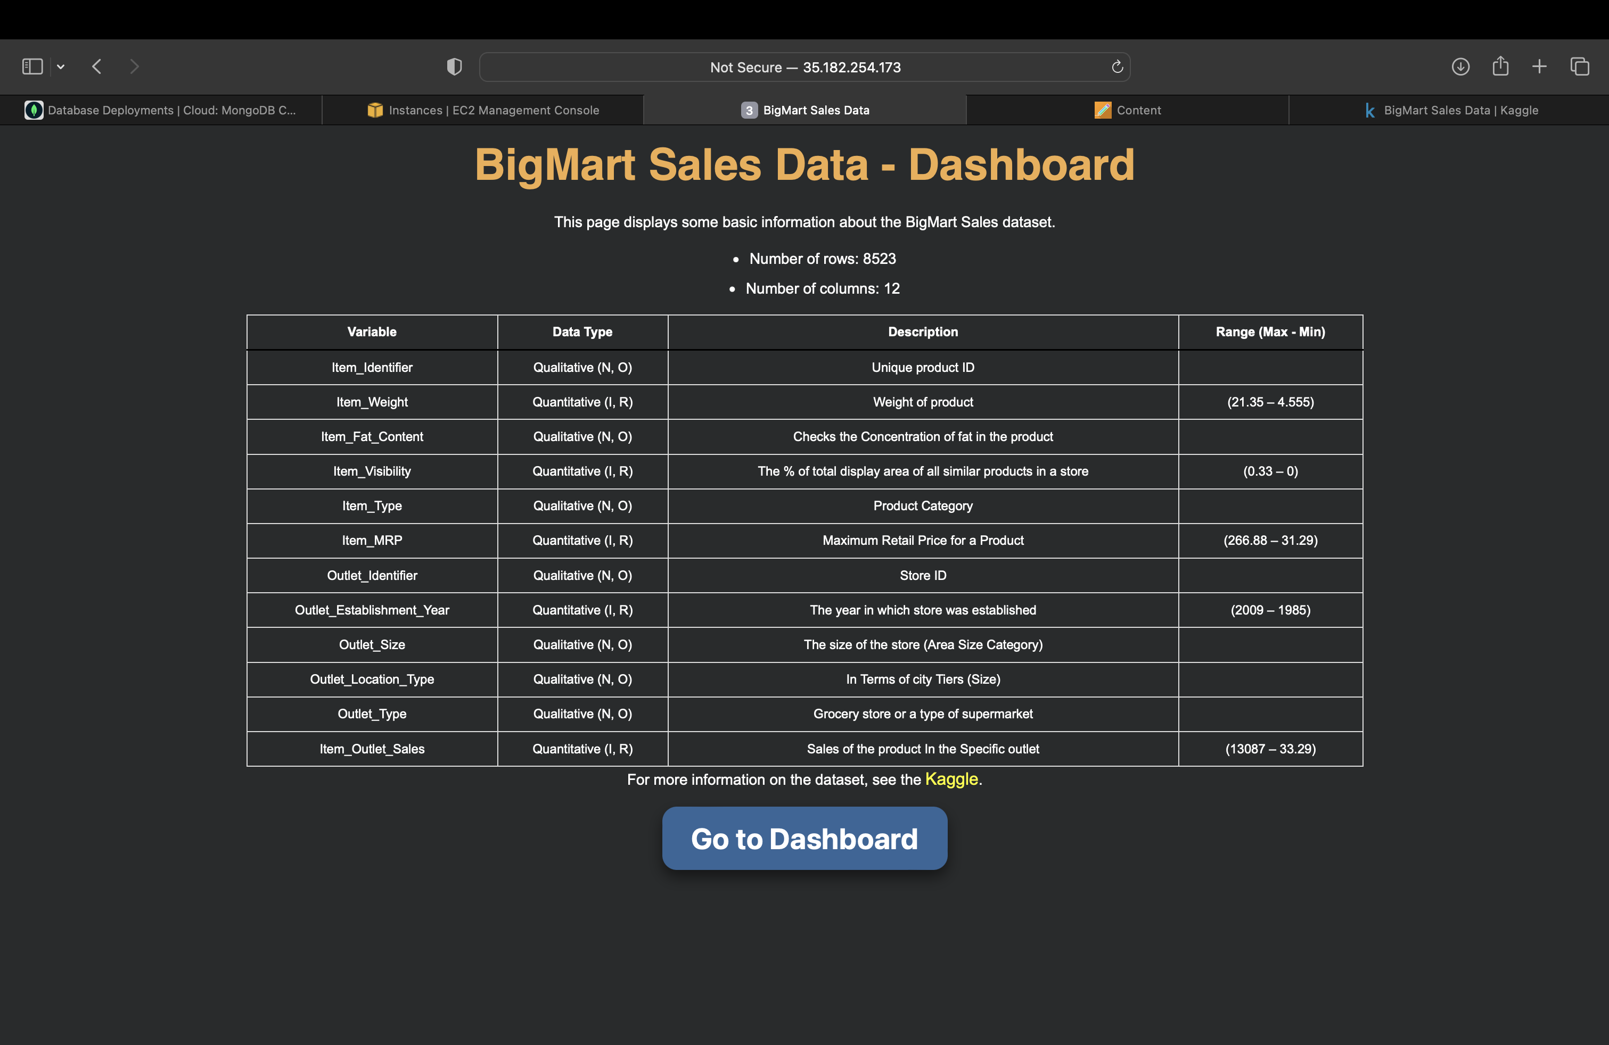
Website : http://35.182.254.173
Bonus API:
1. Get all Items: 35.182.254.173/data
2. Get Range of Items: 35.182.254.173/data/OUT10/OUT30
3. Get item by id: 35.182.254.173/data/FDA15

Slide 15
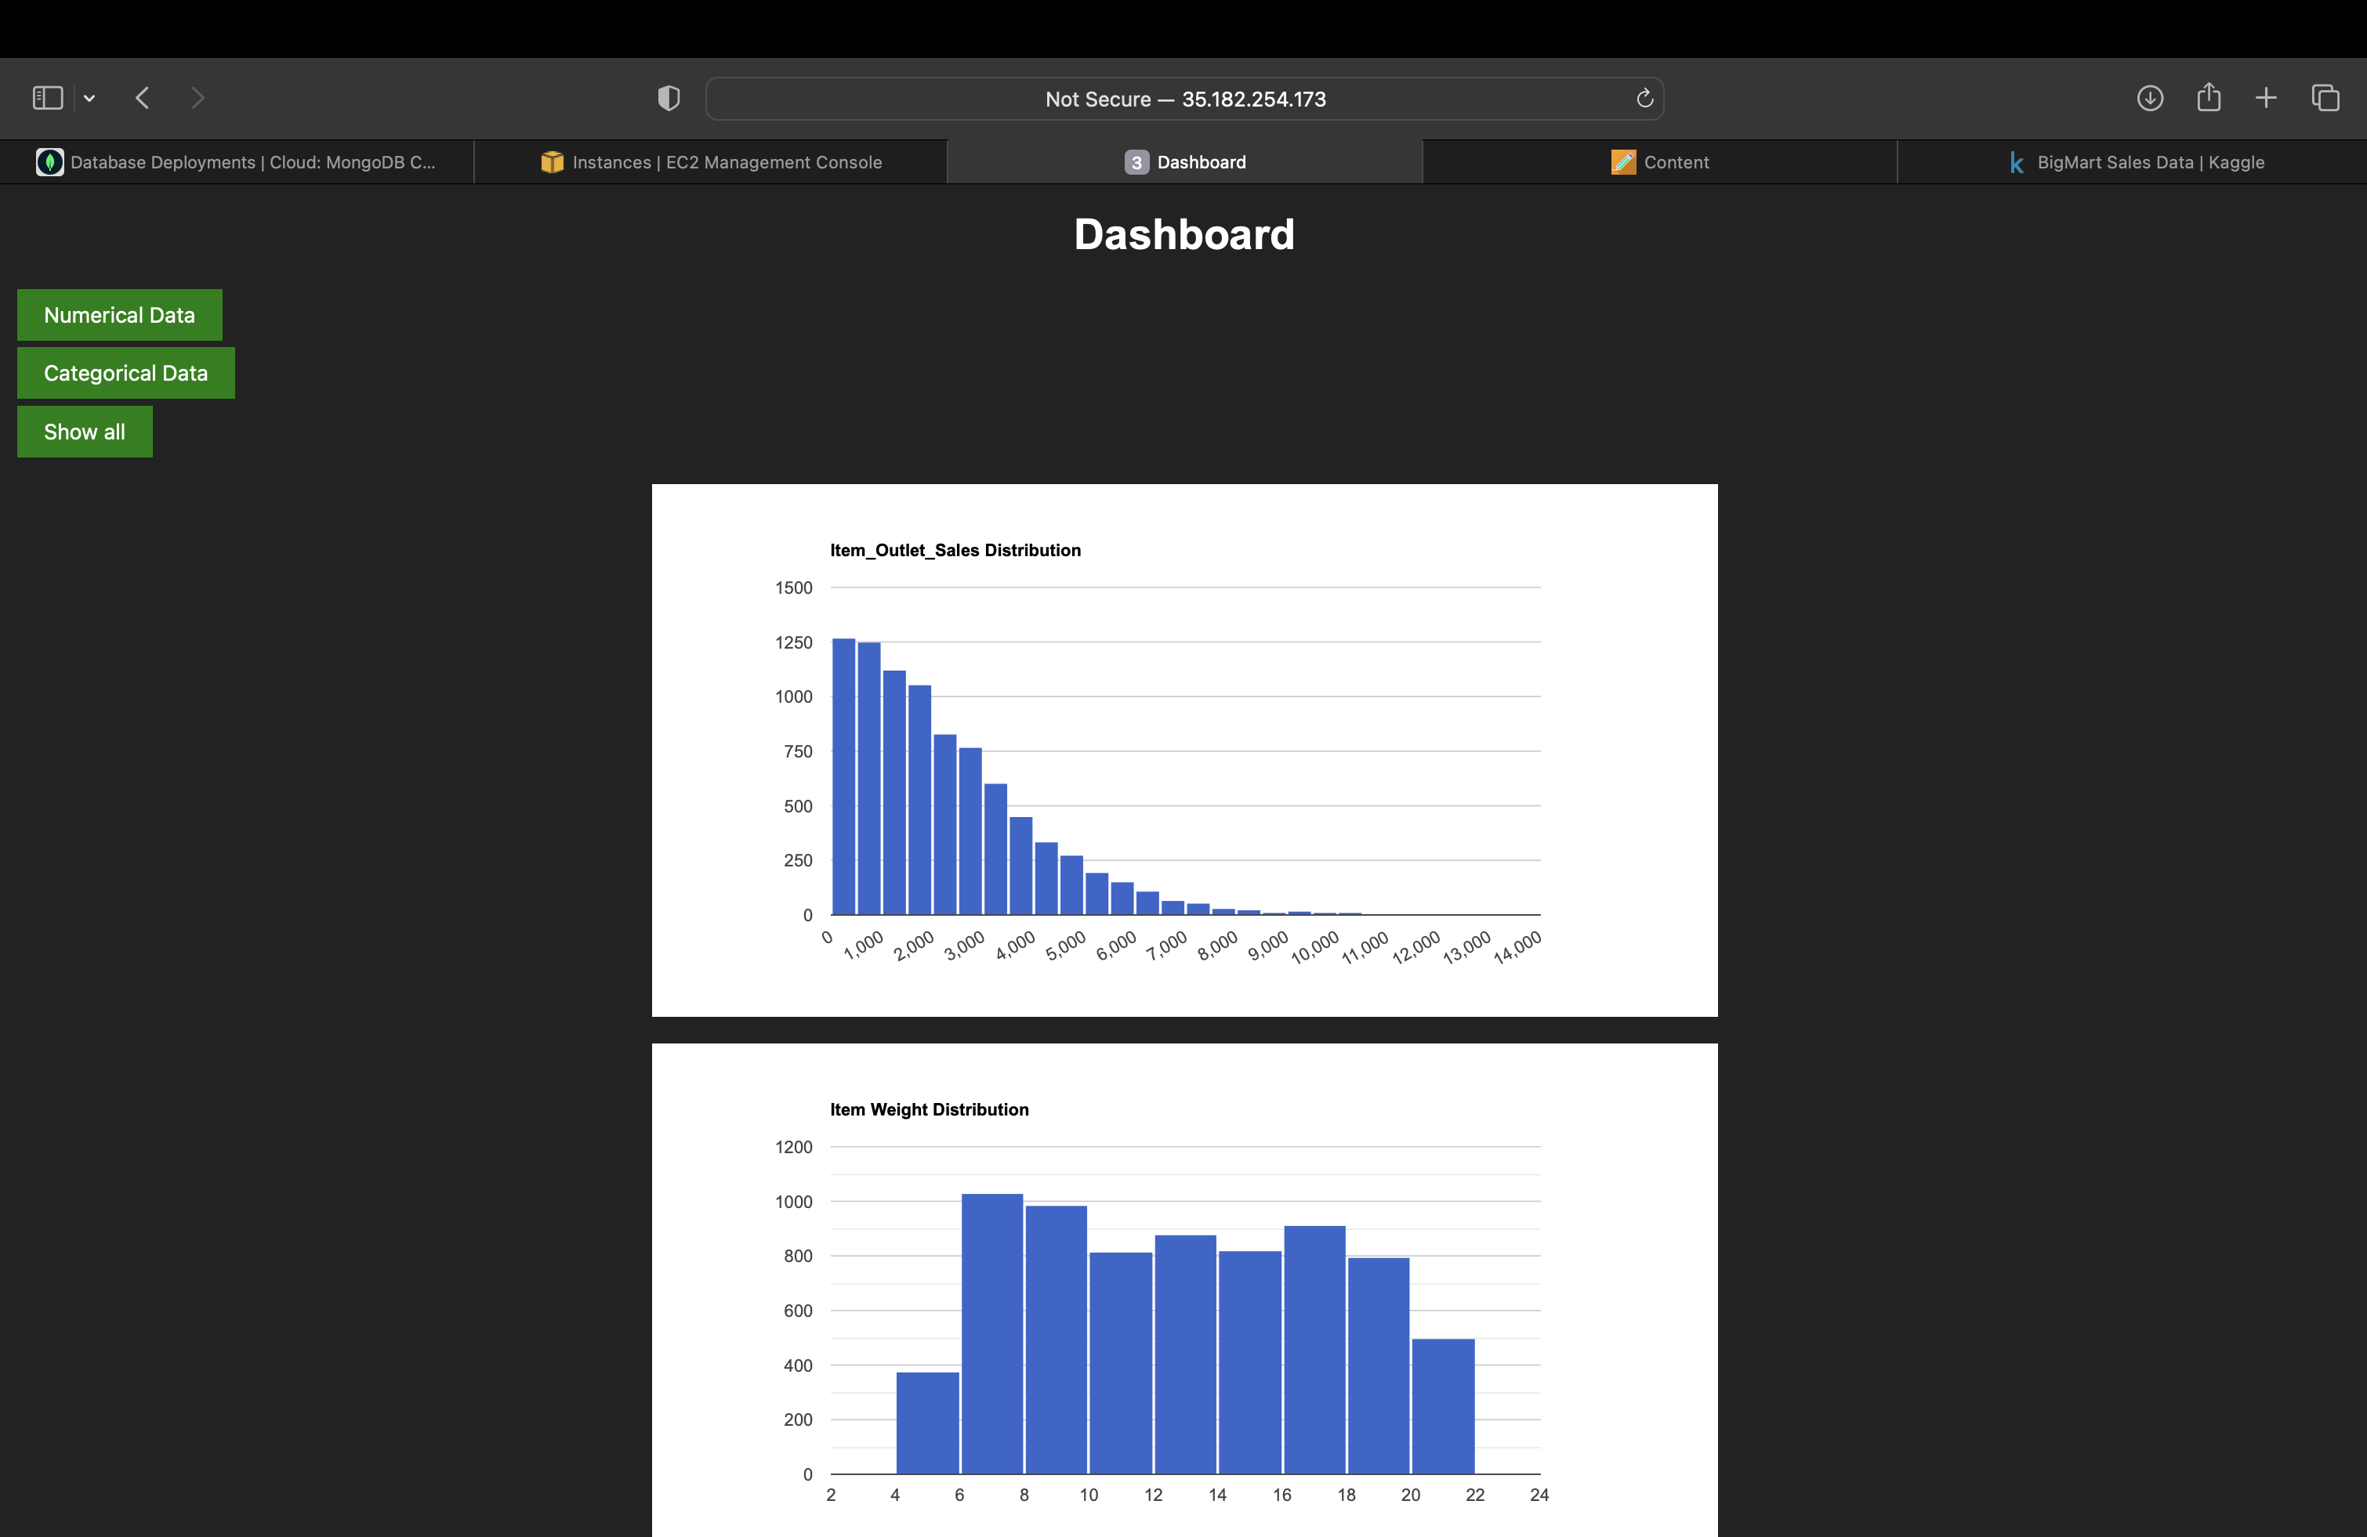

Slide 16
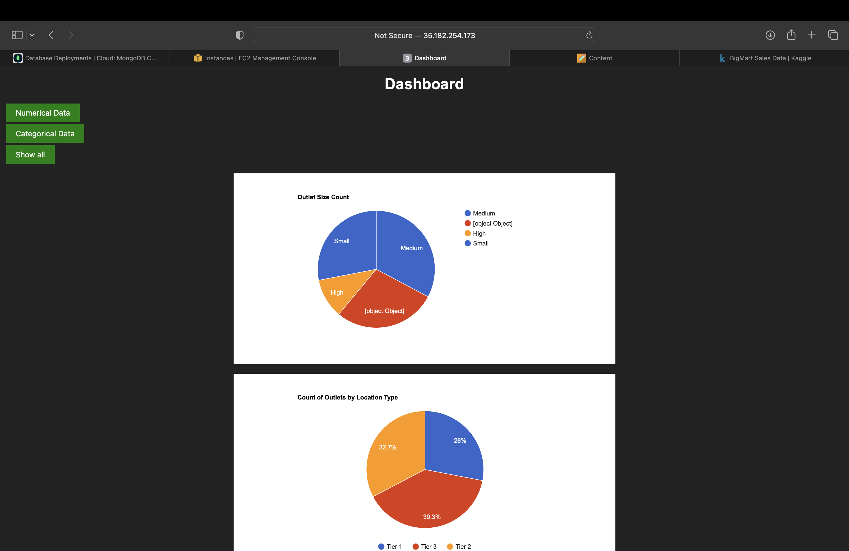

Slide 17
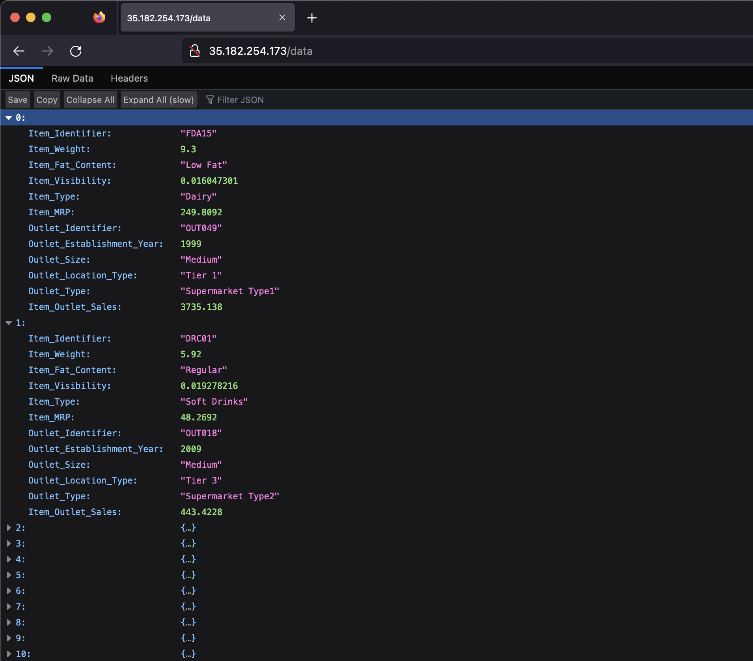

Slide 18
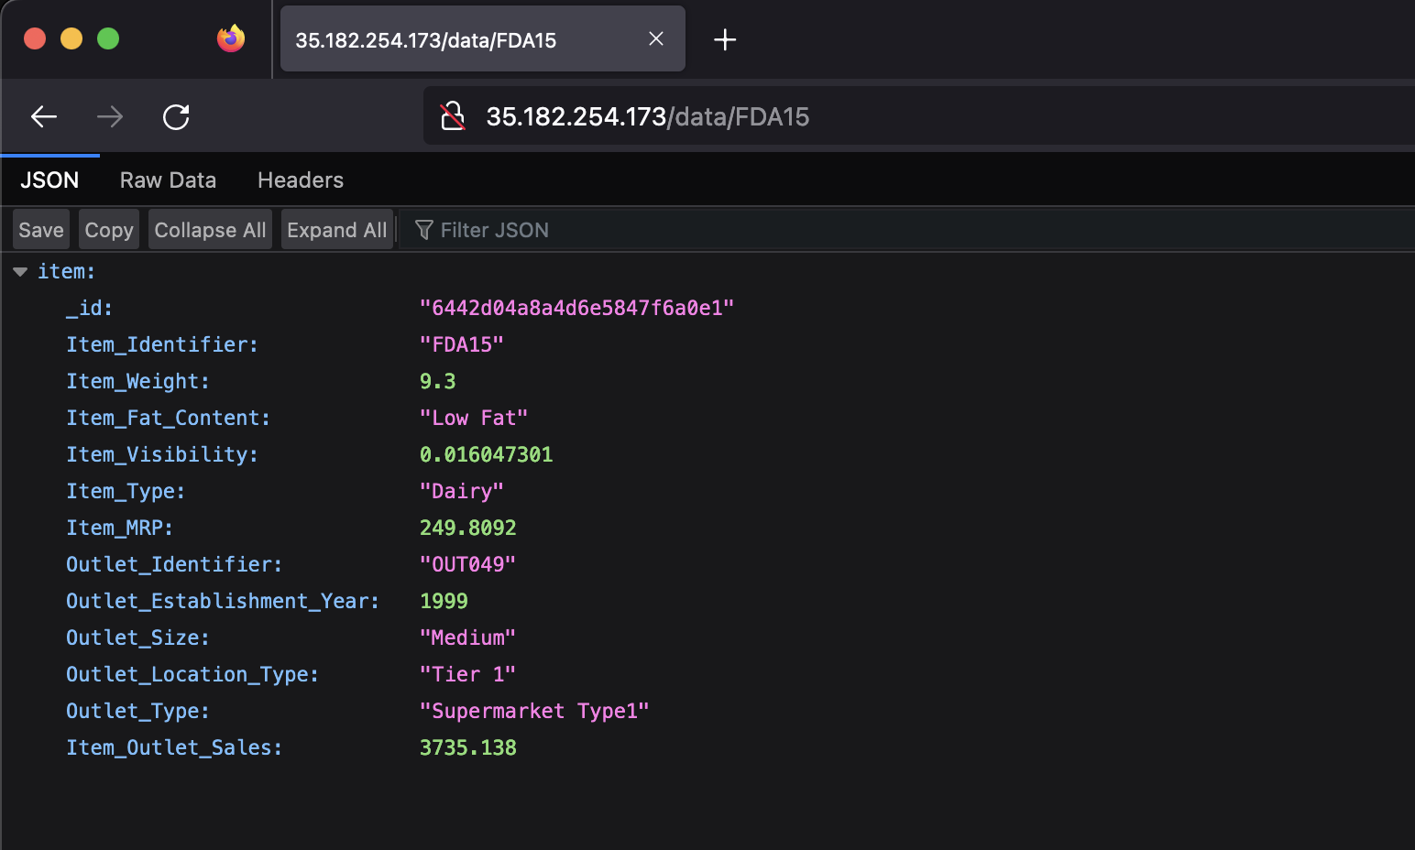
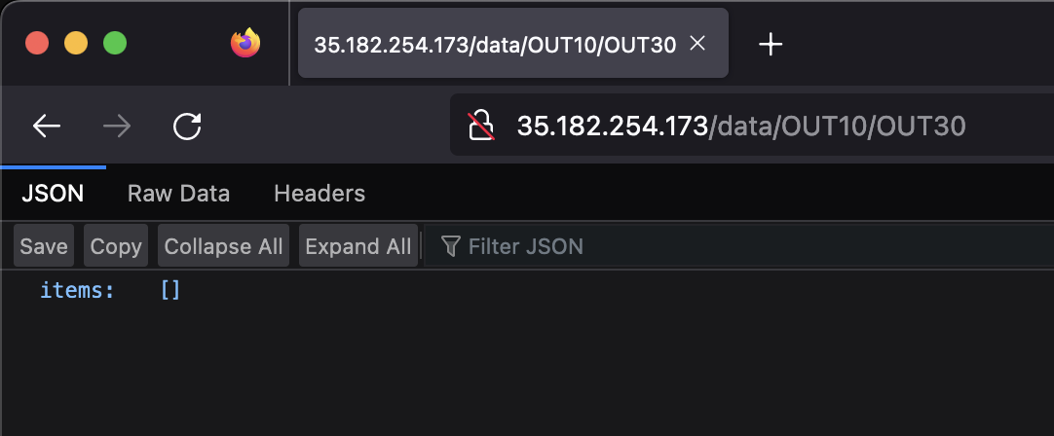

Slide 19
Conclusion
In conclusion, the "BigMart Sales" dataset has been utilized in this project to perform Exploratory Data Analysis by retrieving the data from a remote URL and storing it in MongoDB.
The FastAPI application has been built to expose the data, and visualizations have been created using Google Charts to enhance data interpretation and analysis.
The project has successfully achieved its objective of analyzing the "BigMart Sales" dataset and presenting the insights in a user-friendly manner.
The project can serve as a reference for individuals and organizations seeking to explore and visualize large datasets using modern data analysis tools and techniques.

