Slide 1

Analyzing & Predicting NYC’s 311 Service Requests
Project by:
GROUP 2 – [Trupal] [UmaNG] [Dharti] [Jay] [Khushi] [Sushank]

Slide 2
Objective
The project revolves around an in-depth analysis of the 311-service data, a valuable resource containing a wide range of citizen service requests. The 311 service, established to enhance citizen-government interactions, generates vast amounts of data that can provide insights into urban service needs, efficiency, and areas of improvement.
This project aims to conduct Exploratory Data Analysis (EDA) and employ predictive modeling techniques (classifications) to extract meaningful patterns and trends from the dataset. Through this analysis, we seek to identify key factors impacting service requests, response times, and improve service delivery.

Slide 3
Dataset: 311 service requests NYC
Source : https://www.kaggle.com/datasets/pablomonleon/311-service-requests-nyc
The dataset titled "311 Service Requests NYC" on Kaggle provides a comprehensive collection of service requests made by citizens to various agencies in New York City. This dataset is a valuable resource for understanding urban service needs, tracking citizen concerns, and assessing the efficiency of government responses. It has 364558 tuples and 57 attributes.

Slide 4
Programming Languages and Cloud Infrastructures
- Python
- sci-kit learn
- Pandas
- Matplotlib
- Seaborn
- Google Compute Engine - Google Colab
- Jupyter Notebook

Slide 5
Data Flow
Data Loading: The raw 311 service data will be loaded from the provided CSV file.
Data Preprocessing: Pandas will be used to clean and preprocess the dataset, addressing missing values and inconsistencies.
Exploratory Data Analysis: The preprocessed data will be subjected to EDA, involving statistical analysis and data visualization.
Feature Engineering: Relevant features will be selected or engineered to facilitate predictive modeling.
Modeling: Scikit-Learn's machine learning algorithms will be employed for predictive modeling, particularly Decision Tree classifiers.
Model Evaluation: Model performance will be assessed using appropriate evaluation metrics.

Slide 6
Cost Estimate
As this project primarily utilizes local computing resources and open-source tools, the associated costs are minimal. No significant cloud services or specialized computing environments are required, thus mitigating potential costs.
If one wants to dive in deeper into Machine Learning and AI, the cost of a standalone compute engine will depend on the type and number of virtual machines (VMs) used, as well as the duration of use. Assuming you need 100GB of compute engine with 16/32 RAM, you could use a custom VM with 16 or 32 vCPUs, 100GB of memory, and 1TB of SSD storage. The estimated cost for this VM would be approximately $800 - $1600 per month, depending on the selected region and the duration of use.
Notes:
** All prices in USD

Slide 7
Target Audience
The intended beneficiaries of this project encompass city officials, urban planners, administrators, and municipal service providers.
The insights derived from the analysis can guide resource allocation, prioritize services, and improve responsiveness to citizens' needs.
City administrators can make informed decisions about resource allocation, staffing, and service enhancements based on the analysis. Additionally, urban planners can utilize the insights to design efficient service delivery strategies that align with citizens' demands.

Slide 8
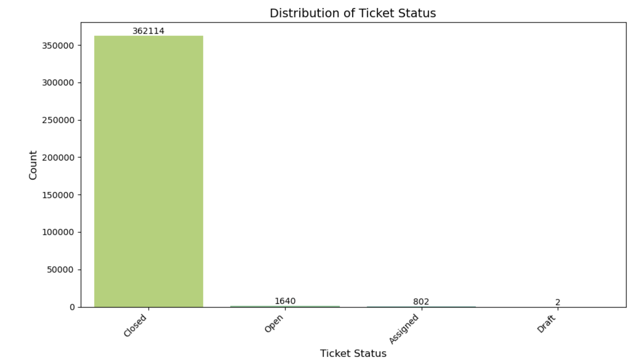
Visualizations and Insights

Slide 9
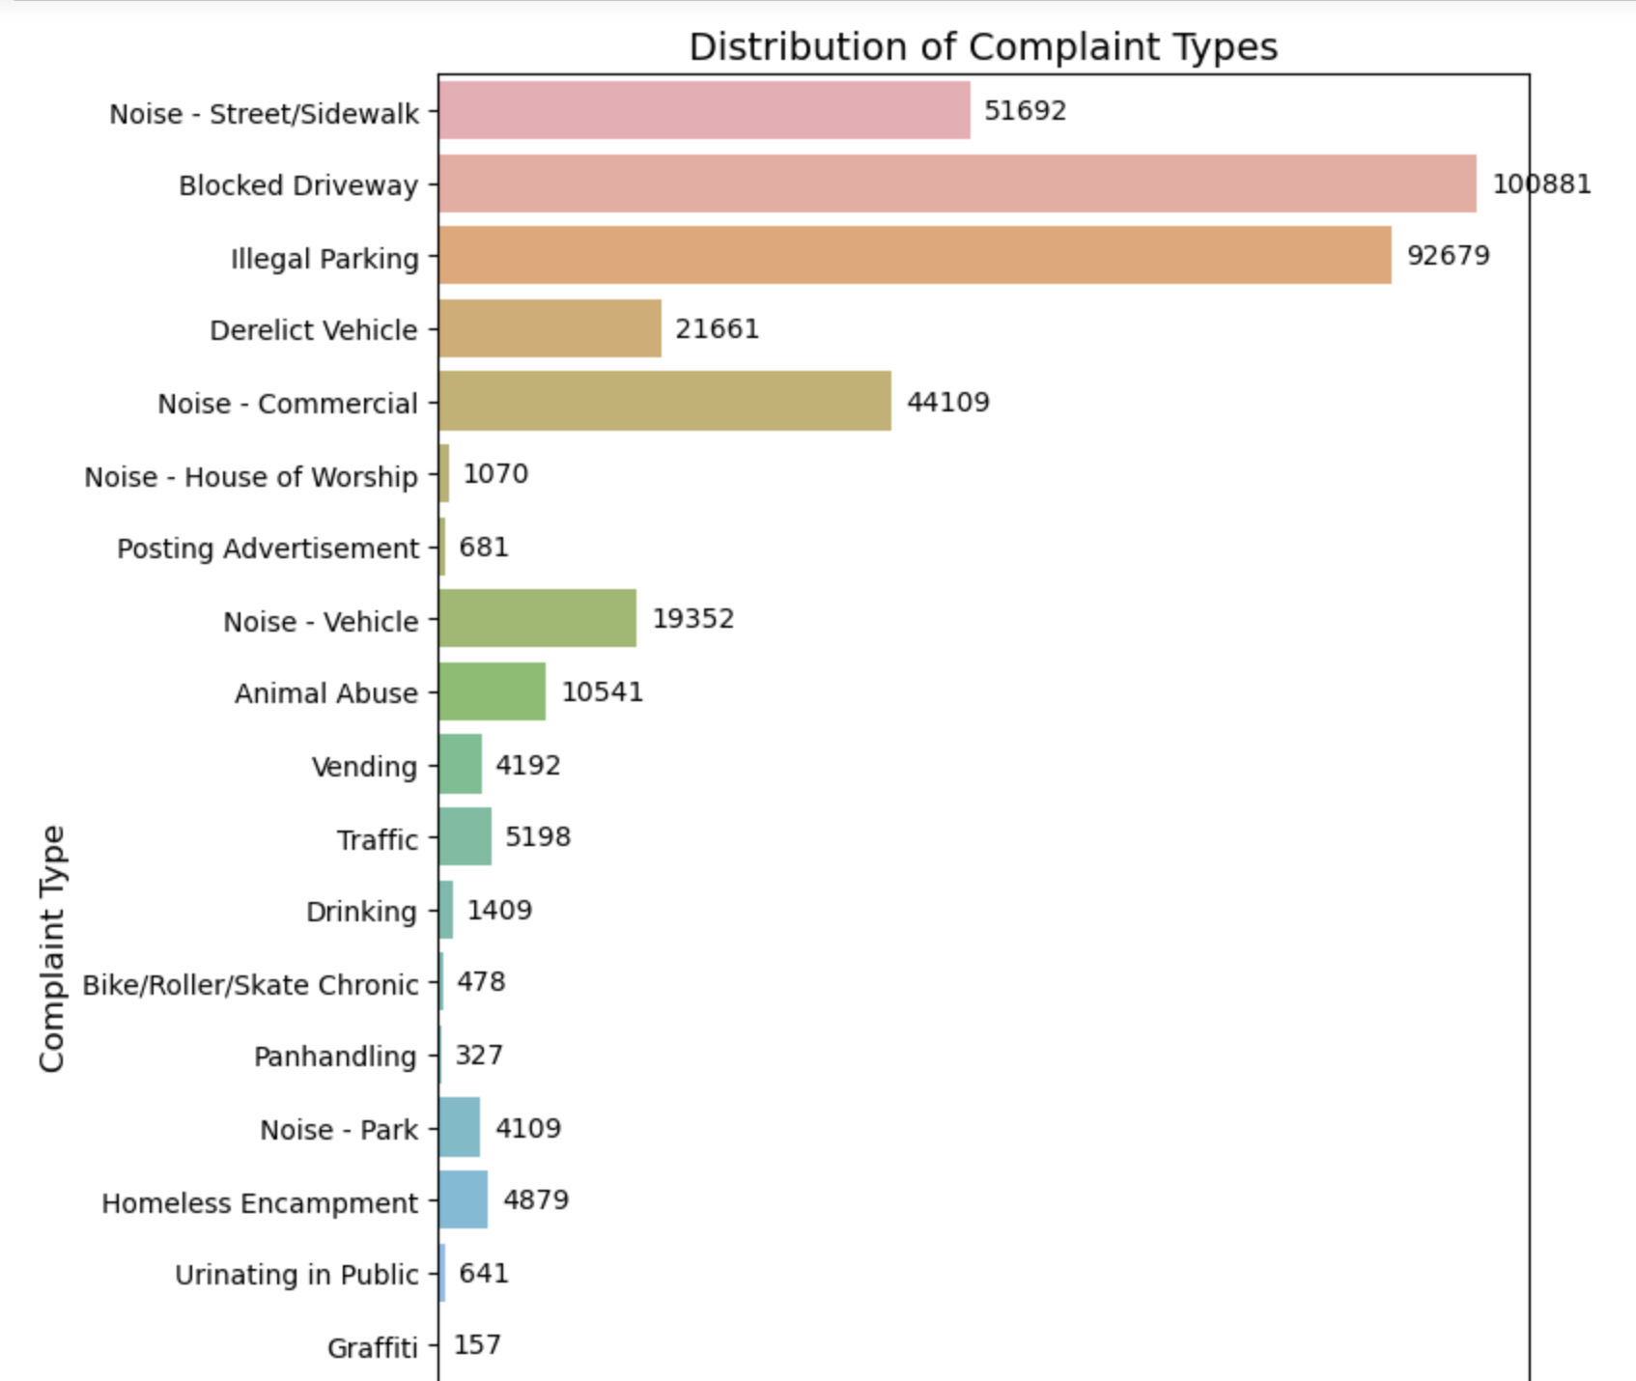

Slide 10
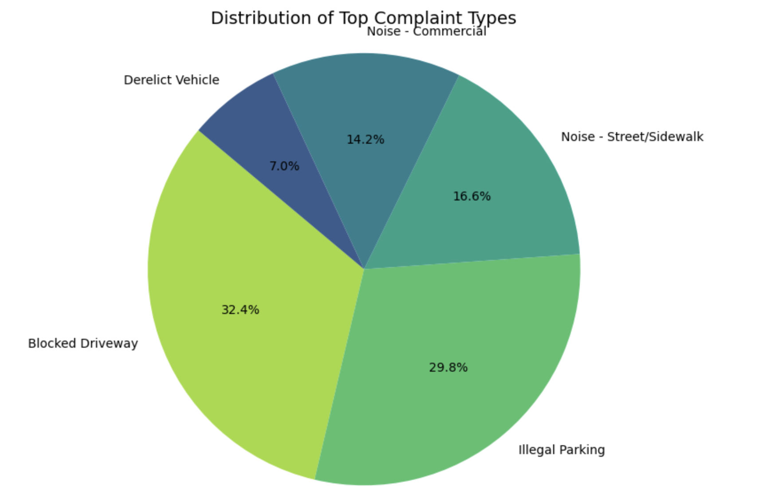

Slide 11
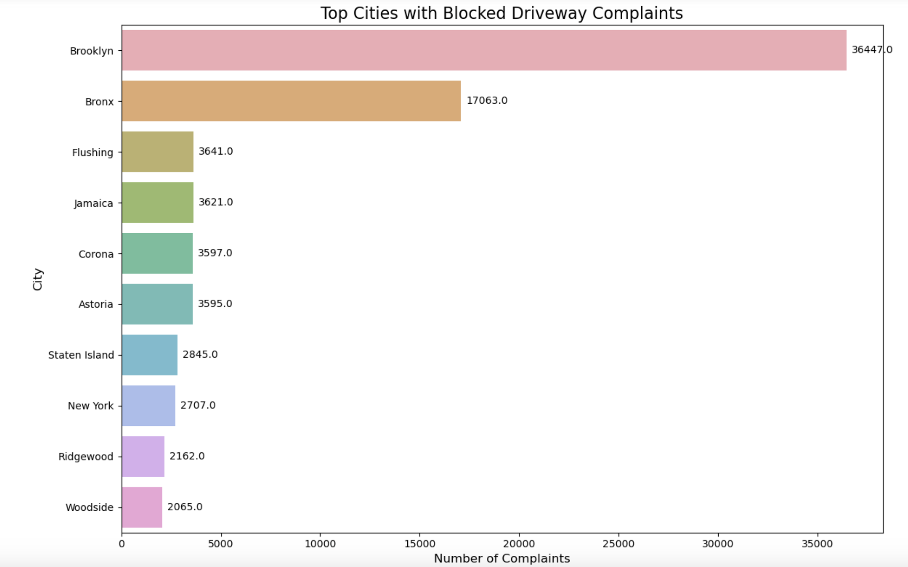

Slide 12
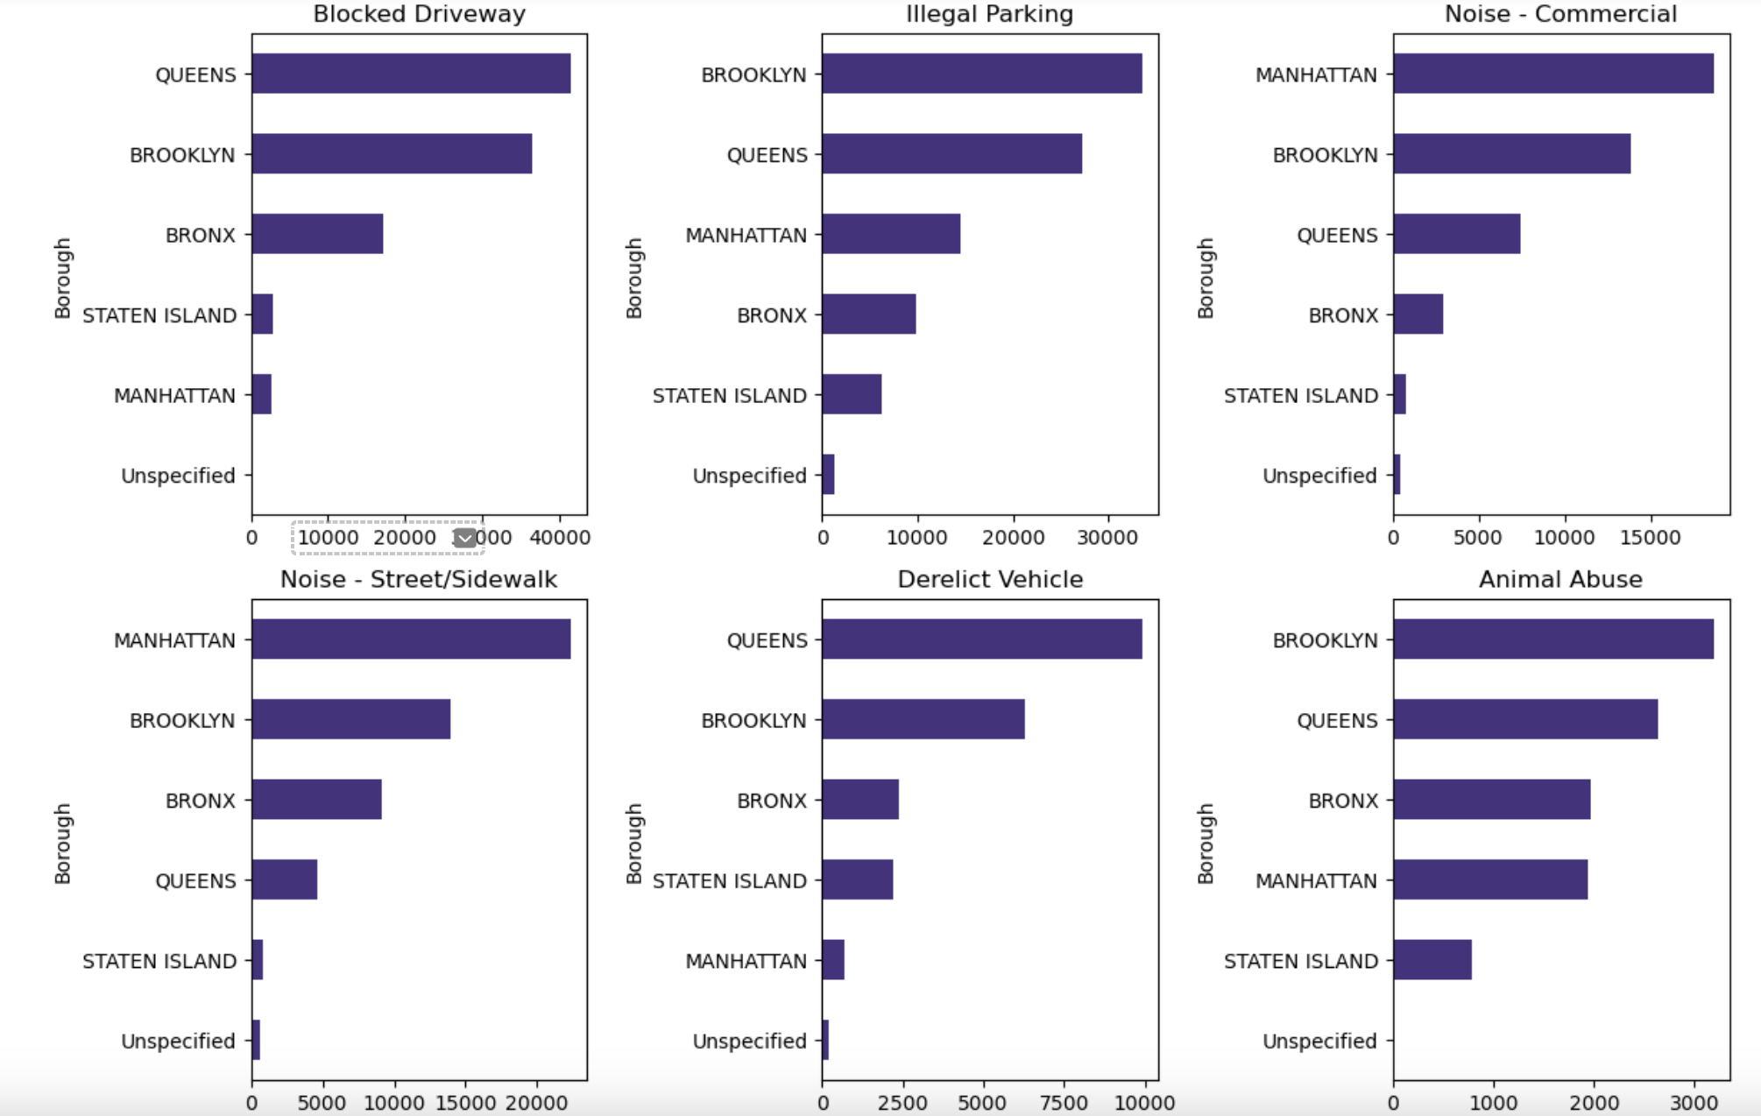

Slide 13
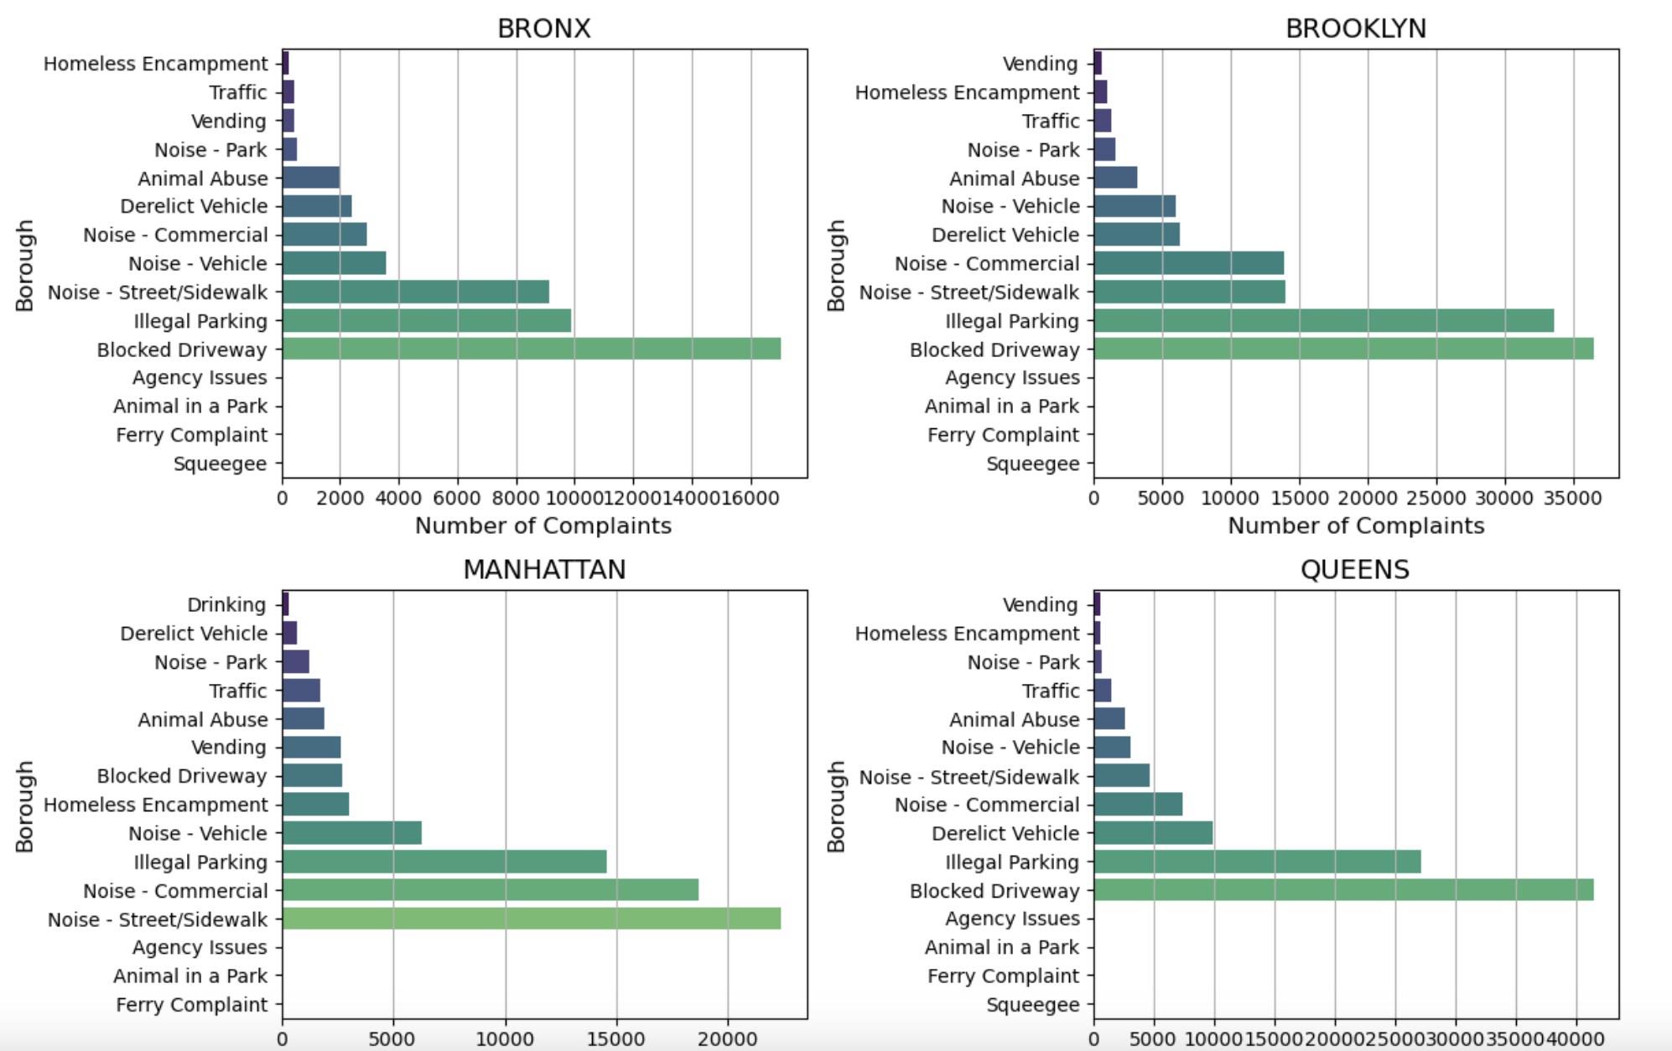

Slide 14
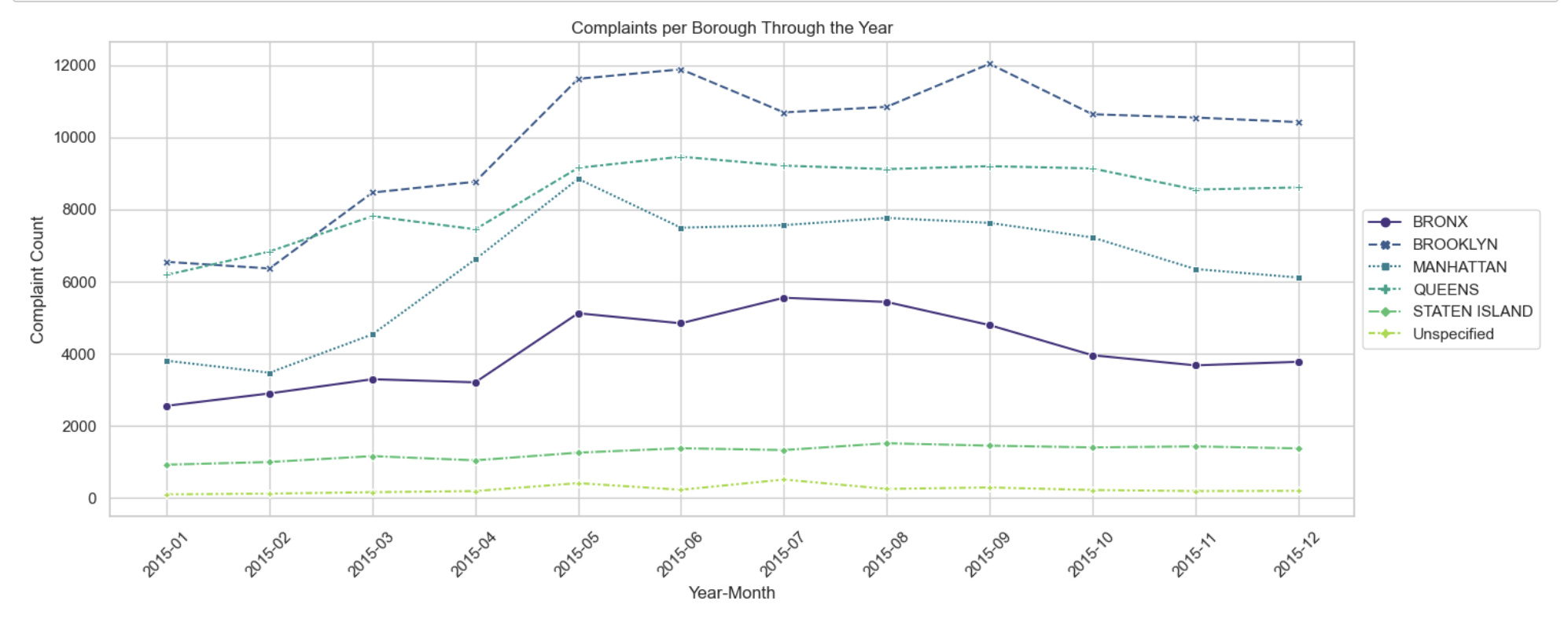

Slide 15
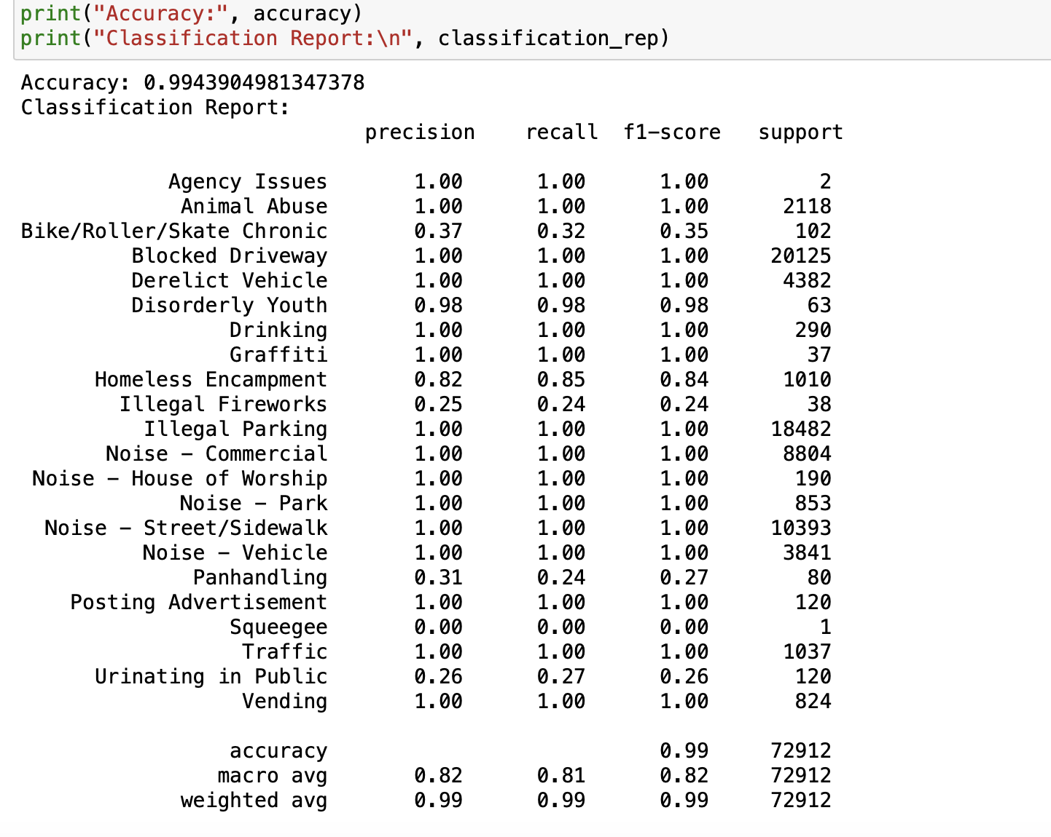

Slide 16
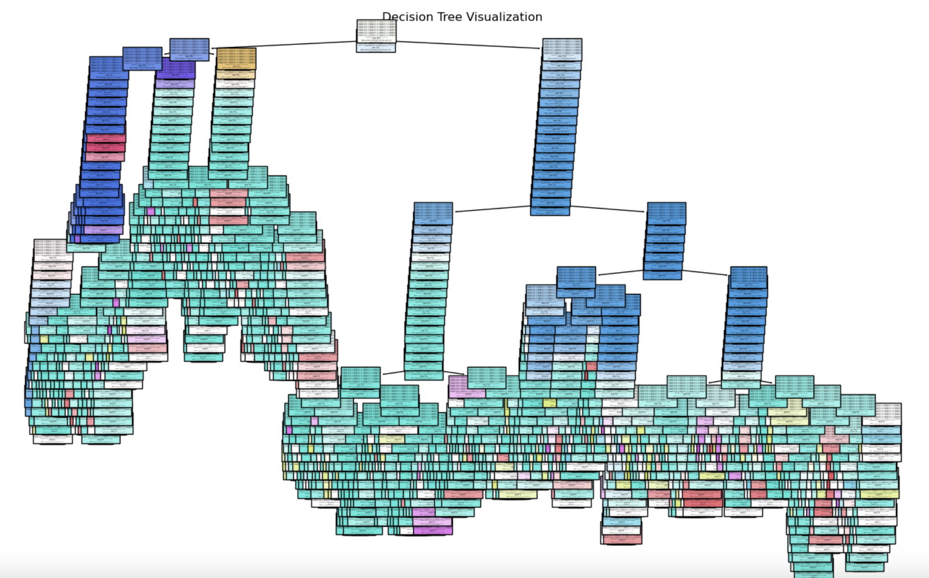

Slide 17
Insights
The analysis of the 311 service requests dataset yields significant insights into service resolution trends. Notably, around 33.63% of requests are promptly resolved within 100 hours, with 97.44% resolved within 1000 hours. Transportation-related issues dominate, accounting for 85% of the requests. However, these concerns tend to experience prolonged resolution times, urging the implementation of traffic management strategies.
Geographically, Brooklyn leads with 32.6% of requests, followed by Queens (27.64%) and Manhattan (21.25%). Interestingly, requests from parks, vacant lots, and commercial areas encounter lengthier resolution times compared to those related to subway stations and restaurants. Road and parking sectors stand out as major complaint raisers, while the average resolution time falls within 150 to 300 hours. These insights collectively empower administrators to optimize service delivery, address traffic concerns, and enhance overall urban governance.

Slide 18
Conclusion
This project holds immense potential to transform how urban service delivery is approached. By combining data-driven insights with predictive modeling, the project aims to optimize resource allocation, streamline service request responses, and enhance the overall urban living experience. The insights gleaned from this analysis have the potential to reshape urban governance, ultimately leading to improved citizen satisfaction, optimized resource allocation, and a more efficient and responsive urban administration.
With the power of data analysis and predictive modeling, we are poised to drive meaningful change in urban service delivery and administration.

