Slide 1

Supervised Classification ST: Statistics
Talha Mahmood Chaudhry
November 18, 2020

Slide 2

The BIG Idea
To build a classifier which is able to assign an observation with an unknown class membership to one of the K known classes.

Slide 3
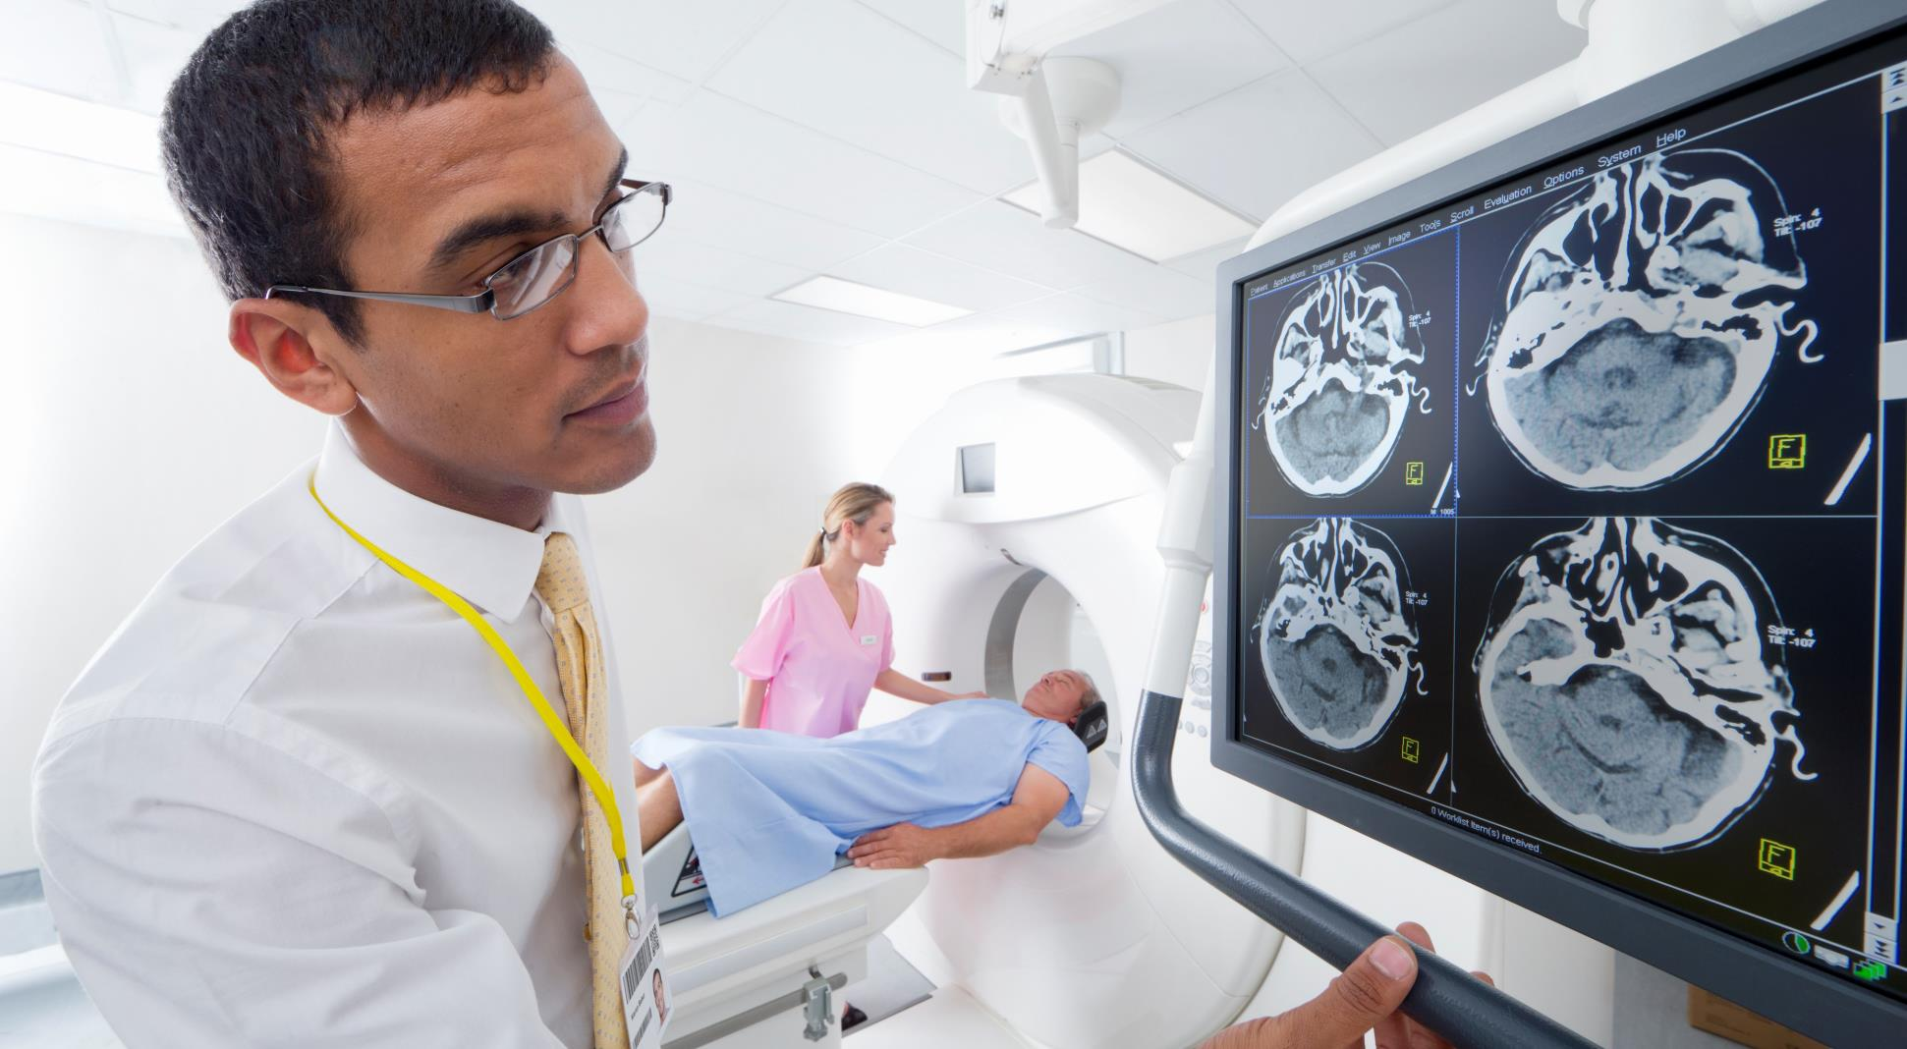
Wisconsin Breast Cancer Data *
569 Patients
30 features of the cell nuclei obtained from a digitized image of a fine needle aspirate (FNA) of a breast mass
Classes: Benign (357) vs Malignant (212)
2/3rd for training
Features in consideration:
Extreme area
Extreme smoothness
Mean texture

Slide 4
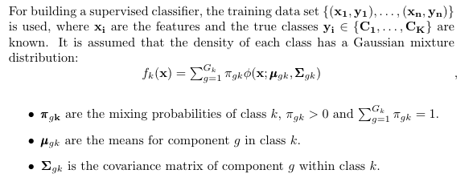
THE Setup

Slide 5
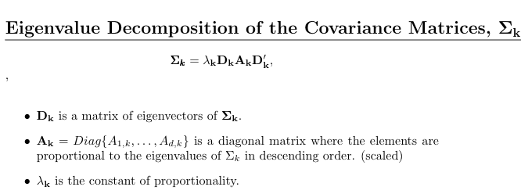
EigenValue Decomposition Discriminant Analysis (EDDA)

Slide 6

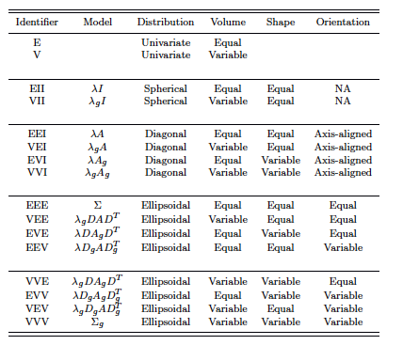
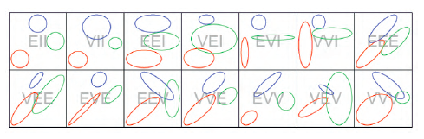
The Key
Call-in GP Consultation Available
Surplus Medical Supplies

Slide 7
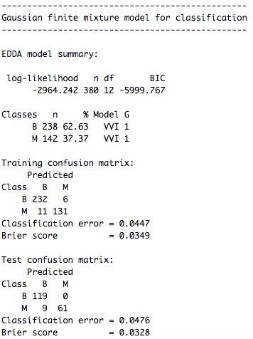
Model 1 (Single Mixture Component)

Slide 8
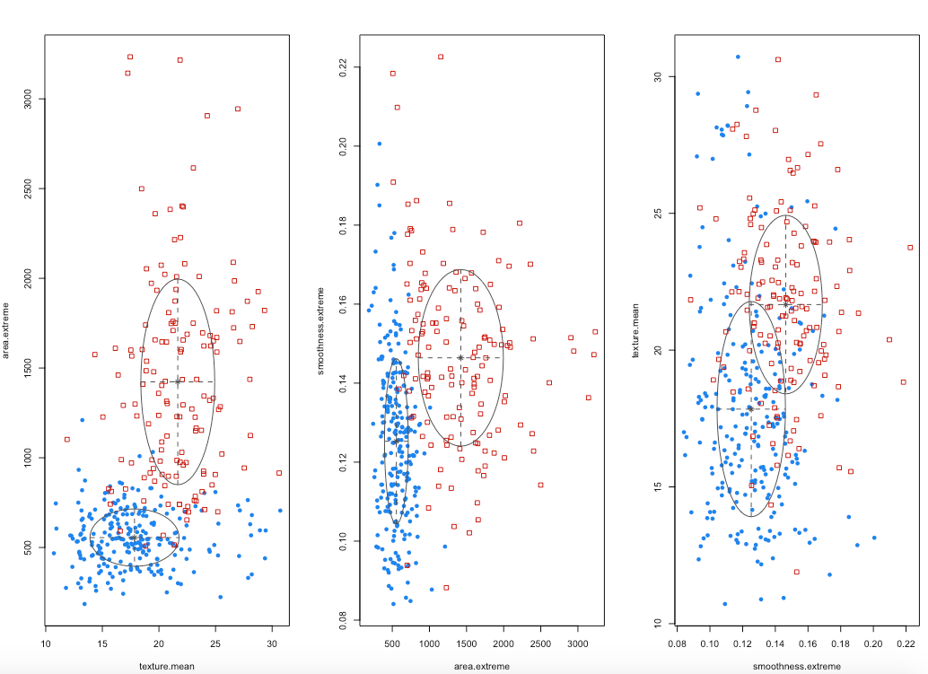
Let’s Visualize

Slide 9
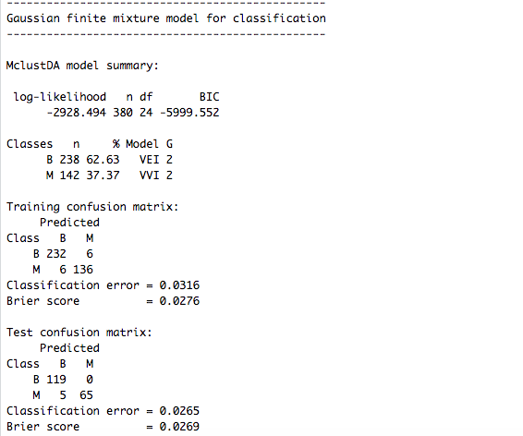
Model 2 (GENERAL APPROACH)

Slide 10
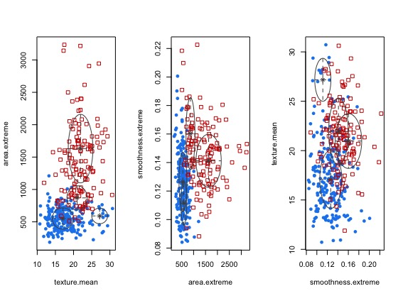
Let’s Visualize

Slide 11
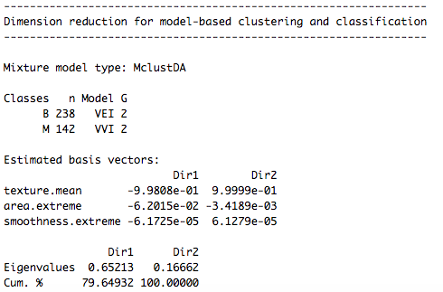
dimension reduced subspace

Slide 12
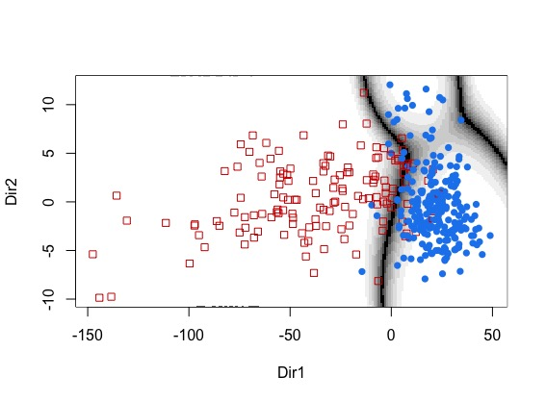
Visualization

Slide 13
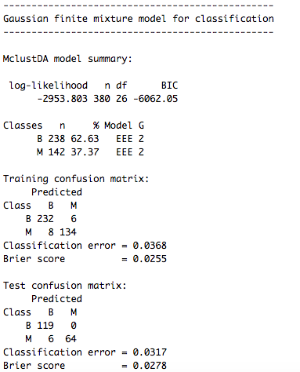
Model 3 (EEE)

Slide 14
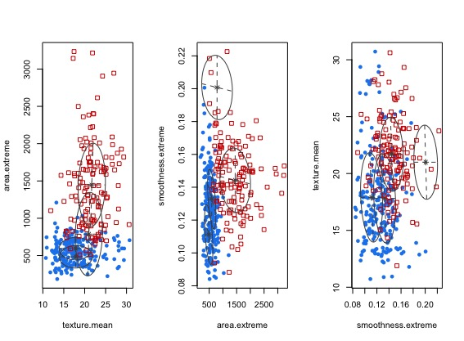
Let’s Visualize

Slide 15

Thank you

