Slide 1
Planning a Software Project

Slide 2
Agenda
Background
Effort estimation
Schedule and resource estimation
Quality Planning
Risk management
Project monitoring plans
Project Planning

Slide 3
Software Project
Goal: Build a software system to meet commitments on cost, schedule, quality
Worldwide - many projects fail
  one-third are runaways with cost or schedule overrun of more than 125%
Project Planning

Slide 4
Project Failures
Major reasons for project runaways
  unclear objectives
  bad planning
  no project management methodology
  new technology
  insufficient staff
All of these relate to project management
Effective project management is key to successfully executing a project
Project Planning

Slide 5
Project Planning
Must incorporate the major issues like :
  Size estimation
  Cost estimation
  Project Scheduling (Development time)
  Project monitoring and reviews
  Personnel selection and evaluation
  Risk management
Project Planning

Slide 6
Successful software project
Understand these :
  Project objectives should be clearly defined
  Scope of work to be done
  The risk to be incurred
  The resources required
  The task to be accomplished
  The cost to be expended
  The schedule to be followed
Project Planning

Slide 7
Why improve PM?
Better predictability leading to commitments that can be met
Lower cost through reduced rework, better resource mgmt, better planning,..
Improved quality through proper quality planning and control
Better control through change control, CM, monitoring etc.
Project Planning

Slide 8
Why improve PM ….
Better visibility into project health and state leading to timely intervention
Better handling of risks reducing the chances of failure
All this leads to higher customer satisfaction
And organization improvement
Project Planning

Slide 9
The Project Mgmt Process
Has three phases - planning, monitoring and control, and closure
Planning is done before the much of the engineering process (life cycle, LC) and closure after the process
Monitoring phase is in parallel with LC
We focus on planning; monitoring covered through its planning
Project Planning

Slide 10
Project Planning
Basic objective: To create a plan to meet the commitments of the project, I.e. create a path that, if followed, will lead to a successful project
Planning involves defining the LC process to be followed, estimates, detailed schedule, plan for quality, etc.
Main output - a project management plan and the project schedule
Project Planning

Slide 11
Key Planning Tasks
Estimate effort
Define project milestones and create a schedule
Define quality objectives and a quality plan
Identify risks and make plans to mitigate them
Define measurement plan, project-tracking procedures, training plan, team organization, etc.
Project Planning

Slide 12
Effort Estimation

Slide 13
Effort Estimation
For a project total cost and duration has to be committed in start
Requires effort estimation, often in terms of person-months
Effort estimate is key to planning - schedule, cost, resources depend on it
Many problems in project execution stem from improper estimation
Project Planning

Slide 14
Estimation..
No easy way, no silver bullet
Estimation accuracy can improve with more information about the project
Early estimates are more likely to be inaccurate than later
  More uncertainties in the start
  With more info, estimation becomes easier
Project Planning

Slide 15
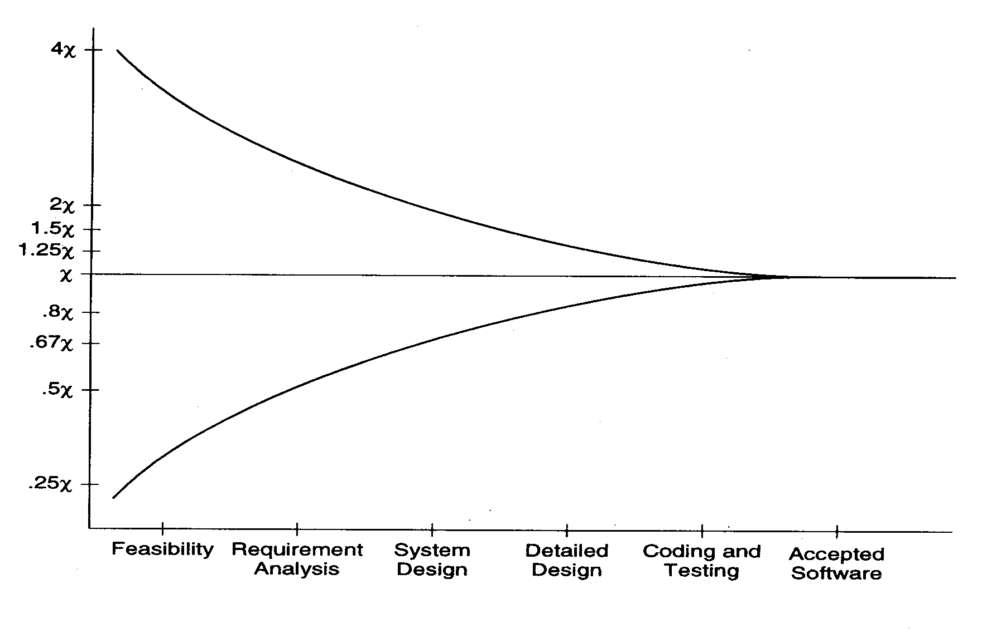
Estimation accuracy
Project Planning

Slide 16
Effort Estimation Models..
A model tries to determine the effort estimate from some parameter values
A model also requires input about the project, and cannot work in vacuum
So to apply a model, we should be able to extract properties about the system
Two types of models - top-down and bottom-up
Project Planning

Slide 17
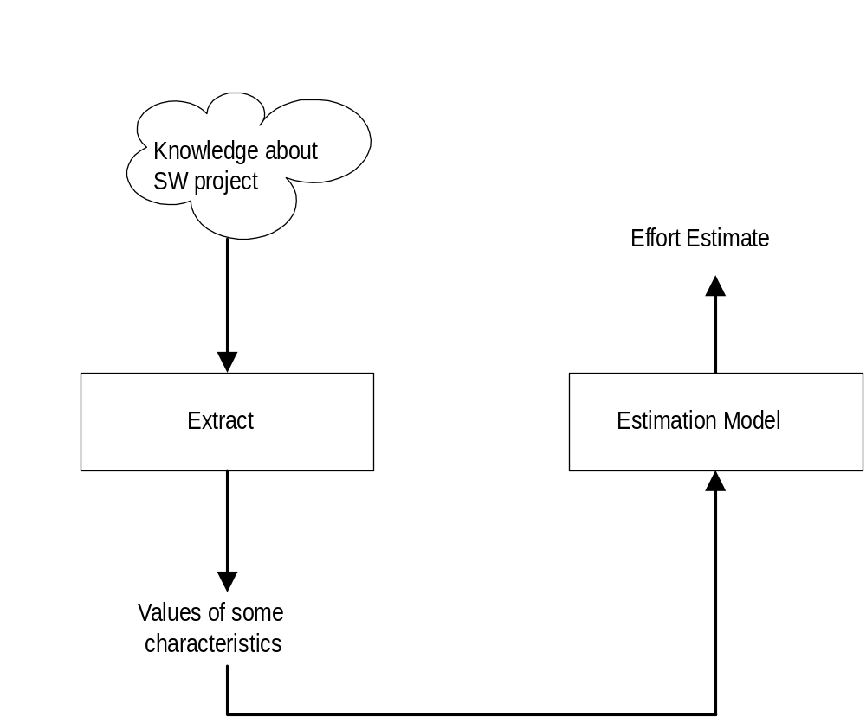
Effort Estimation Models
Project Planning

Slide 18
Top down estimation
First determines the total effort, then effort for components
Simple approach – estimate effort from size and productivity
  Get the estimate of the total size of the software
  Estimate project productivity using past data and project characteristics
  Obtain the overall effort estimate from productivity and size estimates
Effort distribution data from similar project are used to estimate effort for different phases
Project Planning

Slide 19
Top-down Estimation
A better method is to have effort estimate as a function of size using:
Effort = a * (size) ^{b}
Effort E is measured in PM(person-months), size in KLOC or KDSI (thousands of delivered source code instructions)
Incorporates the observation that productivity can dip with increased size
Constants a and b determined through regression analysis of past project data
Project Planning

Slide 20
COCOMO Model
Uses size, but adjusts using some factors
Basic procedure
  Obtain initial estimate using size
  Determine a set of 15 multiplying factors from different project attributes
  Adjust the effort estimate by scaling it with the final multiplying factor
Effort E = EAF * E_{i}, where
  EAF stands for effort adjustment factor = product of 15 attributes and E_{i} is the intial effort computed as Ei = a * (size in KLOC)^{b} where a, b constants which depend on the type of project, namely Organic, Semi-detached or Embedded project.

Slide 21
COCOMO..
Initial estimate: Effort E_{i} = a * (size)^{b} ;
Constants a, b are dependent on the project types which could be – Organic mode, Semi-detached mode or Embedded mode
Organic mode : developed by a small team, system is small and the interface requirements are flexible. Example-payroll, inventory etc. Size varies from 2-50 KLOC.
Embedded mode : Large project, Real time syssems with very tight constraints and changes to the system are costly. Com[plex interfaces, very little previous experience such as ATMs, Air Traffic Control, etc. Typically over 300 KLOC
Semi-detached mode : Medium size project and team size. E.g utility systems like compilers, debuggers, database systems, editors etc.
There are 15 cost driver attributes under the category of Product attributes, Computer Attributes, Personnel attributes & Project Attributes.
Each factor is rated, and for the rating a multiplication factor is given
Final effort adjustment factor is the product of the factors for all 15 attributes
Project Planning

Slide 22

Project Planning

Slide 23
Effort multipliers for Cost drivers
Cost Driver | Very low | Low | Nominal | High | Very High
Product Attributes RELY, Required reliability DATA, Database size CPLX, Product complexity Computer Attributes TIME Execution time constraint STOR, Memory constraint VIRT, virtual machine volatility TURN, computer TAT Personnel attributes Analyst capability Application experience Programmer capability Use of software tools Development schedule | .75 .7 1.46 1.29 1.42 1.24 1.23 | .88 .94 .85 1.19 1.13 .87 .87 1.17 1.10 1.08 | 1.0 1.0 1.0 1.0 1.0 1.0 1.0 1.0 1.0 1.0 1.0 1.0 | 1.15 1.08 1.15 1.11 1.06 .86 .91 1.15 1.07 .86 .91 1.04 | 1.4 1.16 1.3 1.3 1.21 .71 .82 1.30 1.15 .70 .83 1.1
Project Planning

Slide 24
COCOMO – effort distribution
Effort distribution among different phases is given as a percent of effort
Eg. For medium size product it is
  Product design – 16%
  Detailed design – 24%
  Coding and UT – 38%
  Integration and test – 22%
Project Planning

Slide 25
Bottom-up Estimation
An alternate approach to top-down
Effort for components and phases first estimated, then the total
Can use activity based costing - all activities enumerated and then each activity estimated separately
Can group activities into classes - their effort estimate from past data
Project Planning

Slide 26
An Estimation Procedure
Identify programs in the system and classify them as simple, medium, or complex (S/M/C)
Define the average coding effort for S/M/C
Get the total coding effort.
Use the effort distribution in similar projects to estimate effort for other tasks and total
Refine the estimates based on project specific factors
Project Planning

Slide 27
Scheduling and Staffing

Slide 28
Project Schedule
A project Schedule is at two levels - overall schedule and detailed schedule
Overall schedule comprises of major milestones and final date
Detailed schedule is the assignment of lowest level tasks to resources
Project Planning

Slide 29
Overall Schedule
Depends heavily on the effort estimate
For an effort estimate, some flexibility exists depending on resources assigned
Eg a 56 person-months project can be done in 8 months with 7 people, or 7 months with 8 people
Stretching a schedule is easy; compressing is hard and expensive
Project Planning

Slide 30
Overall Scheduling...
One method is to estimate schedule S (in months) as a function of effort in PMs
Can determine the fn through analysis of past data; the function is non linear
COCOMO: S = 2.5 E ^{3.8}
Often this schedule is checked and corrected for the specific project
One checking method – square root check
Project Planning

Slide 31
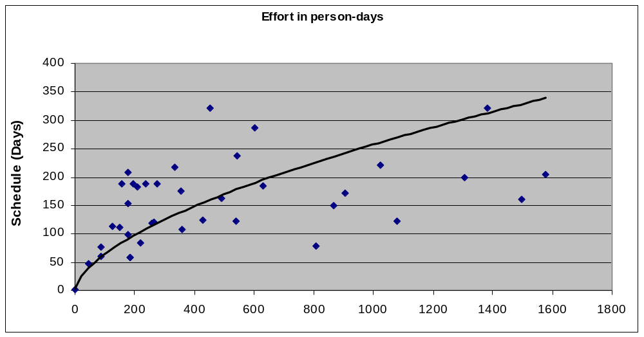
Determining Overall Schedule from past data
Project Planning

Slide 32
Determining Milestones
With effort and overall schedule decided, avg project resources are fixed
Manpower ramp-up in a project decides the milestones
Manpower ramp-up in a project follows a Rayleigh curve - like a normal curve
In reality manpower build-up is a step function
Project Planning

Slide 33
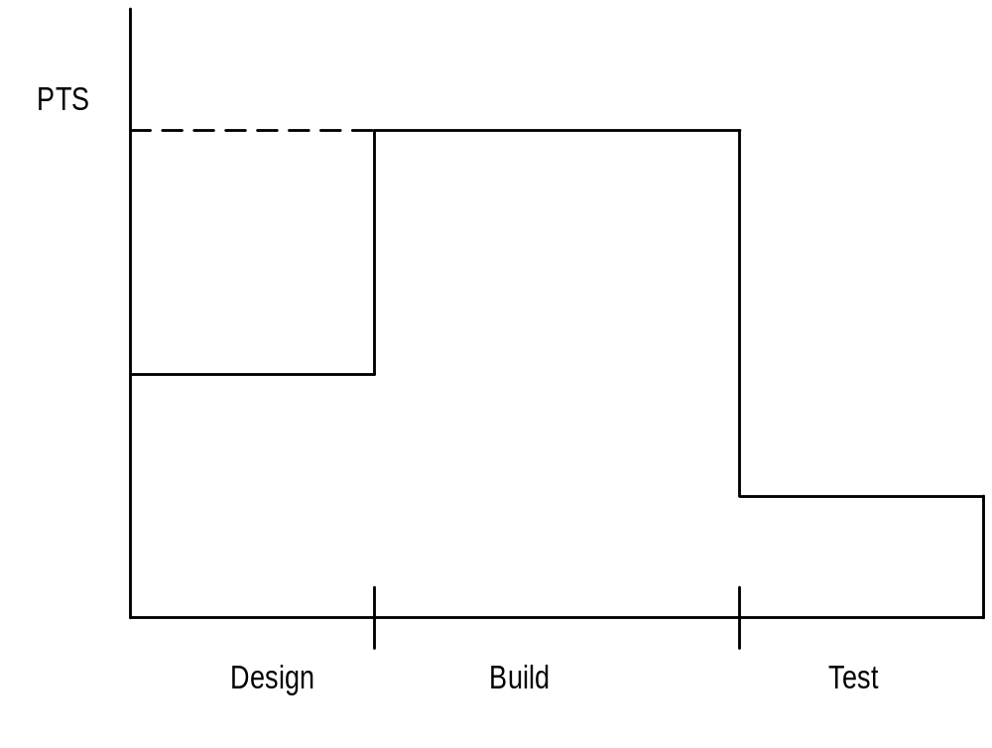
Manpower Ramp-up
Project Planning

Slide 34
Milestones ...
With manpower ramp-up and effort distribution, milestones can be decided
Effort distribution and schedule distribution in phases are different
Generally, the build has larger effort but not correspondingly large schedule
COCOMO specifies distr of overall sched. Design – 19%, programming – 62%, integration – 18%
Project Planning

Slide 35
An Example Schedule
Task | Dur. (days) | Work (p-days) | Start Date | End Date
Project Init tasks | 33 | 24 | 5/4 | 6/23
Training | 95 | 49 | 5/8 | 9/29
Knowledge sharing | 78 | 20 | 6/2 | 9/30
Elaboration iteration I | 55 | 55 | 5/15 | 6/23
Construction iteration I | 9 | 35 | 7/10 | 7/21
Project Planning

Slide 36
Detailed Scheduling
To reach a milestone, many tasks have to be performed
Lowest level tasks - those that can be done by a person (in less than 2-3 days)
Scheduling - decide the tasks, assign them while preserving high-level schedule
Is an iterative task - if cannot “fit” all tasks, must revisit high level schedule
Project Planning

Slide 37
Detailed Scheduling
Detailed schedule not done completely in the start - it evolves
Can use Microsoft Project for keeping it
Detailed Schedule is the most live document for managing the project
Any activity to be done must get reflected in the detailed schedule
Project Planning

Slide 38
An example task in detail schedule
Module | Act Code | Task | Duration | Effort
History | PUT | Unit test # 17 | 1 day | 7 hrs
St. date | End date | %comp | Depend. | Resource
7/18 | 7/18 | 0% | Nil | SB
Project Planning

Slide 39
Detail schedule
Each task has name, date, duration, resource etc assigned
% done is for tracking (tools use it)
The detailed schedule has to be consistent with milestones
  Tasks are sub-activities of milestone level activities, so effort should add up, total schedule should be preserved
Project Planning

Slide 40
Quality Planning

Slide 41
Quality Planning
Delivering high quality is a basic goal
Quality can be defined in many ways
Current industry standard - delivered defect density (e.g. #defects/KLOC)
Defect - something that causes software to behave in an inconsistent manner
Aim of a project - deliver software with low delivered defect density
Project Planning

Slide 42
Defect Injection and Removal
Software development is labor intensive
Defects are injected at any stage
As quality goal is low delivered defect density, these defects have to be removed
Done primarily by quality control (QC) activities of reviews and testing
Project Planning

Slide 43
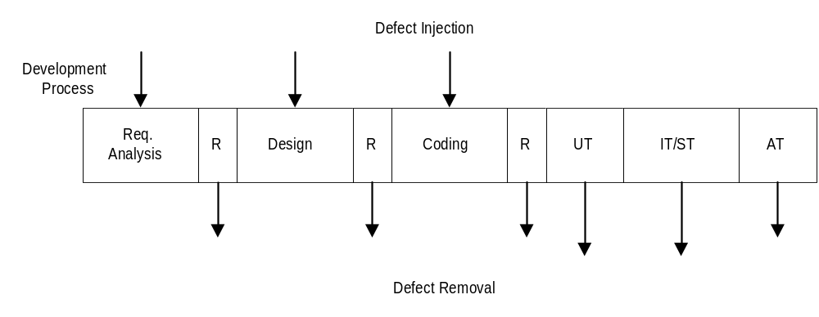
Defect Injection and Removal
Project Planning

Slide 44
Approaches to Quality Management
Ad hoc - some testing, some reviews done as and when needed
Procedural - defined procedures are followed in a project
Quantitative - defect data analysis done to manage the quality process
Project Planning

Slide 45
Procedural Approach
A quality plan defines what QC tasks will be undertaken and when
Main QC tasks - reviews and testing
Guidelines and procedures for reviews and testing are provided
During project execution, adherence to the plan and procedures ensured
Project Planning

Slide 46
Quantitative Approach
Goes beyond asking “has the procedure been executed”
Analyzes defect data to make judgements about quality
Past data is very important
Key parameters - defect injection and removal rates, defect removal efficiency (DRE)
Project Planning

Slide 47
Quality Plan
The quality plan drives the quality activities in the project
Level of plan depends on models available
Must define QC tasks that have to be performed in the project
Can specify defect levels for each QC tasks (if models and data available)
Project Planning

Slide 48
Risk Management

Slide 49
Risk Management
Any project can fail - reasons can be technical, managerial, etc.
Project management aims to tackle the project management aspect
Engineering life cycles aim to tackle the engineering issues
A project may fail due to unforeseen events - risk management aims to tackle this
Project Planning

Slide 50
Risk Management
Risk: any condition or event whose occurrence is not certain but which can cause the project to fail
Aim of risk management: minimize the effect of risks on a project
Risk management has two basic aspects
  Risk assessment
  Risk control
Project Planning

Slide 51
Risk Assessment
To identify possible risks to a project, i.e. to those events that might occur and which might cause the project to fail
No “algorithm” possible, done by “what ifs”, checklists, past experience
Can have a list of “top 10” risks that projects have seen in past
Project Planning

Slide 52
Top Risk Examples
Shortage of technically trained manpower
Too many requirement changes
Unclear requirements
Not meeting performance requirements
Unrealistic schedules
Insufficient business knowledge
Working on new technology
Project Planning

Slide 53
Risk Prioritization
The number of risks might be large
Must prioritize them to focus attention on the “high risk” areas
For prioritization, impact of each risk must be understood
In addition, probability of the risk occurring should also be understood
Project Planning

Slide 54
Risk Prioritization ...
Risk exposure (RE) = probability of risk occurring * risk impact
RE is the expected value of loss for a risk
Prioritization can be done based on risk exposure value
Plans can be made to handle high RE risks
Project Planning

Slide 55
A Simple approach to Risk Prioritization
Classify risk occurrence probabilities as: Low, Medium, High
Classify risk impact as: Low, Medium, High
Identify those that are HH, or HM/MH
Focus on these for risk mitigation
Will work for most small and medium sized projects
Project Planning

Slide 56
Risk Control
Can the risk be avoided?
  E.g. if new hardware is a risk, it can be avoided by working with proven hardware
For others, risk mitigation steps need to be planned and executed
  Actions taken in the project such that if the risk materializes, its impact is minimal
  Involves extra cost
Project Planning

Slide 57
Risk Mitigation Examples
Too many requirement changes
  Convince client that changes in requirements will have an impact on the schedule
  Define a procedure for requirement changes
  Maintain cumulative impact of changes and make it visible to client
  Negotiate payment on actual effort.
Project Planning

Slide 58
Examples ...
Manpower attrition
  Ensure that multiple resources are assigned on key project areas
  Have team building sessions
  Rotate jobs among team members
  Keep backup resources in the project
  Maintain documentation of individual’s work
  Follow the CM process and guidelines strictly
Project Planning

Slide 59
Examples ...
Unrealistic schedules
  Negotiate for better schedule
  Identify parallel tasks
  Have resources ready early
  Identify areas that can be automated
  If the critical path is not within the schedule, negotiate with the client
  Negotiate payment on actual effort
Project Planning

Slide 60
Risk Mitigation Plan
Risk mitigation involves steps that are to be performed (hence has extra cost)
It is not a paper plan - these steps should be scheduled and executed
These are different from the steps one would take if the risk materializes - they are performed only if needed
Risks must be revisited periodically
Project Planning

Slide 61
A Practical Risk Mgmt Approach
Based on methods of some orgs
  List risks; for each risk rate probability as Low, Medium, High
  For each risk assess impact on the project as Low, medium, High
  Rank the risks based on probability and impact – HH is the highest
  Select top few items for mitigation
Project Planning

Slide 62
A risk mgmt plan
Risk | Prob | Impact | Exposure
1. Failure to meet perf reqs | High | High | High
2. Lack of people with right skills | Med | Med | Med
3. Complexity of the application | Med | Med | Med
4. Unclear requirements | Med | Med | Med
Project Planning

Slide 63
Risk Mgmt plan…
Risk | Mitigation plan
1. Failure to meet perf reqs | Train team in perf engg Have perf testing scripts Use suitable tools
2. Lack of people with right skills | Train resources Develop suitable standards
3. Complexity of the application | Ensure ongoing k transfer Use people with domain exp
4. Unclear requirements | Have multiple reviews Build prototype
Project Planning

Slide 64
Project Monitoring Plans

Slide 65
Background
A plan is a mere document that can guide
It must be executed
To ensure execution goes as per plan, it must be monitored and controlled
Monitoring requires measurements
And methods for interpreting them
Monitoring plan has to plan for all the tasks related to monitoring
Project Planning

Slide 66
Measurements
Must plan for measurements in a project
Without planning, measurements will not be done
Main measurements – effort, size, schedule, and defects
  Effort – as this is the main resource; often tracked through effort reporting tools
  Defects – as they determine quality; often defect logging and tracking systems used
During planning – what will be measured, how, tool support, and data management
Project Planning

Slide 67
Project Tracking
Goal: To get visibility in project execution so corrective actions can be taken when needed to ensure project succeeds
Diff types of monitoring done at projects; measurements provide data for it
Project Planning

Slide 68
Tracking…
Activity-level monitoring
  Each activity in detailed schd is getting done
  Often done daily by managers
  A task done marked 100%; tools can determine status of higher level tasks
Status reports
  Generally done weekly to take stock
  Summary of activities completed, pending
  Issues to be resolved
Project Planning

Slide 69
Tracking…
Milestone analysis
  A bigger review at milestones
  Actual vs estimated for effort and sched is done
  Risks are revisited
  Changes to product and their impact may be analyzed
Cost-schedule milestone graph is another way of doing this
Project Planning

Slide 70
Project Management Plan
The project management plan (PMP) contains outcome of all planning activities - focuses on overall project management
Besides PMP, a project schedule is needed
  Reflects what activities get done in the project
  Microsoft project (MSP) can be used for this
  Based on project planning; is essential for day-to-day management
  Does not replace PMP !
Project Planning

Slide 71
PMP Structure - Example
Project overview - customer, start and end date, overall effort, overall value, main contact persons, project milestones, development environment..
Project planning - process and tailoring, requirements change mgmt, effort estimation, quality goals and plan, risk management plan, ..
Project Planning

Slide 72
PMP Example ...
Project tracking - data collection, analysis frequency, escalation procedures, status reporting, customer complaints, …
Project team, its organization, roles and responsibility, …
Project Planning

Slide 73
Project Planning - Summary
Project planning forms the foundation of project management
Key aspects: effort and schedule estimation, quality planning, risk mgmt., …
Outputs of all can be documented in a PMP, which carries all relevant info about project
Besides PMP, a detailed project schedule maintains tasks to be done in the project
Project Planning

