Slide 1
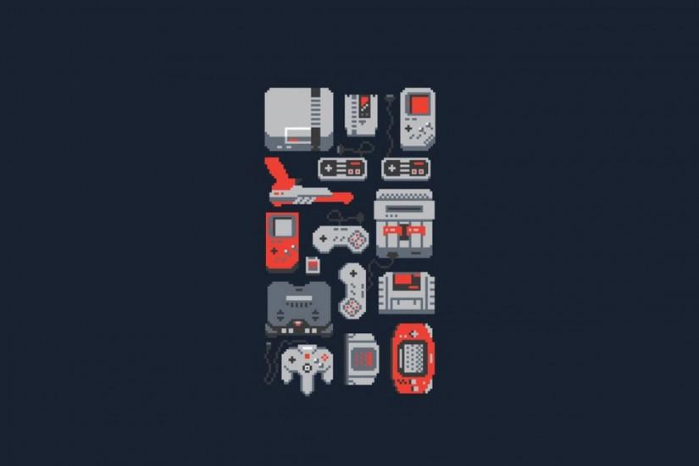
GAMING USING CLOUD SERIVCE
Presented by:Prithvi
Rohit
Vaibhav
Vijay

Slide 2
INTRODUCTION
Cloud gaming, also in some cases called "gaming on demand", is a type of online gaming that allows direct and on-demand video streaming of games onto computers, consoles, and mobile devices, similar to video on demand, through the use of a thin client.

Slide 3

DISADVANTAGES
Building a gaming rig is expensive.
The components of a PC get outdated when better technology comes out in the market every year.
Keeping the components up-to-date with new game requirements is not cost efficient.
Data Loss in case of saving in a local storage.

Slide 4

DESCRIPTION
Subscription based service
Our service provides the customers with high end PCs which will have the latest technologies available in the market so that customers can have an excellent gaming experience.All the processing will be done on our servers and the end result will be displayed to the user on their screen.The user would only need our set top box and a good internet connection to be able to use our servers.
A monitor,keyboard and a mouse is all the user needs!
App for Android and iOS based devices.

Slide 5

ADVANTAGES
Portability
Easy Installation
Cost efficient
Data Security
Scalability

Slide 6
THANK YOU

