Slide 1
Introduction

Slide 2
Software
Q : If you have to write a 10,000 line program in C to solve a problem, how long will it take?
Answers: generally range from 2-4 months
Let us analyze the productivity
  Productivity = output/input resources
  In SW output is considered as LOC
  Input resources is effort - person months; overhead cost modeled in rate for person month
  Though not perfect, some productivity measure is needed, as project has to keep it high

Slide 3
Software …
The productivity is 2.5-5 KLOC/PM
Q: What is the productivity in a typical commercial SW organization ?
A: Between 100 to 1000 LOC/PM
Q: Why is it low, when your productivity is so high? (people like you work in the industry)
A: What the student is building and what the industry builds are two different things

Slide 4
Software…
In a univ a student system is built while the commercial org builds industrial strength sw
What is the difference between a student program and industrial strength sw for the same problem?
Software (IEEE): collection of programs, procedures, rules, and associated documentation and data

Slide 5
Software…
Student
Developer is the user
  bugs are tolerable
  UI not important
  No documentation
Industrial Strength
Others are the users
  bugs not tolerated
  UI v. imp. issue
  Documents needed for the user as well as for the organization and the project

Slide 6
Software…
Student
SW not in critical use
Reliability, robustness not important
No investment
Don’t care about portability
Industrial Strength
Supports important functions / business
Reliability , robustness are very important
Heavy investment
Portability is a key issue here

Slide 7
Industrial strength software
Student programs for a problem & industrial strength software are two different things
Key difference is in quality (including usability, reliability, portability, etc.)
Brooks thumb-rule: Industrial strength sw costs 10 time more than student sw
In this course, software means industrial strength software
This software has some characteristics

Slide 8
Is Expensive
Let us look at costs involved
  Productivity = Appx 1000 LOC/PM
  Cost = $3K to $10K/PM
  Cost per LOC = $5 to $15
  I.e, each line of delivered code costs many $s
A simple application for a business may have 20KLOC to 50KLOC
  Cost = $100K to $2.25Million
  Can easily run on $10K-$20K hardware
  So HW costs in an IT solution are small as compared to SW costs.

Slide 9
Requires tight Schedule
Business requirements today demand short delivery times for software
In the past, software products have often failed to be completed in time
Along with cost, cycle time is a fundamental driving force

Slide 10
Productivity – for cost and schedule
An industrial strength software project is driven by cost and schedule
Both can be modeled by productivity, measured in terms of output per unit effort (e.g. LOC per person month)
  Higher productivity leads to lower cost
  Higher productivity leads to lower cycle time
Hence, for projects (to deliver software), quality and productivity are basic drivers

Slide 11
Quality
Along with productivity, quality is the other major driving factor
Developing high Q sw is a basic goal
Quality of sw is harder to define

Slide 12
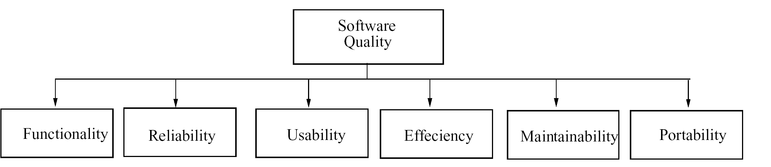
Quality – ISO standard

Slide 13
Quality – ISO std…
ISO std has six attributes
  Functionality
  Reliability
  Usability
  Efficiency
  Maintainability
  Portability

Slide 14
Quality…
Multiple dimensions mean that not easy to reduce Q to a single number
Concept of Q is project specific
  For some reliability is most important
  For others usability may be more important
Reliability is generally considered the main Q criterion

Slide 15
Quality…
Reliability = Probability of failure
  hard to measure
  approximated by no. of defects in software
To normalize Quality = Defect density
  Quality = No. of defects delivered / Size
Defects delivered - approximated with no. of defects found in operation
Current practices: less than 1 def/KLOC
What is a defect? Project specific!

Slide 16
Quality – Maintainability
Once sw delivered, it enters the maintenance phase, in which
  Residual errors are fixed – this is corrective maintenance
  Upgrades and environment changes are done – this is adaptive maintenance
Maintenance can consume more effort than development over the life of the software (can even be 20:80 ratio!)
Hence maintainability is another quality attribute of great interest

Slide 17
Quality and Productivity
Hence, quality and productivity (Q&P) are the basic drivers in a sw project
The aim of most methodologies is to deliver software with a high Q&P
Besides the need to achieve high Q&P there are some other needs

Slide 18
Change
Only constant in business is change!
Requirements change, even while the project is in progress
In a project, up to 40% of development effort may go in implementing changes
Practices used for developing software must accommodate change

Slide 19
Scale
Most industrial strength software tend to be large and complex
Methods for solving small problems do not often scale up for large problems
Two clear dimensions in a project
  engineering
  project management
For small, both can be done informally, for large both have to be formalized

Slide 20
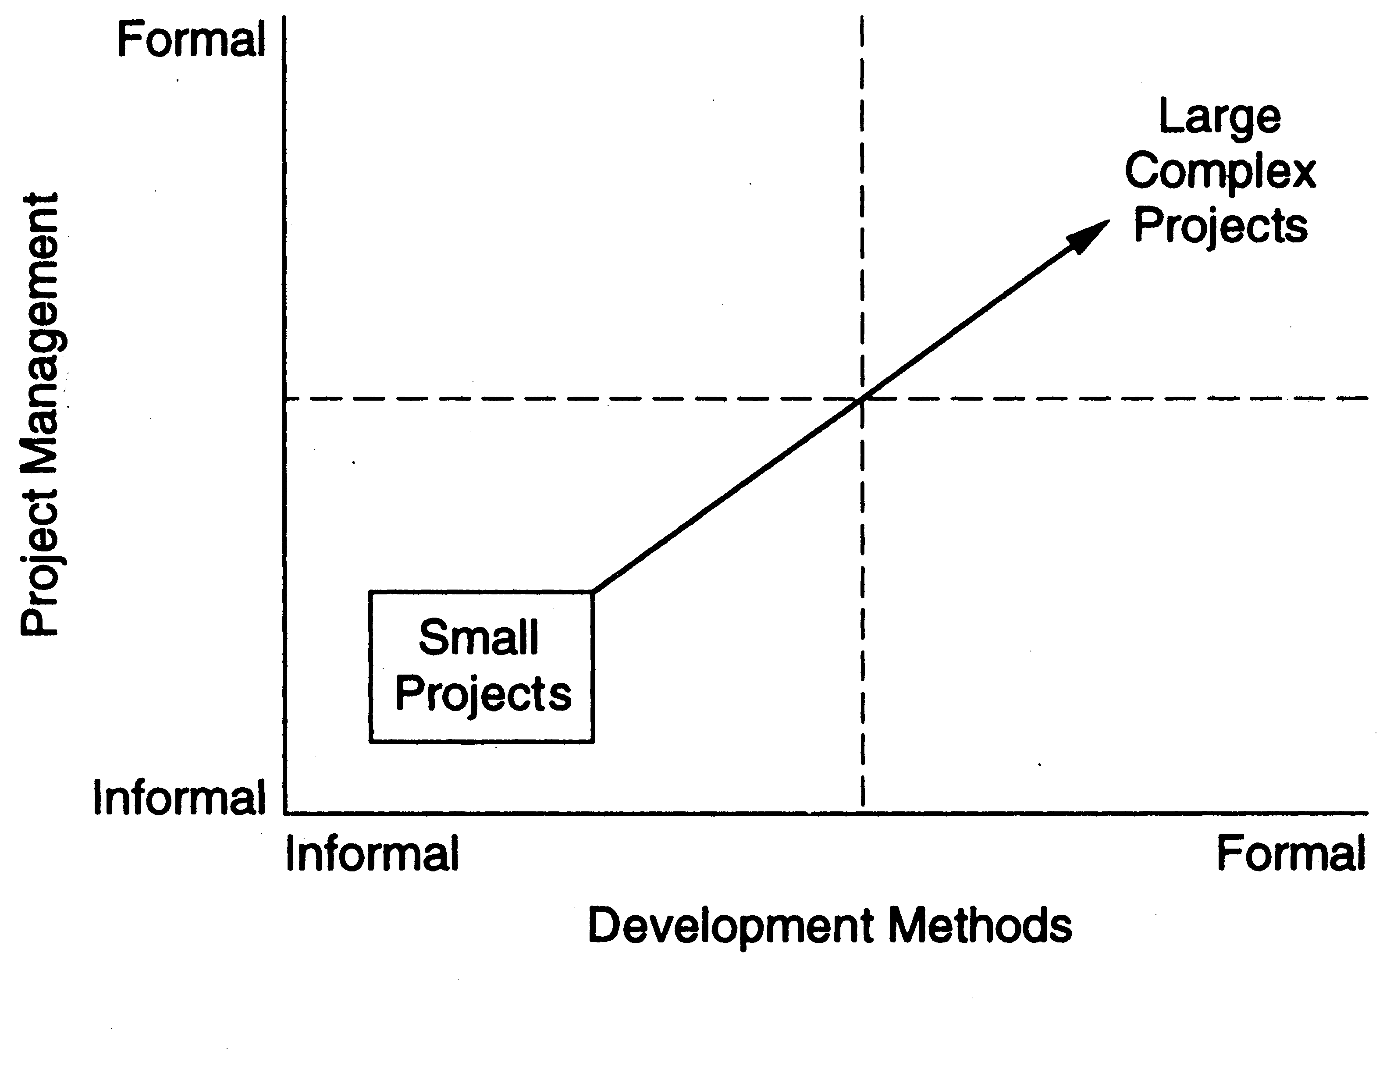
Scale…

Slide 21
Scale…
An illustration of issue of scale is counting the number of people in a room vs taking a census
  Both are counting problems
  Methods used in first not useful for census
  For large scale counting problem, must use different techniques and models
  Management will become critical

Slide 22
Scale: Examples
Gcc | 980KLOC | C, C++, yacc
Perl | 320 KLOC | C, perl, sh
Appache | 100 KLOC | C, sh
Linux | 30,000 KLOC | C, c++
Windows XP | 40,000 KLOC | C, C++

Slide 23
Scale…
As industry strength software tends to be large, hence methods used for building these must be able to scale up
For much of the discussion, we will high Q&P as the basic objective

Slide 24
Summary
The problem domain for SE is industrial strength software
SE aims to provide methods for systematically developing (industrial strength) software
Besides developing software the goal is to achieve high quality and productivity (Q&P)
Methods used must accommodate changes, and must be able to handle large problems

