Slide 1
"Predicting Student Adaptivity at Online Education System"
Project based learning
Under the Supervision of Presented by :-
Dr Sanjay Jain Ankur Singh Chauhan
Professor, Department of CSE, MCAN1CA23039
SOET, ITM University

Slide 2
ABSTRACT
Since, now a days we have so much of our education done online, we must understand the level of adaptivity of students towards online education system. In this PBL we will study a dataset of the said problem and build a classification model that can predict the adaptivity level of the student.

Slide 3
DATASET LINK
The dataset used for this project can be accessed via
https://www.kaggle.com/datasets/mdmahmudulhasansuzan/students-adaptability-level-in-online-education

Slide 4
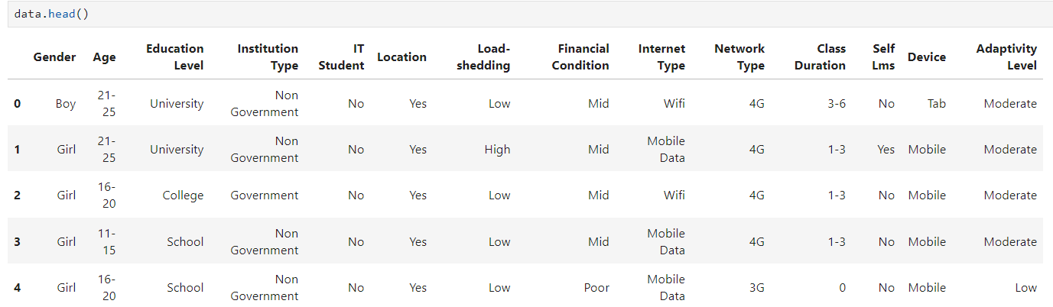
DATA VIEW

Slide 5
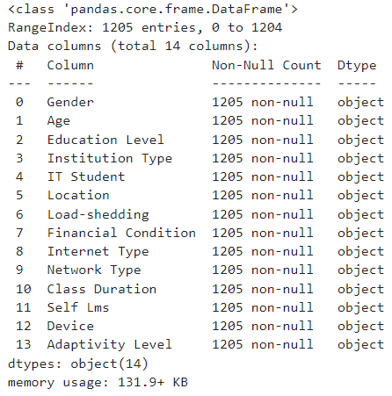
DESCRIPTION OF DATA

Slide 6
DESCRIPTION OF DATA
The dataset comprises the following attributes:
Gender: Gender of the student.
Age: Age ranges
Education Level: Different education levels represented.
Institution Type: Types of institutions.
IT Student: Whether the student is an IT student or not.
Location: Is student location in town.
Load-shedding: Impact or presence of load-shedding.
Financial Condition: Financial status of student’s family.
Internet Type: Types of internet connections.
Network Type: Types of network connections.
Class Duration: Duration of classes.
Self LMS: Institution’s own LMS availability.
Device: Types of devices used.
Adaptivity Level: Level of adaptivity reported.

Slide 7
TOOLS USED
Pandas
Matplotlib
Scikit-Learn
Seaborn
GridSearchCV
KFold
XGBoost
Jupyter Notebook or Google Colab

Slide 8
PROPOSED WORK
Exploratory Data Analysis:
Correlation Analysis
Distribution Analysis of features
Visualization of data
Preprocessing:
Encoding categorical values
Changing the dtype of necessary columns
Defining the independent and dependent variables
Normalization
Feature selection techniques, if required.

Slide 9
PROPOSED WORK
Model Selection:
train_test split of the data
Select various classification models – like KNN, Decision Tree, Random Forest, SVM, XGBoost
4. Model Training and Evaluation
Train all models and test them.
Evaluate each model using classification metrics
Perform hyperparameter tuning of the models
Re-evaluate the models again

Slide 10
Proposed Models
1. Decision Tree
2. Random Forest
3. Naive Bayes
4. Support Vector Machine
5. XGBoost

Slide 11
Expected Outcomes
Model Performance Evaluation
Feature Importance
Hyperparameter optimization
Actionable insights
Visual insights

Slide 12
THANK YOU

