Slide 1
Capstone Project - The Battle of the Neighborhoods (Week 2)
Applied Data Science Capstone by IBM/Coursera

Slide 2
Introduction: Business Problem
In this project we will try to find nearby schools as per finance type. Specifically, this report will be targeted to Realtors working for families (with kids) to find house nearby the school in Hong Kong.
Since there are lots of schools in Hong Kong, we will try to detect **locations that are suitable as per budget**. We would also prefer locations **as close to given location as possible**.
We will use our data science powers to generate a few most promising Districts based on these criteria. Advantages of each area will then be clearly expressed so that best possible final location can be chosen by stakeholders.

Slide 3
Data Analysis
Based on definition of our problem, factors that will influence our decision are:
number of existing schools in the neighborhood.
type of schools in the neighborhood.
Following data sources will be needed to extract/generate the required information:
List of Districts will be generated algorithmically and approximate addresses of centers of those areas will be obtained using **Wikipedia link**
number of schools and their type and location in every district will be obtained using **EDB json file**
coordinates in Hong Kong will be obtained using **Google Maps API geocoding** of any given location.

Slide 4
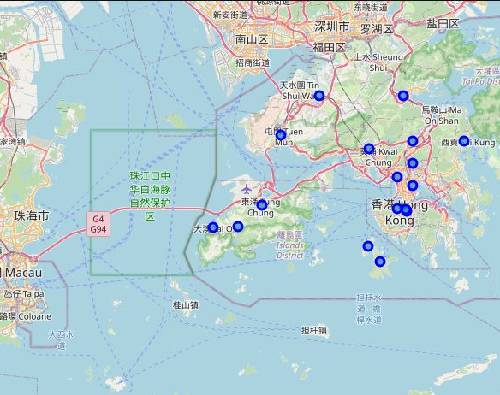
MAP Visualization

Slide 5
Methodology
first step we have collected the required **data: location and type (Finance) of every schools nearby from Tsuen Wan, Hong Kong**.
Second step in our analysis will be calculation and exploration of '**finance Type**' across different areas of Hong Kong - we will use **Bar chart** to identify a few promising areas close to district with different Type of Schools.
third and final step we will focus on most promising areas and within those create **clusters of locations that meet some basic requirements** established in discussion with stakeholders

Slide 6
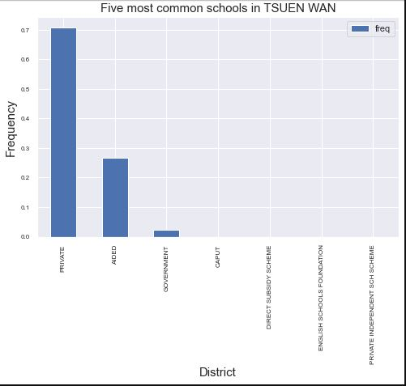
TOP 7 Schools of Tsuen Wan District

Slide 7
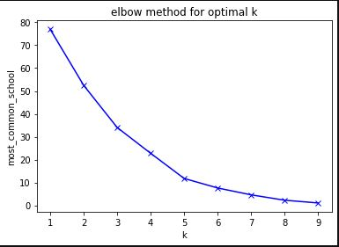
K-Means Elbow Method

Slide 8
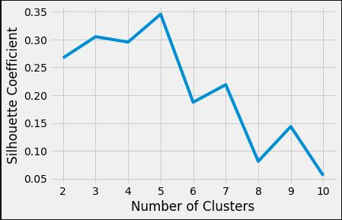
Best K-Means Identification Graph

Slide 9
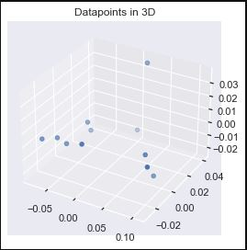
3D Visualization of Cluster

Slide 10
Results and Discussion
Our analysis shows that although there is a great number of schools in Hong Kong, but which are close to nearby districts.
We can see Private, Aided and Government Subsidy schools are most common among all districts and but still we can identify the frequency of popular schools in each district.
We can identify most common schools, and which will help families to identify the schools according to average income.

Slide 11
Conclusion
Purpose of this project was to identify schools nearby to each district of Hong Kong (particularly suitable as per average income) in order to aid stakeholders in narrowing down the search for optimal location for getting the house nearby to school as per the average income.
Clustering of these locations was then performed in order to create major zones of interest (containing greatest number of potential locations) and addresses of those zone centers were created to be used as starting points for final exploration by stakeholders.

Slide 12
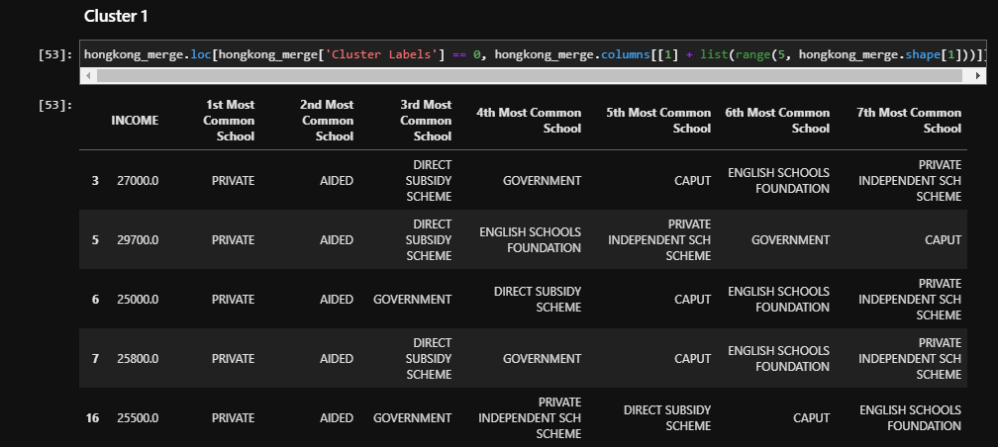
Cluster 1

Slide 13
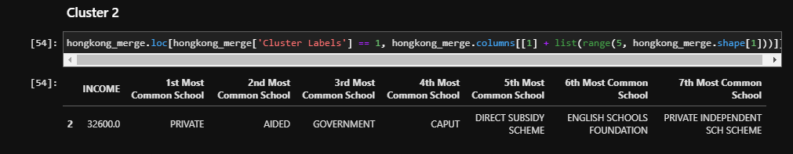
Cluster 2

Slide 14
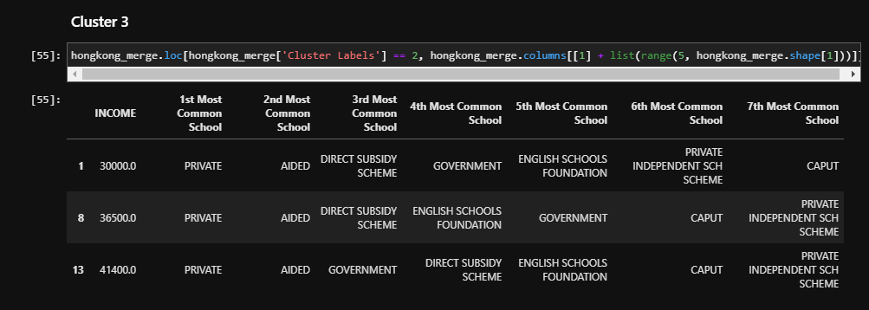
Cluster 3

Slide 15
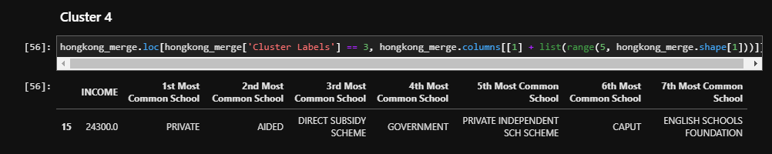
Cluster 4

Slide 16
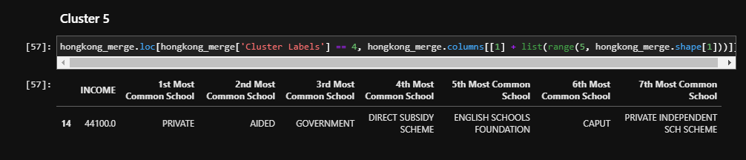
Cluster 5

Slide 17
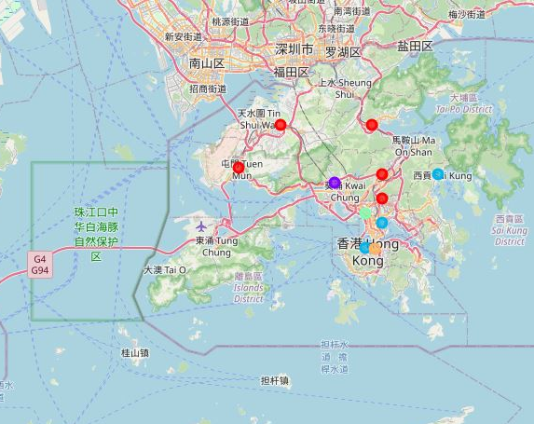
Map visualization of Clusters

Slide 18
Reference
Hong Kong District Details (https://en.wikipedia.org/wiki/Districts_of_Hong_Kong)
Hong Kong Districts Geographical Details (https://www.geodatos.net/en/coordinates/hong-kong)
Hong Kong School geographical Details (https://www.edb.gov.hk/attachment/en/student-parents/sch-info/sch-search/sch-location-info/SCH_LOC_EDB.json)

