Slide 1
Raja Ramanna Centre for Advanced Technology
Young Scientist Research Programme (YSRP-2019)
Detection of Aliments in Medical Images via Image Classification using Deep Convolutional Neural Network
Project Guide-
Shri Gaurav Saxena
SO/F
Computer Divison
RRCAT
Submitted By –
Aniket Chauhan
B.Tech. (CSE)
DIT University , Dehradun

Slide 2
CONTENT
Introduction
Necessity
Road Map
Software and Technology Stack
Dataset Collection and Study
Methodology
Convolutional Neural Network
CNN Layers
Example – Alex Net
Implementation Of Network
Training The CNN
Snapshots
Prediction Of Breast Cancer
Conclusion & Future Work

Slide 3
INTRODUCTION
Breast cancer is the most common invasive cancer in women, and the second main cause of cancer death in women, after lung cancer.
Invasive ductal carcinoma (IDC) also known as infiltrating ductal carcinoma is most common subtype of breast cancer .
Approximately 25% of the female cancer cases in India are Breast Cancer .
Breast cancer detection is the medical screening of asymptomatic, apparently healthy women for breast cancer in an attempt to achieve an earlier diagnosis. The assumption is that early detection will improve outcomes.

Slide 4
NECESSITY
In recent years, Breast cancer is one of the main causes of cancer death worldwide .
Early diagnostics significantly increases the chances of correct treatment and survival, but this process is tedious if done manually .
Computer-aided diagnosis systems showed potential for improving the diagnostic accuracy .
In this project ,an approach is developed based on deep convolution neural networks for IDC breast cancer detection from histopathology images.

Slide 5
ROAD MAP
Dataset Study
Implementation of Network
Snapshots
Source
No. of images , their size , etc .
Python Code for Network Implementation
Model’s Accuracy ,Loss curves
Training CNN Model
Prediction of Breast Cancer
Technical Requirements
Literature Survey
Steps for Training CNN Model
Snapshot showing Predication
Ex .Python Language , etc.
Study about CNN , Layers ,etc.
Image Preprocessing

Slide 6
SOFTWARE AND TECHNOLOGY STACK
Software Library : Tensorflow – gpu 1.2
Programming Language : Python(3.6)
High Level Neural Network API : Keras 2.2.4
Package for Scientific Computing : Numpy 1.5 ,Scipy 1.2
Parallel Computing Platform Programming : CUDA Toolkit 9.2
Deep Neural Network : cuDNN 7.3

Slide 7
DATASET COLLECTION AND STUDY
Dataset consist of 277,544 mount slides images of 50 x 50 scanned at 40x.
Contains 198,738 IDC negative images and 78,786 IDC positive images.
Each image file name is of the format:
u_xX_yY_classC.png — > example 10253_idx5_x1351_y1101_class0.png
where u is the patient ID (10253_idx5), X is the x-coordinate of where this image was cropped from, Y is the y-coordinate of where this image was cropped from, and C indicates the class where 0 is non-IDC and 1 is IDC.

Slide 8
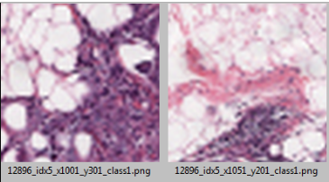
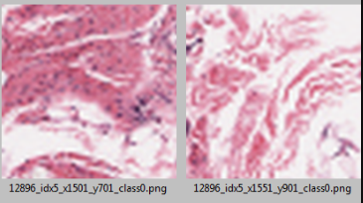
DATASET SNAPSHOT

Slide 9
METHODOLOGY
To achieve our expected outcome, Convolutional Neural Network (CNN) architecture is used with our IDC Breast Cancer image dataset .
For training and testing , dataset is divided with 80% of the dataset used for training the CNN and 20% of dataset left for testing purpose .
In order to implement our CNN model we used Tensorflow as the deep learning framework and Keras as the wrapper library.

Slide 10
CONVOLUTIONAL NEURAL NETWORK
A convolutional neural network (CNN) is a type of artificial neural network used in image recognition and processing that is specifically designed to process pixel data.
Information that flows through the network affects the structure of the ANN because a neural network changes - or learns based on that input and output.
CNNs are powerful image processing model .

Slide 11
CNN LAYERS
A CNN typically has three layers: a convolutional layer, pooling layer, and fully connected layer.
Convolution Layer
The core building block of the CNN.
Layer performs a dot product between two matrices, where one matrix is the set of learnable parameters known as a kernel, and the other matrix is the restricted portion of the images.

Slide 12
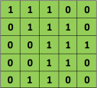

CONVOLUTION OPERATOR
Consider a 5 x 5 image whose
pixel values are only 0 and 1 :
Also, consider another 3 x 3 matrix
as shown below:
Then, the Convolution of the 5 x 5 image
and the 3 x 3 matrix can be computed as
shown in the animation in Figure 5 below:

Slide 13
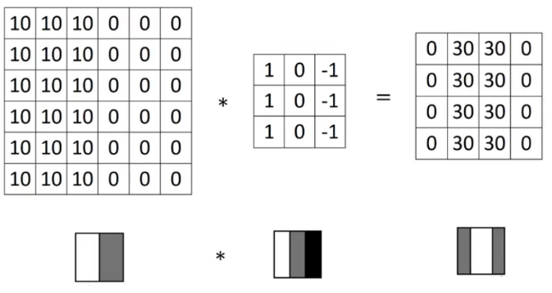
EXAMPLE
Higher pixel values represent the brighter portion of the image and the lower pixel values represent the darker portions. This is how we can detect a vertical edge in an image.

Slide 14
POOLING LAYER
Pooling layer (also called downsampling) reduces the dimensionality of each feature map but retains the most important information.
Pooling can be of different types: Max, Average, Sum etc.
Instead of taking the largest element we could also take the average (Average Pooling) or sum of all elements in that window.
In practice, Max Pooling has been shown to work better.

Slide 15
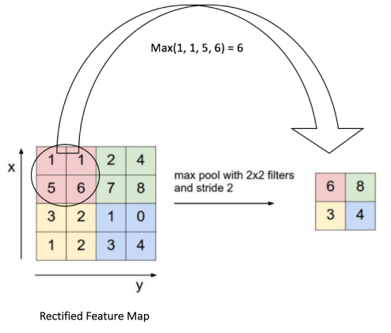
EXAMPLE

Slide 16
FULLY CONNECTED NETWORK
Fully Connected layer is a traditional Neural Network.
The term “Fully Connected” implies that every neuron in the previous layer is connected to every neuron on the next layer.
The output from the convolutional and pooling layers represent high-level features of the input image.
The purpose of the Fully Connected layer is to use these features for classifying the input image into various classes based on the training dataset.

Slide 17
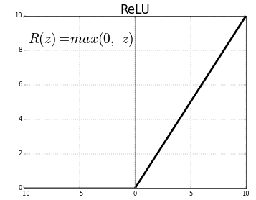
NON – LINEARITY LAYERS
ReLU
ReLU stands for Rectified Linear Unit .
It computes the function ƒ(X)=max (0,X). In other words, the activation is simply threshold at zero.

Slide 18
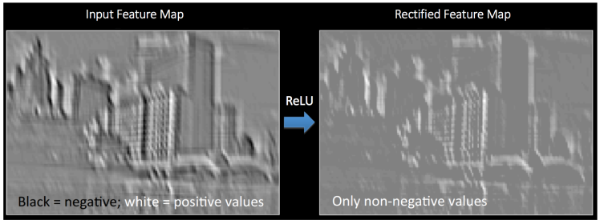
RELU OPERATION

Slide 19

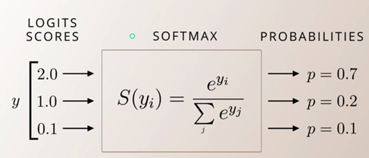
SOFTMAX
Softmax function takes as input a vector of K real numbers, and normalizes it into a probability distribution consisting of K probabilities.
The softmax function is used in various multiclass classification methods
Softmax function is defined by the formula :

Slide 20
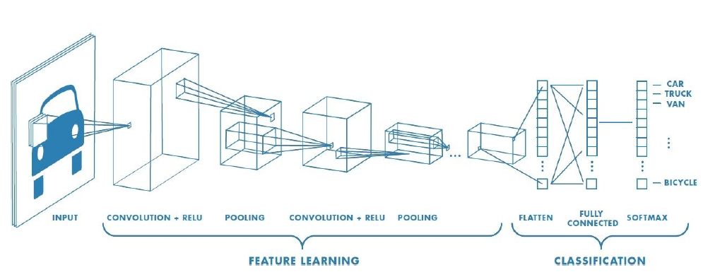
PUTTING IT ALL TOGETHER
The Convolution + Pooling layers act as Feature Extractors from the input image while Fully Connected layer acts as a classifier.

Slide 21
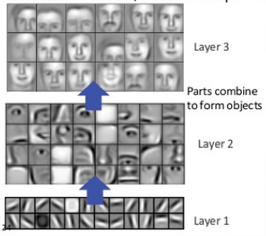
FEATURE HIERACHY
In deep-learning networks, each layer of nodes trains on a distinct set of features based on the previous layer’s output.
The further you advance into the neural net, the more complex the features your nodes can recognize, since they aggregate and recombine features from the previous layer.
This is known as Feature hierarchy.

Slide 22
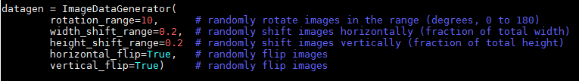
IMAGE PREPROCESSING
Image preprocessing is a method to perform some operations on an image, in order to get an enhanced image or to extract some useful information from it.
Image preprocessing Applied to the IDC Image Dataset

Slide 23
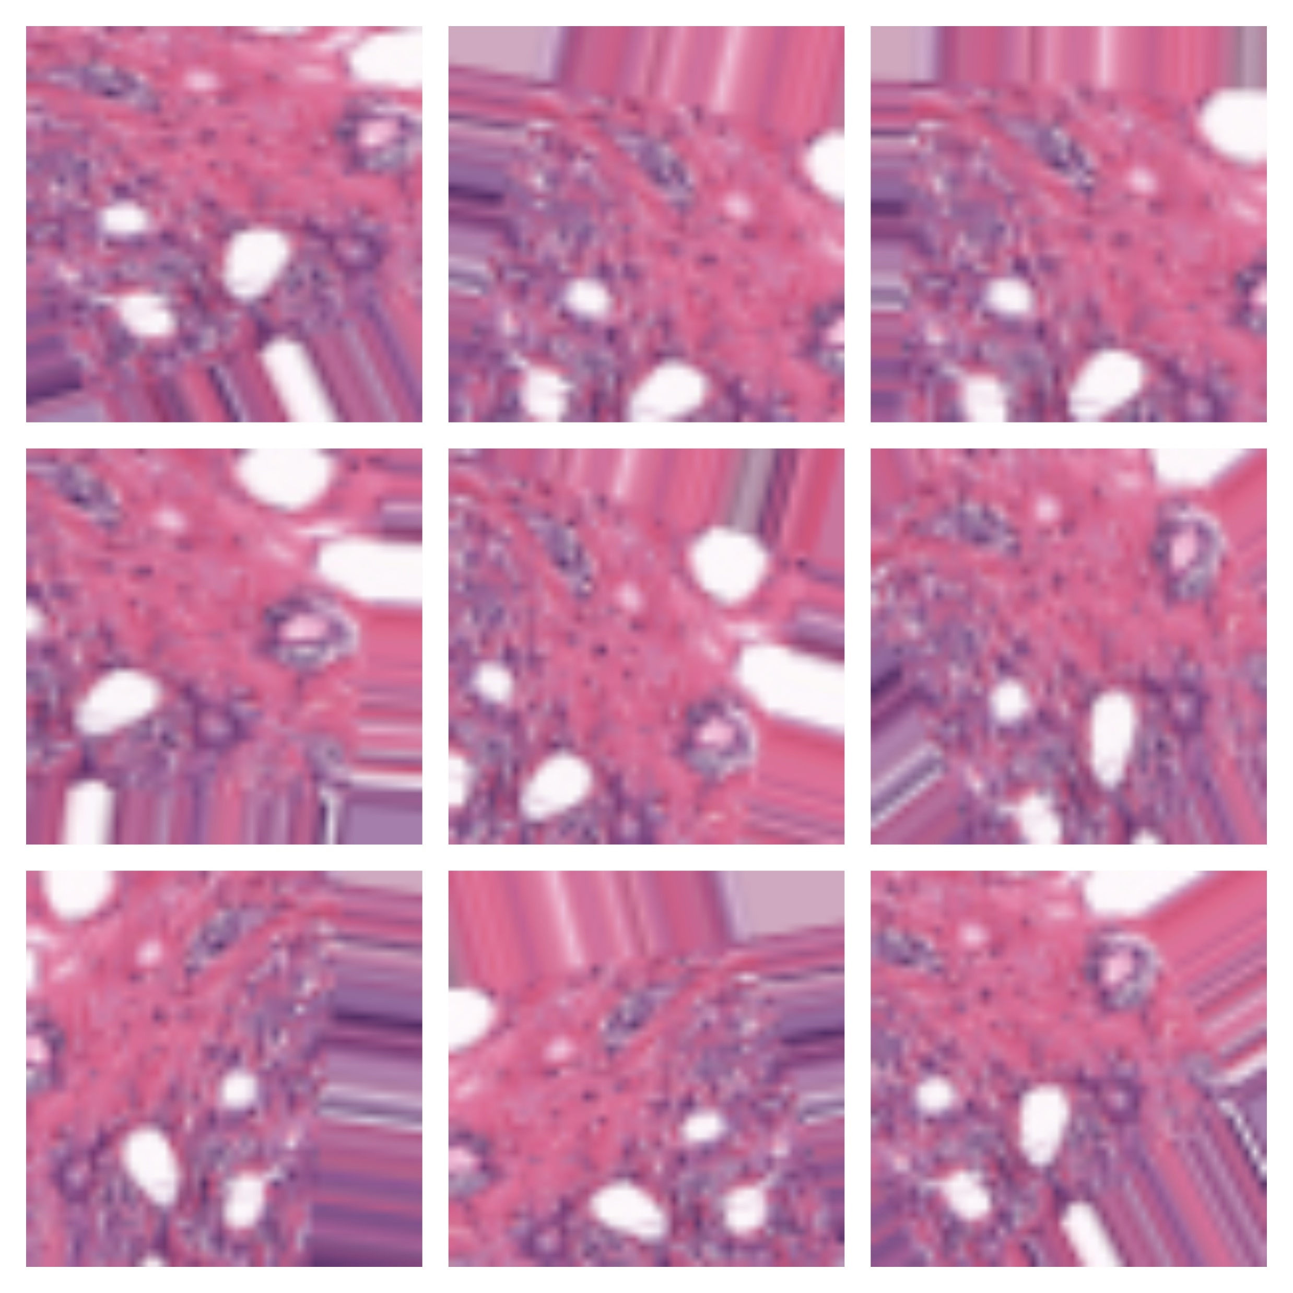
PREPROCESSED IMAGE - SNAPSHOT

Slide 24
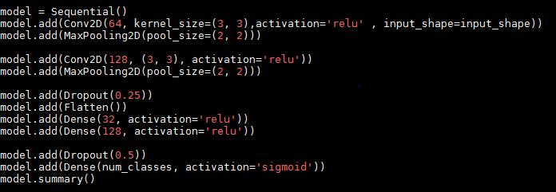
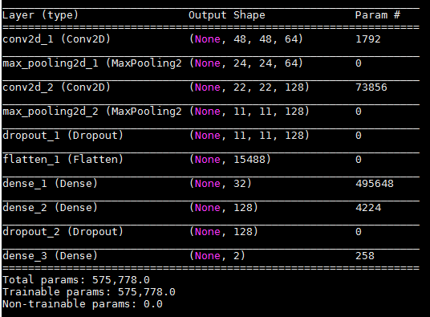
IMPLEMENTATION OF NETWORK
Custom Model Implementation using Python
Hyper Parameters :
Learning Rate : 1.0
Number of epochs : 250
Optimizer : Adam
Batch size : 32

Slide 25
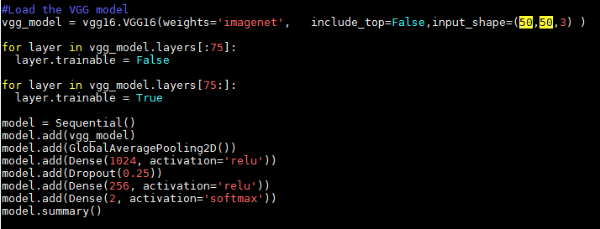
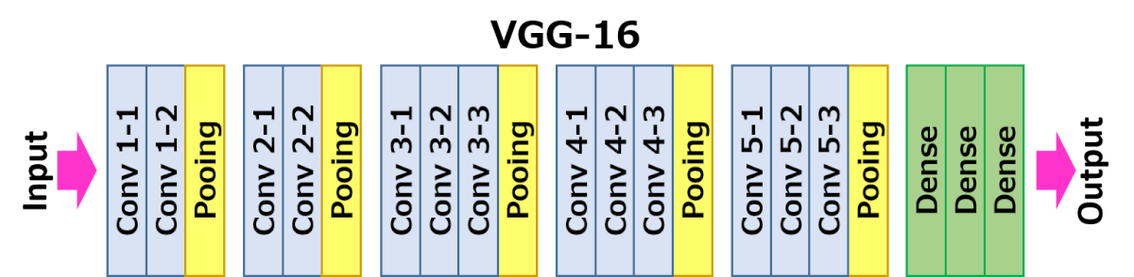
USING VGG16 MODEL
VGG16 Model is a pretrained CNN Model on ImageNet ( Image Dataset containing 14 Million images )
Hyper Parameters :
Learning Rate : 1.0
Number of epochs : 250
Optimizer : Adam
Batch size : 32

Slide 26
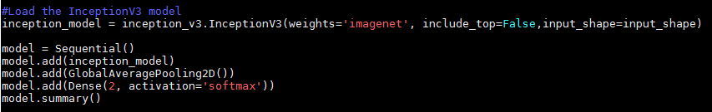
USING INCEPTION V3 MODEL
InceptionV3 Model is a pretrained CNN Model on ImageNet ( Image Dataset containing 14 Million images ) with 42-layer deep learning network
Hyper Parameters :
Learning Rate : 1.0
Number of epochs : 500
Optimizer : Adam
Batch size : 32

Slide 27
TRAINING THE CNN
The overall training process of the Convolution Network may be summarized as below:
Step1: All filters and parameters / weights with random values .
Step2: The network takes a training image as input, goes through the forward propagation step (convolution, ReLU and pooling operations along with forward propagation in the Fully Connected layer) and finds the output probabilities for each class.

Slide 28

Step3: Calculate the total error(squared mean error) at the output layer (summation over all 4 classes)
Total Error = ∑ ½ (target probability – output probability) ²
Step4: Use Backpropagation to calculate the gradients of the error with respect to all weights in the network and use gradient descent to update all filter values / weights and parameter values to minimize the output error.
Step5: Repeat steps 2-4 with all images in the training set.

Slide 29
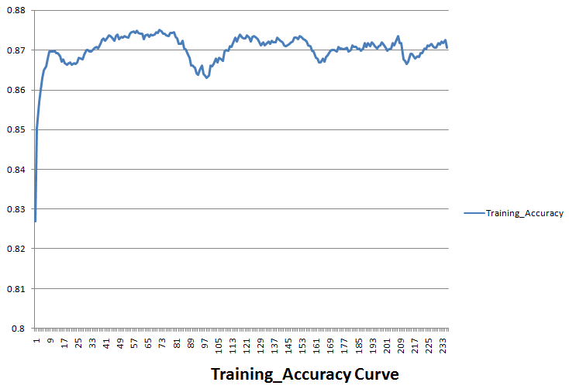
SNAPSHOTS - CUSTOM MODEL

Slide 30
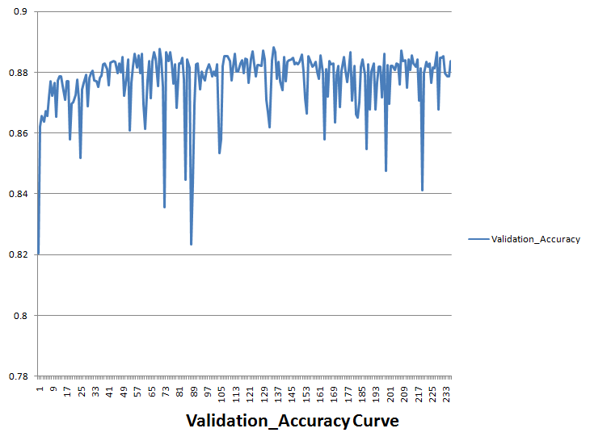

Slide 31
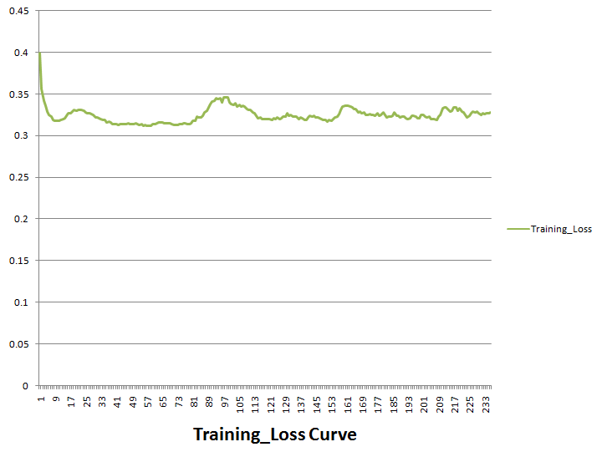

Slide 32
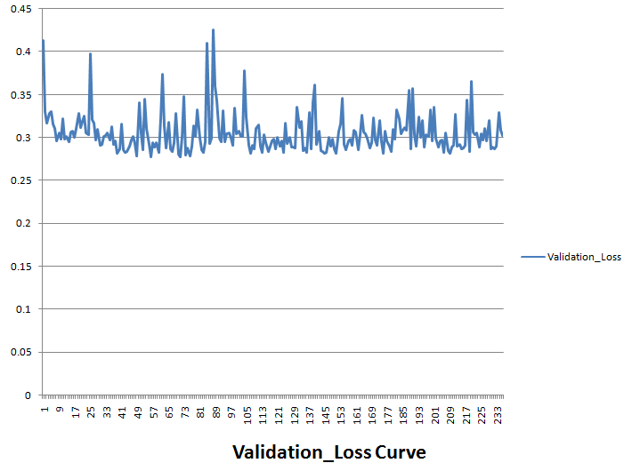

Slide 33
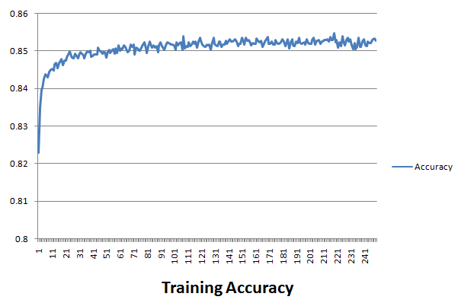
VGG16 MODEL

Slide 34
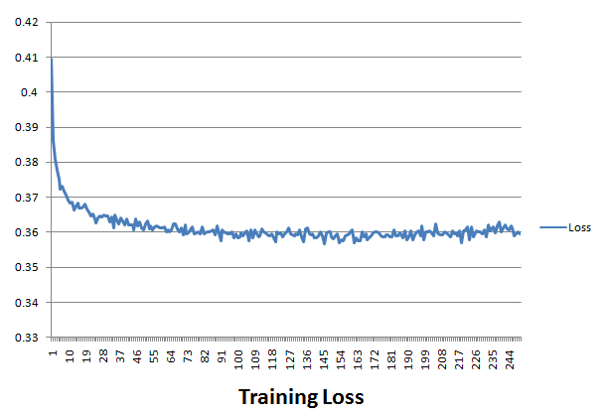

Slide 35
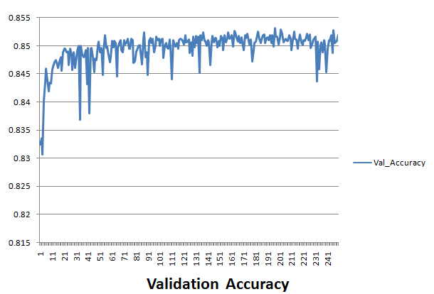

Slide 36
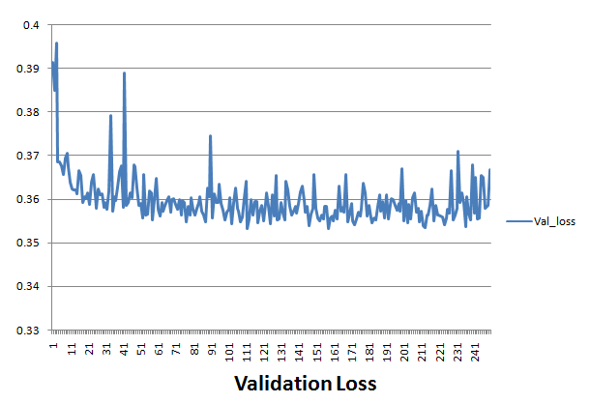

Slide 37
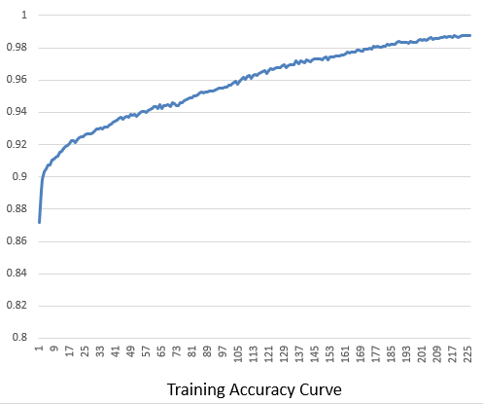
USING INCEPTION V3 MODEL

Slide 38
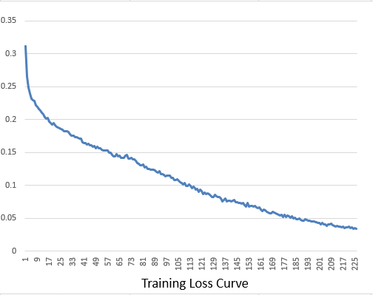

Slide 39
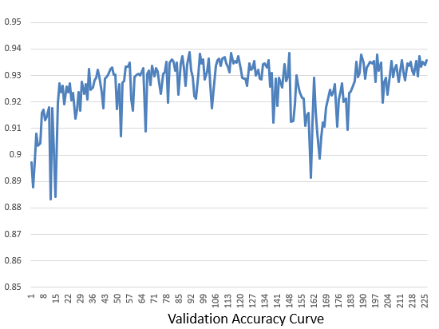

Slide 40
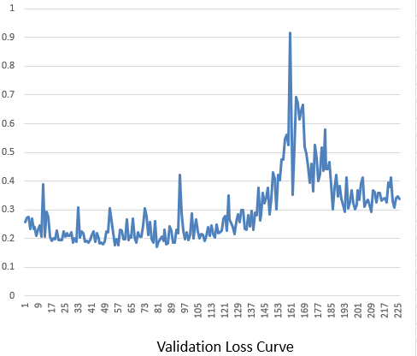

Slide 41
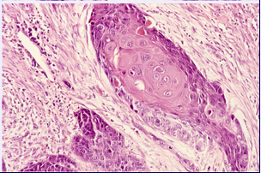
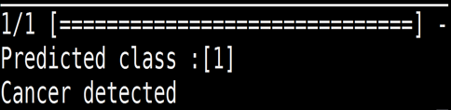
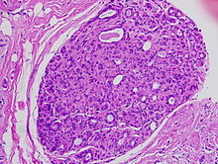
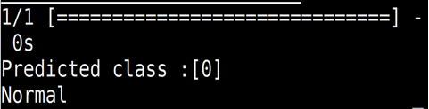
PREDICTION OF BREAST CANCER
Trained CNN Model
Trained CNN Model

Slide 42
CONCLUSION & FUTURE WORK
We concluded that Deep Learning can be applied to medical images for the detection of Aliments in Medical Images.
We also concluded that use of GPU’s for the training of CNN increases the computation speed .
Deep Learning can also be applied for the detection of cancer in the DICOM Images (Cheat X- Ray).
Various pretrained models can be used for the more accurate detection of the diseases in the Medical Images .

Slide 43
REFERENCES
[1] Wang, Justin & Ibrahim, Ali & Zhuang, Hanqi & Muhamed Ali, Ali & Li, Anthony. (2018). A Study on Automatic Detection of IDC Breast Cancer with Convolutional Neural Networks.
[2] Malvia, Shreshtha & Bagadi, Sarangadhara & Dubey, Uma & Saxena, Sunita. (2017). Epidemiology of breast cancer in Indian women: Breast cancer epidemiology. Asia-Pacific Journal of Clinical Oncology. 13. 10.1111/ajco.12661.
[3] Dundar, M. M., Badve, S., Bilgin, G., Raykar, V., Jain, R., Sertel, O., and Gurcan, M. N., “Computerized classification of intraductal breast lesions using histopathological images,” IEEE Transactions on Biomedical Engineering 58, 1977–1984 (July 2011).
[4] https://www.cancer.net/cancer-types/breast-cancer/statistics

Slide 44
Thank You

