Slide 1
DATA ANALYTICS ON CORONA VIRUS
Topic – Impact of Air Pollution on our Lives
Project Guide-
Shri Akash Kumar
HR
Shaaditimes
Submitted By –
Aniket Chauhan
B.Tech. (CSE)
DIT University , Dehradun

Slide 2
TABLE OF CONTENT
Introduction
Objective
Dataset
Pre Corona
Post Corona
Model Evaluation

Slide 3
INTRODUCTION
Air pollution refers to the release of pollutants into the air that are detrimental to human health and the planet as a whole.
The main gases that cause the air pollution as reported by Climate and Clean Air program at NRDC are :
NO(Nitric oxide),
NO2(Nitrogen Dioxide),
SO2(Sulphur Dioxide) , etc.
All these pollutants decay the quality of air and mainly release from Vehicle ad Industries.

Slide 4
OBJECTIVE
The main objective the Project is to perform data analysis in two fragments
Pre Corona : From the time 2016 to 2020 from Data available at different sources about Air Pollutants Concentration.
Post Corona [2020 to 2023] by forecasting the concentration of different pollutants in major cities of India like Ahmedabad ,etc. . Analyzing different factors which affect pollutants trend.

Slide 5
ROAD MAP
Dataset Study
Post Corona Data Analysis
Source
Python Code for Forecasting Pollutants Concentration
Pre Corona Data Analysis
Model Metrics Value
Technical Requirements
Root Mean Square Error
Ex .Python Language , etc.
Distribution Plots of Data
Trend and Seasonality

Slide 6
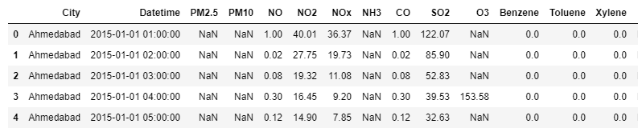
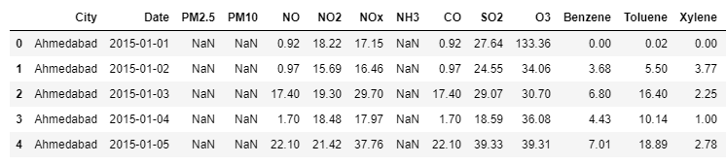
DATASET
The dataset contains air quality data at hourly and daily level of various stations across multiple cities in India.

Slide 7
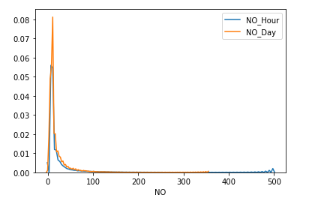
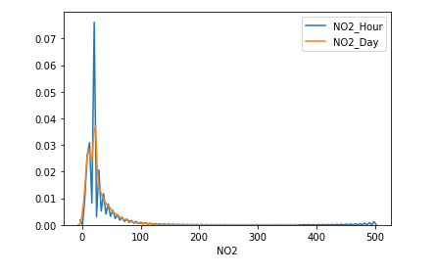
PRE CORONA DATA ANALYSIS
The data is analyzed by using its distribution as given by following distribution plots.
The plot seems to be fairly same for the Day and Hour Basis Concentration.

Slide 8
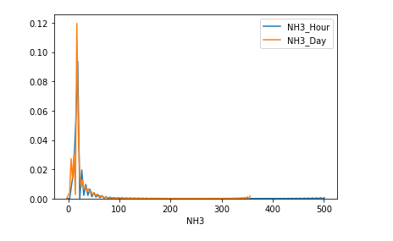
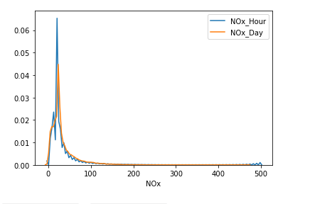
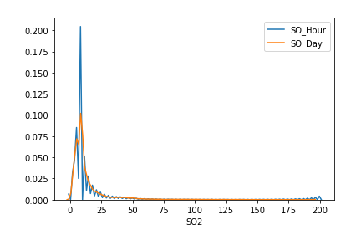
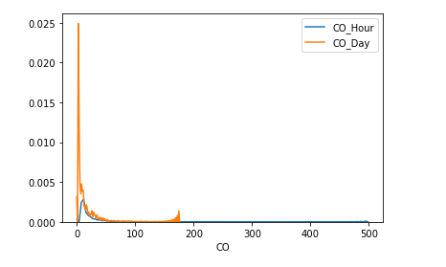

Slide 9
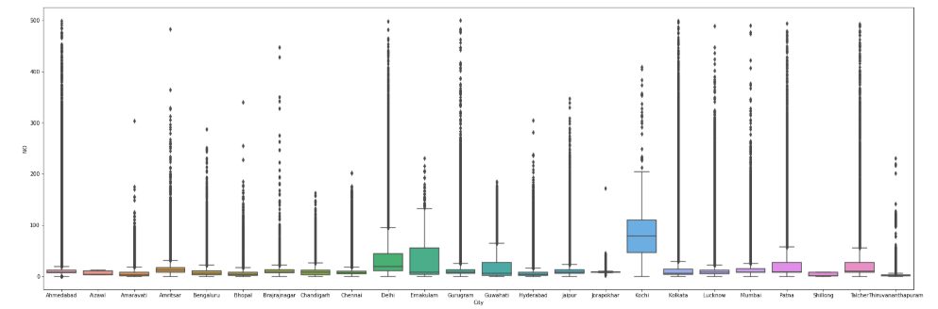
BOX PLOT FOR NO CONCENTRATION IN DIFFERENT CITIES

Slide 10
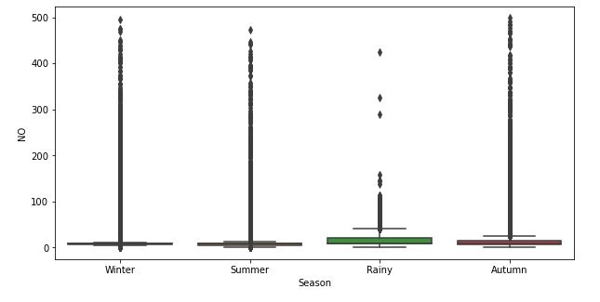
SEASONAL ANALYSIS
From the box plot
The concentration of NO is highest in autumn season .
The concentration of NO is lowest in rainy season .

Slide 11
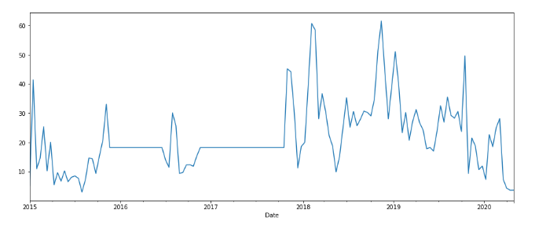
ANALYSIS OF NO CONCENTRATION IN CITY OF AHMEDABAD
From the line plot:
The concentration of NO is highest in year 2019.
The concentration of NO is nearly constant in year 2016 to 2017

Slide 12
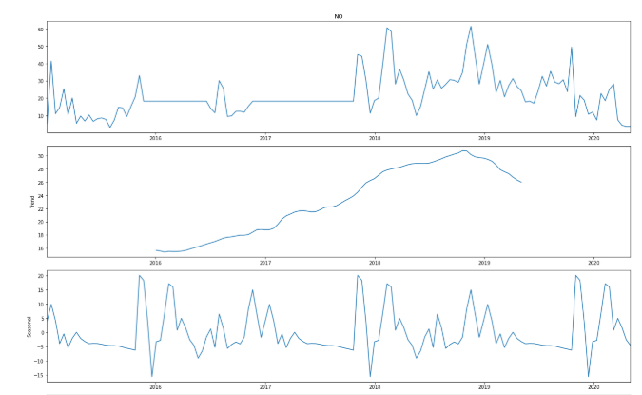
The figure shows that there is an upward trend in the concentration of NO.
From seasonal plots , it looks like the NO has highest presence in the
Stating of year i.e. during winters.

Slide 13
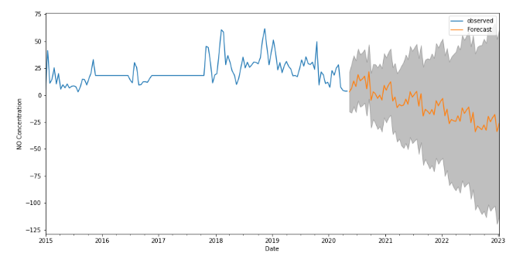
POST CORONA DATA ANALYSIS
Using the SRIMA Model to forecast the concentration of NO in Ahmedabad in the coming year 2020 to 2023.
The concentration of NO will going to decrease in the coming year
This might be because of lockdown , the air pollution decreased as lot.

Slide 14
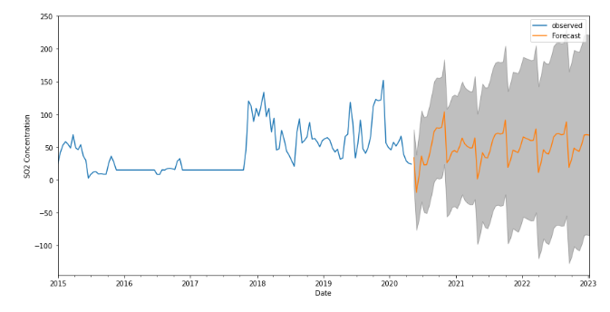

Slide 15
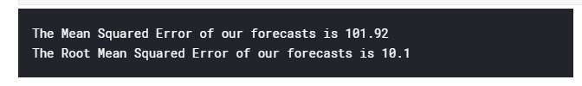
Model Metrics Value
ARIMA model used to forecast the value of concertation has been evaluated using the Mean Squared Error and Root Mean Squared Error.
The model has fairly enough chances for the correct prediction of the value because of its Low value of RMSE.

Slide 16
Thank You

