Slide 1
Campus Recruitment System
Project Guide-
Dr. Naveen Prakash
IIIT - Delhi
Submitted By –
Akhand Pratap Singh(MT20029)
Aniket Chauhan(MT20030)
IIIT - Delhi

Slide 2
TABLE OF CONTENT
Project Description
Cartesian Decomposition
Modular Structure
List of Features
Code Flow
Snapshots of Running Modules
Contribution

Slide 3
PROJECT DESCRIPTION
Campus Recruitment System is designed to conduct the campus placement drive and coordinates the flow between the students and the placement cell.
It provide the platform where companies can list their jobs in different domains.
The system is designed with the help of eight modules. The modules are listed below :

Slide 4
Campus Placement Drive
Company Information
Student Information
Drive Information
Generate List of Eligible Students
Send notifications to Eligible Students
Track Score
Send notifications to Selected Students

Slide 5
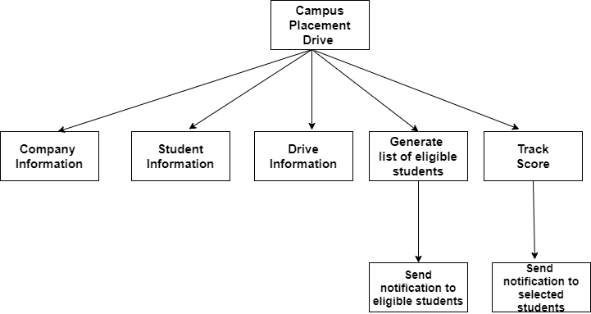
CARTESIAN DECOMPOSITION
We have implemented exactly same Cartesian decomposition that we had provided in the Project Report.

Slide 6
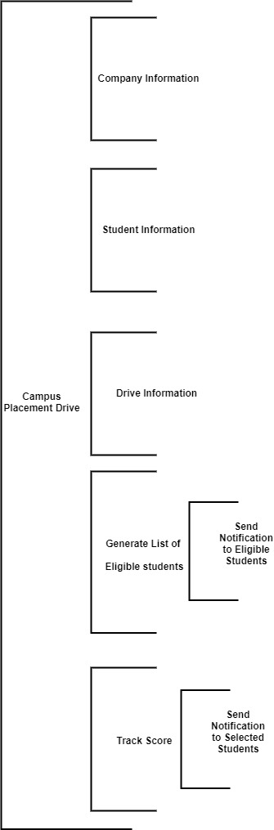
MODULAR STRUCTURE
We have implemented exactly same Modular Structure that we had provided in the Project Report.

Slide 7
LIST OF FEATURES
The system takes company data from companies that include Name, address, turnover, and core business area.
The system takes also takes student data from students, which are used to send notifications to the student about the jobs in which he/she is eligible.
Companies can input drive information so that students can be informed about the job eligibility criteria, etc.
The system generates the list of eligible students to from the student’s data and drive’s data.
Eligible students are then informed about campus drive.
Track the score of the student during the placement process through the form.
Finally , selected students are informed with a message of selection.

Slide 8
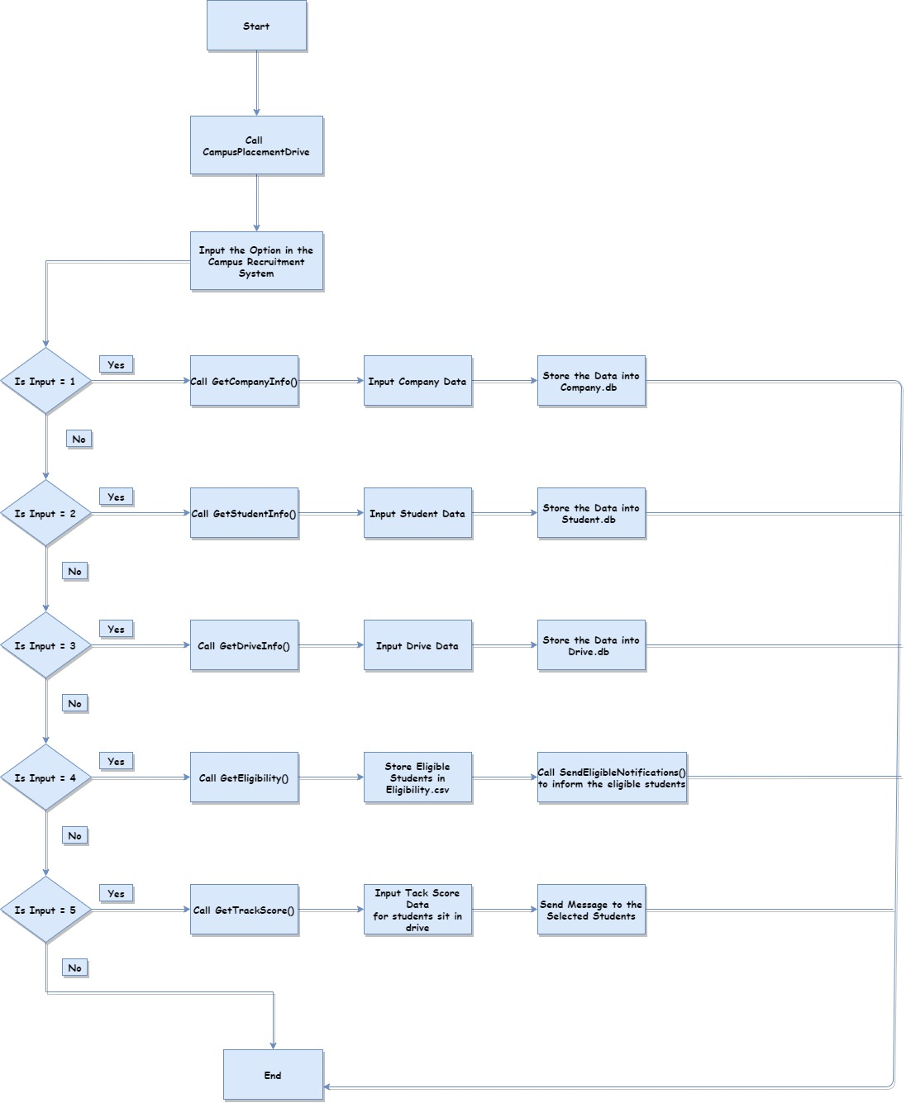
CODE FLOW

Slide 9
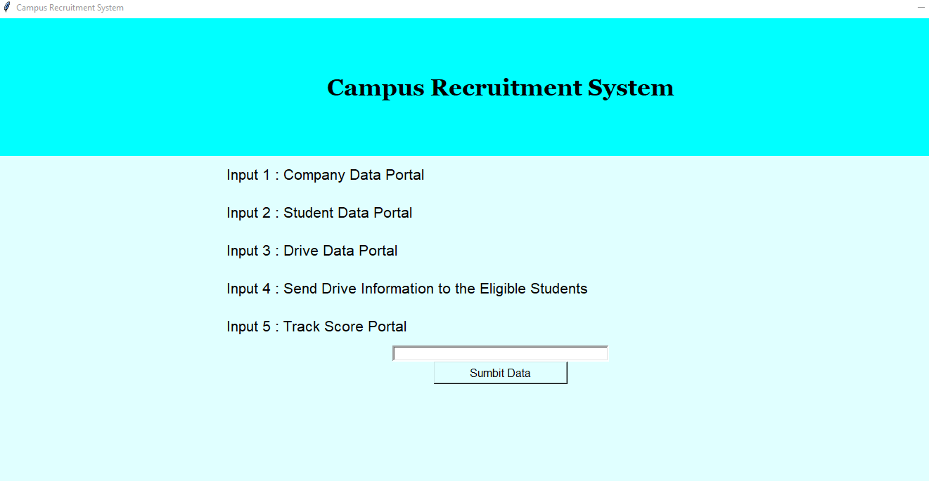
SNAPSHOT OF RUNNING MODULES

Slide 10
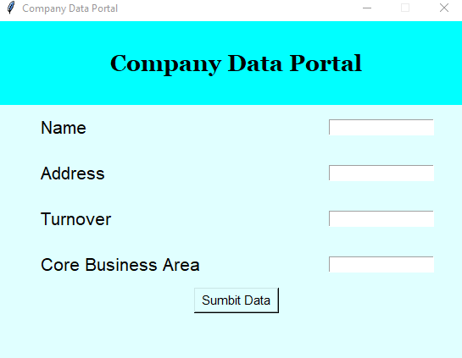
Company Data Portal

Slide 11
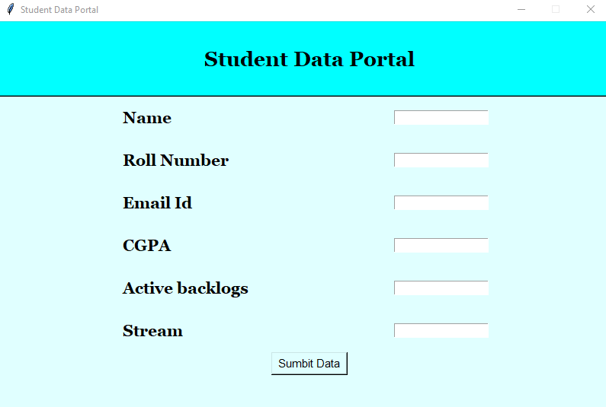
STUDENT DATA PORTAL

Slide 12
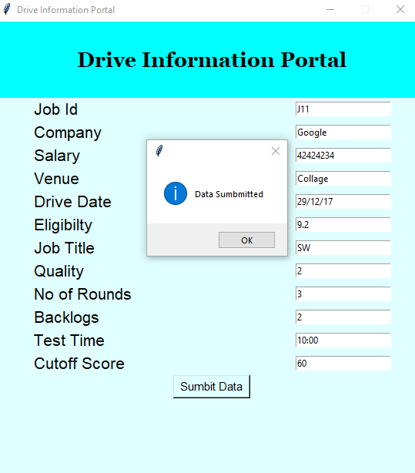
DRIVE INFORMATION PORTAL

Slide 13
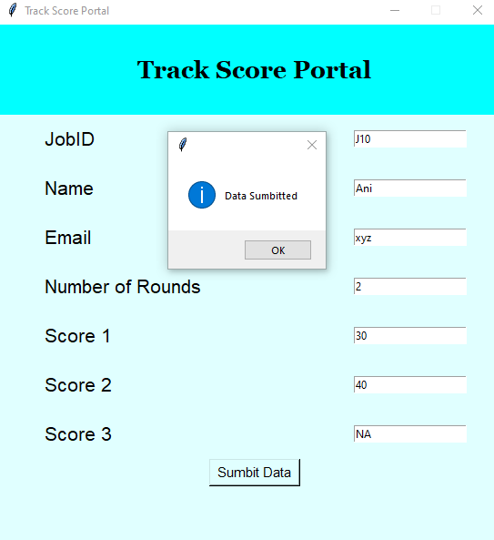
TRACK SCORE PORTAL

Slide 14
CONTRIBUTION
Contribution by Akhand Pratap Singh :
Building Drive Information Module
Building Generate List of Eligible Students Module
Contribution by Aniket Chauhan :
Building Company Information Module
Building Student Information Module
Building Track Score Module
Combining all modules under Main Module

Slide 15
Thank You

