Slide 1
Campus Recruitment System
Project Guide-
Dr. Naveen Prakash
IIIT - Delhi
Submitted By –
Akhand Pratap Singh(MT20029)
Aniket Chauhan(MT20030)
IIIT - Delhi

Slide 2
TABLE OF CONTENT
Project Description
Initial OO Design
SOLID Principle Based Design
Working
List Of Features
New Features
Snapshots Of Running Code

Slide 3
PROJECT DESCRIPTION
Campus Recruitment System is designed to conduct the campus placement drive and coordinates the flow between the students and the placement cell.
It provide the platform where companies can list their jobs in different domains.
The system is designed with the help of classes with design principles following the SOLID Principles.

Slide 4
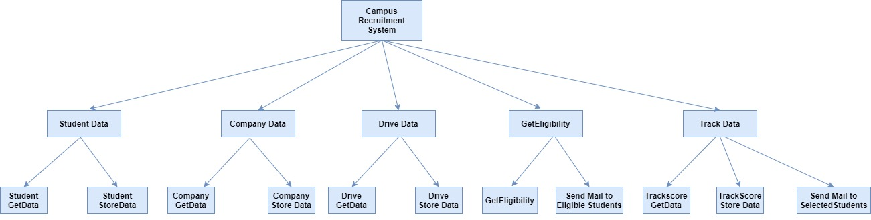
INITIAL OO DESIGN

Slide 5
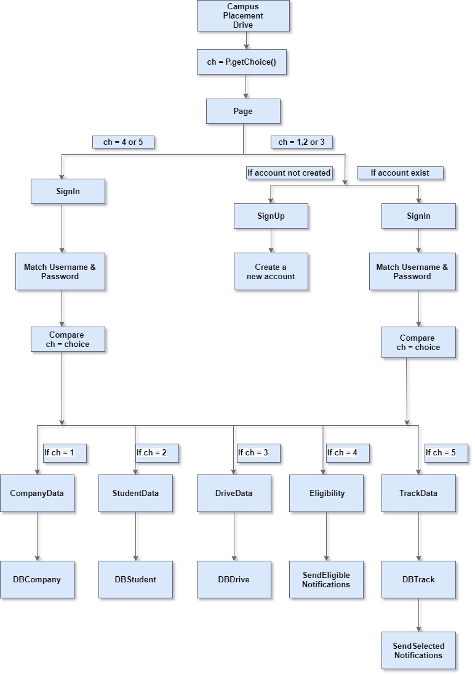
SOLID PRINCIPLE BASED DESIGN

Slide 6
WORKING
When the portal opens, User selects the option based on what he/she want to access.
Then User has to Login with the valid credentials.
If User does not have credentials then he/she has to Sign Up with Username and Password.
Once User Logged In he can access the page based on the option he/she has selected .

Slide 7
LIST OF FEATURES
The system takes company data from companies that include Name, address, turnover, and core business area.
The system takes also takes student data from students, which are used to send notifications to the student about the jobs in which he/she is eligible.
Companies can input drive information so that students can be informed about the job eligibility criteria, etc.
The system generates the list of eligible students to from the student’s data and drive’s data.
Eligible students are then informed about campus drive.
Track the score of the student during the placement process through the form.
Finally , selected students are informed with a message of selection.

Slide 8
NEW FEATURES
Login Page for the different type of User i.e. Company, Student and College.
Each type of User can access only its portal by log in in using its credentials.
Sign Up Page for the User if does not have any account previously.
Once Signed Up then User can access the portal with his Username and password.
Students selected will be sent E-mail notification.

Slide 9
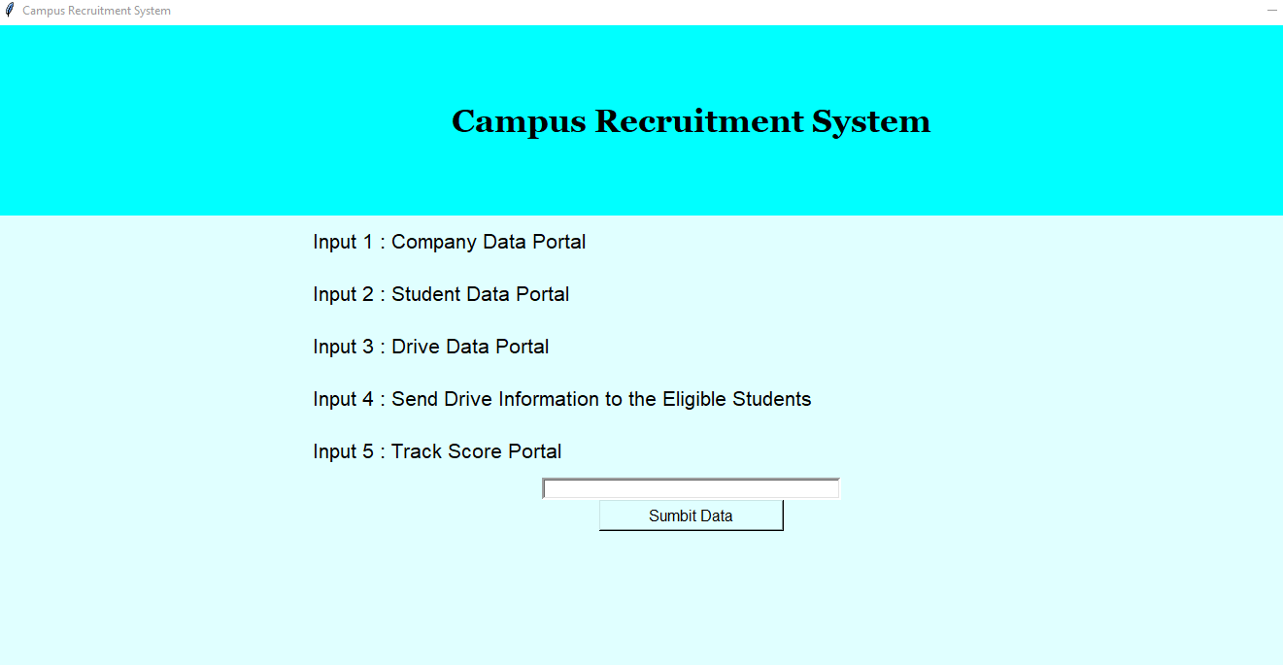
SNAPSHOT OF RUNNING CODE

Slide 10
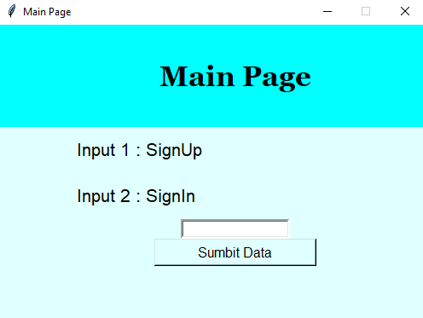
MAIN PAGE

Slide 11
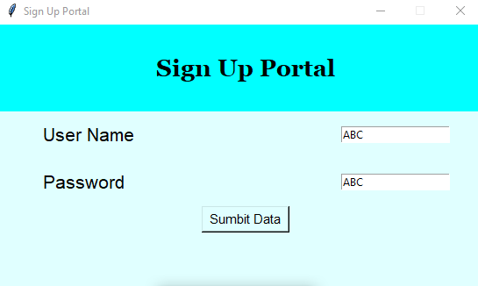
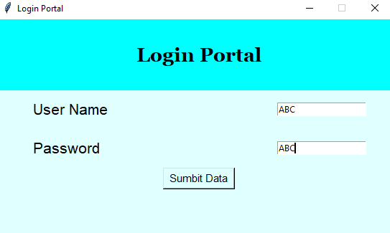
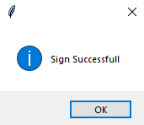
LOGIN AND SIGNUP PAGE

Slide 12
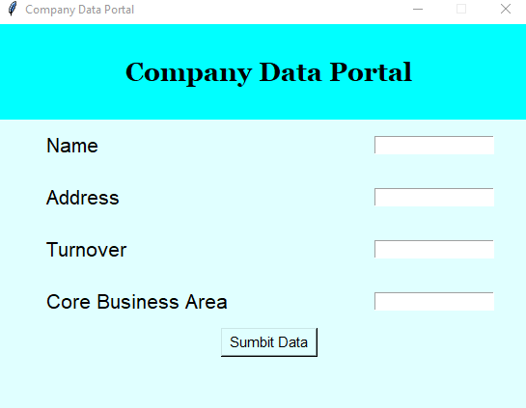
COMPANY DATA PORTAL

Slide 13
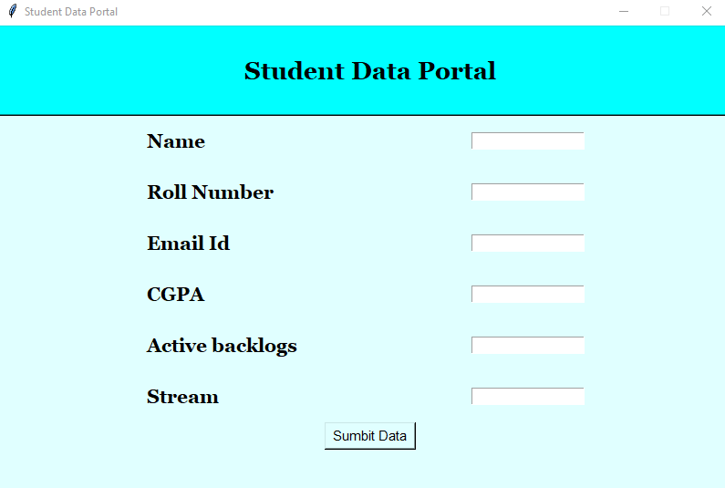
STUDENT DATA PORTAL

Slide 14
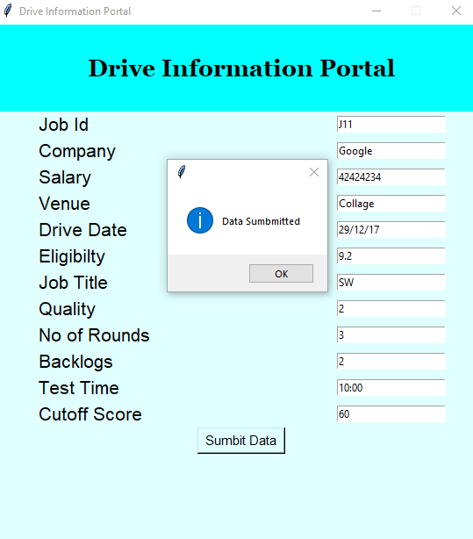
DRIVE INFORMATION PORTAL

Slide 15
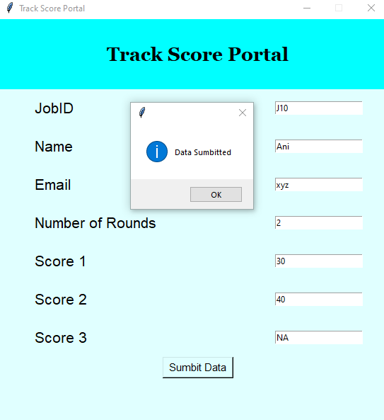
TRACK SCORE PORTAL

Slide 16
Thank You

