Slide 1
ASCELIOS · SALES DECK · 2026
Cloud + SAP, Self-Serve.
Managed Service Operations.
Customers sign up in minutes, provision tenants across AWS / Azure / GCP, and get
AI-powered observability for SAP — all from one portal.
ascelios.com · hello@ascelios.com
Ascelios — Cloud + SAP Managed Services
1 / 18

Slide 2
PART 1 / 3
The marketing site
Public, self-serve front door — visitors can sign up without a sales call. Watch-demo CTA plays a 69-second narrated walkthrough of the entire product.
Ascelios — Cloud + SAP Managed Services
2 / 18

Slide 3
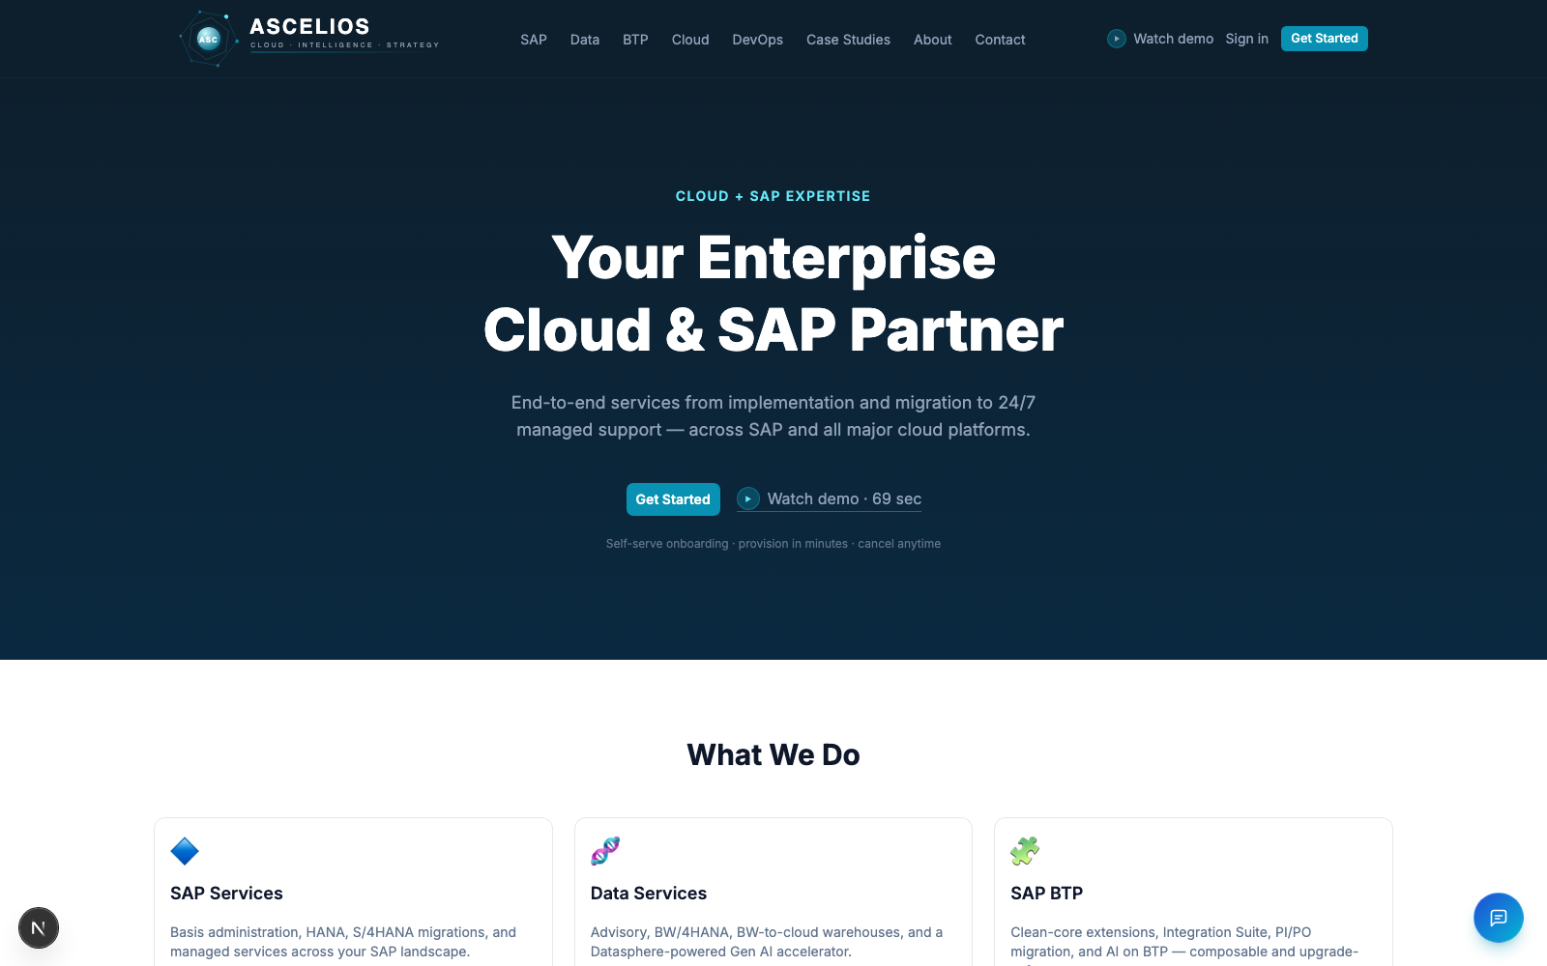
MARKETING · HOMEPAGE
One CTA → onboarded in 5 steps.
› Hero with Get Started + Watch demo · 69 sec CTAs
› Branded logo (cyan hex mark, dark wordmark) — animated SVG
› Top nav: SAP · Data · BTP · Cloud · DevOps + Sign in / Get Started
› Footer attribution to 5 service lines
› Light- and dark-friendly across every breakpoint
Ascelios — Cloud + SAP Managed Services
3 / 18

Slide 4
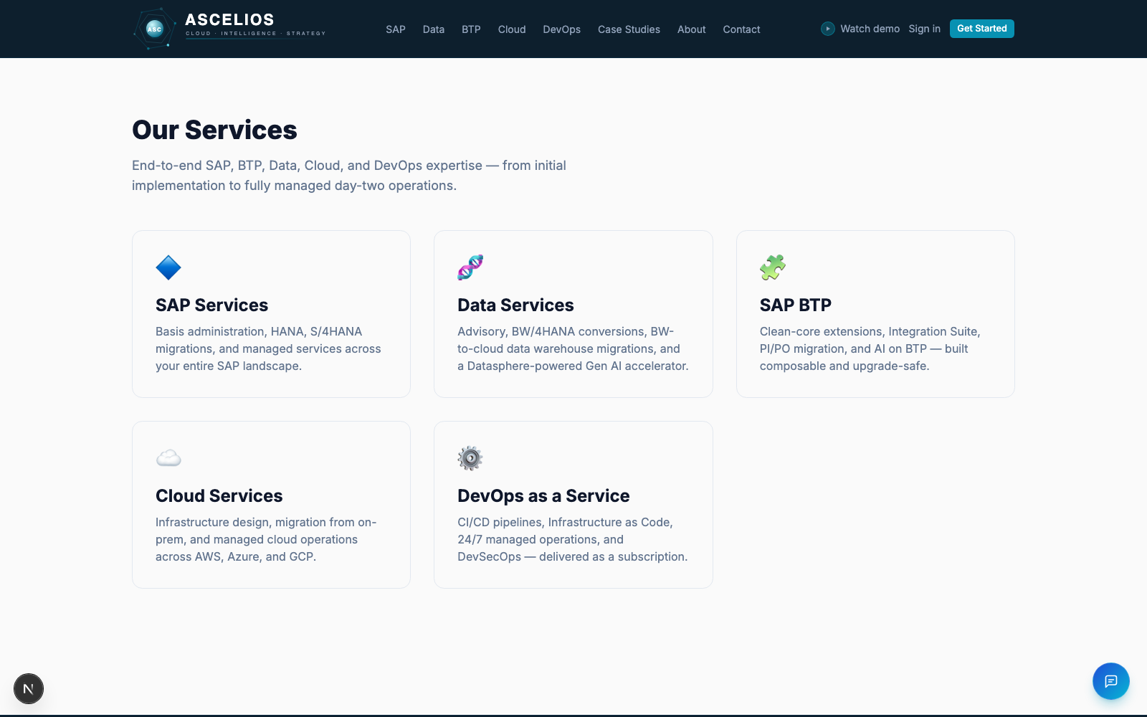
MARKETING · SERVICES
Five service lines, one platform.
› SAP Services — Basis, HANA, S/4HANA migrations, managed Ops
› Data Services — BW/4HANA, BW→cloud warehouse, Gen AI accelerator
› SAP BTP — clean-core extensions, Integration Suite, PI/PO migration
› Cloud Infrastructure — AWS / Azure / GCP landing zones + FinOps
› DevOps as a Service — CI/CD, IaC, SRE, 24/7 on-call
Ascelios — Cloud + SAP Managed Services
4 / 18

Slide 5
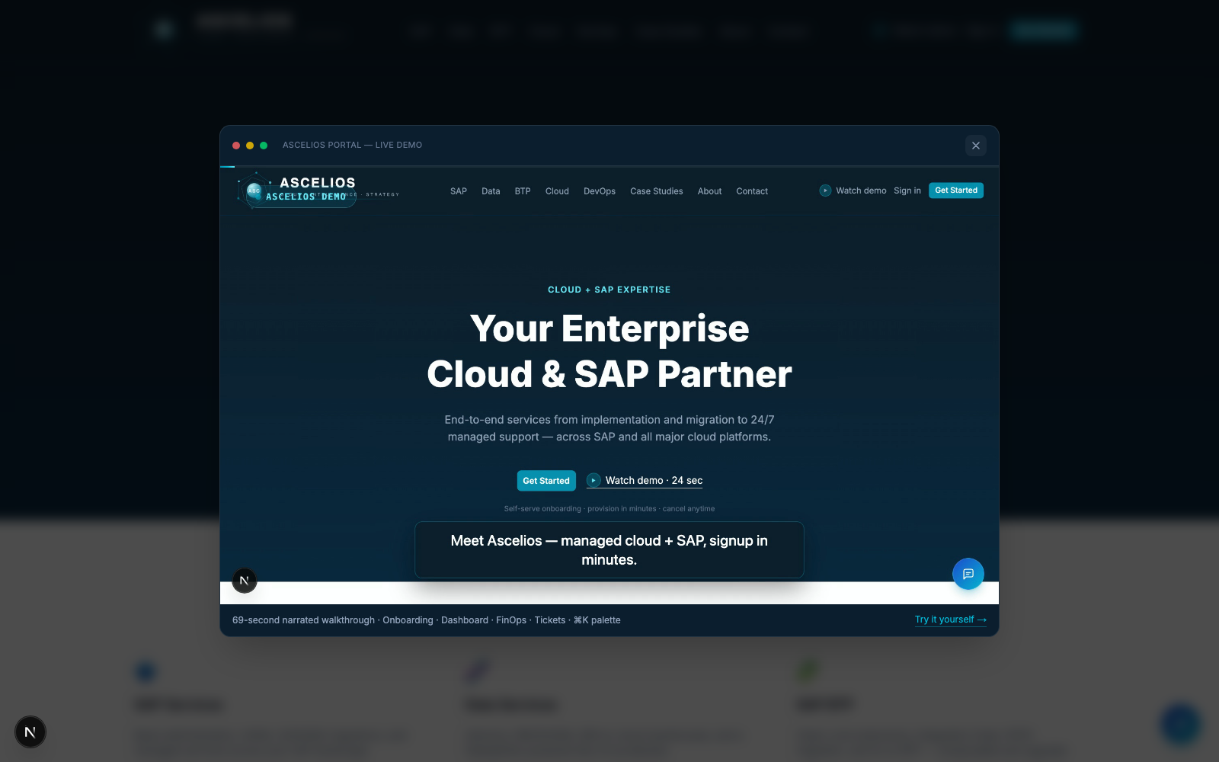
MARKETING · WATCH DEMO
69-second narrated walkthrough.
› Modal player with native HTML5 video controls
› 11 scenes: marketing → onboarding → portal → command bar
› Voiceover generated via local Kokoro-82M TTS (no API)
› MP4 + AAC at 1920×1080, 6.6 MB — ships from /public
› WebP loop fallback for browsers that block autoplay
Ascelios — Cloud + SAP Managed Services
5 / 18

Slide 6
PART 2 / 3
End-to-end self-serve onboarding
A 5-step wizard creates the user, signs the MSA + DPA, provisions cloud tenants, and logs the customer into the portal. No sales touch required.
Ascelios — Cloud + SAP Managed Services
6 / 18

Slide 7
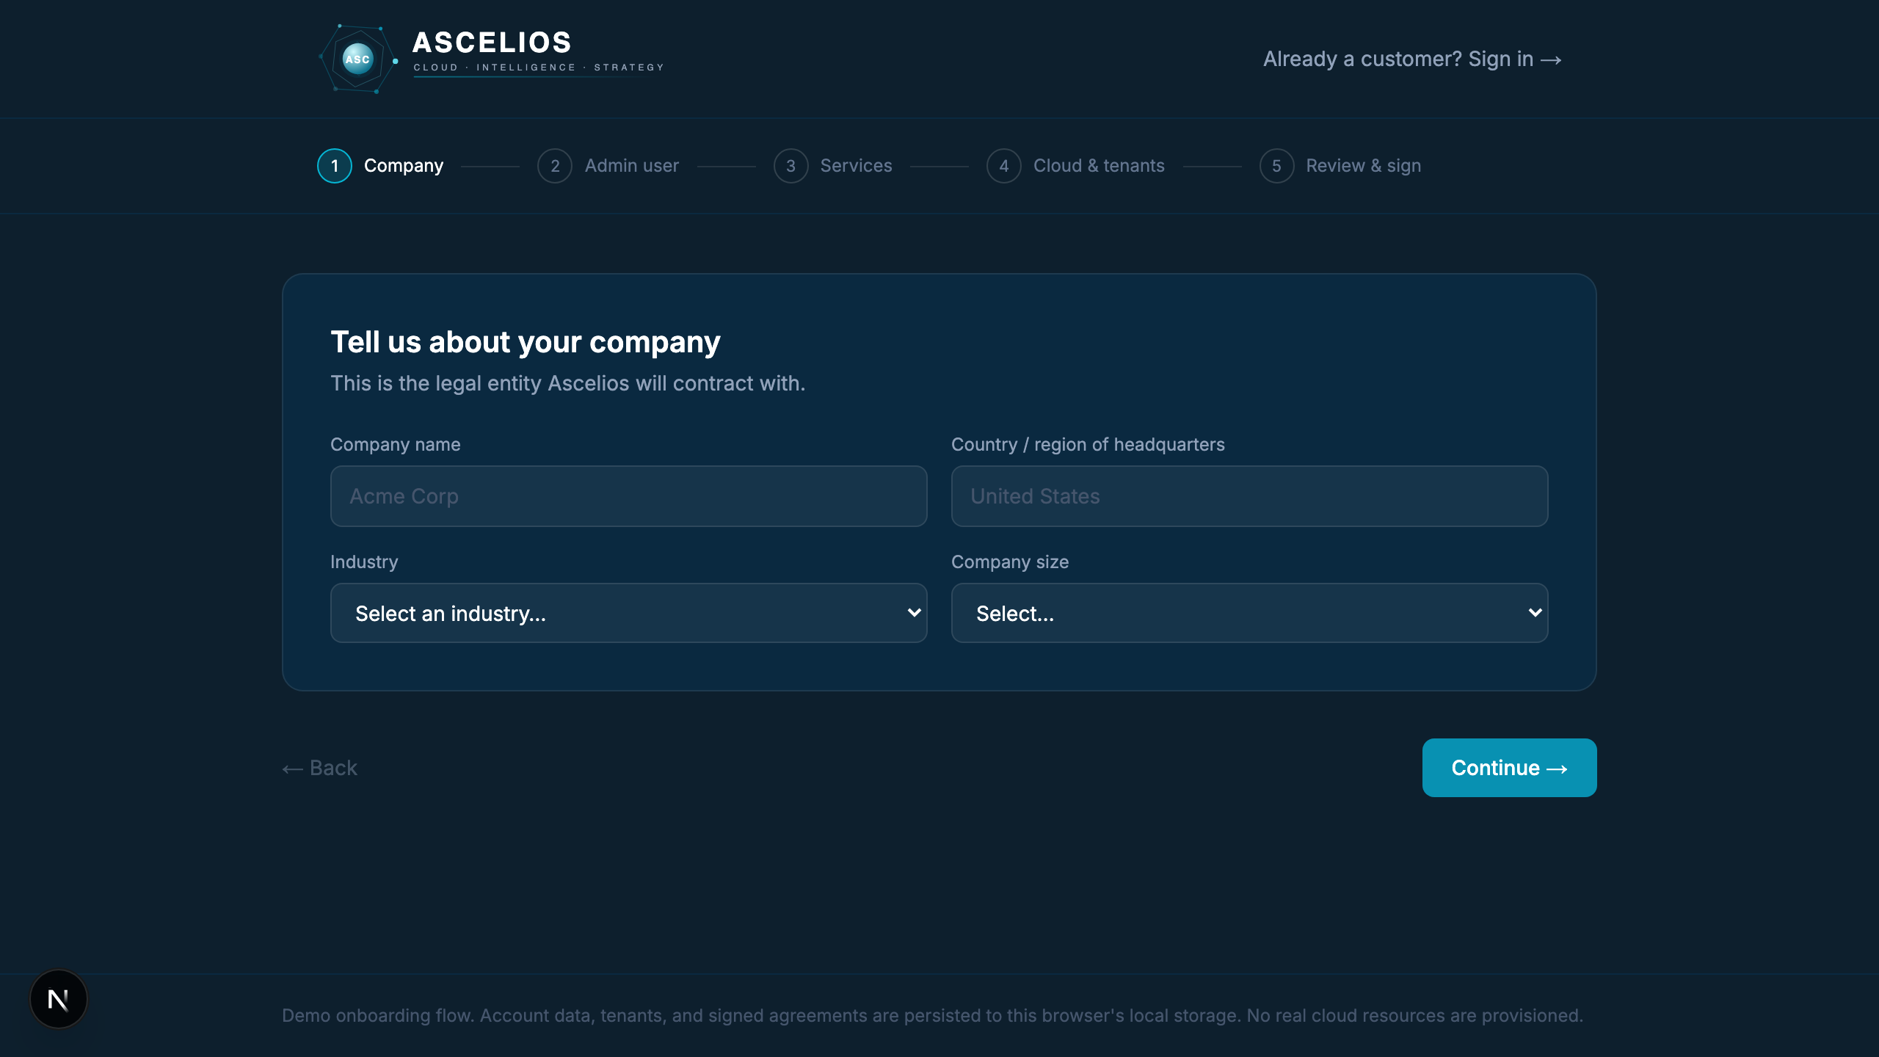
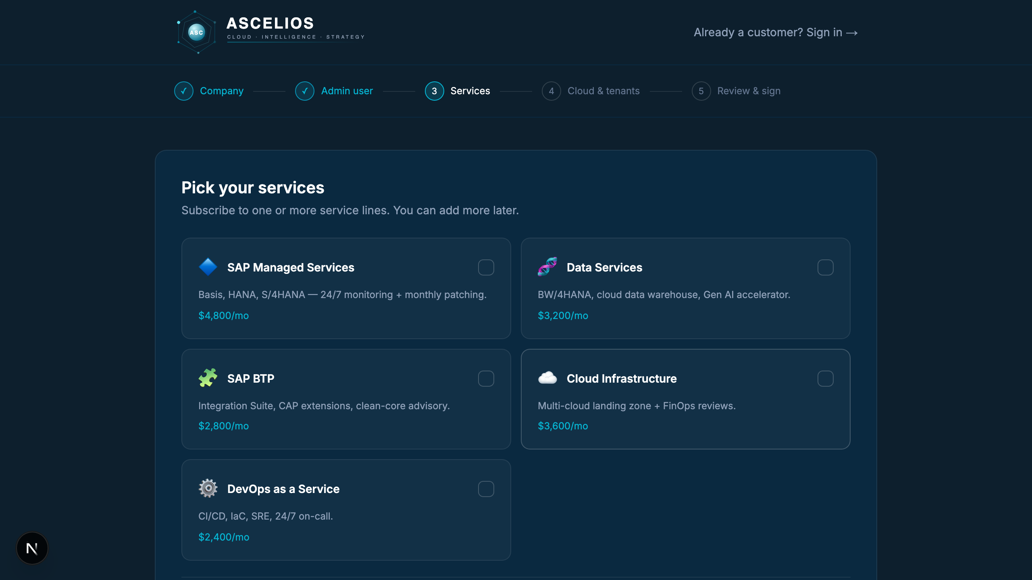
ONBOARDING · STEPS 1–2
Company + admin account.
Legal entity setup and admin credentials — captured in the first ~30 seconds.
Step 1: Company info
Step 2 → Services picker (5 options)
Ascelios — Cloud + SAP Managed Services
7 / 18

Slide 8
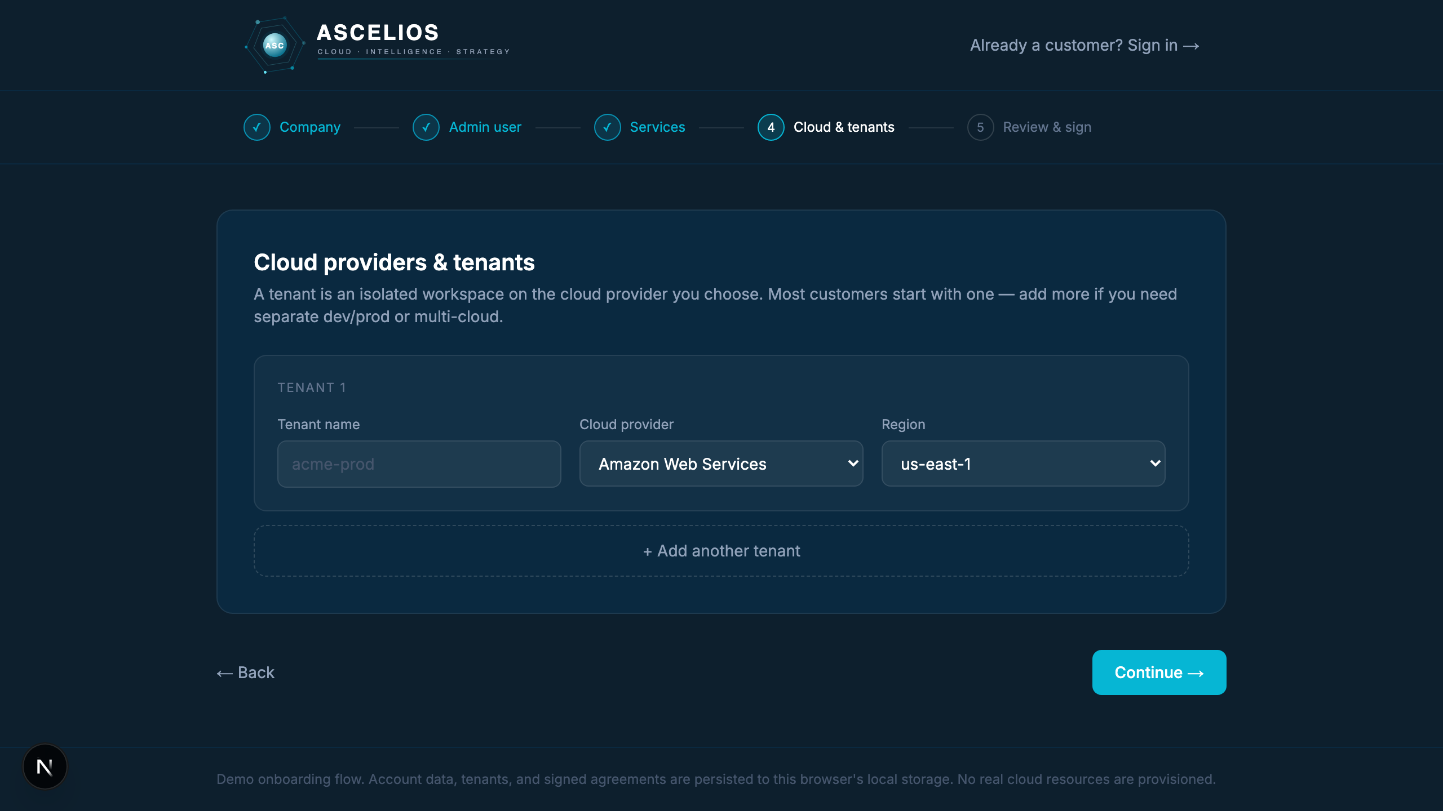
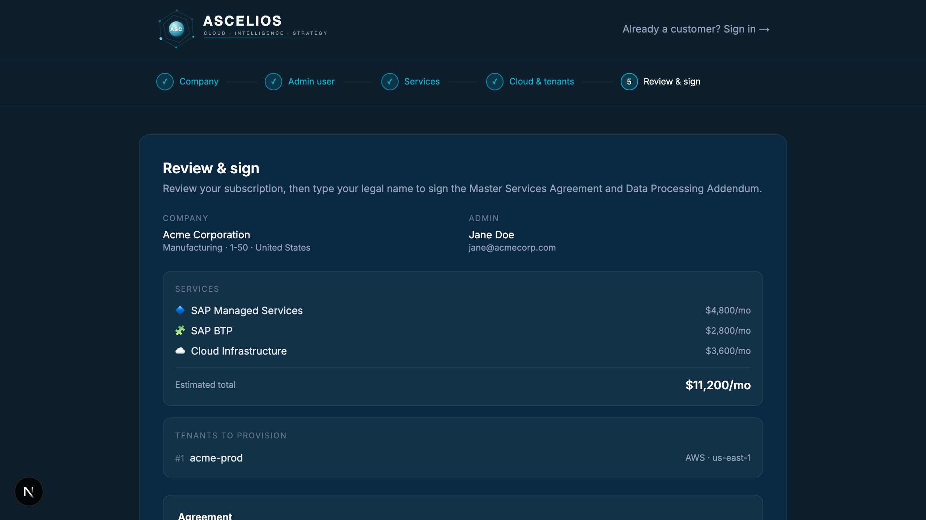
ONBOARDING · STEPS 3–5
Tenants, sign, provision.
Customer picks cloud + region, signs the MSA online, and watches live provisioning begin.
Step 3: Cloud provider & tenant naming
Step 4–5: Review & sign — typed signature
Ascelios — Cloud + SAP Managed Services
8 / 18

Slide 9
PART 3 / 3
The Ascelios client portal
A single workspace for every operational concern — tenants, tickets, infrastructure, monitoring, billing, compliance, and team management. Two-stage RBAC throughout.
Ascelios — Cloud + SAP Managed Services
9 / 18

Slide 10
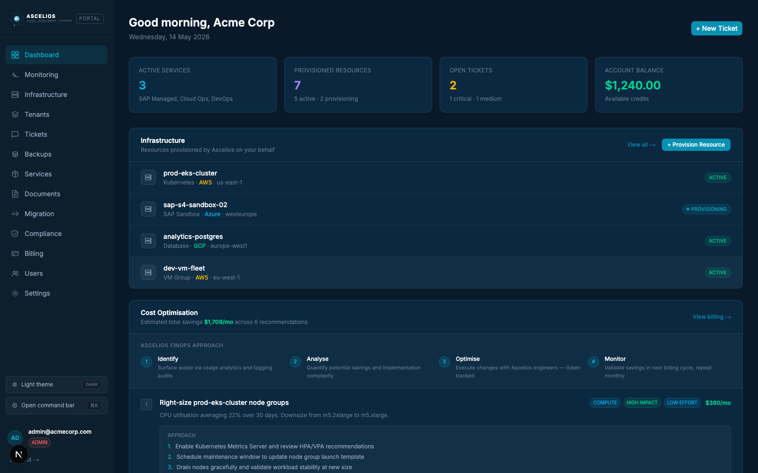
PORTAL · DASHBOARD
One greeting. Every signal.
› Provisioning banner — live progress bars per tenant
› Stats row: Active services, Provisioned resources, Open tickets, Account balance
› Infrastructure inventory with status chips per resource
› FinOps engine — monthly cost-saving recommendations with engineering approach
› Recent tickets + active services on a single scroll
Ascelios — Cloud + SAP Managed Services
10 / 18

Slide 11
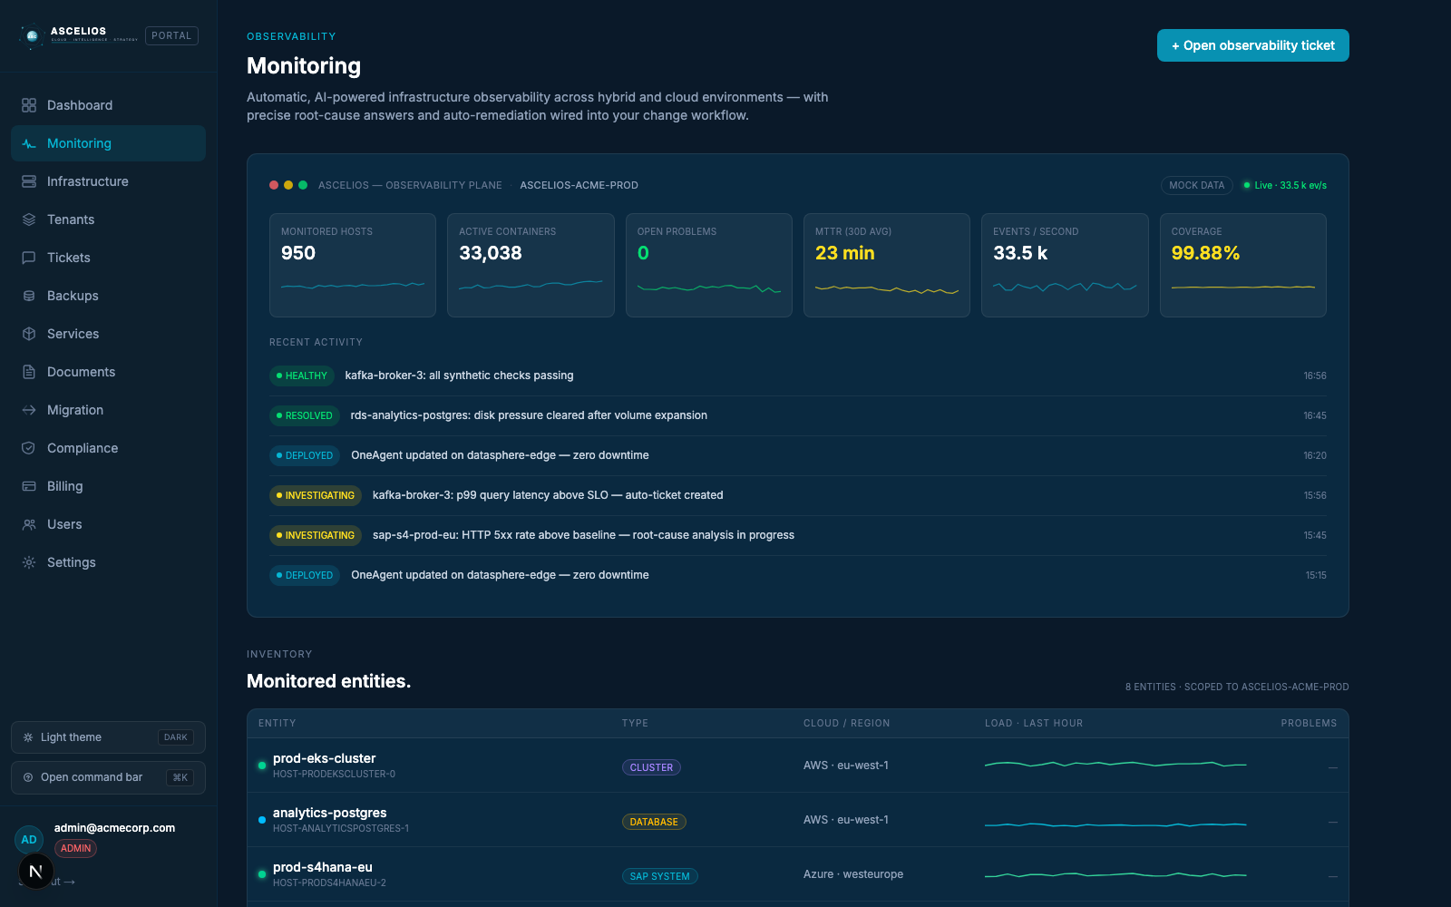
PORTAL · MONITORING
AI-powered observability plane.
› Live console scoped to your Dynatrace Management Zone
› 6 metrics + sparklines + activity feed updating every 30 seconds
› Stale/offline badging — never blocks the page on upstream failure
› Sourced from /api/dynatrace/summary (Phase 1, in production)
› Mock-mode default + 4 OAuth env vars to flip to live Dynatrace
Ascelios — Cloud + SAP Managed Services
11 / 18

Slide 12
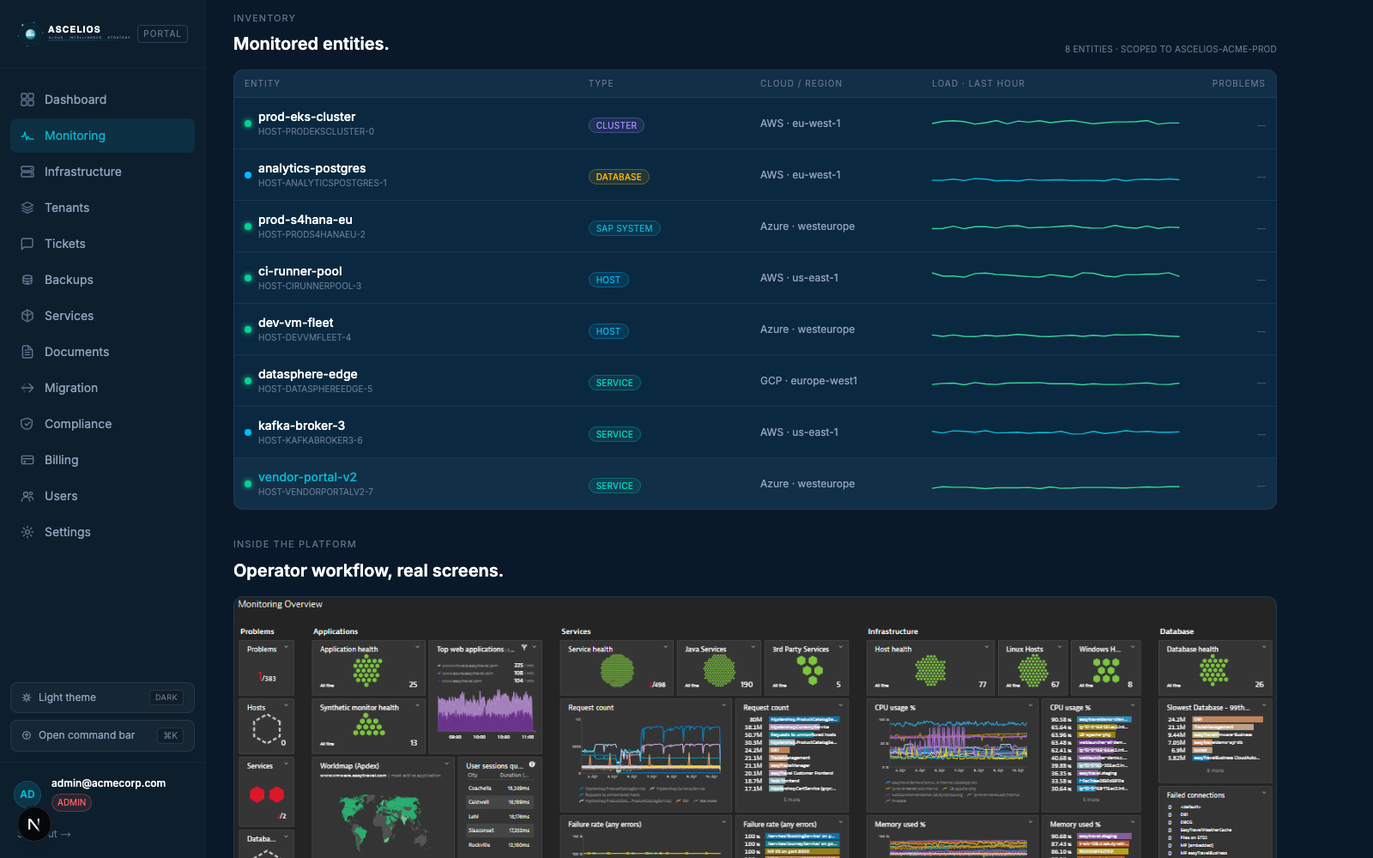
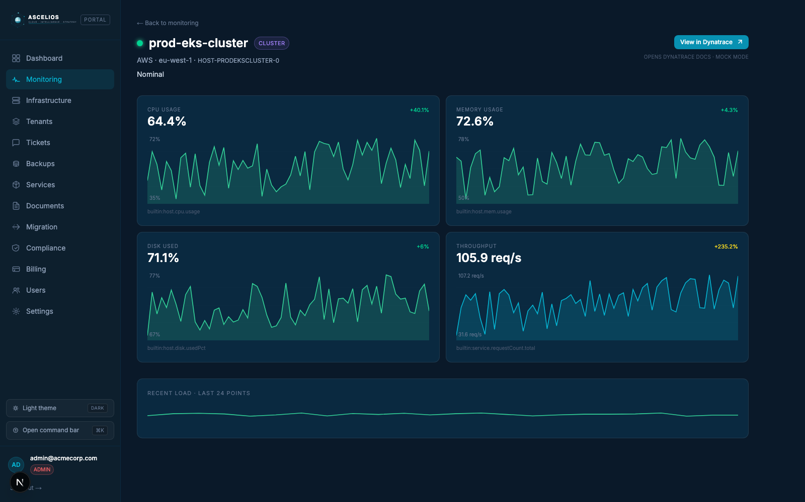
PORTAL · MONITORING
Inventory → per-entity drill-down.
Every monitored resource is a clickable row. Click → 4 live metric charts + Dynatrace deep-link.
Inventory — 8 entities, typed, with last-hour load
Per-entity: CPU / Memory / Disk / Throughput with deltas
Ascelios — Cloud + SAP Managed Services
12 / 18

Slide 13
CLOUD-NATIVE OBSERVABILITY
Depth where you run.
First-party SAP observability layered on top of the Dynatrace platform.
AWS
End-to-End Observability for SAP on AWS
AZURE
Azure Monitor for SAP solutions (AMS)
› CloudWatch Application Insights — auto-monitors for SAP HANA + NetWeaver
› CloudWatch RUM — real-user telemetry for SAP Fiori
› CloudWatch Internet Monitor — ISP-level latency to SAP endpoints
› Compute Optimizer + SLOs — continuous right-sizing and burn-rate alerts
› Amazon Q CLI + MCP — natural-language root-cause analysis
› SAP NetWeaver provider — Dispatcher / ICM / Gateway / Enqueue / IGS
› SAP HANA provider — per-minute SQL pull, replication, backups
› Database providers — Microsoft SQL Server, IBM Db2 for AnyDB
› Pacemaker + Linux OS — HA cluster + OS metrics (SLES/RHEL for SAP)
› Workbooks + Log Analytics — KQL dashboards, alerts, Sentinel integration
Ascelios — Cloud + SAP Managed Services
13 / 18

Slide 14
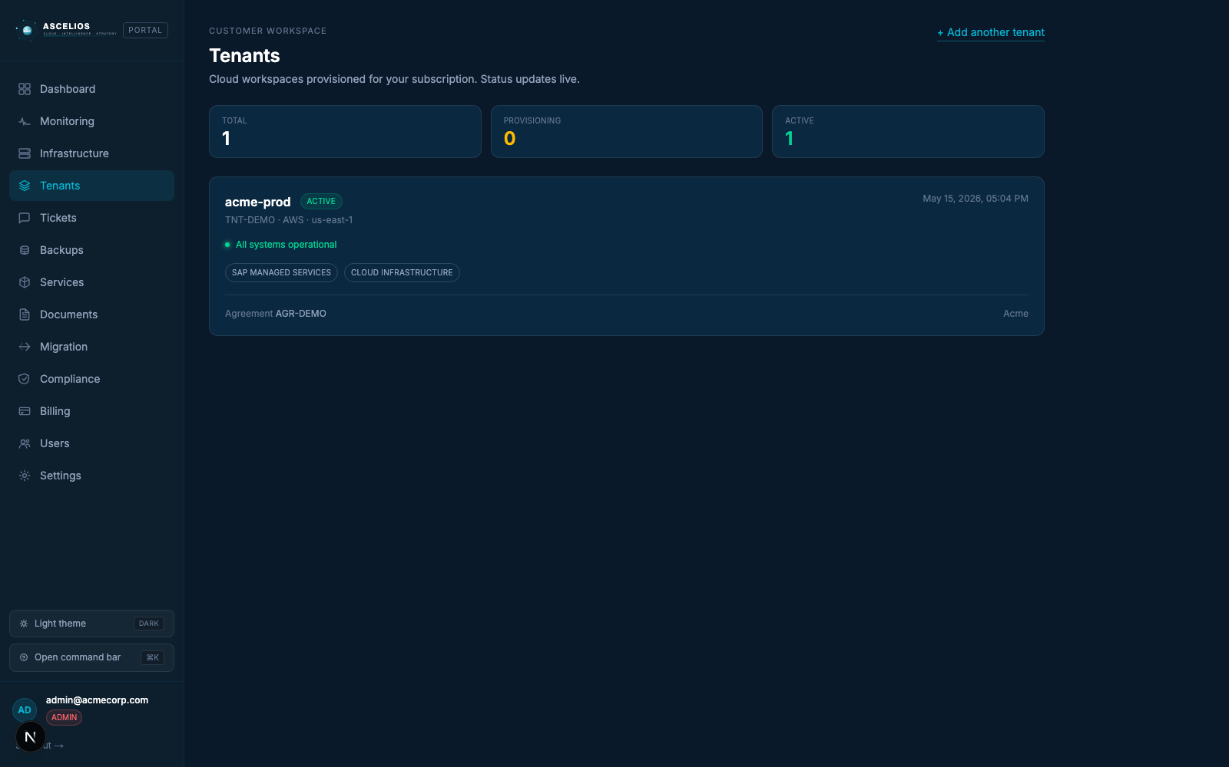
PORTAL · TENANTS
Live provisioning, MZ-bound.
› Each tenant maps 1:1 to a Dynatrace Management Zone
› Provisioning bar ticks through 5 stages live (provisioning → active)
› Multi-tenant safety: every API call MUST carry the MZ id
› Tied to a signed Agreement record (hash + timestamp)
› Add another tenant any time — one customer can run dev + prod or multi-cloud
Ascelios — Cloud + SAP Managed Services
14 / 18

Slide 15
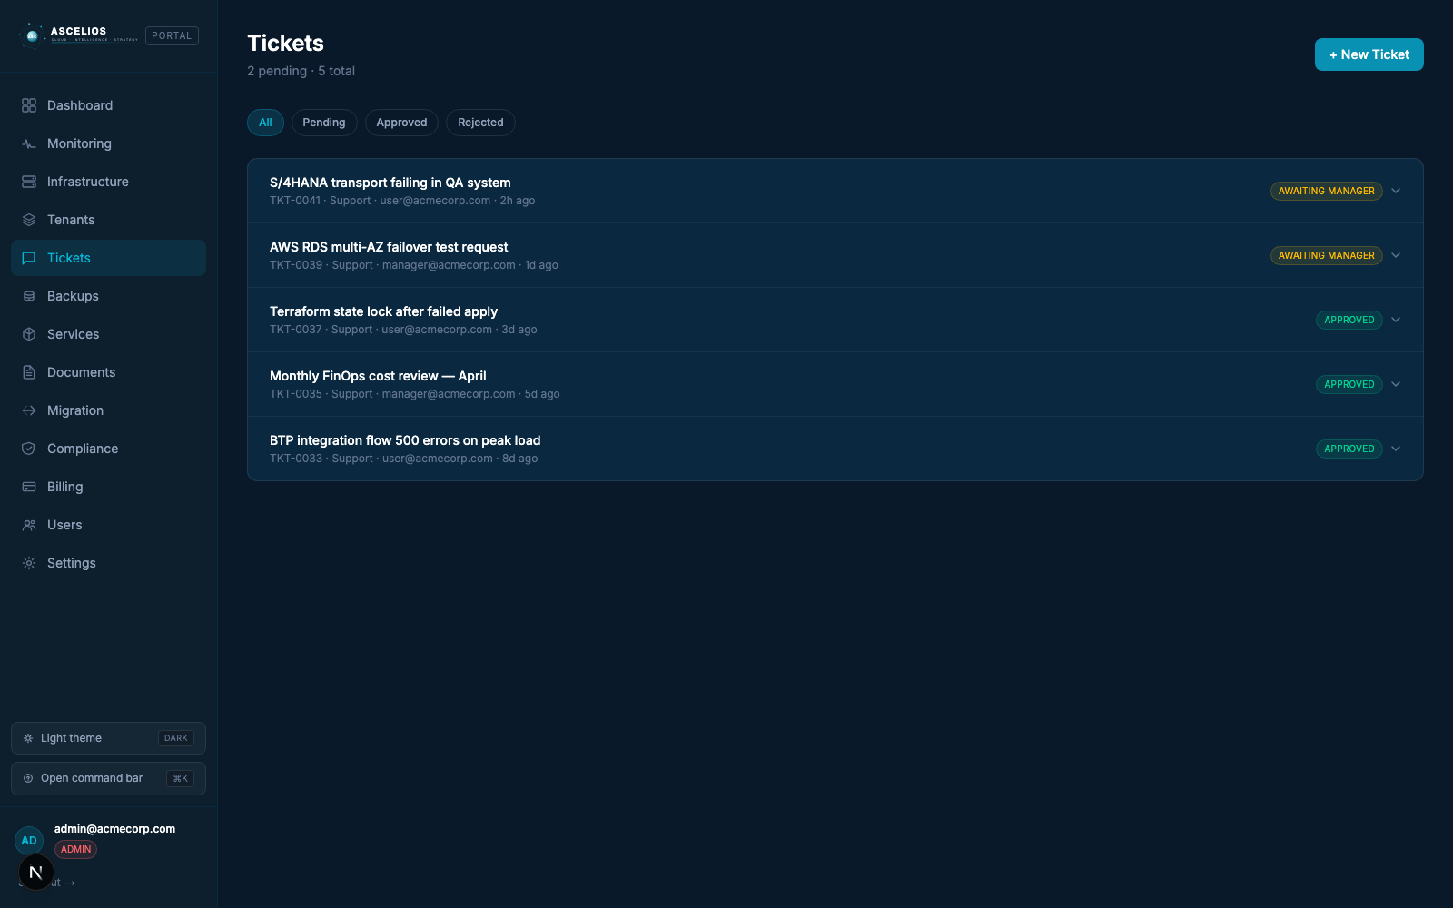
PORTAL · TICKETS
Two-stage approval. SOX audit trail.
› Every provisioning / SAP / infra change is a ticket
› Stage 1 — Manager approves (or rejects with reason)
› Stage 2 — Admin approves (executes the change)
› User / Manager / Admin permissions enforced via hasPermission()
› Full audit trail visible to the customer — exportable for auditors
Ascelios — Cloud + SAP Managed Services
15 / 18

Slide 16
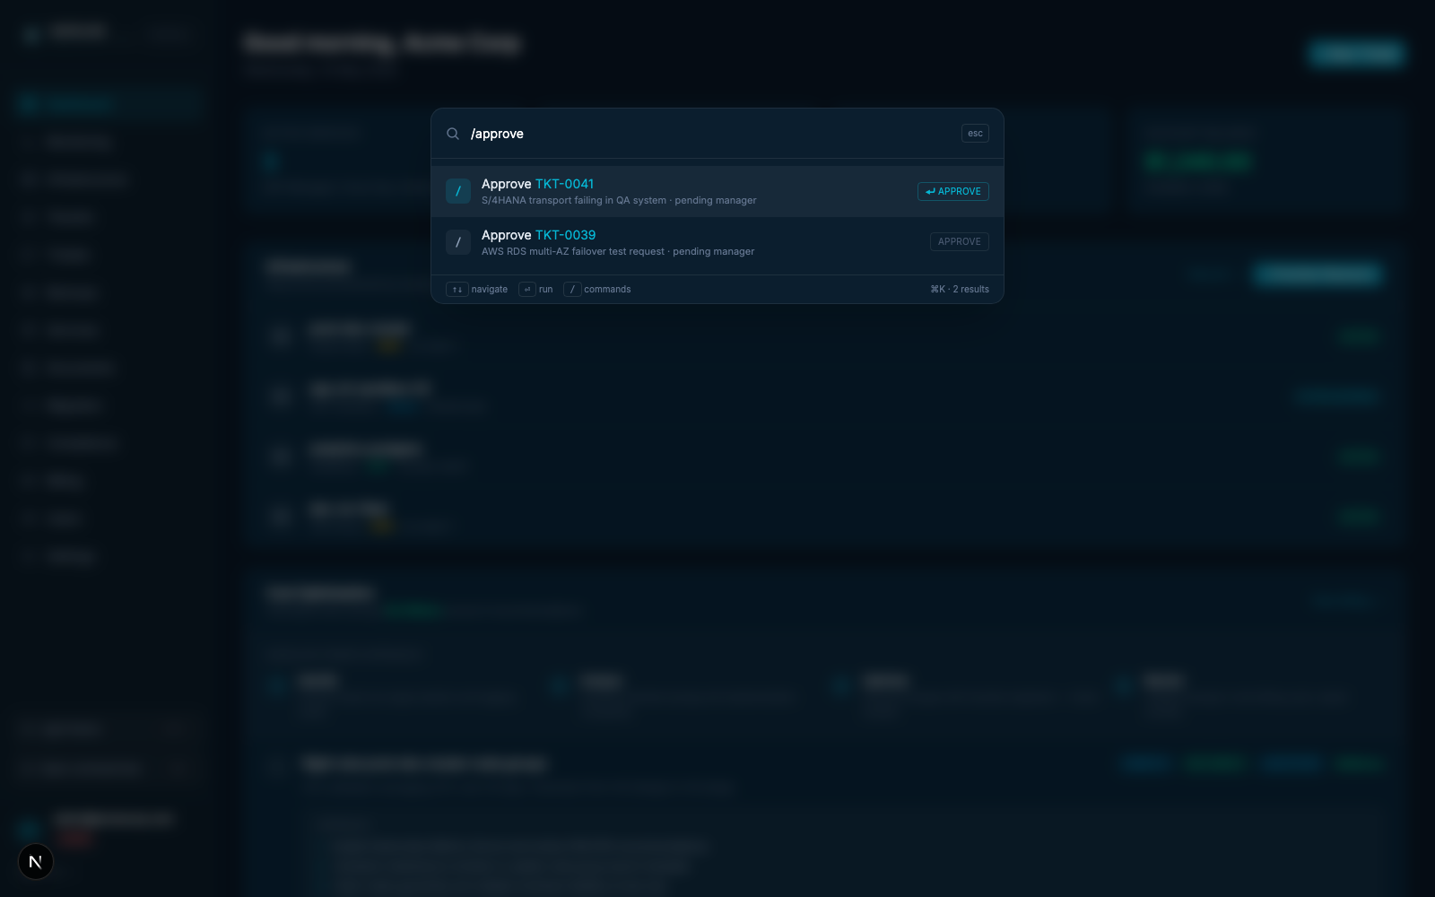
PORTAL · ⌘K COMMAND BAR
Every action, one keystroke.
› Global ⌘K (or Ctrl+K) from anywhere in the portal
› Slash commands: /approve TKT-XXXX · /reject · /provision · /go <page>
› Search across tickets, tenants, pages with fuzzy matching
› Inline approvals — managers/admins can clear the queue keyboard-first
› Ask mode falls back to natural-language Q&A on portal data
Ascelios — Cloud + SAP Managed Services
16 / 18

Slide 17
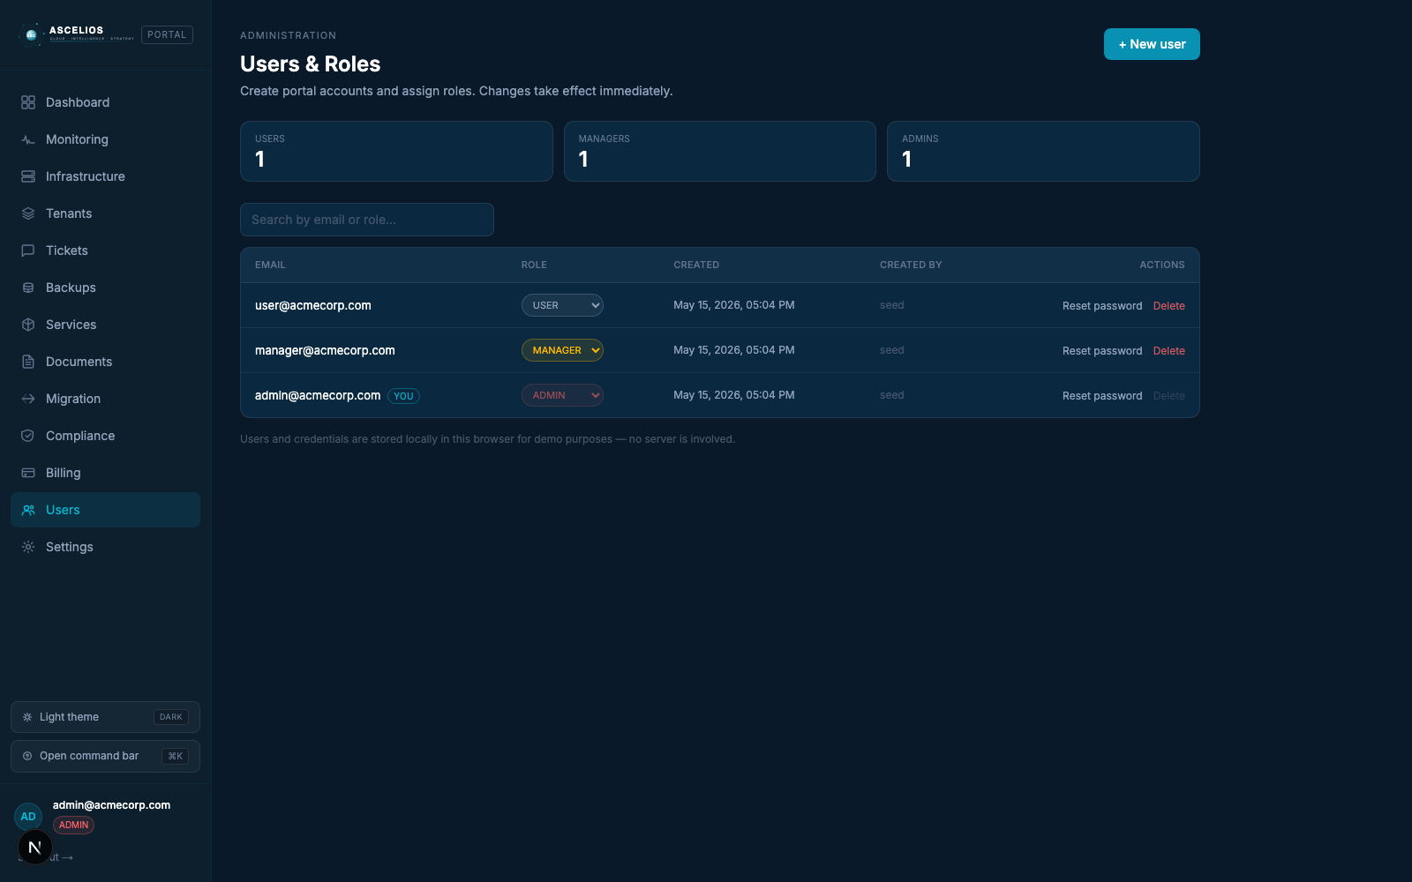
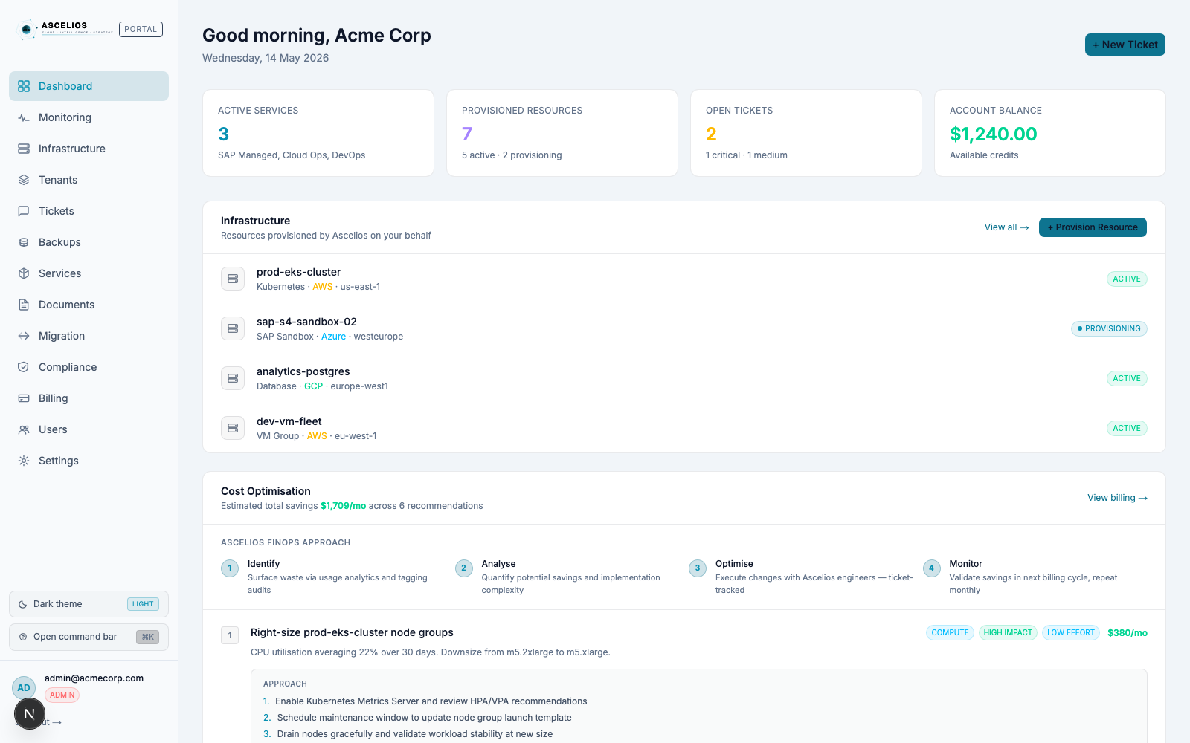
PORTAL · ADMIN + COMFORT
Customer-owned user management + theme toggle.
Admins create user logins and assign roles. Both themes ship — light mode for daytime ops.
Users admin — RBAC role assignment
Light theme — full coverage, persistent
Ascelios — Cloud + SAP Managed Services
17 / 18

Slide 18
OUTCOMES
What customers see in the first 90 days.
Aligned with leading observability platforms — Ascelios delivers the operate-it layer on top.
40%
60%
90%
Operations productivity gain from AI-driven insights
Fewer major outages and service degradations
Improvement in mean time to recovery (MTTR)
Get started → ascelios.com/onboarding · hello@ascelios.com
Ascelios — Cloud + SAP Managed Services
18 / 18

