Slide 1

Presentation On Real Time Temperature Display System
PRESENTED By:
Ayush Badoni (2027698)
Ayush Dhasmana (2027701)
Avishkar Rawat (2027692)
Arjit Chauhan (2027681)
UNDER THE SUPERVISION OF
Dr. Chandni Tiwari
(Assistant Professor ,ECE)
Department of Electronics and Communication Graphic Era University Dehradun, India
Notes:
Animation: Fade In for title & subtitle.
Notes: Introduce the topic briefly and mention why temperature tracking is important.

Slide 2
Contents
Introduction
Problem Statement
Objectives
Significance
Working principle
Components Used
Result & Discussion
Applications
Advantages
Limitations
Future scope
Conclusion
References

Slide 3
Introduction
Temperature is one of the most important physical parameters used to measure
environmental and mechanical conditions.
Monitoring temperature in real time helps detect even small changes immediately.
Many systems such as machines, laboratories, hospitals, and homes require
continuous temperature tracking for safety.
A real-time temperature tracking sensor measures temperature instantly and
displays it without delay.
It improves accuracy and reduces human effort by automating the monitoring
process.
Such systems prevent overheating, equipment damage, and safety hazards.
Modern sensors like LM35 or DHT11 make temperature monitoring more reliable
and efficient.
This project focuses on designing a system that tracks temperature continuously
and provides instant updates to the user.
Notes:
Animation: Wipe Right for bullets.
Notes: Explain why temperature is important and where it is needed daily.

Slide 4
Problem Statement
Manual temperature monitoring is slow, time-consuming, and often inaccurate.
Critical environments such as laboratories, hospitals, industries, and
server rooms require continuous temperature tracking.
Sudden temperature rise or fall can cause equipment failure, product damage,
or safety hazards.
Traditional methods cannot provide instant alerts when temperature crosses
safe limits.
There is a need for an automatic system that can measure temperature accurately
and display it in real time.
Lack of real-time monitoring increases risks, inefficiency, and human dependency.
Therefore, a reliable real-time temperature tracking sensor is required to ensure
safety, accuracy, and continuous monitoring.
Notes:
Animation: Fade In.
Notes: Highlight real-world problems like overheating appliances or labs.

Slide 5
Objectives
To design and develop a system that can monitor temperature in real time.
To measure temperature accurately using a digital temperature sensor.
To continuously display temperature readings on a screen or device.
To alert the user if the temperature crosses a predefined threshold.
To reduce human effort by automating the temperature monitoring process.
To create a reliable and cost-effective solution for various applications.
To ensure safety and prevent damage caused by overheating or extreme
temperature changes.
Notes:
Animation: Split.
Notes: Simple explanation of what your project aims to achieve.

Slide 6
Significance
Ensures continuous temperature monitoring without human supervision.
Helps prevent overheating, equipment damage, and safety hazards.
Useful in hospitals, laboratories, industries, and smart homes for maintaining
safe temperature levels.
Improves accuracy and reliability compared to manual readings.
Provides real-time data, allowing quick decision-making in critical situations.
Supports automation and modern smart systems for better efficiency.
Reduces operational risks and enhances safety in temperature-sensitive
environments.
Helps maintain ideal conditions for machines, medicines, food storage, and
environmental monitoring.
Notes:
Animation: Fly In.
Notes: Connect each point with a small real-life example.

Slide 7
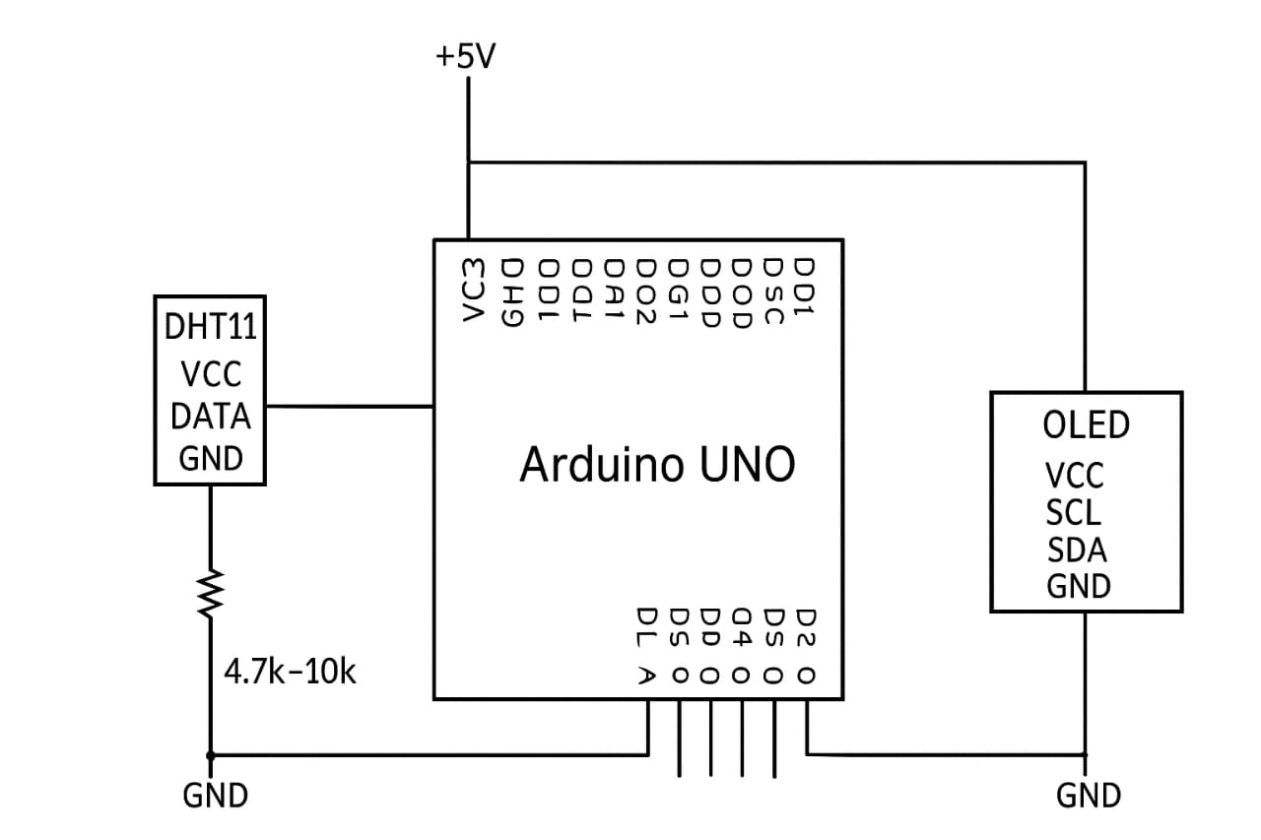
Working Principle
The temperature sensor detects the surrounding temperature using DHT11
(temperature and humidity sensor) and converts it into an electrical signal.
This electrical signal is then sent to a microcontroller (such as Arduino or ESP32).
The microcontroller reads the signal and converts it into a digital temperature
value.
The processed data is displayed on an OLED screen in real time.
If the temperature crosses a predefined limit, the system can send an alert.
The system continues to monitor temperature continuously, ensuring instant
updates.
This allows accurate, fast, and automated temperature tracking without
human effort.
Notes:
Animation: Wipe Down.
Notes: Explain each step like a flow of information.

Slide 8
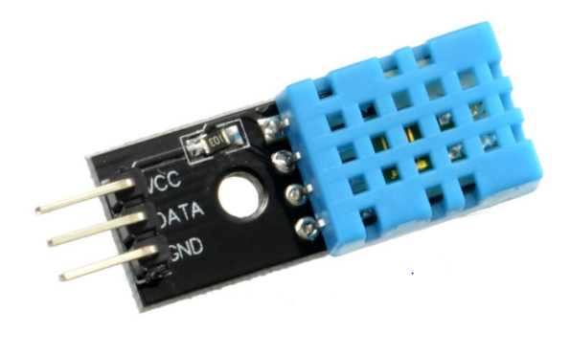
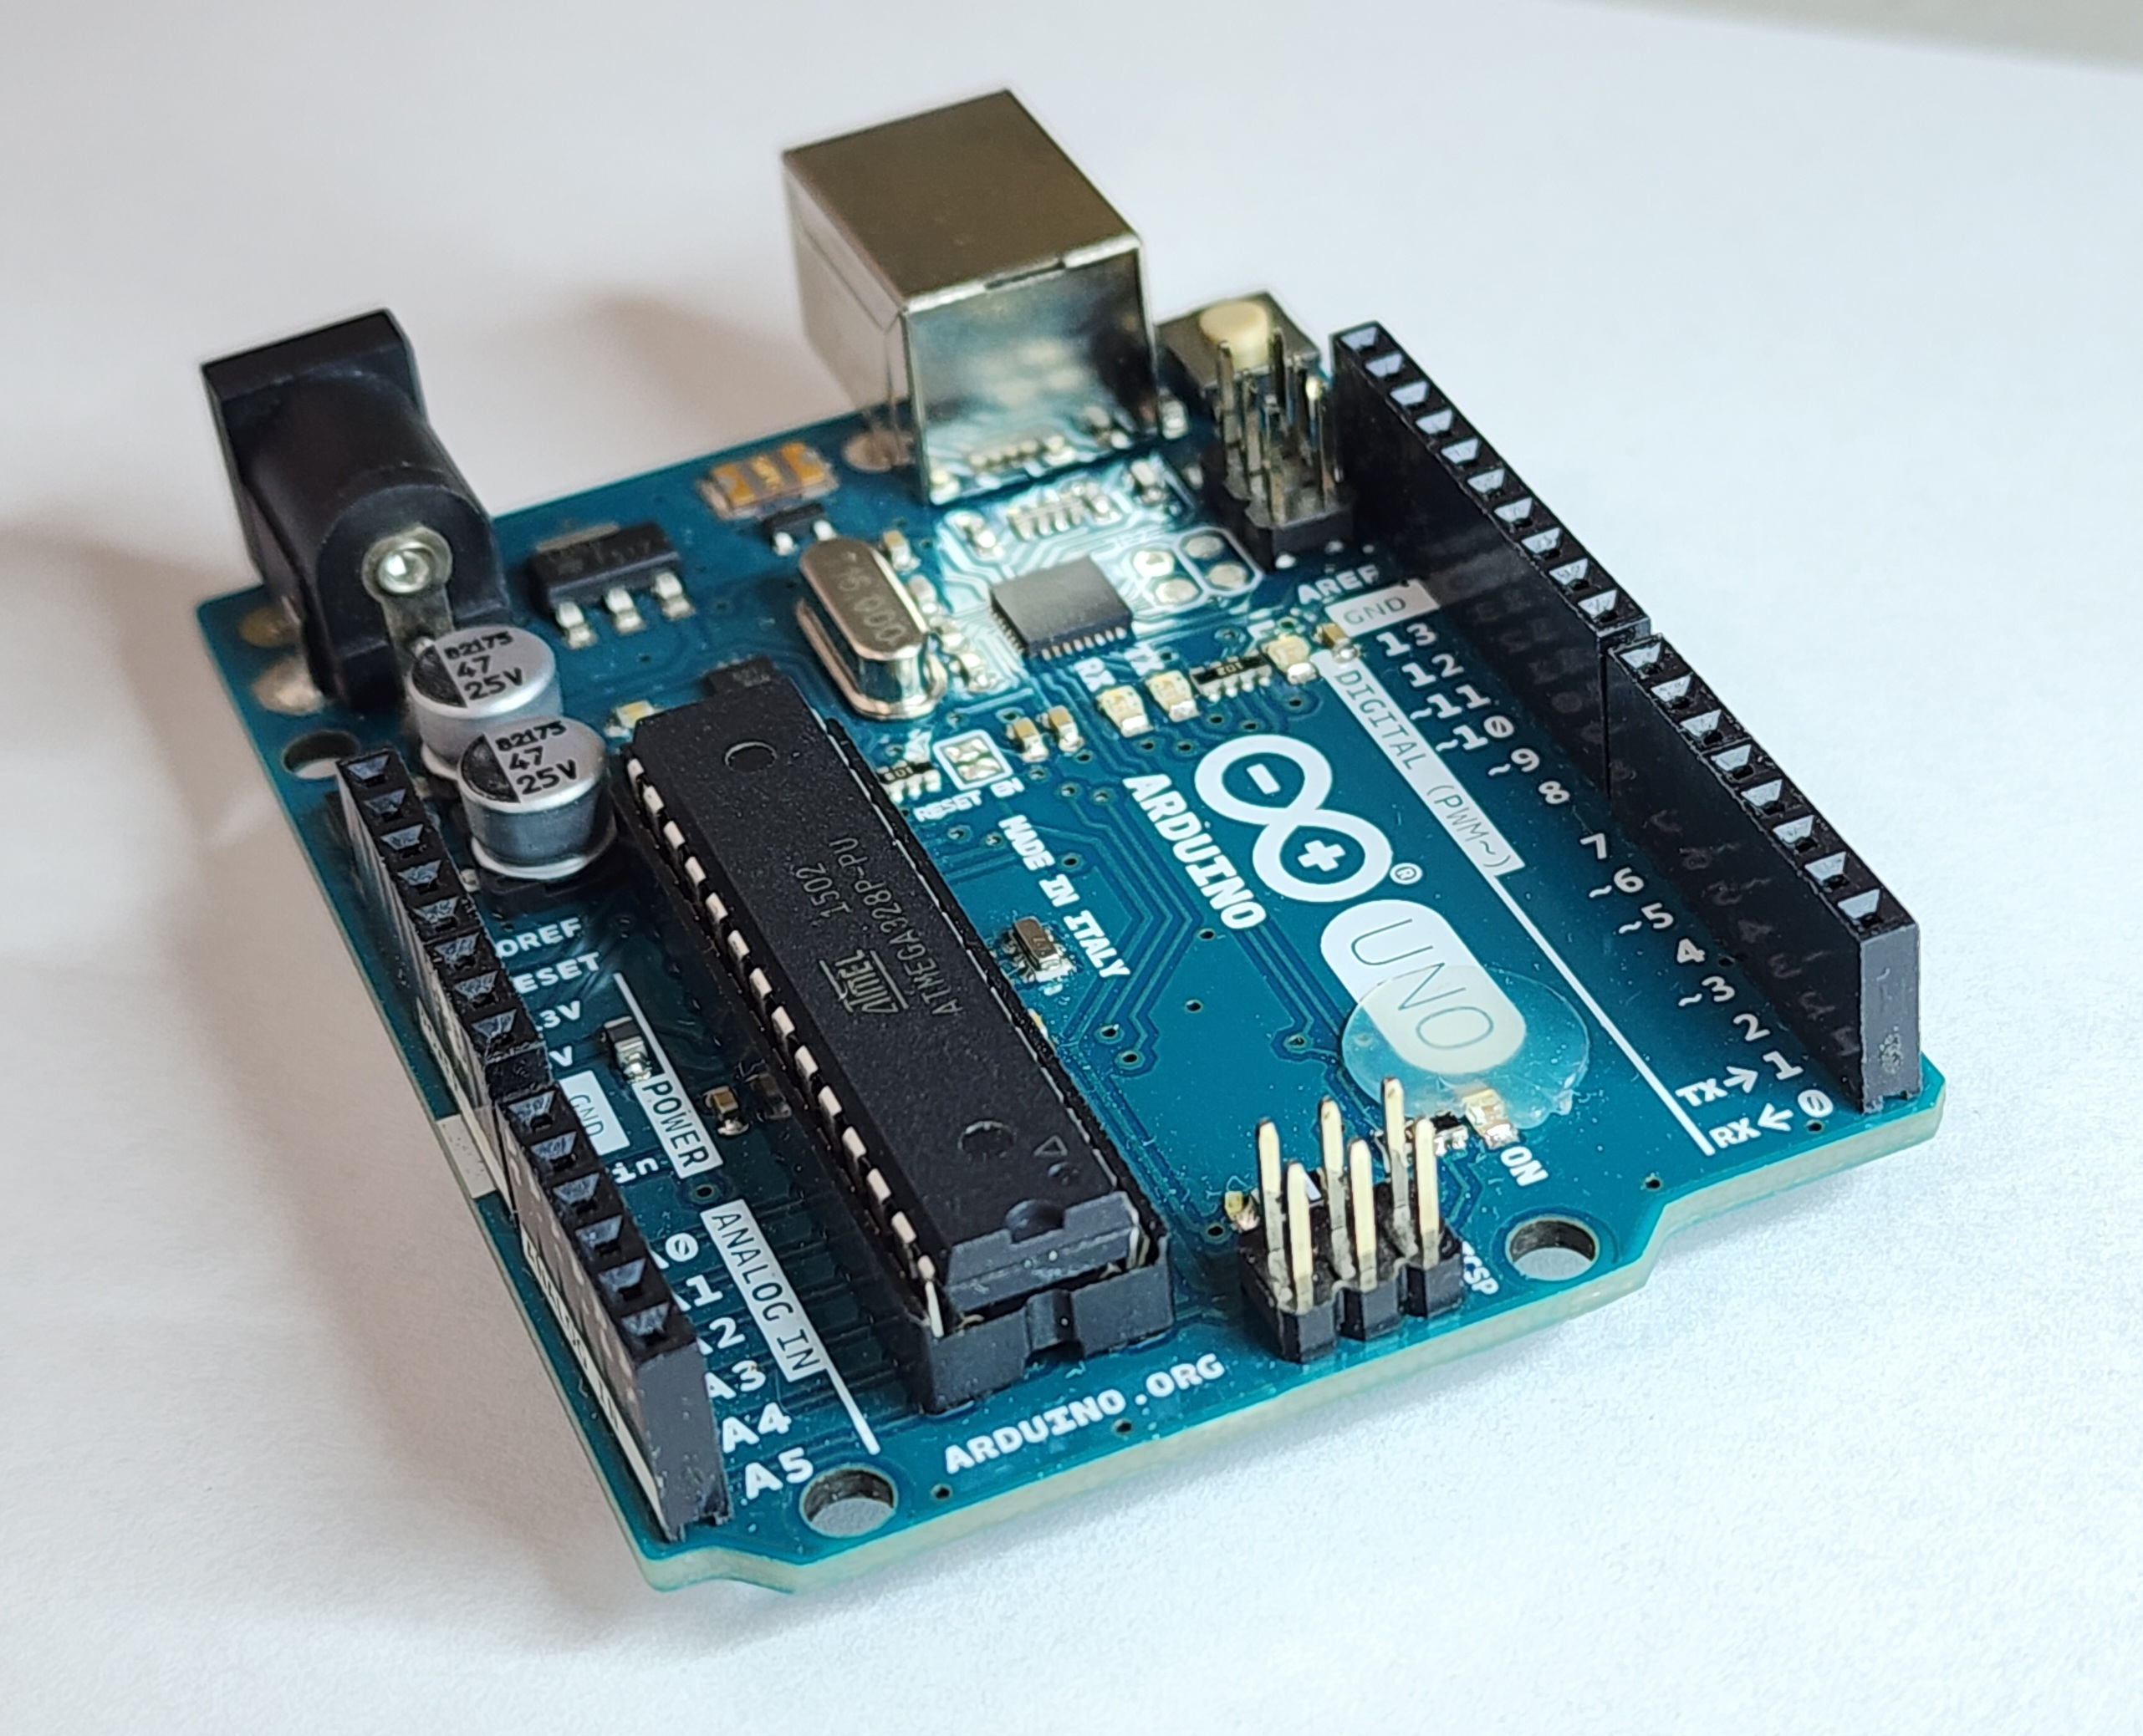
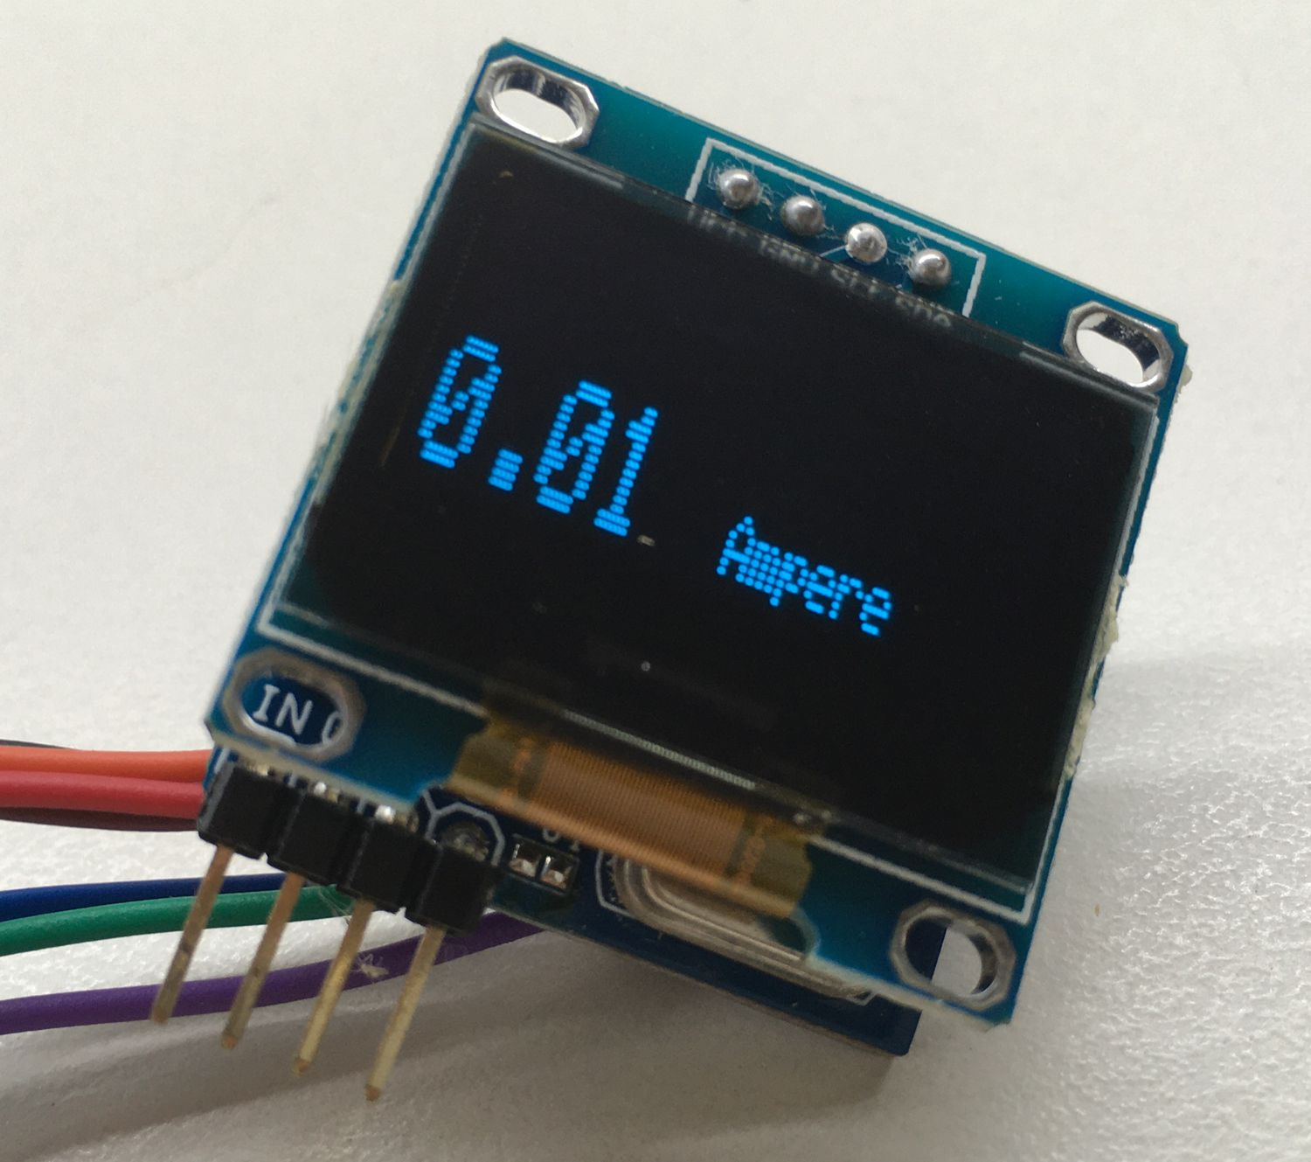

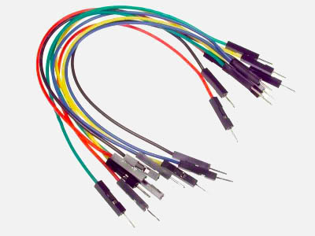
Components Used
Temperature Sensor (DHT11) –
Measures the surrounding temperature.
Microcontroller (Arduino) –
Reads and processes sensor data.
OLED Display –
Shows temperature readings in real time.
Power Supply (USB / 9V Battery / Adapter) –
Powers the entire system.
Jumper Wires –
For connecting components and making the circuit.
This Photo by Unknown Author is licensed under CC BY-SA
Notes:
Animation: Zoom.
Notes: Briefly explain purpose of each component.

Slide 9
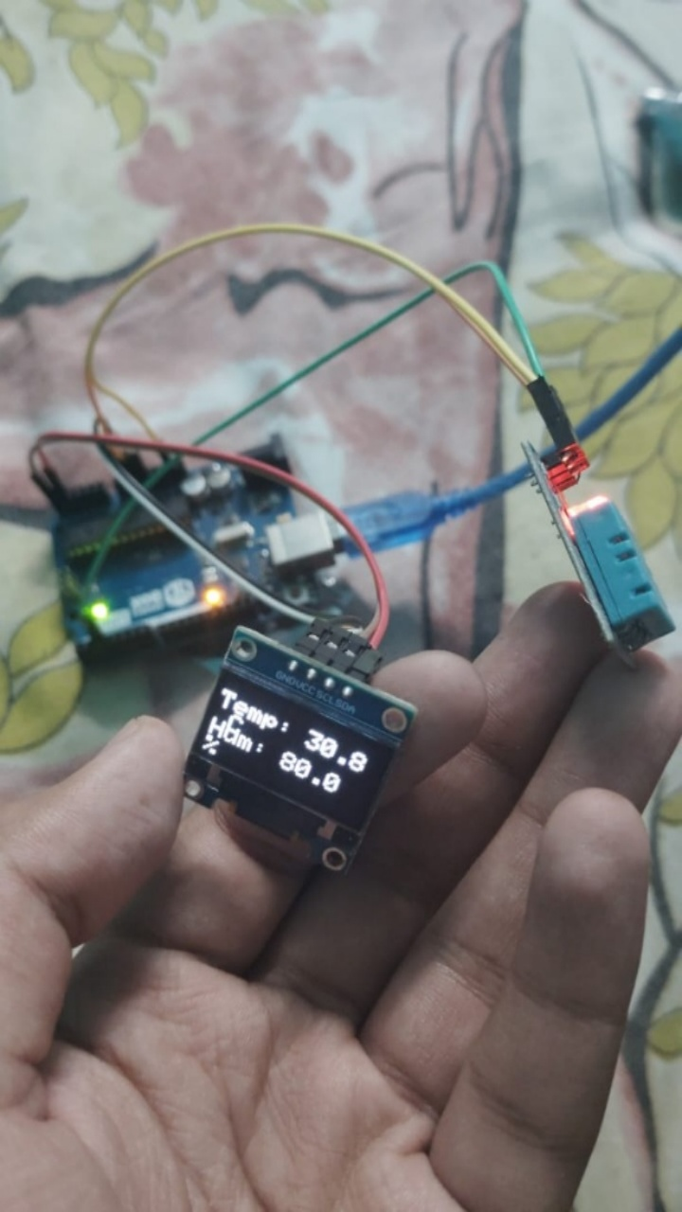
Results & Discussions
The temperature sensor system successfully measured and displayed the temperature in real time.
The output readings were stable, accurate, and responded quickly to temperature changes.
The circuit worked efficiently with all components functioning as expected (sensor, microcontroller, display, power supply).
The project met its objectives of detecting temperature and presenting the results clearly.

Slide 10
Applications
Smart Homes: For monitoring room temperature and controlling appliances
automatically.
Hospitals & Medical Storage: Ensures safe temperature for medicines, vaccines,
and equipment.
Weather Monitoring Systems: Used in environmental stations to track climate
changes.
Industrial Safety: Prevents overheating of machines, motors, and control panels.
Food & Cold Storage: Maintains required temperature for food preservation.
Server Rooms & Data Centers: Protects servers from overheating and system
failure.
Agriculture & Greenhouses: Helps maintain ideal temperature for plant growth.
Laboratories: Ensures accurate temperature for experiments and chemical storage.
Notes:
Animation: Fade.
Notes: Add real examples like refrigerators or server rooms.

Slide 11
Advantages
Provides accurate and real-time temperature readings.
Reduces human effort by automating the monitoring process.
Helps prevent overheating, equipment damage, and safety hazards.
Works continuously 24/7 without interruption.
Improves efficiency by giving instant alerts when temperature crosses limits.
Easy to install and operate with low maintenance.
Cost-effective compared to manual monitoring systems.
Can be easily upgraded with IoT, mobile apps, and cloud storage.
Useful in multiple applications like hospitals, industries, and homes.
Notes:
Animation: Wipe Left.
Notes: Mention why your system is better than manual methods.

Slide 12
Limitations
Sensor accuracy can be affected by dust, and airflow.
Requires proper calibration to maintain accurate readings.
Needs a stable power supply for continuous monitoring.
Limited range and sensitivity depending on the type of sensor used.
May require internet connectivity if used with IoT-based systems.
Sudden temperature spikes may cause delayed response in low-cost sensors.
Installation in harsh environments may need additional protection.
Data may vary if the sensor is not placed in the correct position.
Notes:
Animation: Float In.
Notes: Discuss small challenges in the project.

Slide 13
Future Scope
The system can be upgraded by adding IoT connectivity so temperature
data can be monitored online in real time.
Integration with mobile apps for alerts and notifications when temperature
crosses a set limit.
Improvement of sensor accuracy by using advanced digital sensors.
Adding other environmental sensors like humidity, pressure, and air quality
to make it a multi-parameter monitoring device.
Implementing solar-powered or low-power designs for long-term and remote
use.
Using wireless modules (Bluetooth, Wi-Fi, LoRa) for long-range monitoring in
industries and agriculture.
Notes:
Animation: Fade + Delay.
Notes: Show how your project can be improved.

Slide 14
Conclusion
The temperature sensor project successfully demonstrates how temperature can be measured, monitored, and displayed using simple electronic components. It shows the practical use of sensors in real-life applications such as safety, automation, and environmental monitoring. The project meets its objective by providing accurate readings and helping users understand the importance of temperature control. With further improvements like IoT connectivity and advanced sensors, this system can become even more efficient and applicable in various fields
Notes:
Animation: Zoom.
Notes: Wrap up your project impact in 2-3 lines.

Slide 15
References
https://en.wikipedia.org/wiki/Temperature_ measurement

Slide 16
THANK YOU

