Slide 1
FoodPulse AI
Smart Energy & Process Optimization for Food-Processing SMEs

Slide 2
The problem
SME factories see the electricity bill, but often lack machine-level, real-time visibility.
Energy waste can hide inside ovens, compressors, refrigeration, motors and idle periods.
Efficiency improvements must not reduce throughput or product quality.

Slide 3
Our solution
Retrofit-first sensing + existing PLC/SCADA/ERP data.
Expected-energy baseline + anomaly detection + equipment health.
Constrained optimization: minimize energy while preserving production and quality.
Actionable recommendations with ₹ savings and CO₂ impact.

Slide 4
How it works
Sensors / PLC → edge gateway → time-series data → ML analytics.
Production context normalizes energy into kWh/kg.
Anomalies are correlated with process variables to diagnose likely causes.
Post-action SEC is compared with baseline for verification.

Slide 5
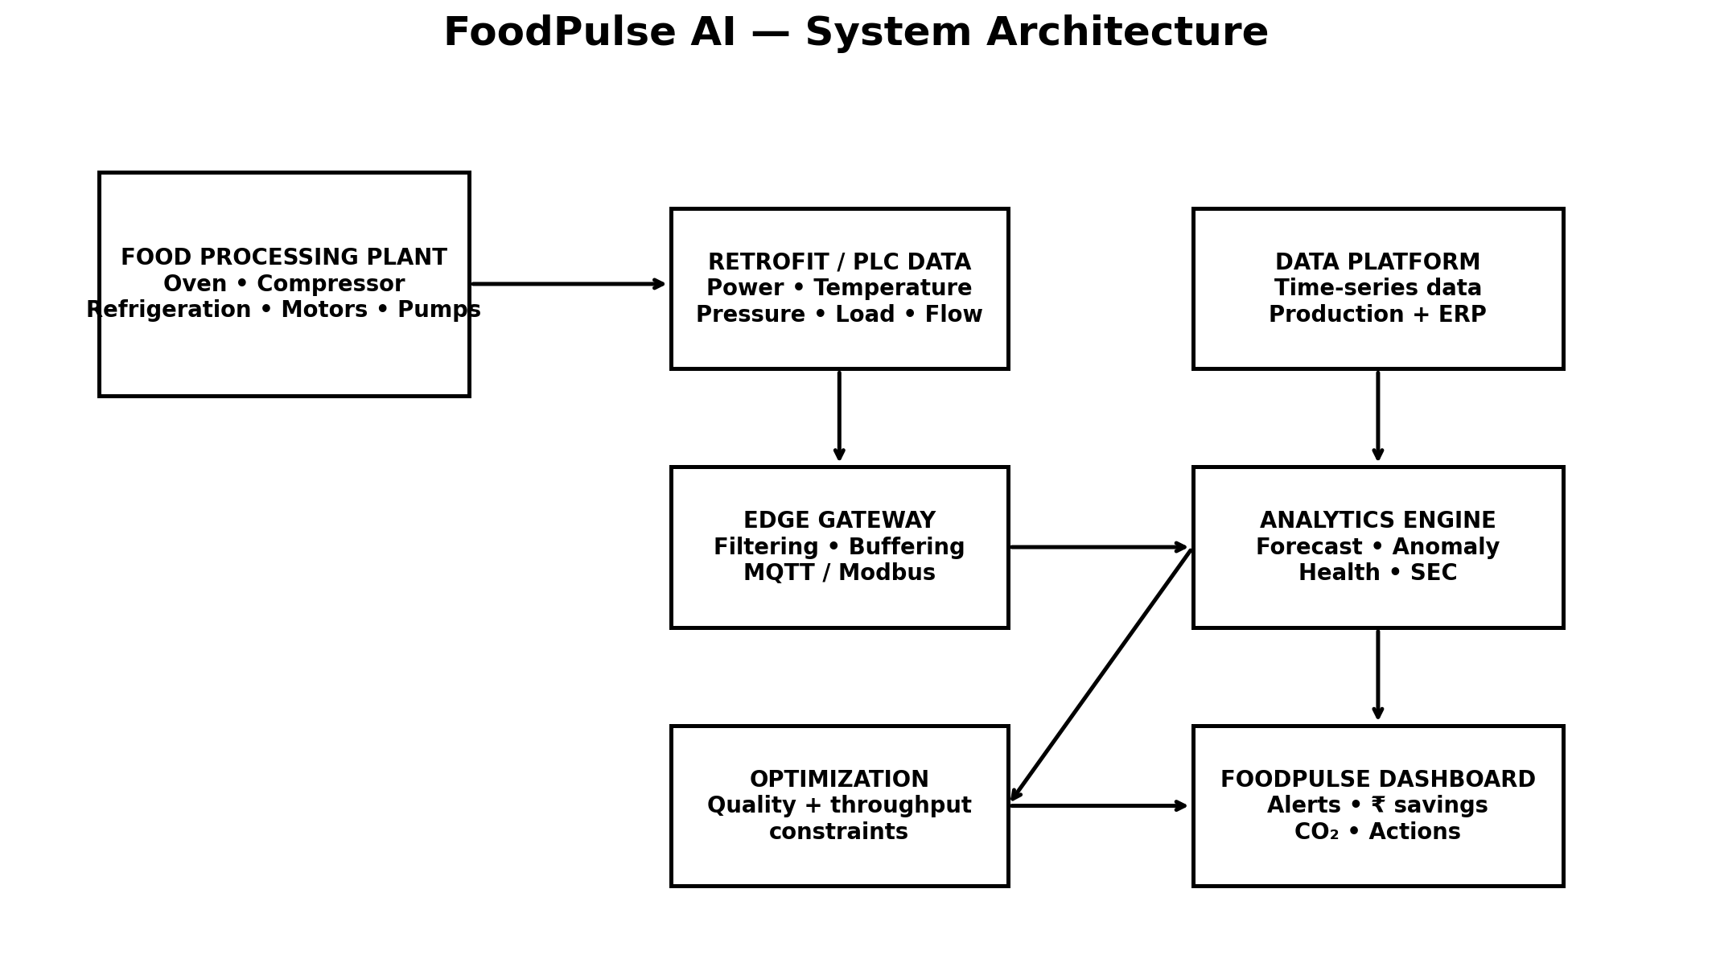
System architecture

Slide 6
Prototype result
Representative simulated food-processing SME: 5,000 kg/day.
Baseline: 2.50 kWh/kg = 12,500 kWh/day.
Optimized: 2.18 kWh/kg = 10,900 kWh/day.
12.8% SEC reduction with production fixed and simulated quality held at 96%.

Slide 7
Business & deployment
Target: small food processors—snacks/bakery, dairy, frozen foods, spices and similar plants.
Indicative starter deployment: ~₹1 lakh for meters/sensors, gateway, installation and setup.
Indicative SaaS: ₹3k–₹8k/month/site.
Pilot → verify savings → standardize retrofit kit → scale across clusters.

Slide 8
Why now / India fit
BEE's current MSME energy-efficiency work explicitly includes Food Processing.
ADEETIE supports energy-efficient technology deployment, audits, project preparation and monitoring/verification.
FoodPulse complements these efforts with continuous operational visibility and measurement.

Slide 9
Demo flow & ask
1. Show live energy dashboard.
2. Trigger compressor/refrigeration anomaly.
3. Show evidence-based recommendation.
4. Open What-if Optimization and preserve quality/throughput.
5. Show 12.8% simulated SEC improvement and business case.

