Slide 1
SPAM EMAIL CLASSIFICATION USING SEMI-SUPERVISED LEARNING
Supervised By – Prof. Graham Wall

Slide 2
TEAM MEMBERS – GROUP 4
Bahauddin Kalyani
Trushna Patel
Krina Patel
Dev Makwana
C0886857
C0885064
C0886910
Mahaveersinh Chauhan
C0884854
C0886861

Slide 3
Problem Statement
Classification Problem - Spam Email Classification using Semi Supervised Learning

Slide 4
Table of contents
01.
02.
03.
About Data
Data Preprocessing
Tokenization
04.
05.
06.
Train Test Split
Training
Result

Slide 5
01.
ABOUT DATA

Slide 6
Data Source
Data | Enron-Spam dataset
Type | Text File
Published By | WANDER FERNANDES JUNIOR
Source | https://www.kaggle.com/datasets/wanderfj/enron-spam
About | Contains the Enron-Spam datasets in txt format
Total Data | 33715

Slide 7
Dataset Description
Email | Body of the Email with subject
Label | 0 – Not Spam, 1 – Spam

Slide 8
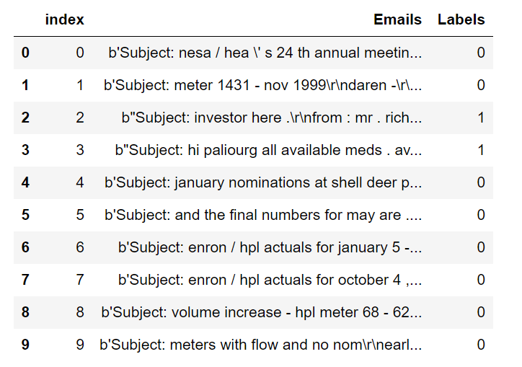
Dataset

Slide 9
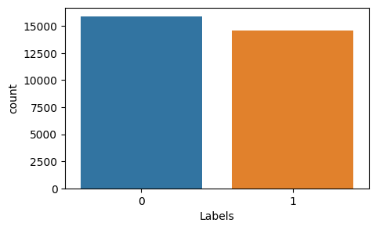
Count of Spam and ham Email

Slide 10
02.
DATA PREPROCESSING

Slide 11
CASE FOLDING
Sometimes people use capital word in email so we need to make it in one format so it wont count that word as different from others.
To maintain the consistency.

Slide 12
CLEANING
Remove non-ascii value in the email body.
Remove digit from the Body of the email.
Remove Hashtag.
Remove Mentions.
Remove additional White Space.
Remove email which length is more than 500 words

Slide 13
STOP WORD
Stop words are a set of commonly used words in a language.
Examples of stop words in English are “a,” “the,” “is,” “are,” etc.
Stop words are commonly used in Text Mining and Natural Language Processing (NLP) to eliminate words that are so widely used that they carry very little useful information.

Slide 14
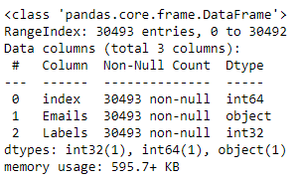
Dataset Info after preprocessing the Data

Slide 15
03.
TOKENIZATION

Slide 16
WORD TOKENIZATION
Word Tokenization is the most commonly used tokenization algorithm.
It splits a piece of text into individual words based on a certain delimiter like white space, comma or any other separators.
For Example – “What is the tallest building?”
The words would be broken down into like “What”, “is”, “the”, “tallest”, “building”.
Problem – Out Of Vocabulary (OOV) words.

Slide 17
SUBWORD TOKENIZATION
Similar to word tokenization but it breaks individual words down a little bit further using specific linguistic rules.
One of the main tools they utilize is breaking off affixes.
For Example – “What is the tallest building?”
The words would be broken down into like “What”, “is”, “the”, “tall”, “est”, “build”, “ing”.
Solve the OOV Problem.

Slide 18
IMPLEMENTATION OF TOKENIZATION
Separate the data by lines.
“fit_on_texts” – This method creates the vocabulary index based on word frequency.
For Example – “The cat sat on the mat.“
“texts_to_sequences” - Transforms each text in texts to a sequence of integers. So it basically takes each word in the text and replaces it with its corresponding integer value from the word_index dictionary.

Slide 19
04.
TRAIN-TEST SPLIT

Slide 20
TRAIN-TEST SPLIT
We have split 30 percent of the data into test data and remaining 70 percent of the data into train data.
As we have some labeled data in test dataset so we are going to delete that label from the testing dataset and make it completely unlabeled.

Slide 21
05.
TRAINING

Slide 22
SEMISUPERVISED LEARNING
Semi-supervised learning uses both labeled and unlabeled data
Labeled data is used to train the model
Unlabeled data is used to generalize the model
Useful when obtaining labeled data is difficult or expensive
Can improve accuracy of models trained on limited labeled data
Techniques include self-training, co-training, and pseudo-labeling
Limitations include the need for high-quality labeled data and potential for bias
Semi-supervised learning is promising for improving models with limited labeled data.

Slide 23
SELFTRAINING CLASSIFIER USING SVC
This allows a given supervised classifier to function as a semi-supervised classifier, allowing it to learn from unlabeled data. It does this by iteratively predicting pseudo-labels for the unlabeled data and adding them to the training set.
We have used Support Vector Classifier as a base estimator in Self Training Classifier.
We got 52.56 % accuracy in this model.

Slide 24
SELFTRAINING CLASSIFIER USING NAIVE BAYES
The multinomial Naive Bayes classifier is suitable for classification with discrete features (e.g., word counts for text classification).
We have used Multinomial Naive bayes Classifier as a base estimator in Self Training Classifier.
We got 52.56 % accuracy in this model.

Slide 25
LSTM MODEL
LSTM – Long Short-Term Memory Model.
It is special kind of recurrent neural network that is capable of learning long term dependencies in data. This is achieved because the recurring module of the model has a combination of four layers interacting with each other.
We have used Adam optimizer for training the model.

Slide 26
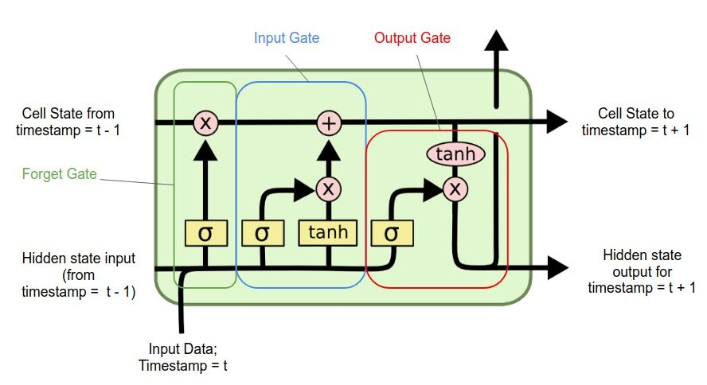
LSTM MODEL

Slide 27
GATES IN LSTM MODEL
The LSTM architecture includes several gates that control the flow of information:
Forget gate: Determines which information to discard from the cell state.
Input gate: Determines which new information to include in the cell state.
Candidate gate: Generates a new candidate value to be added to the cell state.
Output gate: Determines which part of the cell state to output as the hidden state.
These gates work together to selectively remember or forget information from previous time steps, allowing LSTMs to handle long-term dependencies in sequential data.

Slide 28
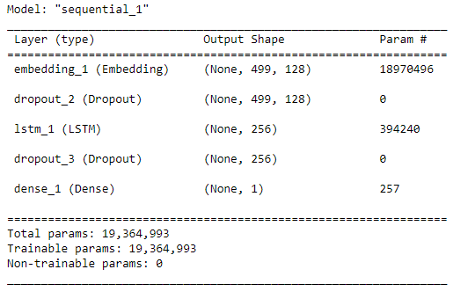
LSTM MODEL

Slide 29
06.
RESULT

Slide 30
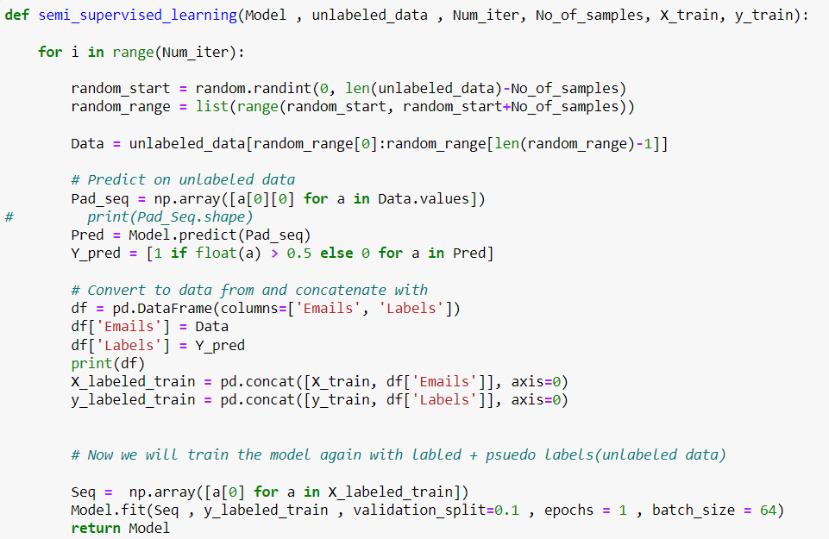
RESULT

Slide 31
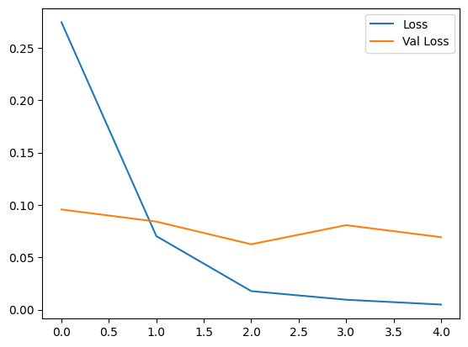
RESULT

Slide 32
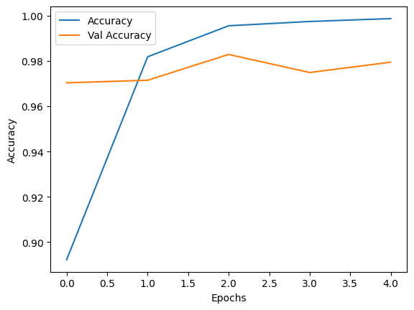
RESULT

Slide 33
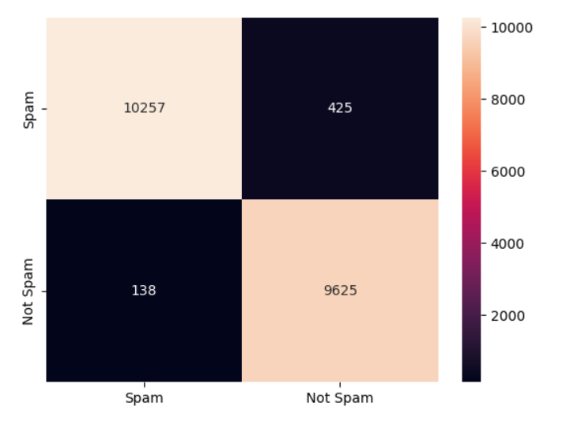
RESULT

Slide 34
Thank you!
Do you have any questions?
Please keep this slide for attribution

