Slide 1

SMART CITIZEN EMERGENCY
REPORTING & RESPONSE SYSTEM
FOR NEPAL
A Digital Platform for Real-Time Emergency Reporting
& Authority Coordination
4th SEMESTER PROJECT PROPOSAL
By
Subash Prasad Chauhan & Nirjal Basnet

Slide 2
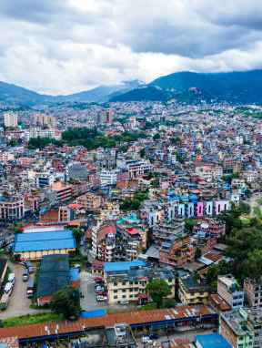
THE PROBLEM
Nepal's Emergency Response Gap
25-45
2+ hrs
18th
min avg. response time
rural response time
global disaster risk rank
■ No unified digital emergency reporting — citizens rely on phone calls to 100+
■ Zero GPS integration — responders cannot locate callers automatically
■ Agencies operate in silos — Police, Fire, Ambulance have no shared system
■ No citizen feedback loop — reporters never know if help is coming
02

Slide 3

OUR SOLUTION
A Connected Emergency Ecosystem
Unified Reporting Platform
Mobile + web platform for instant emergency reports with photo evidence and auto GPS
Intelligent Dispatch
Auto-routes alerts to the right authority based on incident type and location
Real-Time Tracking
Citizens monitor response progress from report to resolution
Built for Nepal
Low-bandwidth ready, offline-capable for remote Himalayan regions
03

Slide 4
KEY FEATURES
Photo Upload
GPS Auto-Location
Real-Time Notifications
Capture and attach incident photos for visual evidence, enabling faster verification by response teams
Automatic precise location sharing eliminates the need to describe your whereabouts during emergencies
Instant alerts to authorities with push notifications to citizens on every status update
Incident Categories
Status Tracking
Authority Dashboard
Pre-defined types — Accidents, Fire, Violence, Floods, Landslides, Missing Persons, Public Safety
Live progress tracker from Reported to Verified, Dispatched, and Resolved
Web-based command center with incident maps, analytics, and team management tools
04

Slide 5
SYSTEM WORKFLOW
From Report to Resolution
01
02
03
04
05
06
REPORT
VERIFY
ALERT
DISPATCH
TRACK
RESOLVE
Citizen submits photo + GPS + category
System validates location and routes incident
Relevant authority gets real-time notification
Response team assigned with ETA
Citizen monitors live progress updates
Case closed with digital record and feedback
The entire workflow is designed to take under 60 seconds from incident report to authority notification.
Every step generates a digital audit trail, ensuring accountability and data for future planning.
05

Slide 6
EXPECTED IMPACT
40-60%
100%
5+
Reduction in average emergency response time through GPS dispatch
Digital audit trail for every reported incident
Agencies integrated in unified network
KEY BENEFITS
Faster Emergency Response — GPS-based dispatch cuts response time dramatically
Increased Transparency — Citizens track every step, no black-box handling
Better Coordination — Breaks down silos between Police, Fire, Ambulance, and Municipalities
Improved Public Safety — Data-driven insights enable proactive resource deployment
Digital Record Keeping — Every incident logged for policy and planning
Scalable Model — Framework extendable to other South Asian countries
06

Slide 7
TARGET USERS
Citizens
Nepal Police
Fire Brigade
General public reporting emergencies via mobile app or our web site — designed for all literacy levels
Law enforcement receiving and managing crime, violence, and accident reports
Fire and rescue teams getting instant alerts with location data and incident photos
Ambulance Services
Municipalities
Disaster Management
Medical emergency dispatch with patient location and incident details
Local government managing public safety issues and infrastructure hazards
NEOC and district offices coordinating large-scale disaster responses
07

Slide 8
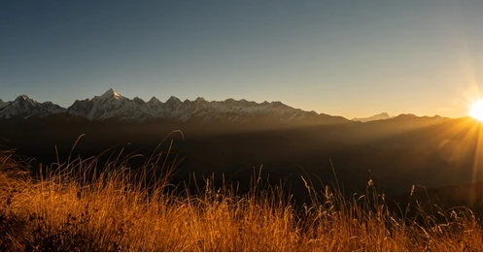
Building a Safer Nepal,
One Report at a Time
This system connects citizens with emergency responders, transforming crisis management in Nepal through real-time reporting, intelligent dispatch, and transparent tracking.
THANK YOU
QUESTIONS & DISCUSSION

