Slide 1

DATA 400 MINI PROJECT
Predicting 5-Year Charge-Off Risk for SBA 7(a) Loans
Random Forest
selected by validation PR-AUC
0.352
42.6%
Research question: using approval-time information, how well can we predict whether a loan will charge off within five years?
locked test PR-AUC
test precision
31.4%
2.36%
test recall
test base rate
End-to-end workflow: target construction → EDA → model selection → locked future test evaluation
Notes:
Slide 1 — Title
Good morning everyone. Today I’m presenting my DATA 400 mini project on SBA 7(a) credit risk.
The main question I wanted to answer is:
Using information that is available around the time a loan is approved, how well can we predict whether that loan will charge off within the next five years?
I chose this question because it is similar to how a real credit-risk screening problem would work. When a lender is evaluating a loan, they do not know the future outcome yet. They only know information that exists at or around approval.
So throughout the project, I tried to keep the modeling process consistent with that real-world setting.
I used the official SBA 7(a) FOIA data, constructed a five-year charge-off target, explored the training data, created features, compared several classification models, selected the best model using validation data, and then evaluated that model only once on a future test set.
The model that ultimately performed best based on my primary validation metric was Random Forest.
So as I go through the presentation, I’ll focus not only on the final performance, but also on why I made each modeling decision and what the results actually mean from a credit-risk perspective.
---

Slide 2

DATA 400 | SBA 7(a) credit-risk mini project
WORKFLOW
02
Project roadmap
The workflow is designed to mimic a real credit-risk screening process: learn from the past, evaluate on the future.
1
Define target
Build chargeoff_5yr and avoid right-censoring.
2
Split by time
Train through 2017, validate on 2018–2019, test on 2020–2021.
3
Explore training data
Use training-only EDA to guide feature choices.
4
Compare models
Pick model by validation PR-AUC, not test results.
5
Evaluate once
Use locked test set for final future-period performance.
Guiding rule
Training data is for learning. Validation data is for model and threshold decisions. Test data is only for final evaluation.
Use case: risk ranking and review prioritization — not standalone approval/denial
Notes:
Slide 2 — Project Roadmap
This slide shows the overall structure of the project.
The first step was actually not modeling. It was making sure I had a valid target variable.
That matters because if the outcome is defined incorrectly, even a sophisticated model will give misleading results.
After defining the target, I split the data by time before doing any target-based EDA.
Then I used only the training period to understand patterns in loan size, term, interest rate, industry, guarantee percentage, and other characteristics.
After that, I created a preprocessing pipeline and compared four models:
a Dummy classifier, Logistic Regression, Decision Tree, and Random Forest.
I selected the model based on validation performance, selected the classification threshold using validation data, checked for overfitting, and only then evaluated on the locked test period.
The overall philosophy is:
training data is for learning, validation data is for making decisions, and test data is only for final evaluation.
The model should also be viewed as a risk-screening or prioritization tool, not as an automatic approval or denial system.
---

Slide 3

DATA 400 | SBA 7(a) credit-risk mini project
PROBLEM FRAMING
03
Research objective: ranking risk, not maximizing accuracy
Because charge-off is rare, a high-accuracy model can still be useless if it never finds risky loans.
Why accuracy is misleading
What this project measures instead
• Overall charge-off rate is only about 3.76%.
• A model could predict “no charge-off” for almost everything and still look accurate.
• That would identify almost none of the loans we actually care about.
• PR-AUC: quality of precision-recall ranking for the positive class.
• Precision: how risky the flagged group actually is.
• Recall: how many true charge-offs the model catches.
• Confusion matrices: translate metrics into actual loan counts.
Use case: risk ranking and review prioritization — not standalone approval/denial
Notes:
Slide 3 — Research Objective
One thing I want to clarify early is that the objective is not simply to maximize accuracy.
In a credit-risk problem, especially when the risky class is rare, accuracy can actually be misleading.
For example, imagine that only around 4% of loans charge off.
A model that predicts “no charge-off” for every single loan could still be around 96% accurate.
But that model would identify zero risky loans, so from a credit-risk perspective it would not be useful at all.
That is why I focus much more on metrics that tell me how well the model identifies the positive class.
Those include PR-AUC, precision, recall, F1-score, and the confusion matrix.
I still report ROC-AUC because it is useful for measuring overall ranking ability, but PR-AUC is my primary model-selection metric.
From a business perspective, what I really want to know is:
Can the model take a very large portfolio and identify a much smaller group where charge-off risk is concentrated?
If it can do that, the lender could use the model to prioritize additional underwriting review or portfolio monitoring.
So the goal is really risk ranking and screening, not perfect binary classification.
---

Slide 4

DATA 400 | SBA 7(a) credit-risk mini project
TARGET DESIGN
04
Target construction: chargeoff_5yr
A valid target is the foundation of the project: recent loans cannot be labeled safe before five years have passed.
Definition
Right-censoring problem
Cutoff used
chargeoff_5yr = 1 if the loan has a documented charge-off within 5 years after approval.
chargeoff_5yr = 0 if no documented charge-off appears during the first 5 years.
A loan approved in 2024 has only about two years of follow-up in a 2026 snapshot. Labeling it as “safe” would be wrong because the full five-year window has not passed yet.
SBA snapshot: June 30, 2026
Latest usable approval date: June 30, 2021
Loans approved after that are excluded from the five-year modeling sample.
Leakage guardrail
Loan status, charge-off date, charge-off amount, and paid-in-full date can help construct the target, but they cannot be predictors.
Use case: risk ranking and review prioritization — not standalone approval/denial
Notes:
Slide 4 — Target Construction
The target variable is called `chargeoff_5yr`.
A value of 1 means the loan had a documented charge-off within five years after approval.
A value of 0 means there was no documented charge-off during the first five years.
The biggest technical issue here is something called right-censoring.
Suppose I have a loan that was approved in 2024, and my dataset ends in 2026.
That loan has only been observed for about two years.
If I label it as a non-charge-off, I would basically be saying it survived five years when five years have not even passed yet.
That would create incorrect labels.
So I only keep loans that have had a complete five-year observation window.
The SBA snapshot date is June 30, 2026.
That means the latest approval date that can have five complete years of follow-up is June 30, 2021.
Anything approved after that date is excluded from the five-year modeling sample.
I also make a very important distinction between variables that can be used to construct the target and variables that can be used as predictors.
Fields such as loan status, charge-off date, charge-off amount, and paid-in-full date contain future outcome information.
They can help me determine whether the loan charged off, but they cannot go into the model.
If I used them as predictors, that would be data leakage because the model would effectively be given information about the answer.
---

Slide 5
DATA 400 | SBA 7(a) credit-risk mini project
DATA
05
Data universe: from raw SBA files to modeling sample
The modeling sample contains 543,110 loans, but only 3.76% charge off within five years.
932,013
2,076
543,110
20,443
3.76%
raw loans after duplicate removal
exact duplicates removed
final modeling universe
five-year charge-offs
overall event rate
Why this matters
The positive class is rare. That makes accuracy a weak metric and makes PR-AUC, precision, recall, and confusion matrices much more informative for model evaluation.
Modeling implication
The task is not “label everything correctly.” The task is to identify a smaller group where charge-off risk is much more concentrated than the base population.
Use case: risk ranking and review prioritization — not standalone approval/denial
Notes:
Slide 5 — Data Universe
After reading the official SBA files and removing exact duplicate records, the raw dataset contains 932,013 loans.
There were 2,076 exact duplicate records removed.
Then I applied the five-year observation requirement and removed cases where the charge-off timing could not be determined reliably.
After those filters, the final modeling universe contains 543,110 loans.
Of those:
- 20,443 charged off within five years
- 522,667 did not
So the overall charge-off rate is only about 3.76%.
That number is important because it immediately tells us this is an imbalanced classification problem.
In other words, there are many more non-charge-offs than charge-offs.
That affects how I evaluate the model.
For example, if I only looked at accuracy, I could easily be impressed by a model that mostly predicts the majority class.
But what I actually care about is whether the model can identify that relatively small 3 to 4 percent group.
That is one major reason PR-AUC becomes more informative than accuracy later in the project.
---

Slide 6
DATA 400 | SBA 7(a) credit-risk mini project
VALIDATION DESIGN
06
Time split: why chronological, not random?
Chronological splitting gives a harder but more realistic past-to-future evaluation than random splitting.
Random split problem
Real deployment logic
Actual split
Random split can mix loans from 2012 and 2021 into both training and validation. That makes the sets more similar and can hide temporal shift.
A lender trains on historical loans and then scores future loans. The split should test whether past information generalizes to newer cohorts.
Train: through 2017
Validation: 2018–2019
Test: Jan 2020–Jun 2021
Train
Validation
Test
393,008
3.86%
95,853
4.18%
54,249
2.36%
Use case: risk ranking and review prioritization — not standalone approval/denial
Notes:
Slide 6 — Time Split
For the model-development process, I used a chronological split instead of a random split.
That was a deliberate choice.
In many machine-learning projects, random splitting is common because it gives training and test sets that come from roughly the same distribution.
But in credit risk, that can make the evaluation look more optimistic than the model would perform in the real world.
Think about how this model would actually be deployed.
A lender would train the model using historical loans and then use it on loans that arrive in the future.
So I wanted the evaluation design to recreate that situation.
My split is:
- Training: approvals through 2017
- Validation: 2018 and 2019
- Test: January 2020 through June 2021
The executed notebook gives me 393,008 training loans, 95,853 validation loans, and 54,249 test loans. The charge-off rates are about 3.86%, 4.18%, and 2.36%, respectively. DATA400_SBA_7a_Credit_Risk_COMP…
And that difference in event rate is actually part of the reason chronological splitting matters.
The future population is not identical to the historical population.
Economic conditions, interest rates, underwriting standards, business conditions, and SBA program activity can all change over time.
If I used random splitting, loans from 2012 and 2021 could be mixed into both training and validation.
That would make the datasets more similar and potentially hide this temporal shift.
So chronological splitting answers a harder but more realistic question:
If I learn from the past, can I still identify risk in future borrowers?
---

Slide 7
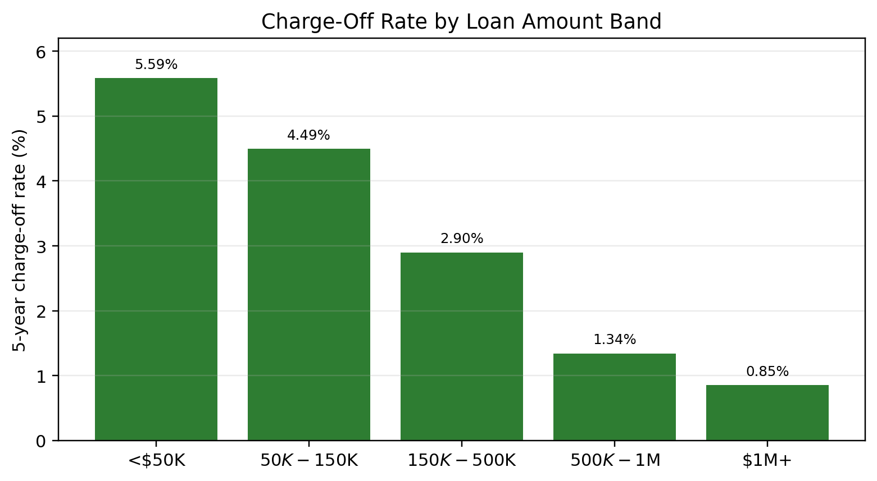
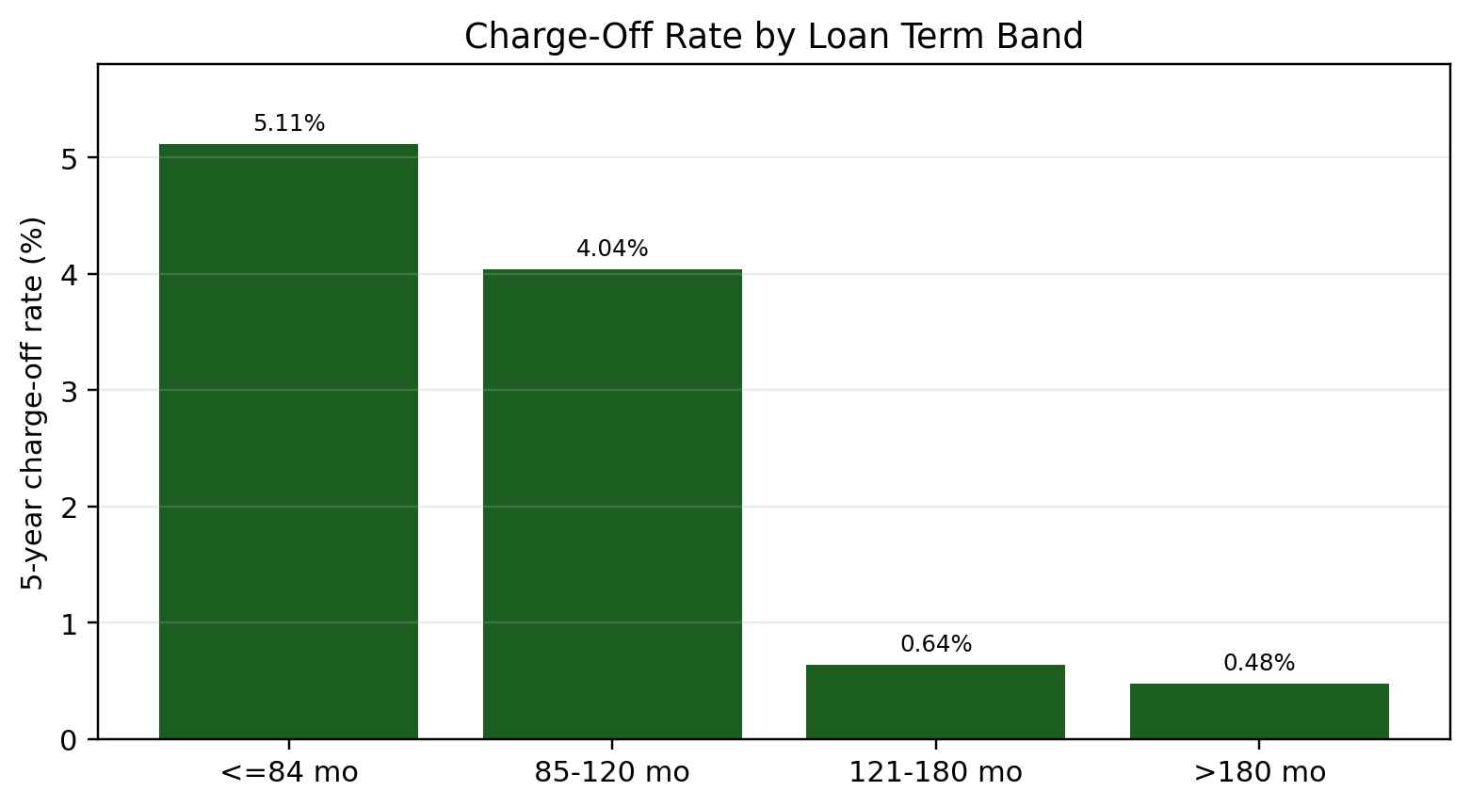
DATA 400 | SBA 7(a) credit-risk mini project
TRAINING-ONLY EDA
07
EDA: loan amount and term show strong risk patterns
The EDA is descriptive, not causal: loan structure appears to contain predictive signal.
Interpretation
Under $50K loans have about 5.59% charge-off, while $1M+ loans are about 0.85%. Short-term loans also show much higher observed charge-off rates than very long-term loans.
Use case: risk ranking and review prioritization — not standalone approval/denial
Notes:
Slide 7 — EDA: Loan Amount and Loan Term
The first major EDA result is that loan structure appears to contain useful predictive information.
I grouped loan amount into bands mainly because the bands make the relationship easier to interpret.
For example, loans under $50,000 have an observed five-year charge-off rate of about 5.59%.
As loan size increases, the observed rate decreases.
For loans above $1 million, the charge-off rate is only about 0.85%. DATA400_SBA_7a_Credit_Risk_COMP…
Loan term shows an even stronger pattern.
Loans with terms of 84 months or less have a charge-off rate of about 5.11%.
Loans with terms above 180 months have a rate below 0.5%. DATA400_SBA_7a_Credit_Risk_COMP…
Now, I want to be careful about interpretation.
I am not claiming that making a loan smaller or shorter directly causes charge-off.
These are associations in the historical data.
Smaller loans may be associated with different borrower types, industries, business maturity levels, underwriting programs, or other characteristics that I do not fully observe.
So the correct conclusion is:
loan size and term appear to contain useful predictive signal.
Another reason I created loan-amount bands only for EDA is interpretability.
For modeling, I would rather preserve the continuous information instead of forcing every loan into a category.
That leads to the next transformation: log gross approval.
---

Slide 8
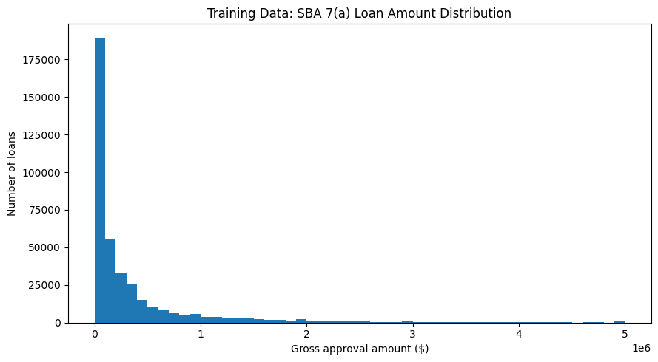
DATA 400 | SBA 7(a) credit-risk mini project
FEATURE DESIGN
08
Why use log_gross_approval?
Log transformation handles a right-skewed financial variable without deleting legitimate large loans.
Why not delete large loans?
A very large SBA loan can be statistically unusual but still valid. Removing it would remove real portfolio variation.
What the log does
log(1 + gross approval) compresses the upper tail while preserving the ordering: larger loans stay larger, but extreme dollar gaps become less dominant.
Why keep it if Random Forest won?
Random Forest does not require log transformation, but the project compares multiple candidate models using one consistent feature set. The transformation helps linear models and does not destroy tree-based ranking information.
Use case: risk ranking and review prioritization — not standalone approval/denial
Notes:
Slide 8 — Why I Use `log_gross_approval`
The raw loan-amount variable is strongly right-skewed.
Most SBA loans are relatively small or medium-sized, but there is a smaller tail of very large loans.
I did not want to simply delete those large loans as outliers.
A $2 million SBA loan might be statistically unusual, but it does not automatically mean the record is wrong.
So instead of deleting legitimate observations, I use a log transformation.
The feature becomes:
log of one plus gross approval amount.
The purpose is to compress the upper tail.
A $2 million loan is still larger than a $200,000 loan, so the ordering is preserved, but the numerical distance becomes less extreme.
This is particularly helpful when I compare models like Logistic Regression, because linear models are more sensitive to the scale and shape of continuous variables.
Now, an important question is:
If Random Forest was the final model, and trees do not technically require log transformation, why did I still use it?
The answer is consistency.
I wanted all candidate models to be compared using the same underlying feature set.
The transformation clearly helps the linear model, it makes the feature easier to work with, and it does not destroy the rank ordering that Random Forest uses.
So I did not use log transformation because Random Forest requires it.
I used it because it is a reasonable representation of a highly skewed financial variable across the full model-comparison framework.
---

Slide 9
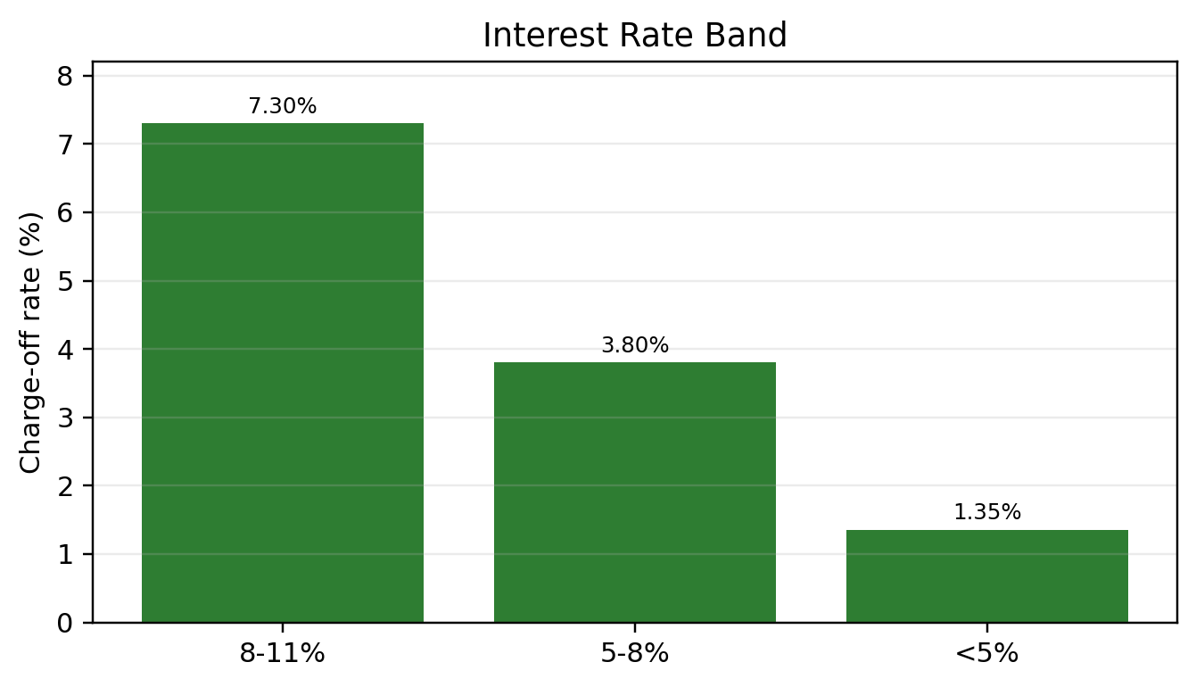
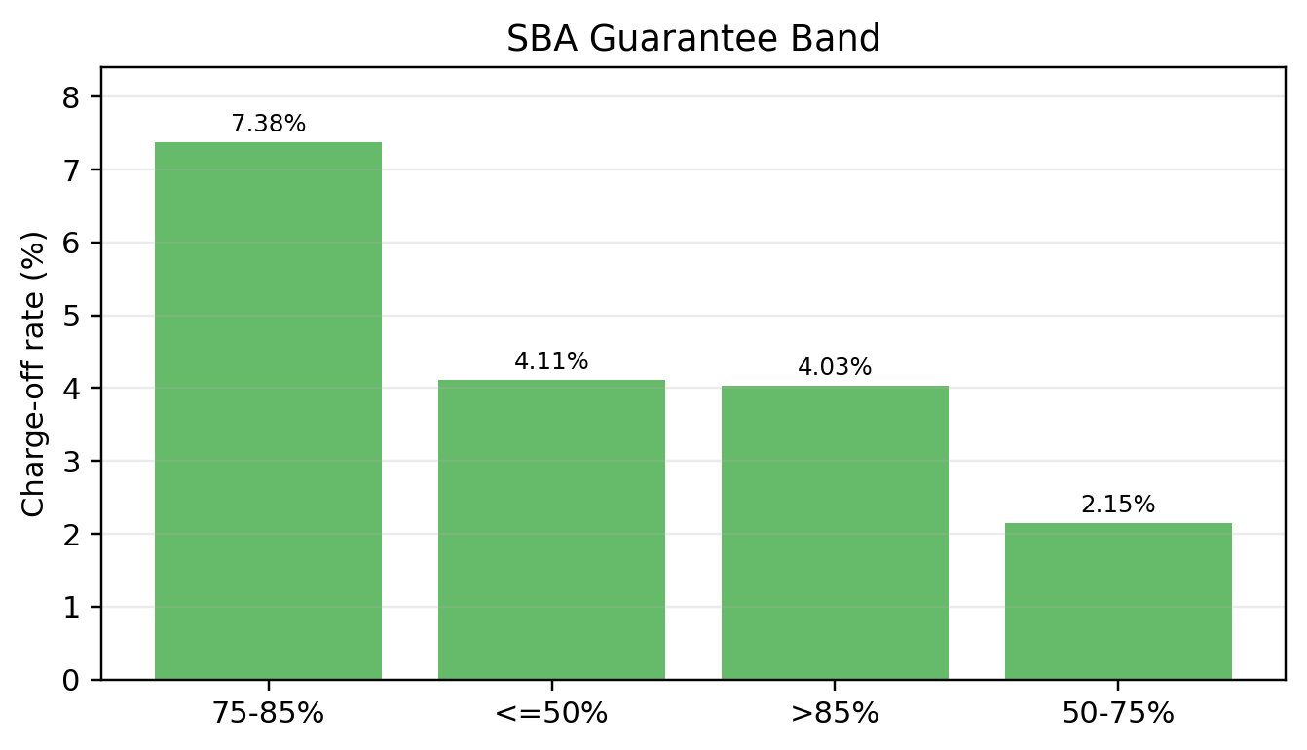
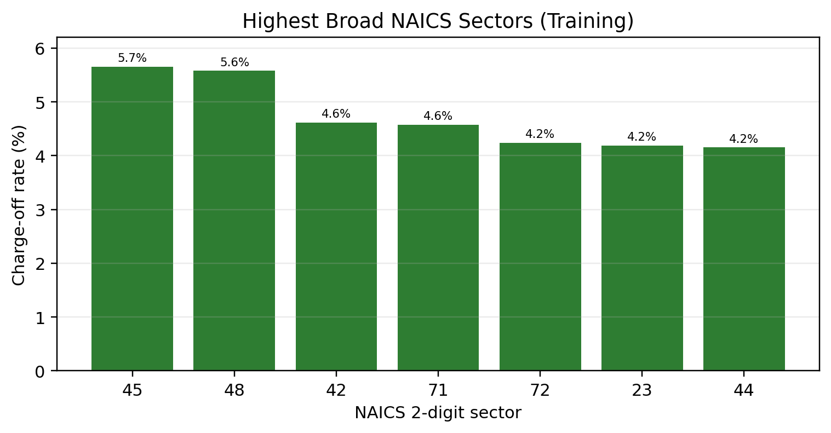
DATA 400 | SBA 7(a) credit-risk mini project
TRAINING-ONLY EDA
09
EDA: pricing, guarantee, and industry also contain signal
Interest rate, guarantee band, and industry are associated with different observed charge-off rates.
How to interpret these patterns
These are associations in historical data, not causal claims. Higher rates may partly reflect risk already identified during underwriting; industry can proxy for cyclicality, margins, revenue stability, and other unobserved factors.
Use case: risk ranking and review prioritization — not standalone approval/denial
Notes:
Slide 9 — EDA: Interest Rate, Guarantee, and Industry
Interest rate shows another clear relationship.
Loans with initial rates between 8% and 11% have an observed charge-off rate of about 7.30%.
Loans below 5% have a much lower observed rate of about 1.35%. DATA400_SBA_7a_Credit_Risk_COMP…
Again, I would not interpret this as “high interest rates cause default.”
Interest rates may partly reflect risk already identified during underwriting.
So there may be reverse interpretation here: riskier borrowers may receive different pricing.
Guarantee percentage also varies.
The 75% to 85% guarantee band has the highest observed charge-off rate in the training data at about 7.38%. DATA400_SBA_7a_Credit_Risk_COMP…
Industry also matters.
Some of the highest broad NAICS sectors include 45, 48, 42, 71, and 72. DATA400_SBA_7a_Credit_Risk_COMP…
But once again, I use these patterns as predictive evidence, not causal evidence.
Industry can capture differences in revenue stability, operating margins, cyclicality, labor intensity, and many other factors that are not directly measured in this public dataset.
So EDA helps me answer:
Which variables appear to contain signal that the model may be able to use?
---

Slide 10
DATA 400 | SBA 7(a) credit-risk mini project
DATA CHECKS
10
Data quality and outliers: unusual is not automatically wrong
I separate statistical outliers from impossible or suspicious values before modeling.
Do not automatically remove outliers
Impossible-value checks
• IQR flags unusual observations, but unusual can still be valid in SBA lending.
• Large loans, long terms, or high jobs-supported counts may reflect real records.
• Deleting them could remove important portfolio variation.
• gross_approval <= 0: 0 rows
• interest_rate < 0: 0 rows
• guarantee_pct > 1.05: 0 rows
• term_months <= 0: 208 rows — needs follow-up in production.
Use case: risk ranking and review prioritization — not standalone approval/denial
Notes:
Slide 10 — Data Quality and Outliers
Before modeling, I also checked unusual and potentially invalid values.
I used the IQR rule to identify statistical outliers.
But I did not automatically delete every IQR outlier.
That is important because statistical outlier does not necessarily mean data error.
A large SBA loan may be far above the median but still be completely valid.
Automatically removing those loans could remove exactly the type of portfolio variation that I want the model to understand.
So instead, I separated two ideas:
unusual values versus impossible or suspicious values.
For example, the notebook shows:
- no gross approvals less than or equal to zero
- no negative interest rates
- no guarantee percentages above 1.05
- but there are 208 records where term_months is less than or equal to zero. DATA400_SBA_7a_Credit_Risk_COMP…
That last point is something I would investigate further in a production project.
I would check the SBA data dictionary or original records before deciding whether those values represent missing codes, special program structures, or actual data errors.
So my approach is not “delete anything unusual.”
It is:
identify unusual values, determine whether they are plausible, and use transformations when appropriate.
---

Slide 11
DATA 400 | SBA 7(a) credit-risk mini project
MODELING SETUP
11
Feature set and preprocessing pipeline
The model uses approval-time variables only, and preprocessing is learned from training data only.
Numerical features
Categorical features
Leakage prevention
log_gross_approval
guarantee_pct
term_months
initial_interest_rate
jobs_supported
approval_year
state, business type, business age, processing method, fixed/variable rate, revolver status, collateral indicator, NAICS 2-digit sector, franchise flag
Excluded outcome fields: loan status, charge-off date, charge-off amount, paid-in-full date.
Excluded borrower name and street address for generalizability and appropriateness.
Pipeline logic
Numeric imputation + scaling; categorical imputation + one-hot encoding. All preprocessing is fit inside the scikit-learn pipeline so validation/test information does not leak into training.
Use case: risk ranking and review prioritization — not standalone approval/denial
Notes:
Slide 11 — Feature Set and Preprocessing
For modeling, I only use variables that are reasonably available around approval time.
The numerical features include:
- log gross approval
- guarantee percentage
- term in months
- initial interest rate
- jobs supported
- approval year
Categorical features include:
- state
- business type
- business age
- processing method
- fixed versus variable rate
- revolver status
- collateral indicator
- two-digit NAICS sector
- franchise indicator
I intentionally exclude borrower name and street address.
Those fields are not necessary for the predictive question and are also not the type of variables I would want to rely on for a generalizable credit-risk model.
I also exclude outcome variables, because that would create leakage.
For preprocessing, numeric missing values are imputed, categorical missing values are imputed, categories are one-hot encoded, and numeric variables are standardized.
A key methodological choice is that the entire preprocessing process is inside a scikit-learn Pipeline.
That means imputation, scaling, and encoding are learned only from the training data during model fitting.
Why does that matter?
Because if I calculated preprocessing values using the entire dataset before splitting, information from validation or test could leak into training.
Even something as simple as a median can technically contain information from the future.
Putting preprocessing inside the pipeline helps prevent that.
---

Slide 12
DATA 400 | SBA 7(a) credit-risk mini project
MODELING SETUP
12
Candidate models: simple baseline to flexible ensemble
I compare models with different levels of flexibility, then let validation performance decide.
Dummy classifier
Logistic Regression
Decision Tree
Random Forest
Baseline only. If real models cannot beat this, the features are not adding useful signal.
Interpretable credit-risk benchmark with regularization. Good reference point for linear relationships.
Simple nonlinear model. Can capture interactions but can overfit if unconstrained.
Flexible ensemble: 120 trees, max_depth=12, min_samples_leaf=20, balanced_subsample. Better for nonlinear patterns and interactions.
Why not let trees grow unlimited?
Unrestricted trees can memorize training details. Complexity controls make validation performance more meaningful.
Use case: risk ranking and review prioritization — not standalone approval/denial
Notes:
Slide 12 — Candidate Models
I compared four models.
The first is a Dummy classifier.
The Dummy model is not expected to perform well.
Its purpose is to give me a baseline.
If a sophisticated model cannot outperform the Dummy baseline, then there is probably not much predictive value in the model.
The second model is Logistic Regression.
I include Logistic Regression because it is simple, interpretable, and commonly used as a benchmark in credit-risk modeling.
The third is a Decision Tree.
That gives me a simple nonlinear model that can capture interactions that Logistic Regression might miss.
The fourth is Random Forest.
Random Forest combines many decision trees and can capture more complex nonlinear relationships and interactions.
My Random Forest uses 120 trees, a maximum depth of 12, a minimum leaf size of 20, and balanced subsampling.
Those restrictions help control complexity.
Why not just let the trees grow as deep as possible?
Because then the model could memorize small patterns in the training data and overfit.
So model complexity is intentionally constrained, and validation performance determines which model I choose.
---

Slide 13
DATA 400 | SBA 7(a) credit-risk mini project
EVALUATION DESIGN
13
Metric plan: PR-AUC is primary because charge-off is rare
The metric was chosen before looking at the winner, so the model choice is not metric shopping.
Accuracy
PR-AUC
ROC-AUC
Can be misleading when only about 3–4% of loans charge off. A “predict all safe” model could look accurate but useless.
Primary selection metric. Focuses on the precision-recall trade-off for the positive class: the loans that actually charge off.
Useful for overall ranking separation, but it can look strong when negatives dominate the dataset.
Threshold metrics
Precision = “Of flagged loans, how many charged off?”
Recall = “Of actual charge-offs, how many did we catch?”
F1 balances both when no explicit cost function is available.
Use case: risk ranking and review prioritization — not standalone approval/denial
Notes:
Slide 13 — Why PR-AUC Is the Main Metric
Before comparing models, I decided that PR-AUC would be my main selection metric.
That choice matters.
I did not look at the model results first and then choose whichever metric made my preferred model look best.
PR-AUC is especially useful here because charge-offs are rare.
Precision asks:
Of the loans I flag, how many actually charge off?
Recall asks:
Of all the loans that actually charge off, how many did I catch?
The precision-recall curve evaluates that trade-off over many possible thresholds.
ROC-AUC is also useful, but ROC-AUC includes the true-negative rate.
When there are a huge number of negative observations, ROC-AUC can still look strong even if positive-class performance is less impressive.
So I still report ROC-AUC, but I prioritize PR-AUC because it is more directly connected to the rare class I care about.
The Dummy PR-AUC is also useful context.
It is approximately equal to the positive-class rate.
So a model needs to beat that baseline substantially before I consider it useful.
---

Slide 14
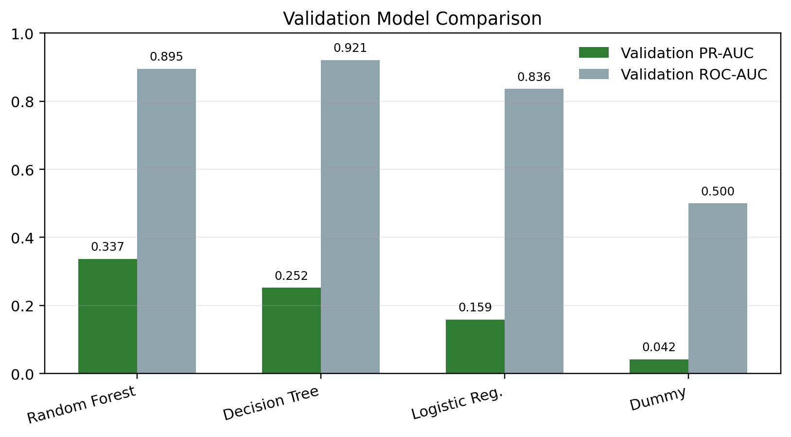
DATA 400 | SBA 7(a) credit-risk mini project
MODEL SELECTION
14
Validation model comparison: Random Forest wins by PR-AUC
Random Forest is selected because it has the strongest validation PR-AUC, the primary metric for rare charge-off detection.
Key decision
Random Forest validation PR-AUC: 0.337
Decision Tree validation PR-AUC: 0.252
Logistic Regression validation PR-AUC: 0.159
Dummy PR-AUC: 0.042
Why not Decision Tree?
Decision Tree has higher ROC-AUC, but PR-AUC was the pre-selected primary metric. Choosing Decision Tree after seeing ROC-AUC would be metric shopping.
Use case: risk ranking and review prioritization — not standalone approval/denial
Notes:
Slide 14 — Validation Model Comparison
This is the main model-selection table.
Random Forest has:
- Training PR-AUC = 0.459
- Validation PR-AUC = 0.337
- Validation ROC-AUC = 0.895
Decision Tree has:
- Validation PR-AUC = about 0.252
- Validation ROC-AUC = about 0.921
Logistic Regression has:
- Validation PR-AUC = about 0.159
- ROC-AUC = about 0.836
And the Dummy model has validation PR-AUC around 0.042. DATA400_SBA_7a_Credit_Risk_COMP…
One result might look confusing at first.
Decision Tree has the highest ROC-AUC, so why did I choose Random Forest?
Because PR-AUC was my primary metric before I saw the results.
Random Forest is much stronger than Decision Tree on PR-AUC: 0.337 compared with about 0.252.
Since my business objective is identifying and concentrating rare charge-off cases, that is the metric I want to optimize.
If I changed my selection rule after seeing that Decision Tree had a better ROC-AUC, that would basically be metric shopping.
So I stay consistent with the original decision rule.
The notebook therefore selects Random Forest as the best validation model. DATA400_SBA_7a_Credit_Risk_COMP…
---

Slide 15
DATA 400 | SBA 7(a) credit-risk mini project
GENERALIZATION
15
Train vs. validation: acknowledge the gap
Random Forest shows some overfitting, but still has the best validation PR-AUC among the candidate models.
0.459
0.337
0.122
0.895
training PR-AUC
validation PR-AUC
train–validation gap
validation ROC-AUC
How to interpret the gap
The gap means the model fits training data more strongly than validation data. That does not automatically disqualify it, but it does require a generalization check.
Why keep Random Forest?
Even with the gap, it still has the strongest out-of-sample precision-recall performance among the tested models.
Use case: risk ranking and review prioritization — not standalone approval/denial
Notes:
Slide 15 — Train vs. Validation Performance
There is one concern with Random Forest that I want to acknowledge.
Training PR-AUC is about 0.459, while validation PR-AUC is about 0.337.
That gives a train-validation gap of approximately 0.122. DATA400_SBA_7a_Credit_Risk_COMP…
A gap like that suggests some overfitting.
But I would not automatically reject the model just because training performance is higher.
Almost every model performs somewhat better on data it has already seen.
What matters is:
How large is the gap?
And is validation performance still useful?
Random Forest still has the strongest validation PR-AUC among all of the candidate models.
So I keep it as the selected model, but I flag generalization as something that needs additional investigation.
That is why later I use a learning curve.
So the conclusion here is not:
“Random Forest does not overfit.”
The more accurate conclusion is:
Random Forest shows some overfitting, but it still provides the strongest out-of-sample precision-recall performance among the models I tested.
---

Slide 16
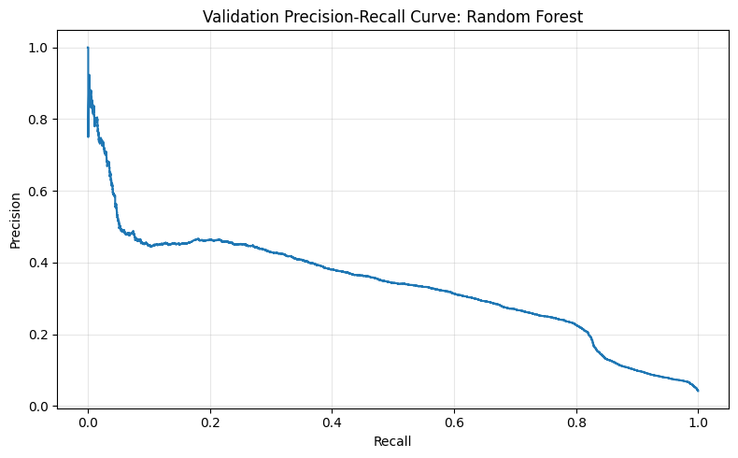
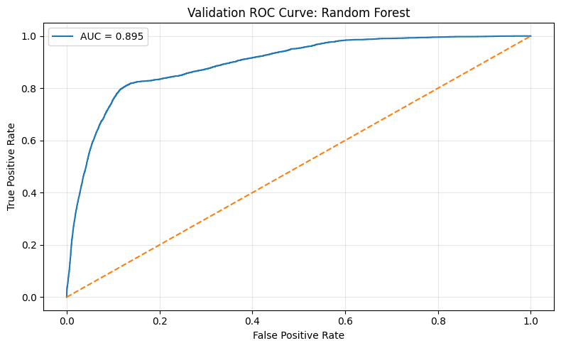
DATA 400 | SBA 7(a) credit-risk mini project
THRESHOLD DESIGN
16
Validation curves: threshold choice changes the business trade-off
The model gives a continuous risk score; the threshold determines how aggressive the review flag will be.
Decision logic
Lower threshold → more flagged loans, higher recall, more false positives. Higher threshold → fewer flagged loans, potentially higher precision, more missed charge-offs.
Use case: risk ranking and review prioritization — not standalone approval/denial
Notes:
Slide 16 — Validation Curves
Before converting the Random Forest score into a final classification decision, I look at both the precision-recall curve and ROC curve.
This is important because the model does not naturally produce only a zero or one.
It produces a continuous score.
Depending on where I place the threshold, I can create a more aggressive or more conservative screening rule.
For example, lowering the threshold would usually flag more loans.
That would increase recall because I would catch more actual charge-offs.
But it would also create more false positives and reduce precision.
Raising the threshold would usually do the opposite.
It would flag fewer loans, potentially improve precision, but miss more actual charge-offs.
So there is no single threshold that is automatically correct.
The best threshold depends on the business objective.
At this stage, the test set is still completely locked.
I only use validation data to choose that operating point.
---

Slide 17
DATA 400 | SBA 7(a) credit-risk mini project
THRESHOLD DESIGN
17
Why the threshold is 0.690
0.50 is not automatically correct; 0.690 is the validation-based F1 operating point.
0.690
33.2%
55.7%
41.6%
chosen validation threshold
validation precision
validation recall
validation F1
Why not use 0.50?
What 0.690 means
• In imbalanced data, 0.50 may not create a useful precision-recall trade-off.
• The business decision is about review capacity and cost of missing risk.
• A threshold should be chosen on validation data, not on the test set.
• It is an operating cutoff, not a perfectly calibrated default probability.
• Random Forest scores are mainly used for ranking in this project.
• A real lender could lower or raise it based on a cost function.
Use case: risk ranking and review prioritization — not standalone approval/denial
Notes:
Slide 17 — Why the Threshold Is 0.690
A common default classification threshold is 0.50.
But there is nothing inherently special about 0.50 for this problem.
Especially in an imbalanced dataset, 0.50 may not give a useful balance between precision and recall.
So instead of automatically choosing 0.50, I use the validation set to select the threshold that maximizes the F1 score.
I use F1 here because I do not yet have a formal dollar cost assigned to false positives versus false negatives.
F1 gives me a neutral starting point that balances precision and recall.
That produces a threshold of approximately 0.690.
At that threshold:
- Validation precision = 33.2%
- Validation recall = 55.7%
- F1 = 41.6% DATA400_SBA_7a_Credit_Risk_COMP…
One thing I would not say is:
“A probability of 0.690 means the borrower has exactly a 69% chance of default.”
The Random Forest score is being used primarily as a ranking score, and the probabilities have not been formally calibrated.
So 0.690 is best interpreted as the operating cutoff selected from validation data.
---

Slide 18
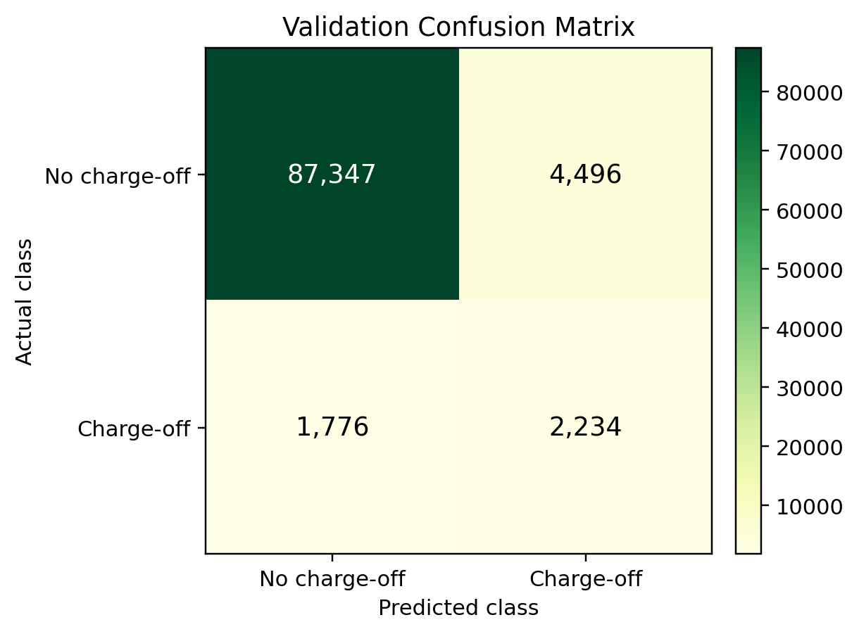
DATA 400 | SBA 7(a) credit-risk mini project
THRESHOLD DESIGN
18
Validation confusion matrix: actual review trade-off
At the validation threshold, the model catches 2,234 charge-offs but still misses 1,776.
Business meaning
True positives = flagged loans that actually charge off.
False positives = extra review for loans that do not charge off.
False negatives = risky loans the model misses.
Threshold is a business choice
If missed charge-offs are very expensive, lower the threshold to increase recall. If review capacity is scarce, raise the threshold to prioritize precision.
Use case: risk ranking and review prioritization — not standalone approval/denial
Notes:
Slide 18 — Validation Confusion Matrix
The validation confusion matrix helps translate those percentages into actual loans.
At the selected threshold, there are:
- 2,234 true positives
- 4,496 false positives
- 1,776 false negatives
- 87,347 true negatives DATA400_SBA_7a_Credit_Risk_COMP…
The true positives are loans that the model flagged and that actually charged off.
The false positives are loans that would have received additional review but did not charge off.
The false negatives are especially important in credit risk.
These are loans that actually charged off but the model failed to flag.
This is why the decision threshold is really a business decision.
If the cost of missing a risky loan is extremely high, I might be willing to lower the threshold and tolerate more false positives.
If a lender has very limited review capacity, I might raise the threshold and prioritize precision.
So the threshold in this project is not meant to be a universal SBA risk cutoff.
It is a transparent validation-based operating point.
---

Slide 19
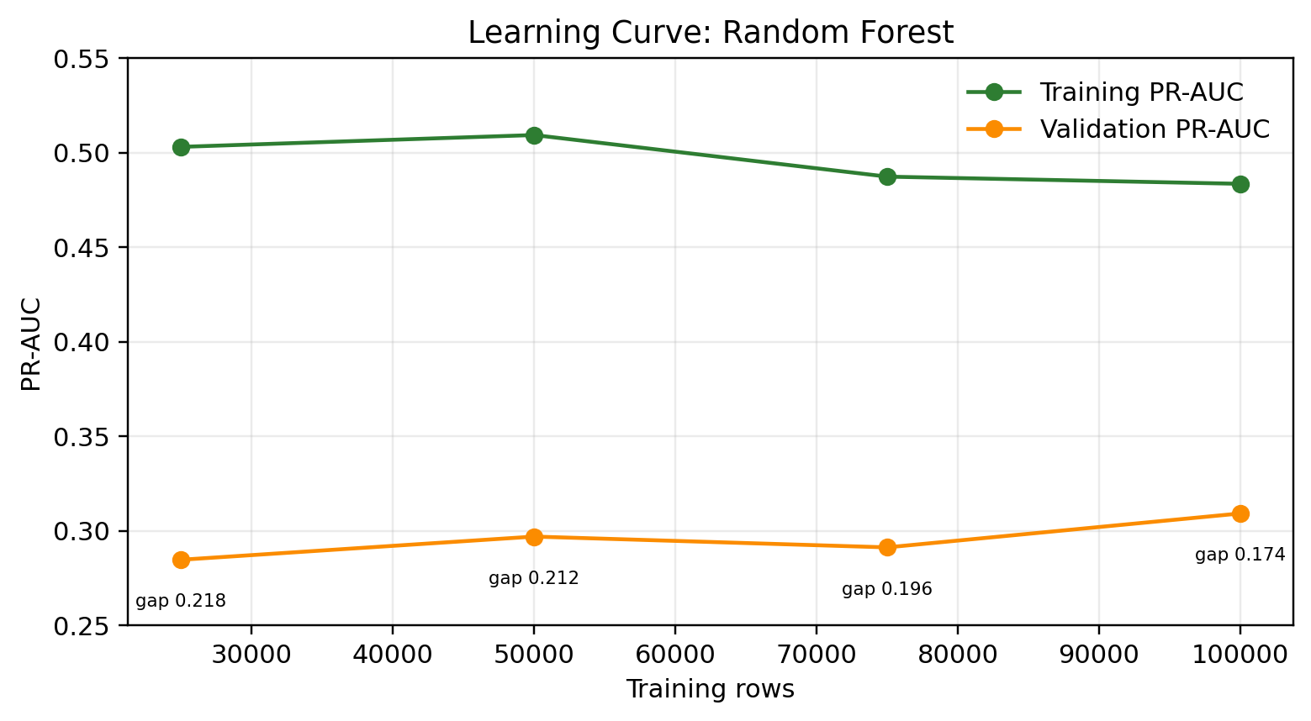
DATA 400 | SBA 7(a) credit-risk mini project
GENERALIZATION
19
Learning curve: does more data reduce overfitting?
The train-validation gap shrinks as the training sample grows, but it does not disappear.
Diagnostic results
25K rows: gap ≈ 0.218
50K rows: gap ≈ 0.212
75K rows: gap ≈ 0.196
100K rows: gap ≈ 0.174
Interpretation
Additional data helps, but Random Forest still needs tuning, complexity control, or richer predictor information for stronger generalization.
Use case: risk ranking and review prioritization — not standalone approval/denial
Notes:
Slide 19 — Learning Curve and Generalization
Because Random Forest has a noticeable train-validation gap, I use a learning curve to investigate whether more data improves generalization.
For computational efficiency, this diagnostic uses up to 100,000 training rows.
At 25,000 observations:
- Training PR-AUC is about 0.503
- Validation PR-AUC is about 0.285
- Gap is about 0.218
At 100,000 observations:
- Training PR-AUC is about 0.484
- Validation PR-AUC is about 0.309
- Gap falls to approximately 0.174. DATA400_SBA_7a_Credit_Risk_COMP…
So the gap becomes smaller as the model gets more training data.
That is encouraging.
It suggests that part of the overfitting problem may improve with additional observations.
However, the gap does not disappear completely.
So if this were a production project, I would consider additional hyperparameter tuning, stronger regularization of tree complexity, and possibly richer features.
Another important clarification is that this 100,000-row learning curve is only a diagnostic.
The final model is not restricted to 100,000 rows.
It is later refit using the complete development data.
---

Slide 20
DATA 400 | SBA 7(a) credit-risk mini project
FINAL EVALUATION
20
Final model training: refit after choices are locked
After model and threshold are selected, validation data can be combined with training data for the final fit.
1
2
3
4
Select model on validation
Select threshold on validation
Refit final model
Evaluate once on test
Random Forest chosen by validation PR-AUC.
Threshold 0.690 chosen by F1.
Use train + validation after choices are locked.
No tuning after seeing test labels.
Why this keeps the test honest
If the test result is used to change the model, threshold, or features, the test set becomes another validation set. The final result would no longer represent unseen future data.
Use case: risk ranking and review prioritization — not standalone approval/denial
Notes:
Slide 20 — Final Model Training
After the model and threshold have already been selected, I combine the training and validation periods.
The reason is that validation has already served its purpose.
It helped me choose the model and threshold.
Once those choices are locked, there is no reason to throw away those observations when fitting the final production-style model.
So I refit the selected Random Forest using training plus validation data.
Then I make predictions on the test set.
This is the first time the test outcomes are used for final performance evaluation.
And this part is very important:
If I see the test results and then change the model, change the threshold, or change my features, the test set would no longer be a true test set.
It would effectively become another validation set.
So even if I see something on the test results that I wish were better, I do not go back and optimize based on those test labels.
That is what keeps the final evaluation honest.
---

Slide 21
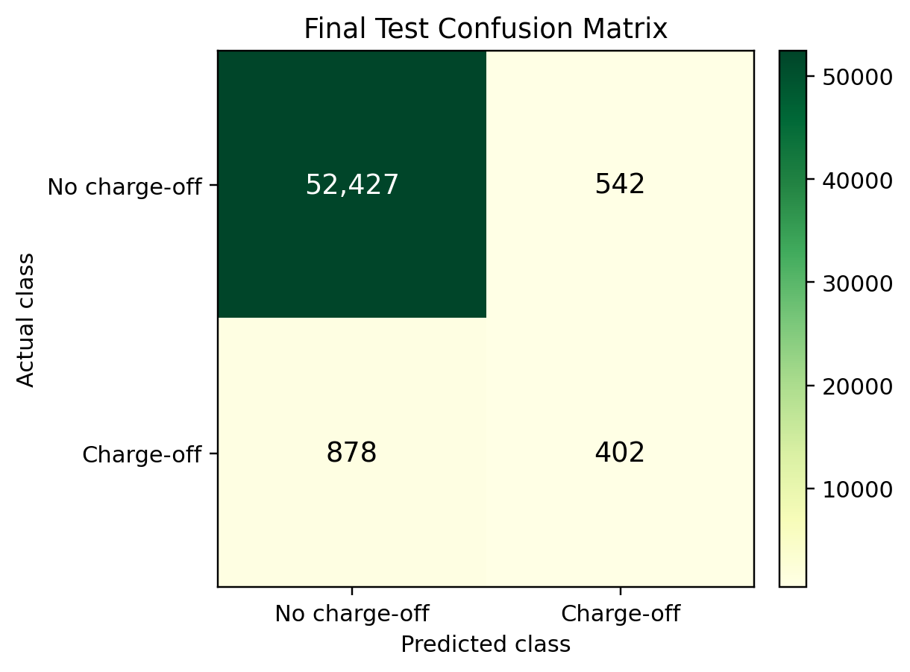
DATA 400 | SBA 7(a) credit-risk mini project
FINAL EVALUATION
21
Locked test performance
The final Random Forest ranks risk well on the future test period, but recall at the fixed threshold is limited.
54,249
2.36%
0.352
0.931
42.6%
31.4%
test loans
test base rate
test PR-AUC
test ROC-AUC
precision
recall
Why PR-AUC can improve while recall falls
PR-AUC and ROC-AUC evaluate ranking across many thresholds. Recall is measured at one fixed threshold: 0.690. A future cohort can keep strong ranking but produce a different cutoff trade-off.
Test confusion matrix
402 true positives
542 false positives
878 false negatives
52,427 true negatives
Use case: risk ranking and review prioritization — not standalone approval/denial
Notes:
Slide 21 — Locked Test Performance
The locked test set contains 54,249 loans, and the observed five-year charge-off rate is approximately 2.36%.
The final Random Forest achieves:
- Test PR-AUC = 0.352
- Test ROC-AUC = 0.931
- Precision = 42.6%
- Recall = 31.4%
- F1 = 36.2% DATA400_SBA_7a_Credit_Risk_COMP…
The test confusion matrix contains:
- 402 true positives
- 542 false positives
- 878 false negatives
- 52,427 true negatives. DATA400_SBA_7a_Credit_Risk_COMP…
One result is worth explaining.
Validation recall was about 55.7%, but test recall falls to 31.4%.
At the same time, test PR-AUC and ROC-AUC are actually strong.
Those results are not contradictory.
PR-AUC and ROC-AUC measure ranking ability across many possible thresholds.
Recall of 31.4% is the result at one fixed threshold—the 0.690 threshold selected earlier.
So the model can still rank the test portfolio very well overall while the same fixed cutoff produces a different precision-recall trade-off in the future cohort.
That is actually a useful example of why threshold stability matters in real credit-risk systems.
---

Slide 22
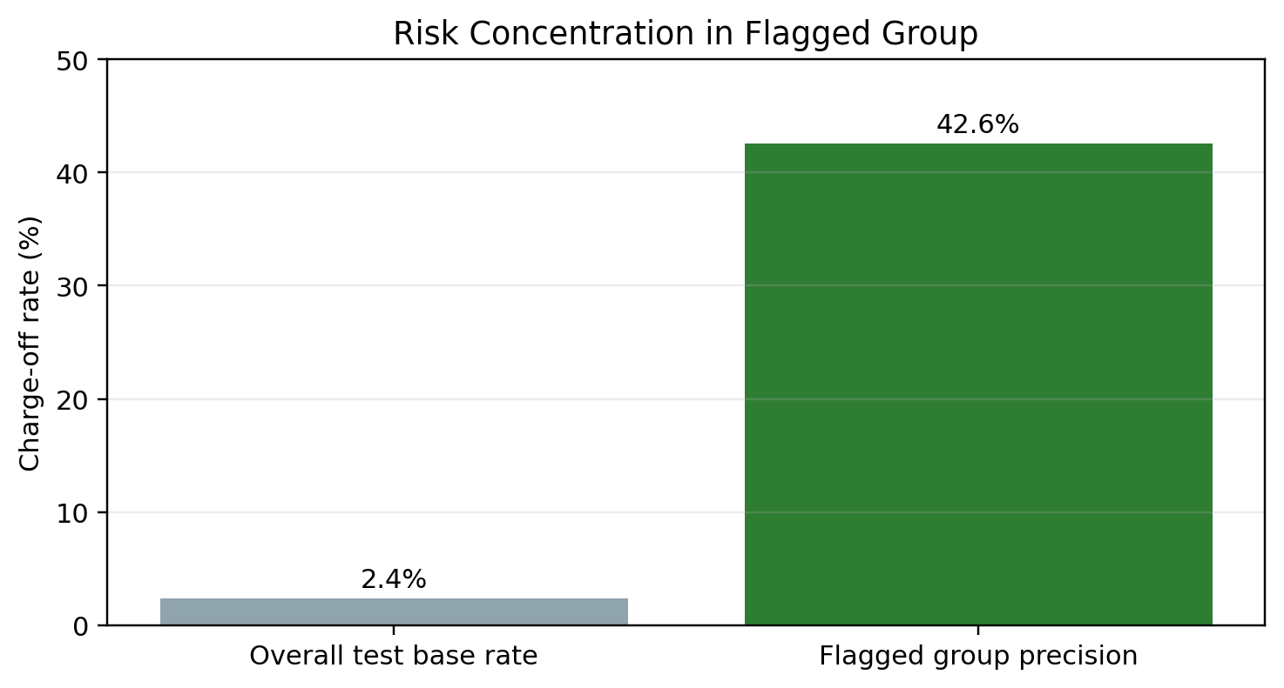
DATA 400 | SBA 7(a) credit-risk mini project
BUSINESS VALUE
22
Business interpretation: small review group, high risk concentration
The model flags only 1.7% of the test portfolio but captures 31.4% of all charge-offs.
944
402
31.4%
loans flagged
flagged loans that charged off
charge-offs captured
Practical value
Reviewing less than 2% of the portfolio captures about 31% of charge-offs. The flagged group has a charge-off rate around 18x the overall test base rate.
Important caveat
The model still misses 878 charge-offs, so a low-risk score should not be interpreted as “definitely safe.”
Use case: risk ranking and review prioritization — not standalone approval/denial
Notes:
Slide 22 — Business Interpretation of the Test Result
The way I would summarize the final test result is not simply by saying precision is 42.6%.
I think a more intuitive interpretation is this:
The entire test portfolio has 54,249 loans.
The model flags only 944 loans.
So it flags about 1.7% of the portfolio.
But inside that very small group, 402 loans actually charge off.
That means the model identifies about 31.4% of all test-period charge-offs while reviewing less than 2% of the portfolio.
Also, the charge-off rate among flagged loans is 42.6%, compared with an overall test base rate of only 2.36%.
That is roughly an 18-times concentration of risk.
To me, that is the strongest practical argument for the model.
The model is clearly finding a small subgroup where credit risk is dramatically higher than average.
However, it still misses 878 charge-offs.
So it would be dangerous to interpret a low-risk prediction as “this loan is definitely safe.”
That is why I position the model as a triage or prioritization tool, not a substitute for underwriting.
---

Slide 23
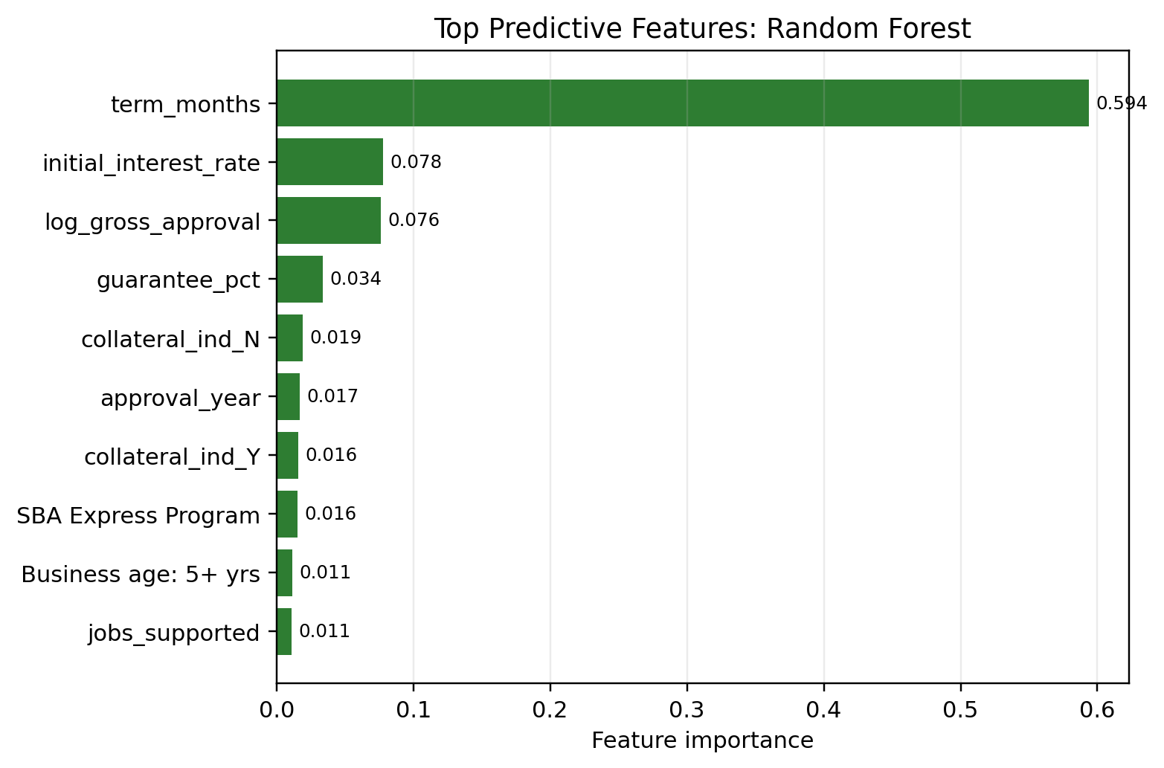
DATA 400 | SBA 7(a) credit-risk mini project
INTERPRETATION
23
Model interpretation: feature importance, not causality
Random Forest uses feature importance; this shows predictive usefulness, not causal impact.
Top signals
term_months ≈ 0.594
initial_interest_rate ≈ 0.078
log_gross_approval ≈ 0.076
guarantee_pct ≈ 0.034
How to interpret this
The model frequently used term, pricing, and loan size to separate risk. That aligns with EDA, but it does not mean term length causes 59.4% of charge-offs.
Limitation
Impurity-based importance can favor continuous variables. In production, confirm with permutation importance or SHAP.
Use case: risk ranking and review prioritization — not standalone approval/denial
Notes:
Slide 23 — Model Interpretation / Feature Importance
Because Random Forest is the selected model, I interpret it using feature importance rather than Logistic Regression coefficients.
The strongest feature by a very large margin is term_months, with importance of approximately 0.594.
After that:
- initial interest rate ≈ 0.078
- log gross approval ≈ 0.076
- guarantee percentage ≈ 0.034
- collateral indicators and approval year also appear among the stronger features. DATA400_SBA_7a_Credit_Risk_COMP…
The dominance of loan term is consistent with the EDA.
Remember that short-term loans had charge-off rates above 5%, while very long-term loans were below 0.5%.
So the model finding term useful makes sense.
But I want to be careful with the interpretation.
An importance of 0.594 does not mean loan term causes 59.4% of defaults.
Feature importance only tells us that Random Forest frequently found the variable useful for separating observations.
There is another limitation.
This is impurity-based feature importance, which can sometimes favor continuous variables because they offer many possible split points.
So in a more advanced project, I would validate this using something like permutation importance or SHAP values.
---

Slide 24
DATA 400 | SBA 7(a) credit-risk mini project
LIMITATIONS
24
Error analysis: what the aggregate metrics hide
False negatives and false positives have different business meanings and should not be treated as equal by default.
False negatives
False positives
878 test loans charged off but were scored below the threshold. These are the missed risks. They show the public SBA features do not capture every source of default risk.
542 test loans were flagged but did not charge off. If the action is extra review or monitoring, these are not necessarily useless. If the action were denial, the cost would be much higher.
Industry-level errors
Higher error rates in some NAICS sectors may reflect industry-specific risk dynamics or borrower details not available in the public data.
Use case: risk ranking and review prioritization — not standalone approval/denial
Notes:
Slide 24 — Error Analysis
I also look beyond the overall metrics and ask where the model makes mistakes.
False negatives are especially important.
Those are loans that later charge off but are scored below the threshold.
In the test set, there are 878 false negatives.
So even though the risk ranking is useful, the model does not capture every source of default risk.
That is not very surprising.
The public SBA dataset does not contain the full financial profile that a real lender would normally use.
False positives are different.
Those are loans that the model flags, but that do not charge off.
Those are not necessarily useless.
If the action associated with a flag is simply an additional review or monitoring step, the cost of a false positive may be relatively small.
If the action were an automatic denial, the cost would be much more serious.
That is another reason I do not recommend using this model as an automatic lending decision system.
Some NAICS sectors also show higher error rates.
That may indicate that risk patterns are more difficult to capture in certain industries or that important industry-specific information is missing from the public dataset.
---

Slide 25
DATA 400 | SBA 7(a) credit-risk mini project
LIMITATIONS
25
Limitations: useful public data, not a full underwriting file
The model can rank risk from approval-time public variables, but many key underwriting variables are missing.
Missing borrower-level data
Missing loan/lender detail
Deployment risks
Financial statements
FICO or business credit scores
Debt-service coverage ratio
Leverage and liquidity
Collateral valuation
Detailed lender behavior
Servicing quality
Local economic conditions
Temporal drift: interest rates, macro conditions, SBA program rules, industry dynamics, and underwriting behavior can change.
Probability calibration is also needed before treating scores as true probabilities.
Bottom line
The model is strongest as a ranking/prioritization layer. It is not strong enough to replace full underwriting judgment.
Use case: risk ranking and review prioritization — not standalone approval/denial
Notes:
Slide 25 — Limitations
The biggest limitation is the information available in the dataset.
The SBA FOIA data is useful, but it is not a complete commercial credit file.
For example, I do not have detailed:
- borrower financial statements
- FICO or business credit scores
- debt-service coverage ratios
- leverage ratios
- liquidity
- collateral valuation
- detailed lender underwriting information
- local economic conditions at the borrower level
Those variables could explain a significant amount of risk that the current model cannot see.
Another limitation is temporal drift.
Relationships learned from 2010 through 2019 may not remain identical forever.
Interest rates change.
Economic conditions change.
SBA program rules can change.
Industry conditions change.
Underwriting behavior changes.
So even a model that performs well today would need ongoing performance monitoring.
A final limitation is probability calibration.
I use the Random Forest score effectively for ranking, but I have not calibrated the score to ensure that a predicted 20% risk truly corresponds to a 20% observed event frequency.
That would be an important next step if the model were used operationally.
---

Slide 26
DATA 400 | SBA 7(a) credit-risk mini project
NEXT STEPS
26
Next steps: from academic model to stronger credit-risk system
The next version should add richer data, improve generalization, and choose thresholds using business costs.
Add better predictors
Improve modeling
Improve decisioning
Borrower financial ratios
Lender-level variables
Macroeconomic context
Local conditions
Time-aware cross-validation
More systematic Random Forest tuning
Compare gradient boosting
Monitor drift by cohort
Calibrate probabilities
Evaluate decile lift
Choose threshold with explicit cost function
Track precision/recall by segment
What I would report next
For a ranking model, decile lift is especially useful: what share of charge-offs appear in the highest-risk 5%, 10%, or 20% of scores?
Use case: risk ranking and review prioritization — not standalone approval/denial
Notes:
Slide 26 — Next Steps
If I continued this project, I would focus on several improvements.
First, I would add richer borrower-level financial information if available.
Second, I would add lender-level features because underwriting quality and servicing behavior may vary across institutions.
Third, I would include macroeconomic variables such as unemployment, interest rates, and local economic conditions.
Fourth, I would tune Random Forest more systematically using time-aware cross-validation.
I would also compare additional algorithms such as gradient boosting.
But I would not add a more complicated model simply because it is more sophisticated.
The new model would need to show better out-of-sample performance and still have a reasonable interpretation framework.
I would also evaluate decile lift.
For a credit-risk ranking model, it would be useful to know what percentage of charge-offs are concentrated in the highest-risk 5%, 10%, or 20% of scores.
Finally, I would calibrate the probability estimates and choose the operating threshold using an explicit cost function rather than F1 alone.
---

Slide 27
DATA 400 | SBA 7(a) credit-risk mini project
WRAP-UP
27
Conclusion: useful ranking, not standalone underwriting
Random Forest creates meaningful risk concentration, but the model should support human review rather than replace it.
0.352
0.931
42.6%
31.4%
18x
test PR-AUC
test ROC-AUC
test precision
test recall
risk concentration vs base rate
Main takeaways
1. Valid five-year target avoids right-censoring.
2. Chronological split tests past-to-future generalization.
3. PR-AUC matches the rare-event objective.
4. Random Forest is strongest on validation PR-AUC.
5. The final model is useful for triage, not automatic approval/denial.
Thank you — I’m happy to answer questions.
Use case: risk ranking and review prioritization — not standalone approval/denial
Notes:
Slide 27 — Conclusion
To conclude, this project shows an end-to-end credit-risk modeling process.
The first major decision was creating a valid five-year charge-off target and avoiding right-censoring.
The second was using a chronological split so the evaluation reflects a realistic past-to-future modeling problem.
The third was selecting a metric that matches the rare-event nature of the problem.
Using validation PR-AUC, Random Forest was the strongest model.
On the locked test set, the final model achieved:
- PR-AUC of 0.352
- ROC-AUC of 0.931
- precision of 42.6%
- recall of 31.4%
The most important business interpretation is that the model flags only about 1.7% of the test portfolio, but that small group contains about 31% of all charge-offs.
And the flagged group has a charge-off rate of 42.6% compared with a portfolio base rate of only 2.36%.
So I would say the model has meaningful value for risk ranking and review prioritization.
But because it still misses many charge-offs and does not have access to a full underwriting file, it should not be used as a standalone approval or denial system.
The best use case is to help a human credit process decide where additional attention is most valuable.
Thank you, and I’m happy to answer any questions.

