Slide 1

PREDICTING 5-YEAR
CHARGE-OFF RISK
SBA 7(a) Loan Approvals | DATA 400 Mini Project
Random Forest selected on validation PR-AUC
End-to-end credit-risk workflow
543,110
3.76%
model-ready loans
overall 5-year charge-off rate
0.352
0.931
test PR-AUC
test ROC-AUC
Prepared by: Chau Pham
DATA 400 | SBA 7(a) Credit-Risk Mini Project
01
Notes:
Suggested time: 0.7 minutes
Good morning everyone. Today I am presenting my DATA 400 mini project on SBA 7(a) credit risk. The central question is whether information available around loan approval can help predict whether a loan will be charged off within five years. I use the official SBA 7(a) FOIA data, build a five-year charge-off target, split the loans by approval time, compare four classification models, select the best model using validation data, and then evaluate only once on a locked future test set. The executed notebook selected Random Forest as the best validation model based on PR-AUC, and the rest of the presentation explains why that model was chosen, how it performs, and what limitations remain.

Slide 2

PRESENTATION MAP
The logic of the project from data to decision use
1. Define the prediction problem
2. Learn patterns carefully
3. Test future performance
Positive class: charge-off within five years
Remove loans without full five-year follow-up
Avoid using outcome fields as predictors
Use training data for target-based EDA
Build approval-time features
Compare models on validation data
Threshold selected on validation only
Final evaluation on 2020–2021 approvals
Interpret as risk ranking, not automatic denial
Main idea: I am trying to prioritize review, not replace human underwriting judgment.
DATA 400 | SBA 7(a) Credit-Risk Mini Project
02
Notes:
Suggested time: 0.8 minutes
This slide gives the structure of the presentation. First, I define the prediction problem and make sure the target is valid. That means I only use loans that have a full five-year observation window, and I avoid leakage by not using outcome fields as predictors. Second, I use the training period for EDA and feature engineering, and I compare models on validation data. Third, I evaluate the final selected model on a future test period. The main idea is that the model should be used to prioritize review or monitoring. It should not be used as a standalone approval or denial rule.

Slide 3

RESEARCH OBJECTIVE
Predictive screening, not automatic lending decisions
Research question
Why this is hard
Using approval-time information, how well can we predict whether an SBA 7(a) loan will charge off within five years?
Charge-offs are rare, so accuracy can be misleading.
Different error types have different business costs.
Public SBA fields are not a full underwriting file.
Primary evaluation lens: Can the model rank the rare charge-off cases high enough to support extra review?
DATA 400 | SBA 7(a) Credit-Risk Mini Project
03
Notes:
Suggested time: 0.9 minutes
The objective is not simply to label every loan correctly. In credit risk, a model is often most useful if it can rank loans so that higher-risk applications or portfolio accounts receive more attention. The positive class is rare, meaning a naive model could achieve high accuracy by predicting almost everything as non-charge-off. That is why I focus on metrics that evaluate the positive class: PR-AUC, precision, recall, F1, and confusion matrices, while also reporting ROC-AUC for comparison. I also keep the business use case in mind. This is a screening and prioritization tool, not an automatic lending decision system.

Slide 4

TARGET CONSTRUCTION
The five-year label must avoid right-censoring
Target: chargeoff_5yr
Right-censoring rule
Value
Meaning
SBA snapshot date: 2026-06-30
Five-year cutoff: 2021-06-30
Approvals after cutoff are excluded, not labeled safe
1
Documented charge-off within 5 years
0
No documented charge-off in first 5 years
Leakage guardrail: Loan status, charge-off date, gross charge-off amount, and paid-in-full date are outcome information. They help define/check the target, but they are not model features.
DATA 400 | SBA 7(a) Credit-Risk Mini Project
04
Notes:
Suggested time: 0.95 minutes
The target variable is chargeoff_5yr. A value of one means that there is a documented charge-off within five years of approval. A value of zero means that there is no documented charge-off during the first five years. The important technical issue is right-censoring. A recent loan cannot be treated as safe simply because five full years have not passed yet. Since the SBA snapshot date is June 30, 2026, the latest approval date that can have a complete five-year window is June 30, 2021. Any loan approved after that cutoff is excluded from the five-year modeling sample instead of being incorrectly labeled as a non-charge-off. I also avoid leakage by not using loan status, charge-off date, charge-off amount, or paid-in-full date as predictors.

Slide 5
DATA UNIVERSE
From official FOIA data to model-ready observations
932,013
2,076
543,110
15
raw rows after duplicate removal
exact duplicate rows removed
loans with usable 5-year target
ambiguous charge-off timing exclusions
Step
Rows / count
What it means
Raw after de-duplication
932,013
Official SBA records after exact duplicates removed
Modeling universe
543,110
Full five-year window + usable target
Charge-off within 5 years
20,443
Positive class
No 5-year charge-off
522,667
Negative class
Overall event rate = 3.76% → this is an imbalanced classification problem.
DATA 400 | SBA 7(a) Credit-Risk Mini Project
05
Notes:
Suggested time: 1 minutes
The executed notebook reads the official SBA 7(a) FOIA files and removes exact duplicates. After that step, the raw dataset has 932,013 loans, with 2,076 exact duplicates removed. Then I filter to loans with a complete five-year observation window and a usable charge-off timing rule. That leaves 543,110 loans in the modeling universe. Among these, 20,443 loans are positive cases, meaning they charged off within five years, and 522,667 are non-charge-off cases during the first five years. The event rate is only 3.76 percent, which confirms that this is an imbalanced classification problem. This is why metrics like precision-recall AUC and recall are more meaningful than accuracy alone.

Slide 6
TIME-BASED SPLIT
Model choices are made before touching the future test set
Split
Approval period
Rows
Charge-off rate
Purpose
Train
2009-10-01 to 2017-12-31
393,008
3.86%
Fit models + EDA
Validation
2018-01-01 to 2019-12-31
95,853
4.18%
Choose model + threshold
Locked test
2020-01-01 to 2021-06-30
54,249
2.36%
Final future-period evaluation
Why not random split?
What changes in test?
Credit-risk patterns drift over time.
A future-period test better reflects deployment.
The test set stays locked until the end.
The test base rate falls to 2.36%, which means future evaluation is harder and more realistic than measuring only older cohorts.
DATA 400 | SBA 7(a) Credit-Risk Mini Project
06
Notes:
Suggested time: 0.9 minutes
I used a chronological split instead of a random split. The training data covers approvals through 2017, validation covers 2018 and 2019, and the locked test set covers January 2020 through June 2021. This is important because model choices are made using validation data before the final test set is touched. It also reflects a real deployment setting, where a model trained on older loans must generalize to newer cohorts. Notice that the test period has a lower observed five-year charge-off rate, only 2.36 percent. That lower base rate makes future-period evaluation especially important.

Slide 7
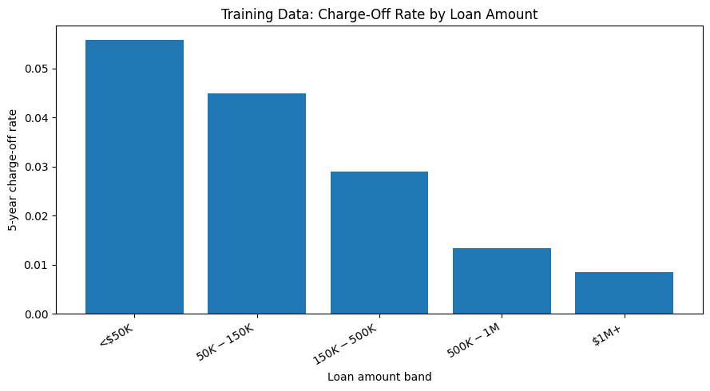
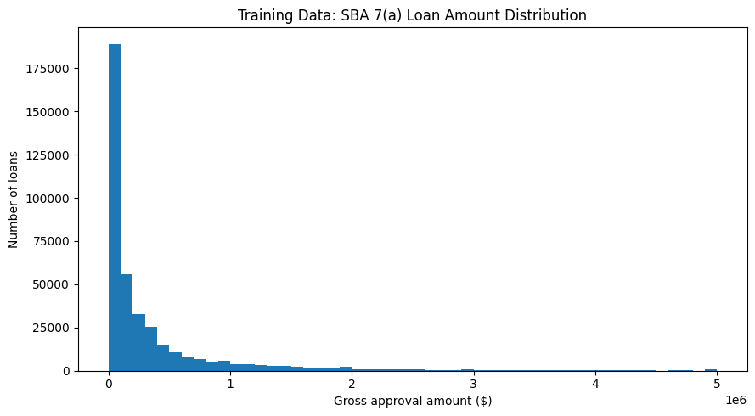
EDA: LOAN AMOUNT AND TERM
Loan structure contains clear risk-ranking signal
Loan amount band
Count
Charge-off rate
Term band
Count
Charge-off rate
<$50K
135,960
5.59%
≤84 mo
219,812
5.11%
$50K–$150K
91,372
4.49%
85–120 mo
85,767
4.04%
$150K–$500K
90,933
2.90%
121–180 mo
21,537
0.64%
$500K–$1M
36,722
1.34%
>180 mo
65,892
0.48%
Chart: charge-off by loan amount
$1M+
38,021
0.85%
Interpretation
Smaller and shorter-term loans show higher observed charge-off rates.
Amounts are right-skewed, so the model uses log_gross_approval.
This is descriptive evidence, not a causal claim.
Distribution: gross approval amount
DATA 400 | SBA 7(a) Credit-Risk Mini Project
07
Notes:
Suggested time: 1.05 minutes
The training EDA shows clear descriptive patterns in loan structure. Smaller loans have higher observed charge-off rates. Loans under fifty thousand dollars charge off at about 5.59 percent, while loans over one million dollars charge off at about 0.85 percent. The term bands show a similar ranking pattern: loans with terms under 84 months have a charge-off rate of about 5.11 percent, while loans over 180 months have a rate below 0.5 percent. This does not prove that small loans or shorter terms cause charge-off. It only shows that loan structure contains useful predictive information. Because loan dollar amounts are heavily right-skewed, I used log gross approval as a model feature instead of raw loan size.

Slide 8
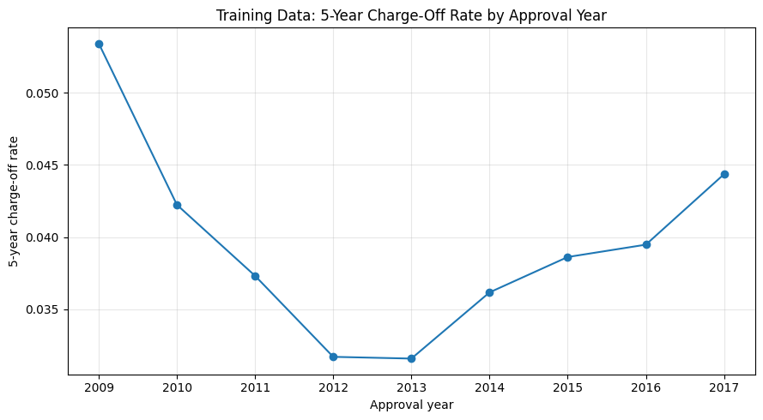
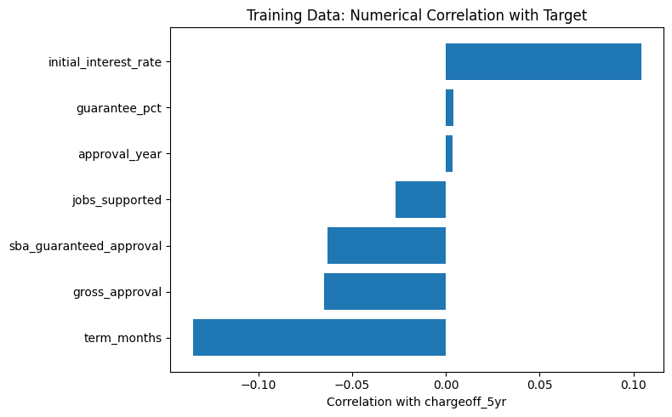
EDA: PRICING, GUARANTEE, AND INDUSTRY
Risk patterns also appear in rate and sector variables
Interest band
Count
Charge-off rate
Guarantee band
Count
Charge-off rate
NAICS2
Count
Rate
8–11%
48,910
7.30%
75–85%
46,098
7.38%
45
14,918
5.66%
5–8%
282,854
3.80%
≤50%
192,700
4.11%
48
18,105
5.58%
<5%
61,241
1.35%
>85%
27,701
4.03%
42
21,367
4.61%
50–75%
126,509
2.15%
71
10,813
4.58%
72
50,426
4.24%
Time trend: charge-off by approval year
Numerical correlations with chargeoff_5yr
DATA 400 | SBA 7(a) Credit-Risk Mini Project
08
Notes:
Suggested time: 1.05 minutes
Other variables also show interpretable patterns. Loans with initial interest rates between eight and eleven percent have a charge-off rate of about 7.30 percent, compared with 1.35 percent for loans under five percent. Guarantee percentage also varies: the 75 to 85 percent guarantee band has the highest observed charge-off rate in training data. Broad NAICS sectors also differ. The highest sectors in the training set include NAICS 45, 48, 42, 71, and 72. These patterns help justify the feature set, but again they are descriptive, not causal. They show association in the historical portfolio, not necessarily a direct mechanism.

Slide 9
DATA QUALITY AND TRANSFORMATIONS
The notebook checks unusual values before modeling
Variable
Flagged rows
Why it matters
Quality check
Rows
gross_approval
48,355
Loan size is highly skewed → log transform
gross_approval <= 0
0
term_months
90,235
Long/short terms are real but influential
term_months <= 0
208
interest_rate < 0
0
initial_interest_rate
23,988
High rates may identify riskier loans
guarantee_pct > 1.05
0
jobs_supported
36,709
Heavy tail; keep but impute/scale
Modeling decision
Unlike a simple IQR-cleaning exercise, I did not automatically delete large SBA loans. A $3M loan can be unusual and still real. Instead, I used transformations, imputation, scaling, and model controls.
DATA 400 | SBA 7(a) Credit-Risk Mini Project
09
Notes:
Suggested time: 0.9 minutes
Before modeling, I checked unusual values and impossible values. The IQR rule flags many observations for gross approval amount, loan term, interest rate, and jobs supported. However, I did not automatically remove these loans. In an SBA lending dataset, a very large loan or a very long term can be a real record, not necessarily a data error. Instead, I use transformations and preprocessing. Loan amount is converted to log gross approval, numeric variables are imputed and scaled, and categorical variables are imputed and one-hot encoded. I also checked impossible values. There are no nonpositive gross approval amounts, no negative interest rates, and no guarantee percentage above 1.05.

Slide 10
FEATURE SET
Use approval-time fields and exclude leakage fields
Numerical features
Categorical features
Excluded fields
log_gross_approval
guarantee_pct
term_months
initial_interest_rate
jobs_supported
approval_year
project_state
business type + business age
processing method
fixed / variable rate
revolver + collateral indicators
NAICS2 + franchise flag
loan_status
chargeoff_date
gross_chargeoff_amount
paid_in_full_date
borrower name/address
Preprocessing step
Rule
Numeric missing values
Median imputation + scaling
Categorical missing values
Most frequent imputation
Categorical encoding
One-hot with unknown categories ignored
Leakage prevention
Fit preprocessing on training data only
DATA 400 | SBA 7(a) Credit-Risk Mini Project
10
Notes:
Suggested time: 0.95 minutes
For the modeling feature set, I only use variables that are reasonably available around approval. Numerical features include log loan amount, guarantee percentage, term, initial interest rate, jobs supported, and approval year. Categorical features include state, business type, business age, processing method, fixed or variable rate, revolver status, collateral indicator, NAICS two-digit sector, and franchise flag. I intentionally exclude outcome fields such as loan status, charge-off date, gross charge-off amount, and paid-in-full date. I also exclude borrower name and street address because the goal is to build an interpretable and appropriate credit-risk screening model. The scikit-learn pipeline learns imputation, scaling, and one-hot encoding from the training data only.

Slide 11
CANDIDATE MODELS
Compare simple baselines with nonlinear models
Model
Purpose
Complexity control
Dummy
Baseline / event-rate reference
No predictive features
Logistic Regression
Interpretable linear benchmark
L2 regularization, C=1.0
Decision Tree
Single nonlinear tree
max_depth=6, min_samples_leaf=25
Random Forest
Ensemble nonlinear model
120 trees, max_depth=12, min_samples_leaf=20
Why multiple models?
Why not test yet?
Dummy tells us the base-rate floor.
Logistic regression provides a readable benchmark.
Trees and forests capture nonlinear relationships.
The validation set is for model choice and threshold choice. The locked test set is reserved for the final evaluation only.
DATA 400 | SBA 7(a) Credit-Risk Mini Project
11
Notes:
Suggested time: 0.9 minutes
I compare four models. The dummy classifier is a baseline, which tells me what a model looks like if it does not learn useful patterns. Logistic regression is a standard interpretable credit-risk benchmark, with L2 regularization. The decision tree is a simple nonlinear model with limited depth and a minimum leaf size. Random Forest is a more flexible tree-based ensemble with 120 trees, max depth of 12, minimum leaf size of 20, and balanced subsampling. These controls matter because I do not want to judge a model only by how closely it fits the training data. The validation set is used for model selection, while the test set remains untouched.

Slide 12
METRIC PLAN
Use metrics that reveal rare-event performance
Metric
Question answered
Why it matters here
PR-AUC
Can the model rank charge-offs above non-charge-offs?
Primary metric for rare positive class
ROC-AUC
Can the model separate classes across thresholds?
Useful but can look optimistic when positives are rare
Precision
Of flagged loans, how many charge off?
Measures review efficiency
Recall
Of all charge-offs, how many are caught?
Measures missed-risk control
F1
Balance between precision and recall
Used to choose initial validation threshold
Business translation: false positives create extra review; false negatives are risky loans that the model misses.
DATA 400 | SBA 7(a) Credit-Risk Mini Project
12
Notes:
Suggested time: 0.95 minutes
Because charge-offs are rare, accuracy is not enough. PR-AUC is the primary comparison metric because it directly focuses on the positive class and evaluates the precision-recall trade-off across thresholds. ROC-AUC is also useful because it measures ranking separation, but it can look strong even when the positive class is rare. Once I choose a threshold, I report precision, recall, and F1. Precision tells us how efficient the flagged group is: of the loans the model flags, how many actually charge off. Recall tells us how many actual charge-offs we catch. F1 balances precision and recall and is used for the first threshold choice. Confusion matrices help translate the metrics into actual counts.

Slide 13
VALIDATION MODEL COMPARISON
Random Forest has the strongest precision-recall ranking
Model
Train PR-AUC
Validation PR-AUC
Gap
Validation ROC-AUC
Random Forest
0.459
0.337
0.122
0.895
Decision Tree
0.325
0.252
0.073
0.921
Logistic Regression
0.162
0.159
0.003
0.836
Dummy
0.039
0.042
-0.003
0.500
Selected model
Random Forest
Key nuance
Decision Tree has higher ROC-AUC, but PR-AUC is the primary metric because the positive class is rare.
DATA 400 | SBA 7(a) Credit-Risk Mini Project
13
Notes:
Suggested time: 1 minutes
This is the core model selection slide. I compared Dummy, Logistic Regression, Decision Tree, and Random Forest. Random Forest has the highest validation PR-AUC at 0.337, so it is selected. Decision Tree has the highest validation ROC-AUC at 0.921, but PR-AUC is the primary metric because charge-offs are rare and I care about ranking the positive class. The Random Forest train PR-AUC is 0.459 and validation PR-AUC is 0.337, giving a gap of 0.122. That gap means the model fits the training data more strongly than the validation data, so I later check generalization with a learning curve. Even with that caveat, Random Forest is clearly strongest on the metric that matters most for this rare-event screening problem.

Slide 14
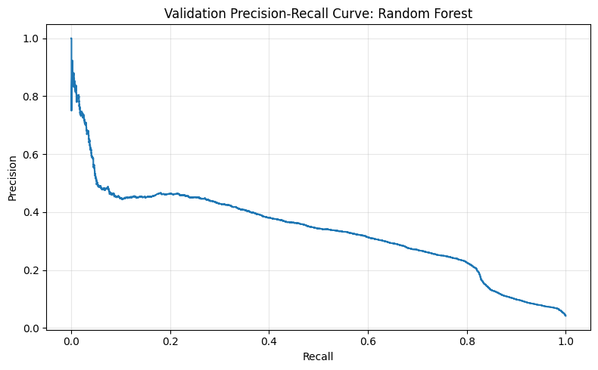
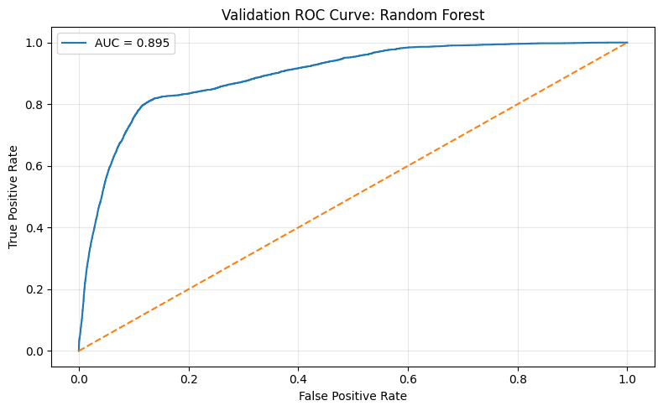
VALIDATION CURVES
What the selected Random Forest looks like before thresholding
Validation precision-recall curve
Validation ROC curve
Curves summarize ranking performance before forcing the model into yes/no decisions. The next slide chooses a cutoff for operational review.
DATA 400 | SBA 7(a) Credit-Risk Mini Project
14
Notes:
Suggested time: 0.9 minutes
Before choosing a cutoff, I look at the validation precision-recall and ROC curves. These curves show how the selected Random Forest behaves across many possible thresholds. The precision-recall curve is especially important because it focuses on the rare charge-off class. The ROC curve shows that the model has strong separation overall, but the threshold still matters because different cutoffs create very different business trade-offs. At this point, the test set is still locked. The next step is to choose a decision threshold on validation data only.

Slide 15
DECISION THRESHOLD
The cutoff controls the review workload and missed-risk trade-off
0.690
33.2%
55.7%
41.6%
Validation flags
chosen validation threshold
precision
recall
F1
6,730 loans flagged; 2,234 were true charge-offs.
Validation confusion matrix
How to explain it
Pred 0
Pred 1
False positives = extra review for loans that perform.
False negatives = charge-offs the model misses.
This threshold catches more than half of validation charge-offs.
Actual 0
87347
4496
Actual 1
1776
2234
DATA 400 | SBA 7(a) Credit-Risk Mini Project
15
Notes:
Suggested time: 1 minutes
After choosing Random Forest, I converted predicted probabilities into a binary review flag. I selected the threshold on validation data using the F1 score, not on the test set. The chosen threshold is 0.690. At that cutoff, validation precision is 33.2 percent, recall is 55.7 percent, and F1 is 41.6 percent. The validation confusion matrix shows 2,234 true positives, 4,496 false positives, 1,776 false negatives, and 87,347 true negatives. In business terms, the model flags 6,730 loans for review, and 2,234 of those actually charge off within five years. The model is not saying every flagged loan will fail. It is selecting a group that is much richer in risk than the overall validation population.

Slide 16
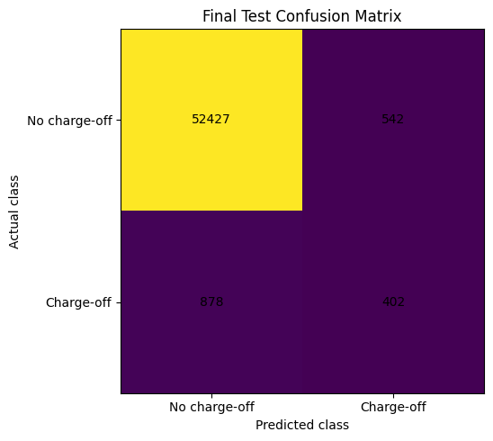
LOCKED TEST PERFORMANCE
Evaluate once on future-period approvals
Metric
Test result
Test confusion matrix
Rows / base charge-off rate
54,249 / 2.36%
Pred 0
Pred 1
PR-AUC
0.352
Actual 0
52427
542
ROC-AUC
0.931
Actual 1
878
402
Precision / Recall / F1
42.6% / 31.4% / 36.2%
Main result
The model flagged 944 test loans. Of those, 402 actually charged off within five years. Precision is much higher than the 2.36% test base rate.
Final test confusion matrix chart
DATA 400 | SBA 7(a) Credit-Risk Mini Project
16
Notes:
Suggested time: 1.05 minutes
This is the final evaluation on the locked future test set. The test set contains 54,249 loans, and the five-year charge-off rate is 2.36 percent. Random Forest achieved a test PR-AUC of 0.352 and a ROC-AUC of 0.931. At the threshold selected from validation data, test precision is 42.6 percent, recall is 31.4 percent, and F1 is 36.2 percent. The confusion matrix shows 402 true positives, 542 false positives, 878 false negatives, and 52,427 true negatives. Another way to interpret this is that the model flagged 944 loans in the test set, and 402 of them actually charged off within five years. That is a much higher risk concentration than the overall test base rate.

Slide 17
BUSINESS INTERPRETATION
The model creates risk concentration, not perfect prediction
2.36%
42.6%
~18×
31.4%
test base charge-off rate
precision among flagged loans
risk enrichment vs base rate
charge-offs caught
What works
What still fails
Flagged group is much riskier than average.
Useful for prioritizing review capacity.
Precision is far above the base event rate.
Recall is only 31.4%, so many charge-offs are missed.
Public SBA data lacks key borrower credit variables.
Not strong enough for standalone approval/denial.
DATA 400 | SBA 7(a) Credit-Risk Mini Project
17
Notes:
Suggested time: 0.95 minutes
This slide translates the test results into a business interpretation. The overall test charge-off rate is 2.36 percent. Among loans flagged by the model, precision is 42.6 percent. That is about eighteen times the base rate, so the model is clearly concentrating risk into a smaller review group. This is useful if the goal is to prioritize human review or portfolio monitoring. However, recall is only 31.4 percent, meaning the model still misses a majority of charge-offs. That is why I do not position it as an automatic underwriting system. It is better understood as a ranking tool that can help decide where to spend additional review effort.

Slide 18
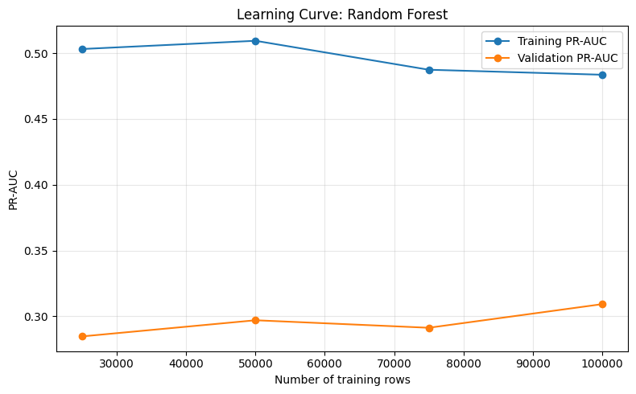
GENERALIZATION CHECK
Learning curve suggests benefit from more data, but overfitting remains
Rows
Train PR-AUC
Val PR-AUC
Gap
25k
0.503
0.285
0.218
50k
0.509
0.297
0.212
75k
0.487
0.291
0.196
100k
0.484
0.309
0.174
Interpretation
Learning curve: Train vs validation PR-AUC
Training PR-AUC remains higher, but the gap shrinks as more rows are used. Random Forest benefits from data but still needs tuning/complexity control.
DATA 400 | SBA 7(a) Credit-Risk Mini Project
18
Notes:
Suggested time: 0.95 minutes
The learning curve uses up to one hundred thousand training rows as a diagnostic. Training PR-AUC is consistently higher than validation PR-AUC, so there is some overfitting. However, the train-validation gap gets smaller as more training data is used. The gap falls from about 0.218 with twenty-five thousand rows to about 0.174 with one hundred thousand rows. This suggests the model benefits from additional data, but it still needs further tuning or additional complexity controls if the goal is stronger generalization. The final model still uses the full development data before the locked test evaluation.

Slide 19
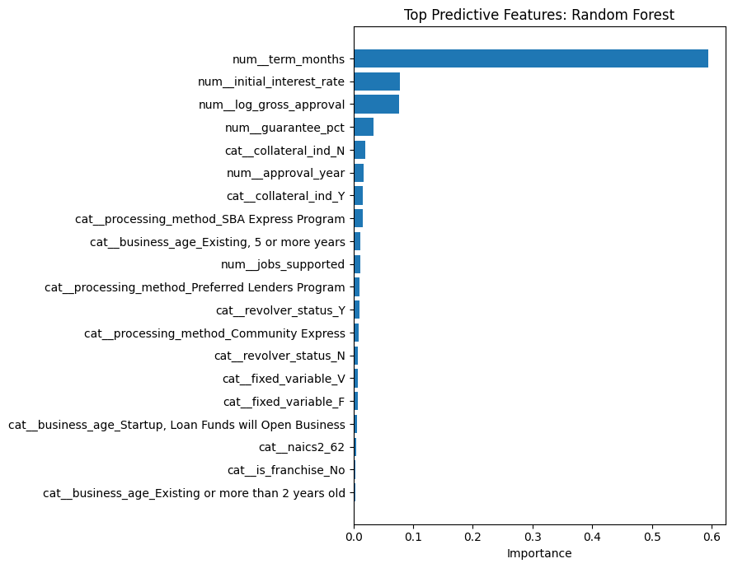
MODEL INTERPRETATION
Random Forest feature importance supports the EDA story
Top feature
Importance
term_months
0.594
initial_interest_rate
0.078
log_gross_approval
0.076
guarantee_pct
0.034
collateral_ind = N
0.019
approval_year
0.017
Caution
Feature importance means the variable helped prediction. It does not mean the feature caused charge-off.
Top Random Forest feature importances
DATA 400 | SBA 7(a) Credit-Risk Mini Project
19
Notes:
Suggested time: 1 minutes
Because the selected model is Random Forest, I interpret it using feature importance rather than logistic regression coefficients. The strongest feature is term_months, with importance around 0.594. Initial interest rate and log gross approval amount are next, followed by guarantee percentage, collateral indicators, and approval year. This fits the EDA story: loan structure and pricing are important signals. However, feature importance is predictive, not causal. A variable can be important because it helps split and rank the data, but that does not mean changing the variable would directly cause a lower or higher charge-off rate.

Slide 20
ERROR ANALYSIS
Where does the model still struggle?
Validation error type
Count
Meaning
High-error NAICS2
Validation loans
Error rate
False Positive
4,496
Flagged for review but did not charge off
48
5,892
8.91%
False Negative
1,777
Actually charged off but scored below threshold
42
4,331
7.90%
71
3,614
7.89%
23
11,206
7.78%
61
1,584
7.77%
False negatives
False positives
Risk misses. These are the charge-offs that were not flagged. They suggest approval-time public fields are incomplete.
Extra review. These are less costly if the action is monitoring, but problematic if the model were used for denial.
DATA 400 | SBA 7(a) Credit-Risk Mini Project
20
Notes:
Suggested time: 1 minutes
The error analysis helps show what the aggregate metrics hide. On validation data, there are 4,496 false positives and 1,777 false negatives. False negatives are the risk misses: loans that actually charged off but were scored below the threshold. False positives are loans flagged as high risk that did not charge off within five years. False positives are not necessarily useless if the action is additional monitoring, because the cost of review may be lower than the cost of a charge-off. The notebook also identifies NAICS sectors with higher validation error rates, including 48, 42, 71, 23, and 61. This may reflect different industry risk dynamics or borrower characteristics that are not directly observed in the public SBA dataset.

Slide 21
LIMITATIONS AND NEXT IMPROVEMENTS
What would make the model more useful in practice?
Limitations
Next improvements
Rare event: only 3.76% overall charge-off rate.
Public SBA data is not a full underwriting file.
No FICO, DSCR, borrower financials, collateral value, or lender behavior.
Performance can drift when macro conditions and underwriting standards change.
Add borrower financial ratios and lender-level variables.
Calibrate probabilities and report decile lift.
Tune threshold using a business cost function.
Monitor performance by year, sector, and borrower segment.
Best current use: rank loans for additional human review and portfolio monitoring.
DATA 400 | SBA 7(a) Credit-Risk Mini Project
21
Notes:
Suggested time: 0.95 minutes
The biggest limitation is that charge-off prediction is inherently difficult with this dataset. The event is rare, and the public SBA fields are not a full credit file. The dataset does not include borrower financial statements, FICO scores, debt-service coverage ratios, collateral values, or detailed lender behavior. The model can learn patterns from approval-time public data, but it cannot see many variables that a lender would normally use in underwriting. Another limitation is temporal drift. If interest rates, underwriting standards, or macroeconomic conditions change, model performance can change. For next steps, I would add borrower financial ratios, lender-level variables, and macroeconomic context. I would also calibrate probabilities, evaluate decile lift, and choose thresholds using a business cost function.

Slide 22
CONCLUSION
Useful ranking signal, not a standalone decision system
Main takeaways
0.352
0.931
Built a valid five-year charge-off target.
Used time-based validation and locked test evaluation.
Selected Random Forest on validation PR-AUC.
Test precision = 42.6% vs 2.36% base rate.
Recall = 31.4%, so many charge-offs are still missed.
test PR-AUC
test ROC-AUC
42.6%
31.4%
test precision
test recall
Questions?
DATA 400 | SBA 7(a) Credit-Risk Mini Project
22
Notes:
Suggested time: 0.9 minutes
To conclude, this project shows an end-to-end credit-risk workflow. I built a valid five-year charge-off target, avoided leakage, split the data by time, compared models on validation data, selected Random Forest, and evaluated once on a locked future test set. The final model has useful risk-ranking power. Its test precision is 42.6 percent, compared with a test base charge-off rate of only 2.36 percent. That means flagged loans are much more concentrated in risk than the average loan. However, recall is only 31.4 percent, so the model still misses many charge-offs. My final conclusion is that the model is useful for risk ranking and review prioritization, but it should not be used as a standalone approval or denial system. Thank you, and I am happy to answer questions.

